Slide 1
Lecture 2: Language Representations
What is NLP + How to represent language
Harvard
AC295/CS287r/CSCI E-115B
Chris Tanner

Slide 2
Lil Bag-of-Words Wow (rapper)
--------------------------------------------------------------------
Shad Gregory Moss (born March 9, 1987), better known by his stage name Bow Wow (formerly Lil' Bow Wow), is an American rapper, actor, and television presenter. Moss' career began upon being discovered by rapper Snoop Dogg in the late 1990s, eventually being brought to record producer Jermaine Dupri and signed to So So Def Recordings. As Lil' Bow Wow, he released his first album at age 13, Beware of Dog, in 2000, which was followed by Doggy Bag a year later.
He has released six studio albums, twenty-six singles, fifty-one music videos, and eight mixtapes.
In his career, Bow Wow has had a total of twelve top 40 singles (three of which were top ten hits) on the US Billboard Hot 100 chart. He has sold over 10 million copies and 14 million digital assets worldwide.^{[1]}
-- https://en.wikipedia.org/wiki/Bow_Wow_(rapper)
Disclaimer: I do not endorse listening to Lil Bow Wow

Slide 3
ANNOUNCEMENTS
Attendance is checked today. See a TF before you leave today.
HW1 was released at midnight. Due in 2 weeks (Mon @ 11:59pm). Start now.
PyTorch tutorial will be tonight @ 6pm, in this room
Lectures slides will be posted on the website and our Twitter @CS287_NLP
Office Hours start tomorrow, Wednesday @ 5pm (see website for all OH)
Location: out back of SEC 1st floor, or SEC 3.301-3.303 if weather isn’t good

Slide 4
Outline
NLP: what and why?
Representing Language
Bag-of-Words
TF-IDF

Slide 5
Outline
NLP: what and why?
Representing Language
Bag-of-Words
TF-IDF

Slide 6
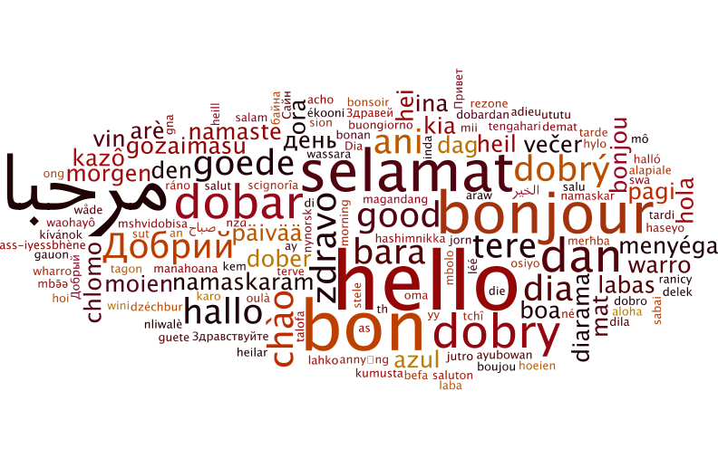
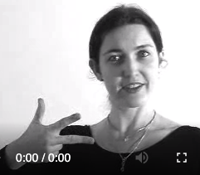
Language
Language symbols are encoded as continuous communication signals, and are invariant across different encodings (same underlying concept, different surface forms)
Slide adapted from or inspired by Chris Manning and Richard Socher

Slide 7
Language is funny
“Red tape holds up new bridges”
“Hospitals are sued by 7 foot doctors”
“Local high school dropouts cut in half”
“Tesla crashed today”
“Obama announced that he will run again”
“Kipchoge announced that he will run again”
“She made him duck”
“Will you visit the bank across from the river bank? You can bank on it”
“Yes” vs “Yes.” vs “YES” vs “YES!” vs “YAS” vs “Yea”

Slide 8
Language is funny
“Maria likes May”
“Maria likes May and Joe”
“Maria likes May and June”
“May likes Maria”
“Maria hit May, then she [fell/ran]”
“Maria and Anqi bullied May, so they got in trouble”
“Maria and Anqi convinced May to prank the teacher, so they got in trouble”
“May may like May, but she really likes June.”

Slide 9
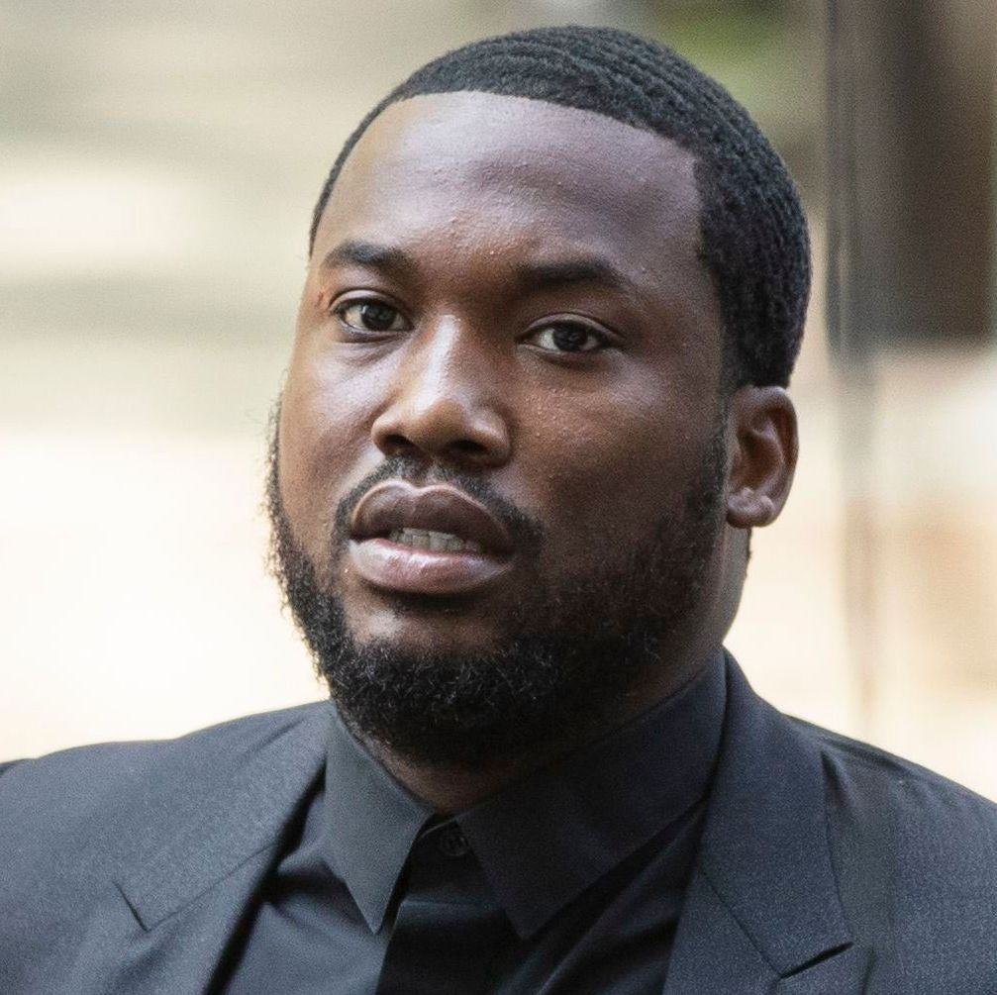
Multiple levels* to a single word
Discourse
Pragmatics
Semantics
Syntax
Lexemes
Morphology
*
phonology
orthography
phonetics
text
speech
Slide adapted from or inspired by Chris Manning and Richard Socher

Slide 10
Multiple levels* to a single word
Inputs (words) are noisy
Capture theoretical concepts that are ~latent variables
Ambiguity abound. Many interpretations at each level
Discourse
Pragmatics
Semantics
Syntax
Lexemes
Morphology
*
phonology
orthography
phonetics
text
speech
Slide adapted from or inspired by Chris Manning and Richard Socher

Slide 11
Multiple levels* to a single word
Humans are very good at resolving linguistic ambiguity (e.g., coreference resolution)
Computer models aren’t
Discourse
Pragmatics
Semantics
Syntax
Lexemes
Morphology
*
phonology
orthography
phonetics
text
speech
Slide adapted from or inspired by Chris Manning and Richard Socher

Slide 12
Multiple levels* to a single word
Many ways to express the same meaning
Infinite meanings can be expressed
Languages widely differ in these complex interactions
Discourse
Pragmatics
Semantics
Syntax
Lexemes
Morphology
*
phonology
orthography
phonetics
text
speech
Slide adapted from or inspired by Chris Manning and Richard Socher

Slide 13
Multiple levels* to a single word
Many ways to express the same meaning
Infinite meanings can be expressed
Languages widely differ in these complex interactions
Discourse
Pragmatics
Semantics
Syntax
Lexemes
Morphology
The study of how sub-components form meaning
(e.g., running, deactivate, Obamacare, Cassandra’s)
*
phonology
orthography
phonetics
text
speech

Slide 14
Multiple levels* to a single word
Many ways to express the same meaning
Infinite meanings can be expressed
Languages widely differ in these complex interactions
Discourse
Pragmatics
Semantics
Syntax
Lexemes
Morphology
Lexical analysis; normalize and disambiguate words
(e.g., bank, mean, hand it to you, make up, take out)
*
phonology
orthography
phonetics
text
speech
Notes:
A language's most basic unit of meaning

Slide 15
Multiple levels* to a single word
Many ways to express the same meaning
Infinite meanings can be expressed
Languages widely differ in these complex interactions
Discourse
Pragmatics
Semantics
Syntax
Lexemes
Morphology
*
Transform a sequence of characters into a hierarchical/compositional structure
(e.g., students hate annoying professors; Mary saw the old man with a telescope)
phonology
orthography
phonetics
text
speech

Slide 16
Multiple levels* to a single word
Many ways to express the same meaning
Infinite meanings can be expressed
Languages widely differ in these complex interactions
Discourse
Pragmatics
Semantics
Syntax
Lexemes
Morphology
Determines meaning
(e.g., NLU / intent recognition; natural language inference; summarization; question-answering)
*
phonology
orthography
phonetics
text
speech

Slide 17
Multiple levels* to a single word
Many ways to express the same meaning
Infinite meanings can be expressed
Languages widely differ in these complex interactions
Discourse
Pragmatics
Semantics
Syntax
Lexemes
Morphology
Understands how context affects meaning
(i.e., not only concerns how meaning depends on structural and linguistic knowledge (grammar) of the speaker, but on the context of the utterance, too)
*
phonology
orthography
phonetics
text
speech
Notes:
Study of HOW language is used. E.g., taking turns in conversation.

Slide 18
Multiple levels* to a single word
Many ways to express the same meaning
Infinite meanings can be expressed
Languages widely differ in these complex interactions
Discourse
Pragmatics
Semantics
Syntax
Lexemes
Morphology
Understands structures and effects of interweaving dialog
(i.e., Jhene tried to put the trophy in the suitcase but it was too big. She finally got it to close.)
*
phonology
orthography
phonetics
text
speech

Slide 19
Common NLP Tasks (aka problems)
Syntax
Semantics
Morphology
Word Segmentation
Part-of-Speech Tagging
Parsing
Constituency
Dependency
Sentiment Analysis
Topic Modelling
Named Entity Recognition (NER)
Relation Extraction
Word Sense Disambiguation
Natural Language Understanding (NLU)
Natural Language Generation (NLG)
Machine Translation
Entailment
Question Answering
Language Modelling
Discourse
Summarization
Coreference Resolution

Slide 20
Common NLP Tasks (aka problems)
Syntax
Semantics
Morphology
Word Segmentation
Part-of-Speech Tagging
Parsing
Constituency
Dependency
Sentiment Analysis
Topic Modelling
Named Entity Recognition (NER)
Relation Extraction
Word Sense Disambiguation
Natural Language Understanding (NLU)
Natural Language Generation (NLG)
Machine Translation
Entailment
Question Answering
Language Modelling
“Overall, Pfizer’s COVID-19 vaccine is very safe and one of the most effective vaccines ever produced”
Discourse
Summarization
Coreference Resolution

Slide 21
Common NLP Tasks (aka problems)
Syntax
Semantics
Morphology
Word Segmentation
Part-of-Speech Tagging
Parsing
Constituency
Dependency
Sentiment Analysis
Topic Modelling
Named Entity Recognition (NER)
Relation Extraction
Word Sense Disambiguation
Natural Language Understanding (NLU)
Natural Language Generation (NLG)
Machine Translation
Entailment
Question Answering
Language Modelling
Discourse
Discourse
sports
news
politics
fashion
Summarization
Coreference Resolution
Summarization
Coreference Resolution

Slide 22
Common NLP Tasks (aka problems)
Syntax
Semantics
Morphology
Word Segmentation
Part-of-Speech Tagging
Parsing
Constituency
Dependency
Sentiment Analysis
Topic Modelling
Named Entity Recognition (NER)
Relation Extraction
Word Sense Disambiguation
Natural Language Understanding (NLU)
Natural Language Generation (NLG)
Machine Translation
Entailment
Question Answering
Language Modelling
“Alexa, play Drivers License by Olivia Rodrigo”
“Alexa, play Drivers License by Olivia Rodrigo”
INTENT
SONG
ARTIST
Discourse
Summarization
Coreference Resolution

Slide 23
Common NLP Tasks (aka problems)
Syntax
Semantics
Morphology
Word Segmentation
Part-of-Speech Tagging
Parsing
Constituency
Dependency
Sentiment Analysis
Topic Modelling
Named Entity Recognition (NER)
Relation Extraction
Word Sense Disambiguation
Natural Language Understanding (NLU)
Natural Language Generation (NLG)
Machine Translation
Entailment
Question Answering
Language Modelling
El perro marrón
The brown dog
SPANISH
ENGLISH
Discourse
Summarization
Coreference Resolution

Slide 24
Very brief history of NLP
1960s: pattern-matching and rules (highly limiting)
1970s – 1980s: linguistically rich, logic-driven systems; labor-intensive successes on a few, very specific tasks
1990s – 2000s: statistical modelling takeover! ML becomes a central component; some systems are deployed for practical use (e.g., speech to text)
2010s – 2020s: Deep Learning (neural nets) yields astronomical progress on nearly every NLP task; systems become fairly useful for consumers
2020s – 2030s: ???? You can help drive the change
Slide adapted from or inspired by Sam Bowman

Slide 25
Very brief history of NLP
First huge revolution: early 1990s (statistical approaches)
“But it must be recognized that the notion ‘probability of a sentence’ is an entirely useless one, under any known interpretation of this term”
-- Noam Chomsky (1969)
“Anytime a linguist leaves the group, the recognition rate goes up”
-- Frederick Jelinek (1988)
Notes:
Jelinek regarded speech recognition as an information theory problem—a noisy channel, in this case the acoustic signal—which some observers considered a daring approach.^{[5][16][19]} The concept of perplexity was introduced in their first model (1976).

Slide 26
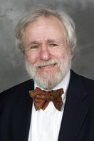
Very brief history of NLP
First huge revolution: early 1990s (statistical approaches)
“I refer to all of my work before ~1990 as the B.S. era. That is, ‘before statistics’”
-- paraphrasing my PhD adviser, Eugene Charniak at his ACL Lifetime Achievement Award (2011)

Slide 27
NLP nowadays
GPT-2 (generates text and can fine-tune on your own data)
SYSTEM PROMPT (HUMAN-WRITTEN)
A train carriage containing controlled nuclear materials was stolen in Cincinnati today. Its whereabouts are unknown.
MODEL COMPLETION (MACHINE-WRITTEN, FIRST TRY)
The incident occurred on the downtown train line, which runs from Covington and Ashland stations.
In an email to Ohio news outlets, the U.S. Department of Energy said it is working with the Federal Railroad Administration to find the thief.
“The theft of this nuclear material will have significant negative consequences on public and environmental health, our workforce and the economy of our nation,” said Tom Hicks, the U.S. Energy Secretary, in a statement. “Our top priority is to secure the theft and ensure it doesn’t happen again.”
The stolen material was taken from the University of Cincinnati’s Research Triangle Park nuclear research site, according to a news release from Department officials.
The Nuclear Regulatory Commission did not immediately release any information.

Slide 28
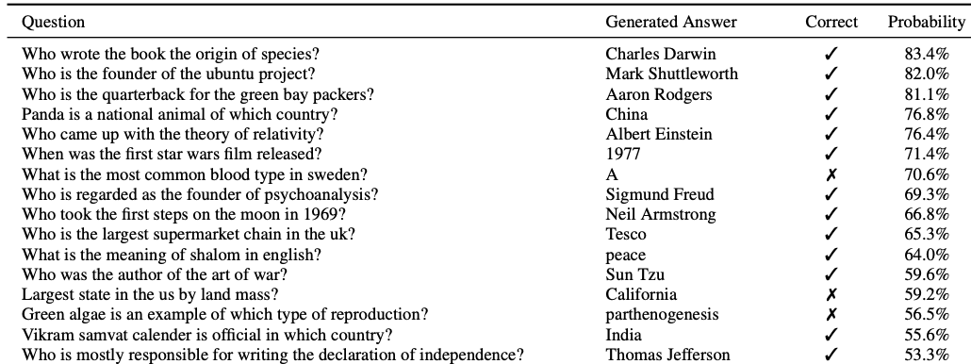
NLP nowadays
GPT-2 (generates text and can fine-tune on your own data)

Slide 29
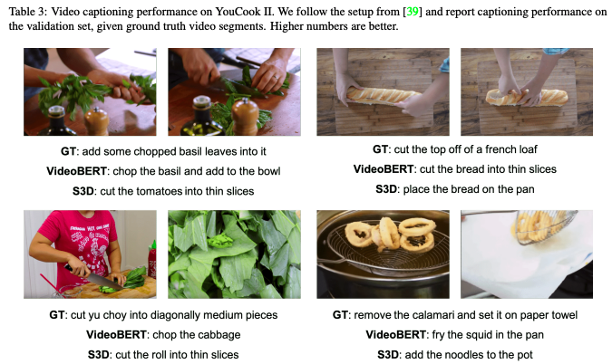
NLP nowadays
VideoBERT: A Joint Model for Video and Language Representation Learning. Sun, et al. ICCV 2019.

Slide 30
Deep Learning (breakthrough moment)
Data
AlexNet Model
14 million images. 20,000 distinct categories (e.g., shoes).
The network achieved a top-5 error of 15.3%, more than 10.8 percentage points lower than that of the runner up.
Task
Given an image, correctly predict which category it belongs to
ImageNet Classification with Deep Convolutional Neural Networks. Krizhevsky, et al. (2012)

Slide 31
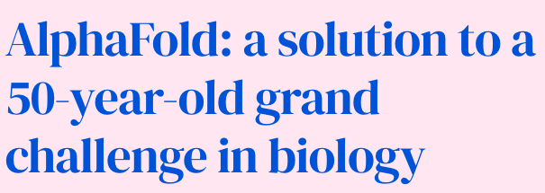
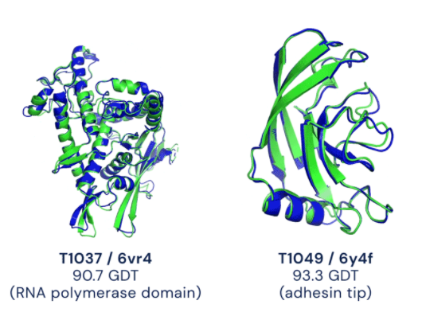
Deep Learning (recent breakthrough)

Slide 32
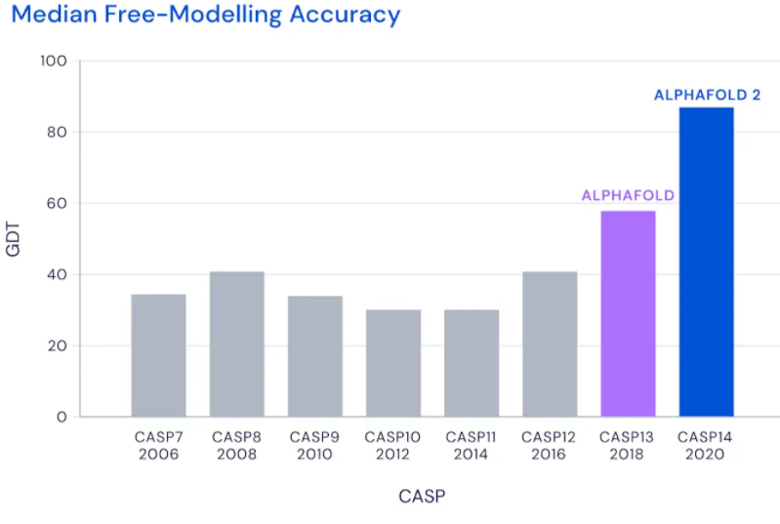
Deep Learning (recent breakthrough)

Slide 33
Deep Learning (recent breakthrough)

Slide 34
Deep Learning
Deep Learning is just neural networks with more than 1 hidden layer (non-linear activation functions).
For the 1st time ever, one paradigm of modelling (deep learning) yields the best results across nearly every domain of problems
Our understanding of why and how the results are so compelling is very surface-level.
Much work lies ahead (e.g., bias/fairness, explainability, robustness)

Slide 35
The Two Cornerstones of NLP
How do we get any system to process, ”understand”, leverage language?
Representation: how do we transform symbolic meaning (e.g., words, signs, braille, speech audio) into something the computer can use
Modelling: given these represented symbols, how do we use them to model the task at hand?

Slide 36
Outline
NLP: what and why?
Representing Language
Bag-of-Words
TF-IDF

Slide 37
Outline
NLP: what and why?
Representing Language
Bag-of-Words
TF-IDF

Slide 38
Representing Numbers
Remember, a computer only has bits: 0’s and 1’s
Computer architecture allows us to perform basic arithmetic operations (+ - * / )
Computational models “need” numeric data. The relationship of numbers is natural (e.g., < > ==). Think of logistic regression.
Numeric data? No problem
Notes:
Your input is some #. You’re applying some transformations to it, which give you different numbers, and your model eventually makes a decision based on those #s. E.g., is the output value higher than 0.5 (in terms of a sigmoid, like in logistic regression). Or what is the highest output value (in terms of softmax)?

Slide 39
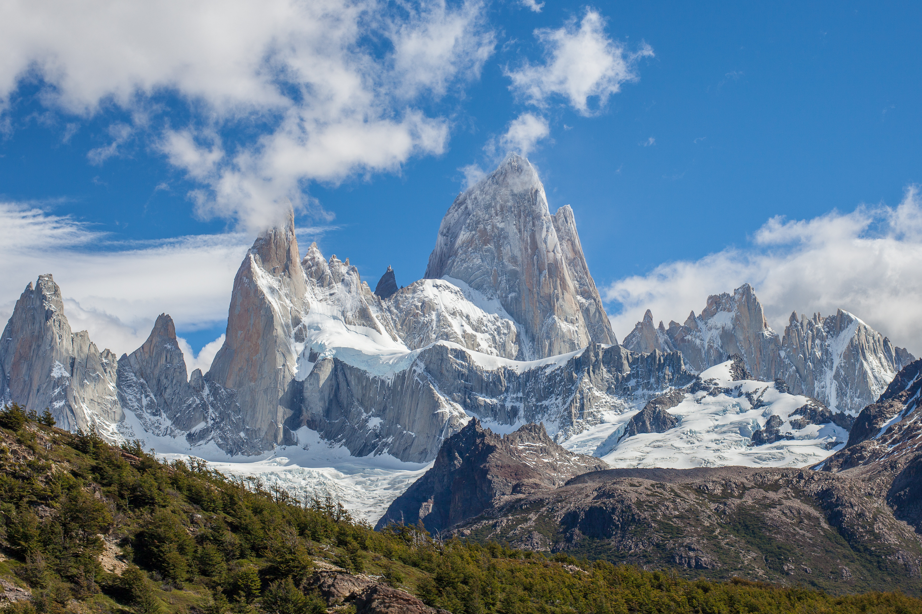
Representing Images
Images (like language) capture tons of real-world concepts
The data itself is well-represented and captured by pixel values (0-255)
Little cumbersome to capture spatial information (LBP and CNNs)
Image data? Not too difficult to represent.
I am making no claims about the modelling
Notes:
Intensities are conveyed. Darker red. Lighter green. All colors are perfectly captured and we the relationships are perfectly captured. How much darker or lighter? A: half of the range darker.

Slide 40
Representing Images
170
33
71
r
g
b
Meaningful relation between the byte values and color.
Notes:
Intensities are conveyed. Darker red. Lighter green. All colors are perfectly captured and we the relationships are perfectly captured. How much darker or lighter? A: half of the range darker.

Slide 41
Representing Images
255
33
71
r
g
b
Meaningful relation between the byte values and color.
Notes:
Intensities are conveyed. Darker red. Lighter green. All colors are perfectly captured and we the relationships are perfectly captured. How much darker or lighter? A: half of the range darker.

Slide 42
Representing Images
255
33
71
r
g
b
Meaningful relation between the byte values and color.
Thus, colors, and images at large, are well-represented.

Slide 43
Representing Language
Words are represented by Strings
a
t
e
61
74
65
Each byte corresponds to language’s smallest meaningful unit! Yay!

Slide 44
Representing Language
Words are represented by Strings
a
t
f
61
74
66
No meaningful relation between the byte values and language!
Notes:
“atf’ isn’t something that is slightly more than “ate”

Slide 45
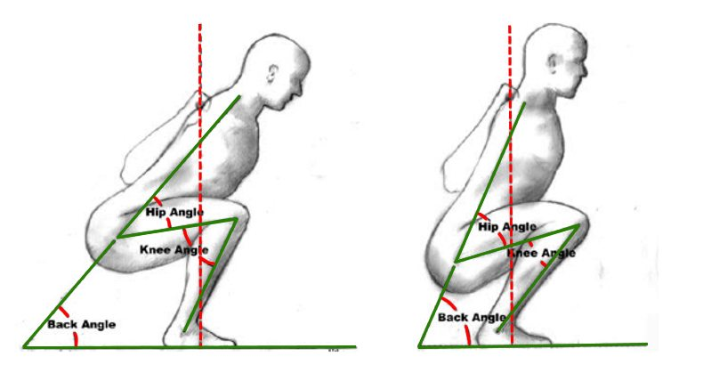
Representing Language
Words are represented by Strings
a
t
g
61
74
67
A.T.G. is, however, more intense. Never mind. Ignore this slide.

Slide 46
Representing Language
Words are represented by Strings
h
a
t
e
68
61
74
65
hate and ate. No relation but similar byte values.

Slide 47
Representing Language
Words are represented by Strings
h
a
t
68
61
74
hate and hat. No relation but similar byte values.

Slide 48
Representing Language
Words are represented by Strings
H
a
t
48
61
74
Hat and hat. Identical concept but different byte values.

Slide 49
Symbolic Representations?
The earliest approaches used symbolic representations. Active research still.
Conceptual Dependency Theory (1972) asserted two assumptions:
If two sentences have the same meaning, they should be represented the same, regardless of the particular words used.
Information implicitly stated or inferred from the sentence should be represented explicitly.

Slide 50
Conceptual Dependencies
Everything centered around primitives, states, and dependencies.
Conceptual Dependency and its Descendants. Lytinen, S.L. Computers, Mathematics, and Applications (1992)

Slide 51
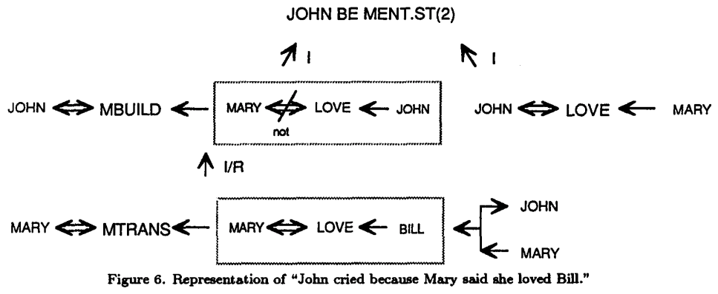
Conceptual Dependencies
Conceptual Dependency and its Descendants. Lytinen, S.L. Computers, Mathematics, and Applications (1992)
Notes:
CD’s add to predicate-calculus by “recommending” predicates to be used

Slide 52
External Resources
There are rich, external resources that define real-world relationships and concepts
(e.g., WordNet, BabelNet, PropBank, VerbNet, FrameNet, ConceptNet)

Slide 53
WordNet
A large lexical database with English nouns, verbs, adjectives, and adverbs grouped into over 100,000 sets of cognitive synonyms (synsets) – each expressing a different concept.
Most frequent relation: super-subordinate relation (”is-a” relations).
{furniture, piece_of_furniture}
Fine-grained relations: {bed, bunkbed}
Part-whole relations: {chair, backrest}
Synonyms: {adept, expert, good, practiced, proficient}

Slide 54
ConceptNet
A multilingual semantic knowledge graph, designed to help computers understand the meaning of words that people use.
Started in 1999. Pretty large now.
Finally becoming useful (e.g, commonsense reasoning)
Has synonyms, ways-of, related terms, derived terms

Slide 55
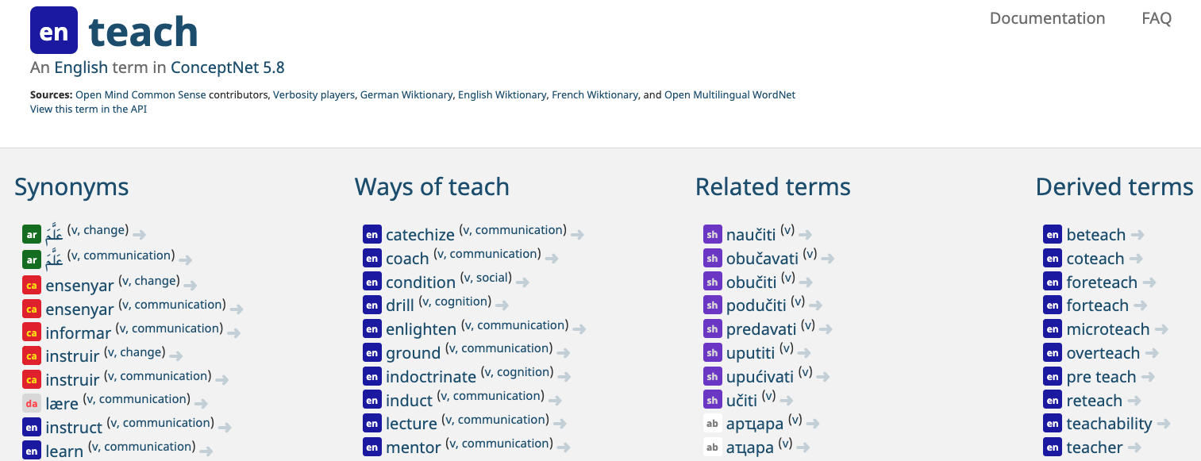
ConceptNet
Entry for “teach”

Slide 56
Limitations
Great resources but ultimately finite
Can’t perfectly capture nuance (especially context-sensitive) (e.g., ‘proficient’ is grouped with ‘good’, which isn’t always true)
Will always have many out-of-vocabulary terms (OOV) (e.g., COVID19, Brexit, bet, wicked, stankface, “no cap”)
Subjective
Laborious to annotate
Words with the same spelling are doomed to be imprecise

Slide 57
Outline
NLP: what and why?
Representing Language
Bag-of-Words
TF-IDF

Slide 58
Outline
NLP: what and why?
Representing Language
Bag-of-Words
TF-IDF

Slide 59
Text Classification
Let’s zoom out for a bit and first address coarse-grain processing at the document level
Input: document $d$
Output: predicted class $c ∈\left\{c_{1},c_{2},…, c_{n}\right\}$

Slide 60
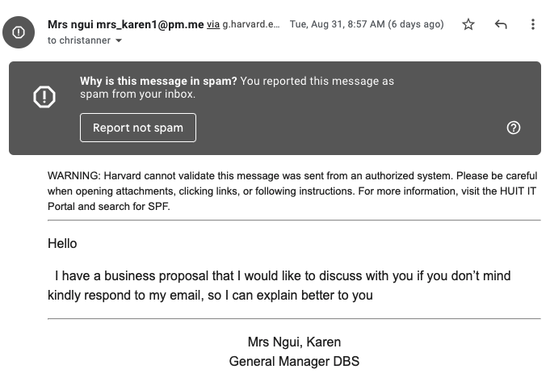
Spam Detection
Is this spam?

Slide 61
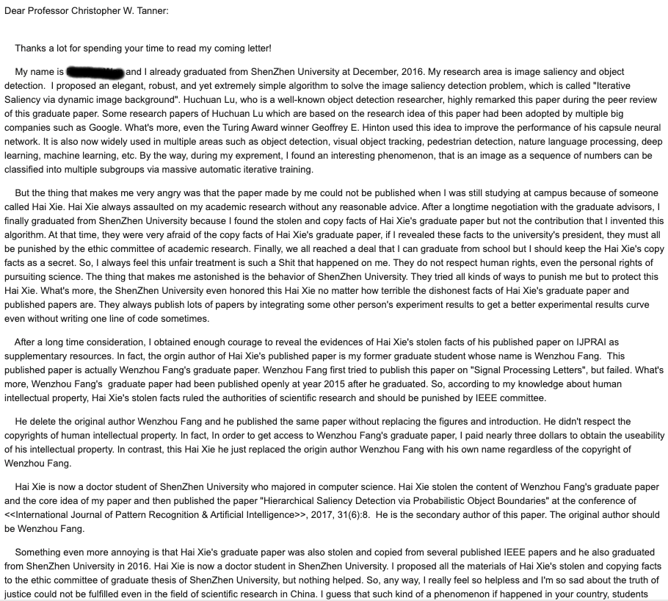
Spam Detection
Is this spam?
61

Slide 62
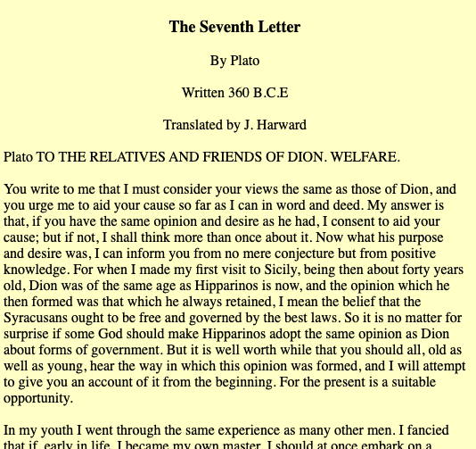
Authorship Identification
Did Plato really write this?
62

Slide 63
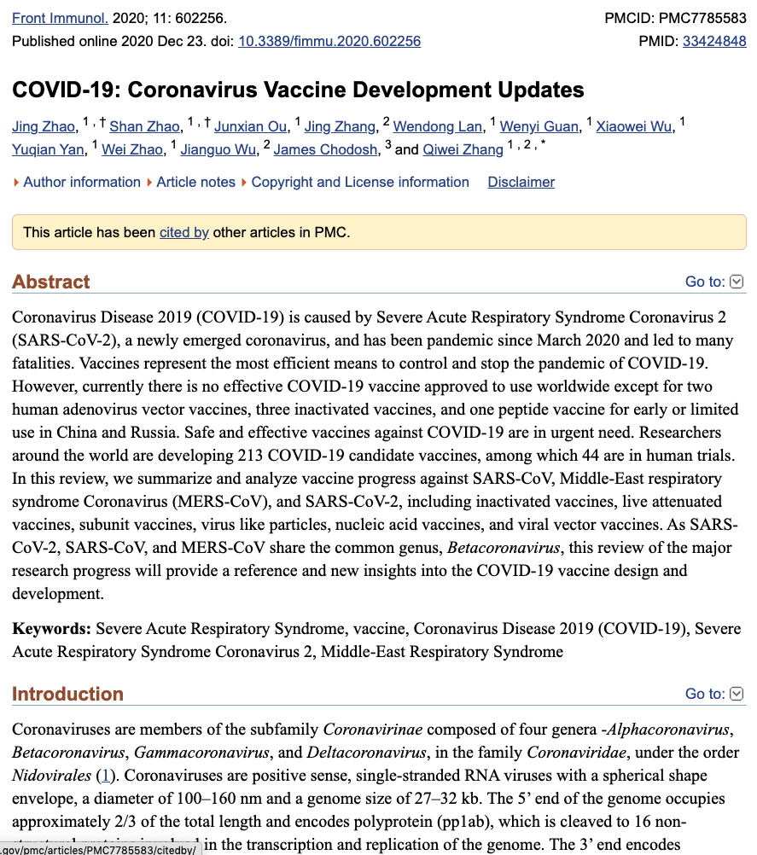
What’s the subject of this article?
MeSH Subject Category Hierarchy
Antogonists and Inhibitors
Blood Supply
Chemistry
Drug Therapy
Embryology
Epidemiology
…
Slide inspired by or adapted from Dan Jurafsky. https://web.stanford.edu/~jurafsky/slp3/slides/7_NB.pdf

Slide 64
Yelp Sentiments
Really slow wait. Took forever to get food.
Freshest ingredients ever. New favorite restaurant. Will be back!
Found a hair in the food. Horrible.
Waited 6 months to get a reservation at this place. Totally worth it.

Slide 65
Text Classification (supervised ML)
Training Data: ($d_{1},c_{1},d_{2},c_{2}$,…, $d_{M},c_{M}$)
Simple idea: let’s represent each document as a feature vector, which can serve as the input to any of your favorite supervised ML models
Notes:
This will allow us to quantify words into numeric values!

Slide 66
Bag-of-words (BoW)
Let’s say our dataset’s entire vocabulary is just 10 words. Each unique word can have its own dimension (feature index).
dog
the
quick
went
brown
a
jumped
fast
over
store
[ 0 0 0 0 0 0 0 0 0 0 ]
NOTE: This is the Boolean version, which isn’t the most popular BoW representation
Notes:
NOTE: One could imagine also adding other features to this vector. Perhaps document length, source of article, date, etc.

Slide 67
Bag-of-words (BoW)
Each document’s vector has a 1 if the word is present. Otherwise, 0.
e.g., “the dog jumped” is represented as
dog
the
quick
went
brown
a
jumped
fast
over
store
[ 1 1 0 0 0 0 1 0 0 0 ]
NOTE: This is the Boolean version, which isn’t the most popular BoW representation

Slide 68
Bag-of-words (BoW)
Each document’s vector has a 1 if the word is present. Otherwise, 0.
e.g., “the dog went fast” is represented as
dog
the
quick
went
brown
a
jumped
fast
over
store
[ 1 1 0 1 0 0 0 1 0 0 ]
NOTE: This is the Boolean version, which isn’t the most popular BoW representation

Slide 69
Bag-of-words (BoW)
NOTE: The most common way of referring to this is as a “bag-of-words model”. Technically, the “bag-of-words” is referring to the representation, not the model.
“bag-of-words model” actually means “Model that uses a bag-of-words representation”

Slide 70
Bag-of-words (BoW)
Are there any weaknesses with this type of representation?

Slide 71
Bag-of-words (BoW)
Weaknesses:
Flattened view of the document
Context-insensitive (“the horse ate” = “ate the horse”)
Curse of Dimensionality (vocab could be over 100k)
Orthogonality: no concept of semantic similarity at the word-level
e.g., $d($dog, cat) =$d($dog, chair)

Slide 72
Bag-of-words (BoW)
Let’s address the “flattened view of the document”

Slide 73
Bag-of-words (BoW)
Imagine a document is a sports broadcast transcript, which concerns a few teams but mostly discusses the local home team, the Cubs
baseball
chicago
cubs
the
wringley
padres
shohei
mvp
homerun
crowd
[ 1 1 1 1 0 1 0 0 0 1 ]

Slide 74
Bag-of-words (BoW)
We have no indication of how much the document is about the Cubs.
baseball
chicago
cubs
the
wringley
padres
shohei
mvp
homerun
crowd
[ 1 1 1 1 0 1 0 0 0 1 ]
Notes:
Instead of just Boolean representation, it would be better if we had a signal as to how frequent the words appeared. Words that appear more often in a document are likely more important to the document and thus should be represented accordingly.

Slide 75
Bag-of-words (BoW)
Now we can see that it’s much more about the Chicago Cubs than the Padres.
baseball
chicago
cubs
the
wringley
padres
shohei
mvp
homerun
crowd
[ 2 9 17 8 0 2 0 0 0 2 ]

Slide 76
Bag-of-words (BoW)
Now we can see that it’s much more about the Chicago Cubs than the Padres.
This count-based approach is the most common BoW representation, and it’s what we expect in HW1
baseball
chicago
cubs
the
wringley
padres
shohei
mvp
homerun
crowd
[ 2 9 17 8 0 2 0 0 0 2 ]

Slide 77
Outline
NLP: what and why?
Representing Language
Bag-of-Words
TF-IDF

Slide 78
Outline
NLP: what and why?
Representing Language
Bag-of-Words
TF-IDF

Slide 79
TF-IDF
Notice that longer documents will naturally have higher counts than shorter documents.
baseball
chicago
cubs
the
wringley
padres
shohei
mvp
homerun
crowd
[ 2 9 17 8 0 2 0 0 0 2 ]

Slide 80
TF-IDF
Also notice that “the” has a fairly high count, too.
baseball
chicago
cubs
the
wringley
padres
shohei
mvp
homerun
crowd
[ 2 9 17 8 0 2 0 0 0 2 ]

Slide 81
TF-IDF
Simple ideas. Let’s:
disproportionately weight the common words that appear in many documents
Use that info and combine it with the word frequency info

Slide 82
TF-IDF
TF (term frequency) = $fw_{i}$ = # times word $w_{i}$ appeared in the document
IDF (inverse document frequency) = $log⁡$($\frac{\text{\# }\text{docs} \text{in} \text{corpus}}{\text{\# }\text{docs} \text{containing}{ w}_{i}}$)
TFIDF = $fw_{i}$ * $log⁡$($\frac{\text{\# }\text{docs} \text{in} \text{corpus}}{\text{\# }\text{docs} \text{containing}{ w}_{i}}$)
Notes:
WARNING: if a word doesn’t appear in the corpus, then the denom is 0. The max value is if the item is very rare. The lowest value is 0, which is when the word is in every document.
There isn’t much of a theoretical justification for IDF.

Slide 83
TF-IDF
Weaknesses:
Flattened view of the document
Context-insensitive (“the horse ate” = “ate the horse”)
Curse of Dimensionality (vocab could be over 100k)
Orthogonality: no concept of semantic similarity at the word-level
e.g., $d($dog, cat) =$d($dog, chair)

Slide 84
TF-IDF
Weaknesses:
Flattened view of the document
Context-insensitive (“the horse ate” = “ate the horse”)
Curse of Dimensionality (vocab could be over 100k)
Orthogonality: no concept of semantic similarity at the word-level
e.g., $d($dog, cat) =$d($dog, chair)
Next lecture, we’ll address this

Slide 85
TF-IDF
Weaknesses:
Flattened view of the document
Context-insensitive (“the horse ate” = “ate the horse”)
Curse of Dimensionality (vocab could be over 100k)
Orthogonality: no concept of semantic similarity at the word-level
e.g., $d($dog, cat) =$d($dog, chair)
In the following lecture, we’ll address these points

Slide 86
EXTRA
The Naïve Bayes Classifier often used while assuming word independence
When performing text classification, we’re interested in predicting class $c$ for a given document $d$
$$P\left(c | d\right)= \frac{P\left(d | c\right)P(c)}{P(d)}$$

Slide 87
Naïve Bayes Classifier
$$c_{MAP}=\underset{c∈C}{argmax}{P(c|d)}$$
$$=\underset{c∈C}{argmax}{\frac{P\left(d | c\right)P(c)}{P(d)}}$$
$$=\underset{c∈C}{argmax}{P\left(d | c\right)P(c)}$$
$$=\underset{c∈C}{argmax}{P\left(w_{1},w_{2},…, w_{n} | c\right)P(c)}$$
We assume word order doesn’t matter.

Slide 88
Naïve Bayes Classifier
We assume word order doesn’t matter.
$P\left(w_{1},w_{2},…, w_{n} | c\right)= P\left(w_{1} | c\right)$ *$P\left(w_{2} | c\right)$ $P\left(w_{3} | c\right)$… $P\left(w_{n} | c\right)$
$$c_{NB}=\underset{c_{j}∈C}{argmax}{P\left(c_{j}\right)}\prod_{w_{i}∈W}{P(w_{i}|c_{j})}$$
$$w\text{here}\text{, }P\left(w_{i} | c_{j}\right)= \frac{\text{count}(wi,c_{j}\text{)}}{\sum_{w∈W}{\text{count}(w,c_{j})}}$$

