Slide 1
Lecture 9: Compression Techniques and Distillation
AC295
AC295
Advanced Practical Data Science
Pavlos Protopapas

Slide 2
Outline
1: Communications
2: Motivations and what is Compression
3: Compression Techniques
4: Distillation

Slide 3
Communications
Exercise 7 was due 10:15 AM.
Exercise 8 will be released today - due (11/10 10:15 AM )
Reading questions due tomorrow 11/04 noon on Ed.
Last set of presentations this Thursday - 11/05
Practicum will be released by Sunday - due 11/17
Practicum week - No lectures on 11/10 Tue and 11/12 Thursday
Three lectures remaining in the semester - 11/17, 11/19 and 11/24

Slide 4
Why do we need it?
We want to process data (ideally a lot) and we do not have enough computing resources. For example:
your phone can’t run GoogleNet to assist you in some tasks
you can’t compress ginormous images coming from the space (8Kx8K pixels from 3K satellites)
Using machine learning is resource intensive:
computing power to train M/B parameters
limited bandwidth (you could use)
So what? Model compression techniques
Hannah Peterson and George Williams, An Overview of Model Compression Techniques for Deep Learning in Space, August 2020

Slide 5
What is Model Compression?
The main idea is to simplify the model without diminishing accuracy. A simplified model means reduced in size and/or latency from the original. Both types of reduction are desirable.
Size reduction can be achieved by reducing the model parameters and thus using less RAM.
Latency reduction can be achieved by decreasing the time it takes for the model to make a prediction, and thus lowering energy consumption at runtime (and carbon footprint).
Karen Hao, Training a single AI model can emit as much carbon as five cars in their lifetimes, June 2019

Slide 6
Compression Techniques (Algos)
Pruning
Quantization
Low-rank approximation and sparsity
Knowledge distillation
Low-rank approximation and sparsity
Neural Architecture Search (NAS) [another class]

Slide 7
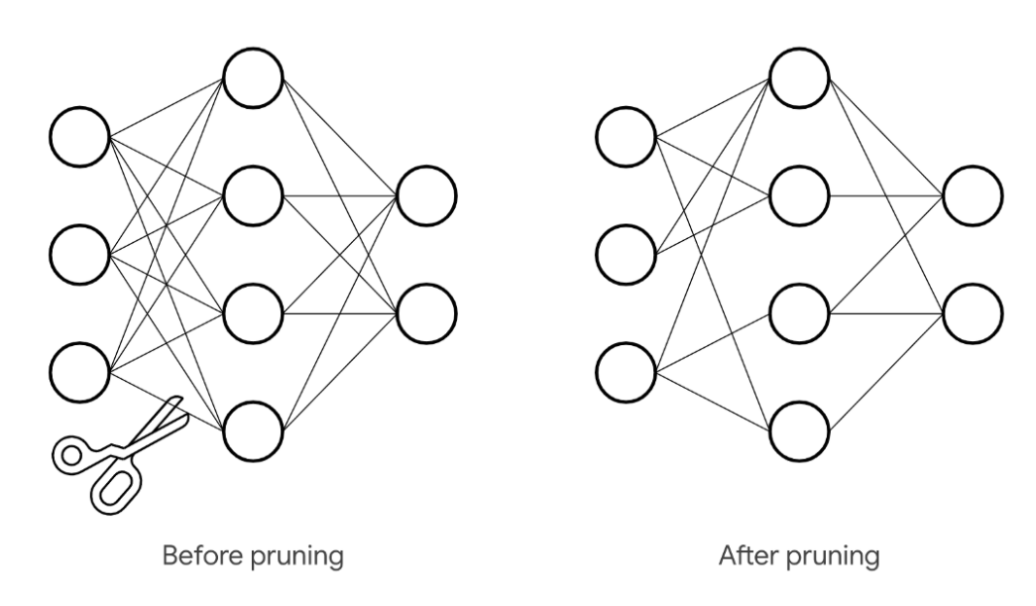
Compression Techniques: Pruning
The main idea is to remove features with nearly the same information.
Pruning involves removing connections between neurons, channels, or filters from a trained network. To prune a connection, we set a weight in the matrix to zero. To prune a neuron, we set all values of a column to zero.
2 types of pruning:
Unstructured removes connections or neurons
Structured removes filters or channels
To learn more about pruning: Derrick Mwiti, Research Guide: Pruning Techniques for Neural Networks, November 2019

Slide 8
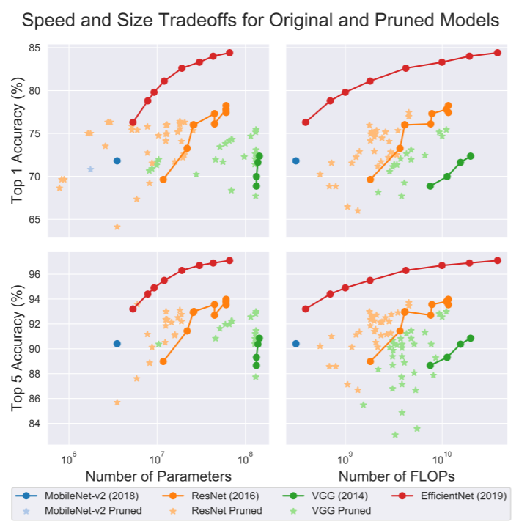
Compression Techniques: Pruning <cont>
Pruning has a few potential drawbacks:
Unclear how well given methods generalize across different architectures.
Fine-tuning is cumbersome and can slow down implementation.
May be more effective to simply use a more efficient architecture than to prune a suboptimal one.
Blalock D. et al, What is the state of neural network pruning?, March 2020

Slide 9
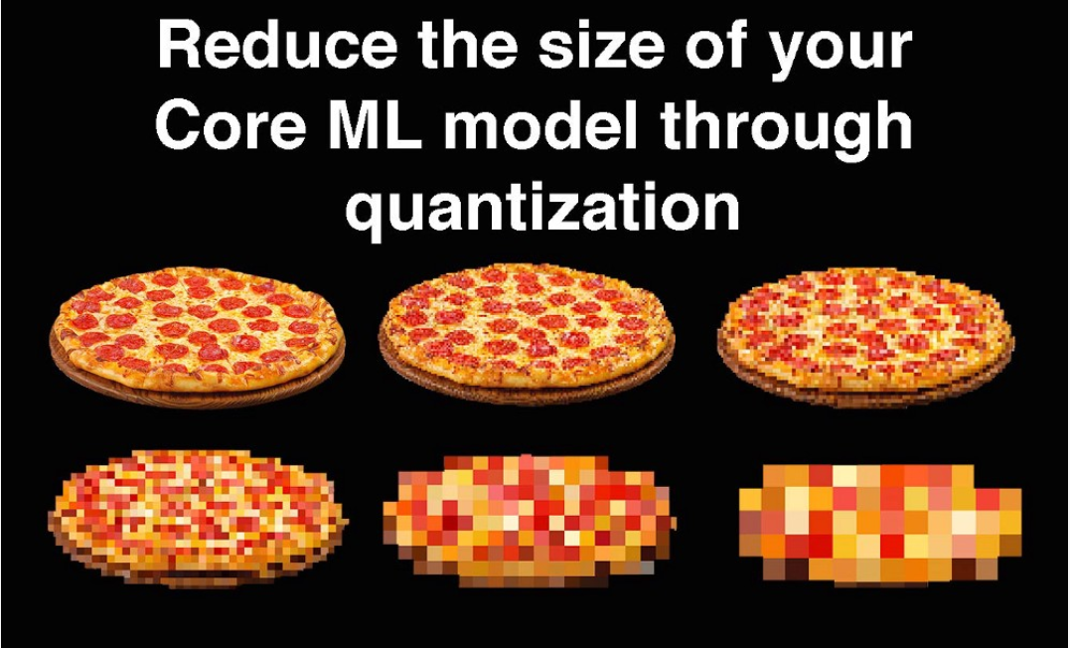
Compression Techniques: Quantization
Main idea is to map values from a large set to values in a smaller set without losing too much information in the process. So by reducing the number of pixels, the image below should still be clear.
To implement quantization with Tensorflow: MC.AI, Quantization in Deep Learning using TensorFlow 2.X, May 2020

Slide 10
Compression Techniques: Quantization
Quantization can be achieved by changing the output or NN architecture:
Post Training Quantization: reducing the size of the weights stored (e.g. from 32-bit floating point numbers to 8-bit)
To implement quantization with Tensorflow: MC.AI, Quantization in Deep Learning using TensorFlow 2.X, May 2020

Slide 11
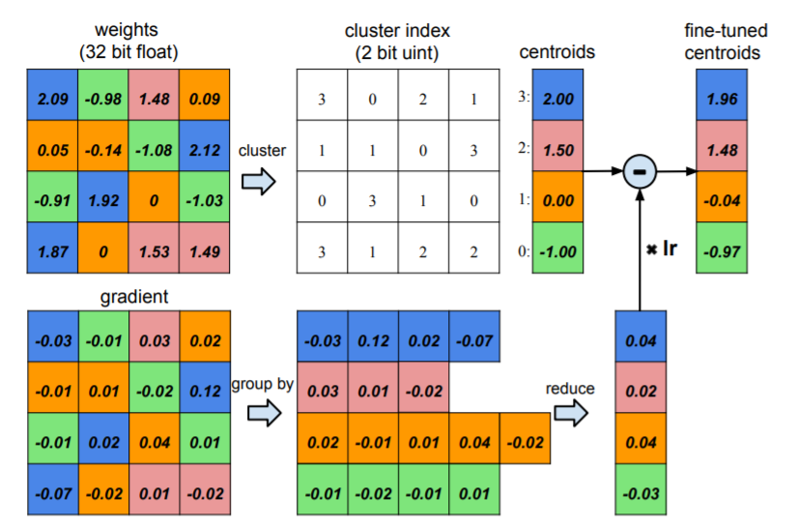
Compression Techniques: Quantization <cont>
Quantization-Aware Training:
There could be an accuracy loss in a post-training model quantization and to avoid this and if you don’t want to compromise the model accuracy we do quantization aware training.
This technique ensures that the forward pass matches precision for both training and inference.
https://www.tensorflow.org/model_optimization/guide/quantization/training
Han S. et al, Deep compression: compressing deep neural networks with pruning, trained quantization and huffman coding, 2016

Slide 12
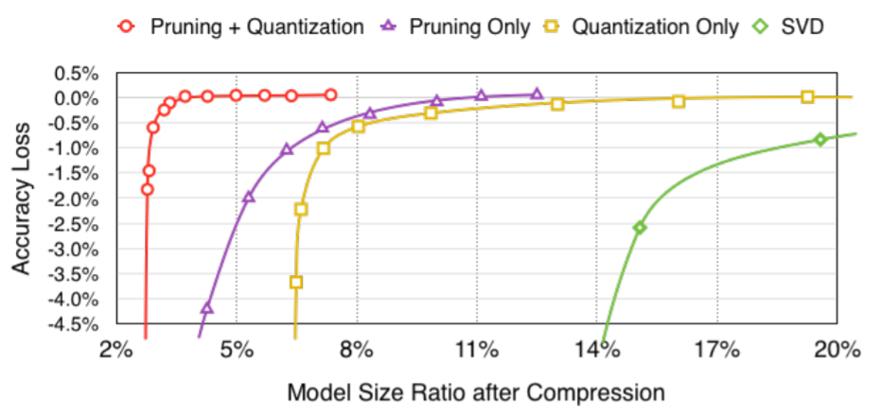
Compression Techniques: Quantization <cont>
Quantization can be tricky:
Requires having a decent understanding of hardware and bit-wise computations
Savings are tied to the features of the hardware being used
Han S. et al, Deep compression: compressing deep neural networks with pruning, trained quantization and huffman coding, 2016

Slide 13
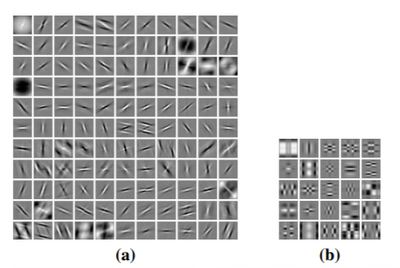
Low Rank Approximantion
Main idea is to approximate the redundant filters of a layer using a linear combination of fewer filters. Compressing layers in this way reduces the network’s memory footprint, the computational complexity of convolutional operations and can yield significant speedups.
Examples:
Singular Value Decomposition
Tucker decomposition
Canonical Polyadic decomposition
Rigamonti R. et al., Learning Separable Filters, 2013

Slide 14
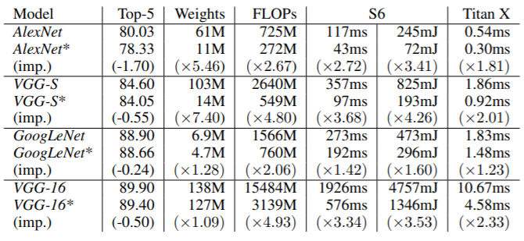
Low Rank Approximantion <cont>
Kim et al. use Tucker decomposition to determine the ranks that the compressed layers should have. They apply the compression to various models for image classification tasks and run them on both a Titan X and Samsung Galaxy S6 phone*:
Low-rank approximation achieve significant size and latency reductions
Prove potential deployment on mobile devices
Reduce parameters simplifying model structure
Does not require specialized hardware to implement
* S6 has a GPU with 35× lower computing ability and 13× smaller memory bandwidth than Titan
Kim et al, Compression of deep convolutional neural networks for fast and low power mobile applications, 2016

Slide 16
Compression Technique: Distillation
Problem:
During training, a model does not have to operate in real time and does not necessarily face restrictions on computational resources, as its primary goal is simply to extract as much structure from the given data as possible.
But latency and resource consumption do become of concern if it is to be deployed for inference.
So what? we must develop ways to compress model for inference.

Slide 17
Compression Technique: Distillation <cont>
Idea:
In 2006, Buciluă et al. showed that it was possible to transfer knowledge from a large trained model (or ensemble of models) to a smaller model for deployment by training it to mimic the larger model’s output.
In 2014 Hinton et al generalized the process and gave the name Distillation.
Main idea of distillation is that training and inference are 2 different tasks; thus a different model should be used.
Buciluă et al., Model Compression, 2006
Hinton et al., Distilling the Knowledge in a Neural Network, 2014

Slide 18
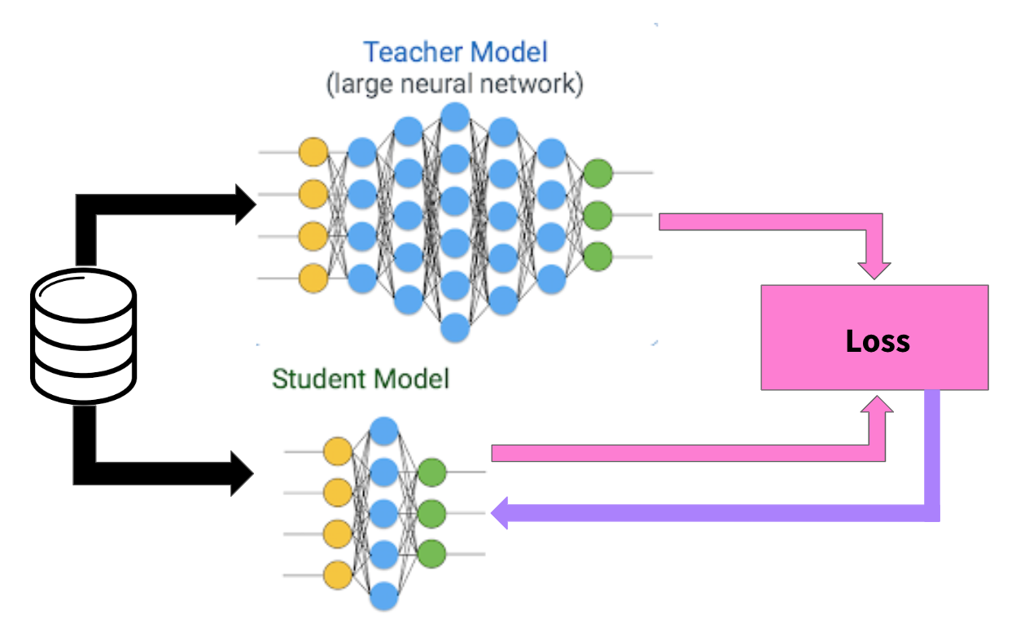
Distillation: Teacher Student <cont>
Source: https://towardsdatascience.com/knowledge-distillation-simplified-dd4973dbc764
Notes:
axolotl mexican, pudu

Slide 19
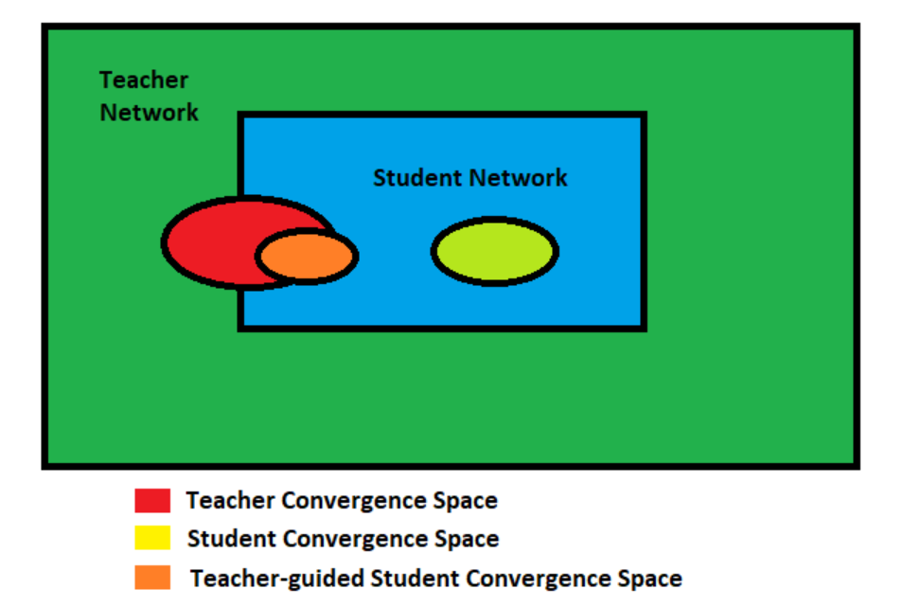
Distillation: Teacher Student
Assumption: if we can achieve similar convergence using a smaller network, then the convergence space of the Teacher Network should overlap with the solution space of the Student Network. (design diagram again if needed)

Slide 20
Teacher Student Model: Training <cont>
Train the Teacher Network.
Establish correspondence among intermediate outputs of the student network and the teacher network.
Pass the data through the Teacher Network to get all intermediate outputs.
Backpropagation through the Student Network. Use the outputs from the Teacher Network and the correspondence relation to backpropagate error in the Student Network.

Slide 21
Distillation: Teacher Student Loss <cont>
Modified softmax function with Temperature:
q ᵢ : resulting probability
z ᵢ : logit of a class
z ⱼ : other logits
T: temperature (T=1, “hard output” )
$$qi=\frac{\exp\left(\frac{z\text{ᵢ}}{T}\right)}{\text{∑}\text{ⱼ}\exp\left(\frac{z\text{ⱼ}}{T}\right)}$$
Geoffrey Hinton, Oriol Vinyals & Jeff Dean, Dark Knowledge
Notes:
axolotl mexican, pudu

Slide 22
Distillation: Teacher Student Training <cont>
Trained to minimize the sum of two different cross entropy functions:
one involving the original hard labels obtained using a softmax with T=1
one involving the softened targets, T>1
Geoffrey Hinton, Oriol Vinyals & Jeff Dean, Dark Knowledge
Notes:
axolotl mexican, pudu

Slide 23
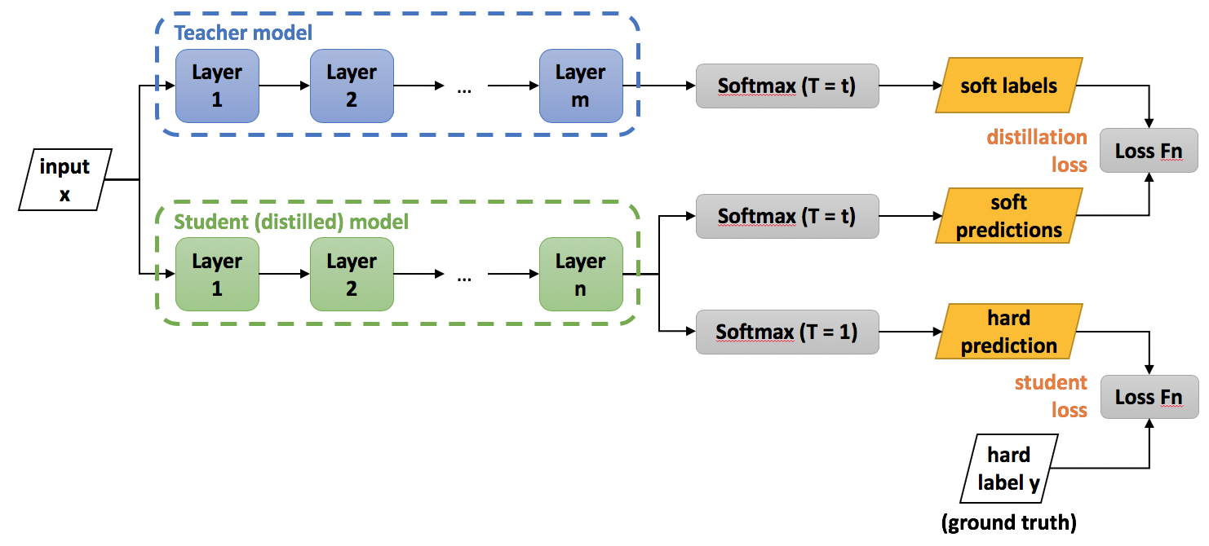
Distillation: Teacher Student Training
Source: https://medium.com/neuralmachine/knowledge-distillation-dc241d7c2322

Slide 24
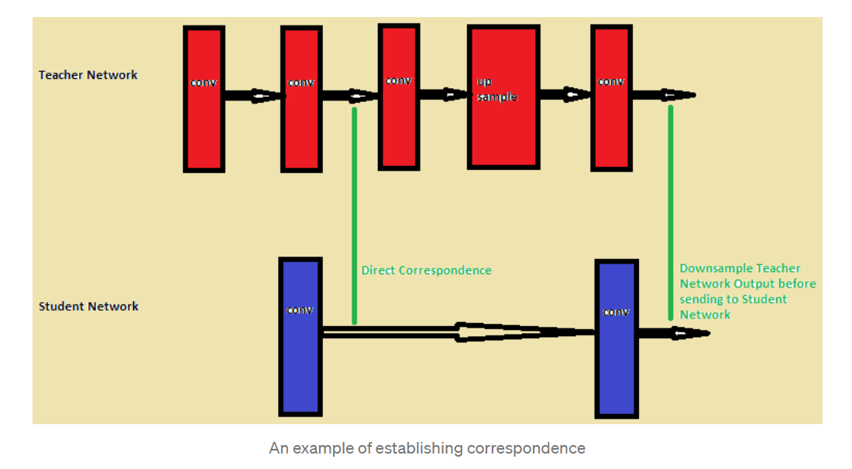
Distillation: Teacher Student Training <cont>
2: Example of Establishing Correspondence (reproduce image if needed)

Slide 25
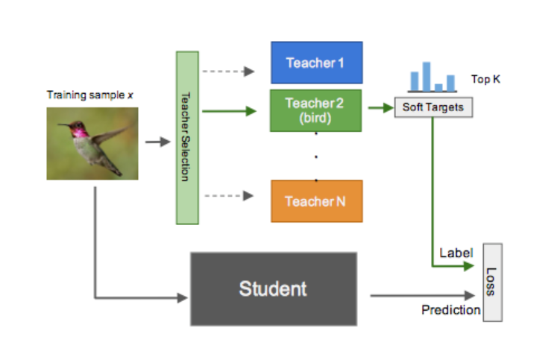
Distillation: Teacher Student Training

Slide 26
What is next in Distillation?
1: Multiple teacher (i.e. converting an ensemble into a single network).
2: Introducing a teaching assistant (the teacher first teaches the TA, who then in turn teaches the student) etc.
3: Quite young field
A drawback of knowledge distillation as a compression technique, therefore, is that there are many decisions that must be made up-front by the user to implement it (student network doesn’t even need to have a similar structure to the teacher).

Slide 27
To the notebook
LECTURE 9: Compression Techniques and Distillation

Slide 28
THANK YOU
AC295
Advanced Practical Data Science
Pavlos Protopapas

