Slide 1
Lecture 4: Dask
AC295
AC295
Advanced Practical Data Science
Pavlos Protopapas

Slide 2
Outline
1: Communications
2: Motivation
3: Dask API
4: Exercise: Exploratory Data Analysis with DASK
5: Directed Acyclical Graph (DAGs)
6: Computational Resources
7: Exercise: Visualize Directed Acyclic Graphs (DAGs)
8: Task Scheduling
9: Exercise: Manipulate Structured Data
10: Limitations

Slide 3
Outline
1: Communications
Please delete your clusters and virtual machines. Do NOT keep them running.
Submit your reading questions on Ed before wed (09/23) noon.
Exercise 3 coming soon (Exercise 2 was due at 10:15 AM)

Slide 4
Outline
1: Communications
2: Motivations

Slide 5
Motivation
Competitive Advantage
Computing More Powerful
How to enable it?
From Analytics to Data Science
Increasing Data

Slide 6
Motivation
Dataset type | Size range | Fits in RAM? | Fits on local disk?
Small dataset | Less than 2-4 GB | Yes | Yes
Medium dataset | Less than 2 TB | No | Yes
Large dataset | Greater than 2 TB | No | No
Adapted from Data Science with Dask

Slide 7
Outline
1: Communications
2: Motivations
3: Dask API

Slide 8
Dask API
What is unique about Dask:
allow to work with larger datasets making it possible to parallelize computation (e.g. "simple" sorting and “aggregating” functions would otherwise spill on persistent memory).
it simplifies the cost of using more complex infrastructure.
it is easy to learn for data scientists with a background in the Python (similar syntax) and flexible.
Adapted from Data Science with Dask

Slide 9
Dask API
Dask is fully implemented in Python and natively scales NumPy, Pandas, and scikit-learn.
Dask can be used effectively to work with both medium datasets on a single machine and large datasets on a cluster.
Dask can be used as a general framework for parallelizing most Python objects.
Dask has a very low configuration and maintenance overhead.
Adapted from Data Science with Dask
Notes:
Dask dataframe is made from smaller panda dataframes Dask arrays is made from smaller numpy arrays
Syntactially similar to pandas, scikit-learn, numpy etc
Easy for users to prototype tasks on their local machines and seamlessly submit those tasks to a cluster when needed
.
Dask also supports interfacing with popular cluster resource managers such as Kupernetes
Delayed can be used to parallize
pip or conda install

Slide 10
Motivation
Dataset type | Size range | Fits in RAM? | Fits on local disk?
Small dataset | Less than 2-4 GB | Yes | Yes
Medium dataset | Less than 2 TB | No | Yes
Large dataset | Greater than 2 TB | No | No
Adapted from Data Science with Dask

Slide 11
Dask API <cont>
not of great help for small size datasets: It generates greater overheads. Complex operations can be done without spilling to disk and slowing down process.
very useful for medium size dataset: it allows to work with medium size in local machine. Difficult to take advantage of parallelism within Pandas (no sharing work between processes on multicore systems).
essential for large datasets: Pandas, NumPy, and scikit-learn are not suitable at all for datasets of this size, because they were not inherently built to operate on distributed datasets.

Slide 12
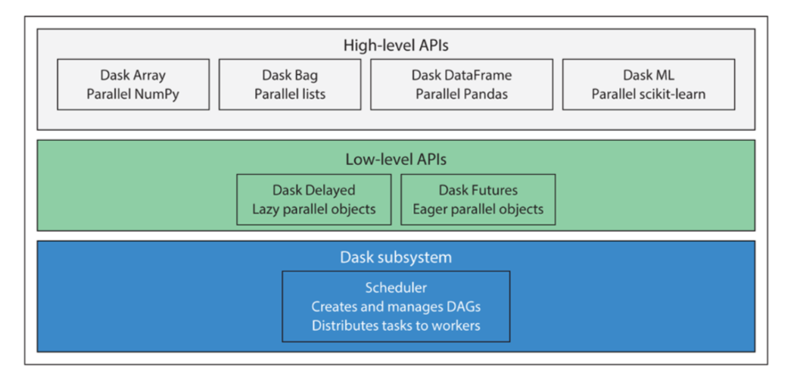
Dask API <cont>
Adapted from Data Science with Dask

Slide 13
Outline
1: Communications
2: Motivation
3: Dask API
4: Exercise: Exploratory Data Analysis with DASK

Slide 14
Outline
1: Communications
2: Motivation
3: Dask API
4: Exercise: Exploratory Data Analysis with DASK
5: Directed Acyclical Graph (DAGs)

Slide 15
Directed Acyclical Graph
A graph is a representation of a set of objects that have a relationship with one another. It is used to representing a wide variety of information.
A graph is consisted by:
node: a function, an object or an action
line: symbolize the relationship among nodes
In a directed acyclical graph there is one logical way to traverse the graph. No node is visited twice.
In a cyclical graph: exist a feedback loop that allow to revisit and repeat the actions within the same node.

Slide 16
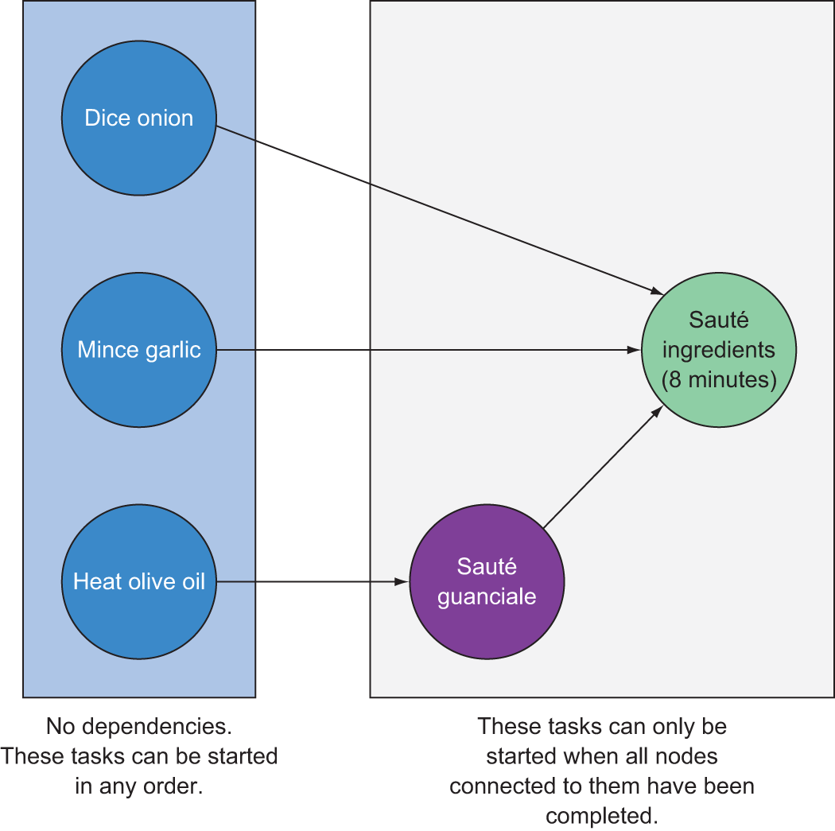
Directed Acyclical Graph <cont>
Adapted from
Data Science with Dask
Notes:
Transitive dependancy

Slide 17
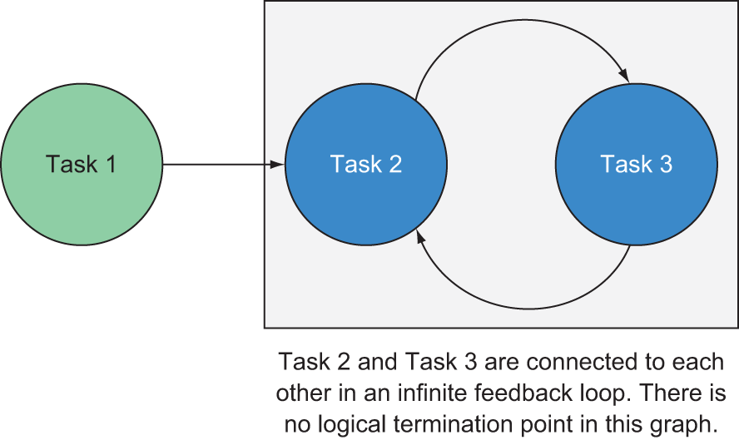
Directed Acyclical Graph <cont>
Adapted from
Data Science with Dask

Slide 18
Outline
1: Communications
2: Motivation
3: Dask API
4: Exercise: Exploratory Data Analysis with DASK
5: Directed Acyclical Graph (DAGs)
6: Computational Resources

Slide 19
Computational Resources
How to handle computational resources? As the problem we solve requires more resources we have two options:
scale up: increase size of the available resource: invest in more efficient technology. cons diminishing return.
scale out: add other resources (dask’s main idea). Invest in more cheap resources. cons distribute workload.

Slide 20
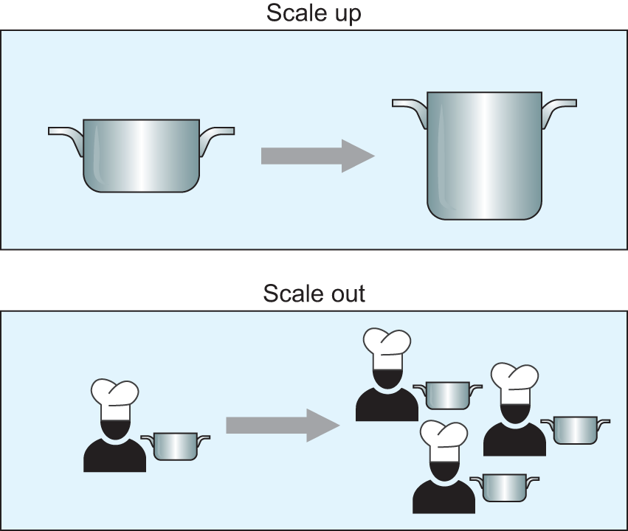
Computational Resources <cont>
Adapted from
Data Science with Dask

Slide 21
Computational Resources <cont>
As we approach greater number of "work to be completed", some resources might be not fully exploited. This phenomenon is called concurrency.
For instance some might be idling because of insufficient shared resources (i.e. resource starvation). Schedulers handle this issue by making sure to provide enough resources to each worker.

Slide 22
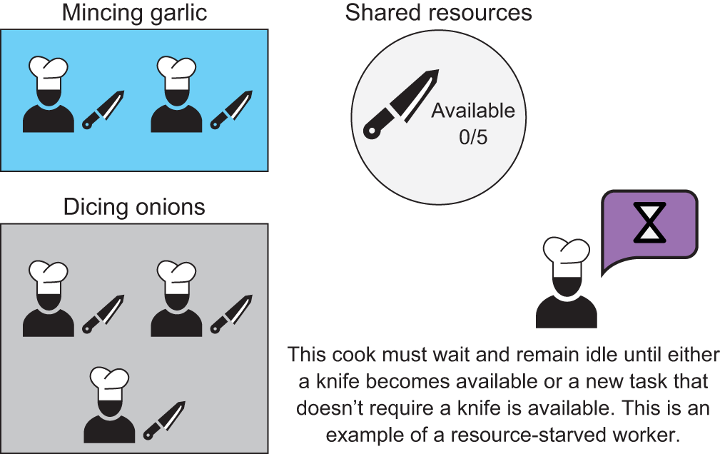
Computational Resources <cont>
Adapted from
Data Science with Dask

Slide 23
Computational Resources <cont>
In case of a failure, Dask reach a node and repeat the action without disturbing the rest of the process. There are two types of failures:
work failures: a worker leave, and you know that you must assign another one to their task. This might potentially slow down the execution, however it won't affect previous work (aka data loss).
data loss: some accident happens, and you have to start from the beginning. The scheduler stops and restarts from the beginning the whole process.

Slide 24
Dask Review
Dask can be used to scale popular Python libraries such as Pandas and NumPy allowing to analyze dataset with greater size (>8GB).
Dask uses directed acyclical graph to coordinate execution of parallelized code across processors.
Upstream actions are completed before downstream nodes.
Scaling out (i.e. add workers) can improve performances of complex workloads, however, create overhead that can reduces gains.
In case of failure, the step to reach a node can be repeated from the beginning without disturbing the rest of the process.

Slide 25
Outline
1: Communications
2: Motivation
3: Dask API
4: Exercise: Exploratory Data Analysis with DASK
5: Directed Acyclical Graph (DAGs)
6: Computational Resources
7: Exercise: Visualize Directed Acyclic Graphs (DAGs)

Slide 26
Outline
1: Communications
2: Motivation
3: Dask API
4: Exercise: Exploratory Data Analysis with DASK
5: Directed Acyclical Graph (DAGs)
6: Computational Resources
7: Exercise: Visualize Directed Acyclic Graphs (DAGs)
8: Task Scheduling

Slide 27
Task scheduling
Dask performs a so called lazy computation. Until you run the method .compute(), Dask only splits the process into smaller logical pieces.
Even though the process is defined, the number of resources assigned and the place where the result will be stored are not assigned because the scheduler assigns them dynamically. This allow to recover from worker failure.

Slide 28
Task scheduling <cont>
Dask uses a central scheduler to orchestrate the work. It splits the workload among different servers which they will unlikely be perfectly balanced with respect to load, power and data access. Due to these conditions, scheduler needs to promptly react to avoid bottlenecks that will affect overall runtime.

Slide 29
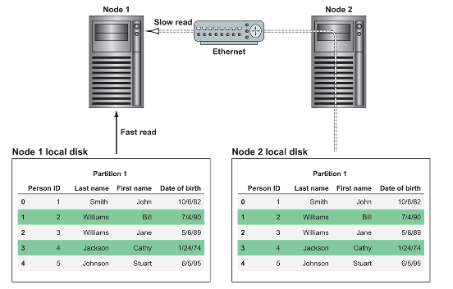
Task scheduling <cont>
For best performance, a Dask cluster should use a distributed file system (S3, HDFS) as a data storage. Assuming there are two nodes like in the image below and data are stored in one. In order to perform computation in the other node we have to move the data from one to the other creating an overhead proportional to the size of the data. The remedy is to split data minimizing the number of data to broadcast across different local machines.

Slide 30
Outline
1: Communications
2: Motivation
3: Dask API
4: Exercise: Exploratory Data Analysis with DASK
5: Directed Acyclical Graph (DAGs)
6: Computational Resources
7: Exercise: Visualize Directed Acyclic Graphs (DAGs)
8: Task Scheduling
9: Exercise: Manipulate Structured Data

Slide 31
Outline
1: Communications
2: Motivation
3: Dask API
4: Exercise: Exploratory Data Analysis with DASK
5: Directed Acyclical Graph (DAGs)
6: Computational Resources
7: Exercise: Visualize Directed Acyclic Graphs (DAGs)
8: Task Scheduling
9: Exercise: Manipulate Structured Data
10: Review and Limitations

Slide 32
Dask Review
Dask can be used to scale popular Python libraries such as Pandas and NumPy allowing to analyze dataset with greater size (>8GB).
Dask uses directed acyclical graph to coordinate execution of parallelized code across processors.
Upstream actions are completed before downstream nodes.
Scaling out (i.e. add workers) can improve performances of complex workloads, however, create overhead that can reduces gains.
In case of failure, the step to reach a node can be repeated from the beginning without disturbing the rest of the process.

Slide 33
Dask Limitations
Dask dataframe are immutable. Functions such as pop and insert are not supported.
Dask does not allow for functions with a lot of data shuffling like stack/unstack and melt.
Do major filter and preprocessing in Dask and then dump the final dataset into Pandas.
Join, merge, groupby, and rolling are supported but expensive due to shuffling.
Do major filter and preprocessing in Dask and then dump the final dataset into Pandas or limit operations only on index which can be pre-sorted.

Slide 34
THANK YOU
AC295
Advanced Practical Data Science
Pavlos Protopapas

