Slide 1
Lecture 20: GANS

Slide 2
Outline
Game Theory, minmax
Challenges:
  Big Samples
  Modal collapse

Slide 3
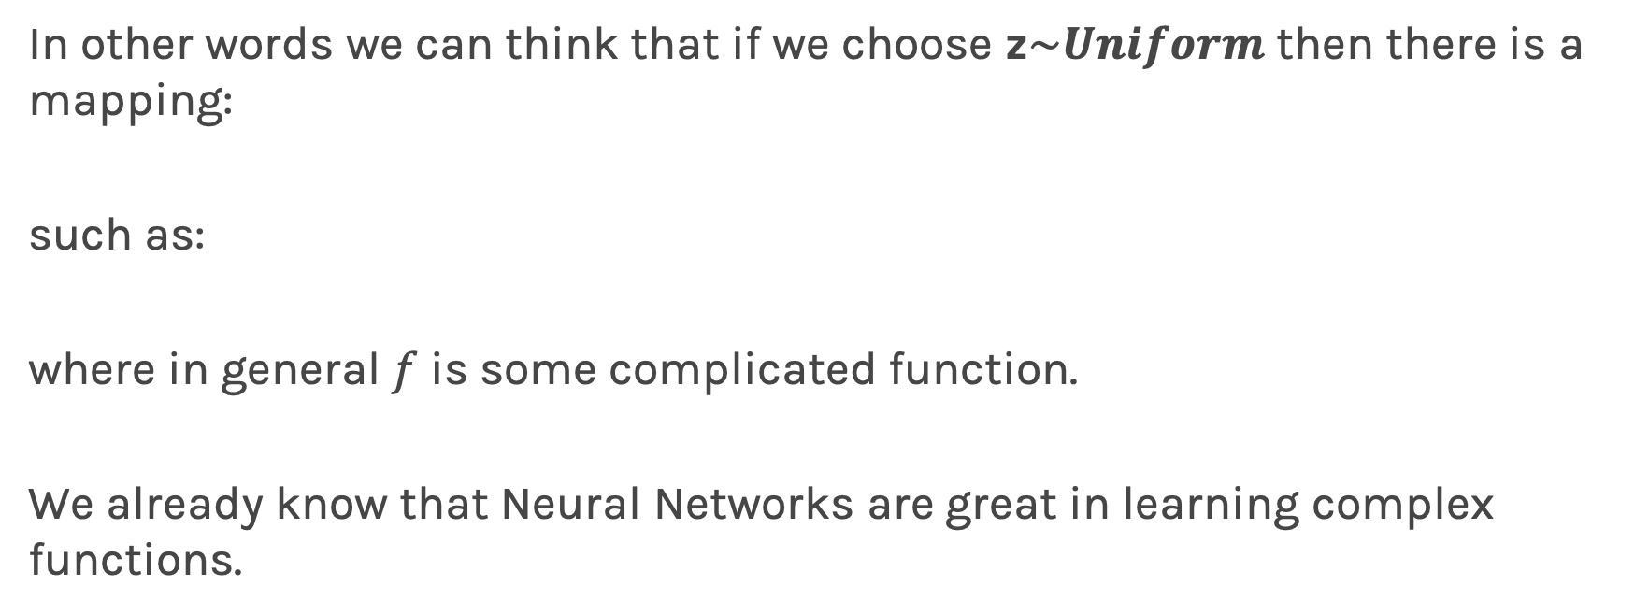
Generative models
In other words we can think that if we choose z$\sim Uniform$ then there is a mapping:
such as:
where in general $f$ is some complicated function.
We already know that Neural Networks are great in learning complex functions.

Slide 4
Generative models
We would like to construct our generative model, which we would like to train to generate lightcurves like these from scratch.
A generative model in this case could be one large neural network that outputs samples from the model.
Deep Generative Models
Explicit Density
Markov Chain
Implicit Density
Markov Chain
Direct
Variational
Boltzmann Machines
Deep Belief Networks
Variational
Autoencoders (VAE)
Generative Adversarial Networks (GAN)
Generative Moment Matching Networks (GMM)

Slide 5
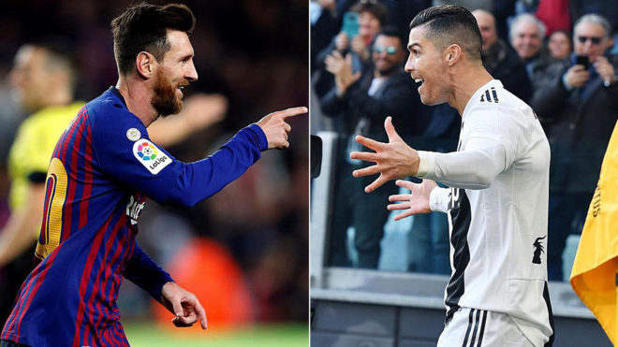
Adversarial
2 Athletes: Messi and Ronaldo. Adversaries!

Slide 6



Generative Adversarial Networks (GANs)
Gary
Marketer
David
Spam Filterer
Yes, it is spam
Spam
No, it is not spam

Slide 7



Generative Adversarial Networks (GANs)
Discarded a valid email
David
checks the results
Yes, it is spam
Spam
Spam
Spam
Spam
Spam
Spam
No, it is not spam
Allow some spams

Slide 8
Generative Adversarial Networks (GANs)
David and Gary
learned what went wrong
It was spam, for real
It was not spam
Spam
Spam
Yes, it is spam
Spam
Spam
No, it is not spam
Spam
Spam

Slide 9
Generative Adversarial Networks (GANs)
Gary
Find more sophisticated words than spam
David
The email contains the word spam
Yes, it is spam
No, it is not spam

Slide 10
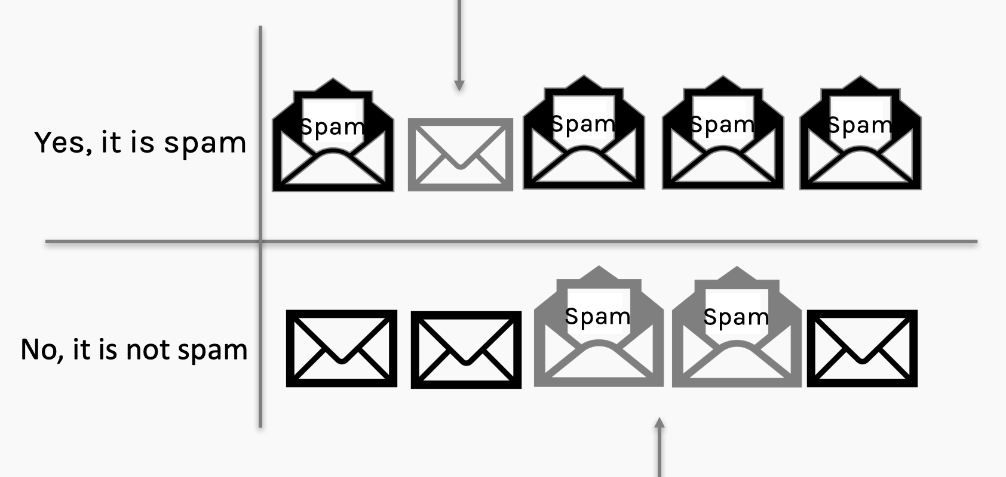

Generative Adversarial Networks (GANs)
Discarded a valid email
David and Gary
learned what went wrong
Yes, it is spam
No, it is not spam
Allow fewer spams

Slide 11
Generative Adversarial Networks (GANs)
David
learned what went wrong
It was spam, for real
It was not spam
Yes, it is spam
No, it is not spam

Slide 12
Generative Adversarial Networks (GANs)
Understanding confusion matrix through an example
label: it was not spam
False
Positive
False Positive
true
false
positive
TP
FP
M
prediction matches label?
Yes or True
+
=
prediction:
yes, it is spam
false
true
negative
FN
TN
No or False
SPAM: POSITIVE
TRUE/FALSE: If prediction and true match do not match
POSITIVE/NEGATIVE: Prediction class

Slide 13
Generative Adversarial Networks (GAN)
label: it is spam
D
prediction matches label?
Yes
No action for discriminator. Generator must do better.
prediction:
yes, it is spam
Show spam email
It was spam, for real
It was not spam
Yes, it is spam
True positive (TP): the discriminator see a spam and predicts correctly. No need for further actions for discriminator. Generator must do a better job.
No, it is not spam

Slide 14
Generative Adversarial Networks (GANs)
label: it is spam
D
prediction matches label?
prediction:
it is not spam
show spam email
No
It was spam, for real
It was not spam
Discriminator learn more about spam
Yes, it is spam
False Negative (FN): the discriminator see an email and predict it as spam even though it is not. The discriminator learn more
No, it is not spam

Slide 15
Generative Adversarial Networks (GANs)
label: it is not spam
D
prediction matches label?
Yes
prediction:
it is spam
show spam email
No
Discriminator learn more about spam
It was spam, for real
It was not spam
Yes, it is spam
False positive (FP): generator try to fool discriminator and the discriminator fails. The generator succeeded and the generator is forced to improve.
No, it is not spam

Slide 16
Generative Adversarial Networks (GANs)
label: it is not a spam
D
prediction matches label?
Yes
No action for discriminator and no action for generator.
prediction:
yes, it is not a spam
Show spam email
It was spam, for real
It was not spam
Yes, it is spam
True negative (TN): generator try to fool discriminator, however the discriminator predict correctly. The generator learn what was wrong and try something else.
No, it is not spam

Slide 17
The Discriminator
The discriminator is very simple. It takes a sample as input, and its output is a single value that reports the network’s confidence that the input is from the training set, rather than being a fake.
There are not many restrictions on what the discriminator is.
confidence that sample is real
Discriminator
sample

Slide 18
The Generator
The generator takes as input a bunch of random numbers.
If we build our generator to be deterministic, then the same input will always produce the same output. In that sense we can think of the input values as latent variables. But here the latent variables weren’t discovered by analyzing the input, as they were for the VAE.
sample
Generator
noise

Slide 19

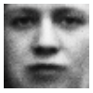
The Generator
Is it really noise?
Remember our VAE
q_{ϕ}(z|x)
Encoder
z
Decoder
p_{θ}(x|z)

Slide 20
The Generator
Is it really noise? Remember our Variational Autoencoder.
q_{ϕ}(z|x)
z
Decoder
p_{θ}(x|z)

Slide 21
The Generator
Is it really noise? Remember our Variational Autoencoder.
z
Decoder
p_{θ}(x|z)

Slide 22
The Generator
Is it really noise? Remember our Variational Autoencoder.
z
Decoder
p_{θ}(x|z)

Slide 23
The Generator
Is it really noise? Remember our Variational Autoencoder.
z
Generator

Slide 24
The Generator
So the random noise is not “random” but represents (an image in the example below) in the “latent” space.
z
Generator

Slide 25
Learning
The process – known as Learning Round - accomplishes three jobs:
The discriminator learns to identify features that characterize a real sample
The discriminator learns to identify features that reveal a fake sample
The generator learns how to avoid including the features that the discriminator has learned to spot

Slide 26
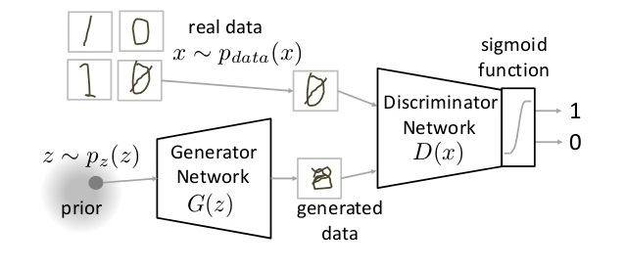

Slide 27
Min-max Cost
Discriminator seeks to predict 1 on training samples
Discriminator wants to predict 0 on samples generated by G
Generator wants D to not distinguish between original and generated samples!

Slide 28
Training GANs
Sample mini-batch of training images x, and generator codes z
Update G using backprop
Update D using backprop
Optional: Run k steps of one player for every step of the other player.
D:4 G:1 (this was the norm a year ago. So much has changed)

Slide 29
Training the GAN
False negative (I: Real/D: Fake):
In this case we feed reals to the discriminator. The Generator is not involved in this step at all.
The error function here only involves the Discriminator and if it makes a mistake the error drives a backpropagation step through the discriminator, updating its weights, so that it will get better at recognizing reals.
Error
Function
Update
Fake
Discriminator
Real
Reals

Slide 30
Training the GAN
Error
Function
True negative (I: Fake/D: Fake):
We start with random numbers going into the generator.
The generator’s output is a fake.
The error function gets a large value if this fake is correctly identified as fake. Meaning that the generator got caught.
Backprop, goes through the discriminator (which frozen) to the generator.
Update the generator, so it can better learn how to fool the discriminator.
Fake
Discriminator
Update
Fake
Generator
noise

Slide 31
Training the GAN
Error
Function
Update
False positives (I:Fake/D:Real):
Here we generate a fake and punish the discriminator if it classifies it as real.
Real
Discriminator
Fake
Generator
noise

Slide 32
Min-max Cost
Discriminator seeks to predict 1 on training samples
Discriminator wants to predict 0 on samples generated by G
Generator wants D to not distinguish between original and generated samples!

Slide 33



Generative Models
Generated distribution
True distribution
$$\hat{p}(x)$$
$$p(x)$$
Generative Model
(Neural Network)
W_{G}
$$z\sim Unif$$
Loss function
KL Divergence

Slide 34

Generative Adversarial Networks
Generated distribution
True distribution
$$\hat{p}(x)$$
$$p(x)$$
Generative Model
(Neural Network)
W_{G}
Discriminator
(Neural Network)
W_{D}
$$z\sim Unif$$
From Generator
From True Distribution
Loss function
KL Divergence
Loss function: Binary Cross Entropy, $L_{D}$

Slide 35
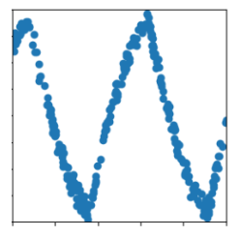



Generative Adversarial Networks
Generated distribution
True distribution
$$\hat{p}(x)$$
$$p(x)$$
Generative Model
(Neural Network)
$$z\sim Unif$$
Discriminator
(Neural Network)
From Generator
From True Distribution

Slide 36
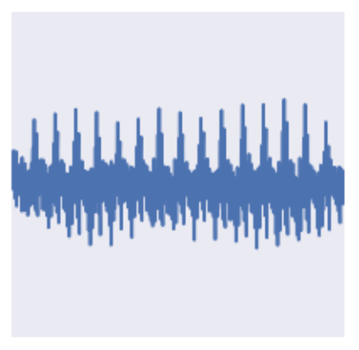
Generative Adversarial Networks
Generated distribution
True distribution
$$\hat{p}(x)$$
$$p(x)$$
Generative Model
(Neural Network)
$$z\sim Unif$$
Discriminator
(Neural Network)
From Generator
From True Distribution

Slide 37
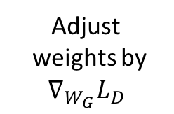
Generative Adversarial Networks
Generated distribution
True distribution
$$\hat{p}(x)$$
$$p(x)$$
Generative Model
(Neural Network)
$$z\sim Unif$$
Adjust
weights by
$$∇_{W_{G}}L_{D}$$
Discriminator
(Neural Network)
Generator
Loss
From Generator
From True Distribution

Slide 38
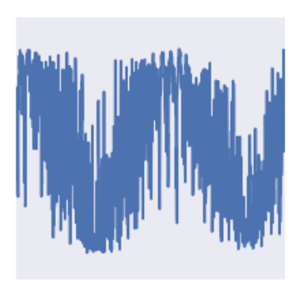
Generative Adversarial Networks
Generated distribution
True distribution
$$\hat{p}(x)$$
$$p(x)$$
Generative Model
(Neural Network)
$$z\sim Unif$$
Discriminator
(Neural Network)
From Generator
From True Distribution

Slide 39
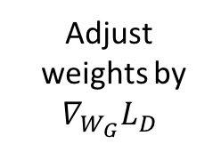
Generative Adversarial Networks
Generated distribution
True distribution
$$\hat{p}(x)$$
$$p(x)$$
Generative Model
(Neural Network)
$$z\sim Unif$$
Discriminator
(Neural Network)
Adjust
weights by
$$∇_{W_{G}}L_{D}$$
Generator
Loss
From Generator
From True Distribution

Slide 40
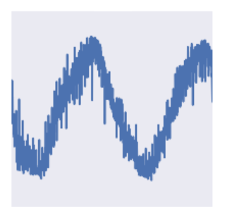
Generative Adversarial Networks
Generated distribution
True distribution
$$\hat{p}(x)$$
$$p(x)$$
Generative Model
(Neural Network)
$$z\sim Unif$$
Discriminator
(Neural Network)
From Generator
From True Distribution

Slide 41
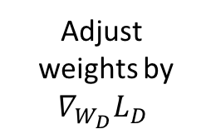
Generative Adversarial Networks
Generated distribution
True distribution
$$\hat{p}(x)$$
$$p(x)$$
Generative Model
(Neural Network)
$$z\sim Unif$$
Adjust
weights by
$$∇_{W_{D}}L_{D}$$
Discriminator
(Neural Network)
Discriminator
Loss
From Generator
From True Distribution

Slide 42
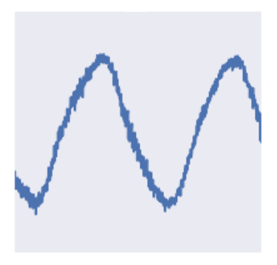
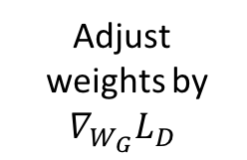
Generative Adversarial Networks
Generated distribution
True distribution
$$\hat{p}(x)$$
$$p(x)$$
Generative Model
(Neural Network)
$$z\sim Unif$$
Discriminator
(Neural Network)
Adjust
weights by
$$∇_{W_{G}}L_{D}$$
Generator
Loss
From Generator
From True Distribution

Slide 43
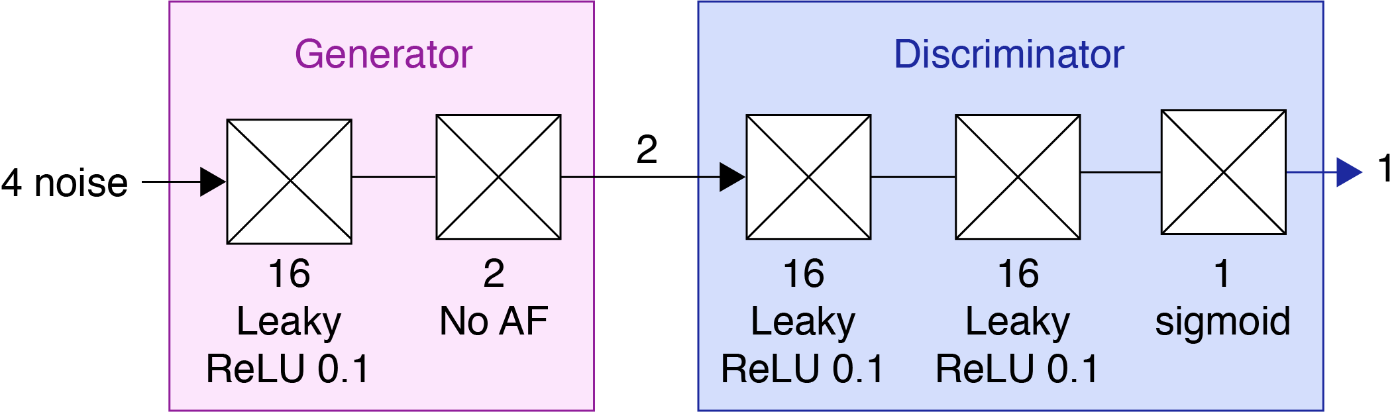
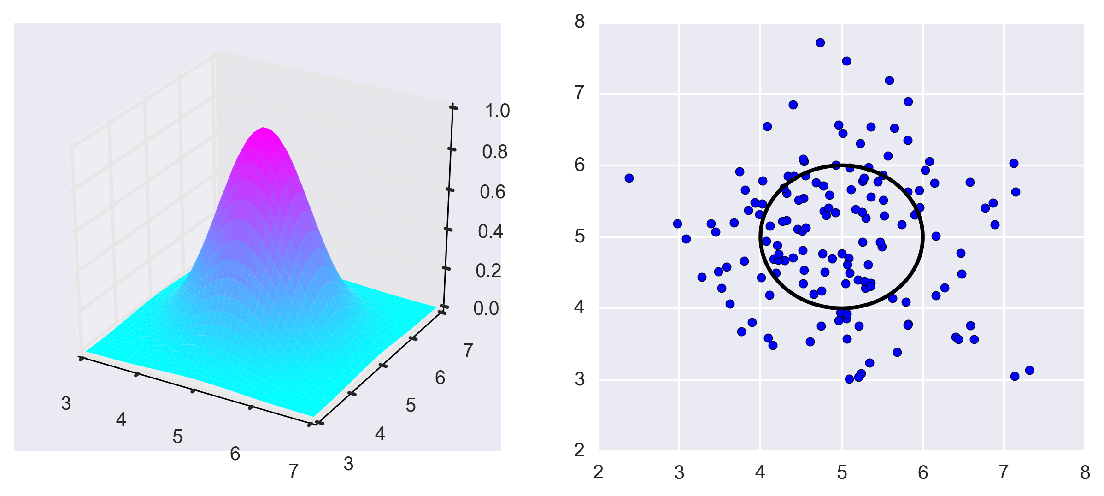
Building GANS: Fully Connected Case
Let’s build a FC simple GAN to generate points in a 2-dimensional Gaussian Distribution.
Generator
  Takes 4 random numbers
  Generates a coordinate pair drawn from a specific 2-D Gaussian
Discriminator
  Takes an input point in the form of a coordinate pair
  Determines whether the point is drawn from a specific 2-D Gaussian

Slide 44
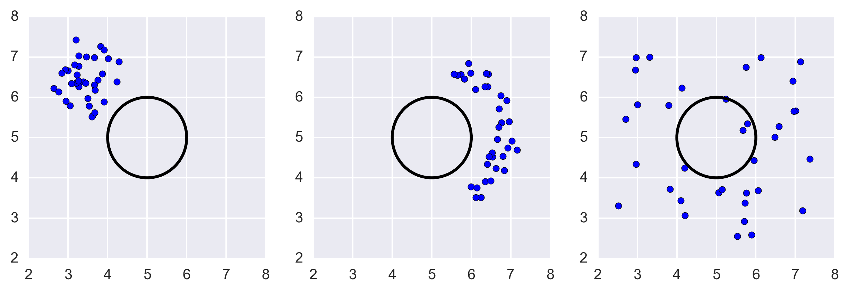
Building GANS: Fully Connected Case
Train the Networks based on their ability to generate/discriminate batches of points drawn from the distribution.
Are these batches of points drawn from the right distribution?

Slide 45
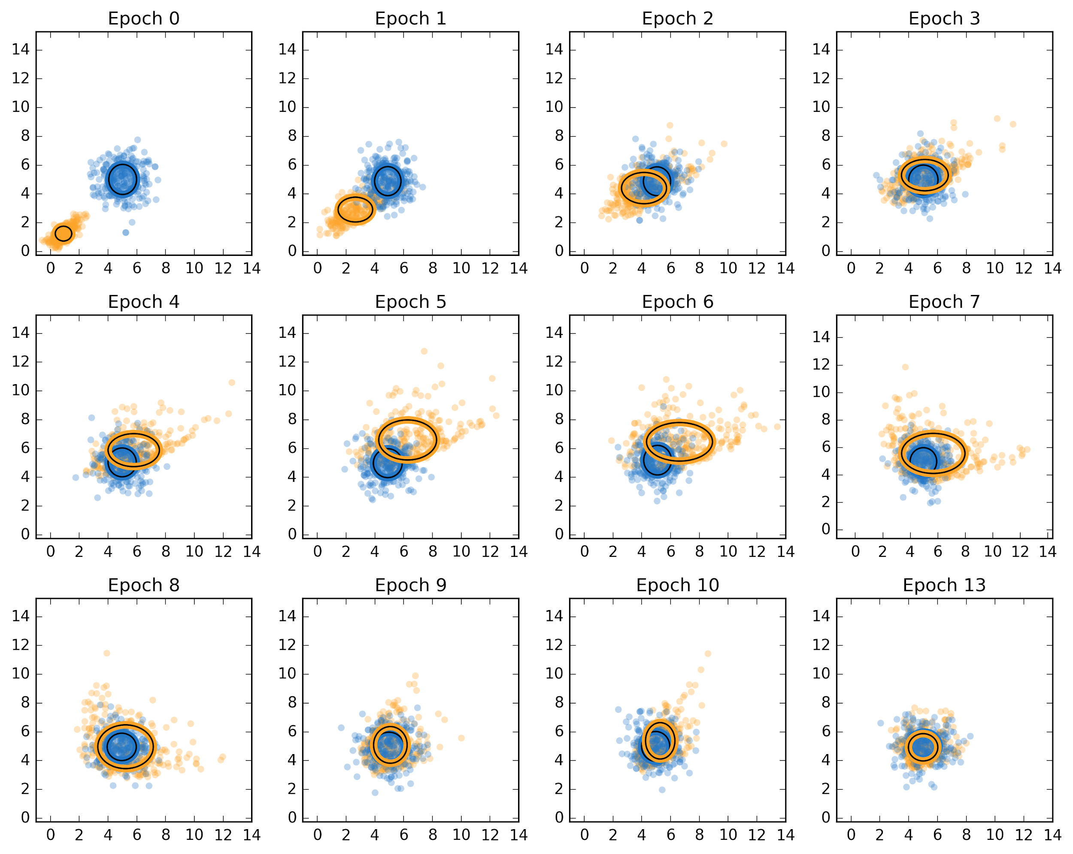
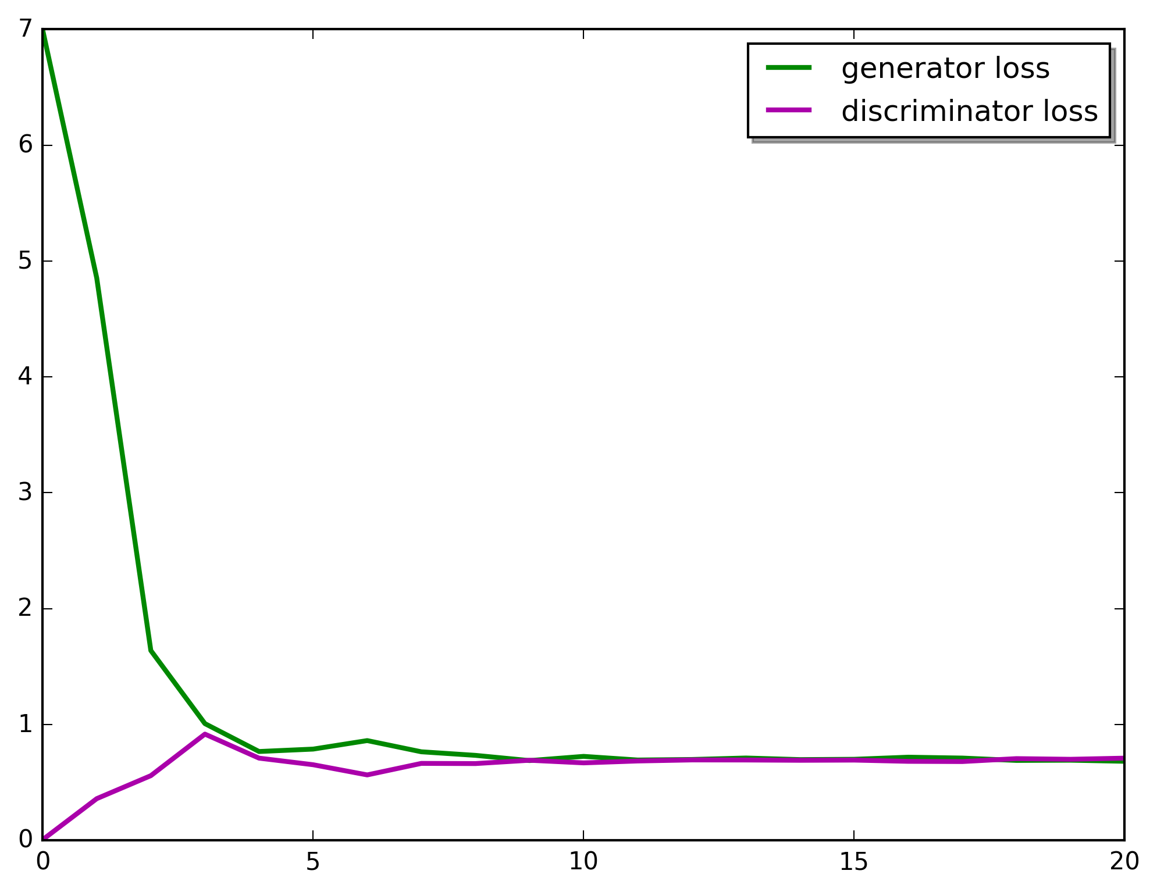
Building GANS: Fully Connected Case
As the generator and discriminator loss converges, the batch of points generated by the generator (in the yellow) approaches the real batch of points (in the blue)

Slide 46
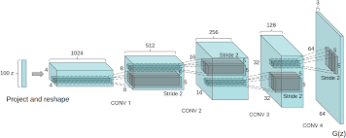
Building GANS: DCGAN
Deep Convolutional GAN (DCGAN) -- Alex Radford et al. 2016
Eliminate fully connected layers.
Max Pooling BAD! Replace all max pooling with convolutional stride
Use transposed convolution for upsampling.
Use Batch normalization

Slide 47
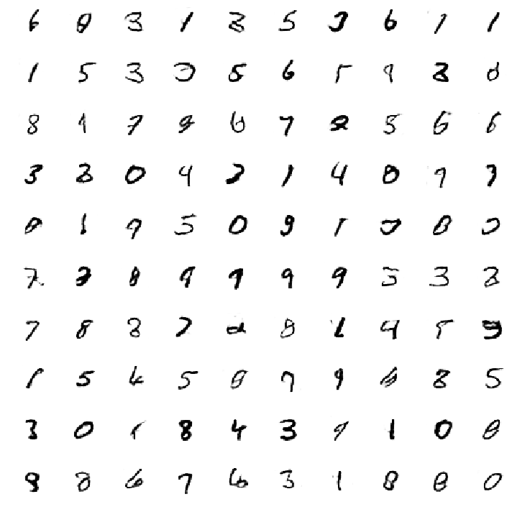
Building GANS: DCGAN
DCGAN on MNIST
Generated digits

Slide 48
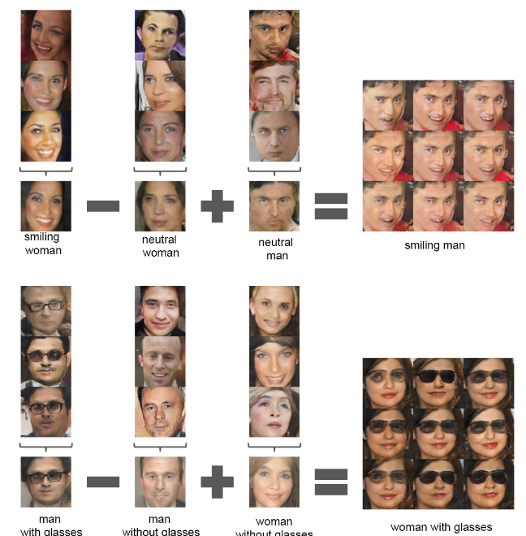
Building GANS: DCGAN
DCGAN Interpretable Vector Arithmetic
Parallels to Autoencoder Case
https://arxiv.org/pdf/1511.06434v2.pdf

Slide 49
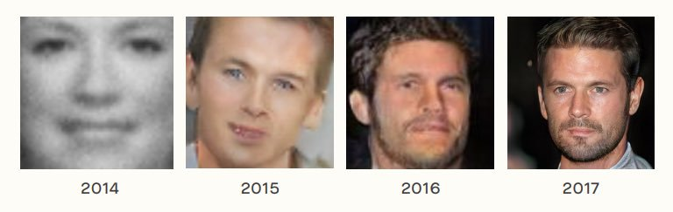
Evolution of GANs
5 Years of Improvement in Artificially Generated Faces
2019
https://twitter.com/goodfellow_ian/status/969776035649675265?lang=en

Slide 50
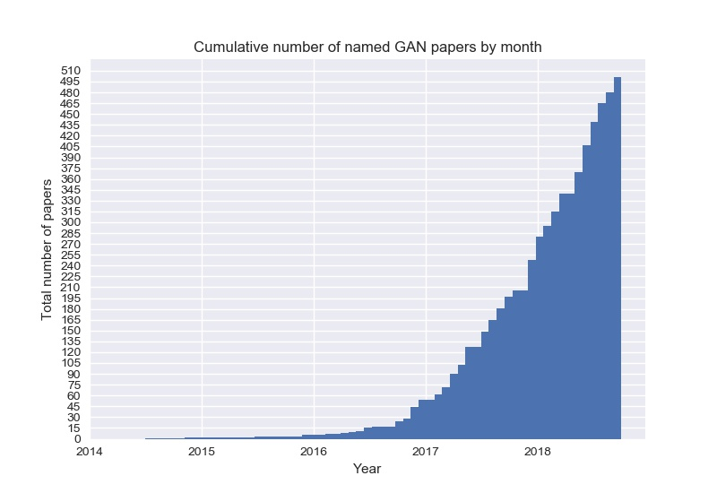
Evolution of GANs

Slide 52
GAN Rules of Thumb (GANHACKs)
Normalize the inputs
normalize the images between -1 and 1
tanh as the last layer of the generator output
Use Spherical Z
Don’t sample from a Uniform distribution
When doing interpolations, do the interpolation via a great circle, rather than a straight line from point A to point B
Tom White's Sampling Generative Networks ref code https://github.com/dribnet/plat has more details

Slide 53
GAN Rules of Thumb (GANHACKs)
BatchNormalization
Construct different mini-batches for real and fake, i.e. each mini-batch needs to contain only all real images or all generated images.
when batchnorm is not an option use instance normalization (for each sample, subtract mean and divide by standard deviation).
Avoid Sparse Gradients: ReLU, MaxPool
the stability of the GAN game suffers if you have sparse gradients
LeakyReLU = good (in both G and D)
For Downsampling, use: Average Pooling, Conv2d + stride
For Upsampling, use: PixelShuffle, ConvTranspose2d + stride
  PixelShuffle: https://arxiv.org/abs/1609.05158

Slide 54
GAN Rules of Thumb (GANHACKs)
Use Soft and Noisy Labels
Label Smoothing, i.e. if you have two target labels: Real=1 and Fake=0, then for each incoming sample, if it is real, then replace the label with a random number between 0.7 and 1.2, and if it is a fake sample, replace it with 0.0 and 0.3 (for example).
  Salimans et. al. 2016
make the labels noisy for the discriminator: occasionally flip the labels when training the discriminator
See GANHACKs (https://github.com/soumith/ganhacks) for more tips

Slide 55
Outline
Review of AE and VAE
GANS
Motivation
Formalism
Training
Game Theory, minmax
Challenges:
  Big Samples
  Modal collapse

Slide 56
Game Theory
In some games there are unbounded resources. For example, in a game of poker, the pot can theoretically get larger and larger without limit.
Zero-sum game: Players compete for a fixed and limited pool of resources. Players compete for resources, claiming them and each player’s total number of resources can change, but the total number of resources remain constant.
In zero-sum games each player can try to set things up so that the other player’s best move is of as little advantage as possible. This is called a minimax, or minmax, technique.

Slide 57
Game Theory (cont)
Our goal in training the GAN is to produce two networks that are each as good as they can be. In other words, we don’t end up with a “winner.”
Instead, both networks have reached their peak ability given the other network’s abilities to prevent it. Game theorists call this state a Nash equilibrium, where each network is at its best configuration with respect to the other.
More on this in the a-sec.

Slide 58
Outline
Review of AE and VAE
GANS
Motivation
Formalism
Training
Game Theory, minmax
Challenges:
  Big Samples
  Modal collapse

Slide 59
Challenges
Biggest challenge to using GANs is practice is their sensitivity to both structure and parameters.
If either the discriminator or generator gets better than the other too quickly, the other will never be able to catch up.
Finding that combination can be challenging. Following the rules of thumb we discussed above is generally recommended when we’re building a new GAN or DCGAN.

Slide 60
Challenges (cont)
Also there is no proof that they will converge.
GANs do seem to perform very well most of the time when we find the right parameters, but there’s no guarantee beyond that.

Slide 61
Challenges: Using Big Samples
Trying to train a GAN generator to produce large images, such as 1000 by 1000 pixels can be problematic.
The problem is that with large images, it’s easy for the discriminator to tell the generated fakes from the real images.
Many pixels can lead to error gradients that cause the generator’s output to move in almost random directions, rather than getting closer to matching the inputs.
Compute power, memory, and time to process large numbers of these big samples.

Slide 62
Challenges: Using Big Samples (cont)
Start by resizing the images: 512x512, 128x128, 64x64, … ,4x4.
Then build a small generator and discriminator, each with just a few layers of convolution.
Train with the 4 by 4 images until it does well.
Add a few more convolution layers to the end network, and now train them with 8 by 8 images. Again, when the results are good, add some more convolution layers to the end of each network and train them on 16 by 16 images.
This process takes much less time to complete than if we’d trained with only the full-sized images from the start.

Slide 63
Challenges: Modal collapse
I would like to use GAN to produce faces like the ones below from NVIDIA [Karras, Laine, Aila / Nvidia].

Slide 64
Challenges: Modal collapse (cont)
The generator somehow finds one image that fools the discriminator.
[Karras, Laine, Aila / Nvidia].

Slide 65
Challenges: Modal collapse (cont)
A generator could then just produce that image every time independently of the input noise.
The discriminator will always say it is real, so the generator has accomplished its goal and stops learning.
However: The problem is that every sample made by the generator is identical.
This problem of producing just one successful output over and over is called modal collapse.
[Karras, Laine, Aila / Nvidia].

Slide 66
Challenges: Modal collapse (cont)
Much more common is when the system produces the same few outputs, or minor variations of them.
This is called partial modal collapse
Solution:
Extend the loss function with an additional terms to measure the diversity of the outputs produced.
If the outputs are all the same, or nearly the same, the discriminator can assign a larger error to the result.
The generator will diversify because that action will reduce the error

Slide 67

Notes:
LiveSlide Site
https://poloclub.github.io/ganlab/

Slide 68
https://poloclub.github.io/ganlab/

Slide 69
https://arxiv.org/pdf/1809.11096.pdf

Slide 70
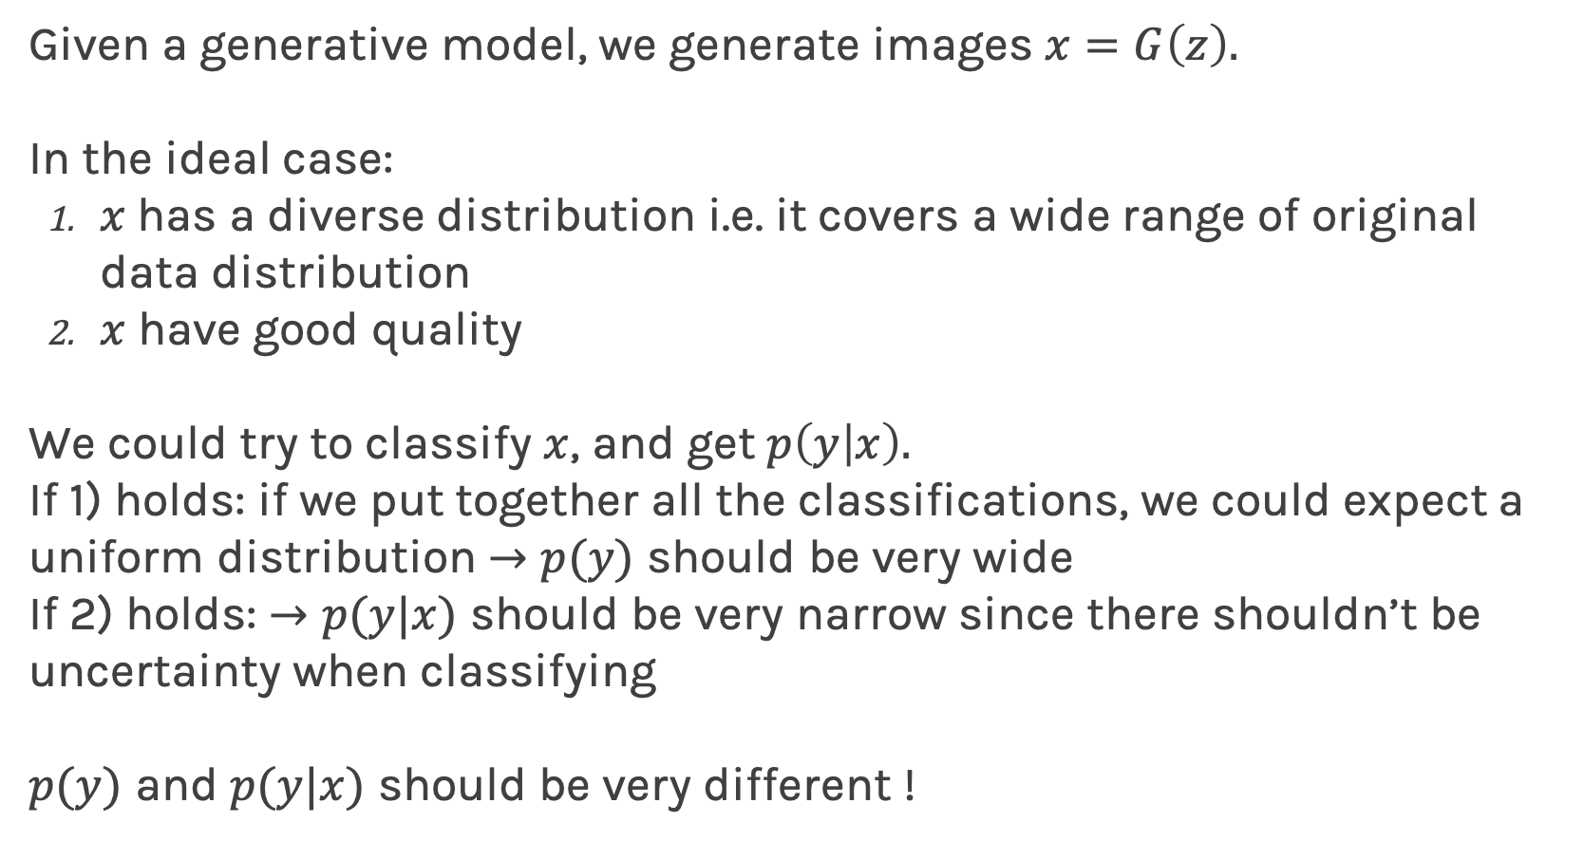
Evaluation
Given a generative model, we generate images $x=G\left(z\right).$
In the ideal case:
$x$has a diverse distribution i.e. it covers a wide range of original data distribution
$x$ have good quality
We could try to classify $x$, and get $p\left(y | x\right).$
If 1) holds: if we put together all the classifications, we could expect a uniform distribution $→p(y)$ should be very wide
If 2) holds: $→p(y|x)$ should be very narrow since there shouldn’t be uncertainty when classifying
$p(y)$ and $p(y|x)$ should be very different !

Slide 71
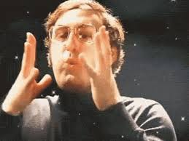
Evaluation (cont)
In order to do this, we need a good classifier.
In the context of images, why don’t we use the inception network…
and then call it inception score

Slide 72
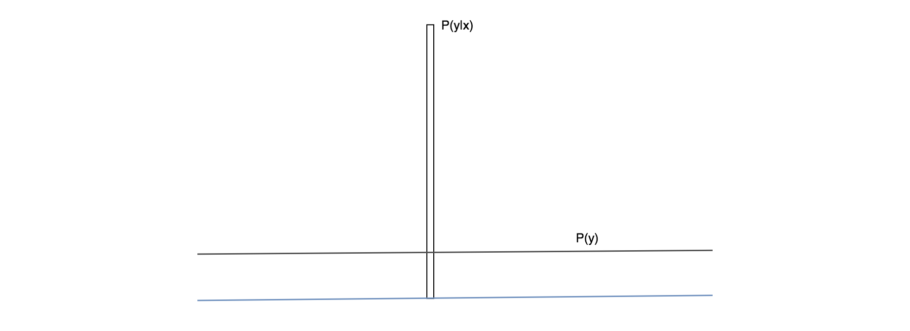
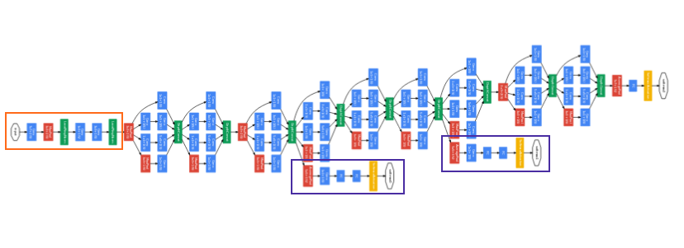

Evaluation: Inception Score
Highly predictable (low entropy)
Inception network
$IS\left(G\right)=\exp{(𝔼_{x\sim p_{g}}D_{KL}(}p\left(y | x\right)||p(y))$

Slide 73
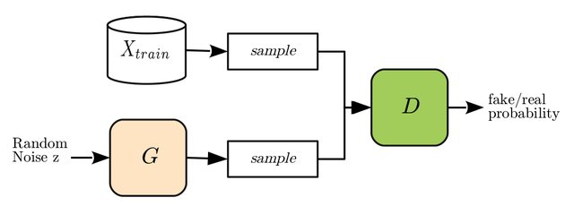
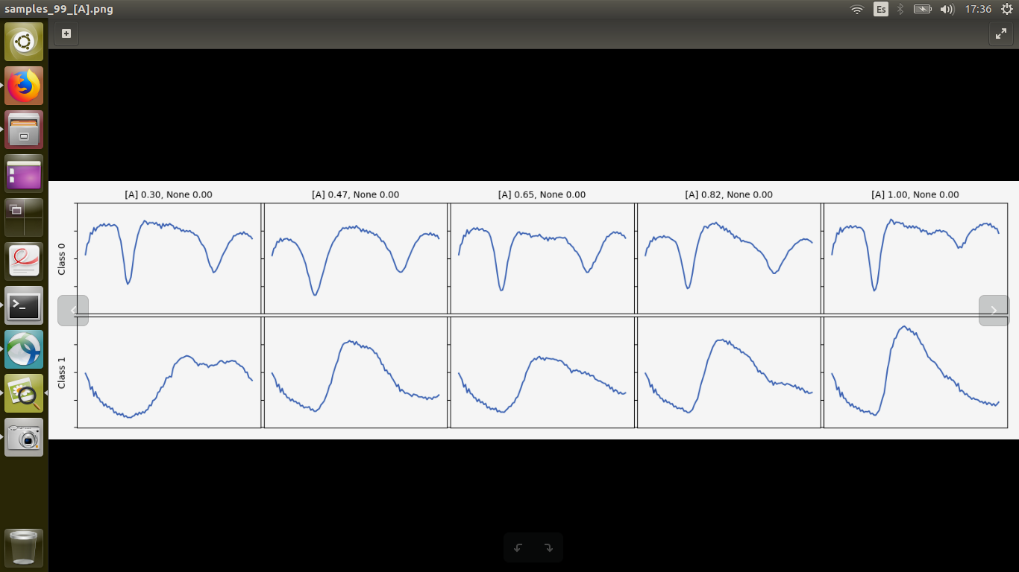
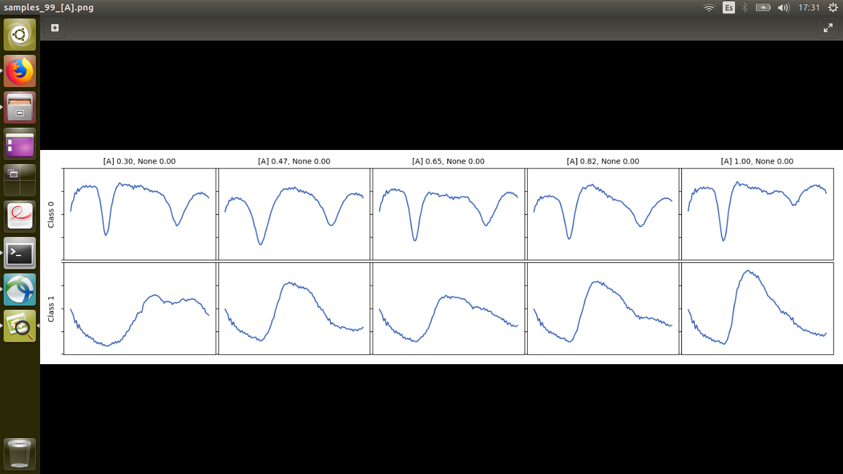
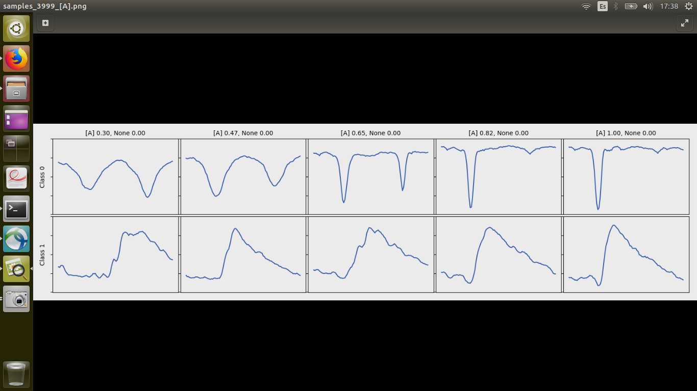
Evaluation: TSTR
GAN model trained on Time series

Slide 74
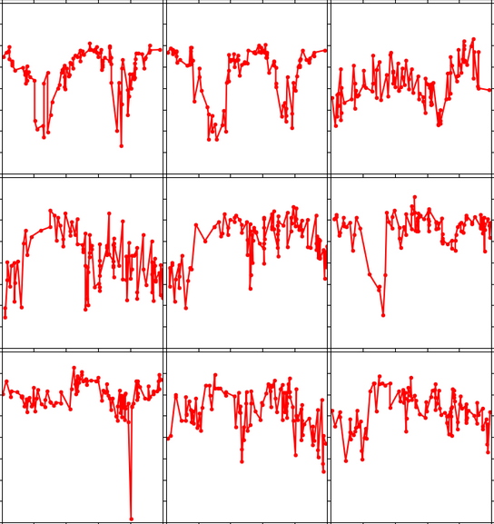
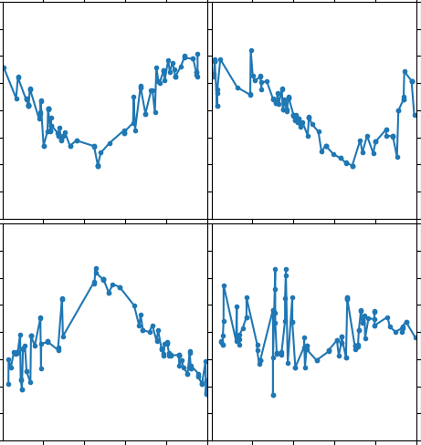
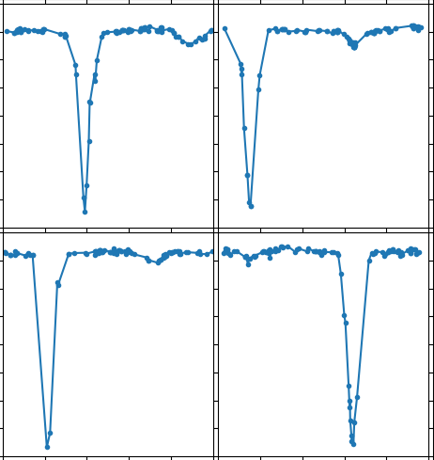
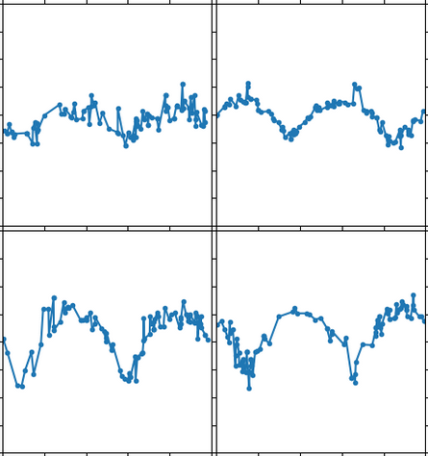
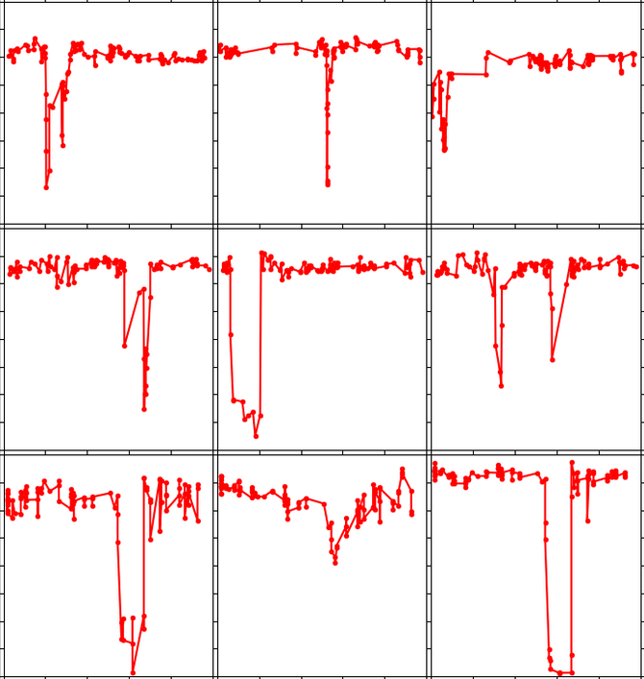
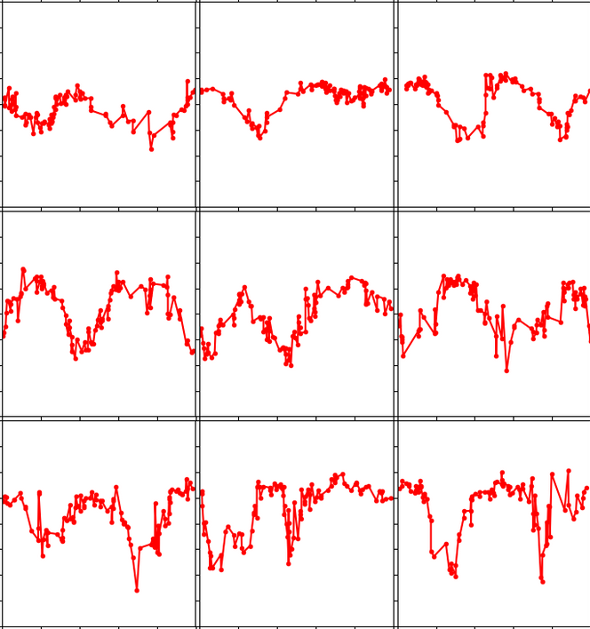
Evaluation: TSTR (cont)
Train on Synthetic Test on Real (TSTR)
Synthetic Data (GAN generated)
Real Data
Class 0
Class 0
Class 1
Class 2
Noise z
Class
Generator
Class 1
Amplitude
Period
Train
Test
Classifier
Class 2
Accuracy on Test is: TSTR

Slide 75
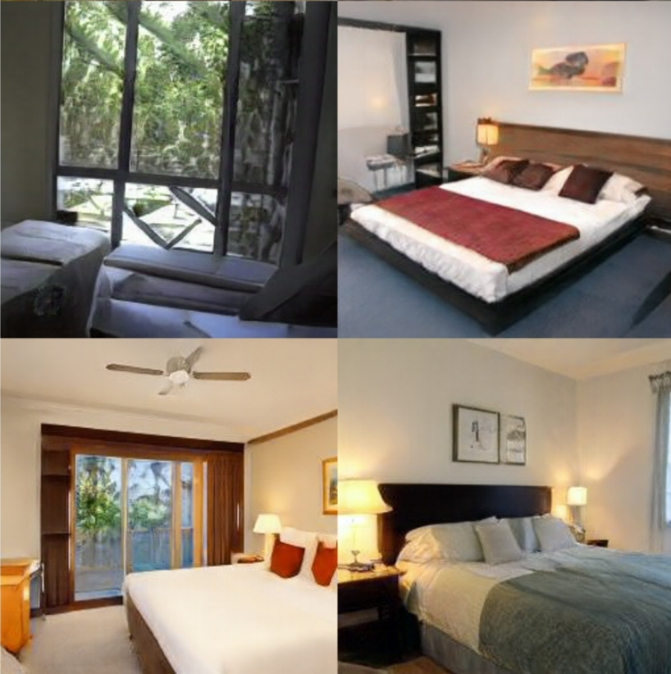
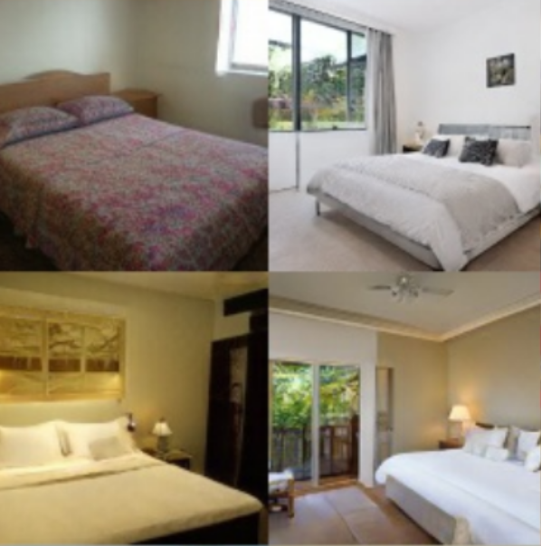
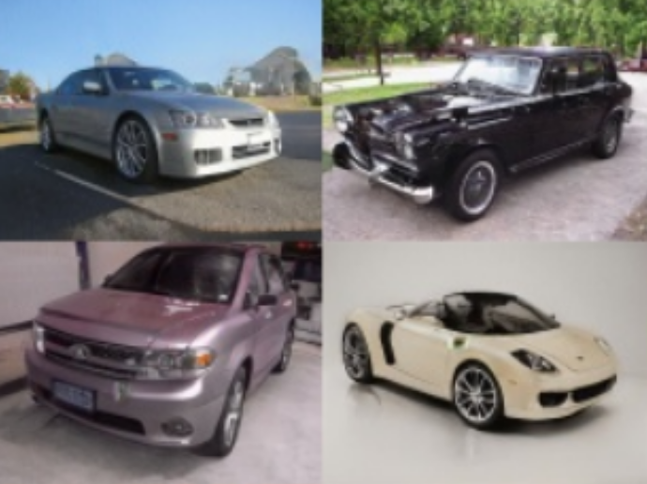
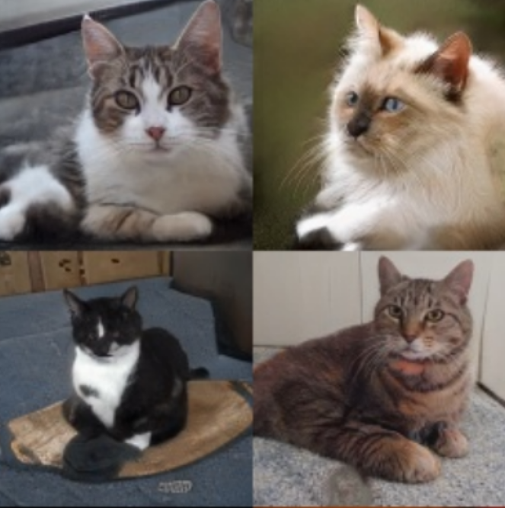
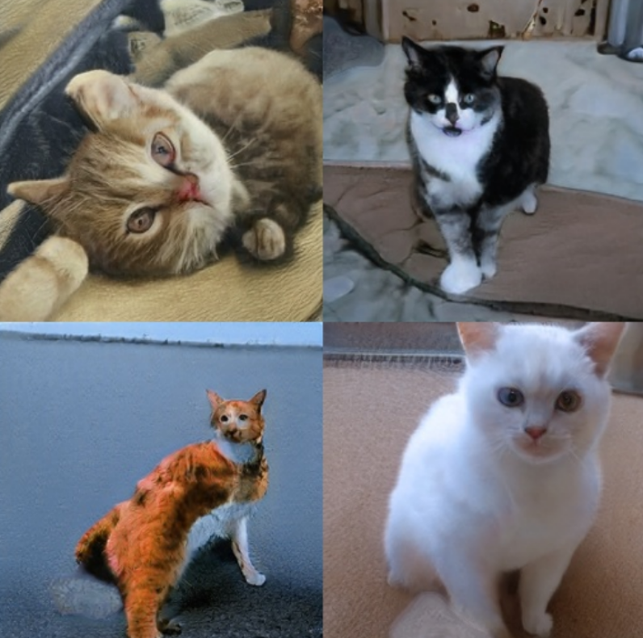
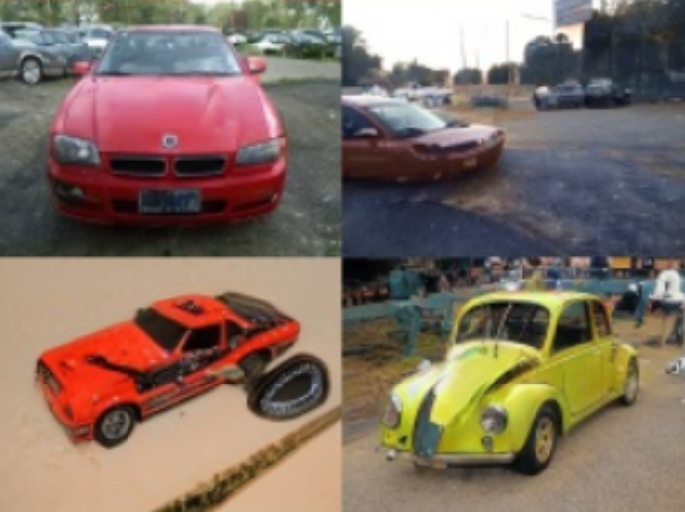
Evaluation: TSTR (cont)
Test on Synthetic Train on Real (TSTR)
Synthetic Data (GAN generated)
Real Data
Class 1
Class 0
Class 0
Class 2
Noise z
Generator
Class 1
Class
Train
Test
Classifier
Class 2
Accuracy on Test is: TSTR
75

