Slide 1
Lecture 17: Language Modelling 2

Slide 2
Outline
Seq2Seq +Attention
Transformers +BERT
Embeddings
Notes:
As a reminder, this is where we are.

Slide 3
Illustration: http://jalammar.github.io/illustrated-bert/

Slide 4
ELMo: Stacked Bi-directional LSTMs
ELMo yielded incredibly good word embeddings, which yielded state-of-the-art results when applied to many NLP tasks.
Main ELMo takeaway: given enough training data, having tons of explicit connections between your vectors is useful (system can determine how to best use context)
ELMo Slides: https://www.slideshare.net/shuntaroy/a-review-of-deep-contextualized-word-representations-peters-2018

Slide 5
REFLECTION
So far, for all of our sequential modelling, we have been concerned with emitting 1 output per input datum.
Sometimes, a sequence is the smallest granularity we care about though (e.g., an English sentence)

Slide 7
Outline
Seq2Seq +Attention
Transformers +BERT
Embeddings
Notes:
As a reminder, this is where we are.

Slide 8
Sequence-to-Sequence (seq2seq)
If our input is a sentence in Language A, and we wish to translate it to Language B, it is clearly sub-optimal to translate word by word (like our current models are suited to do).
Instead, let a sequence of tokens be the unit that we ultimately wish to work with (a sequence of length N may emit a sequences of length M)
Seq2seq models are comprised of 2 RNNs: 1 encoder, 1 decoder

Slide 9
Sequence-to-Sequence (seq2seq)
$$h_{1}^{E}$$
$$h_{2}^{E}$$
$$h_{3}^{E}$$
$$h_{4}^{E}$$
Hidden layer
Input layer
The
brown
dog
ran
ENCODER RNN

Slide 10
Sequence-to-Sequence (seq2seq)
The final hidden state of the encoder RNN is the initial state of the decoder RNN
$$h_{1}^{E}$$
$$h_{2}^{E}$$
$$h_{3}^{E}$$
$$h_{4}^{E}$$
Hidden layer
Input layer
The
brown
dog
ran
ENCODER RNN

Slide 11
Sequence-to-Sequence (seq2seq)
The final hidden state of the encoder RNN is the initial state of the decoder RNN
$$h_{1}^{E}$$
$$h_{2}^{E}$$
$$h_{3}^{E}$$
$$h_{4}^{E}$$
$$h_{1}^{D}$$
Hidden layer
Input layer
The
brown
dog
ran
<s>
ENCODER RNN
DECODER RNN

Slide 12
Sequence-to-Sequence (seq2seq)
The final hidden state of the encoder RNN is the initial state of the decoder RNN
Le
$$h_{1}^{E}$$
$$h_{2}^{E}$$
$$h_{3}^{E}$$
$$h_{4}^{E}$$
$$h_{1}^{D}$$
Hidden layer
Input layer
The
brown
dog
ran
<s>
ENCODER RNN
DECODER RNN

Slide 13
Sequence-to-Sequence (seq2seq)
The final hidden state of the encoder RNN is the initial state of the decoder RNN
Le
$$h_{1}^{E}$$
$$h_{2}^{E}$$
$$h_{3}^{E}$$
$$h_{4}^{E}$$
$$h_{1}^{D}$$
$$h_{2}^{D}$$
Hidden layer
Input layer
The
brown
dog
ran
<s>
Le
ENCODER RNN
DECODER RNN

Slide 14
Sequence-to-Sequence (seq2seq)
The final hidden state of the encoder RNN is the initial state of the decoder RNN
Le
chien
$$h_{1}^{E}$$
$$h_{2}^{E}$$
$$h_{3}^{E}$$
$$h_{4}^{E}$$
$$h_{1}^{D}$$
$$h_{2}^{D}$$
Hidden layer
Input layer
The
brown
dog
ran
<s>
Le
ENCODER RNN
DECODER RNN

Slide 15
Sequence-to-Sequence (seq2seq)
The final hidden state of the encoder RNN is the initial state of the decoder RNN
Le
chien
$$h_{1}^{E}$$
$$h_{2}^{E}$$
$$h_{3}^{E}$$
$$h_{4}^{E}$$
$$h_{1}^{D}$$
$$h_{2}^{D}$$
$$h_{3}^{D}$$
Hidden layer
Input layer
The
brown
dog
ran
<s>
Le
chien
ENCODER RNN
DECODER RNN

Slide 16
Sequence-to-Sequence (seq2seq)
The final hidden state of the encoder RNN is the initial state of the decoder RNN
Le
chien
brun
$$h_{1}^{E}$$
$$h_{2}^{E}$$
$$h_{3}^{E}$$
$$h_{4}^{E}$$
$$h_{1}^{D}$$
$$h_{2}^{D}$$
$$h_{3}^{D}$$
Hidden layer
Input layer
The
brown
dog
ran
<s>
Le
chien
ENCODER RNN
DECODER RNN

Slide 17
Sequence-to-Sequence (seq2seq)
The final hidden state of the encoder RNN is the initial state of the decoder RNN
Le
chien
brun
$$h_{1}^{E}$$
$$h_{2}^{E}$$
$$h_{3}^{E}$$
$$h_{4}^{E}$$
$$h_{1}^{D}$$
$$h_{2}^{D}$$
$$h_{3}^{D}$$
$$h_{4}^{D}$$
Hidden layer
Input layer
The
brown
dog
ran
<s>
Le
chien
brun
ENCODER RNN
DECODER RNN

Slide 18
Sequence-to-Sequence (seq2seq)
The final hidden state of the encoder RNN is the initial state of the decoder RNN
Le
chien
brun
a
$$h_{1}^{E}$$
$$h_{2}^{E}$$
$$h_{3}^{E}$$
$$h_{4}^{E}$$
$$h_{1}^{D}$$
$$h_{2}^{D}$$
$$h_{3}^{D}$$
$$h_{4}^{D}$$
Hidden layer
Input layer
The
brown
dog
ran
<s>
Le
chien
brun
ENCODER RNN
DECODER RNN

Slide 19
Sequence-to-Sequence (seq2seq)
The final hidden state of the encoder RNN is the initial state of the decoder RNN
Le
chien
brun
a
$$h_{1}^{E}$$
$$h_{2}^{E}$$
$$h_{3}^{E}$$
$$h_{4}^{E}$$
$$h_{1}^{D}$$
$$h_{2}^{D}$$
$$h_{3}^{D}$$
$$h_{4}^{D}$$
$$h_{5}^{D}$$
Hidden layer
Input layer
The
brown
dog
ran
<s>
Le
chien
brun
a
ENCODER RNN
DECODER RNN

Slide 20
Sequence-to-Sequence (seq2seq)
The final hidden state of the encoder RNN is the initial state of the decoder RNN
Le
chien
brun
a
couru
$$h_{1}^{E}$$
$$h_{2}^{E}$$
$$h_{3}^{E}$$
$$h_{4}^{E}$$
$$h_{1}^{D}$$
$$h_{2}^{D}$$
$$h_{3}^{D}$$
$$h_{4}^{D}$$
$$h_{5}^{D}$$
Hidden layer
Input layer
The
brown
dog
ran
<s>
Le
chien
brun
a
ENCODER RNN
DECODER RNN

Slide 21
Sequence-to-Sequence (seq2seq)
The final hidden state of the encoder RNN is the initial state of the decoder RNN
Le
chien
brun
a
couru
$$h_{1}^{E}$$
$$h_{2}^{E}$$
$$h_{3}^{E}$$
$$h_{4}^{E}$$
$$h_{1}^{D}$$
$$h_{2}^{D}$$
$$h_{3}^{D}$$
$$h_{4}^{D}$$
$$h_{5}^{D}$$
$$h_{6}^{D}$$
Hidden layer
Input layer
The
brown
dog
ran
<s>
Le
chien
brun
a
couru
ENCODER RNN
DECODER RNN

Slide 22
Sequence-to-Sequence (seq2seq)
The final hidden state of the encoder RNN is the initial state of the decoder RNN
Le
chien
brun
a
couru
</s>
$$h_{1}^{E}$$
$$h_{2}^{E}$$
$$h_{3}^{E}$$
$$h_{4}^{E}$$
$$h_{1}^{D}$$
$$h_{2}^{D}$$
$$h_{3}^{D}$$
$$h_{4}^{D}$$
$$h_{5}^{D}$$
$$h_{6}^{D}$$
Hidden layer
Input layer
The
brown
dog
ran
<s>
Le
chien
brun
a
couru
ENCODER RNN
DECODER RNN

Slide 23
Sequence-to-Sequence (seq2seq)
$${\hat{y}}_{1}$$
$${\hat{y}}_{2}$$
$${\hat{y}}_{3}$$
$${\hat{y}}_{4}$$
$${\hat{y}}_{5}$$
$${\hat{y}}_{6}$$
$$h_{1}^{E}$$
$$h_{2}^{E}$$
$$h_{3}^{E}$$
$$h_{4}^{E}$$
$$h_{1}^{D}$$
$$h_{2}^{D}$$
$$h_{3}^{D}$$
$$h_{4}^{D}$$
$$h_{5}^{D}$$
$$h_{6}^{D}$$
Hidden layer
Input layer
The
brown
dog
ran
<s>
Le
chien
brun
a
couru
ENCODER RNN
DECODER RNN

Slide 24
Sequence-to-Sequence (seq2seq)
$${\hat{y}}_{1}$$
$${\hat{y}}_{2}$$
$${\hat{y}}_{3}$$
$${\hat{y}}_{4}$$
$${\hat{y}}_{5}$$
$$h_{1}^{E}$$
$$h_{2}^{E}$$
$$h_{3}^{E}$$
$$h_{4}^{E}$$
$$h_{1}^{D}$$
$$h_{2}^{D}$$
$$h_{3}^{D}$$
$$h_{4}^{D}$$
$$h_{5}^{D}$$
Hidden layer
Input layer
The
brown
dog
ran
Le
chien
brun
a
couru
ENCODER RNN
DECODER RNN

Slide 25
Sequence-to-Sequence (seq2seq)
Training occurs like RNNs typically do; the loss (from the decoder outputs) is calculated, and we update weights all the way to the beginning (encoder)
$${\hat{y}}_{1}$$
$${\hat{y}}_{2}$$
$${\hat{y}}_{3}$$
$${\hat{y}}_{4}$$
$${\hat{y}}_{5}$$
$$h_{1}^{E}$$
$$h_{2}^{E}$$
$$h_{3}^{E}$$
$$h_{4}^{E}$$
$$h_{1}^{D}$$
$$h_{2}^{D}$$
$$h_{3}^{D}$$
$$h_{4}^{D}$$
$$h_{5}^{D}$$
Hidden layer
Input layer
The
brown
dog
ran
Le
chien
brun
a
couru
ENCODER RNN
DECODER RNN

Slide 26
Sequence-to-Sequence (seq2seq)
Testing decoder generates outputs one word at a time, until we generate a </S> token.
Each decoder’s ${\hat{y}}_{i}$ becomes the input $x_{i+1}$
$${\hat{y}}_{1}$$
$${\hat{y}}_{2}$$
$${\hat{y}}_{3}$$
$${\hat{y}}_{4}$$
$${\hat{y}}_{5}$$
$$h_{1}^{E}$$
$$h_{2}^{E}$$
$$h_{3}^{E}$$
$$h_{4}^{E}$$
$$h_{1}^{D}$$
$$h_{2}^{D}$$
$$h_{3}^{D}$$
$$h_{4}^{D}$$
$$h_{5}^{D}$$
Hidden layer
Input layer
The
brown
dog
ran
Le
chien
brun
a
couru
ENCODER RNN
DECODER RNN

Slide 27
Sequence-to-Sequence (seq2seq)
See any issues with this traditional seq2seq paradigm?

Slide 28
Sequence-to-Sequence (seq2seq)
It’s crazy that the entire “meaning” of the 1st sequence is expected to be packed into this one embedding, and that the encoder then never interacts w/ the decoder again. Hands free.
$${\hat{y}}_{1}$$
$${\hat{y}}_{2}$$
$${\hat{y}}_{3}$$
$${\hat{y}}_{4}$$
$${\hat{y}}_{5}$$
$$h_{1}^{E}$$
$$h_{2}^{E}$$
$$h_{3}^{E}$$
$$h_{4}^{E}$$
$$h_{1}^{D}$$
$$h_{2}^{D}$$
$$h_{3}^{D}$$
$$h_{4}^{D}$$
$$h_{5}^{D}$$
Hidden layer
Input layer
The
brown
dog
ran
Le
chien
brun
a
couru
ENCODER RNN
DECODER RNN

Slide 29
Sequence-to-Sequence (seq2seq)
Instead, what if the decoder, at each step, pays attention to a distribution of all of the encoder’s hidden states?

Slide 30
seq2seq + Attention
NOTE: each attention weight $a_{i}^{j}$ is based on the decoder’s current hidden state, too.
$$c_{1}^{D}$$
Le
$${\hat{y}}_{1}$$
$$a_{1}^{1}$$
$$a_{3}^{1}$$
$$a_{4}^{1}$$
$$a_{2}^{1}$$
Hidden layer
$[c_{1}^{D}$, $h_{4}^{E}]$
Input layer
The
brown
dog
ran
DECODER RNN
ENCODER RNN

Slide 31
seq2seq + Attention
NOTE: each attention weight $a_{i}^{j}$ is based on the decoder’s current hidden state, too.
$$c_{2}^{D}$$
Le
chien
$${\hat{y}}_{1}$$
$${\hat{y}}_{2}$$
$$a_{1}^{2}$$
$$a_{3}^{2}$$
$$a_{4}^{2}$$
$$a_{2}^{2}$$
Hidden layer
$[c_{1}^{D}$, $h_{4}^{E}]$
$[c_{2}^{D}$,${\hat{y}}_{1}]$
Input layer
The
brown
dog
ran
DECODER RNN
ENCODER RNN

Slide 32
seq2seq + Attention
NOTE: each attention weight $a_{i}^{j}$ is based on the decoder’s current hidden state, too.
$$c_{3}^{D}$$
Le
chien
brun
$${\hat{y}}_{1}$$
$${\hat{y}}_{2}$$
$${\hat{y}}_{3}$$
$$a_{1}^{3}$$
$$a_{3}^{3}$$
$$a_{4}^{3}$$
$$a_{2}^{3}$$
Hidden layer
$[c_{1}^{D}$, $h_{4}^{E}]$
$[c_{2}^{D}$,${\hat{y}}_{1}]$
$[c_{3}^{D}$,${\hat{y}}_{2}]$
Input layer
The
brown
dog
ran
DECODER RNN
ENCODER RNN

Slide 33
seq2seq + Attention
NOTE: each attention weight $a_{i}^{j}$ is based on the decoder’s current hidden state, too.
$$c_{4}^{D}$$
Le
chien
brun
a
$${\hat{y}}_{1}$$
$${\hat{y}}_{2}$$
$${\hat{y}}_{3}$$
$${\hat{y}}_{4}$$
$$a_{1}^{4}$$
$$a_{3}^{4}$$
$$a_{4}^{4}$$
$$a_{2}^{4}$$
Hidden layer
$[c_{1}^{D}$, $h_{4}^{E}]$
$[c_{2}^{D}$,${\hat{y}}_{1}]$
$[c_{3}^{D}$,${\hat{y}}_{2}]$
$[c_{4}^{D}$,${\hat{y}}_{3}]$
Input layer
The
brown
dog
ran
DECODER RNN
ENCODER RNN

Slide 34
seq2seq + Attention
NOTE: each attention weight $a_{i}^{j}$ is based on the decoder’s current hidden state, too.
$$c_{5}^{D}$$
Le
chien
brun
a
couru
$${\hat{y}}_{1}$$
$${\hat{y}}_{2}$$
$${\hat{y}}_{3}$$
$${\hat{y}}_{4}$$
$${\hat{y}}_{5}$$
$$a_{1}^{5}$$
$$a_{3}^{5}$$
$$a_{4}^{5}$$
$$a_{2}^{5}$$
Hidden layer
$[c_{1}^{D}$, $h_{4}^{E}]$
$[c_{2}^{D}$,${\hat{y}}_{1}]$
$[c_{3}^{D}$,${\hat{y}}_{2}]$
$[c_{4}^{D}$,${\hat{y}}_{3}]$
$[c_{5}^{D}$,${\hat{y}}_{4}]$
Input layer
The
brown
dog
ran
DECODER RNN
ENCODER RNN

Slide 35
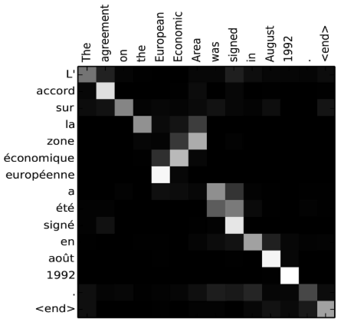
seq2seq + Attention
Attention:
greatly improves seq2seq results
allows us to visualize the contribution each word gave during each step of the decoder
Image source: Fig 3 in Bahdanau et al., 2015

Slide 36
Outline
Seq2Seq +Attention
Transformers +BERT
Embeddings
Notes:
As a reminder, this is where we are.

Slide 38
Self-Attention
Models direct relationships between all words in a given sequence (e.g., sentence)
Does not concern a seq2seq (i.e., encoder-decoder RNN) framework
Each word in a sequence can be transformed into an abstract representation (embedding) based on the weighted sums of the other words in the same sequence

Slide 39
Self-Attention
This is a large simplification.
The representations are created from using Query, Key, and Value vectors, produced from learned weight matrices during Training
Output representation
$$z_{1}^{}$$
$$a_{1}^{1}$$
$$a_{3}^{1}$$
$$a_{4}^{1}$$
$$a_{2}^{1}$$
Input vectors
The
brown
dog
ran

Slide 40
Self-Attention
This is a large simplification.
The representations are created from using Query, Key, and Value vectors, produced from learned weight matrices during Training
Output representation
$$z_{2}^{}$$
$$a_{1}^{2}$$
$$a_{3}^{2}$$
$$a_{4}^{2}$$
$$a_{2}^{2}$$
Input vectors
The
brown
dog
ran

Slide 41
Self-Attention
This is a large simplification.
The representations are created from using Query, Key, and Value vectors, produced from learned weight matrices during Training
Output representations
$$a_{1}^{2}$$
$$a_{3}^{2}$$
$$a_{4}^{2}$$
$$a_{2}^{2}$$
Input vectors
The
brown
dog
ran

Slide 42
Self-Attention
To recap:
Attention determines which pieces of sequence A are most relevant w.r.t. sequence B
Self-attention determines which pieces of sequence A are most relevant w.r.t. sequence A
A Transformer combines both; it has an encoder-decoder component, yet also uses self-attention to refine each respective sequence’s representation

Slide 43
Self-Attention
Transformers yield the best results for machine translation (seq2seq)
Transformers handle long-range dependencies better than LSTMs
BERT is an example of a Transformer

Slide 44
BERT
BERT is like the encoder portion of a Transformer
Uses self-attention
Uses bi-directional conditioning to perform language modelling
Yet, it doesn’t see its own words because it cleverly masks 15% of its words
Fine-tunes on a sentence/entailment task
BERT provides generalized contextual embeddings which can be fine-tuned toward other classification tasks (e.g., sentiment classification)

Slide 45
Conclusion
There has been significant progress in the past few years.
Some of the complex models are incredible, but rely on having a lot of data and computational resources (e.g., Transformers)
With all data science and machine learning, it’s best to understand your data and your task very well, then clean the data, and start with a simple model (instead of jumping to the most complex model)

Slide 46
Conclusion
Models
N-gram: count statistics; elementary sequence modelling
FFNN: fixed-length context window; basic sequence modelling
(Vanilla) RNN: uses context; fair sequence modelling
LSTM: great contextual usage; great sequence modelling
Seq2Seq: maps 1 sequence to another
Attention: determines which elements in sequence A pertain to sequence B
Self-Attention: determines great representations for items in a sequence
Transformers: learns excellent representation, via a seq2seq framework and self-attention

Slide 47
Sequential Modelling
LSTM
Transformer
RNN
FFNN
LSTM w/ attention
n-grams
Sequence Modelling (1-to-1 mapping)
seq2seq

Slide 48
Credit & further resources:
Backprop: http://cs231n.github.io/optimization-2/
Abigail See’s lectures: http://web.stanford.edu/class/cs224n/index.html
Illustrated BERT: http://jalammar.github.io/illustrated-bert/
Andrew Ng (Attention): https://www.youtube.com/watch?v=quoGRI-1l0A
Illustrated Transformer: https://jalammar.github.io/illustrated-transformer/
Google (Transformers): https://ai.googleblog.com/2017/08/transformer-novel-neural-network.html
ELMo paper: https://arxiv.org/pdf/1802.05365.pdf

Slide 49
Outline
Seq2Seq +Attention
Transformers +BERT
Embeddings
Notes:
As a reminder, this is where we are.

Slide 50
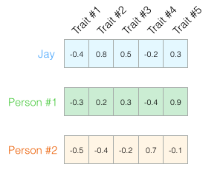
The basics idea
Observe a bunch of people
Infer personality traits from them
Vector of traits is called an Embedding
Who is more similar? Jay and who?
Use Cosine Similarity of the vectors
Images by Jay Alammar

Slide 51
Categorical Data
Example:
Rossmann Kaggle Competition: Rossmann is a 3000 store European Drug Store Chain. The idea is to predict sales 6 weeks in advance.
Consider store_id as an example. This is a categorical predictor, i.e. values come from a finite set.
We usually one-hot encode this: a single store is a length 3000 bit-vector with one bit flipped on.

Slide 52
Categorical Data
What is the problem with this?
The 3000 stores have commonalities, but the one-hot encoding does not represent this.
Indeed the dot-product (cosine similarity) of any two 1-hot bitmaps must be 0.
Would be useful to learn a lower-dimensional embedding for the purpose of sales prediction.
These store "personalities" could then be used in other models (different from the model used to learn the embedding) for sales prediction.
The embedding can be also used for other tasks, such as employee turnover prediction.

Slide 53
Training an Embedding
Normally you would do a linear or MLP regression with sales as the target, and both continuous and categorical features.
The game is to replace the 1-hot encoded categorical features by "lower-width" embedding features, for each categorical predictor.
This is equivalent to considering a neural network with the output of an additional Embedding Layer concatenated in.
The Embedding layer is simply a linear regression.
Image from Guo and Berkhahn

Slide 54
Training an Embedding (cont)
A 1-hot vector for a categorical variable with cardinality can be written using the Kronecker Delta symbol as:
$v_{k}=δ_{jk} , j∈\{1,…,N\left(v\right)\}$
Then an embedding of width (dimension) $L$ is just a $N\left(v\right)×L$ matrix of weights $W_{ij}$ such that multiplying the k^{th} 1-hot vector by this weight matrix picks out the k^{th} row of weights (see right).
But how do we find these weights?
We fit for them with the rest of the weights in the MLP!

Slide 55
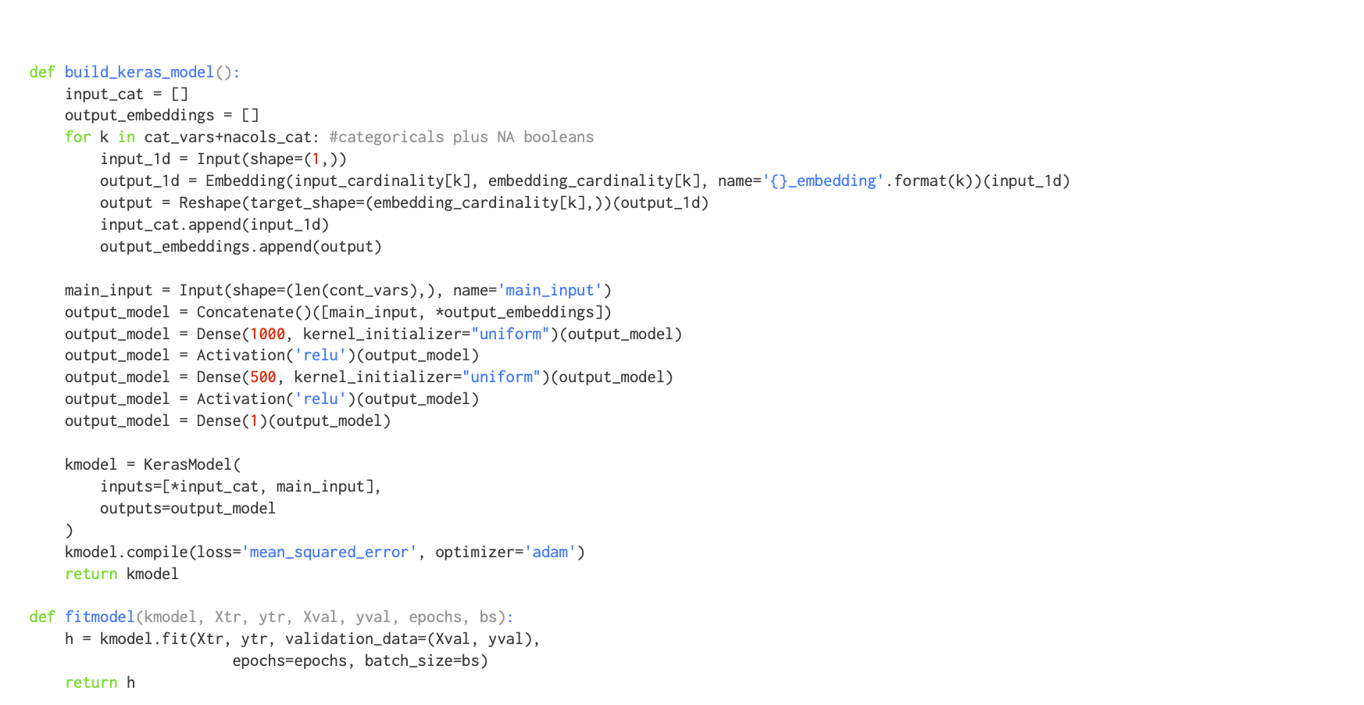
Training an Embedding (cont)

Slide 56
Embedding is just a linear regression
So why are we giving it another name?
it is usually to lower the dimensional space
traditionally we have done linear dimensional reduction through PCA and truncation, but sparsity can throw a spanner into the works.
we train the weights of the embedding regression using gradient descent (or stochastic gradient descent), along with the weights of the downstream task (here prediting the sales 6 weeks in advanced).
the embedding can be used for alternate tasks, such as finding the similarity of users.
See how Spotify does all this.

Slide 57
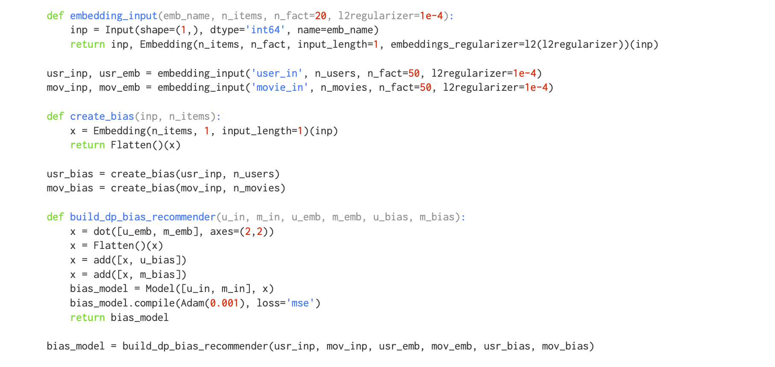

Slide 58
Word Embeddings
the vocabulary $V$ of a corpus (large swath of text) can have 10,000 and maybe more words.
a 1-hot encoding is huge, moreover, similarities between words cannot be established.
we map words to a smaller dimensional latent space of size $L$ by considering some downstream task to train on.
we hope that the embeddings learned are useful for other tasks.
images in this section from Illustrated word2vec

Slide 59
Obligatory example
See man->boy as woman->girl, similarities of king and queen, for e.g. These are lower dimensional GloVe embedding vector.

Slide 60
How do we train word embeddings?
We need to choose a downstream task.
We could choose Language Modeling: predict the next word.
We'll start with random "weights" for the embeddings and other parameters and start learning.
A trained model+embeddings would look like this:

Slide 61
How do we set up a training set?
Why not look both ways? This leads to the Skip-Gram and CBOW architectures..

Slide 62
SKIP-GRAM: Predict Surrounding Words
Choose a window size (here 4) and construct a dataset by sliding a window across.

Slide 63
SKIP-GRAM: Details
We assume that, Naive Bayes style, the joint probability of all context words in a window conditioned on the central word $(w_{c})$ is the product of the individual conditional probabilities:
Now assume that each word is represented as 2 embeddings, an input embedding ${(v}_{c}$) when we talk about the central word and a context embedding ($u_{o})$ when we talk about the surrounding window.

Slide 64
The probability of an output word, given a central word, is assumed to be given by a softmax of the dot product of the embeddings.
Then, assuming a text sequence of length T and window size m , the likelihood function is:
We'll use the Negative Log Likelihood as loss (NLL)

Slide 65
Prediction
With random initial weights , we make a prediction for surrounding words, and calculate the NLL for the prediction. We then backpropagate the NLL's gradients to find new weights and repeat
Consider two sentences: "I am running." and "I am writing.". "I" and "am" targets will backprop to same input embedding and so, after some training, "writing" and "running" will be highly correlated. Appropriate correlations will emerge as corpus size increases.

Slide 66
Problems
in the forward mode, the calculation of softmax requires a sum over the entire vocabulary
in the backward mode, the gradients need this sum too. For example:
For large vocabularies, this is very expensive!

Slide 67
Changing Tasks
Changing from predicting neighbors to "are we neighbors?" changes model from neural net to logistic regression.

Slide 68
Changing Tasks (cont)
We'll now thus choose $P\left(D=1 | w_{c},w_{o}\right)=σ(u_{o}^{T}v_{c})$ and will maximize the likelihood:
But the response variable in the dataset changes to all 1's and a trivial classifier always returning 1 will give the best score. Not good (this is equivalent to all embeddings being equal and infinite)!

Slide 69
Negative Sampling
To fix we randomly choose words from our vocabulary and label them with 0.

Slide 70
Likelihood model
We go back to the old likelihood:
But now, the probability is approximated using negative sampling as:
The NLL now has a sum over a K--sized window, rather than the full vocabulary.

Slide 71
Training the model
The negative sampling probabilities are now sigmoids subtracted from 1, whereas the positives are simply sigmoids.
We now compute the loss, and repeat over training examples in our batch.
And backpropagate to obtain gradients and change the embeddings and weights some, for each batch, in each epoch

Slide 72
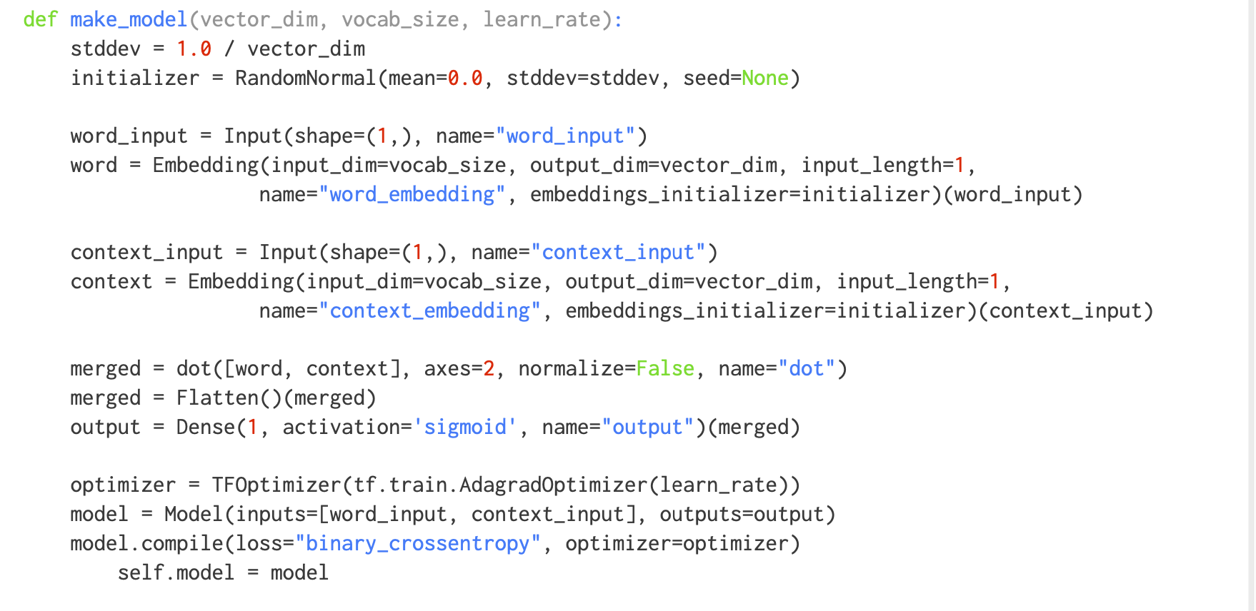

Slide 74
The result
We discard the Context matrix, and save the embeddings matrix.
We can use the embeddings matrix for our next task (perhaps a sentiment classifier).
We could have trained embeddings along with that particular task to make the embeddings sentiment specific. There is always a tension between domain/task specific embeddings and generic ones.
This tension is usually resolved in favor of using generic embeddings since task specific datasets seem to be smaller
We can still unfreeze pre-trained embedding layers to modify them for domain specific tasks via transfer learning.

Slide 75
Usage of word2vec
the pre-trained word2vec and other embeddings (such as GloVe) are used everywhere in NLP today.
the ideas have been used elsewhere as well. AirBnB and Anghami model sequences of listings and songs using word2vec like techniques.
Alibaba and Facebook use word2vec and graph embeddings for recommendations and social network analysis.

