Slide 1
Lecture 14: Recurrent Neural Networks

Slide 2
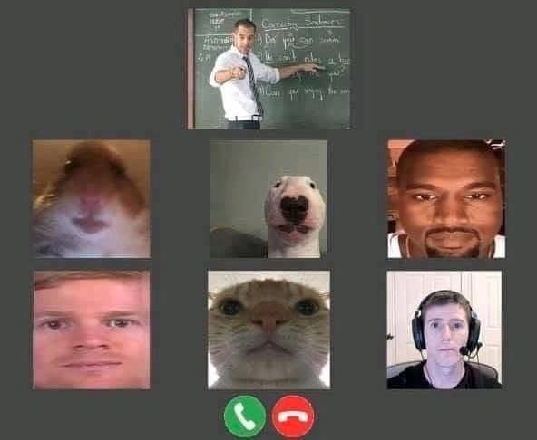
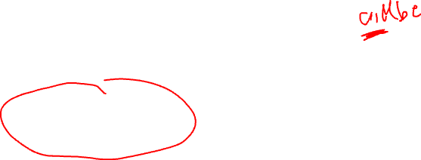
Online lectures guidelines
We would prefer you have your video on, but it is OK if you have it off.
We would prefer you have your real name.
All lectures, labs and a-sections will be live streamed and als available for viewing later on canvas/zoom.
We will have course staff in the chat online and during lecture you can also make use of this spreadsheet to enter your own questions or 'up vote' those of your fellow students.
Quizzed will be available for 24 hours.

Slide 3
Outline
Why Recurrent Neural Networks (RNNs)
Main Concept of RNNs
More Details of RNNs
RNN training
Gated RNN

Slide 4
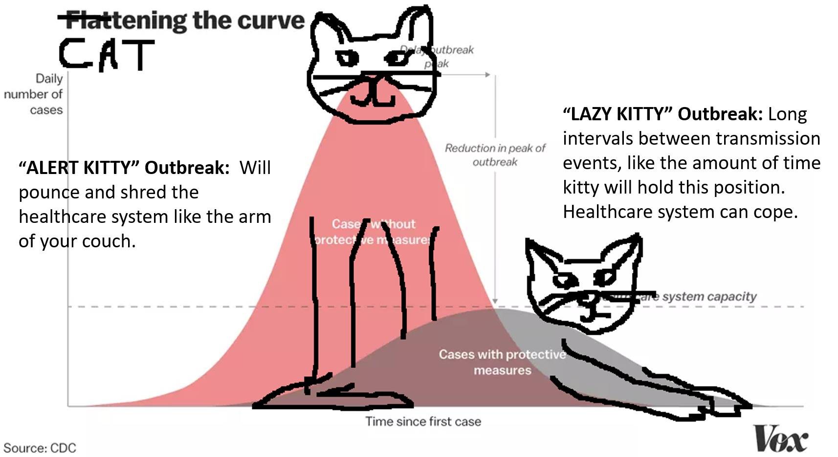

Slide 5
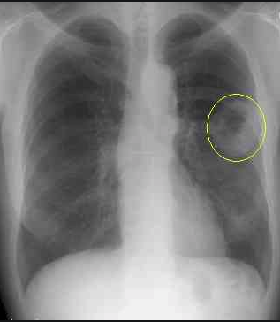
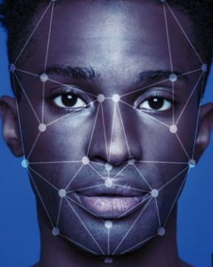
Background
Many classification and regression tasks involve data that is assumed to be independent and identically distributed (i.i.d.). For example:
Detecting lung cancer
Face recognition
Risk of heart attack

Slide 6
Background
Much of our data is inherently sequential
scale
examples
WORLD
Natural disasters (e.g., earthquakes)
Climate change
HUMANITY
Stock market
Virus outbreaks
INDIVIDUAL PEOPLE
Speech recognition
Machine Translation (e.g., English -> French)
Cancer treatment

Slide 7
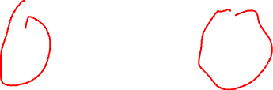
Background
Much of our data is inherently sequential
PREDICTING
EARTHQUAKES

Slide 8
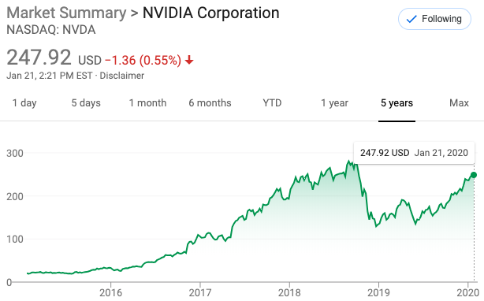
Background
Much of our data is inherently sequential
STOCK MARKET PREDICTIONS

Slide 9
Background
Much of our data is inherently sequential
SPEECH RECOGNITION
“What is the weather today?”
“What is the weather two day?”
“What is the whether too day?”
“What is, the Wrether to Dae?”
Notes:
Understanding the complete sentence depends on each individual word together, not just each word in isolation

Slide 10

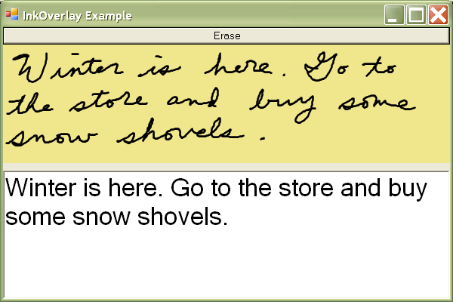
Sequence Modeling: Handwritten Text
Input : Image
Output: Text
https://towardsdatascience.com/build-a-handwritten-text-recognition-system-using-tensorflow-2326a3487cd5
Notes:
http://www.research.att.com/articles/featured_stories/2012_10/201210_StorEbook.html?fbid=dKukkzHjbdh
https://devblogs.nvidia.com/parallelforall/introduction-neural-machine-translation-gpus-part-3/
http://www.ironpython.info/index.php?title=Basic_Handwriting_Recognition

Slide 11
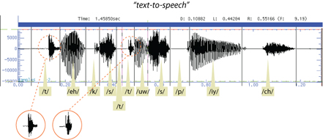
Sequence Modeling: Text-to-Speech
Input : Text
Output: Audio

Slide 12
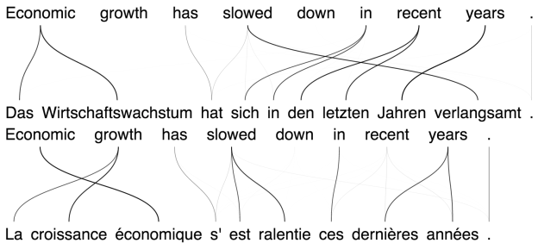
Sequence Modeling: Machine Translation
Input : Text
Output: Translated Text

Slide 13
Outline
Why RNNs
Main Concept of RNNs (part 1)
More Details of RNNs
RNN training
Gated RNN

Slide 15
What can my NN do?
Training: Present to the NN examples and learn from them.
NN
[George, Mary, Tom, Suzie]

Slide 16

What can my NN do?
Prediction: Given an example
NN
George
NN
Mary

Slide 17
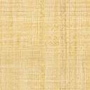
What my NN can NOT do?
WHO IS IT?
?

Slide 18
Learn from previous examples
Time

Slide 19
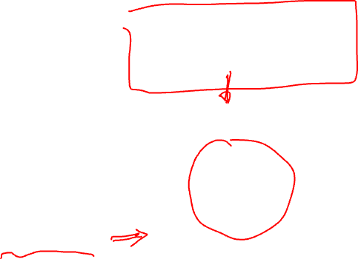
Recurrent Neural Network (RNN)
NN
George

Slide 20
Recurrent Neural Network (RNN)
I have seen George moving in this way before.
NN
George
RNNs recognize the data's sequential characteristics and use patterns to predict the next likely scenario.

Slide 21
Recurrent Neural Network (RNN)
WHO IS HE?
I do not know. I need to know who said that and what he said before. Can you tell me more?
He told me I could have it
Our model requires context - or contextual information - to understand the subject (he) and the direct object (it) in the sentence.

Slide 22
RNN – Another Example with Text
WHO IS HE?
- Hellen: Nice sweater Joe.
- Joe: Thanks, Hellen. It used to belong to my brother and he told me I could have it.
I see what you mean now! The noun “he” stands for Joe’s brother while ”it” for the sweater.
After providing sequential information, the model recognize the subject (Joe’s brother) and the object (sweater) in the sentence.

Slide 23
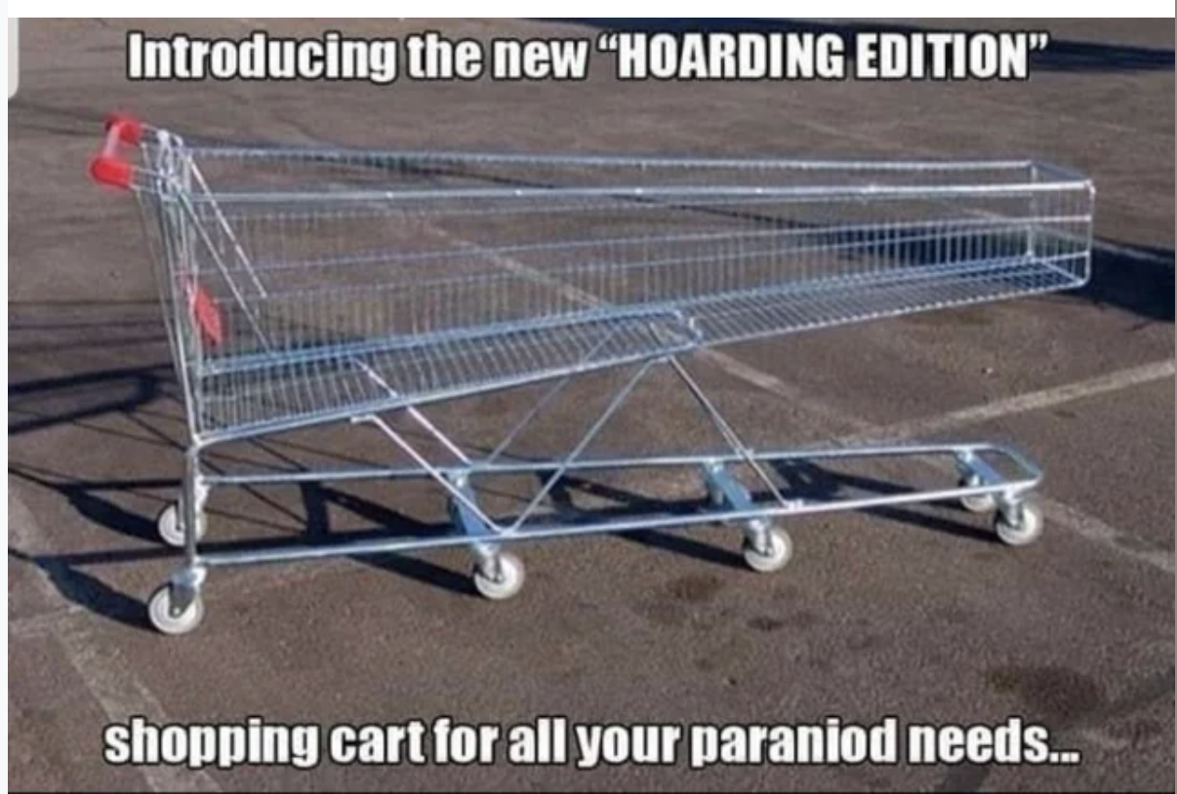
Batch_size = 2048

Slide 24
Sequences
We want a machine learning model to understand sequences, not isolated samples.
Can MLP do this?
Assume we have a sequence of temperature measurements and we want to take 3 sequential measurements and predict the next one
features
1
2
3
4
5
6
7
…
35
32
45
48
41
39
36
…
samples

Slide 25

Sequences
We want a machine learning model to understand sequences, not isolated samples.
Can MLP do this?
Assume we have a sequence of temperature measurements and we want to take 3 sequential measurements and predict the next one
features
1
2
3
4
5
6
7
…
35
32
45
48
41
39
36
…
1
2
3
4
35
32
45
48
samples

Slide 26
Sequences
We want a machine learning model to understand sequences, not isolated samples.
Can MLP do this?
Assume we have a sequence of temperature measurements and we want to take 3 sequential measurements and predict the next one
features
1
2
3
4
5
6
7
…
35
32
45
48
41
39
36
…
1
2
3
4
35
32
45
48
2
3
4
5
32
45
48
41
samples

Slide 27
Sequences
We want a machine learning model to understand sequences, not isolated samples.
Can MLP do this?
Assume we have a sequence of temperature measurements and we want to take 3 sequential measurements and predict the next one
features
1
2
3
4
5
6
7
…
35
32
45
48
41
39
36
…
1
2
3
4
35
32
45
48
2
3
4
5
32
45
48
41
3
4
5
6
45
48
41
39
samples

Slide 28
Sequences
We want a machine learning model to understand sequences, not isolated samples.
Can MLP do this?
Assume we have a sequence of temperature measurements and we want to take 3 sequential measurements and predict the next one
features
1
2
3
4
5
6
7
…
35
32
45
48
41
39
36
…
1
2
3
4
35
32
45
48
2
3
4
5
32
45
48
41
3
4
5
6
45
48
41
39
samples

Slide 29
Windowed dataset
This is called overlapping windowed dataset, since we’re windowing observations to create new.
We can easily do using a MLS:
3
1
10 ReLU
10 ReLU
1 ReLU
But re-arranging the order of the inputs like:
3
1
2
4
45
35
32
2
4
3
5
32
48
45
5
4
3
6
41
48
45
will produce the same results

Slide 30
Why not CNNs or MLPs?
MLPs/CNNs require fixed input and output size
MLPs/CNNs can’t classify inputs in multiple places

Slide 31
Windowed dataset
What follows after: `I got in the car and’ ?
`drove away’
What follows after: `In car the and I got’ ?
Not obvious that it should be `drove away’
The order of words matters. This is true for most sequential data.
A fully connected network will not distinguish the order and therefore missing some information.

Slide 32
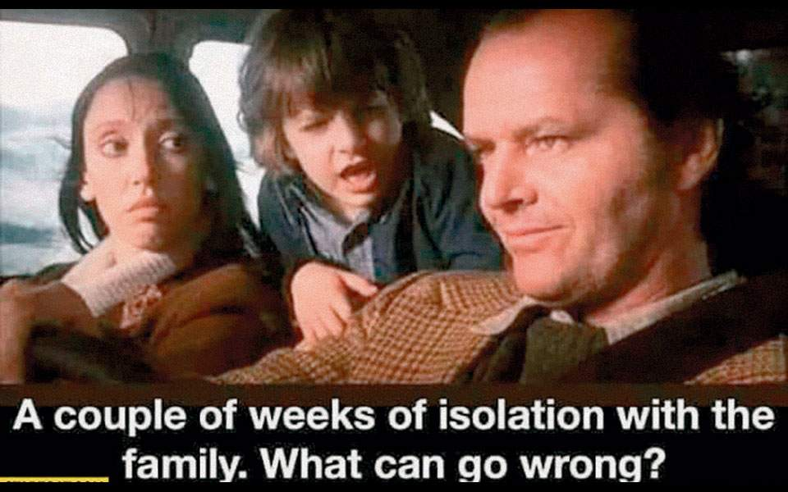

Slide 33
Outline
Why RNNs
Main Concept of RNNs
More Details of RNNs
RNN training
Gated RNN

Slide 34


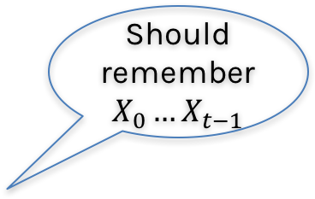
Memory
Somehow the computational unit should remember what it has seen before.
$$Y_{t}$$
Should remember $X_{0}…X_{t−1}$
Unit
$$X_{t}$$

Slide 35
Memory
Somehow the computational unit should remember what it has seen before.
$$Y_{t}$$
Unit
Internal memory
$$X_{t}$$

Slide 36
Memory
Somehow the computational unit should remember what it has seen before.
We’ll call the information the unit’s state.
$$Y_{t}$$
RNN
Internal memory
$$X_{t}$$

Slide 37
Memory
In neural networks, once training is over, the weights do not change. This means that the network is done learning and done changing.
Then, we feed in values, and it simply applies the operations that make up the network, using the values it has learned.
But the RNN units can remember new information after training has completed.
That is, they’re able to keep changing after training is over.

Slide 38
Memory
Question: How can we do this? How can build a unit that remembers the past?
The memory or state can be written to a file but in RNNs, we keep it inside the recurrent unit.
In an array or in a vector!
Work with an example:
Anna Sofia said her shoes are too ugly. Her here means Anna Sofia.
Nikolas put his keys on the table. His here means Nikolas

Slide 39
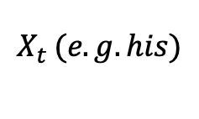
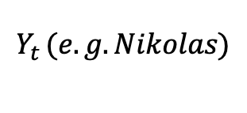
Memory
Question: How can we do this? How can we build a unit that remembers the past?
The memory or state can be written to a file but in RNNs, we keep it inside the recurrent unit.
In an array or in a vector!
$$Y_{t }(e.g. Nikolas)$$
RNN
Memory
RNN
Memory
$$X_{t }(e.g. his)$$

Slide 40



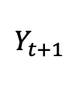
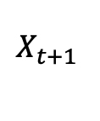
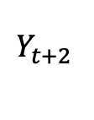
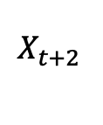
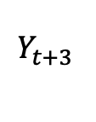
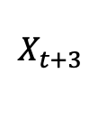
Building an RNN
$$Y_{t }$$
Memory
RNN
Memory
$$X_{t }$$
$$Y_{t }$$
$$Y_{t+1 }$$
$$Y_{t+2 }$$
$$Y_{t+3 }$$
RNN
RNN
Memory
RNN
Memory
RNN
Memory
Memory
Memory
$$X_{t }$$
$$X_{t+1 }$$
$$X_{t+2 }$$
$$X_{t+3 }$$

Slide 41
Outline
Why RNNs
Main Concept of RNNs
More Details of RNNs
RNN training
Gated RNN

Slide 42
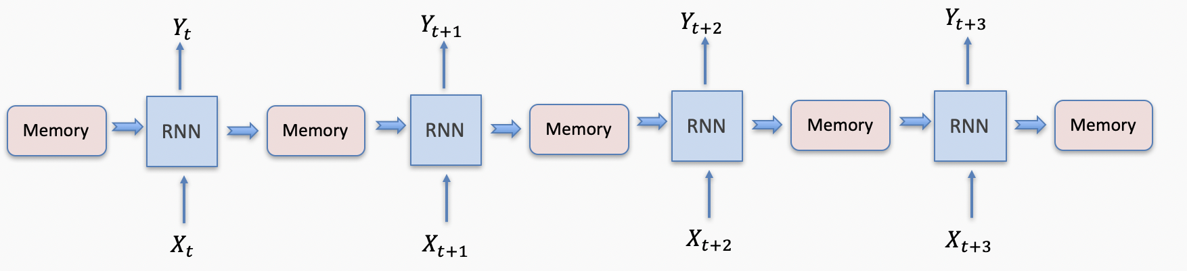



Structure of an RNN cell
$$Y_{t }$$
$$Y_{t }$$
output
weight
update
weight
RNN
State
RNN
State
input
weight
$$X_{t }$$
$$X_{t }$$

Slide 43
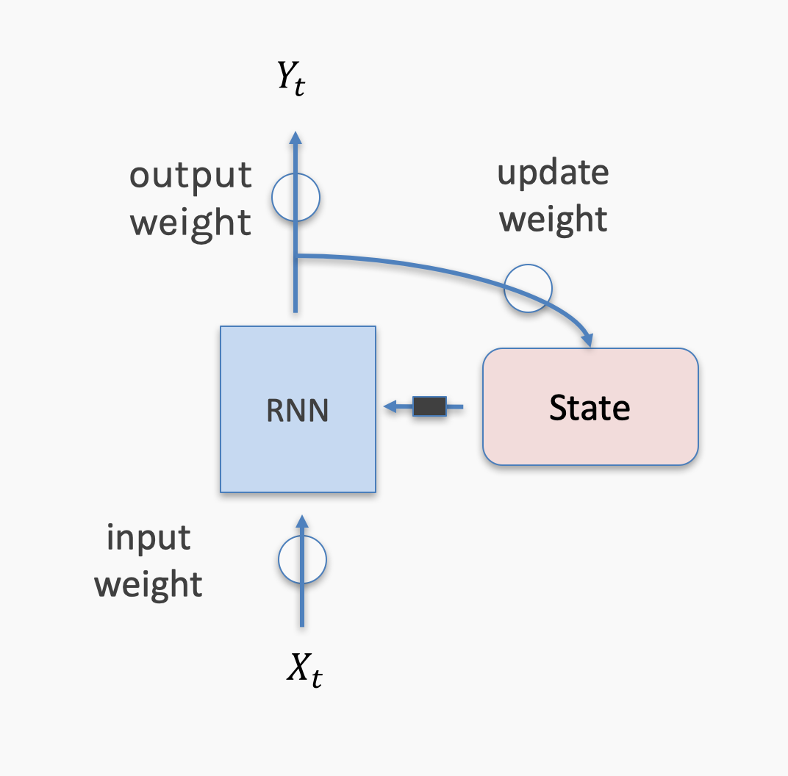







Output, $y_{t}$
Anatomy of an RNN unit
activation
activation
$$W_{1}h_{t}+b_{1}$$
$$W_{2}h_{t}+b_{2}$$
W₁
W₂
U
activation
$$h_{t}=g(z_{t})$$
Hidden state, $h_{t−1}$
$$z_{t}=Vx_{t}+Uh_{t−1}+b_{r}$$
V
Input, $x_{t}$

Slide 44
Outline
Why RNNs
Main Concept of RNNs
More Details of RNNs
RNN training
Gated RNN

Slide 45
Backprop Through Time
For each input, unfold network for the sequence length T
Back-propagation: apply forward and backward pass on unfolded network
Memory cost: O(T)

Slide 46


Backprop Through Time
$$Y_{t }$$
output
weights
update
weights
RNN
State
input
weights
$$X_{t }$$

Slide 47
Backprop Through Time
$$Y_{t }$$
output
weights
update
weights
RNN
State
input
weights
$$X_{t }$$

Slide 48

Backprop Through Time
$$Y_{t }$$
Output Weights: W
Update Weights: U
$$h_{t }$$
RNN
State
Input Weights: V
$$X_{t }$$

Slide 49
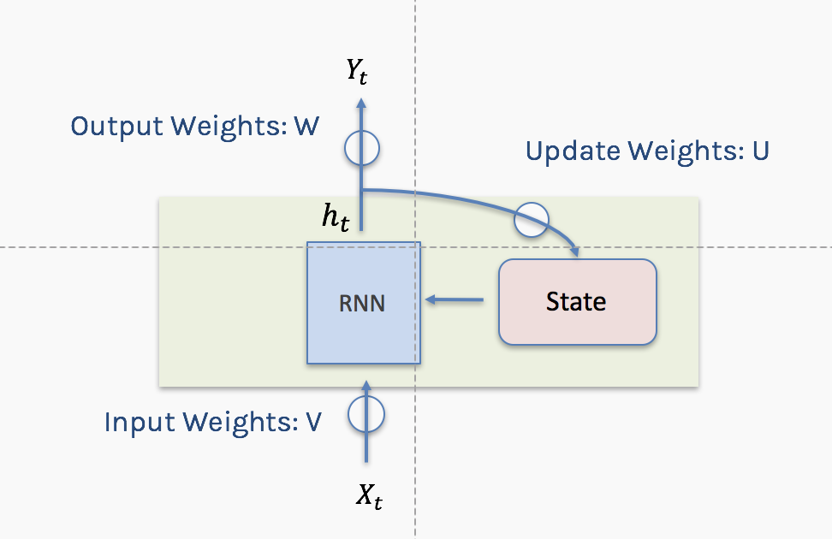


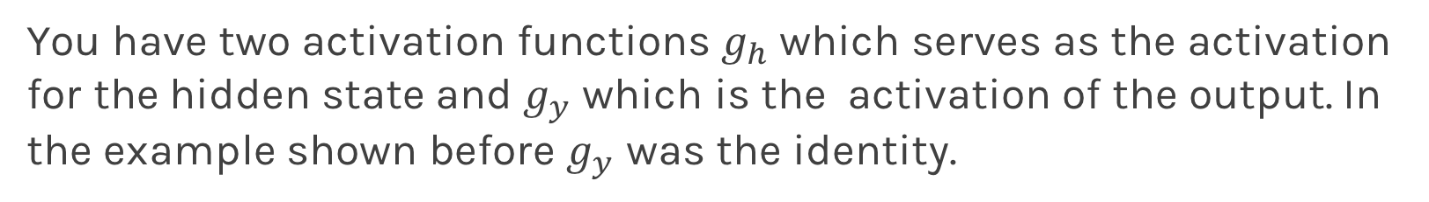

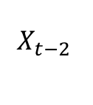

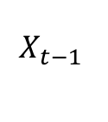

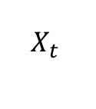

Backprop Through Time
$\hat{y}$t-2
$\hat{y}$t-1
$\hat{y}$t
W
W
W
U
U
U
$$h_{t−2}$$
$$h_{t−1}$$
$$h_{t}$$
V
V
V
$$X_{t−2 }$$
$$X_{t−1 }$$
$$X_{t }$$
You have two activation functions $g_{h}$ which serves as the activation for the hidden state and $g_{y}$ which is the activation of the output. In the example shown before $g_{y}$ was the identity.

Slide 50
Backprop Through Time
$\hat{y}$t-2
$\hat{y}$t-1
$\hat{y}$t
W
W
W
U
U
U
$$h_{t−2}$$
$$h_{t−1}$$
$$h_{t}$$
V
V
V
$$X_{t−2 }$$
$$X_{t−1 }$$
$$X_{t }$$

Slide 51
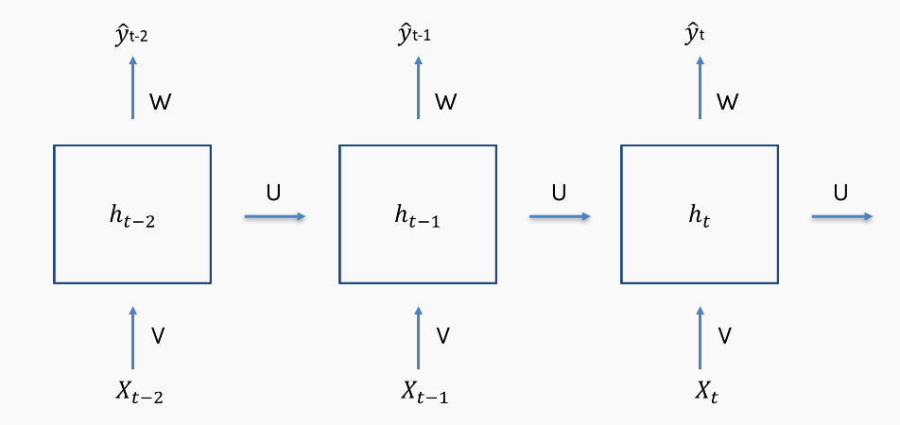

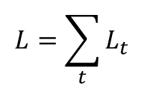
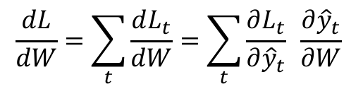

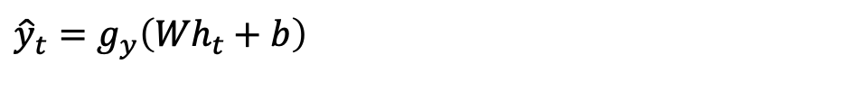
Backprop Through Time
$${\hat{y}}_{t}=g_{y}\left({Wh}_{t}+b\right)$$
$$L=\sum_{t}{L_{t}}$$
$$L_{t}=L_{t}({\hat{y}}_{t})$$
$$\frac{dL}{dW}=\sum_{t}{\frac{dL_{t}}{dW}}=\sum_{t}{\frac{∂L_{t}}{∂{\hat{y}}_{t}} \frac{∂{\hat{y}}_{t}}{∂W}}$$
$$\frac{∂{\hat{y}}_{t}}{∂W}=g_{y}′h_{t}$$

Slide 52
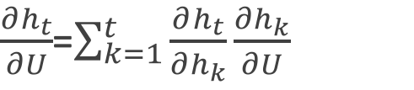
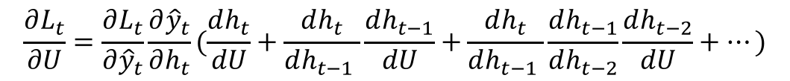
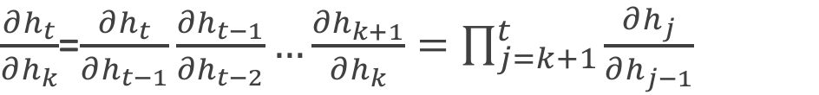
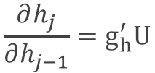
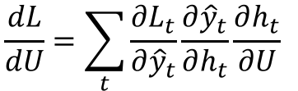
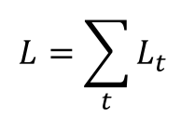

Backprop Through Time
$${\hat{y}}_{t}=g_{y}\left({Wh}_{t}+b\right)$$
$$h_{t}=g_{h}\left(Vx_{t}+Uh_{t−1}+b^{′}\right)$$
$${\hat{y}}_{t}=g_{y}({Wg}_{h}\left(Vx_{t}+Uh_{t−1}+b^{′}\right)+b)$$
$$L=\sum_{t}{L_{t}}$$
$$L_{t}=L_{t}({\hat{y}}_{t})$$
$$\frac{dL}{dU}=\sum_{t}{\frac{{∂L}_{t}}{∂{\hat{y}}_{t}}\frac{∂{\hat{y}}_{t}}{∂h_{t}}\frac{∂h_{t}}{∂U} }$$
$$\frac{∂h_{j}}{∂h_{j−1}}=g_{h}^{′}U$$
$\frac{∂h_{t}}{∂U}$=$\sum_{k=1}^{t}{\frac{∂h_{t}}{∂h_{k}}\frac{∂h_{k}}{∂U}}$
$\frac{∂h_{t}}{∂h_{k}}$=$\frac{∂h_{t}}{∂h_{t−1}}\frac{∂h_{t−1}}{∂h_{t−2}}…\frac{∂h_{k+1}}{∂h_{k}}=\prod_{j=k+1}^{t}{\frac{∂h_{j}}{∂h_{j−1}}}$
$$\frac{∂L_{t}}{∂U}=\frac{∂L_{t}}{∂{\hat{y}}_{t}}\frac{∂{\hat{y}}_{t}}{∂h_{t}}(\frac{dh_{t}}{dU}+\frac{dh_{t}}{dh_{t−1} }\frac{dh_{t−1}}{dU}+\frac{dh_{t}}{dh_{t−1} }\frac{dh_{t−1}}{dh_{t−2}}\frac{dh_{t−2}}{dU}+…)$$

Slide 53
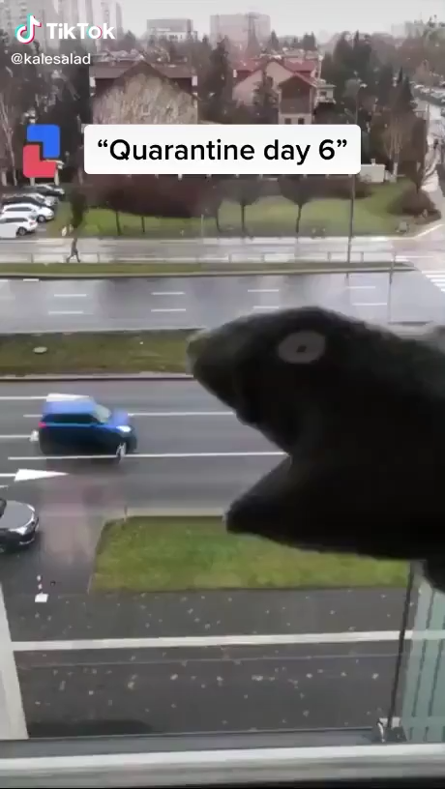

Slide 54
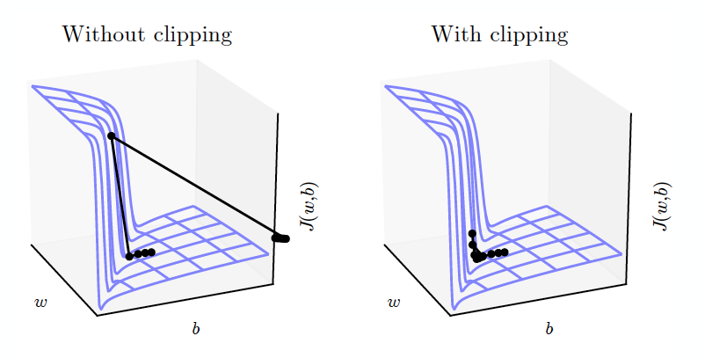
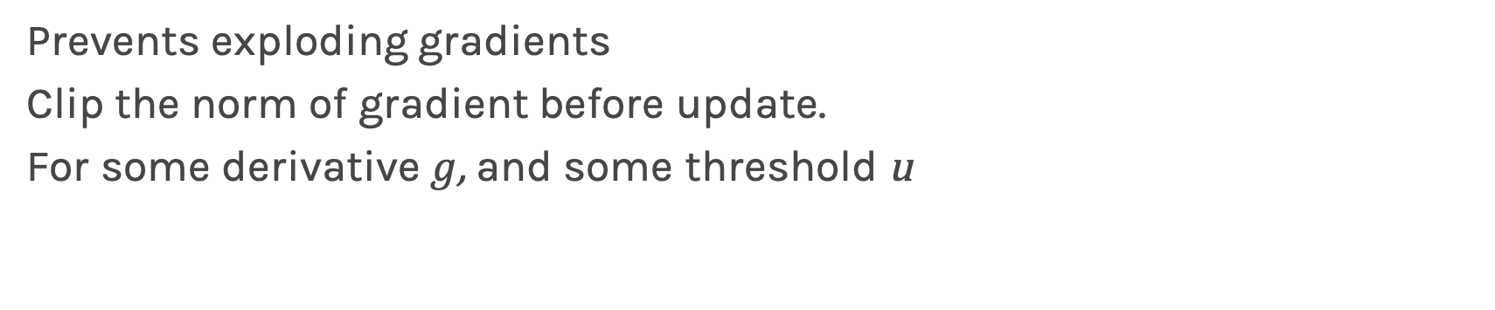

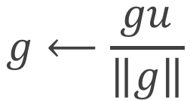
Gradient Clipping
Prevents exploding gradients
Clip the norm of gradient before update.
For some derivative $g$, and some threshold u
$$if \left\|g\right\|>u$$
$$g⟵\frac{gu}{\left\|g\right\|}$$

Slide 55
Outline
Why RNNs
Main Concept of RNNs
More Details of RNNs
RNN training
Gated RNN

Slide 56
Long-term Dependencies
Unfolded networks can be very deep
Long-term interactions are given exponentially smaller weights than small-term interactions
Gradients tend to either vanish or explode

Slide 57
Long Short-Term Memory
Handles long-term dependencies
Leaky units where weight on self-loop α is context-dependent
Allow network to decide whether to accumulate or forget past info

Slide 58

Notation
Using conventional and convenient notation
$$Y_{t }$$
$$X_{t }$$

Slide 59
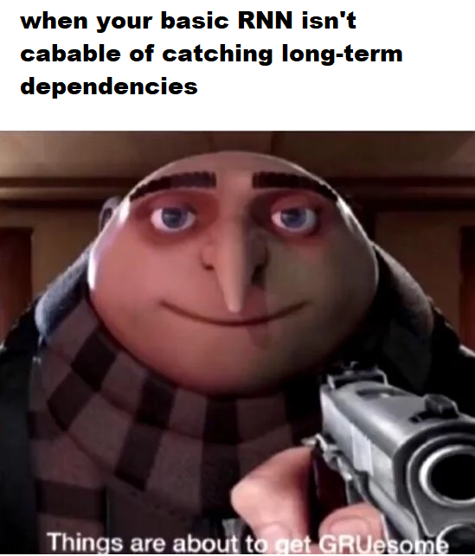

Slide 60







Simple RNN again
Output, $y_{t}$
$$Y_{t }$$
activation
activation
$$W_{1}h_{t}+b_{1}$$
$$W_{2}h_{t}+b_{2}$$
σ
W₁
W₂
W
U
activation
$$h_{t}=g(z_{t})$$
$$h_{t }$$
State
Hidden state, $h_{t−1}$
$$z_{t}=Vx_{t}+Uh_{t−1}+b_{r}$$
σ
+
U
V
V
Input, $x_{t}$
$$X_{t }$$

Slide 61
Simple RNN again
Output, $y_{t}$
$$Y_{t }$$
activation
activation
$$W_{1}h_{t}+b_{1}$$
$$W_{2}h_{t}+b_{2}$$
σ
W₁
W₂
W
U
activation
$$h_{t}=g(z_{t})$$
$$h_{t }$$
State
Hidden state, $h_{t−1}$
$$z_{t}=Vx_{t}+Uh_{t−1}+b_{r}$$
σ
+
U
V
V
Input, $x_{t}$
$$X_{t }$$

Slide 62


Simple RNN again: Memories
$$Y_{t }$$
σ
W
$$h_{t }$$
State
σ
+
U
V
$$X_{t }$$

Slide 63
Simple RNN again: Memories - Forgetting
$$Y_{t }$$
σ
W
$$h_{t }$$
State
σ
+
U
V
$$X_{t }$$

Slide 64
Simple RNN again: New Events
$$Y_{t }$$
σ
W
$$h_{t }$$
State
σ
+
U
V
$$X_{t }$$

Slide 65
Simple RNN again: New Events Weighted
$$Y_{t }$$
σ
W
$$h_{t }$$
State
σ
+
U
V
$$X_{t }$$

Slide 66
Simple RNN again: Updated memories
$$Y_{t }$$
σ
W
$$h_{t }$$
State
σ
+
U
V
$$X_{t }$$

Slide 67
Ref
[Chen17b] Qiming Chen, Ren Wu, “CNN Is All You Need”, arXiv 1712.09662, 2017. https://arxiv.org/abs/1712.09662
[Chu17] Hang Chu, Raquel Urtasun, Sanja Fidler, “Song From PI: A Musically Plausible Network for Pop Music Generation”, arXiv preprint, 2017. https://arxiv.org/abs/1611.03477
[Johnson17] Daniel Johnson, “Composing Music with Recurrent Neural Networks”, Heahedria, 2017. http://www.hexahedria.com/2015/08/03/ composing-music-with-recurrent-neural-networks/
[Deutsch16b] Max Deutsch, “Silicon Valley: A New Episode Written by AI”, Deep Writing blog post, 2017. https://medium.com/deep-writing/ silicon-valley-a-new-episode-written-by-ai-a8f832645bc2
[Fan16] Bo Fan, Lijuan Wang, Frank K. Soong, Lei Xie “Photo-Real Talking Head with Deep Bidirectional LSTM”, Multimedia Tools and Applications, 75(9), 2016. https://www.microsoft.com/en-us/research/wp-content/uploads/2015/04/icassp2015_fanbo_1009.pdf

