Slide 1
Lecture 12: Autoencoders

Slide 4
Announcements:
Homework 3 deadline …
Project group have been formed and will be announced …

Slide 5
Original LeCun cake analogy slide presented at NIPS 2016, the highlighted area has now been updated.

Slide 6
LeCun updated his cake recipe last week at the 2019 International Solid-State Circuits Conference (ISSCC) in San Francisco, replacing “unsupervised learning” with “self-supervised learning,” a variant of unsupervised learning where the data provides the supervision.

Slide 7
Outline
What are eutoencoders?
Brief history of encoding/decoding.
Inside autoencoders.
Regularization of autoencoders.
Applications
Denoising
Blending

Slide 8
Outline
What are eutoencoders?
Brief history of encoding/decoding.
Inside autoencoders.
Regularization of autoencoders.
Applications
Denoising
Blending

Slide 9
Quick Review. Neural Networks as function approximation.
Given an input x and an output y there exists a mapping from input space to output space as follows:
$$x→y \\ y=f\left(x\right)+ε$$
Our goal is to find an estimate of f(x) which we will call $\hat{f}(x)$.
Statistical learning or modeling is the process of finding $\hat{f}(x)$.
Neural networks are one of many possible methods we can use to obtain the estimate $\hat{f}(x)$.

Slide 10
Representational Learning
Representation Matters
$$x$$
$$\hat{y}$$
Linear
Regression
Fit quadratic function
Do your best !
$$y$$
$$y=x^{2}$$
$$y$$
$$x$$
$$x$$

Slide 11
Representational Learning
Representation Matters
$$x_{1},x_{2}$$
$$\hat{y}$$
Logistic
Regression
Fit polynomial function
Do your best !
$$x_{2}$$
$$x_{2}$$
$$x_{1}$$
$$x_{1}$$

Slide 12
Representational Learning
Representation Matters
$$x$$
$$φ(x)$$
$$\hat{y}$$
Learn
Representation
Linear
Regression
$$y$$
$$y$$
$$φ(x)=x^{2}$$
$$x$$
$$φ(x)$$

Slide 13
Representational Learning
Representation Matters
$$x$$
$$φ(x)$$
$$\hat{y}$$
Learn
Representation
Linear
Regression
$$x_{2}$$
$$φ\left(x\right)$$
$$θ$$
$$r^{2}=x_{1}^{2}+x_{2}^{2}$$
$$θ=\tan^{−1}{\frac{x_{2}}{x_{1}}}$$
$$x_{1}$$
$$r$$

Slide 14
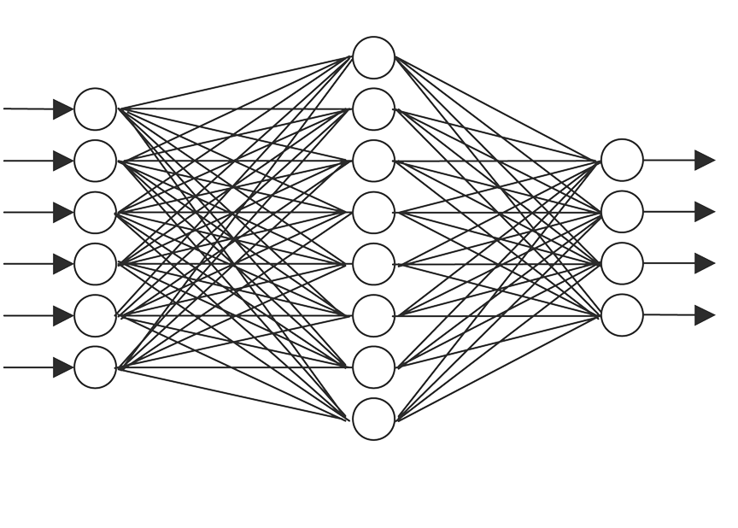
Representational Learning
Representation Matters
$$x$$
$$φ(x)$$
$$\hat{y}$$
Learn
Representation
Task

Slide 15
Representational Learning: Supervised Learning
We train the two networks by minimizing the loss function (cross entropy loss)
X
Y
Features
$$φ\left(x\right)$$
{Cat,Dog}
Feature Discovery Network
Classification Network

Slide 16
Representational Learning: Self-supervised Learning
No labels
Specialized features for Task
We train the two networks by minimizing the loss function (cross entropy loss)
X
Y
Features
$$φ\left(x\right)$$
{Cat,Dog}
Feature Discovery Network
Classification Network

Slide 17
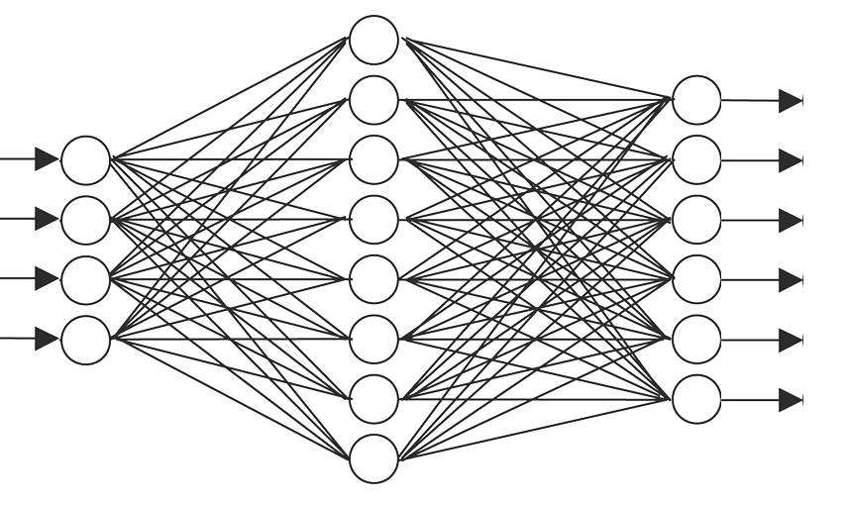
Representational Learning: Self-supervised Learning
We train the two networks by minimizing the reconstruction loss function:
$$ℒ=∑{\left(x_{i}−{\hat{x}}_{i}\right)}^{2}$$
AUTOENCODER
X
$$\hat{X}$$
Latent Space
$$Z$$
Features
$$φ\left(x\right)$$
Feature Discovery Network
Second Network
ENCODER
DECODER
This is an autoencoder. It gets that name because it automatically finds the best way to encode the input so that the decoded version is as close as possible to the input.

Slide 18
Brief history of encoding/decoding
Is this a new idea?
MP3 can compress music files by a factor of 10 enabling digital storage and transmission large volumes of audio.
JPG compresses images by a factor of 10-20 and enables storage and transmission of image data.
These technologies led the way to the image-rich web and abundance of music that we enjoy today.

Slide 19
Brief history of encoding/decoding (cont)
We say that both MP3 and JPG take an input (a music or image file), and encode it into a compressed form.
Then we decode or decompress the intermediate version to some lower quality original version.

Slide 20
Lossless and Lossy Encoding
The greater the difference between the original version and the version post-decompression the greater the loss.
Example: Imagine you are in Boston and you want to write a birthday text to a special friend while walking home.
HANNAH HAPPY BIRTHDAY I LOVE YOU DAN
In the freezing Boston winter (-20C) you do not want to have your hands out in the open, so you shorten the message as much as possible using text-speak:
H HBD ILY D
Your 36 characters message is compressed to 11 characters

Slide 21
Lossless and Lossy Encoding (cont)
Question: Is this an example lossy or lossless compression?
HPD is unambiguous given that it is her birthday today, but D could mean Dan or David or Donny ... You can imagine the potential drama.
A way to test if a transformation is lossy or lossless is to consider if it can be inverted, or run backwards, to provide us with the original data. In autoencoders this is the loss function.
x
$$\hat{x}$$
Z
$$ℒ=∑{\left(x_{i}−{\hat{x}}_{i}\right)}^{2}$$
ENCODER
DECODER

Slide 22
What are autoencoders?
A particular kind of learning architecture.
A mechanism of compressing inputs into a form that can later be decompressed similar to the way MP3 compresses audio and JPG compresses images.
Autoencoders are more general than either MP3 or JPG.
They are usually used to …
reduce data dimensionality or find a more general representation for many tasks
blend inputs from one input to another
denoising, infilling
…

Slide 23
MP3 and JPG Image Compression
original
MP3
JPG
Original image 256x256=262,000, MP3=37,000, and JPG=26,000
Image taken from A. Glassner, Deep Learning, Vol. 2: From Basics to Practice

Slide 24
MP3 and JPG Image Compression(cont)
original
MP3
JPG
Image taken from A. Glassner, Deep Learning, Vol. 2: From Basics to Practice

Slide 25
The simplest autoencoder
Encode with a simple fully connected network (FCN)
Image 100x100
Flatten Image 10,000
FCN with 20 neurons
20 numbers
…
…
…
Parameters: 10K x 20 + 20

Slide 26
The simplest autoencoder
Encode and decode together after training
Image 100x100
Flatten Image 10,000
FCN with 20 neurons
FCN with 10,000 neurons
.reshape(100,100)
…
…
…
10,000 numbers
…
…
Parameters: 10K x 20 + 20
Parameters: 10K x 20 + 10K

Slide 27
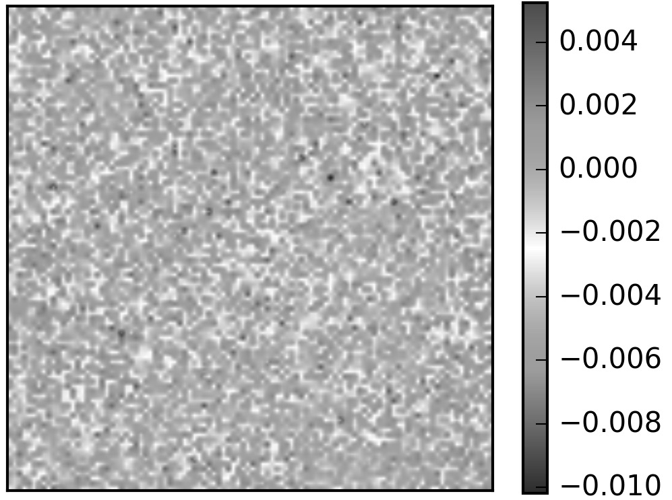
Autoencoders in action
Comparing the input and output pixel by pixel.
Input Image 100x100
Output Image 100x100
Residuals 100x100

Slide 28
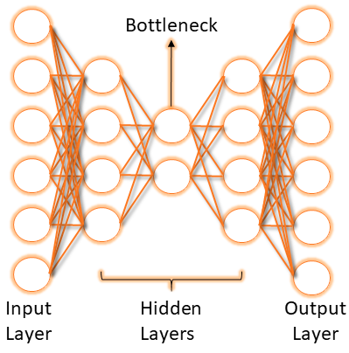
Bottleneck
We start with 10,000 elements
We have 20 in the middle
And 10,000 elements again at the end

Slide 30
Latent variables and latent layer
We say that an autoencoder is an example of semi-supervised or self-supervised learning.
It sort-of is supervised learning because we give the system explicit goal data (the output should be the same as the input), and it sort-of isn’t supervised learning because we don’t have any manually determined labels or targets on the inputs.

Slide 31
Autoencoders in action (cont)
Passing ”Pavlos” to the trained autoencoder returns:
20 neurons
10K neurons
How about if we input the “Eagle”?
20 neurons
10K neurons

Slide 32
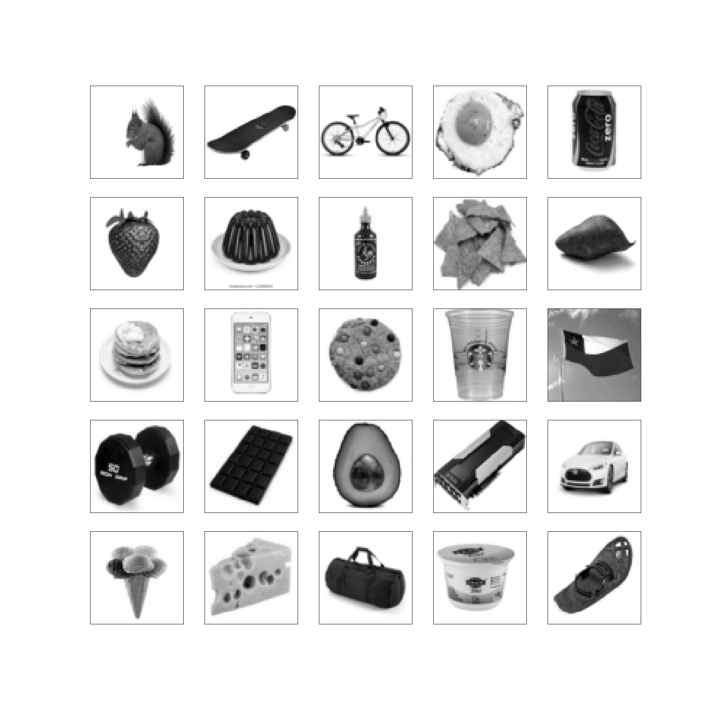
Autoencoders in action (cont)
We must train with a variety of images.

Slide 33
Autoencoders in action (cont)
After training with those images, let’s test how well it generalizes:
20 neurons
10K neurons
Network never seen anything like this, so it is no surprise that could not reconstruct this.

Slide 34
Autoencoders in action (cont)
We can use a better training set such as the Olivetti faces
20 neurons
10K neurons

Slide 35
A better autoencoder
MNIST data: train a simple AE with one-layer FCN encoder and one-layer FCN decoder
20 neurons
784 neurons

Slide 36
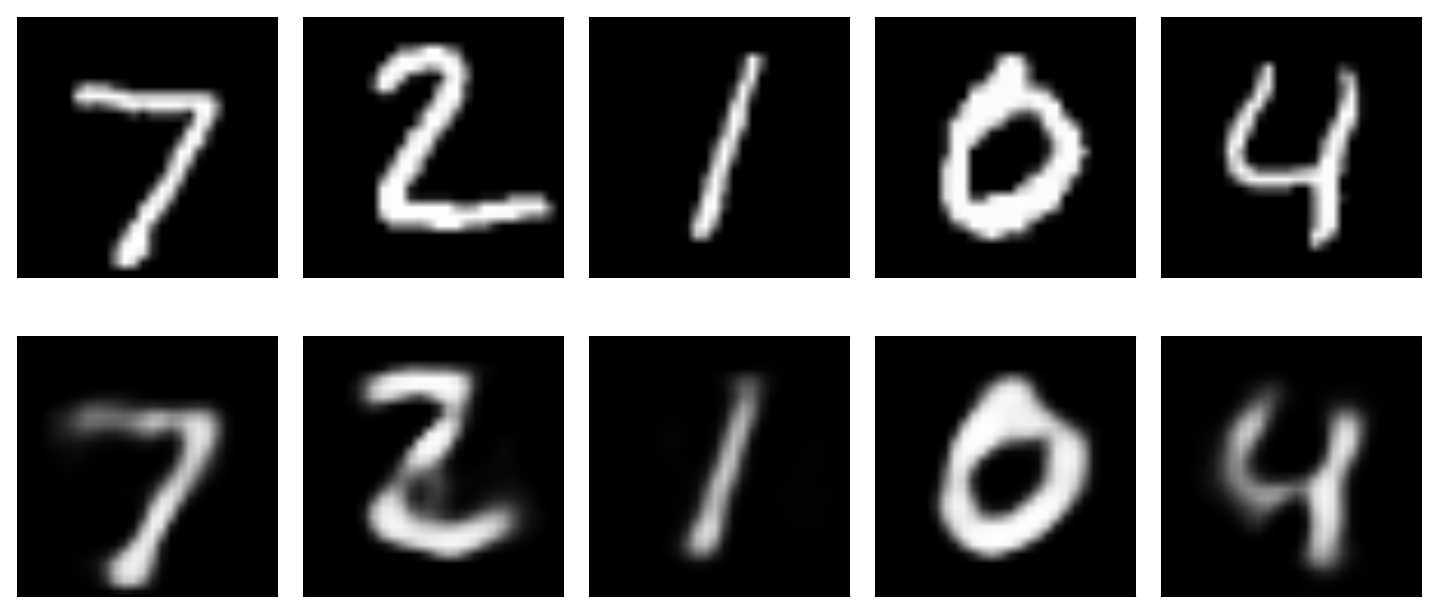
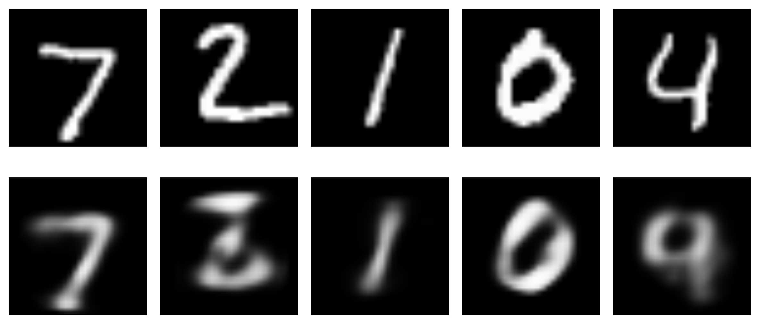
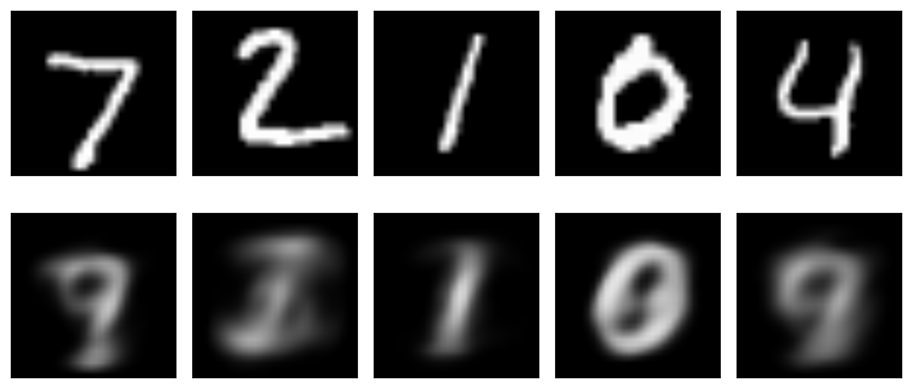
original
20 latent variables
reconstructed
original
10 latent variables
reconstructed
WHY DOES IT WORK?
original
2 latent variables
reconstructed
Image taken from A. Glassner, Deep Learning, Vol. 2: From Basics to Practice

Slide 37
Deeper
For a better representation we can add neurons in one layer or go deeper.
512 neurons
256 neurons
20 neurons
256 neurons
512neurons
784 neurons
28x28
28x28
Z is 20 dimensional
Original Images
Deeper 20 latent variables
Reconstructed Images
Shallow 20 latent variables
DEEPER IS BETTER

Slide 38
Exploring autoencoders
How can be sure that there is information in the latent space?
original
2 latent variables
reconstructed
20 neurons
10K neurons

Slide 39
Exploring autoencoders (cont)
For that let’s explore the actual latent space.
Input
Latent space
Each plot a hist of the values of the 20 Z’s
Output
Image taken from A. Glassner, Deep Learning, Vol. 2: From Basics to Practice

Slide 40
Exploring autoencoders (cont)
If latent space does not contain any information, then changing the values randomly won’t change the output or it will not be robust.
Input
Latent space
Add random noise +/-10 to z’s
Output

Slide 41
Exploring autoencoders (cont)
If latent space does not contain any information, then changing the values randomly won’t change the output or it will not be robust.
Input
Latent space
Add random noise +/-100 to z’s
Output

Slide 42
Exploring autoencoders (cont)
If latent space does not contain any information, then changing the values randomly won’t change the output or it will not be robust.
Input
Latent space
Add random noise +/-100 to z’s
Output

Slide 43
Exploring autoencoders (cont)
If latent space does not contain any information, then changing the values randomly won’t change the output or it will not be robust.
Input
Latent space
Just noise
Output

Slide 44
Parameter space of autoencoder
Further examine the latent space. Is there any separation of the different classes? If the AE learned the “essence” of the MNIST images, similar images should be close to each other. Plot the latent space and examine the separation.
Here we plot the 2 PCA components of the latent space.
Image taken from A. Glassner, Deep Learning, Vol. 2: From Basics to Practice

Slide 45
Blending
We blend inputs to create new data that is similar to the input data, but not exactly the same.
One example of blending is content blending where the content of two pieces of data is directly blended. An example is if we overlay images of a cow and zebra.
Image taken from A. Glassner, Deep Learning, Vol. 2: From Basics to Practice

Slide 46
Blending
Content blending on MNIST images
Image taken from A. Glassner, Deep Learning, Vol. 2: From Basics to Practice

Slide 47
Blending (cont)
Another type of blending is parametric or representation blending:
In this type of blending we take advantage of parameterization to describe the objects we’re interested in. By engaging in blending in the parameter space, we can create results that blend the inherent qualities of the objects of interest.

Slide 48
Blending (cont)
Image taken from A. Glassner, Deep Learning, Vol. 2: From Basics to Practice

Slide 49
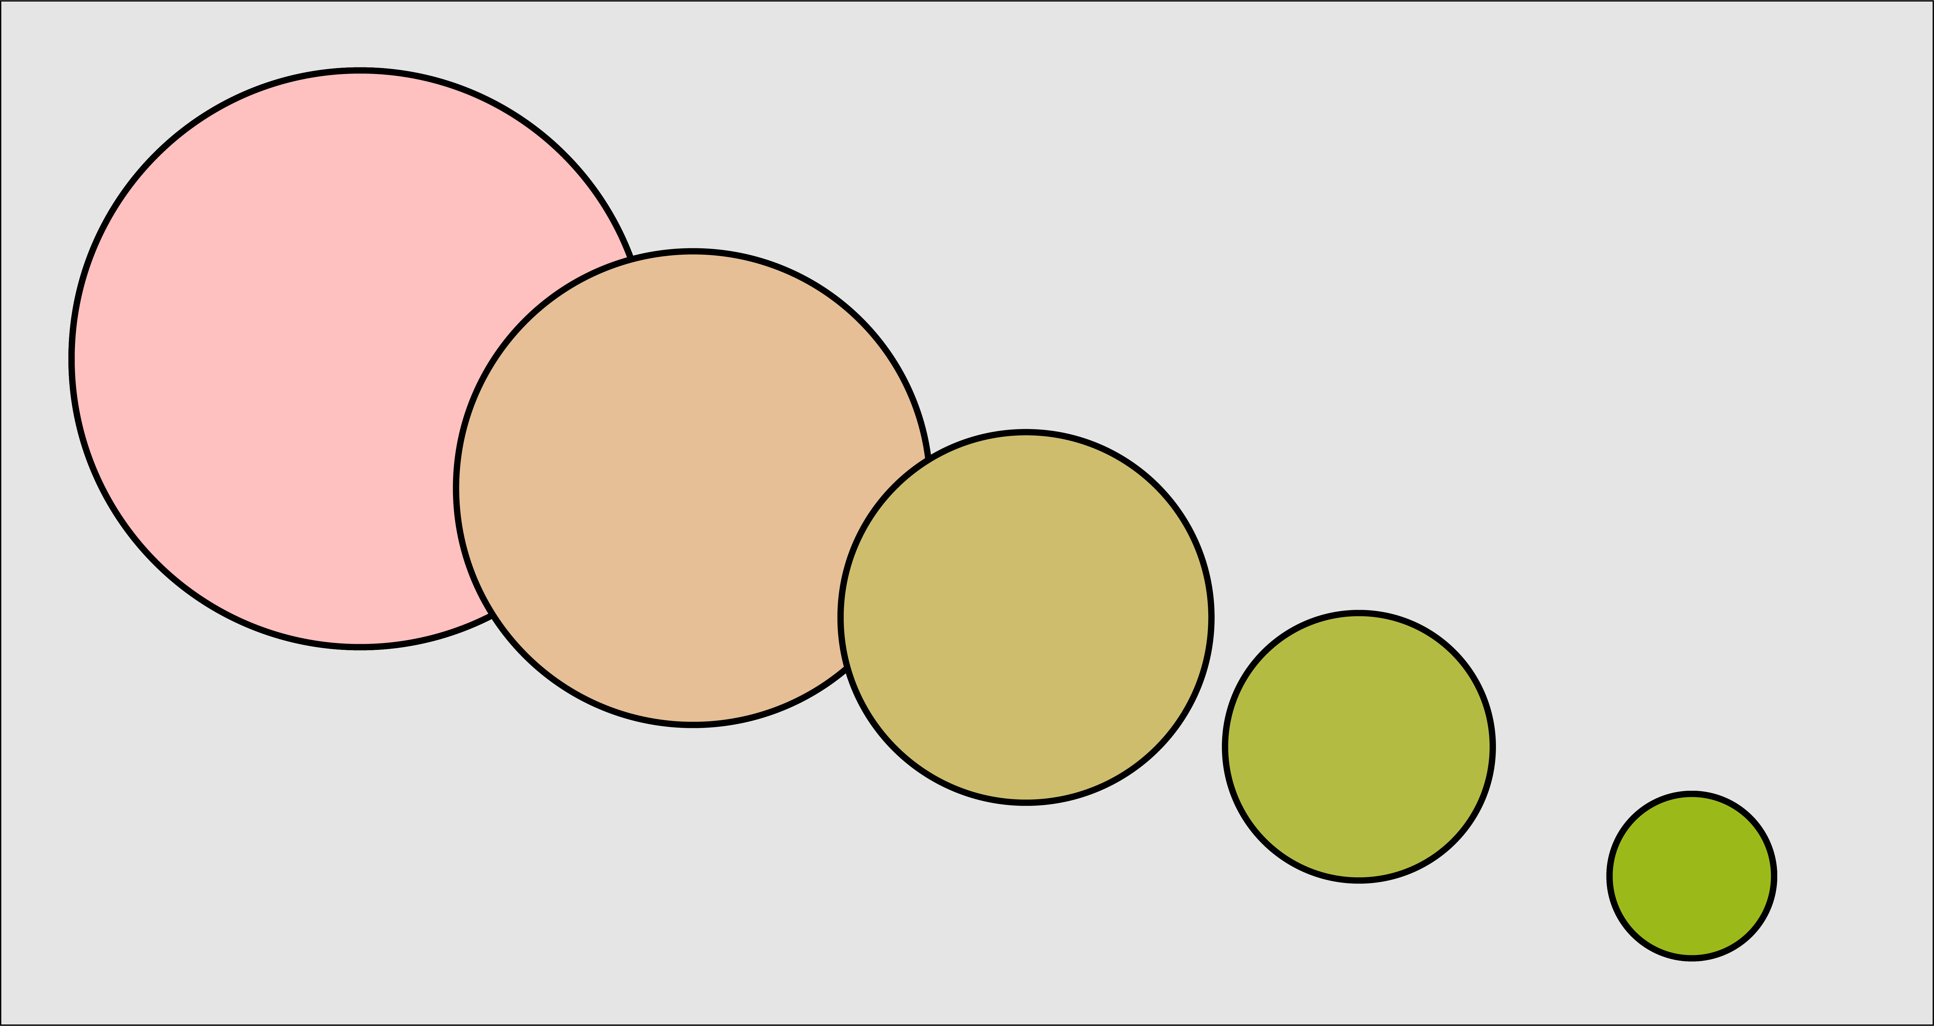
Parametric or representation blending
Image taken from A. Glassner, Deep Learning, Vol. 2: From Basics to Practice

Slide 50
Blending in compressed representation
While the blending we’ve described works well for uncompressed objects what happens when compression is involved?
The compressed form may not be the best representation with what we would like to blend the objects.
For example, let’s take the sounds of the words cherry and orange.
We can blend these sounds together or we can compress them into written words.
Image taken from A. Glassner, Deep Learning, Vol. 2: From Basics to Practice

Slide 51
Blending Latent Variables
Back to the example of MNIST.
We start at the start of the arrows in latent space and then move to end of the arrow in 7 steps.
For each value of z we use the already trained decoder to produce an image.
Image taken from A. Glassner, Deep Learning, Vol. 2: From Basics to Practice

Slide 53
Applying to novel input
Check again if the deep AE trained on MNIST works with “Pavlos” image?
512 neurons
256 neurons
20 neurons
256 neurons
512neurons
784 neurons
NO
Since we are dealing with images, it is best to use CNNs

Slide 54
Convolutional Autoencoders
16 filters (3x3x1) same padding
Output: 28x28x16
8 filters (3x3x16) same
Output: 14x14x8
3 filters (3x3x8) same
Output: 7x7x3
Max pooling 2x2
Output: 14x14x16
Max pooling 2x2
Output: 7x7x8

Slide 55
Convolutional Autoencoders
1 filter (3x3x16) same
Output: 28x28x1
Upsampling 2x2
Output: 14x14x3
16 filters (3x3x3) same
Output: 14x14x16
3 filters (3x3x8) same
Output: 7x7x3
Upsampling 2x2
Output: 28x28x16

Slide 56
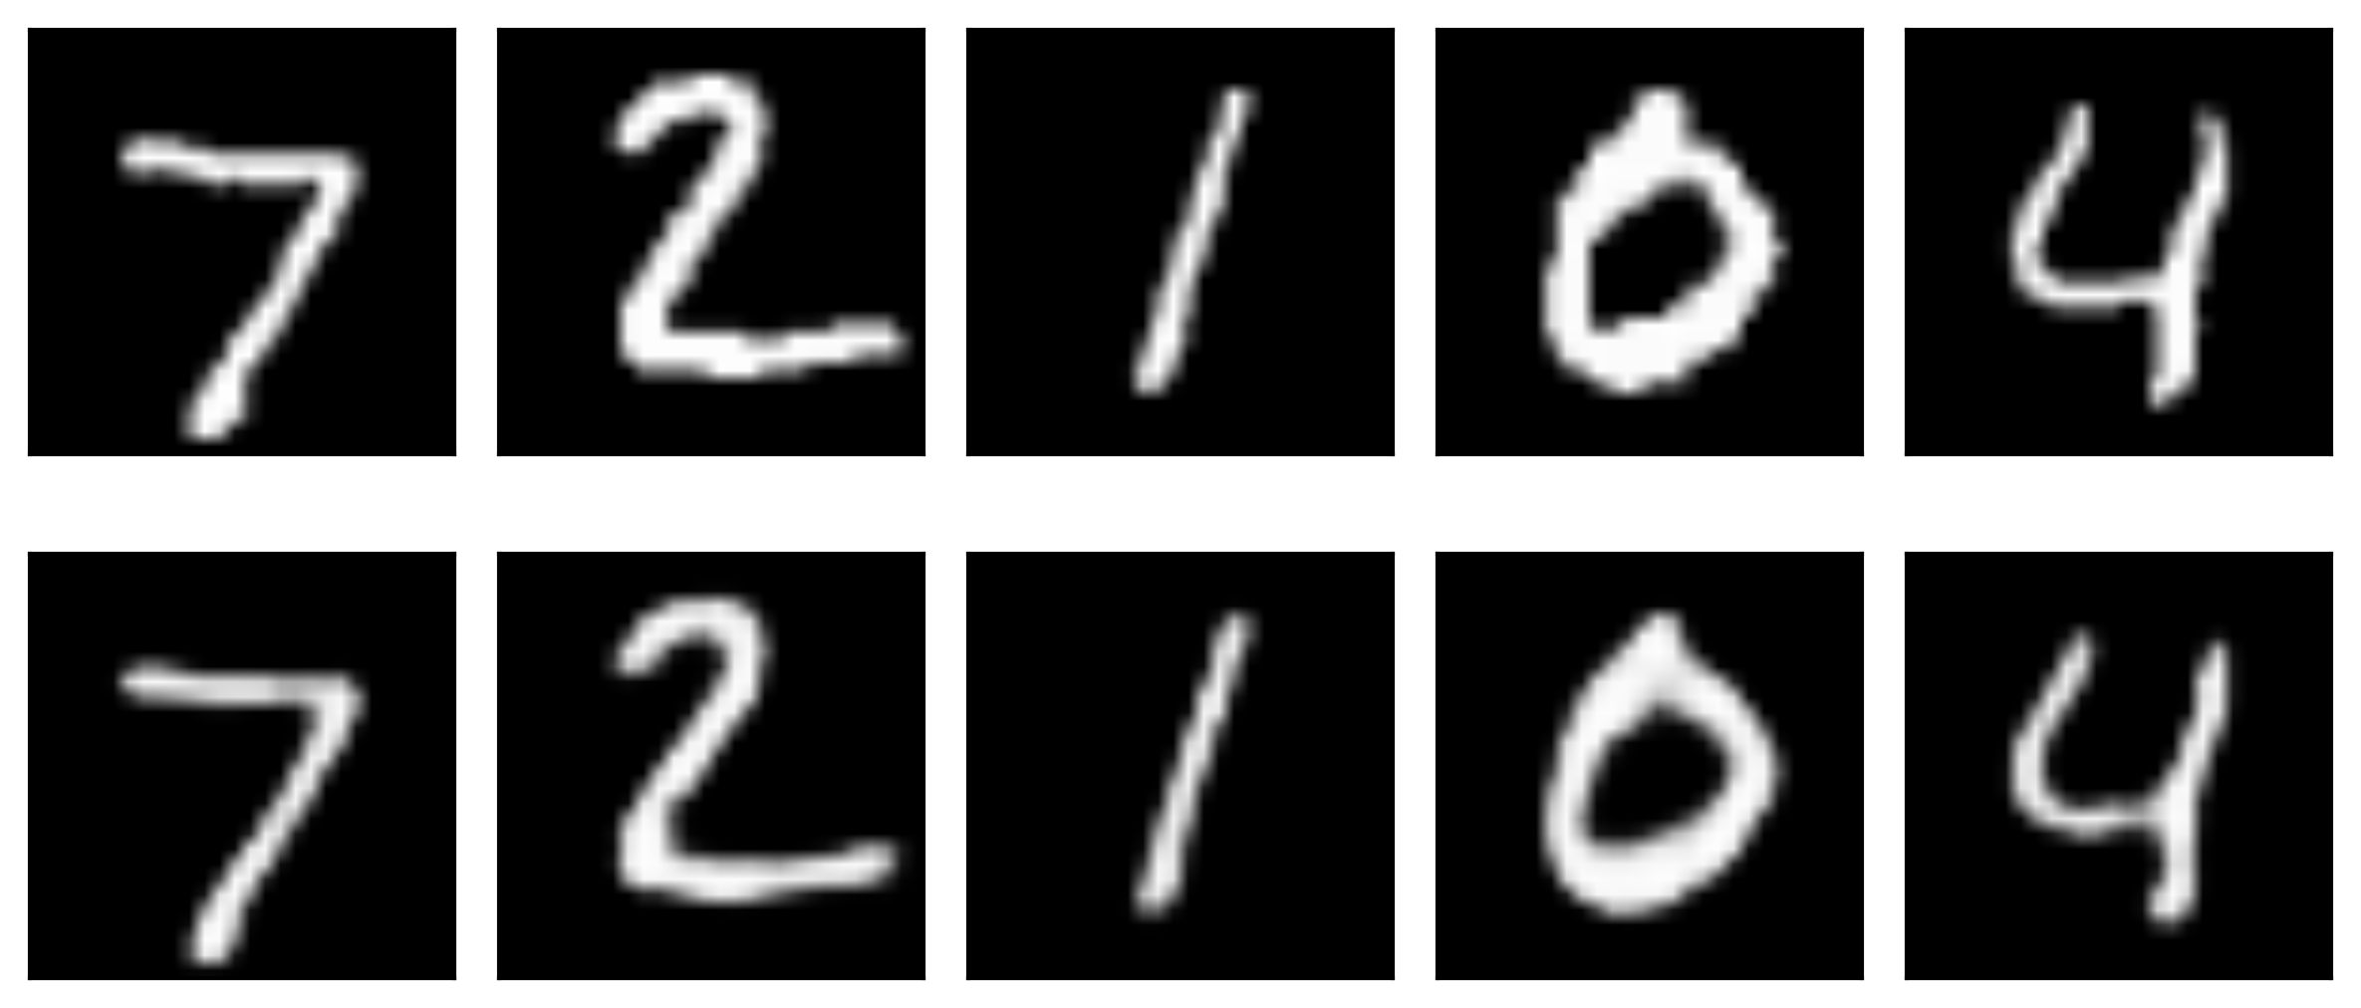
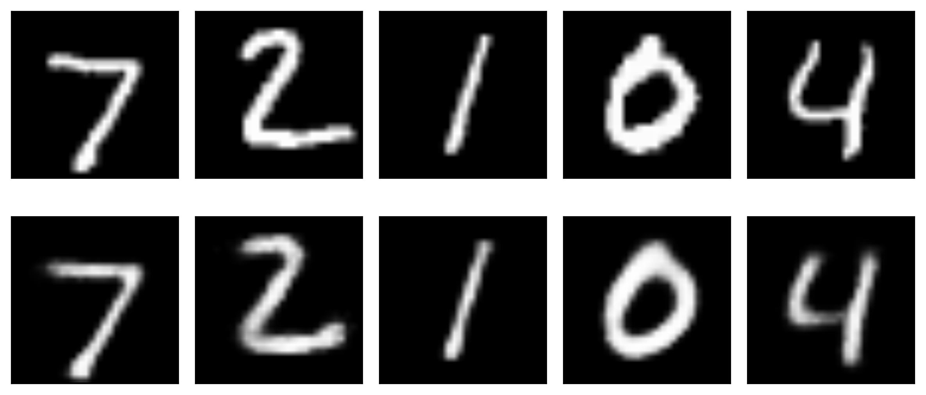
Convolutional Autoencoders
Original Images
Reconstructed Images with Conv AE
ConvAE latent variables
DeepFCN latent variables

Slide 57
Denoising
A popular use of autoencoders is to remove noise from samples.
Start with a pristine images
Measure reconstruction loss against pristine image
Add noise to to the input images
Feed corrupted input into autoencoder

Slide 58
Infilling
Claim is that AE learns the contextual information of the images. That would mean if some parts of the image is missing then

Slide 59
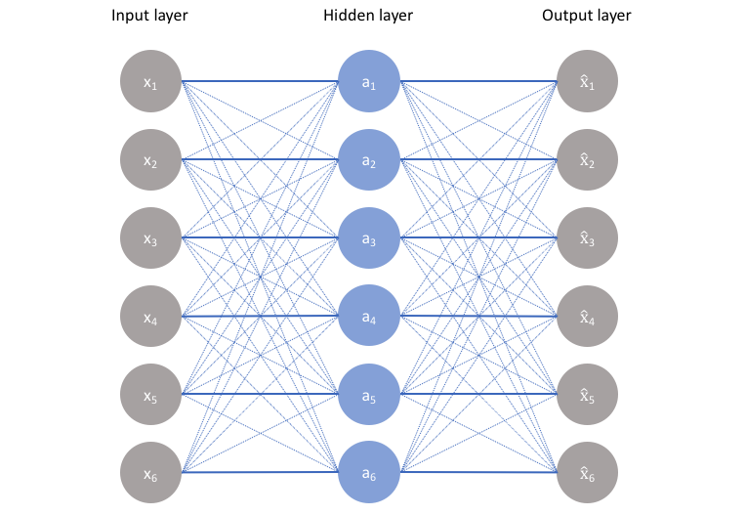
Overcomplete Autoencoders
Over-complete autoencoder is when z has greater dimension than x.
Autoencoder may simply copy input to output without learning anything useful – Mark’s point.
The ideal autoencoder model balances the following:
Sensitive to the inputs enough to accurately build a reconstruction.
Insensitive enough to the inputs that the model doesn't simply memorize or overfits the training data.
.

Slide 60
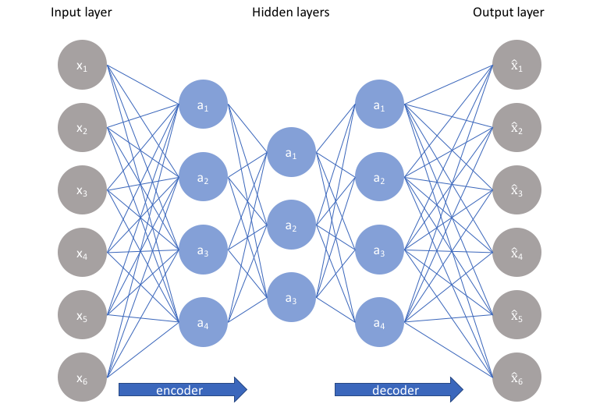
Overcomplete Autoencoders
We’ve assumed so far that the size of the bottleneck is smaller than the size of the inputs – this is called an undercomplete autoencoder.
The case in which the size of the bottleneck is greater than or equal to the number of inputs we call an overcomplete autoencoder.

Slide 61
Overcomplete Autoencoders
The size of the bottleneck (i.e. the number of latent variables) makes a difference!
original
20 latent variables
reconstructed
original
2 latent variables
reconstructed
61

Slide 62
Regularized Autoencoders
Sparse autoencoders
Contractive autoencoders
Denoising autoencoders and dropout

Slide 63
Sparse Autoencoders
This trade-off requires the model to maintain only the variations in the data required to reconstruct the input without holding on to redundancies within the input.
Question: How to achieve this?
For most cases, this involves constructing a loss function where one term encourages our model to be sensitive to the inputs (ie. reconstruction loss $ℒ\left(x,\hat{x}\right)$ and a second term discourages memorization/overfitting (ie. an added regularizer).
$$ℒ\left(x,g\left(f\left(x\right)\right)\right)+Ω(z)$$
Regularization on output of encoder (latent space), not on network parameters

Slide 64
Sparse Autoencoders
We allow our network to sensitize individual hidden layer nodes toward specific attributes of the input data.
A sparse autoencoder is selectively activate regions of the network depending on the input data.
Limiting the network's capacity to memorize the input data without limiting the networks capability to extract features from the data.
$$ℒ\left(x, \hat{x}\right)+λ\sum_{i}{|z_{i}|}$$

Slide 65
Contractive Autoencoders
One would expect that for very similar inputs, the learned encoding would also be very similar.
We can explicitly train our model for this to be the case by requiring that the derivative of the hidden layer activations are small with respect to the input.
Question: How do we find how much the encoded space would change if the input changes?
Notes:
We can explicitly train our model in order for this to be the case by requiring that the derivative of the hidden layer activations are small with respect to the input.

Slide 66
Contractive Autoencoders
Derivatives
$$ℒ\left(x,g\left(f\left(x\right)\right)\right)+λ\sum_{i}{{\left|\left|∇_{x}z_{i}\right|\right|}^{2}}$$
This forces the model to learn a function that does not change much when x changes slightly. Because this penalty is applied only at training examples, it forces the autoencoder to learn features that capture information about the training distribution.
Notes:
We can explicitly train our model in order for this to be the case by requiring that the derivative of the hidden layer activations are small with respect to the input.

Slide 67
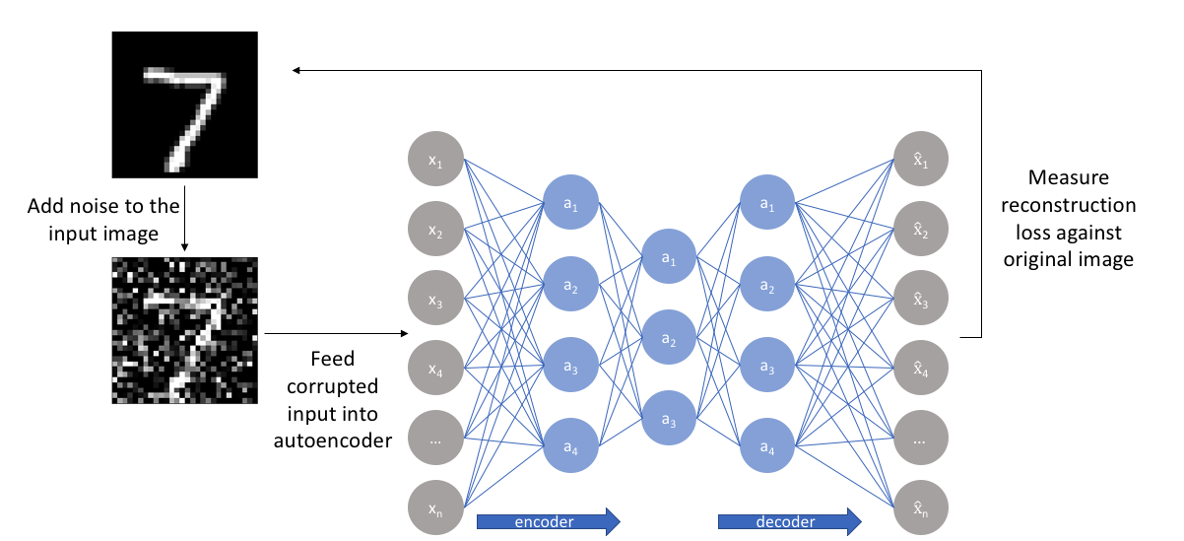
Denoising Autoencoders
The denoising autoencoder is an autoencoder that receives a corrupted data point as input and is trained to predict the original, uncorrupted data point as its output.
For each epoch:

Slide 68
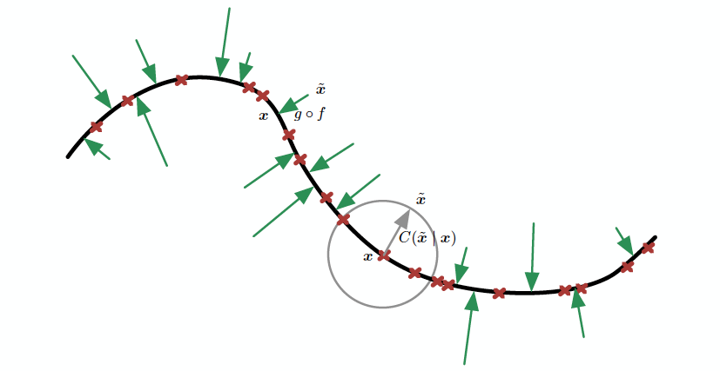
Denoising Autoencoders (cont)
Denoising autoencoders learn a manifold. Vector field learned by denoising autoencoder. Each arrow is proportional to g(f(x)) – x

Slide 69
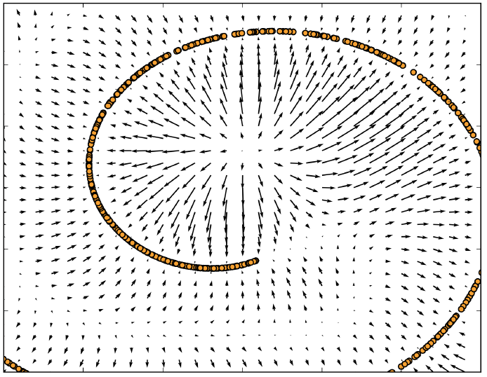
Denoising Autoencoders (cont)
Vector field learned by denoising autoencoder. Each arrow is proportional to g(f(x)) – x

Slide 70
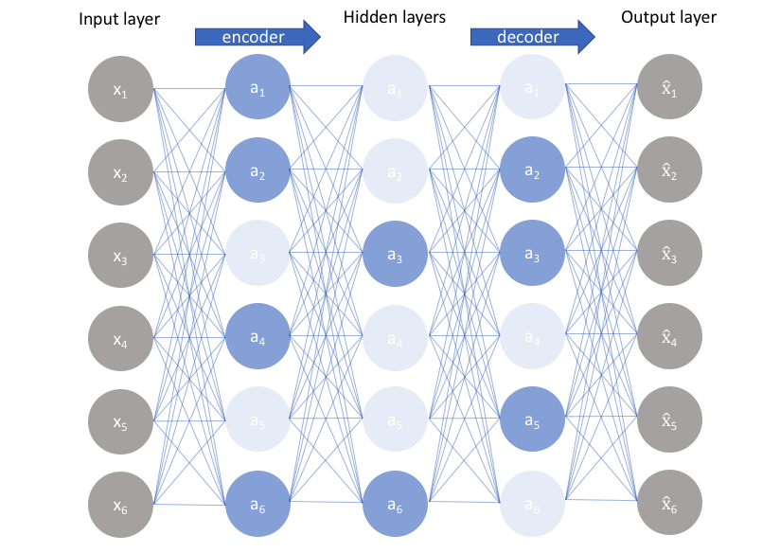
We allow our network to sensitize individual hidden layer nodes toward specific attributes of the input data.

Slide 71
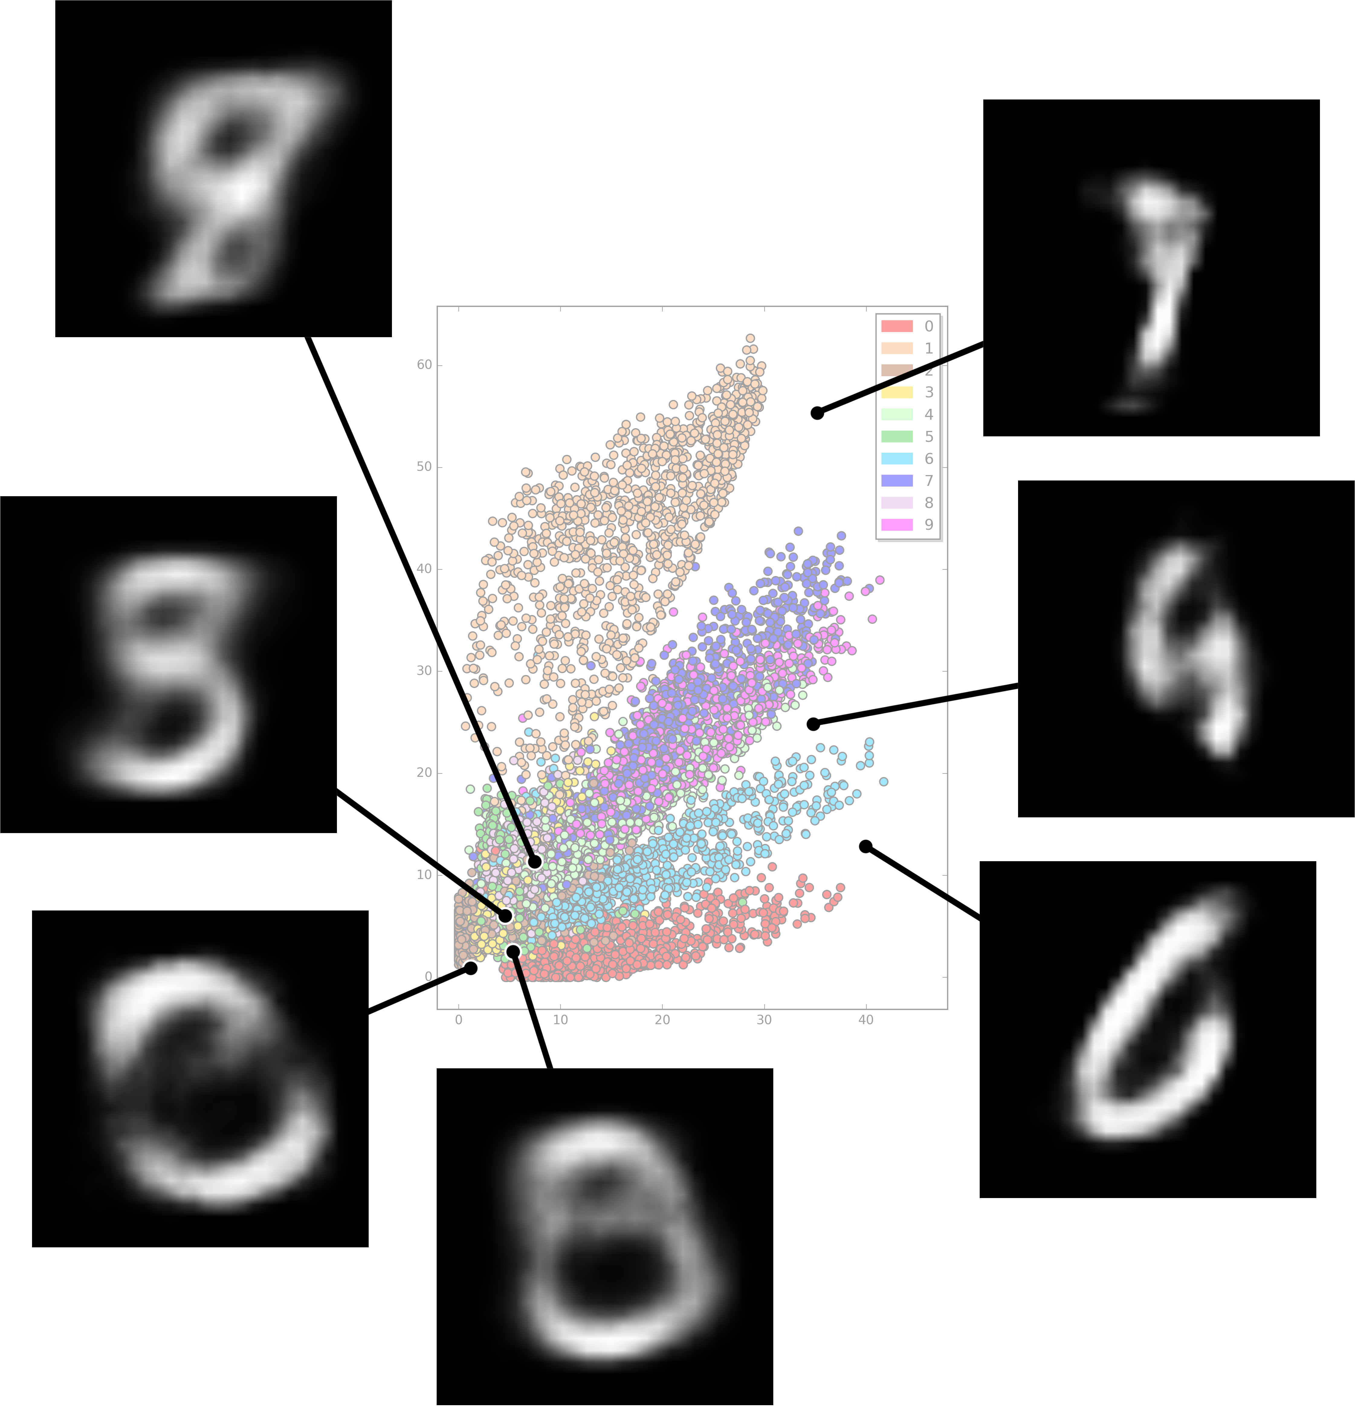
Problems with Autoencoders
Gaps in the latent space
Separability in the latent space
Discrete latent space

