Slide 1
Prediction Intervals

Slide 2
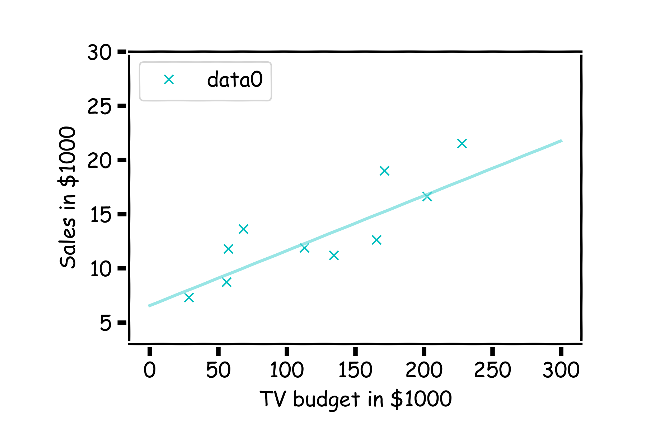
How well do we know $\hat{f}$?
Our confidence in $f$ is directly connected with our confidence in $β$s. For each bootstrap sample, we have one $β,$which we can use to determine the model, $f\left(x\right)=Xβ$.

Slide 3
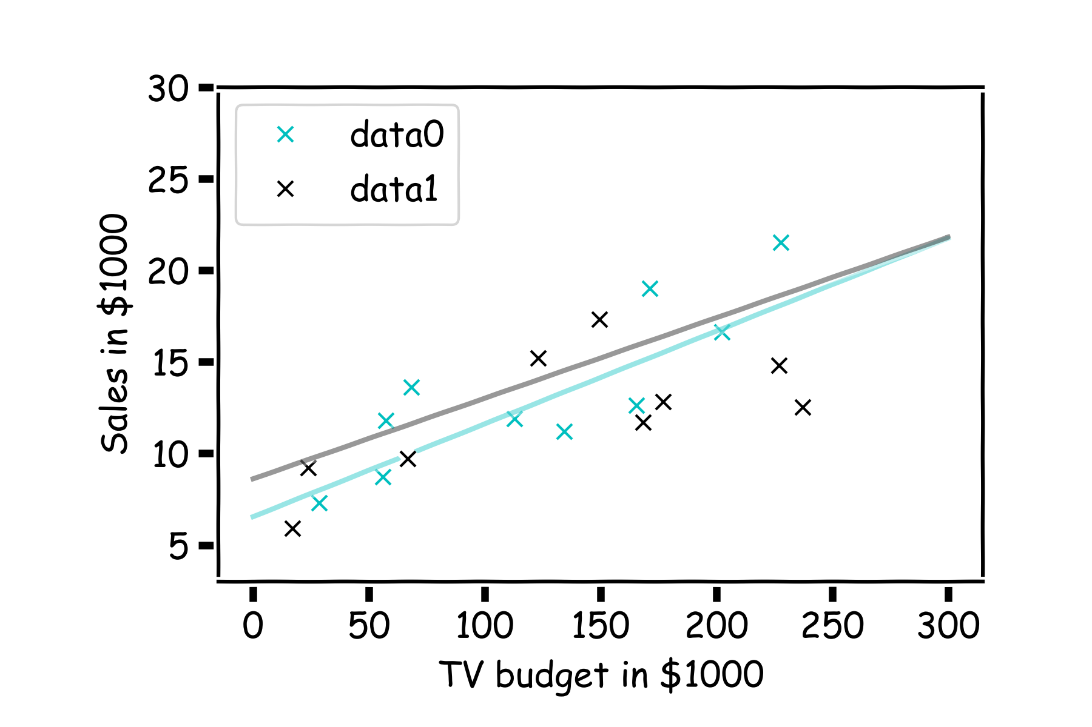
How well do we know $\hat{f}$?
Here we show two difference models predictions given the fitted coefficients.

Slide 4
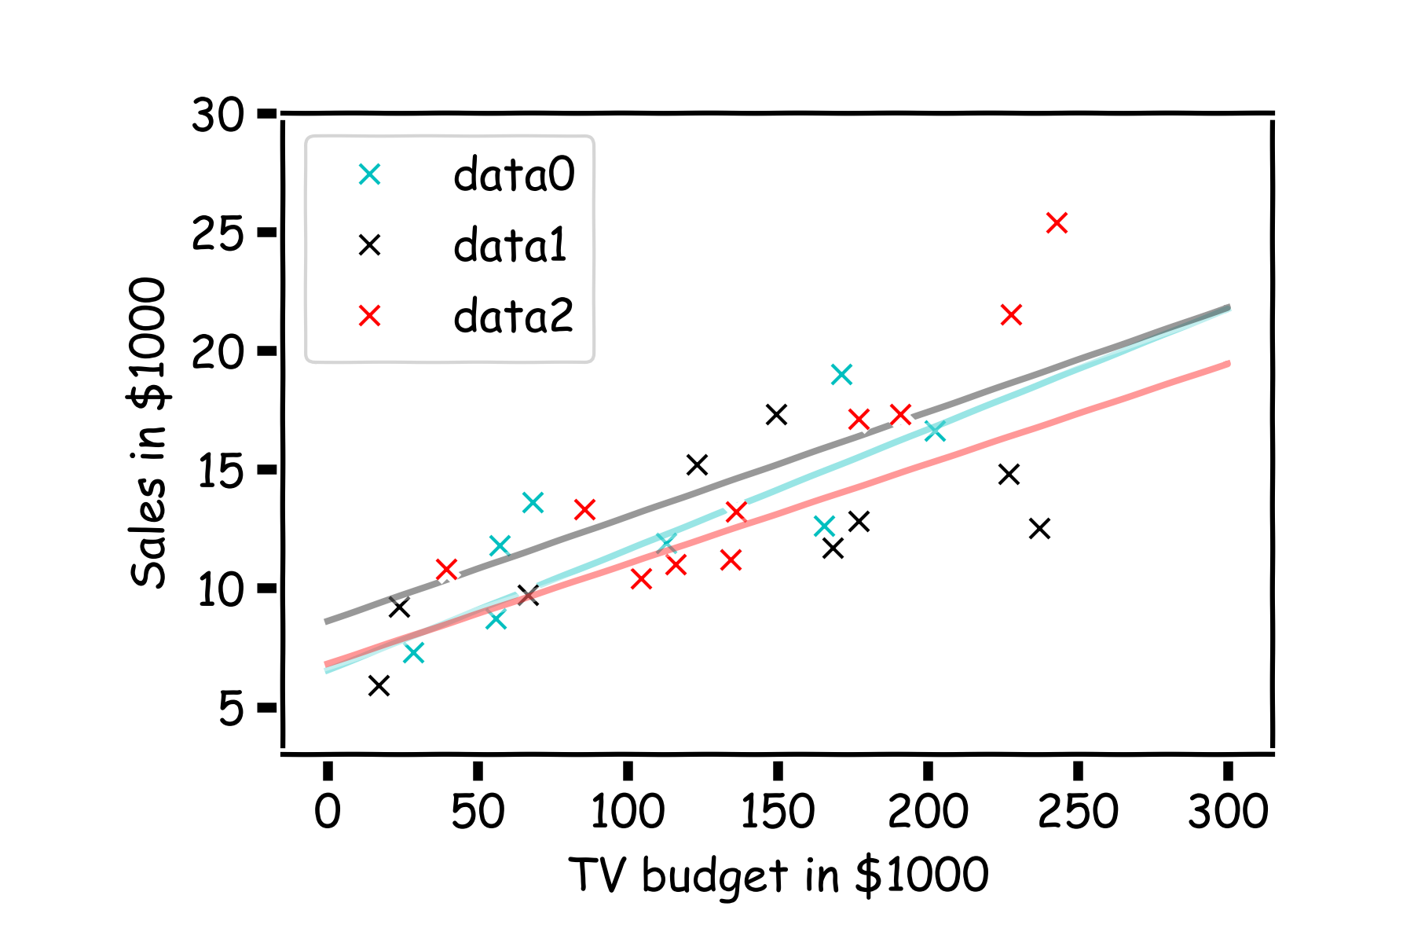
How well do we know $\hat{f}$?
There is one such regression line for every bootstrapped sample.

Slide 5
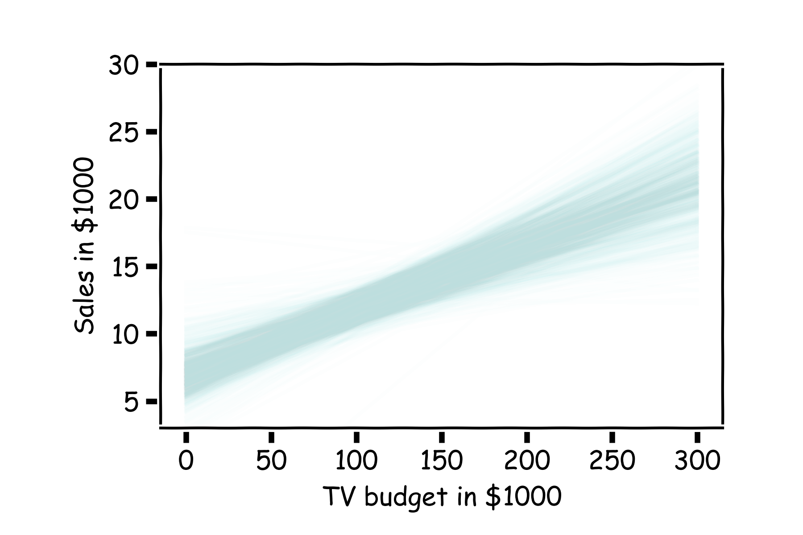
How well do we know $\hat{f}$?
Below we show all regression lines for a thousand of such bootstrapped samples.
For a given $x$, we examine the distribution of $\hat{f}$, and determine the mean and standard deviation.

Slide 6
How well do we know $\hat{f}$?
Below we show all regression lines for a thousand of such bootstrapped samples.
For a given $x$, we examine the distribution of $\hat{f}$, and determine the mean and standard deviation.

Slide 7
How well do we know $\hat{f}$?
We determine the confidence interval of $\hat{f}$ by selecting the region that contains 95% of the samples of $\hat{f}\left(x\right)=X \hat{β}.$
Confidence interval

Slide 8
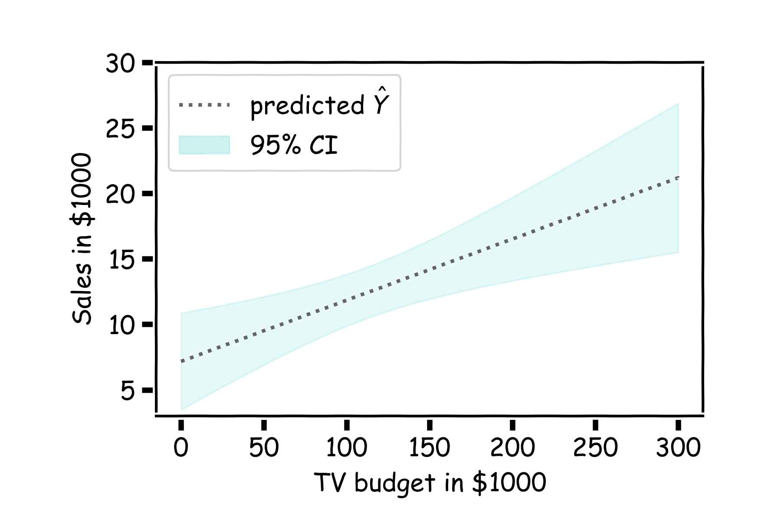
How well do we know $\hat{f}$?
For every $x$, we calculate the mean of the models, $\hat{μ_{f}}$ (shown with dotted line) and the 95% CI of those models (shaded area).
Estimated $\hat{f}$

Slide 9
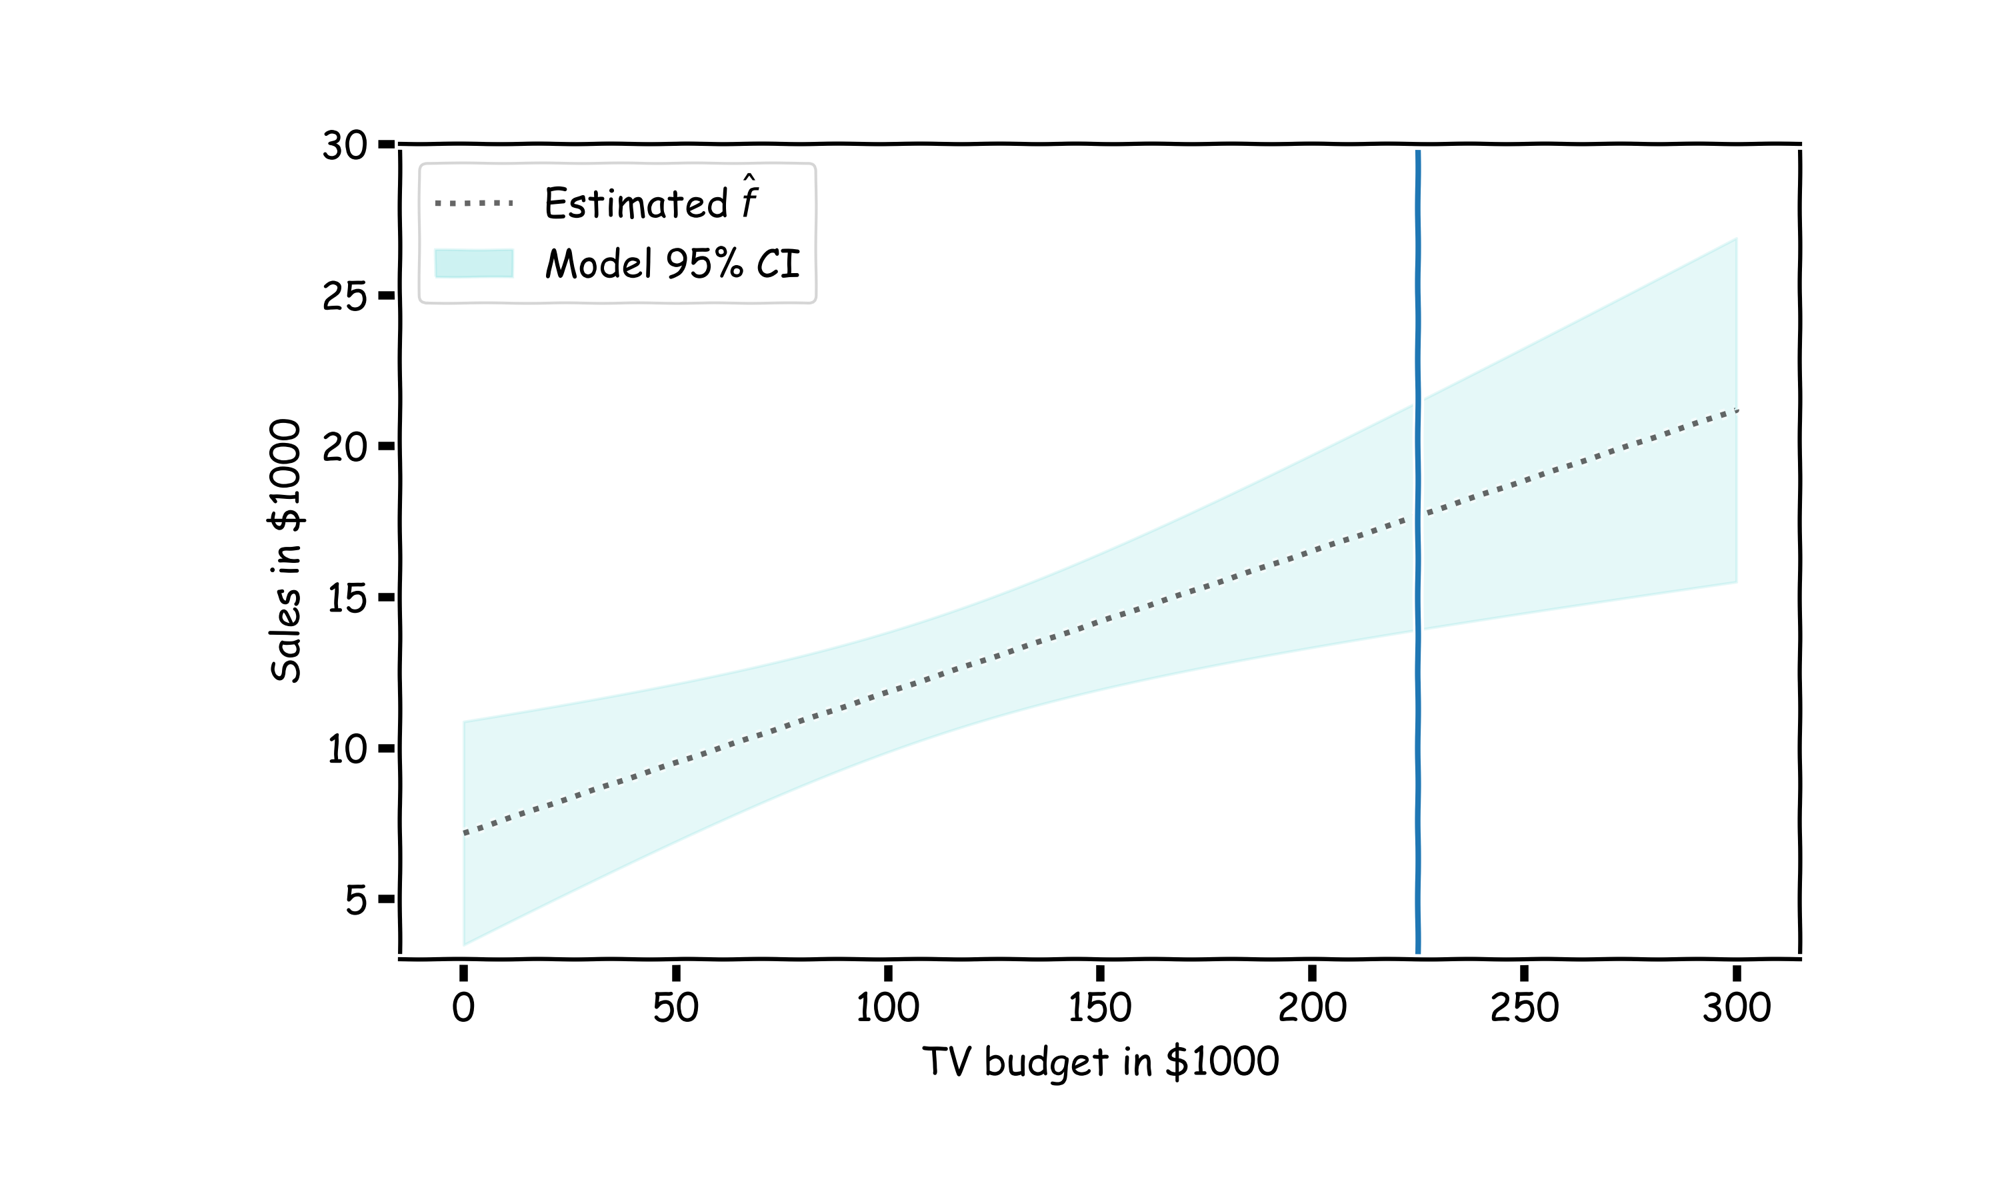
Confidence in predicting $\hat{y}$
Even if we knew $f(x)$ —the response value cannot be predicted perfectly because of the random error in the model (irreducible error).
How much will $Y$ vary from $\hat{Y}$? We use prediction intervals to answer this question.

Slide 10
Confidence in predicting $\hat{y}$
Even if we knew $f(x)$ —the response value cannot be predicted perfectly because of the random error in the model (irreducible error).
How much will $Y$ vary from $\hat{Y}$? We use prediction intervals to answer this question.

Slide 11
Confidence in predicting $\hat{y}$
for a given x, we have a distribution of models $f\left(x\right)$
for each of these $f\left(x\right),$the prediction for $y\sim N(f(x), σ_{ε})$

Slide 12
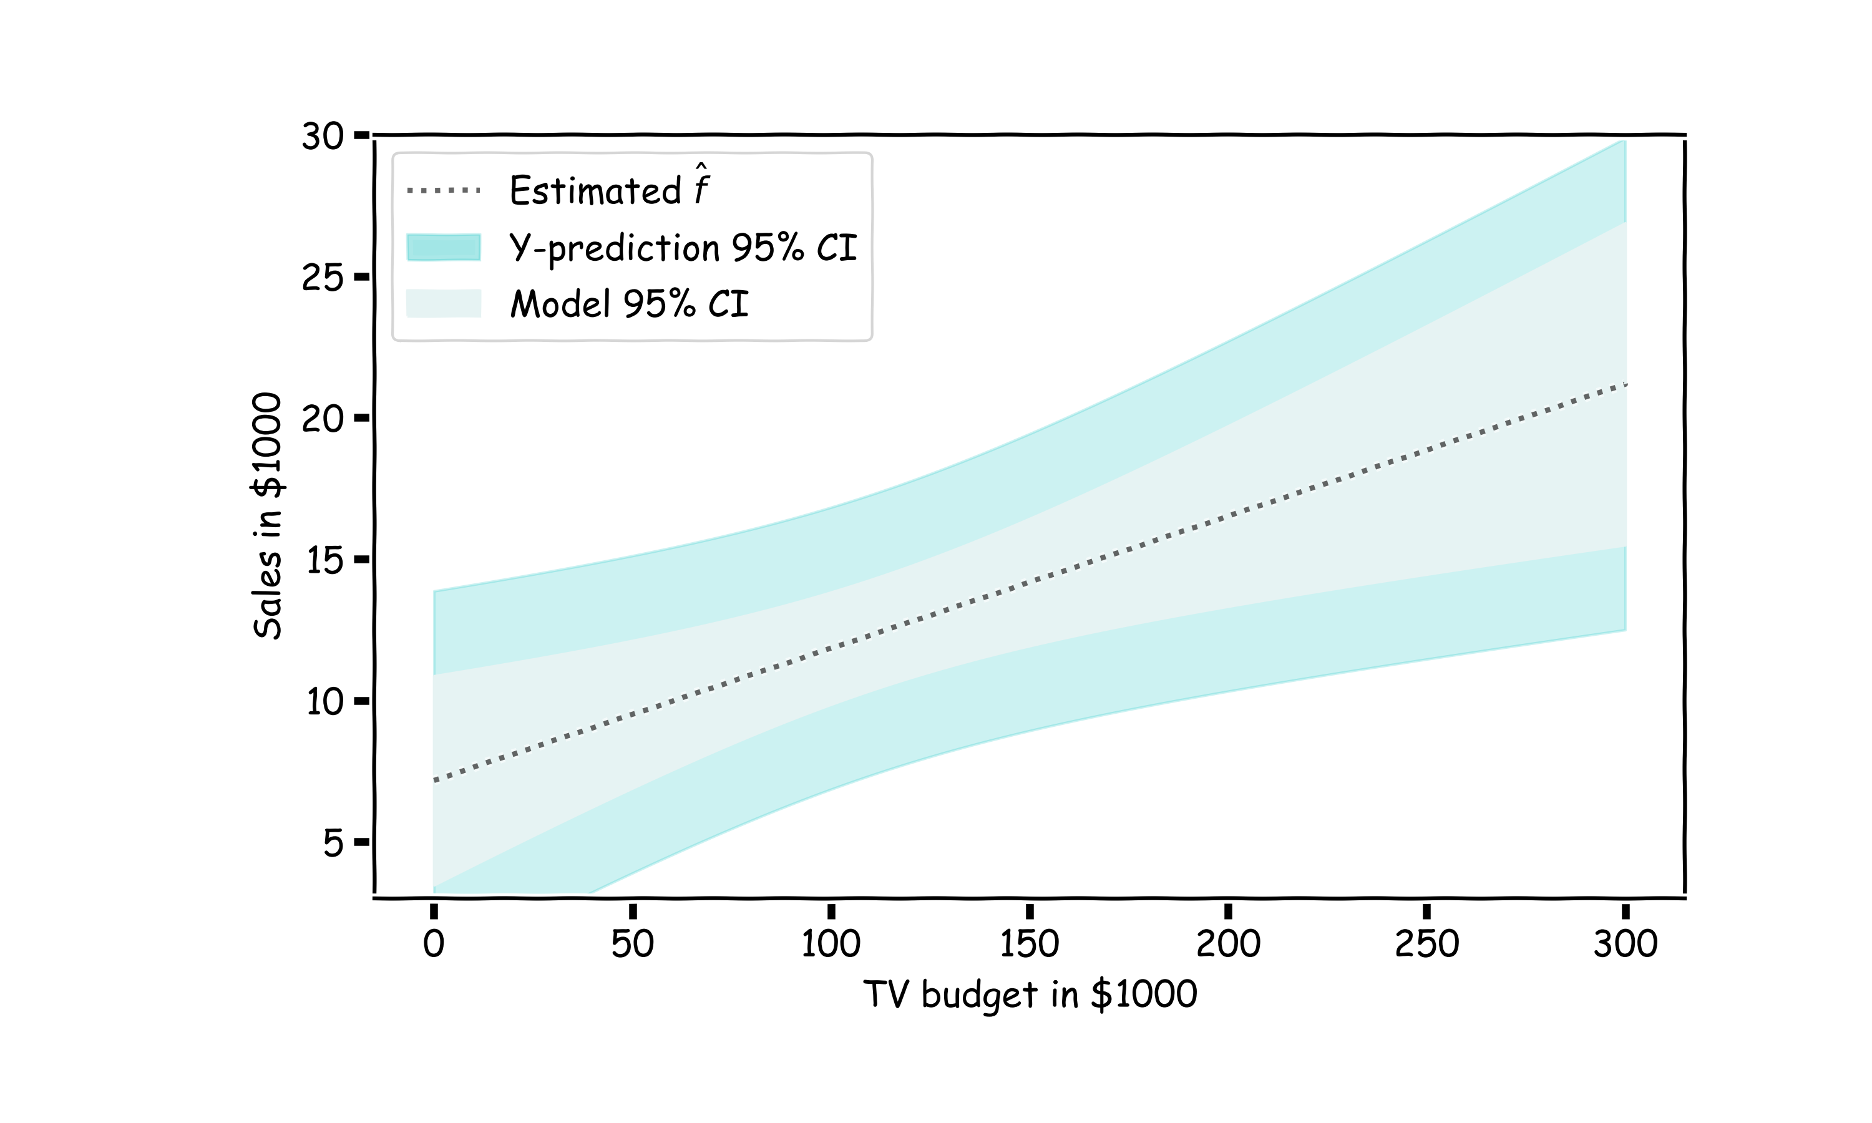
Confidence in predicting $\hat{y}$
for a given x, we have a distribution of models $f\left(x\right)$
for each of these $f\left(x\right),$the prediction for $y\sim N\left(f(x), σ_{ε}\right)$
The prediction confidence intervals are then …

