Slide 1
Bootstrapping and Confidence Intervals

Slide 2
Outline
Part A and B: Assessing the Accuracy of the Coefficient Estimates
Bootstrapping and confidence intervals
Part C: Evaluating Significance of Predictors
Does the outcome depend on the predictors?
Hypothesis testing
Part D: How well do we know $\hat{f}$
The confidence intervals of $\hat{f}$

Slide 3
Bootstrap
In the lack of active imagination, parallel universes and the likes, we need an alternative way of producing fake data set that resemble the parallel universes.
Bootstrapping is the practice of sampling from the observed data (X,Y) in estimating statistical properties.

Slide 4
Bootstrap
Imagine we have 5 billiard balls in a bucket.

Slide 5
Bootstrap
We first pick randomly a ball and replicate it. This is called sampling with replacement.
We move the replicated ball to another bucket.

Slide 6
Bootstrap

Slide 7
Bootstrap
We then randomly pick another ball and again we replicate it.
As before, we move the replicated ball to the other bucket.

Slide 8
Bootstrap

Slide 9
Bootstrap
We repeat this process.
Notes:
Fix this with true replacement

Slide 10
Bootstrap
Again

Slide 11
Bootstrap
And again

Slide 12
Bootstrap
We continue until the “other” bucket has the same number of balls as the original one.
This new bucket represents a new parallel universe

Slide 13
Bootstrap
We repeat the same process and acquire another sample.

Slide 14
Bootstrap
We repeat the same process and acquire another sample.

Slide 15
Bootstrap
Sample 1
Size N
Size N
Sample 2
Sample with replacement
Size N
Dataset
Sample 3
14
Size N
14
14

Slide 16
Bootstrapping for Estimating Sampling Error
Definition
Bootstrapping is the practice of estimating properties of an estimator by measuring those properties by, for example, sampling from the observed data.
For example, we can compute ${\hat{β}}_{0}$ and ${\hat{β}}_{1}$multiple times by randomly sampling from our data set. We then use the variance of our multiple estimates to approximate the true variance of ${\hat{β}}_{0}$ and ${\hat{β}}_{1}$.

Slide 17
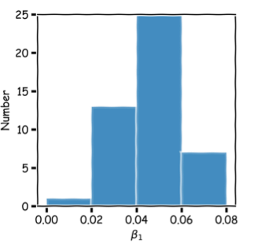
Bootstrap
train
Model 1:
$\hat{y}={\hat{β}}_{0}^{(1)}+{\hat{β}}_{1}^{(1)}x$
Size N
$$μ_{\hat{β}}= \frac{1}{s}\sum_{i=1}^{s}{{\hat{β}}^{(i)}}$$
train
Model 2:
$\hat{y}={\hat{β}}_{0}^{(2)}+{\hat{β}}_{1}^{(2)}x$
Sample with replacement
$$σ_{\hat{β}}=\sqrt{\frac{1}{s}\sum_{i=1}^{s}{{\left({\hat{β}}^{\left(i\right)}−\overline{β}\right)}^{2}}}$$
Dataset
train
Model s:
$\hat{y}={\hat{β}}_{0}^{(s)}+{\hat{β}}_{1}^{(s)}x$
16
16
16

Slide 18
Confidence intervals for the predictors estimates: Standard Errors
We can empirically estimate the standard deviations $σ_{\hat{β}}$ which are called the standard errors, $SE\left({\hat{β}}_{0}\right),SE\left({\hat{β}}_{1}\right)$ through bootstrapping.
Alternatively:
If we know the variance $σ_{ε}^{2}$ of the noise $ε$, we can compute $SE\left({\hat{β}}_{0}\right),SE\left({\hat{β}}_{1}\right)$ analytically using the formulae below (no need to bootstrap):
$$SE \left({\hat{β}}_{0}\right)=σ_{ε}\sqrt{\frac{1}{n}+\frac{{\overline{x}}^{2}}{\sum_{i}{{\left(x_{i}−\overline{x}\right)}^{2}}}}$$
Where $n$ is the number of observations
$\overline{x}$ is the mean value of the predictor.
$$SE \left({\hat{β}}_{1}\right)=\frac{σ_{ε}}{\sqrt{\sum_{i}{{\left(x_{i}−\overline{x}\right)}^{2}}}}$$
Notes:
If data set is small this approximation does not work

Slide 19
Standard Errors
$$SE \left({\hat{β}}_{0}\right)=σ_{ε}\sqrt{\frac{1}{n}+\frac{{\overline{x}}^{2}}{\sum_{i}{{\left(x_{i}−\overline{x}\right)}^{2}}}}$$
More data: $n↑$ and $\sum_{i}{({x_{i}−\overline{x})}^{2}}↑⟹SE↓$
Larger coverage: $var(x)$ or $\sum_{i}{({x_{i}−\overline{x})}^{2}}↑ ⟹$ $SE↓$
Better data: $σ_{ε}^{2}↓ ⇒SE↓$
$$SE \left({\hat{β}}_{1}\right)=\frac{σ(ε)}{\sqrt{\sum_{i}{{\left(x_{i}−\overline{x}\right)}^{2}}}}$$
$$σ\left(ε\right)=\sqrt{\sum{\frac{{\left(\hat{f}\left(x\right)−y_{i}\right)}^{2}}{n−2}}}$$
Better model: $(\hat{f}−y_{i}) ↓$ $⟹σ_{ε}↓ ⟹SE↓$
Question: What happens to the $\hat{β_{0}}$, $\hat{β_{1}}$ under these scenarios?

Slide 20
Standard Errors
In practice, we do not know the value of $σ_{ε}$ since we do not know the exact distribution of the noise $ε$.
However, if we make the following assumptions,
the errors $ε_{i}=y_{i}−{\hat{y}}_{i}$and $ε_{j}=y_{j}−{\hat{y}}_{j}$ are uncorrelated, for $i≠j$ ,
each $ε_{i}$ has a mean 0 and variance $σ_{ε}^{2}$,
then, we can empirically estimate $σ^{2}$, from the data and our regression line:
$$σ_{ε}=\sqrt{\frac{n∙MSE}{n−2}=} \sqrt{\sum{\frac{{\left(\hat{f}\left(x\right)−y_{i}\right)}^{2}}{n−2}}}$$
Remember:$y_{i}=f\left(x_{i}\right)+ε_{i}⟹ε_{i}=y_{i}−f(x_{i})$

Slide 21
Standard Errors
The following results are for the coefficients for TV advertising:
Method | $$SE\left({\hat{β}}_{1}\right)$$
Analytic Formula | 0.0061
Bootstrap | 0.0061
The coefficients for TV advertising but restricting the coverage of x are:
The coefficients for TV advertising but with added extra noise:
Method | $$SE\left({\hat{β}}_{1}\right)$$
Analytic Formula | 0.0068
Bootstrap | 0.0068
SE increase
Method | $$SE\left({\hat{β}}_{1}\right)$$
Analytic Formula | 0.028
Bootstrap | 0.023
SE increase

Slide 22
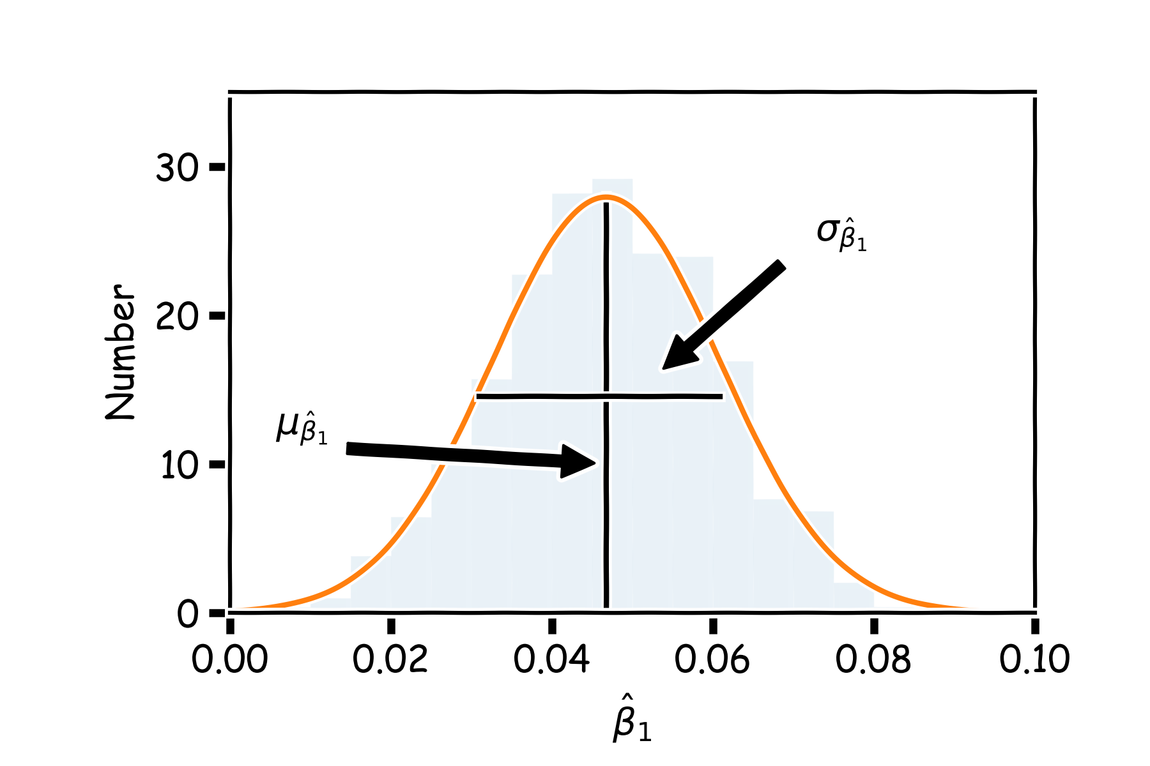
Confidence intervals for the predictors estimates (cont)
We can now estimate the mean and standard deviation of the estimates of ${{\hat{β}}_{0}, \hat{β}}_{1}$.
2

Slide 23
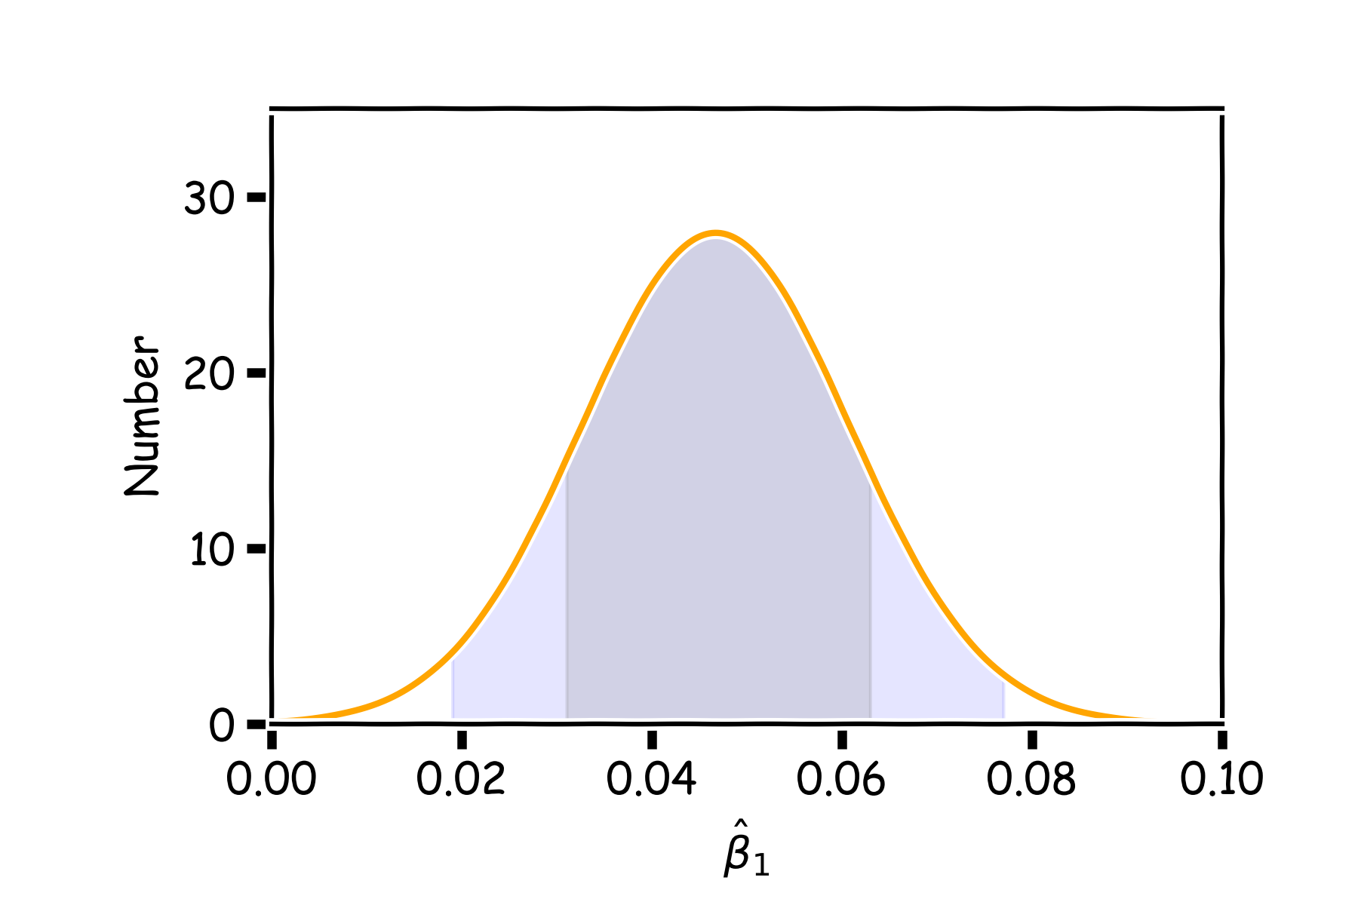
Confidence intervals for the predictors estimates (cont)
The standard errors give us a sense of our uncertainty over our estimates.
Typically we express this uncertainty as a 95% confidence interval, which is the range of values such that the true value of $β_{1}$is contained in this interval with 95% percent probability.
95%
68%
$$CI_{\hat{β}}=(\hat{β}−2σ_{\hat{β}},\hat{β}+2σ_{\hat{β}})$$

