Slide 1
Lecture 18: Autoencoders

Slide 2
Original LeCun cake analogy slide presented at NIPS 2016, the highlighted area has now been updated.

Slide 3
LeCun updated his cake recipe last week at the 2019 International Solid-State Circuits Conference (ISSCC) in San Francisco, replacing “unsupervised learning” with “self-supervised learning,” a variant of unsupervised learning where the data provides the supervision.

Slide 4
Outline
Quick review of representation learning
Brief history of encoding/decoding
Autoencoder Variations:
Convolutional Autoencoders
Denoising Autoencoders
Sparse Autoencoders

Slide 5
Quick Review. Neural Networks as function approximation.
Given an input x and an output y there exists a mapping from input space to output space as follows:
$$x→y \\ y=f\left(x\right)+ε$$
Our goal is to find an estimate of f(x) which we will call $\hat{f}(x)$.
Statistical learning or modeling is the process of finding $\hat{f}(x)$.
Neural networks are one of many possible methods we can use to obtain the estimate $\hat{f}(x)$.

Slide 6
Representational Learning
Representation Matters
$$x$$
$$\hat{y}$$
Linear
Regression
$$y=x^{2}$$
$$y$$
$$y$$
$$x$$
$$x$$

Slide 7
Representational Learning
Representation Matters
$$x_{1},x_{2}$$
Logistic
Regression
$$\hat{y}$$
$$x_{2}$$
Polynomial
$$x_{1}$$

Slide 8
Representational Learning
Representation Matters
Representation
Task
$$x$$
$$φ(x)$$
$$\hat{y}$$
Linear
Regression
$$y$$
$$y$$
$$φ(x)$$
$$=x^{2}$$
$$x^{2}$$
$$x$$

Slide 9
Representational Learning
Representation Matters
Representation
Task
$$x$$
$$φ(x)$$
$$\hat{y}$$
Logistic
Regression
$$x_{2}$$
$$φ$$
$$θ$$
$$x_{1}$$
$$θ$$
$$x_{2}$$
$$r$$
$$x_{1}$$
$$r$$

Slide 10
Representational Learning
Representation Matters
$$x$$
$$\hat{y}$$
Representation
Task

Slide 11
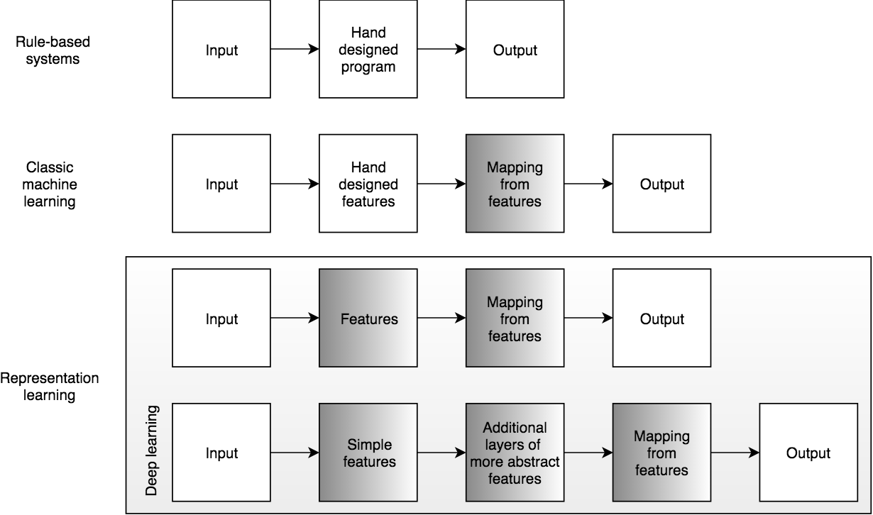
Representational Learning (cont)

Slide 12
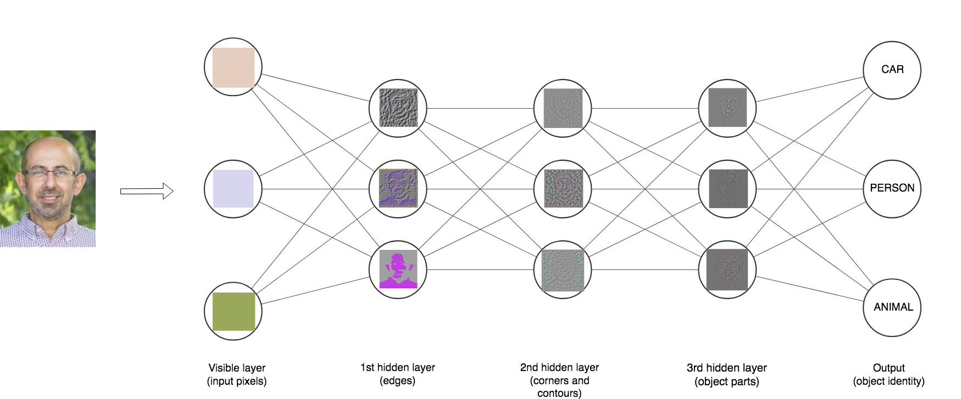
Representational Learning (cont)

Slide 13
Representational Learning: Supervised Learning
We train the two networks by minimizing the loss function (cross entropy loss)
x
{ Features }
{Cat,Dog,…}
Feature Discovery Network
Classification Network

Slide 14
Representational Learning: Self-supervised Learning
We train the two networks by minimizing the reconstruction loss function: $ℒ=∑{\left(x_{i}−{\hat{x}}_{i}\right)}^{2}$
x
$$\hat{x}$$
{ Features }
Feature Discovery Network
Second Network

Slide 15
Representational Learning: Self-supervised Learning
AUTOENCODER
x
$$\hat{x}$$
Latent Space
Z
ENCODER
DECODER
This is an autoencoder. It gets that name because it automatically finds the best way to encode the input so that the decoded version is as close as possible to the input.

Slide 16
Brief history of encoding/decoding
MP3 can compress music files by a factor of 10 enabling digital storage and transmission large volumes of audio.
JPG compresses images by a factor of 10-20 and enables storage and transmission of image data
These technologies led the way to the image-rich web and abundance of music that we enjoy today.

Slide 17
Brief history of encoding/decoding (cont)
We say that both MP3 and JPG take an input (a music or image file), and encode it into a compressed form.
Then we decode or decompress the intermediate version to some lower quality original version.

Slide 18
What are autoencoders?
A particular kind of learning architecture
A mechanism of compressing inputs into a form that can later be decompressed
Similar to the way MP3 compresses audio and JPG compresses images
Autoencoders are more general than either MP3 or JPG
They are usually used to …
reduce data dimensionality or find a better suited representation for another task
blend inputs from one input to another.
denoise, infill, etc.

Slide 19
Lossless and Lossy Encoding
The greater the difference between the original version and the version post-decompression the greater the loss.
For example imagine you are in Boston and you want to write a birthday text to a special friend.
HANNAH HAPPY BIRTHDAY I LOVE YOU DAN
In the freezing (-20C) Boston winter you do not want to have your hands out in the open, so you shorten the message as much as possible using text-speak:
H HBD ILY D
Your 36 characters message is compressed to 11 characters

Slide 20
Lossless and Lossy Encoding (cont)
HPD is unambiguous given that it is her birthday today, but D could mean Dan or David or Donny ... You can imagine the potential drama. (Is this an example lossy or lossless compression?)
A way to test if a transformation is lossy or lossless is to consider if it can be inverted, or run backwards, to provide us with the original data.

Slide 21
Autoencoder
We train the two networks by minimizing the reconstruction loss function: $ℒ=∑{\left(x_{i}−{\hat{x}}_{i}\right)}^{2}$
x
$$\hat{x}$$
Latent Space
Z
ENCODER
DECODER
This is an autoencoder. It gets that name because it automatically finds the best way to encode the input so that the decoded version is as close as possible to the input.

Slide 22
MP3 and JPG Image Compression
original
MP3
JPG
Original image 256x256=262,000, MP3=37,000, and JPG=26,000
Image taken from A. Glassner, Deep Learning, Vol. 2: From Basics to Practice

Slide 23
MP3 and JPG Image Compression(cont)
original
MP3
JPG
Image taken from A. Glassner, Deep Learning, Vol. 2: From Basics to Practice

Slide 24
The simplest autoencoder
Encode with a simple fully connected network (FCN)
20 neurons
20 numbers
Image 100x100
FCN with 20 neurons

Slide 25
The simplest autoencoder
Encode and decode
20 neurons
10K neurons
10000 numbers
Image 100x100
FCN: 20 neurons
FCN:10000 neurons

Slide 26
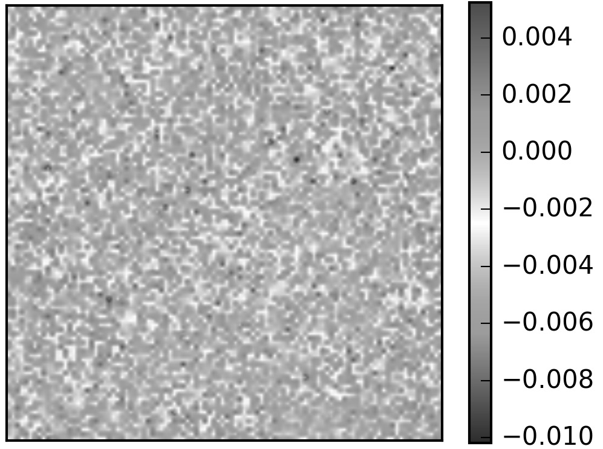
Autoencoders in action
Comparing the input and output pixel by pixel.

Slide 27
Bottleneck
We start with 10,000 elements
We have 20 in the middle
And 10,000 elements again at the end

Slide 28
Latent variables and latent layer
We say that an autoencoder is an example of semi-supervised or self-supervised learning.
It sort-of is supervised learning because we give the system explicit goal data (the output should be the same as the input), and it sort-of isn’t supervised learning because we don’t have any manually determined labels or targets on the inputs.

Slide 29
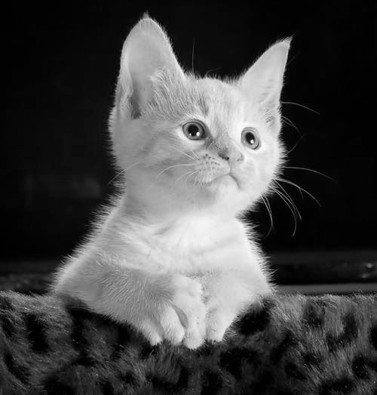
Autoencoders in action (cont)
20 neurons
10K neurons

Slide 30
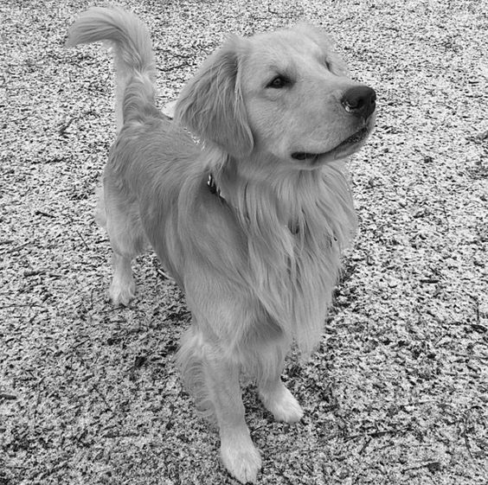
Autoencoders in action (cont)
20 neurons
10K neurons

Slide 31
Autoencoders in action (cont)
We must train with a variety of images.

Slide 32
Autoencoders in action (cont)
Testing it again
20 neurons
10K neurons

Slide 33
A Better autoencoder
20 neurons
784 neurons

Slide 34
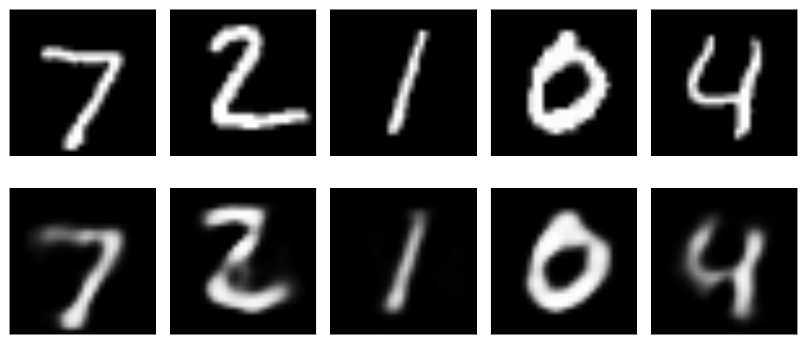
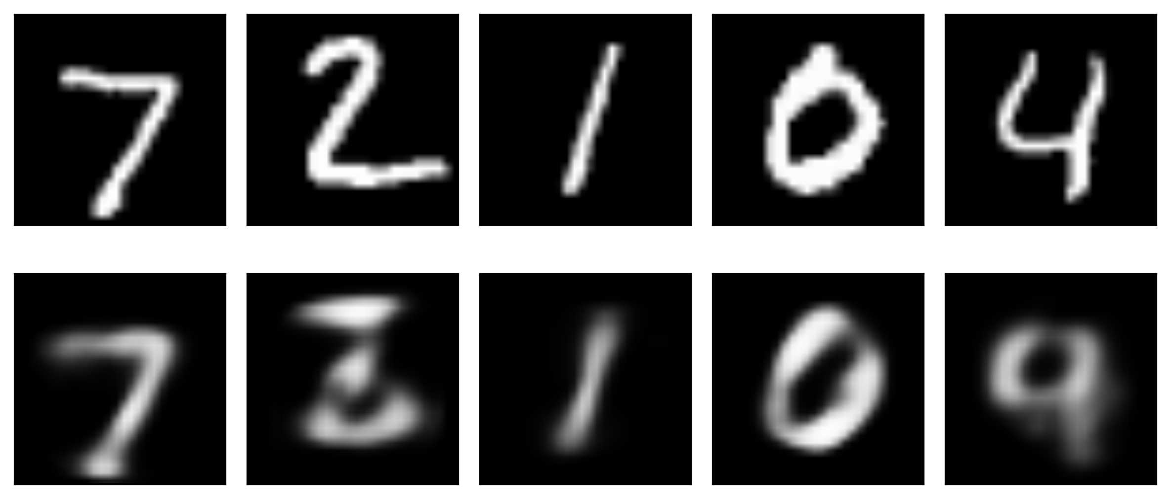
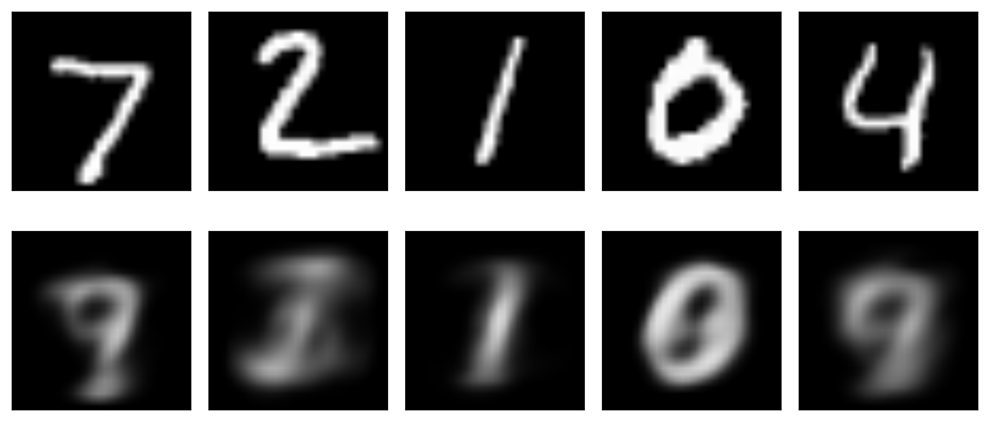
original
20 latent variables
reconstructed
original
10 latent variables
reconstructed
original
2 latent variables
reconstructed
Image taken from A. Glassner, Deep Learning, Vol. 2: From Basics to Practice

Slide 35
Deeper
512 neurons
256 neurons
20 neurons
256 neurons
512neurons
784 neurons
Shallow 20 latent variables

Slide 36
Exploring autoencoders

Slide 37
Exploring autoencoders (cont)
Change +/- 1 the latent variables

Slide 38
Exploring autoencoders (cont)
Change +/- 10 the latent variables

Slide 39
Exploring autoencoders (cont)
Change +/- 100 the first latent variables

Slide 40
Exploring autoencoders (cont)
Just noise

Slide 41
Parameter space of autoencoder

Slide 42
Blending
We blend inputs to create new data that is similar to the input data, but not exactly the same.
One example of blending is content blending where the content of two pieces of data is directly blended. An example is if we overlay images of a cow and zebra.
Image taken from A. Glassner, Deep Learning, Vol. 2: From Basics to Practice

Slide 43
Blending (cont)
Another type of blending is parametric or representation blending:
In this type of blending we take advantage of parameterization to describe the objects we’re interested in. By engaging in blending in the parameter space, we can create results that blend the inherent qualities of the objects of interest.

Slide 44
Blending (cont)
Image taken from A. Glassner, Deep Learning, Vol. 2: From Basics to Practice

Slide 45
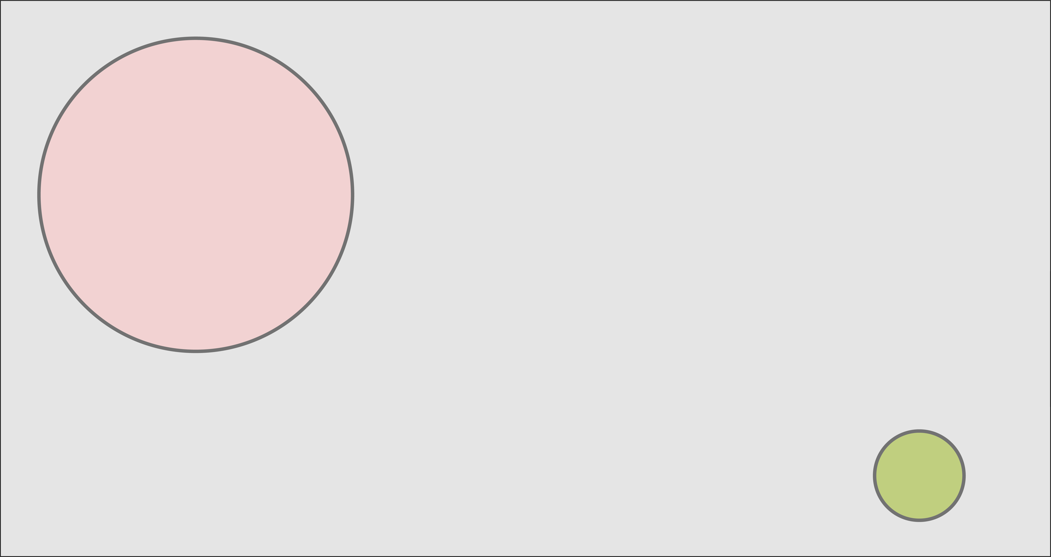
Content blending
Image taken from A. Glassner, Deep Learning, Vol. 2: From Basics to Practice

Slide 46
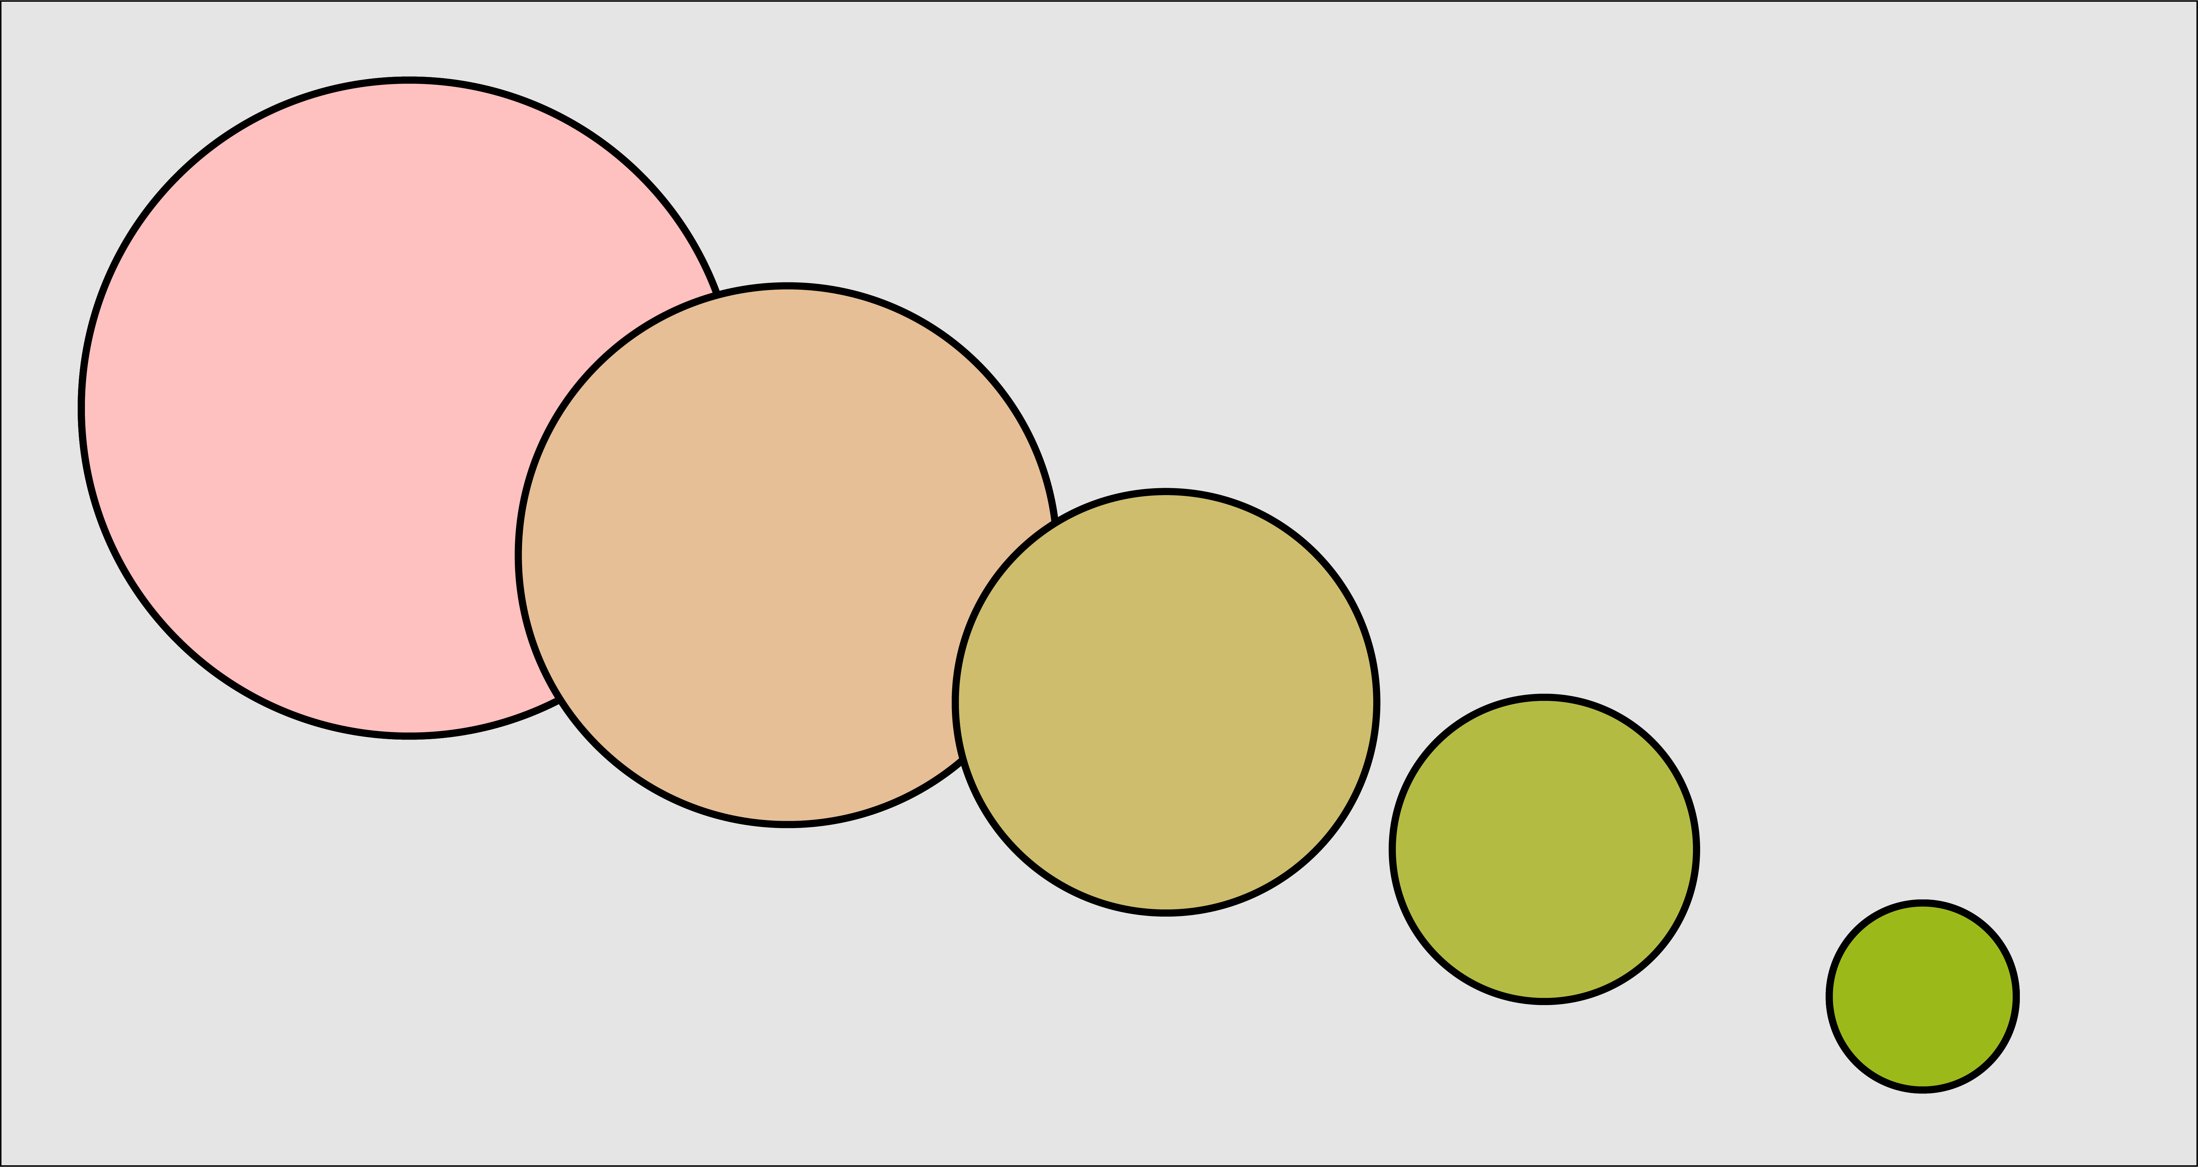
Parametric or representation blending
Image taken from A. Glassner, Deep Learning, Vol. 2: From Basics to Practice

Slide 47
Blending in compressed representation
While the blending we’ve described works well for uncompressed objects what happens when compression is involved?
The compressed form may not be the best representation with what we would like to blend the objects.
For example, let’s take the sounds of the words cherry and orange.
We can blend these sounds together or we can compress them into written words.
Image taken from A. Glassner, Deep Learning, Vol. 2: From Basics to Practice

Slide 49
Blending Latent Variables
Back to the example of MNIST

Slide 50
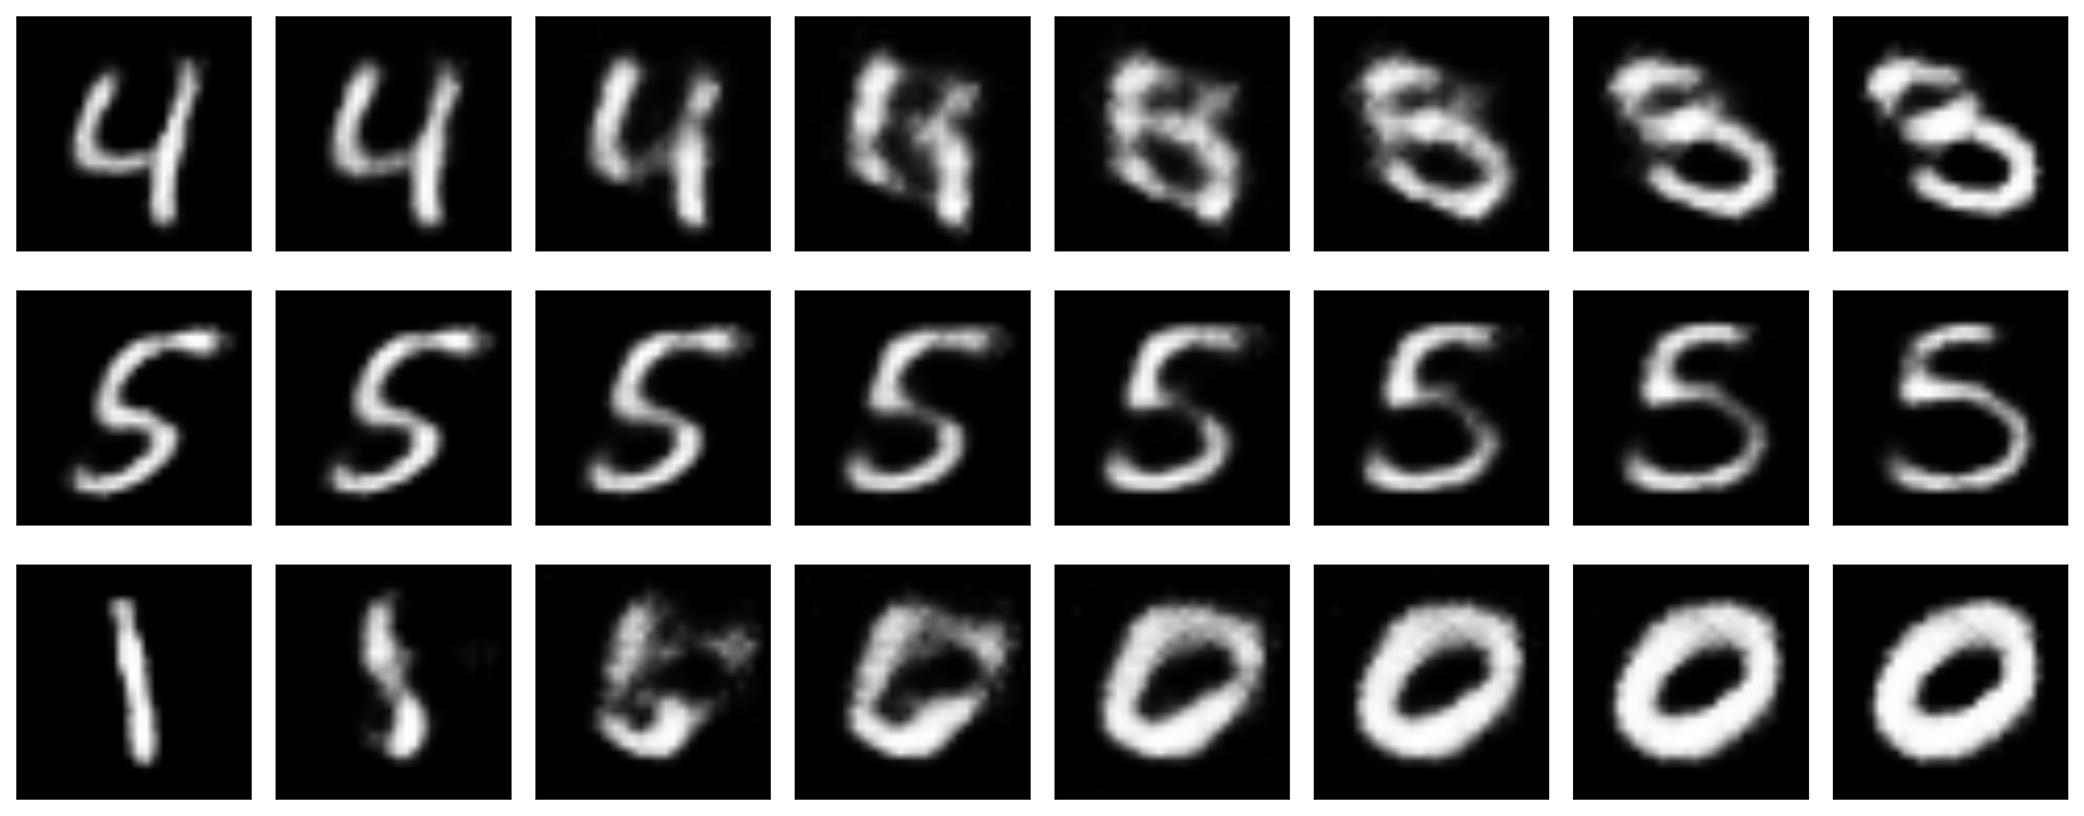
Blending Latent Variables (cont)

Slide 51
Applying to novel input
512 neurons
256 neurons
20 neurons
256 neurons
512neurons
784 neurons

Slide 52
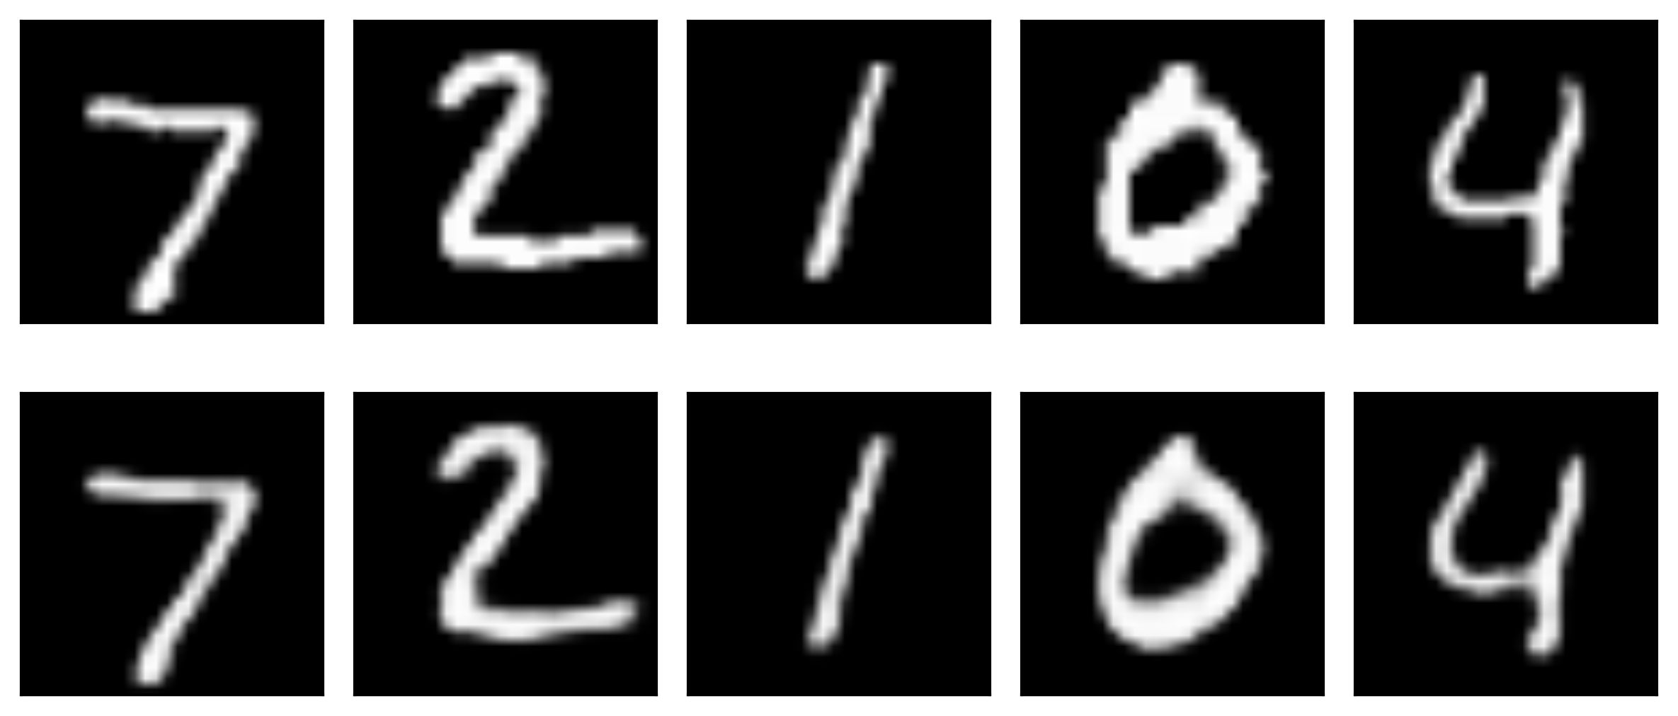
Convolutional Autoencoders

Slide 53
Denoising
A popular use of autoencoders is to remove noise from samples.

Slide 54
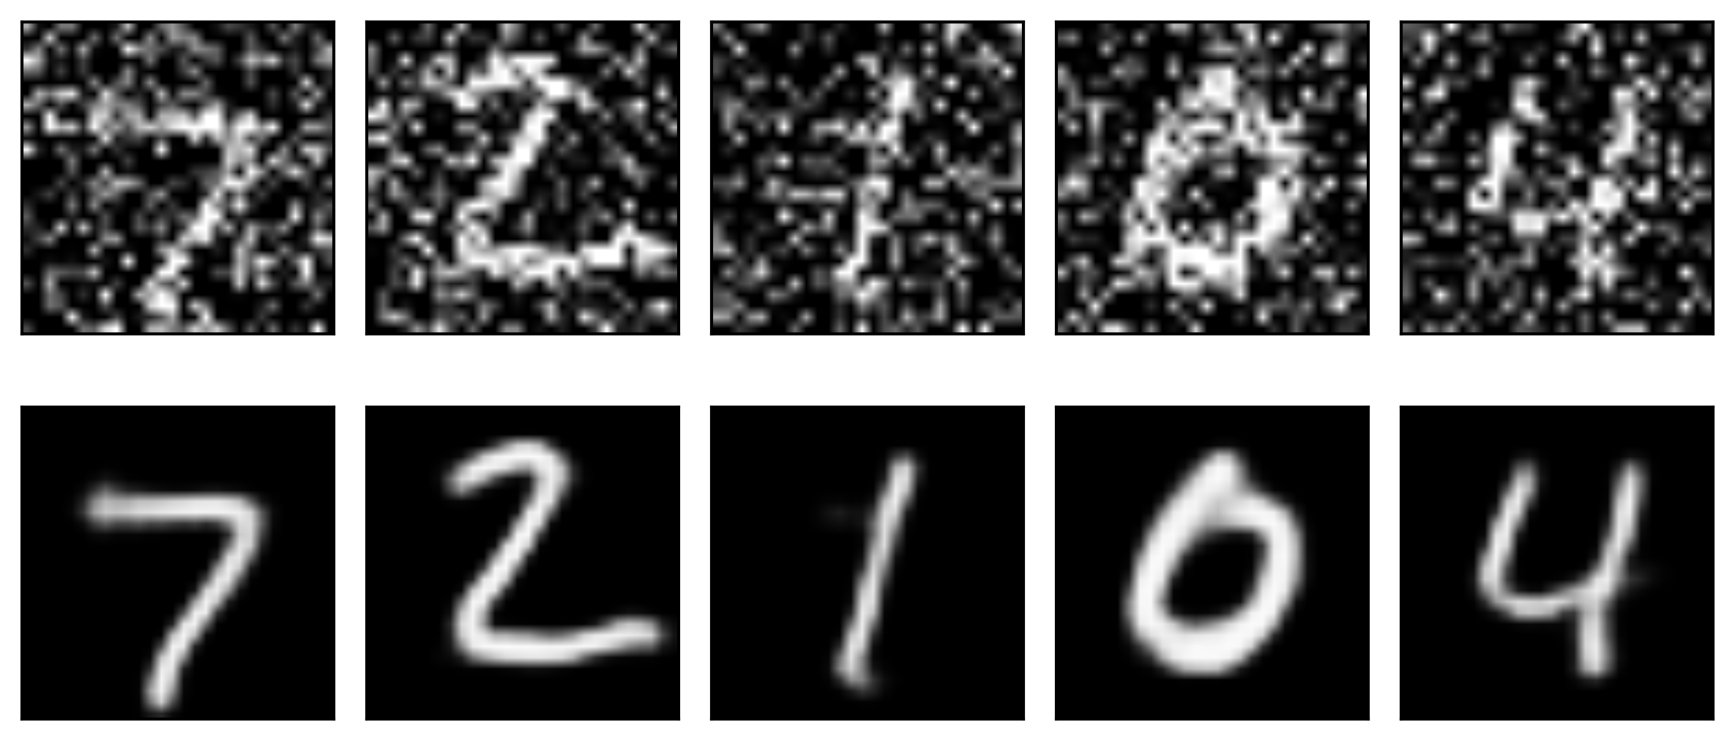
Denoising (cont)
Note that we start with a clean image, add noise and train our networks to return a clean decoded image.

Slide 55
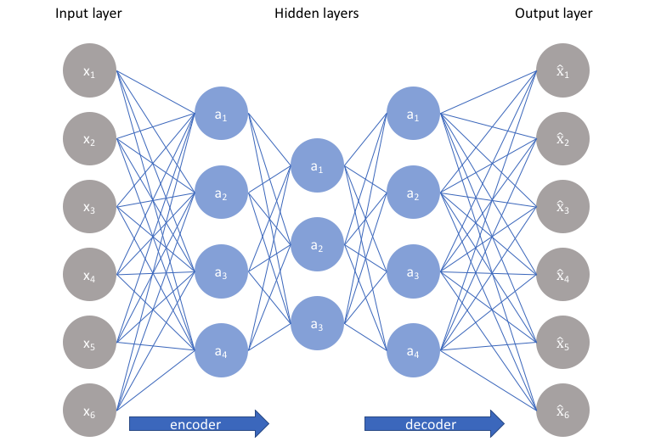
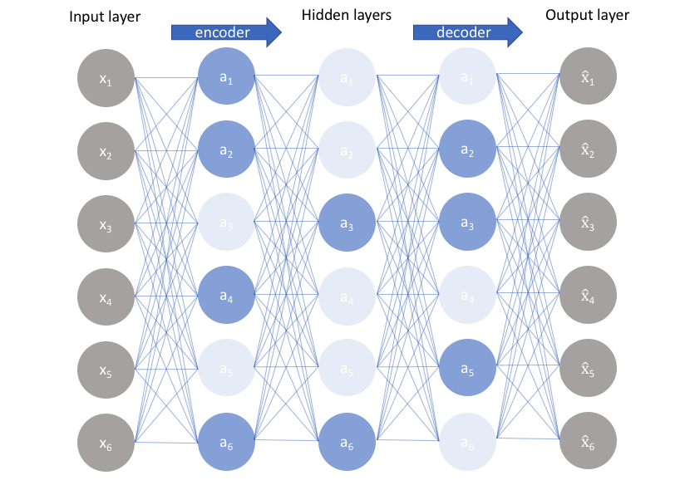
Sparse Autoencoder
We’ve assumed so far that the size of the bottleneck is smaller than the size of the inputs – this is called an undercomplete autoencoder
The case in which the size of the bottleneck is greater than or equal to the number of inputs we call an overcomplete autoencoder

Slide 56
Sparse Autoencoder (cont)
The size of the bottleneck (i.e. the number of latent variables) makes a difference!
original
20 latent variables
reconstructed
original
2 latent variables
reconstructed
56

Slide 57
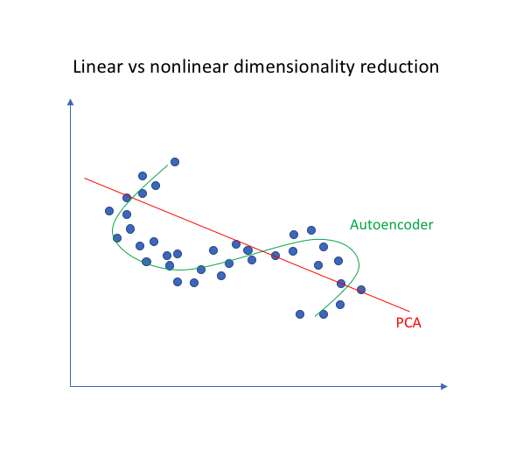
Undercomplete Autoencoders
z has lower dimension than x
Must discard some information in z
Learning involves minimizing loss:
L is the MSE:
$$L\left(x,g\left(f\left(x\right)\right)\right)=\sum_{i}{{\left(x_{i}−{\hat{x}}_{i}\right)}^{2}}$$
Equivalent to PCA when f is linear.

Slide 58
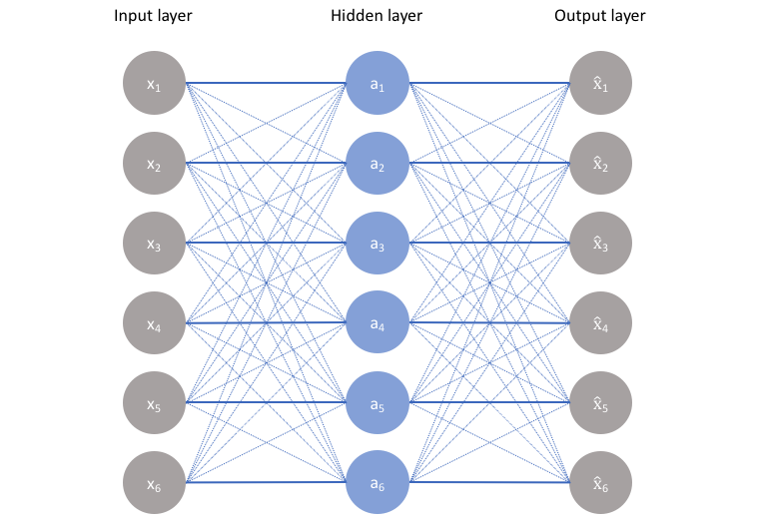
Overcomplete Autoencoders
z has greater dimension than x
Autoencoder may simply copy input to output without learning anything useful
The ideal autoencoder model balances the following:
Sensitive to the inputs enough to accurately build a reconstruction.
Insensitive enough to the inputs that the model doesn't simply memorize or overfit the training data.
.

Slide 59
Regularized Autoencoders
Sparse autoencoders
Denoising autoencoders
Autoencoders with dropout on z
Contractive autoencoders

Slide 60
Regularized Autoencoders (cont)
This trade-off requires the model to maintain only the variations in the data required to reconstruct the input without holding on to redundancies within the input.
Question: How to achieve this?
For most cases, this involves constructing a loss function where one term encourages our model to be sensitive to the inputs (ie. reconstruction loss $ℒ\left(x,\hat{x}\right)$ and a second term discourages memorization/overfitting (ie. an added regularizer).
$$ℒ\left(x,g\left(f\left(x\right)\right)\right)+Ω(z)$$
Regularization on output of encoder, not on network parameters

Slide 61
Sparse Autoencoders
We allow our network to sensitize individual hidden layer nodes toward specific attributes of the input data.
A sparse autoencoder is selectively activate regions of the network depending on the input data.
Limiting the network's capacity to memorize the input data without limiting the networks capability to extract features from the data.
$$ℒ\left(x, \hat{x}\right)+λ\sum_{i}{|z_{i}|}$$

Slide 62
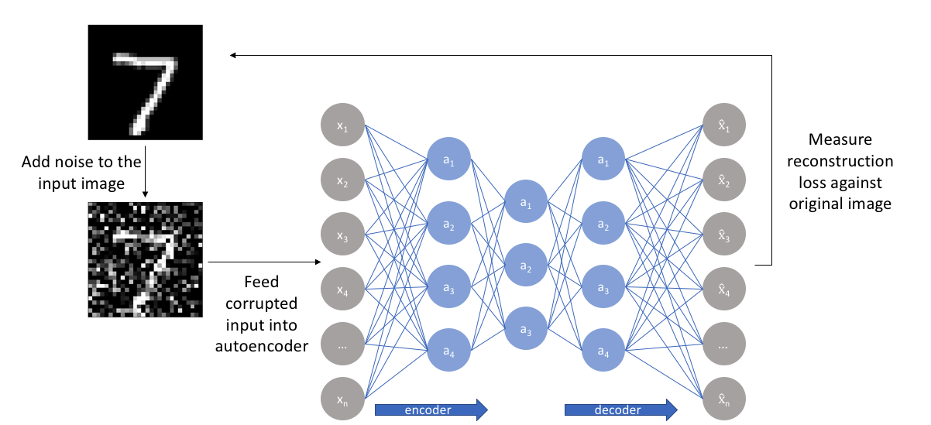
Denoising Autoencoders
Trained with corrupted data points, but to reconstruct original data points

Slide 63
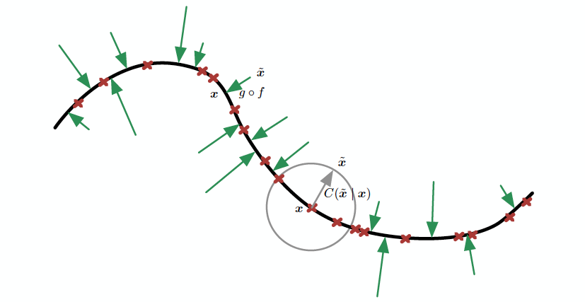
Denoising Autoencoders (cont)
Denoising autoencoders learn a manifold. Vector field learned by denoising autoencoder. Each arrow is proportional to g(f(x)) – x

Slide 64
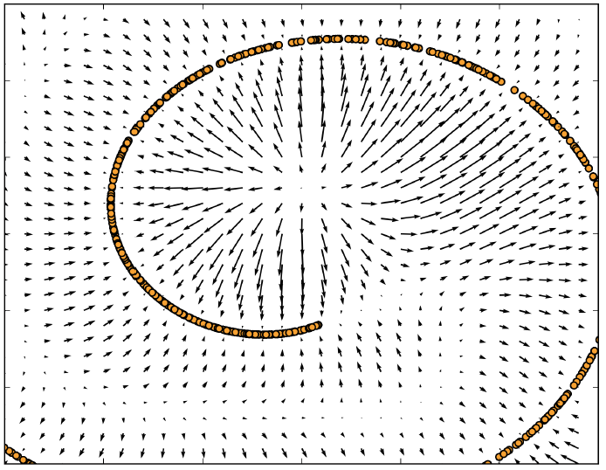
Denoising Autoencoders (cont)
Vector field learned by denoising autoencoder. Each arrow is proportional to g(f(x)) – x

Slide 65
Contractive Autoencoders
One would expect that for very similar inputs, the learned encoding would also be very similar.
We can explicitly train our model in order for this to be the case by requiring that the derivative of the hidden layer activations are small with respect to the input.
Question: How do we find how much the encoded space would change if the input changes?
Derivatives

Slide 66
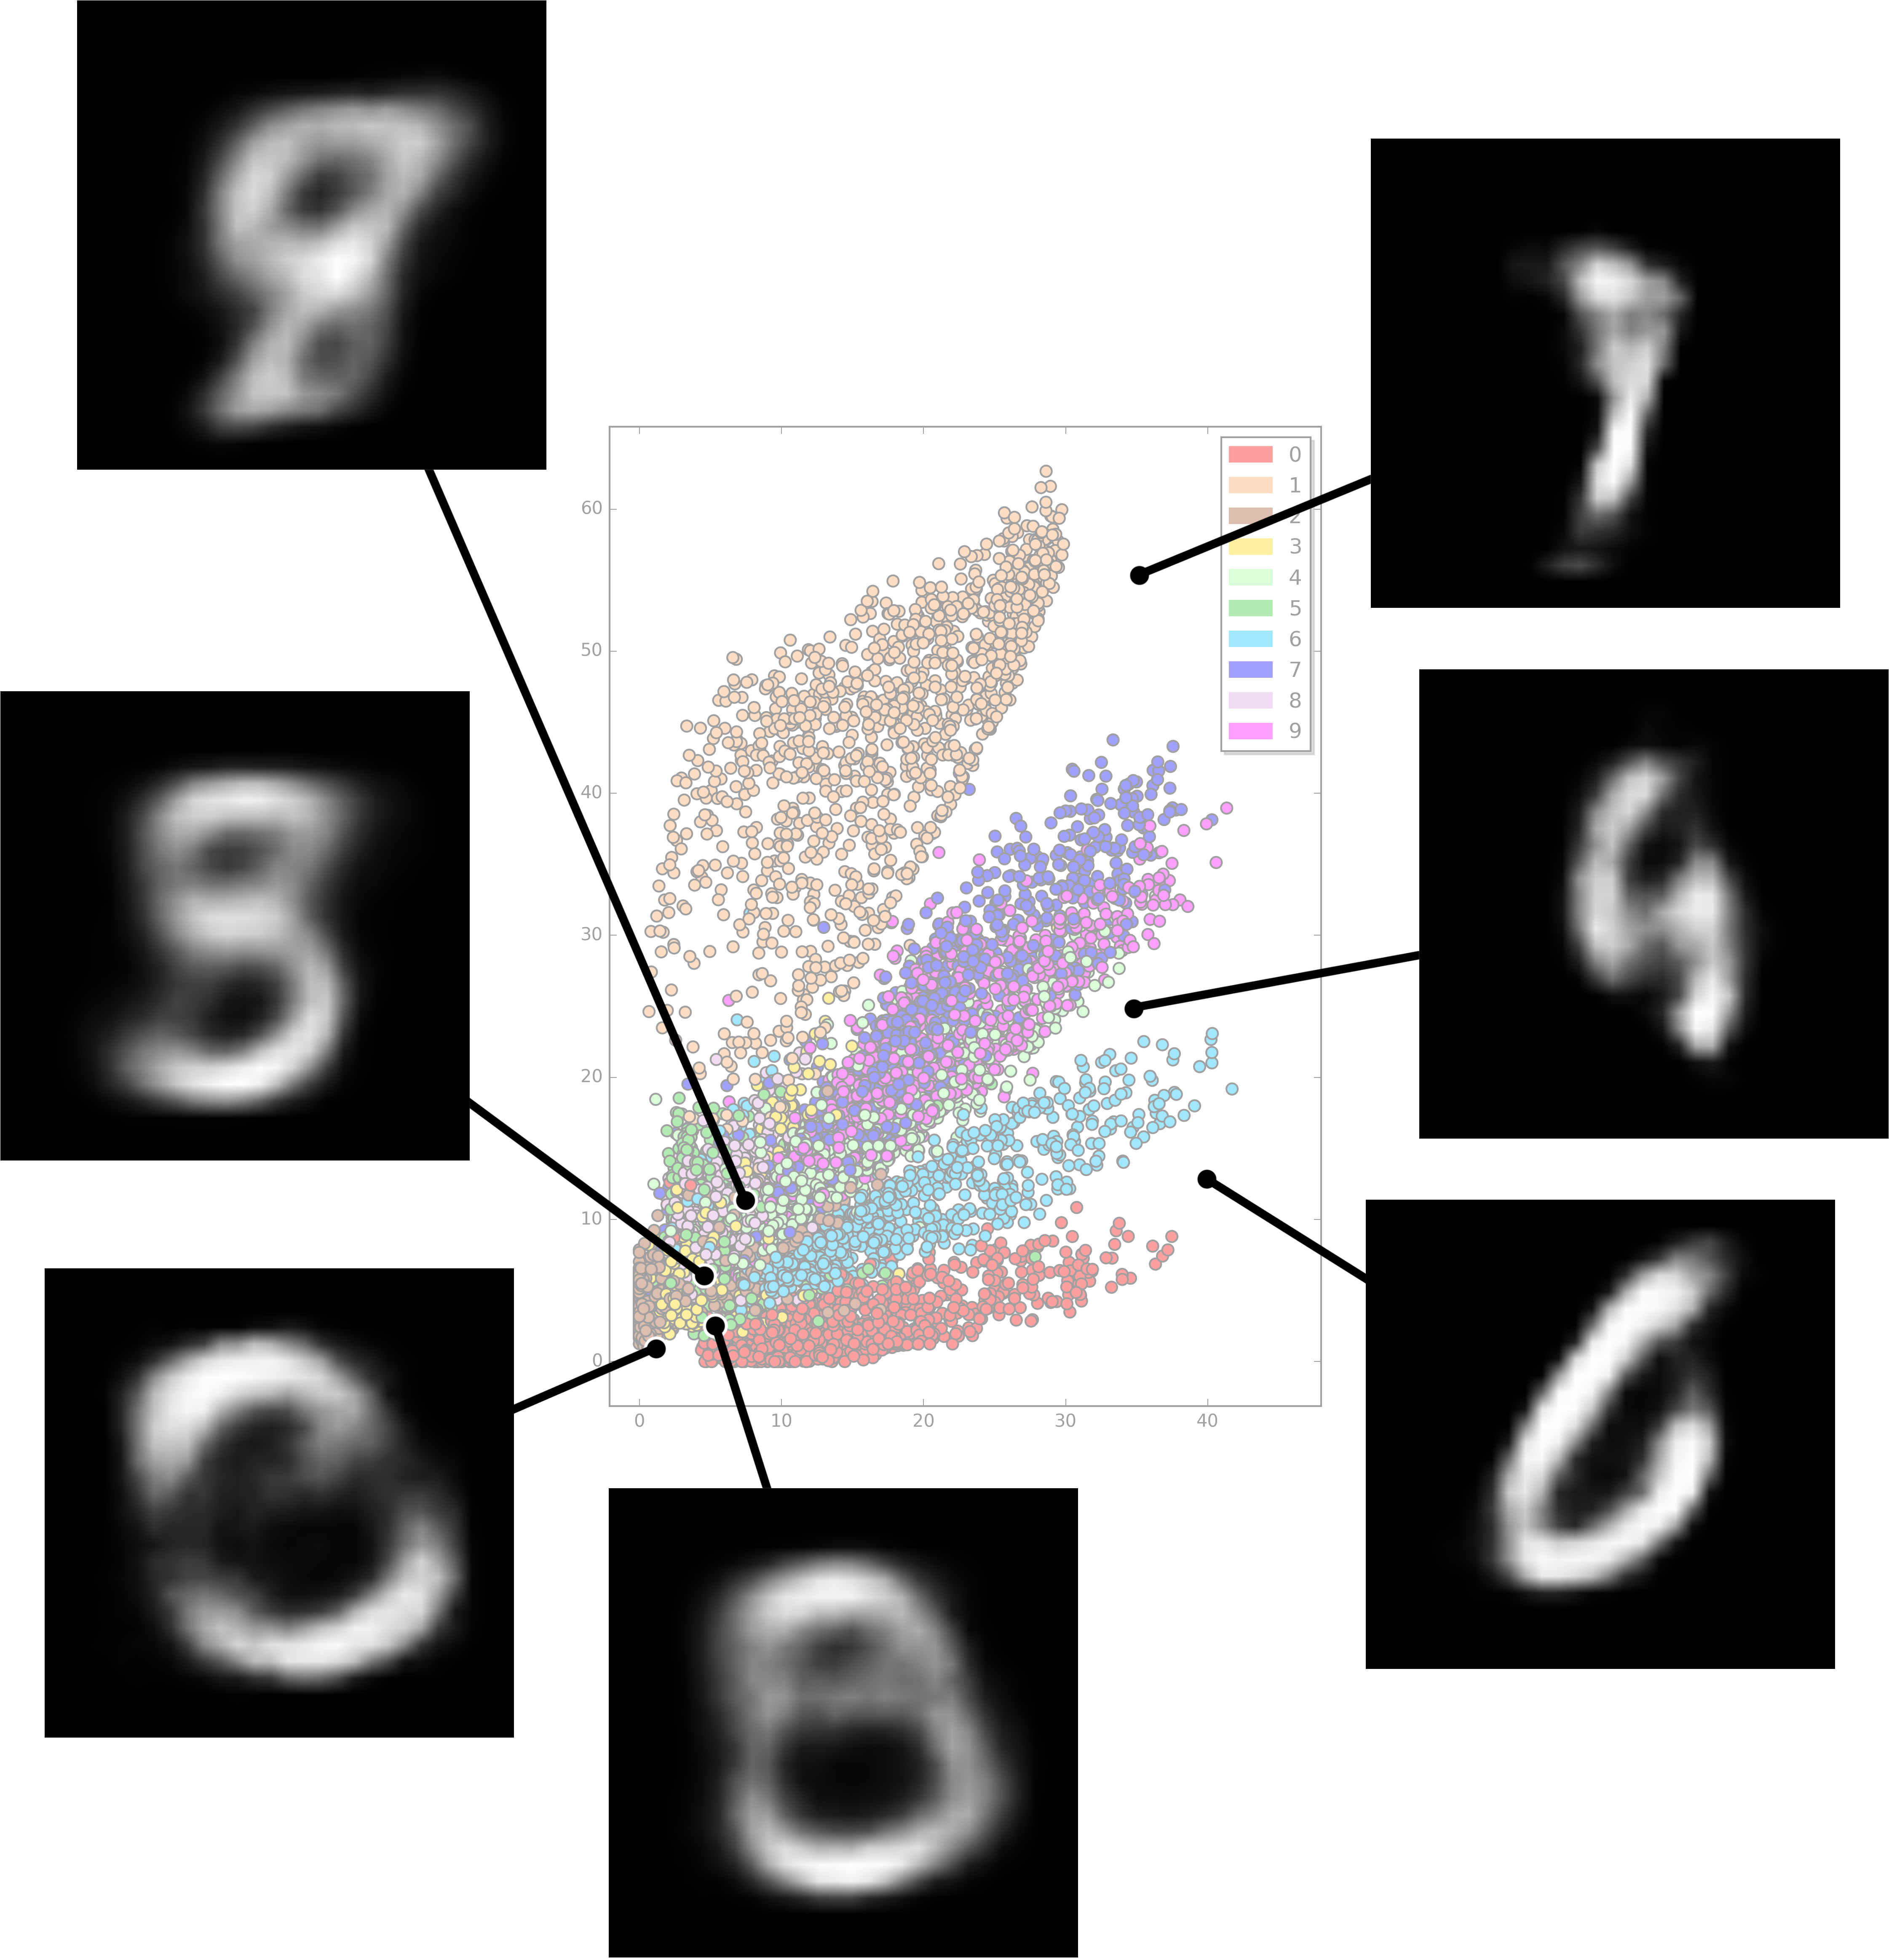
Problems with Autoencoders
Gaps in the latent space
Separability in the latent space
Discrete latent space

