Slide 1
Lecture 9: Convolutional Neural Networks 2

Slide 2
Outline
Review from last lecture
BackProp of MaxPooling layer
A bit of history
Layers Receptive Field
Saliency maps
Transfer Learning
CNN for text analysis (example)

Slide 3
Outline
Review from last lecture
BackProp of MaxPooling layer
A bit of history
Layers Receptive Field
Saliency maps
Transfer Learning
CNN for text analysis (example)

Slide 4
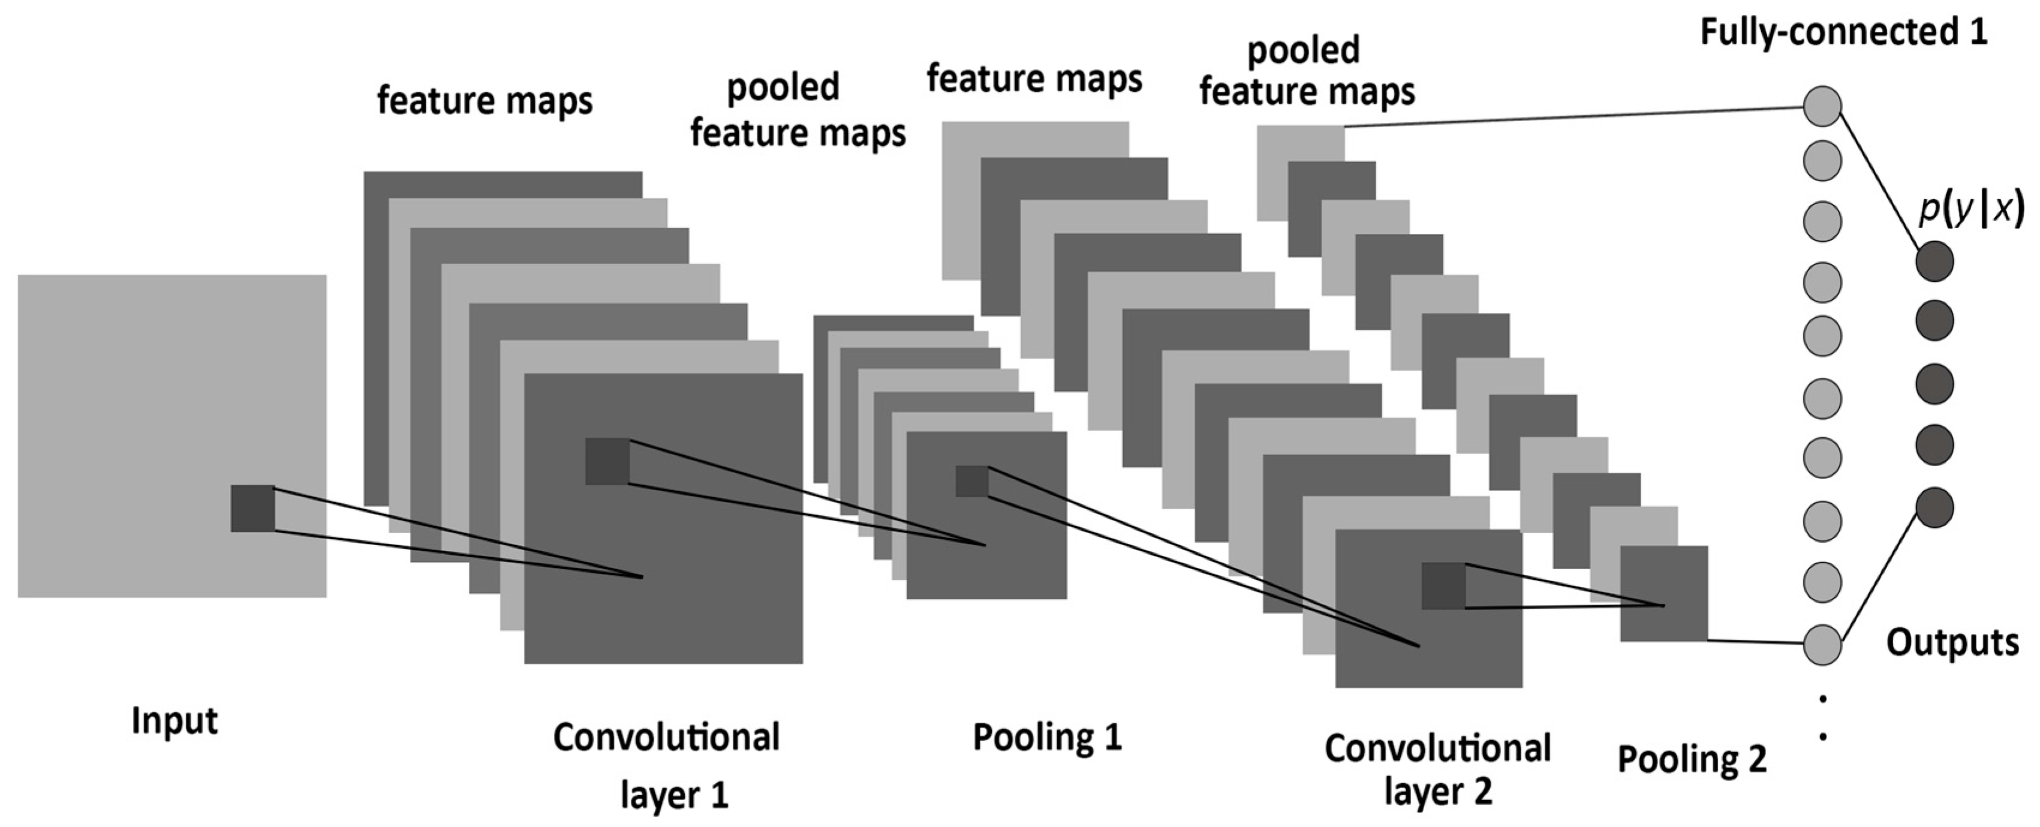
From last lecture
+ ReLU
+ ReLU

Slide 5
Examples
I have a convolutional layer with 16 3x3 filters that takes an RGB image as input.
What else can we define about this layer?
Activation function
Stride
Padding type
How many parameters does the layer have?
16 x 3 x 3 x 3 + 16 = 448
Number of filters
Size of Filters
Number of channels of prev layer
Biases (one per filter)

Slide 6
Examples
Let C be a CNN with the following disposition:
Input: 32x32x3 images
Conv1: 8 3x3 filters, stride 1, padding=same
Conv2: 16 5x5 filters, stride 2, padding=same
Flatten layer
Dense1: 512 nodes
Dense2: 4 nodes
How many parameters does this network have?
(8 x 3 x 3 x 3 + 8) + (16 x 5 x 5 x 8 + 16) + (16 x 16 x 16 x 512 + 512) + (512 x 4 + 4)
Conv1
Conv2
Dense1
Dense2

Slide 7
What do CNN layers learn?
Each CNN layer learns filters of increasing complexity.
The first layers learn basic feature detection filters: edges, corners, etc.
The middle layers learn filters that detect parts of objects. For faces, they might learn to respond to eyes, noses, etc.
The last layers have higher representations: they learn to recognize full objects, in different shapes and positions.

Slide 8
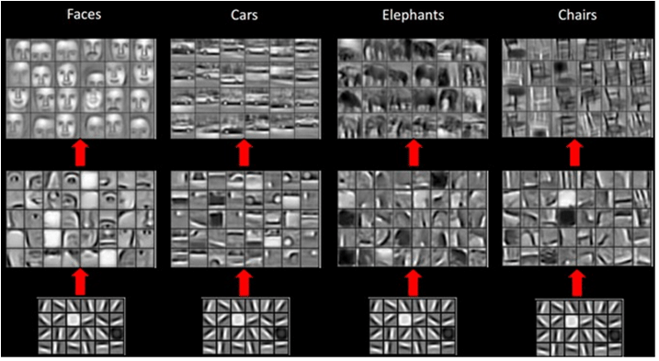

Slide 9
3D visualization of networks in action
http://scs.ryerson.ca/~aharley/vis/conv/
https://www.youtube.com/watch?v=3JQ3hYko51Y

Slide 10
Outline
Review from last lecture
BackProp of MaxPooling layer
A bit of history
Layers Receptive Field
Saliency maps
Transfer Learning
CNN for text analysis (example)

Slide 11
Backward propagation of Maximum Pooling Layer
Forward mode, 3x3 stride 1
2 | 4 | 8 | 3 | 6
9 | 3 | 4 | 2 | 5
5 | 4 | 6 | 3 | 1
2 | 3 | 1 | 3 | 4
2 | 7 | 4 | 5 | 7

Slide 12
Backward propagation of Maximum Pooling Layer
Forward mode, 3x3 stride 1
2 | 4 | 8 | 3 | 6
9 | 3 | 4 | 2 | 5
5 | 4 | 6 | 3 | 1
2 | 3 | 1 | 3 | 4
2 | 7 | 4 | 5 | 7
9

Slide 13
Backward propagation of Maximum Pooling Layer
Forward mode, 3x3 stride 1
2 | 4 | 8 | 3 | 6
9 | 3 | 4 | 2 | 5
5 | 4 | 6 | 3 | 1
2 | 3 | 1 | 3 | 4
2 | 7 | 4 | 5 | 7
9 | 8

Slide 14
Backward propagation of Maximum Pooling Layer
Forward mode, 3x3 stride 1
2 | 4 | 8 | 3 | 6
9 | 3 | 4 | 2 | 5
5 | 4 | 6 | 3 | 1
2 | 3 | 1 | 3 | 4
2 | 7 | 4 | 5 | 7
9 | 8 | 8

Slide 15
Backward propagation of Maximum Pooling Layer
Forward mode, 3x3 stride 1
2 | 4 | 8 | 3 | 6
9 | 3 | 4 | 2 | 5
5 | 4 | 6 | 3 | 1
2 | 3 | 1 | 3 | 4
2 | 7 | 4 | 5 | 7
9 | 8 | 8
9 | 6 | 6
7 | 7 | 7

Slide 16
Backward propagation of Maximum Pooling Layer
Backward mode. Large fonts represents the values of the derivatives of the current layer (max-pool) and small font the corresponding value of the previous layer.
2 | 4 | 8 | 3 | 6
9 | 3 | 4 | 2 | 5
5 | 4 | 6 | 3 | 1
2 | 3 | 1 | 3 | 4
2 | 7 | 4 | 5 | 7
1 ₉ | 3 ₈ | 1 ₈
1 ₉ | 4 ₆ | 2 ₆
6 ₇ | 2 ₇ | 1 ₇

Slide 17
Backward propagation of Maximum Pooling Layer
Backward mode. Large fonts represents the values of the derivatives of the current layer (max-pool) and small font the corresponding value of the previous layer.
2 | 4 | 8 | 3 | 6
9 | 3 | 4 | 2 | 5
5 | 4 | 6 | 3 | 1
2 | 3 | 1 | 3 | 4
2 | 7 | 4 | 5 | 7
1 ₉ | 3 ₈ | 1 ₈
1 ₉ | 4 ₆ | 2 ₆
6 ₇ | 2 ₇ | 1 ₇

Slide 18
Backward propagation of Maximum Pooling Layer
Backward mode. Large fonts represents the values of the derivatives of the current layer (max-pool) and small font the corresponding value of the previous layer.
2 | 4 | 8 | 3 | 6
9 | 3 | 4 | 2 | 5
5 | 4 | 6 | 3 | 1
2 | 3 | 1 | 3 | 4
2 | 7 | 4 | 5 | 7
1 ₉ | 3 ₈ | 1 ₈
1 ₉ | 4 ₆ | 2 ₆
6 ₇ | 2 ₇ | 1 ₇

Slide 19
Backward propagation of Maximum Pooling Layer
Backward mode. Large fonts represents the values of the derivatives of the current layer (max-pool) and small font the corresponding value of the previous layer.
2 | 4 | 8 | 3 | 6
9 | 3 | 4 | 2 | 5
5 | 4 | 6 | 3 | 1
2 | 3 | 1 | 3 | 4
2 | 7 | 4 | 5 | 7
+1
1 ₉ | 3 ₈ | 1 ₈
1 ₉ | 4 ₆ | 2 ₆
6 ₇ | 2 ₇ | 1 ₇

Slide 20
Backward propagation of Maximum Pooling Layer
Backward mode. Large fonts represents the values of the derivatives of the current layer (max-pool) and small font the corresponding value of the previous layer.
2 | 4 | 8 | 3 | 6
9 | 3 | 4 | 2 | 5
5 | 4 | 6 | 3 | 1
2 | 3 | 1 | 3 | 4
2 | 7 | 4 | 5 | 7
+1
1 ₉ | 3 ₈ | 1 ₈
1 ₉ | 4 ₆ | 2 ₆
6 ₇ | 2 ₇ | 1 ₇

Slide 21
Backward propagation of Maximum Pooling Layer
Backward mode. Large fonts represents the values of the derivatives of the current layer (max-pool) and small font the corresponding value of the previous layer.
+3
2 | 4 | 8 | 3 | 6
9 | 3 | 4 | 2 | 5
5 | 4 | 6 | 3 | 1
2 | 3 | 1 | 3 | 4
2 | 7 | 4 | 5 | 7
+1
1 ₉ | 3 ₈ | 1 ₈
1 ₉ | 4 ₆ | 2 ₆
6 ₇ | 2 ₇ | 1 ₇

Slide 22
Backward propagation of Maximum Pooling Layer
Backward mode. Large fonts represents the values of the derivatives of the current layer (max-pool) and small font the corresponding value of the previous layer.
+3
2 | 4 | 8 | 3 | 6
9 | 3 | 4 | 2 | 5
5 | 4 | 6 | 3 | 1
2 | 3 | 1 | 3 | 4
2 | 7 | 4 | 5 | 7
+1
1 ₉ | 3 ₈ | 1 ₈
1 ₉ | 4 ₆ | 2 ₆
6 ₇ | 2 ₇ | 1 ₇

Slide 23
Backward propagation of Maximum Pooling Layer
Backward mode. Large fonts represents the values of the derivatives of the current layer (max-pool) and small font the corresponding value of the previous layer.
+3
2 | 4 | 8 | 3 | 6
9 | 3 | 4 | 2 | 5
5 | 4 | 6 | 3 | 1
2 | 3 | 1 | 3 | 4
2 | 7 | 4 | 5 | 7
+1
1 ₉ | 3 ₈ | 1 ₈
1 ₉ | 4 ₆ | 2 ₆
6 ₇ | 2 ₇ | 1 ₇

Slide 24
Backward propagation of Maximum Pooling Layer
Backward mode. Large fonts represents the values of the derivatives of the current layer (max-pool) and small font the corresponding value of the previous layer.
+4
2 | 4 | 8 | 3 | 6
9 | 3 | 4 | 2 | 5
5 | 4 | 6 | 3 | 1
2 | 3 | 1 | 3 | 4
2 | 7 | 4 | 5 | 7
+1
1 ₉ | 3 ₈ | 1 ₈
1 ₉ | 4 ₆ | 2 ₆
6 ₇ | 2 ₇ | 1 ₇

Slide 25
Outline
Review from last lecture
BackProp of MaxPooling layer
A bit of history
Layers Receptive Field
Saliency maps
Transfer Learning
CNN for text analysis (example)

Slide 26
Initial ideas
The first piece of research proposing something similar to a Convolutional Neural Network was authored by Kunihiko Fukushima in 1980, and was called the NeoCognitron¹.
Inspired by discoveries on visual cortex of mammals.
Fukushima applied the NeoCognitron to hand-written character recognition.
End of the 80’s: several papers advanced the field
Backpropagation published in French by Yann LeCun in 1985 (independently discovered by other researchers as well)
TDNN by Waiber et al., 1989 - Convolutional-like network trained with backprop.
Backpropagation applied to handwritten zip code recognition by LeCun et al., 1989
¹ K. Fukushima. Neocognitron: A self-organizing neural network model for a mechanism of pattern recognition unaffected by shift in position. Biological Cybernetics, 36(4): 93-202, 1980.

Slide 27
LeNet
November 1998: LeCun publishes one of his most recognized papers describing a “modern” CNN architecture for document recognition, called LeNet¹.
Not his first iteration, this was in fact LeNet-5, but this paper is the commonly cited publication when talking about LeNet.
¹ LeCun, Yann, et al. "Gradient-based learning applied to document recognition." Proceedings of the IEEE 86.11 (1998): 2278-2324.

Slide 28
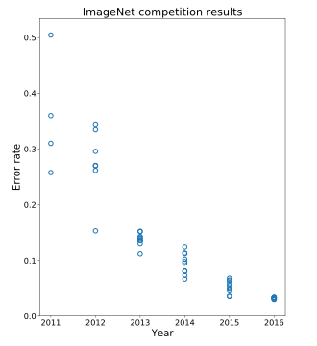
AlexNet
Developed by Alex Krizhevsky, Ilya Sutskever and Geoffrey Hinton at Utoronto in 2012. More than 25000 citations.
Destroyed the competition in the 2012 ImageNet Large Scale Visual Recognition Challenge. Showed benefits of CNNs and kickstarted AI revolution.
top-5 error of 15.3%, more than 10.8 percentage points lower than runner-up.
AlexNet
Main contributions:
Trained on ImageNet with data augmentation
Increased depth of model, GPU training (five to six days)
Smart optimizer and Dropout layers
ReLU activation!

Slide 29
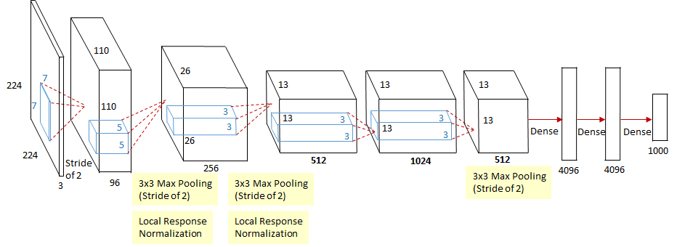
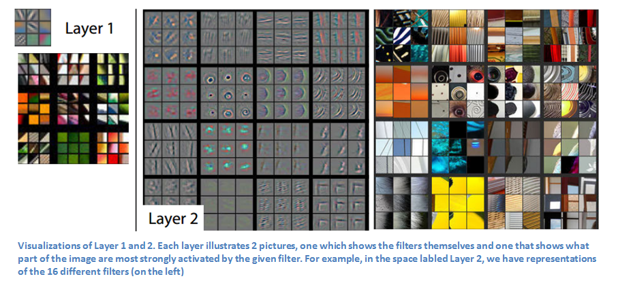
ZFNet
Introduced by Matthew Zeiler and Rob Fergus from NYU, won ILSVRC 2013 with 11.2% error rate. Decreased sizes of filters.
Trained for 12 days.
Paper presented a visualization technique named Deconvolutional Network, which helps to examine different feature activations and their relation to the input space.

Slide 30
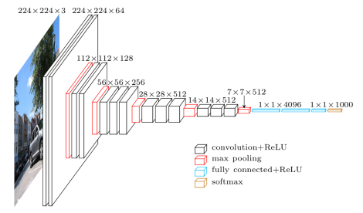
VGG
Introduced by Simonyan and Zisserman (Oxford) in 2014
Simplicity and depth as main points. Used 3x3 filters exclusively and 2x2 MaxPool layers with stride 2.
Showed that two 3x3 filters have an effective receptive field of 5x5.
As spatial size decreases, depth increases.
Trained for two to three weeks.
Still used as of today.

Slide 31
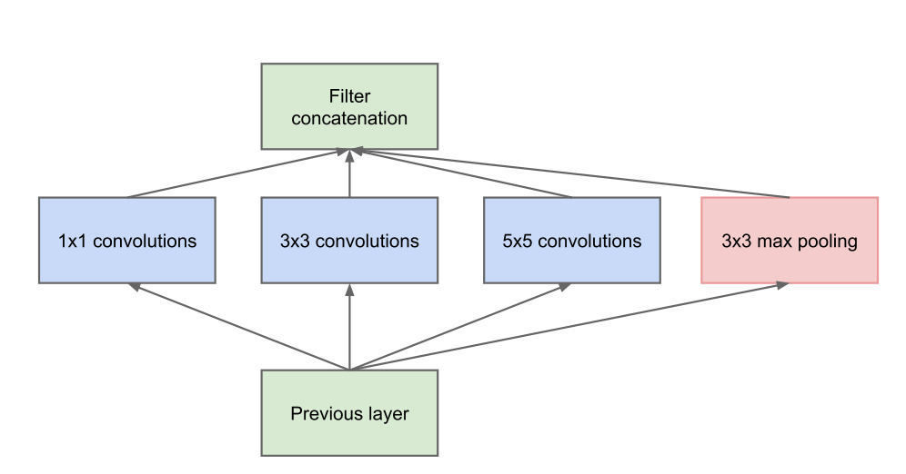
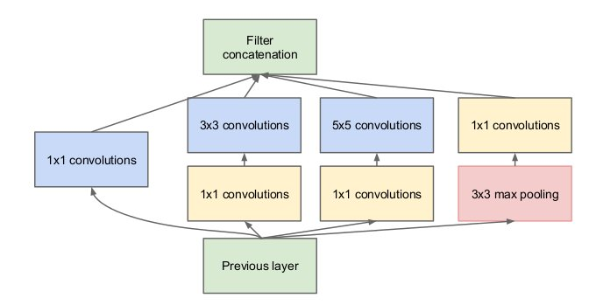
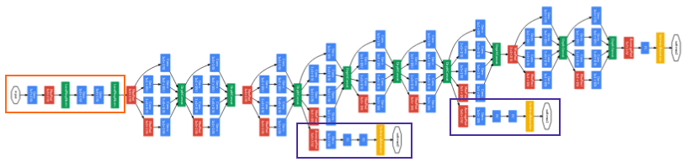
GoogLeNet (Inception-v1)
Introduced by Szegedy et al. (Google), 2014. Winners of ILSVRC 2014.
Introduces inception module: parallel conv. layers with different filter sizes. Motivation: we don’t know which filter size is best – let the network decide. Key idea for future archs.
No fully connected layer at the end. AvgPool instead. 12x fewer params than AlexNet.
1x1 convs to Reduce number of parameters
Proto Inception module
Inception module

Slide 32
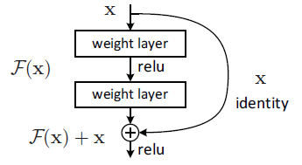
ResNet
Presented by He et al. (Microsoft), 2015. Won ILSVRC 2015 in multiple categories.
Main idea: Residual block. Allows for extremely deep networks.
Authors believe that it is easier to optimize the residual mapping than the original one. Furthermore, residual block can decide to “shut itself down” if needed.
Residual Block

Slide 33
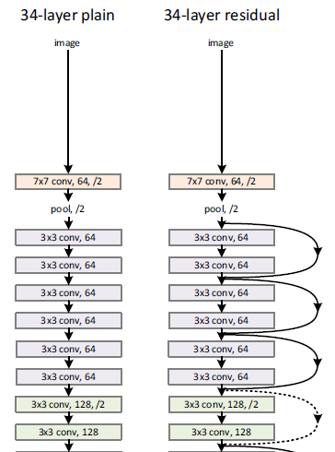
ResNet
Presented by He et al. (Microsoft), 2015. Won ILSVRC 2015 in multiple categories.
Main idea: Residual block. Allows for extremely deep networks.
Authors believe that it is easier to optimize the residual mapping than the original one. Furthermore, residual block can decide to “shut itself down” if needed.
Residual Block

Slide 34
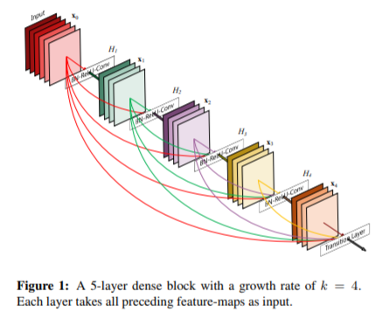
DenseNet
Proposed by Huang et al., 2016. Radical extension of ResNet idea.
Each block uses every previous feature map as input.
Idea: n computation of redundant features. All the previous information is available at each point.
Counter-intuitively, it reduces the number of parameters needed.

Slide 35
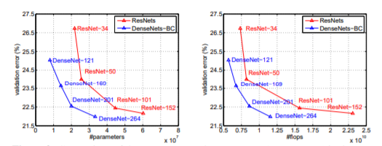
DenseNet
Proposed by Huang et al., 2016. Radical extension of ResNet idea.
Each block uses every previous feature map as input.
Idea: n computation of redundant features. All the previous information is available at each point.
Counter-intuitively, it reduces the number of parameters needed.

Slide 36
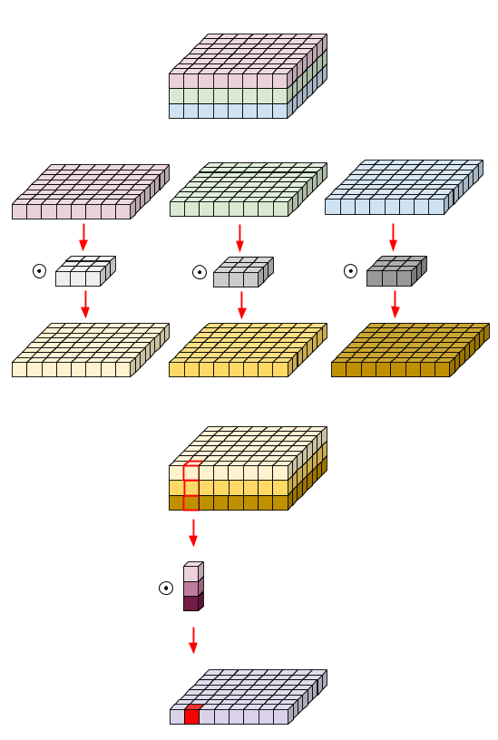
MobileNet
Published by Howard et al., 2017.
Extremely efficient network with decent accuracy.
Main concept: depthwise-separable convolutions. Convolve each feature maps with a kernel, then use a 1x1 convolution to aggregate the result.
This approximates vanilla convolutions without having to convolve large kernels through channels.

Slide 37
More on the greatest latest at a-sec later today

Slide 38
Outline
Review from last lecture
BackProp of MaxPooling layer
A bit of history
Layers Receptive Field
Saliency maps
Transfer Learning
CNN for text analysis (example)

Slide 39
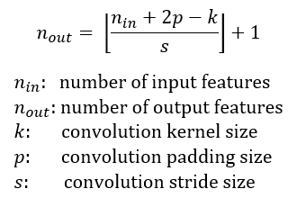
Layer’s Receptive Field
The receptive field is defined as the region in the input space that a particular CNN’s feature is looking at (i.e. be affected by).
Apply a convolution C with kernel size k = 3x3, padding size p = 1x1, stride s = 2x2 on an input map 5x5, we will get an output feature map 3x3 (green map).

Slide 40
Layer’s Receptive Field
Applying the same convolution on top of the 3x3 feature map, we will get a 2x2 feature map (orange map)

Slide 41
Dilated CNNs
Let’s look at the receptive field again in 1D, no padding, stride 1 and kernel 3x1

Slide 42
Dilated CNNs (cont)
Let’s look at the receptive field again in 1D, no padding, stride 1 and kernel 3x1

Slide 43
Dilated CNNs (cont)
Let’s look at the receptive field again in 1D, no padding, stride 1 and kernel 3x1

Slide 44
Dilated CNNs (cont)
Let’s look at the receptive field again in 1D, no padding, stride 1 and kernel 3x1

Slide 45
Dilated CNNs (cont)
Let’s look at the receptive field again in 1D, no padding, stride 1 and kernel 3x1.
Skip some of the connections

Slide 46
Outline
Review from last lecture
BackProp of MaxPooling layer
A bit of history
Layers Receptive Field
Saliency maps
Transfer Learning
CNN for text analysis (example)

Slide 47
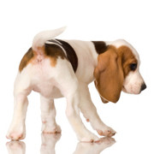
Saliency maps

Slide 48
Saliency maps (cont)
If you are given an image of a dog and asked to classify it. Most probably you will answer immediately – Dog! But your Deep Learning Network might not be as smart as you. It might classify it as a cat, a lion or Pavlos!
What are the reasons for that?
bias in training data
no regularization
or your network has seen too many celebrities

Slide 49
Saliency maps (cont)
We want to understand what made my network give a certain class as output?
Saliency Maps, they are a way to measure the spatial support of a particular class in a given image.
“Find me pixels responsible for the class C having score S(C) when the image I is passed through my network”.

Slide 50
Saliency maps (cont)
We want to understand what made my network give a certain class as output?
Saliency Maps, they are a way to measure the spatial support of a particular class in a given image.
“Find me pixels responsible for the class C having score S(C) when the image I is passed through my network”.

Slide 51
Salience maps (cont)
Question: How do we do that?
We differentiate!
For any function f(x, y, z), we can find the impact of variables x, y, z on fat any specific point (x0, y0, z0) by finding its partial derivative w.r.t these variables at that point.
Similarly, to find the responsible pixels, we take the score function S, for class C and take the partial derivatives w.r.t every pixel.

Slide 52
Salience maps (cont)
Question: Easy Peasy?
Sort of! Auto-grad can do this!
Forwar pass of the image through the network
Calculate the scores for every class
Enforce derivative of score S at last layer for all classes except class C to be 0. For C, set it to 1
Backpropagate this derivative till the start
Render them and you have your Saliency Map!
Note: On step #2. Instead of doing softmax, we turn it to binary classification and use the probabilities.

Slide 53
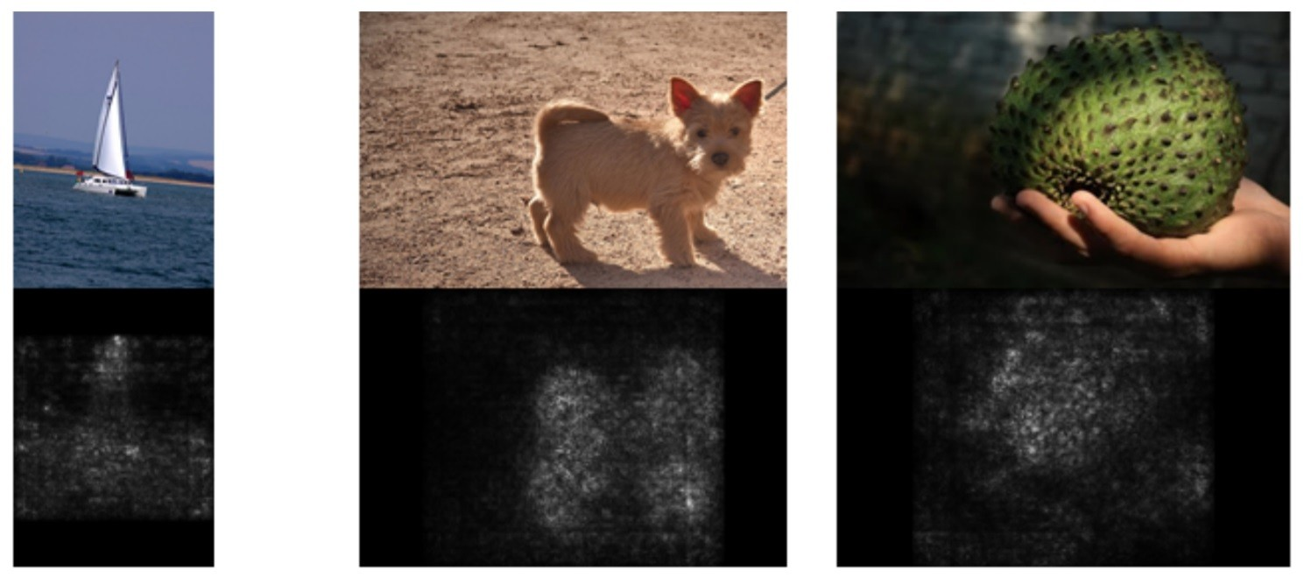
Salience maps (cont)

Slide 54
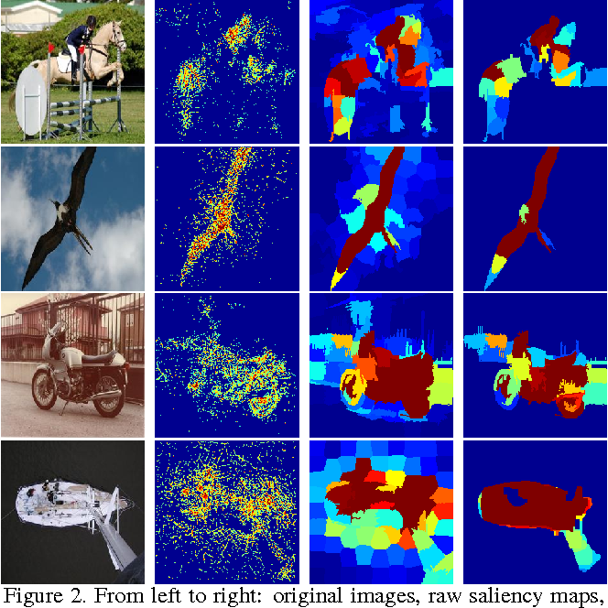
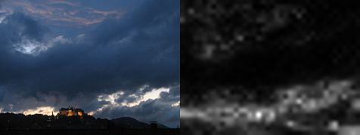
Salience maps (cont)
Question: What do we do with color images?
Take the saliency map for each channel and either take the max or average or use all 3 channels.
[1]: Deep Inside Convolutional Networks: Visualising Image Classification Models and Saliency Maps
[2]: Attention-based Extraction of Structured Information from Street View Imagery

Slide 55
Outline
Review from last lecture
BackProp of MaxPooling layer
A bit of history
Layers Receptive Field
Saliency maps
Transfer Learning
CNN for text analysis (example)

Slide 56
Transfer Learning
How do you make an image classifier that can be trained in a few hours (minutes) on a CPU?
Use pre-trained models, i.e., models with known weights.
Main Idea: earlier layers of a network learn low level features, which can be adapted to new domains by changing weights at later and fully-connected layers.
Example: use Imagenet trained with any sophisticated huge network. Then retrain it on a few thousand hotdog images and you get...

Slide 57
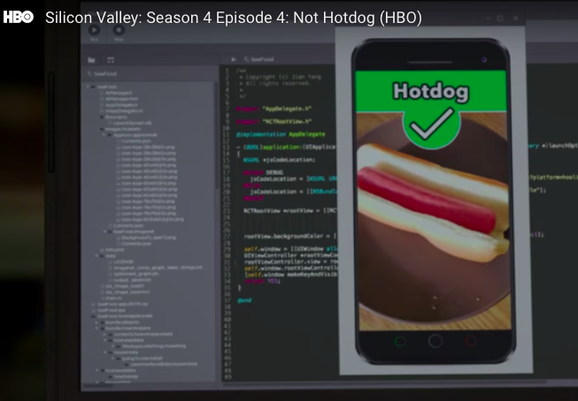
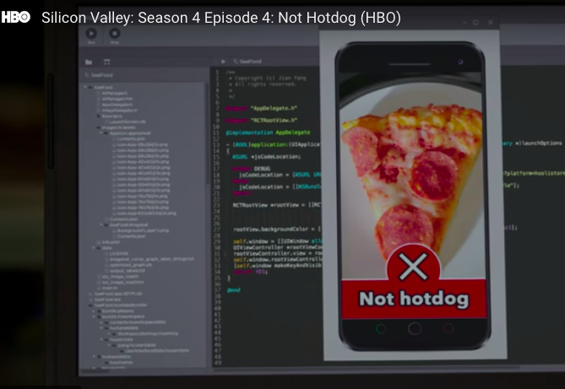
Hotdog or NotHotDog: https://youtu.be/ACmydtFDTGs (offensive language and tropes alert)

Slide 58
Transfer Learning (cont)
Get existing network weights
Un-freeze the “head” fully connected layers and train on your new images
Un-freeze the latest convolutional layers and train at a very low learning rate starting with the weights from the previously trained weights. This will change the latest layer convolutional weights without triggering large gradient updates which would have occurred had we not done 2.
See https://medium.com/@timanglade/how-hbos-silicon-valley-built-not-hotdog-with-mobile-tensorflow-keras-react-native-ef03260747f3and https://blog.keras.io/building-powerful-image-classification-models-using-very-little-data.html for some details

Slide 59
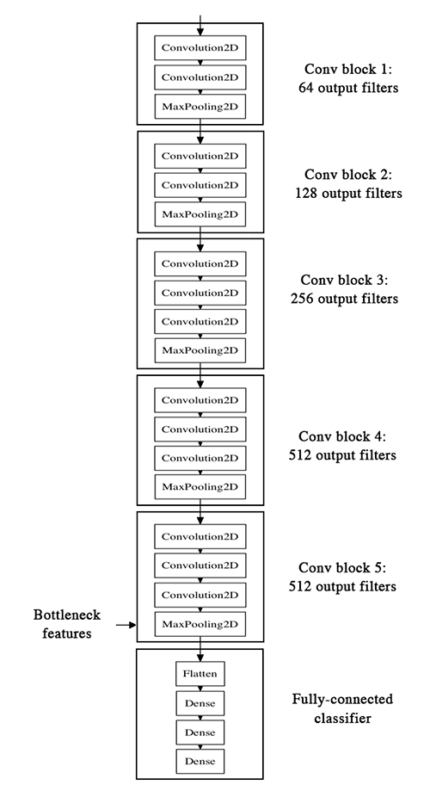
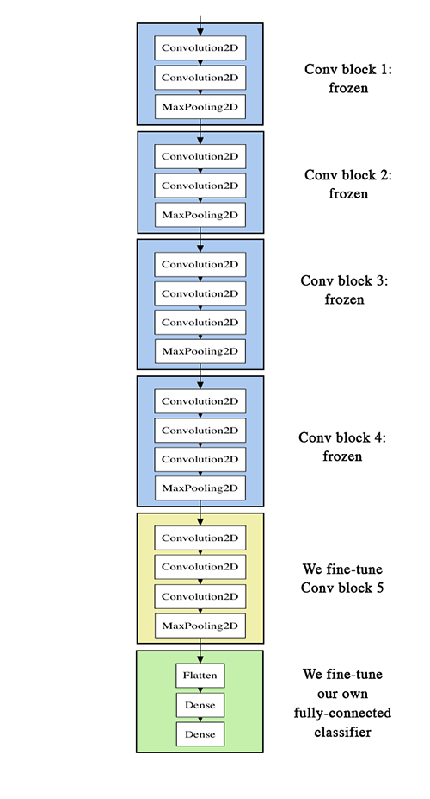

Slide 60
Outline
Review from last lecture
BackProp of MaxPooling layer
A bit of history
Layers Receptive Field
Saliency maps
Transfer Learning
CNN for text analysis (example)

Slide 61
Convolutional Neural Networks for Text Classification
When applied to text instead of images, we have an 1 dimensional array representing the text.
Here the architecture of the ConvNets is changed to 1D convolutional-and-pooling operations.
One of the most typically tasks in NLP where ConvNet are used is sentence classification, that is, classifying a sentence into a set of pre-determined categories by considering n-grams, i.e. it’s words or sequence of words, or also characters or sequence of characters.
LETS SEE THIS THROUGH AN EXAMPLE

Slide 62
Beyond
MobileNetV2 (https://arxiv.org/abs/1801.04381)
Inception-Resnet, v1 and v2 (https://arxiv.org/abs/1602.07261)
Wide-Resnet (https://arxiv.org/abs/1605.07146)
Xception (https://arxiv.org/abs/1610.02357)
ResNeXt (https://arxiv.org/pdf/1611.05431)
ShuffleNet, v1 and v2 (https://arxiv.org/abs/1707.01083)
Squeeze and Excitation Nets (https://arxiv.org/abs/1709.01507 )

