Slide 1
Lecture 8: Convolutional Neural Networks 1

Slide 2
Outline

Slide 3
Main drawbacks of MLPs
MLPs use one perceptron for each input (e.g. pixel in an image, multiplied by 3 in RGB case). The amount of weights rapidly becomes unmanageable for large images.
Training difficulties arise, overfitting can appear.
MLPs react differently to an input (images) and its shifted version – they are not translation invariant.

Slide 4
Latest events on Image Recognition
You Only Look Once (YOLO) - 2016

Slide 5
Latest events on Image Recognition
Mask- RCNN - 2017

Slide 6
Latest events on Image Recognition
NVIDIA Video to Video Synthesis - 2018

Slide 7
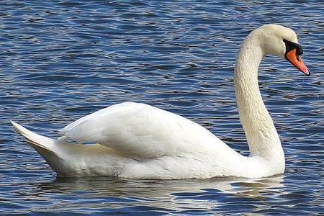
Image analysis
Imagine that we want to recognize swans in an image:
Round, elongated oval with orange protuberance
Oval-shaped white blob (body)
Long white rectangular shape (neck)

Slide 8
Cases can be a bit more complex…
Round, elongated head with orange or black beak
Oval-shaped white body with or without large white symmetric blobs (wings)
Long white neck, square shape

Slide 9
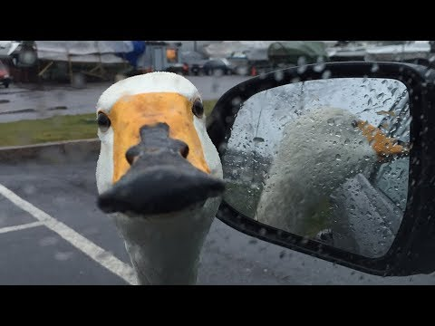
Now what?
Round, elongated head with orange or black beak, can be turned backwards
Small black circles, can be facing the camera, sometimes can see both
Long white neck, can bend around, not necessarily straight
Black triangular shaped form, on the head, can have different sizes
White tail, generally far from the head, looks feathery
White elongated piece, can be squared or more triangular, can be obstructed sometimes
Luckily, the color is consistent…
Black feet, under body, can have different shapes
White, oval shaped body, with or without wings visible

Slide 11
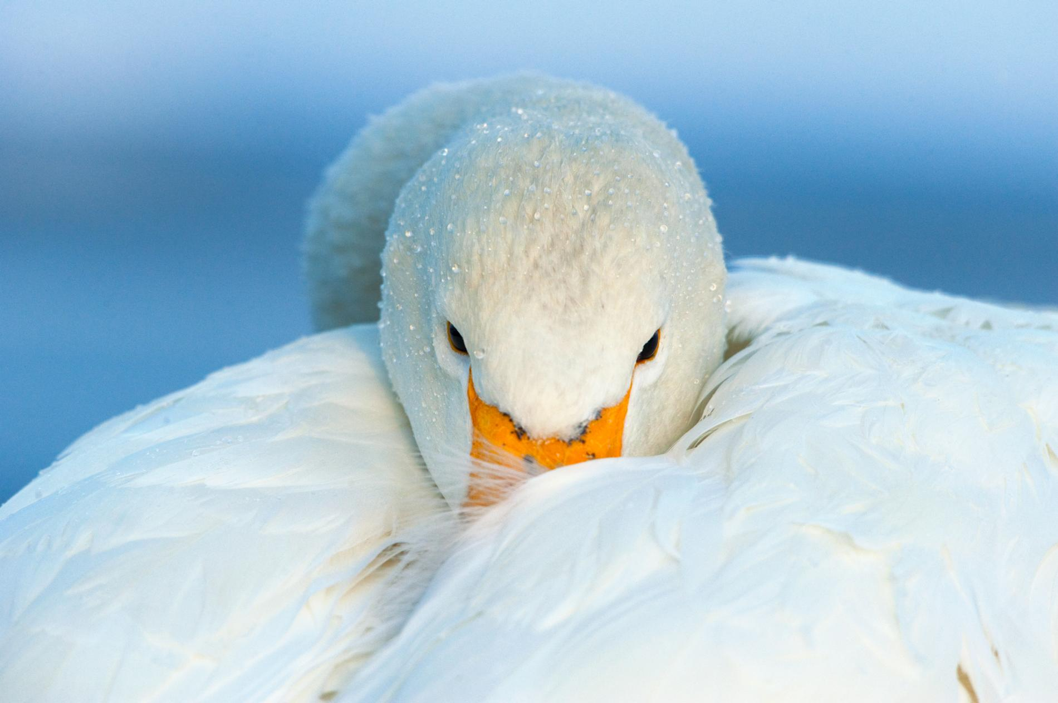
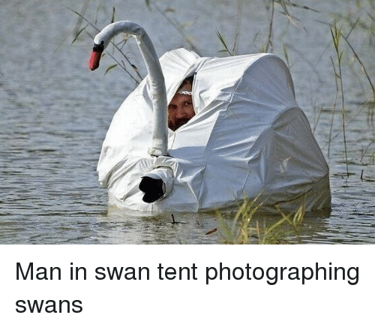
We need to be able to deal with these cases.

Slide 12
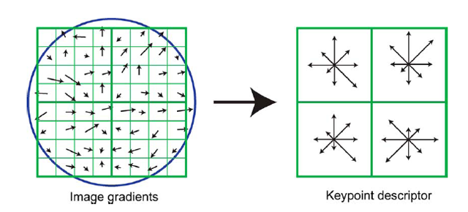
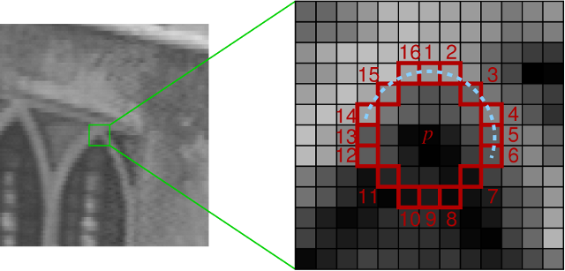
Image features
We’ve been basically talking about detecting features in images, in a very naïve way.
Researchers built multiple computer vision techniques to deal with these issues: SIFT, FAST, SURF, BRIEF, etc.
However, similar problems arose: the detectors where either too general or too over-engineered. Humans were designing these feature detectors, and that made them either too simple or hard to generalize.
SIFT feature descriptor
FAST corner detection algorithm

Slide 13
Image features (cont)
What if we learned the features to detect?
We need a system that can do Representation Learning (or Feature Learning).
Representation Learning: technique that allows a system to automatically find relevant features for a given task. Replaces manual feature engineering.
Multiple techniques for this:
Unsupervised (K-means, PCA, …).
Supervised (Sup. Dictionary learning, Neural Networks!)

Slide 14
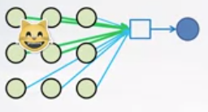
Drawbacks
Imagine we want to build a cat detector with an MLP.
In this case, the red weights will be modified to better recognize cats
In this case, the green weights will be modified.
We are learning redundant features. Approach is not robust, as cats could appear in yet another position.

Slide 15
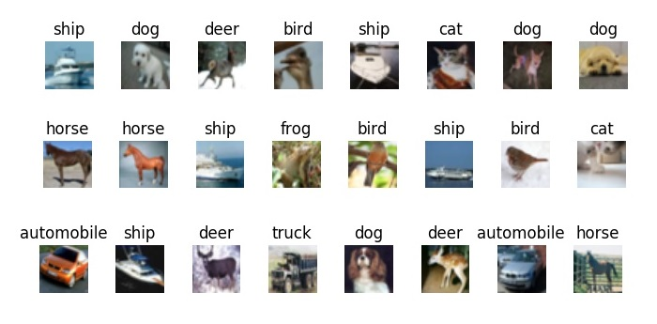
Drawbacks
Example: CIFAR10
Simple 32x32 color images (3 channels)
Each pixel is a feature: an MLP would have 32x32x3+1 = 3073 weights per neuron!

Slide 16
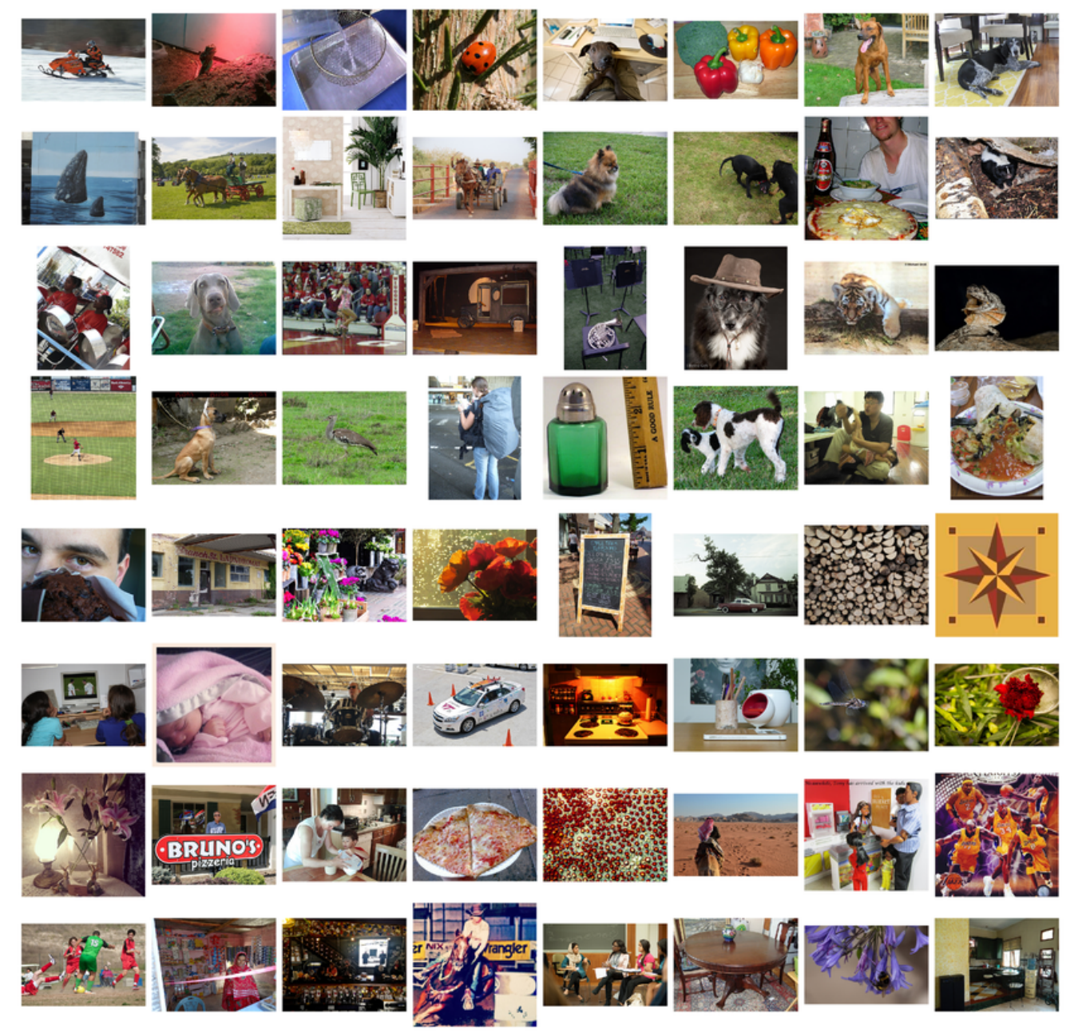
Drawbacks
Example: ImageNet
Images are usually 224x224x3: an MLP would have 150129 weights per neuron. If the first layer of the MLP is around 128 nodes, which is small, this already becomes very heavy to calculate.
Model complexity is extremely high: overfitting.

Slide 17
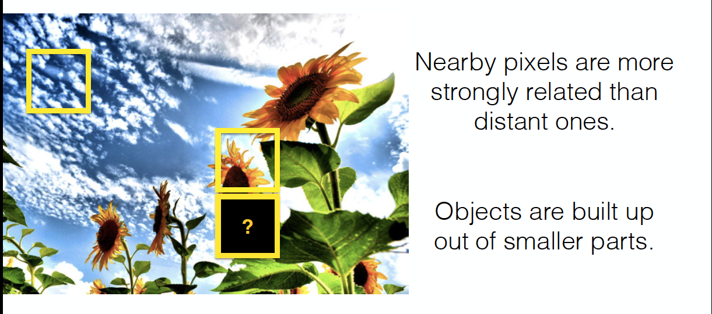
Images are Local and Hierarchical

Slide 18
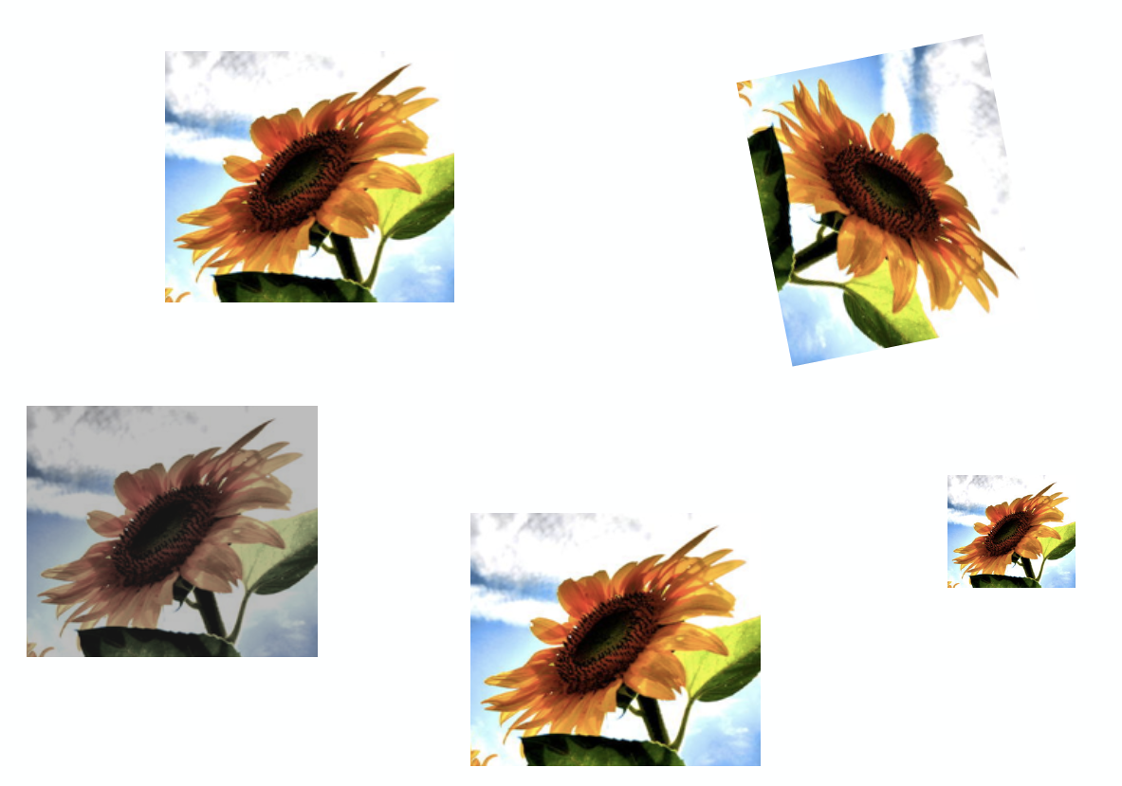
Images are Invariant

Slide 19
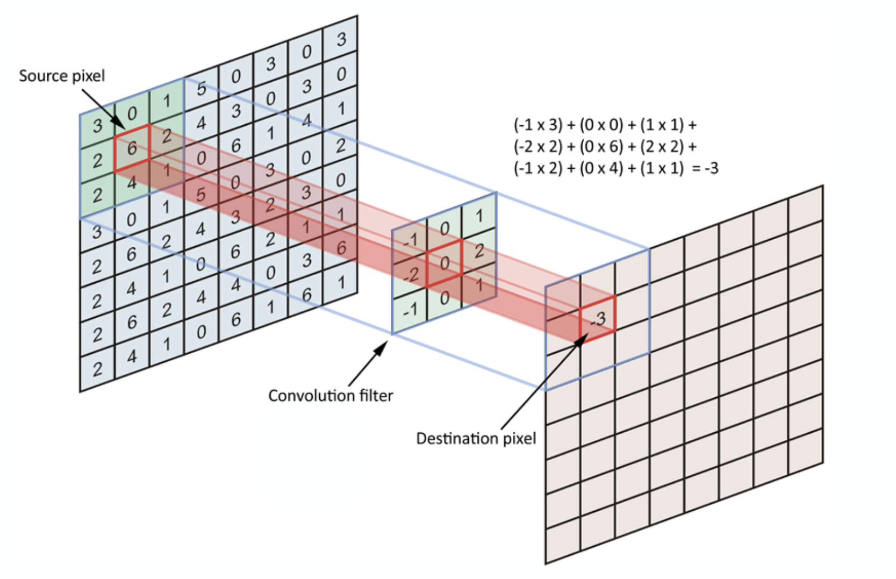
“Convolution” Operation

Slide 20
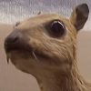
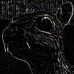
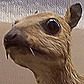
“Convolution” Operation
Kernel
Edge detection
*
=
Sharpen
*
=
wikipedia.org

Slide 21
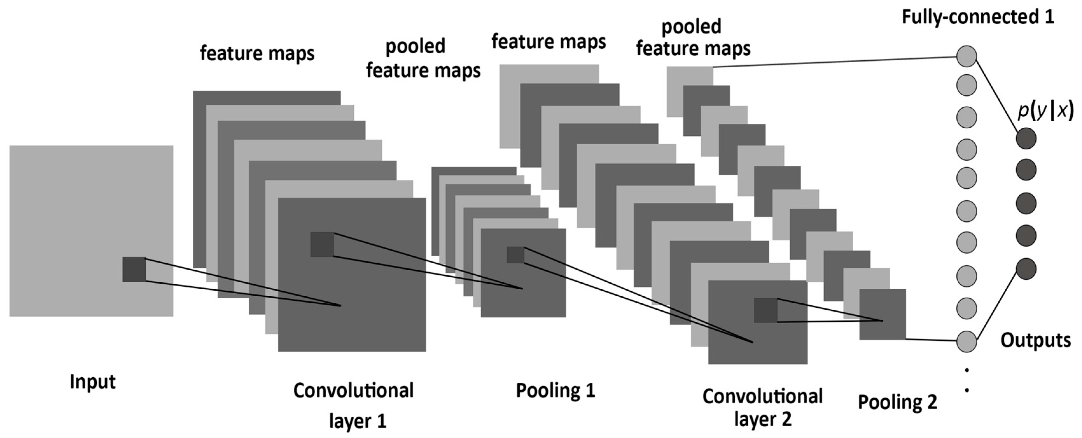
A Convolutional Network
+ ReLU
+ ReLU

Slide 22
Basics of CNNs
We know that MLPs:
Do not scale well for images
Ignore the information brought by pixel position and correlation with neighbors
Cannot handle translations
The general idea of CNNs is to intelligently adapt to properties of images:
Pixel position and neighborhood have semantic meanings.
Elements of interest can appear anywhere in the image.

Slide 23
Basics of CNNs
MLP
CNN
CNNs are also composed of layers, but those layers are not fully connected: they have filters, sets of cube-shaped weights that are applied throughout the image. Each 2D slice of the filters are called kernels.
These filters introduce translation invariance and parameter sharing.
How are they applied? Convolutions!

Slide 24
Convolution and cross-correlation
A convolution of f and g $(f∗g)$ is defined as the integral of the product, having one of the functions inverted and shifted:
$$\left(f∗g\right)\left(t\right)=\int_{a}{f\left(a\right)g\left(t−a\right)da}$$
Discrete convolution:
$$\left(f∗g\right)\left(t\right)=\sum_{a=−∞}^{∞}{f\left(a\right)g(t−a)}$$
Discrete cross-correlation:
$$\left(f⋆g\right)\left(t\right)=\sum_{a=−∞}^{∞}{f\left(a\right)g(t+a)}$$
Function is inverted and shifted left by t

Slide 25
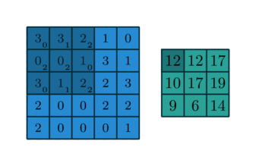
Convolutions – step by step

Slide 26
Convolutions – another example

Slide 27
Convolutions – 3D input

Slide 28
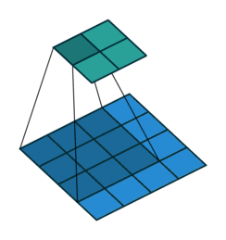
Convolutions – what happens at the edges?
If we apply convolutions on a normal image, the result will be down-sampled by an amount depending on the size of the filter.
We can avoid this by padding the edges in different ways.

Slide 29
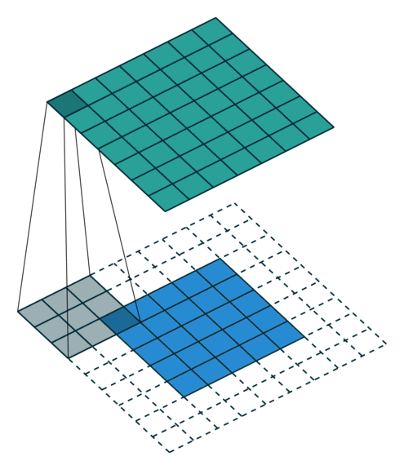
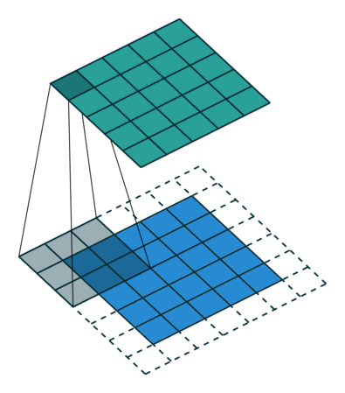
Padding
Full padding. Introduces zeros such that all pixels are visited the same amount of times by the filter. Increases size of output.
Same padding. Ensures that the output has the same size as the input.

Slide 30
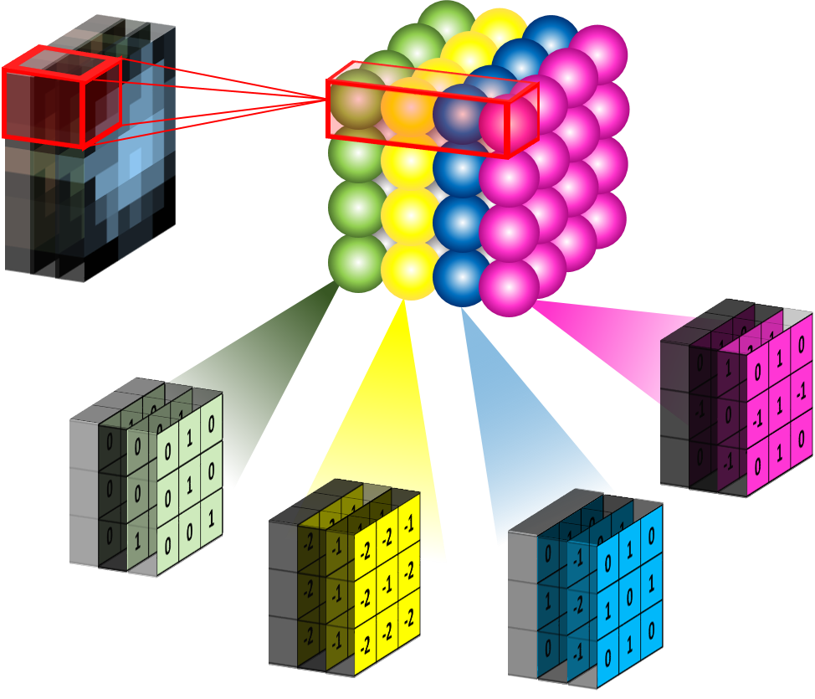
Convolutional layers
Convolutional layer with four 3x3 filters on an RGB image. As you can see, the filters are now cubes, and they are applied on the full depth of the image..
Convolutional layer with four 3x3 filters on a black and white image (just one channel)

Slide 31
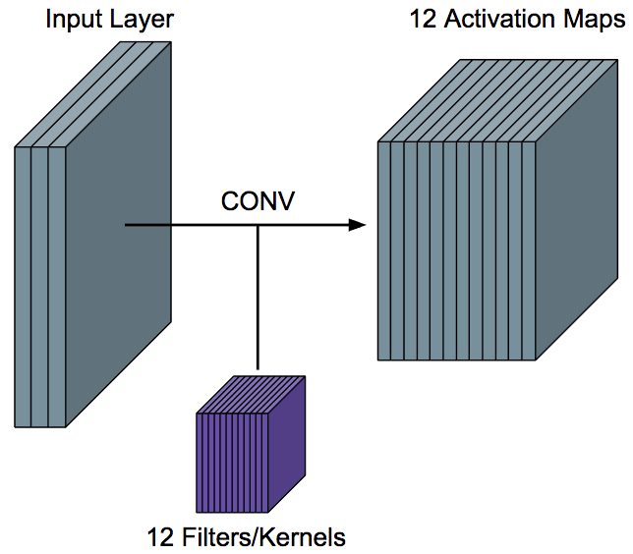
Convolutional layers (cont)
To be clear: each filter is convolved with the entirety of the 3D input cube, but generates a 2D feature map.
Because we have multiple filters, we end up with a 3D output: one 2D feature map per filter.
The feature map dimension can change drastically from one conv layer to the next: we can enter a layer with a 32x32x16 input and exit with a 32x32x128 output if that layer has 128 filters.

Slide 32
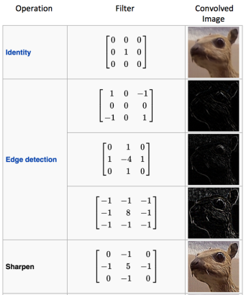
Why does this make sense?
In image is just a matrix of pixels.
Convolving the image with a filter produces a feature map that highlights the presence of a given feature in the image.

Slide 33
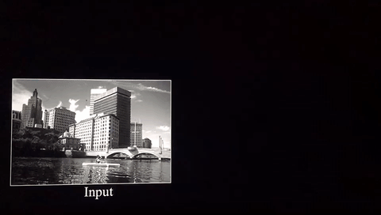

Slide 34
Learning CNN
In a convolutional layer, we are basically applying multiple filters at over the image to extract different features.
But most importantly, we are learning those filters!
One thing we’re missing: non-linearity.

Slide 35
Introducing ReLU
The most successful non-linearity for CNNs is the Rectified Non-Linear unit (ReLU):
Combats the vanishing gradient problem occurring in sigmoids, is easier to compute, generates sparsity (not always beneficial)

Slide 36
Convolutional layers so far
A convolutional layer convolves each of its filters with the input.
Input: a 3D tensor, where the dimensions are Width, Height and Channels (or Feature Maps)
Output: a 3D tensor, with dimensions Width, Height and Feature Maps (one for each filter)
Applies non-linear activation function (usually ReLU) over each value of the output.
Multiple parameters to define: number of filters, size of filters, stride, padding, activation function to use, regularization.

Slide 37
Building a CNN
A convolutional neural network is built by stacking layers, typically of 3 types:
Convolutional Layers
Pooling Layers
Fully connected Layers

Slide 38
Building a CNN
Convolutional Layers
A convolutional neural network is built by stacking layers, typically of 3 types:
Action
Apply filters to extract features
Filters are composed of small kernels, learned.
One bias per filter.
Apply activation function on every value of feature map
Parameters
Number of kernels
Size of kernels (W and H only, D is defined by input cube)
Activation function
Stride
Padding
Regularization type and value
I/O
Input: 3D cube, previous set of feature maps
Output: 3D cube, one 2D map per filter
Pooling Layers
Fully connected Layers

Slide 39
Building a CNN
A convolutional neural network is built by stacking layers, typically of 3 types:
Convolutional Layers
Pooling Layers
Fully connected Layers

Slide 40
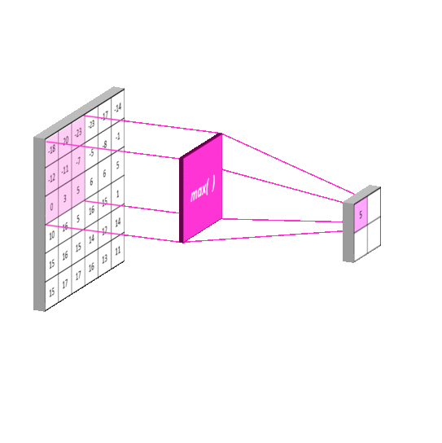
Building a CNN
Pooling Layers
A convolutional neural network is built by stacking layers, typically of 3 types:
Action
Reduce dimensionality
Extract maximum of average of a region
Sliding window approach
Parameters
Stride
Size of window
I/O
Input: 3D cube, previous set of feature maps
Output: 3D cube, one 2D map per filte, reduced spatial dimensions
Convolutional Layers
Fully connected Layers

Slide 41
Building a CNN
A convolutional neural network is built by stacking layers, typically of 3 types:
Convolutional Layers
Pooling Layers
Fully connected Layers

Slide 42
Building a CNN
Fully connected Layers
A convolutional neural network is built by stacking layers, typically of 3 types:
Action
Aggregate information from final feature maps
Generate final classification
Parameters
Number of nodes
Activation function: usually changes depending on role of layer. If aggregating info, use ReLU. If producing final classification, use Softmax.
I/O
Input: FLATTENED 3D cube, previous set of feature maps
Output: 3D cube, one 2D map per filter
Convolutional Layers
Pooling Layers

Slide 43
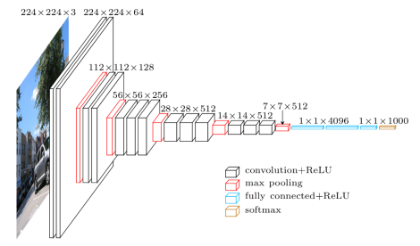
Fully built CNN (VGG)

Slide 44
What do CNN layers learn?
Each CNN layer learns filters of increasing complexity.
The first layers learn basic feature detection filters: edges, corners, etc.
The middle layers learn filters that detect parts of objects. For faces, they might learn to respond to eyes, noses, etc.
The last layers have higher representations: they learn to recognize full objects, in different shapes and positions.

Slide 45
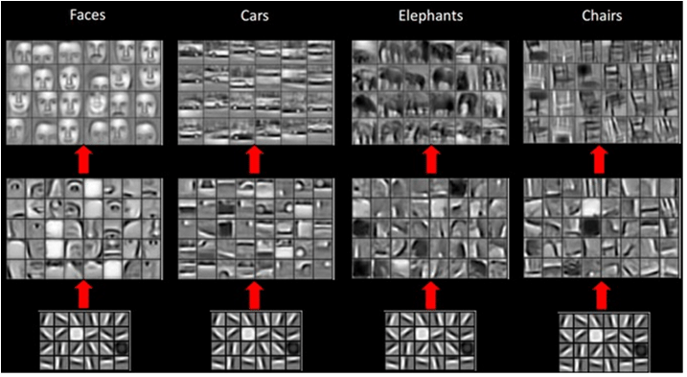

Slide 46
Examples
I have a convolutional layer with 16 3x3 filters that takes an RGB image as input.
What else can we define about this layer?
Activation function
Stride
Padding type
How many parameters does the layer have?
16 x 3 x 3 x 3 + 16 = 448
Number of filters
Size of Filters
Number of channels of prev layer
Biases (one per filter)

Slide 47
Examples
Let C be a CNN with the following disposition:
Input: 32x32x3 images
Conv1: 8 3x3 filters, stride 1, padding=same
Conv2: 16 5x5 filters, stride 2, padding=same
Flatten layer
Dense1: 512 nodes
Dense2: 4 nodes
How many parameters does this network have?
(8 x 3 x 3 x 3 + 8) + (16 x 5 x 5 x 8 + 16) + (16 x 16 x 16 x 512 + 512) + (512 x 4 + 4)
Conv1
Conv2
Dense1
Dense2

Slide 48
3D visualization of networks in action
http://scs.ryerson.ca/~aharley/vis/conv/
https://www.youtube.com/watch?v=3JQ3hYko51Y

Slide 49
Evolution of CNNs
A bit of history

Slide 50
Initial ideas
The first piece of research proposing something similar to a Convolutional Neural Network was authored by Kunihiko Fukushima in 1980, and was called the NeoCognitron¹.
Inspired by discoveries on visual cortex of mammals.
Fukushima applied the NeoCognitron to hand-written character recognition.
End of the 80’s: several papers advanced the field
Backpropagation published in French by Yann LeCun in 1985 (independently discovered by other researchers as well)
TDNN by Waiber et al., 1989 - Convolutional-like network trained with backprop.
Backpropagation applied to handwritten zip code recognition by LeCun et al., 1989
¹ K. Fukushima. Neocognitron: A self-organizing neural network model for a mechanism of pattern recognition unaffected by shift in position. Biological Cybernetics, 36(4): 93-202, 1980.

Slide 51
LeNet
November 1998: LeCun publishes one of his most recognized papers describing a “modern” CNN architecture for document recognition, called LeNet¹.
Not his first iteration, this was in fact LeNet-5, but this paper is the commonly cited publication when talking about LeNet.
¹ LeCun, Yann, et al. "Gradient-based learning applied to document recognition." Proceedings of the IEEE 86.11 (1998): 2278-2324.

Slide 52
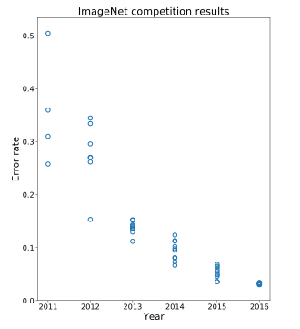
AlexNet
Developed by Alex Krizhevsky, Ilya Sutskever and Geoffrey Hinton at Utoronto in 2012. More than 25000 citations.
Destroyed the competition in the 2012 ImageNet Large Scale Visual Recognition Challenge. Showed benefits of CNNs and kickstarted AI revolution.
top-5 error of 15.3%, more than 10.8 percentage points lower than runner-up.
AlexNet
Main contributions:
Trained on ImageNet with data augmentation
Increased depth of model, GPU training (five to six days)
Smart optimizer and Dropout layers
ReLU activation!

Slide 53
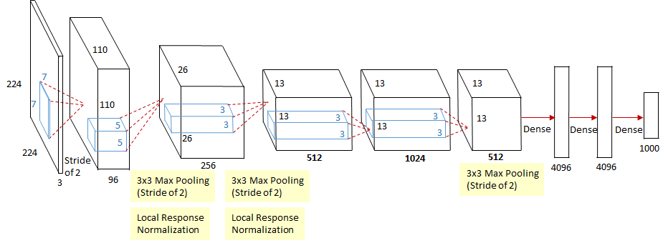
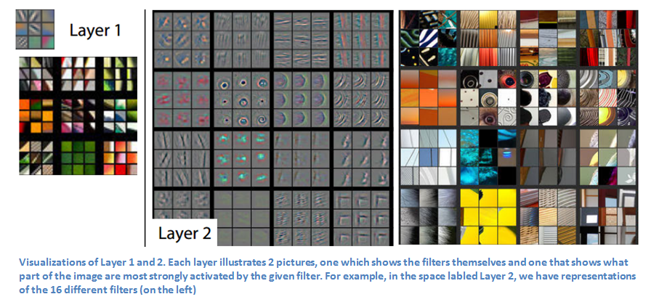
ZFNet
Introduced by Matthew Zeiler and Rob Fergus from NYU, won ILSVRC 2013 with 11.2% error rate. Decreased sizes of filters.
Trained for 12 days.
Paper presented a visualization technique named Deconvolutional Network, which helps to examine different feature activations and their relation to the input space.

Slide 54
VGG
Introduced by Simonyan and Zisserman (Oxford) in 2014
Simplicity and depth as main points. Used 3x3 filters exclusively and 2x2 MaxPool layers with stride 2.
Showed that two 3x3 filters have an effective receptive field of 5x5.
As spatial size decreases, depth increases.
Trained for two to three weeks.
Still used as of today.

Slide 55
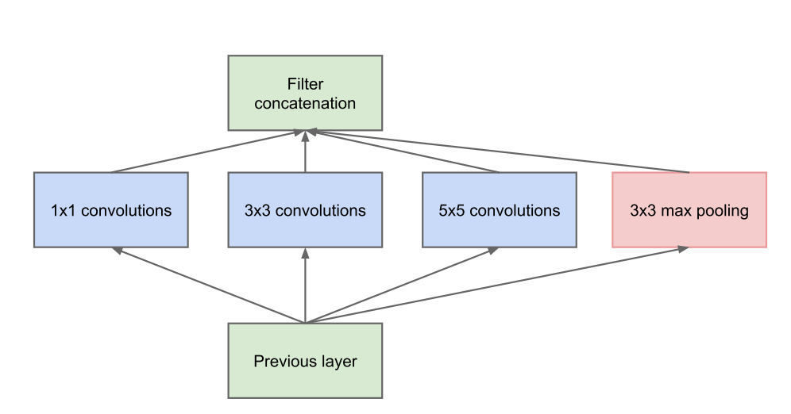
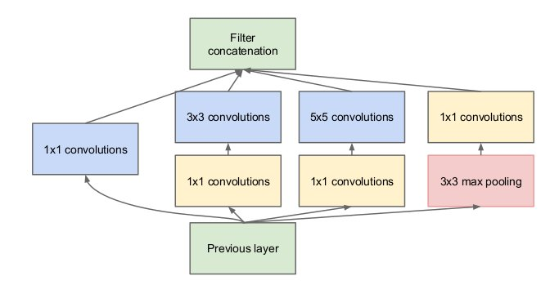
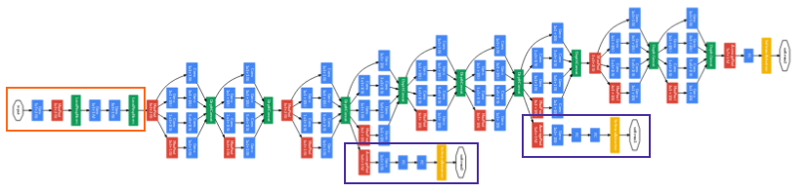
GoogLeNet (Inception-v1)
Introduced by Szegedy et al. (Google), 2014. Winners of ILSVRC 2014.
Introduces inception module: parallel conv. layers with different filter sizes. Motivation: we don’t know which filter size is best – let the network decide. Key idea for future archs.
No fully connected layer at the end. AvgPool instead. 12x fewer params than AlexNet.
1x1 convs to Reduce number of parameters
Proto Inception module
Inception module

Slide 56
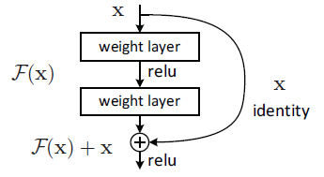
ResNet
Presented by He et al. (Microsoft), 2015. Won ILSVRC 2015 in multiple categories.
Main idea: Residual block. Allows for extremely deep networks.
Authors believe that it is easier to optimize the residual mapping than the original one. Furthermore, residual block can decide to “shut itself down” if needed.
Residual Block

Slide 57
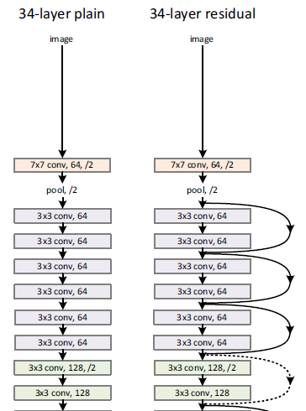
ResNet
Presented by He et al. (Microsoft), 2015. Won ILSVRC 2015 in multiple categories.
Main idea: Residual block. Allows for extremely deep networks.
Authors believe that it is easier to optimize the residual mapping than the original one. Furthermore, residual block can decide to “shut itself down” if needed.
Residual Block

Slide 58
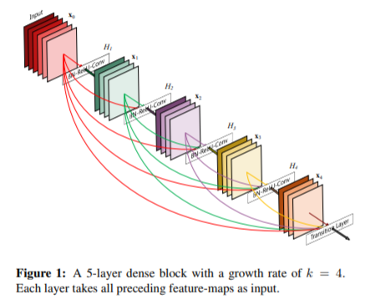
DenseNet
Proposed by Huang et al., 2016. Radical extension of ResNet idea.
Each block uses every previous feature map as input.
Idea: n computation of redundant features. All the previous information is available at each point.
Counter-intuitively, it reduces the number of parameters needed.

Slide 59
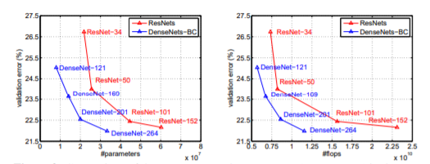
DenseNet
Proposed by Huang et al., 2016. Radical extension of ResNet idea.
Each block uses every previous feature map as input.
Idea: n computation of redundant features. All the previous information is available at each point.
Counter-intuitively, it reduces the number of parameters needed.

Slide 60
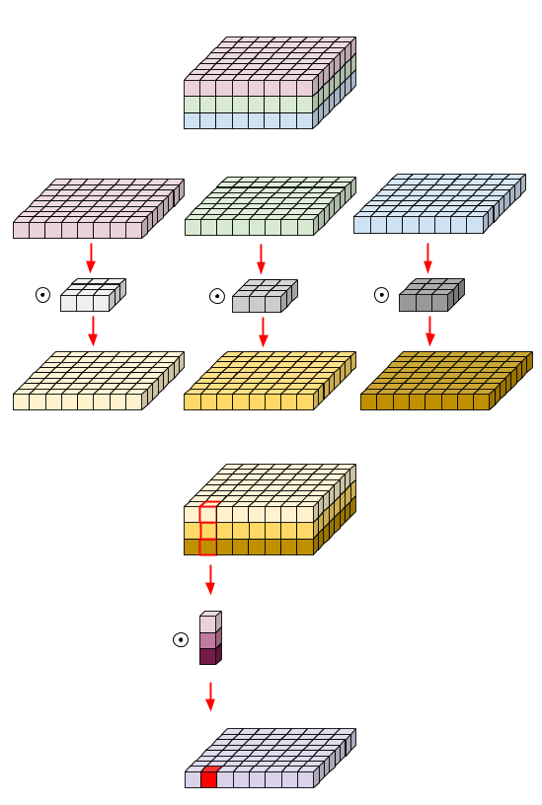
MobileNet
Published by Howard et al., 2017.
Extremely efficient network with decent accuracy.
Main concept: depthwise-separable convolutions. Convolve each feature maps with a kernel, then use a 1x1 convolution to aggregate the result.
This approximates vanilla convolutions without having to convolve large kernels through channels.

Slide 61
Beyond
MobileNetV2 (https://arxiv.org/abs/1801.04381)
Inception-Resnet, v1 and v2 (https://arxiv.org/abs/1602.07261)
Wide-Resnet (https://arxiv.org/abs/1605.07146)
Xception (https://arxiv.org/abs/1610.02357)
ResNeXt (https://arxiv.org/pdf/1611.05431)
ShuffleNet, v1 and v2 (https://arxiv.org/abs/1707.01083)
Squeeze and Excitation Nets (https://arxiv.org/abs/1709.01507 )

