Slide 1
Lecture 9: Visualization for EDA and Communication

Slide 2
As the matplotlib thickens …

Slide 3
ANNOUNCEMENTS
Projects have been posted!
Check the website for details and read the guidelines file for due dates
Added more Office Hours!
Check the weekly schedule on our website

Slide 4
Lecture Outline
EDA Refresher
Effective Visualization
Graphical Integrity
Scope
Displays
Sensible Design
Communication
Motivation
Key Considerations

Slide 5
Lecture Outline
EDA Refresher
Effective Visualization
Graphical Integrity
Scope
Displays
Sensible Design
Communication
Motivation
Key Considerations

Slide 6
EDA Refresher
Assume you know a given dataset is credible, complete with the info you want, and has no missing values. Why do further EDA?

Slide 7
EDA Refresher
Purposes of EDA:
Maximize insight into a dataset
Uncover underlying structure
Detect outliers
Test underlying assumptions
Develop parsimonious models
Notes:
graphics gives the analysts unparalleled power to do so

Slide 8
EDA Refresher: English Premier League
name
club
age
position
market value
Alexis Sanchez
Arsenal
28
LW
65
Mesut Ozil
Arsenal
28
AM
50
Petr Cech
Arsenal
35
GK
7
Theo Walcott
Arsenal
28
RW
20
Laurent Koscielny
Arsenal
31
CB
22
from www.transfermarkt.us
Notes:
graphics gives the analysts unparalleled power to do so

Slide 9
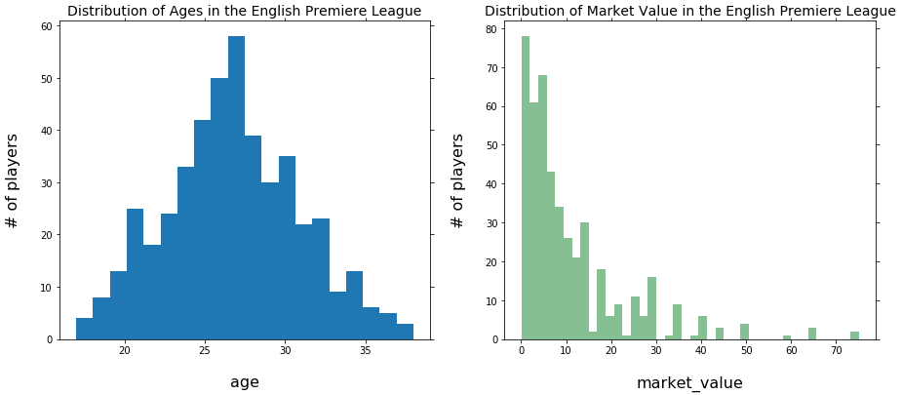
EDA Refresher: English Premier League

Slide 10
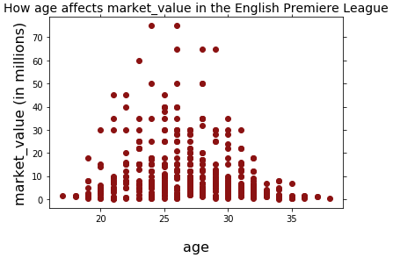
EDA Refresher: English Premier League

Slide 11
EDA Refresher: English Premier League
Are the outliers legit?

Slide 12
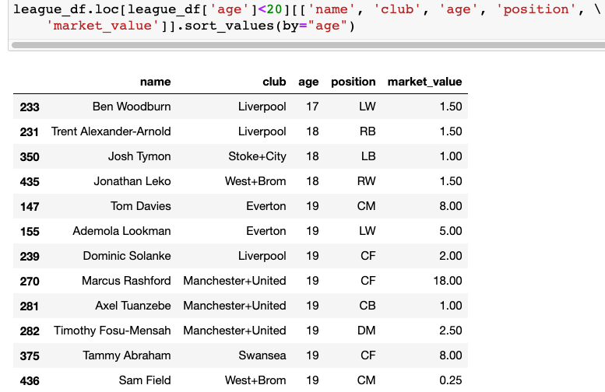
EDA Refresher: English Premier League

Slide 13
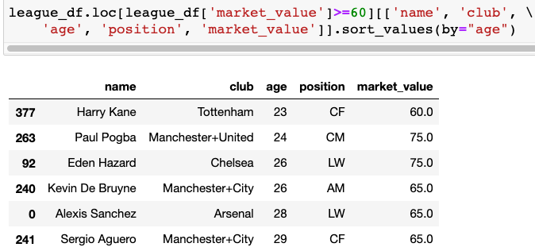
EDA Refresher: English Premier League

Slide 14
EDA Refresher: English Premier League
Notes:
our predictive models should learn how to appropriate weight each feature (independent variable), but that doesn’t excuse us from not checking out our data and ensuring nothing is wonky.

Slide 15
Lecture Outline
EDA Refresher
Effective Visualization
Graphical Integrity
Scope
Displays
Sensible Design
Communication
Motivation
Key Considerations

Slide 16
Lecture Outline
EDA Refresher
Effective Visualization
Graphical Integrity
Scope
Displays
Sensible Design
Communication
Motivation
Key Considerations
Notes:
For the most part, we’ve guided you on the plots by explicitly telling you which types of plots we want, but as you …

Slide 17
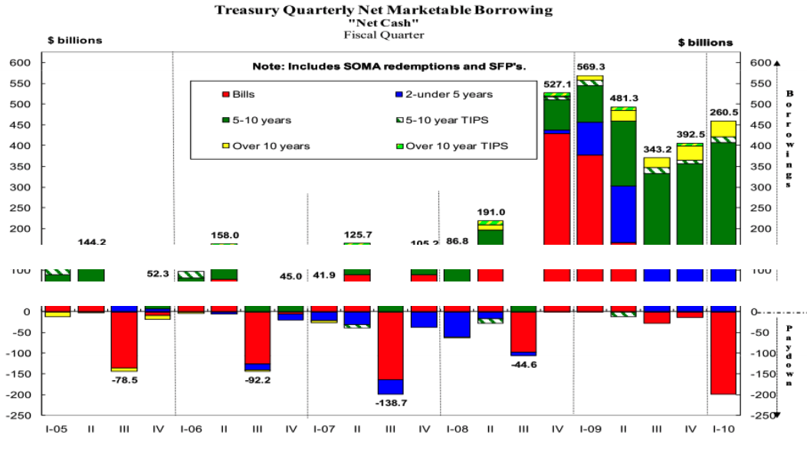
Effective Visualization
Not effective:
Notes:
our predictive models should learn how to appropriate weight each feature (independent variable), but that doesn’t excuse us from not checking out our data and ensuring nothing is wonky.

Slide 18
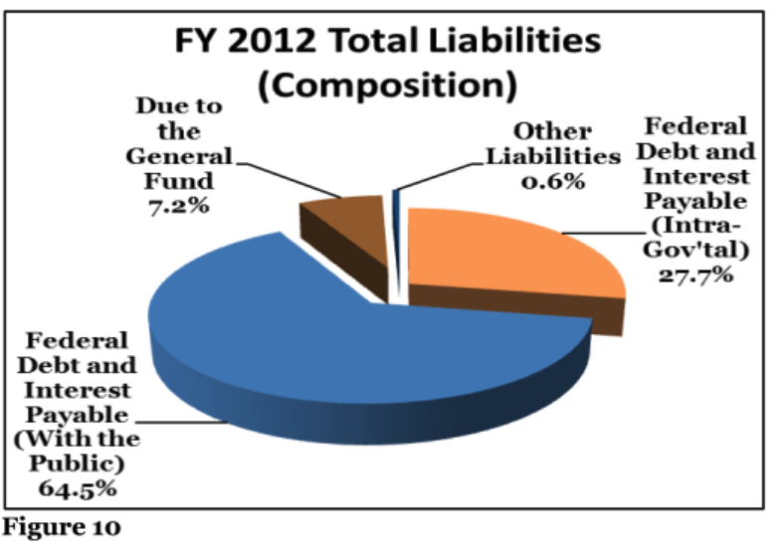
Effective Visualization
Not effective:
Notes:
our predictive models should learn how to appropriate weight each feature (independent variable), but that doesn’t excuse us from not checking out our data and ensuring nothing is wonky.

Slide 19
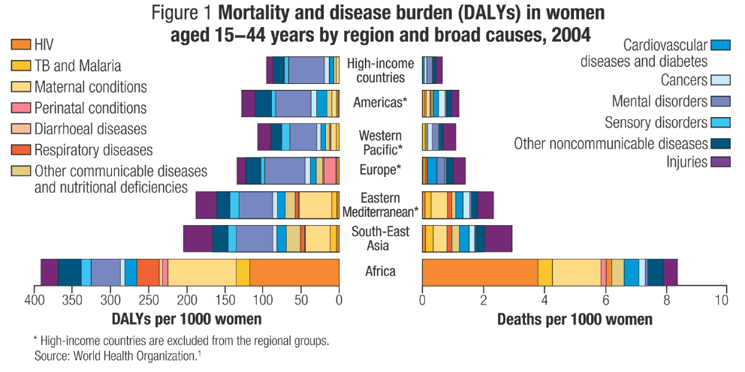
Effective Visualization
Not effective:
Notes:
our predictive models should learn how to appropriate weight each feature (independent variable), but that doesn’t excuse us from not checking out our data and ensuring nothing is wonky.

Slide 20
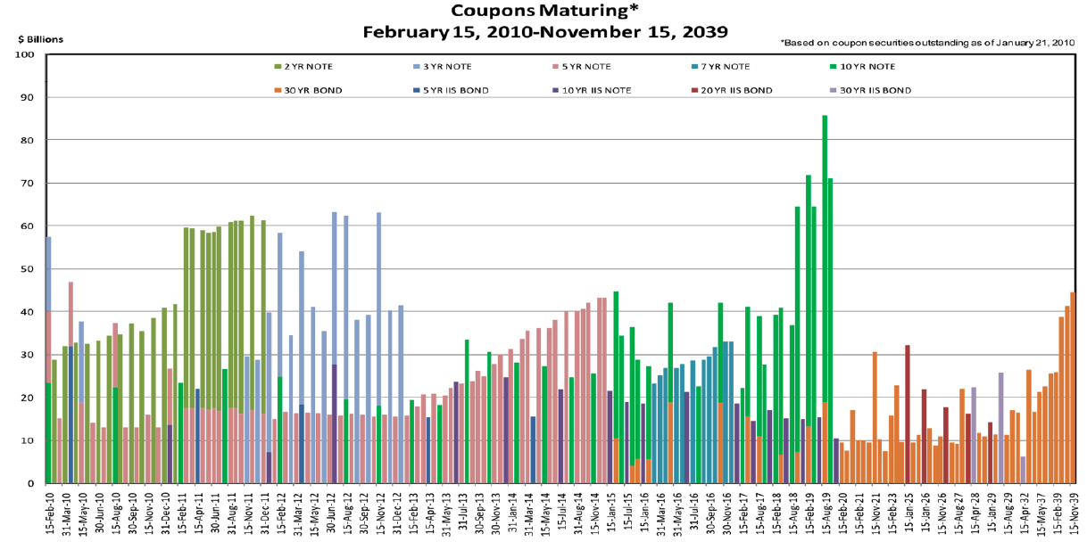
Effective Visualization
Not effective:
Notes:
our predictive models should learn how to appropriate weight each feature (independent variable), but that doesn’t excuse us from not checking out our data and ensuring nothing is wonky.

Slide 21
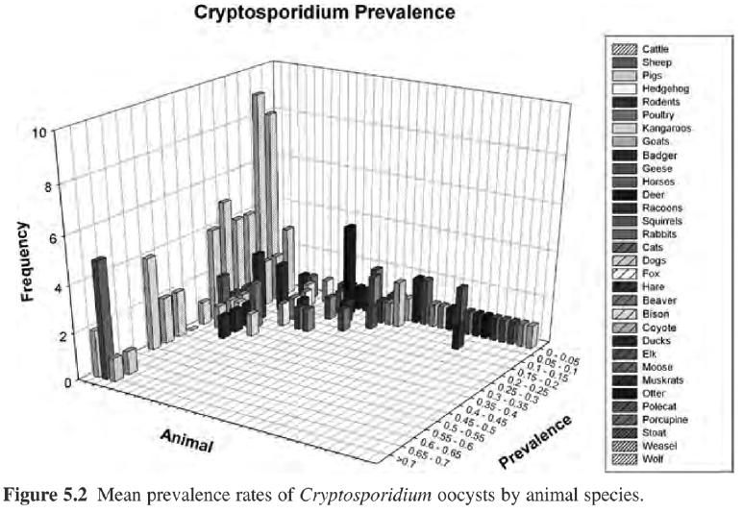
Effective Visualization
Not effective:
Notes:
our predictive models should learn how to appropriate weight each feature (independent variable), but that doesn’t excuse us from not checking out our data and ensuring nothing is wonky.

Slide 22
Lecture Outline
EDA Refresher
Effective Visualization
Graphical Integrity
Scope
Displays
Sensible Design
Communication
Motivation
Key Considerations
Notes:
For the most part, we’ve guided you on the plots by explicitly telling you which types of plots we want, but as you …

Slide 23
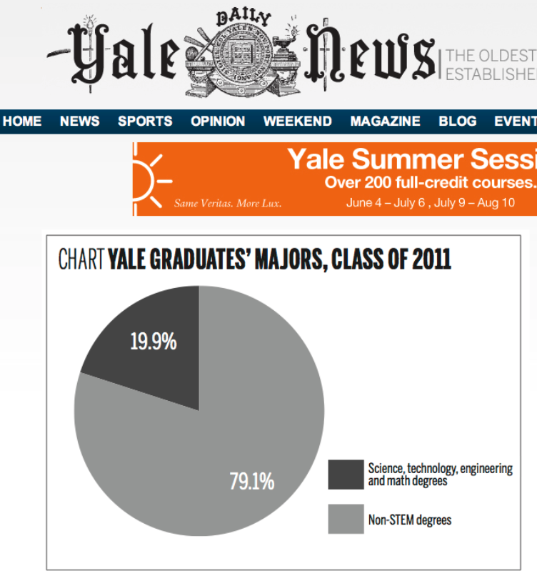
Graphical Integrity
What’s wrong?
Notes:
For the most part, we’ve guided you on the plots by explicitly telling you which types of plots we want, but as you …

Slide 24
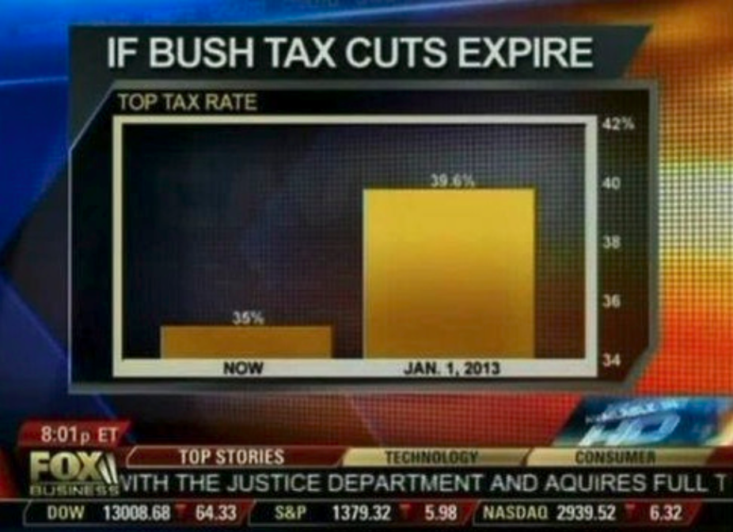
Graphical Integrity
What’s wrong?
Notes:
For the most part, we’ve guided you on the plots by explicitly telling you which types of plots we want, but as you …

Slide 25
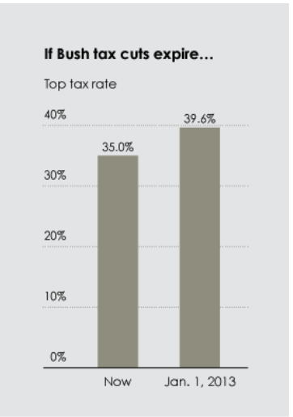
Graphical Integrity
What’s wrong?
Notes:
For the most part, we’ve guided you on the plots by explicitly telling you which types of plots we want, but as you …

Slide 26
Graphical Integrity
What’s wrong?
Notes:
For the most part, we’ve guided you on the plots by explicitly telling you which types of plots we want, but as you …

Slide 27
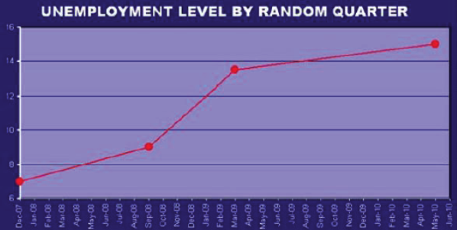
Graphical Integrity
What’s wrong?
Notes:
For the most part, we’ve guided you on the plots by explicitly telling you which types of plots we want, but as you …

Slide 28
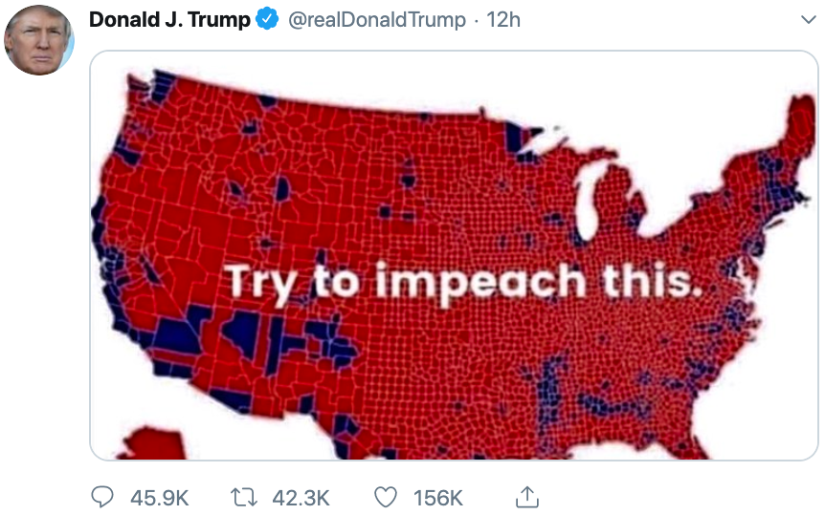
Graphical Integrity
What’s wrong?
October 1, 2019
Notes:
For the most part, we’ve guided you on the plots by explicitly telling you which types of plots we want, but as you …

Slide 29
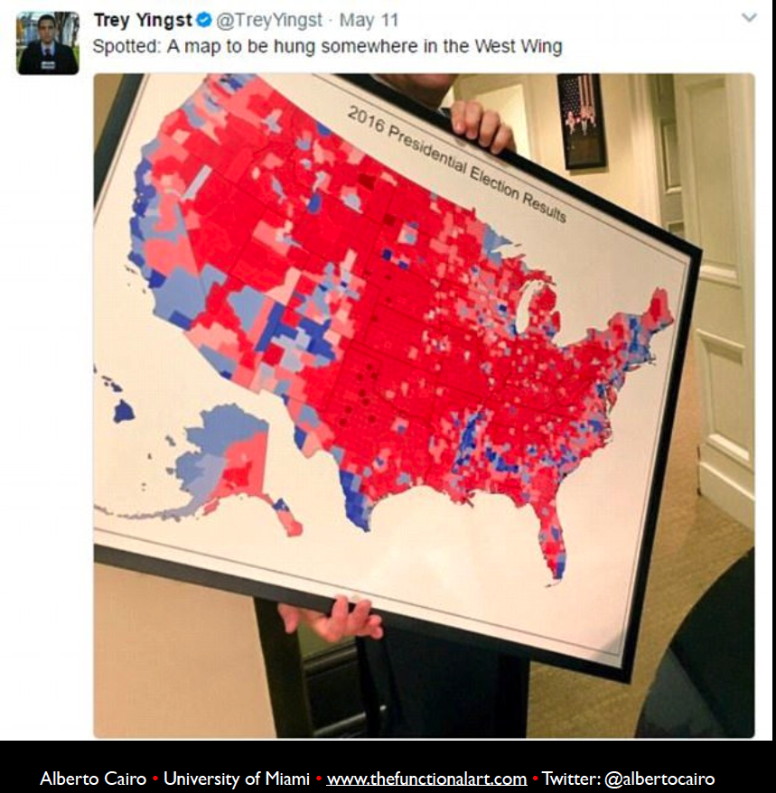
Graphical Integrity
Notes:
For the most part, we’ve guided you on the plots by explicitly telling you which types of plots we want, but as you …

Slide 30
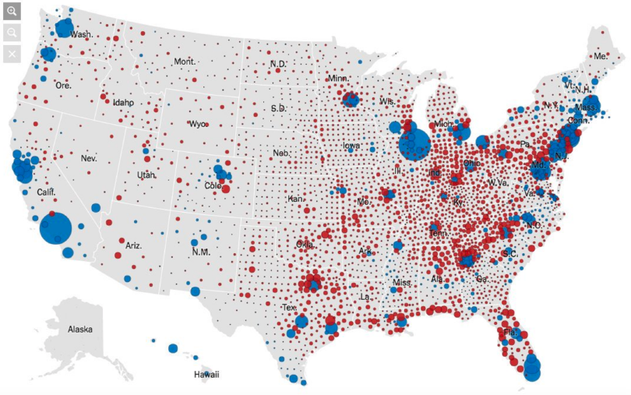
Graphical Integrity
Notes:
For the most part, we’ve guided you on the plots by explicitly telling you which types of plots we want, but as you …

Slide 31
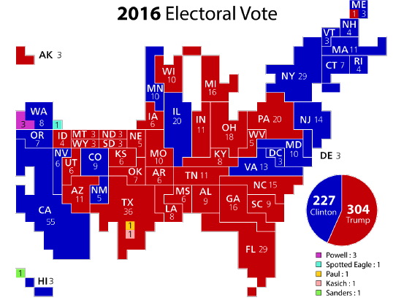
Graphical Integrity
Notes:
For the most part, we’ve guided you on the plots by explicitly telling you which types of plots we want, but as you …

Slide 32
Graphical Integrity
Lesson: be proportional
Notes:
For the most part, we’ve guided you on the plots by explicitly telling you which types of plots we want, but as you …

Slide 33
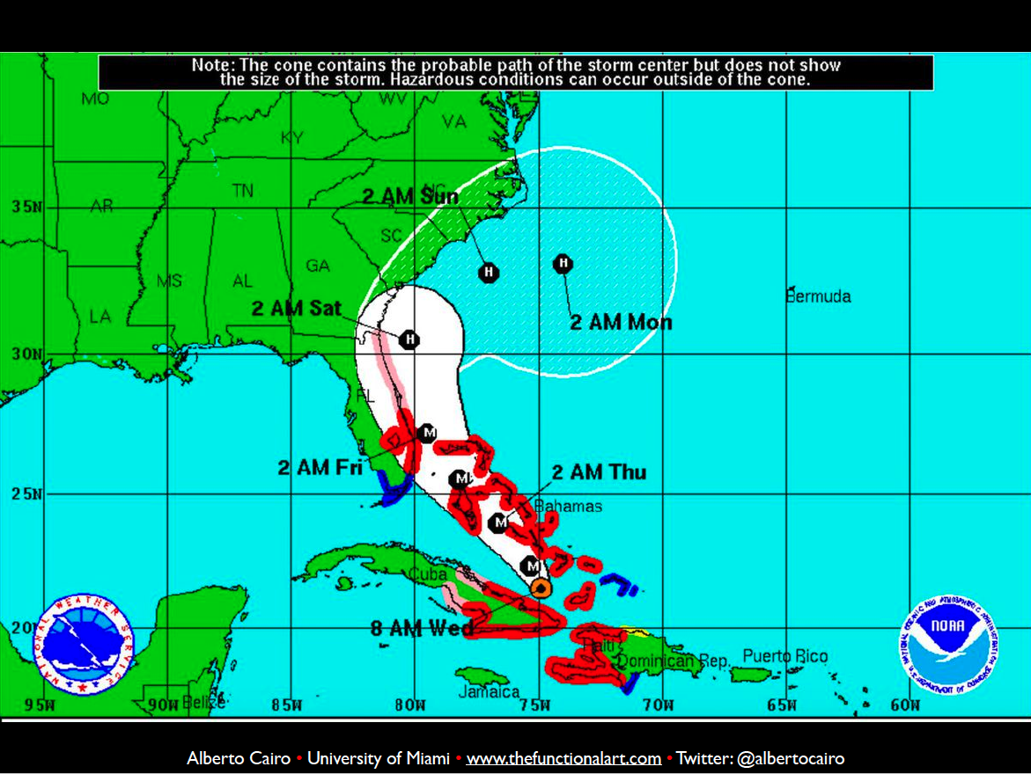
Graphical Integrity
What’s wrong?

Slide 34
Graphical Integrity
What’s wrong?

Slide 35
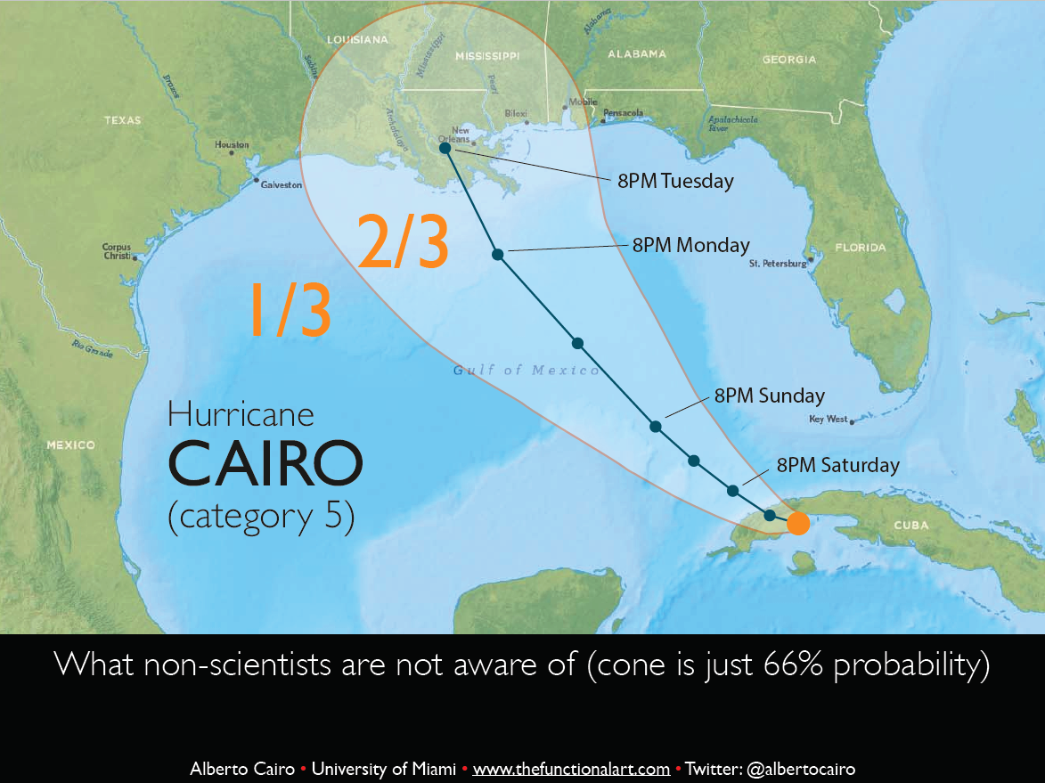
Graphical Integrity
What’s wrong?

Slide 36
Graphical Integrity
What’s wrong?

Slide 37
Graphical Integrity
Lesson: include uncertainty
Notes:
For the most part, we’ve guided you on the plots by explicitly telling you which types of plots we want, but as you …

Slide 38
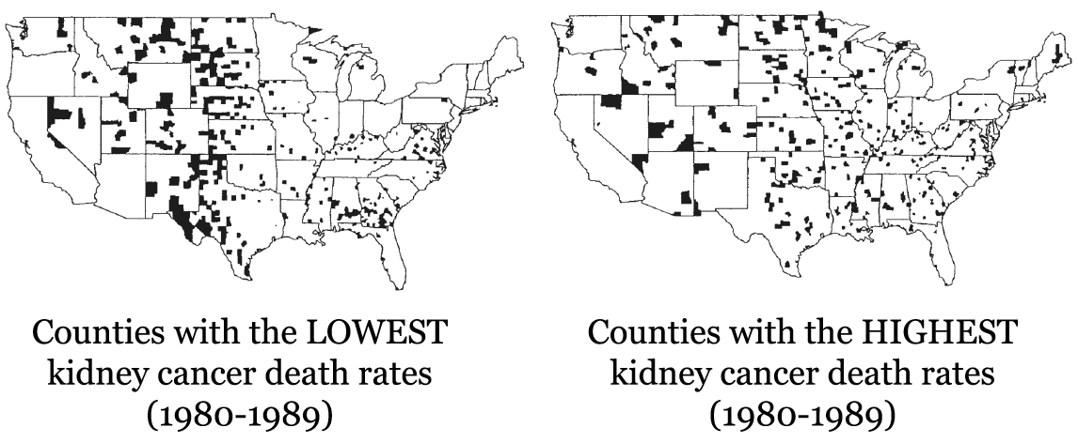
Graphical Integrity
What’s wrong?

Slide 39
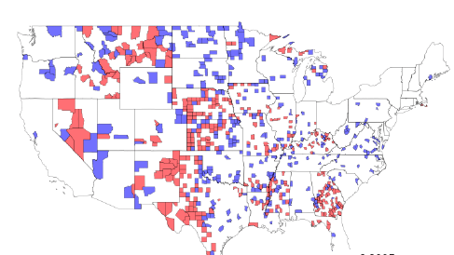
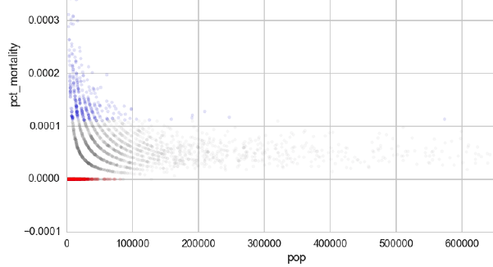
Graphical Integrity

Slide 40
Graphical Integrity
Lesson: plot all the data

Slide 41
Lecture Outline
EDA Refresher
Effective Visualization
Graphical Integrity
Scope
Displays
Sensible Design
Communication
Motivation
Key Considerations

Slide 42
Lecture Outline
EDA Refresher
Effective Visualization
Graphical Integrity
Scope
Displays
Sensible Design
Communication
Motivation
Key Considerations

Slide 43
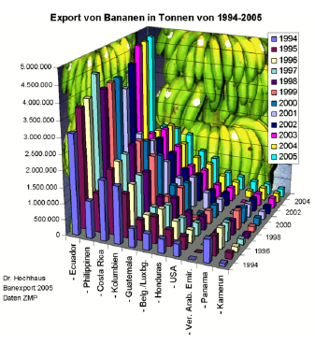
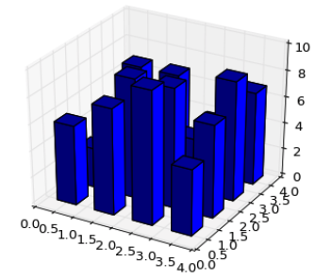
Scope
What’s wrong?

Slide 44
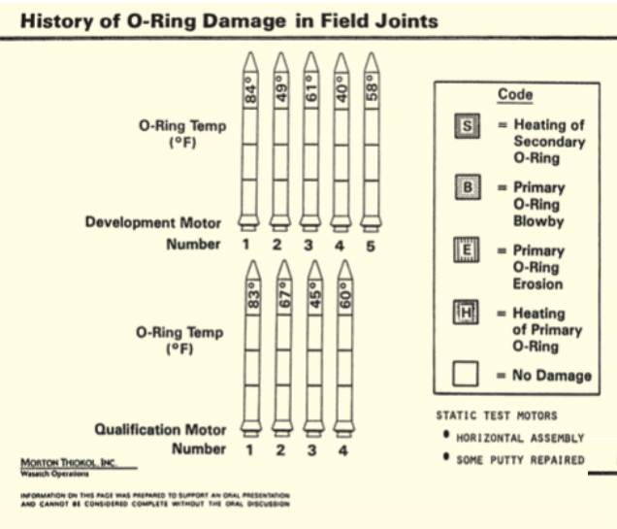
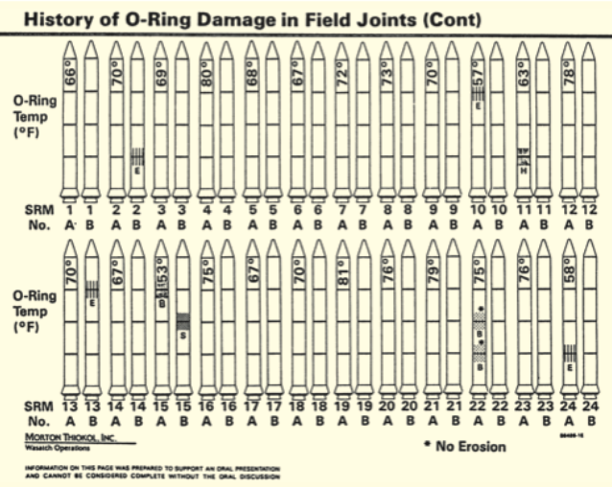
Scope
What’s wrong?

Slide 45
Scope
Lesson: keep it simple… enough

Slide 46
Scope
“You should have stayed with the soup question. The object of a question is to obtain information that matters only to us”
-- Sean Connery in Finding Forrester (movie)

Slide 47
Scope
Making plots is effectively providing an answer to an implicit question
You get to pick the answer
Ensure the answer doesn’t leave the viewer with uncertainty as to what it’s answering or the completeness of the answer
A good plot should invoke and inspire new questions

Slide 48
Lecture Outline
EDA Refresher
Effective Visualization
Graphical Integrity
Scope
Displays
Sensible Design
Communication
Motivation
Key Considerations

Slide 49
Lecture Outline
EDA Refresher
Effective Visualization
Graphical Integrity
Scope
Displays
Sensible Design
Communication
Motivation
Key Considerations

Slide 50
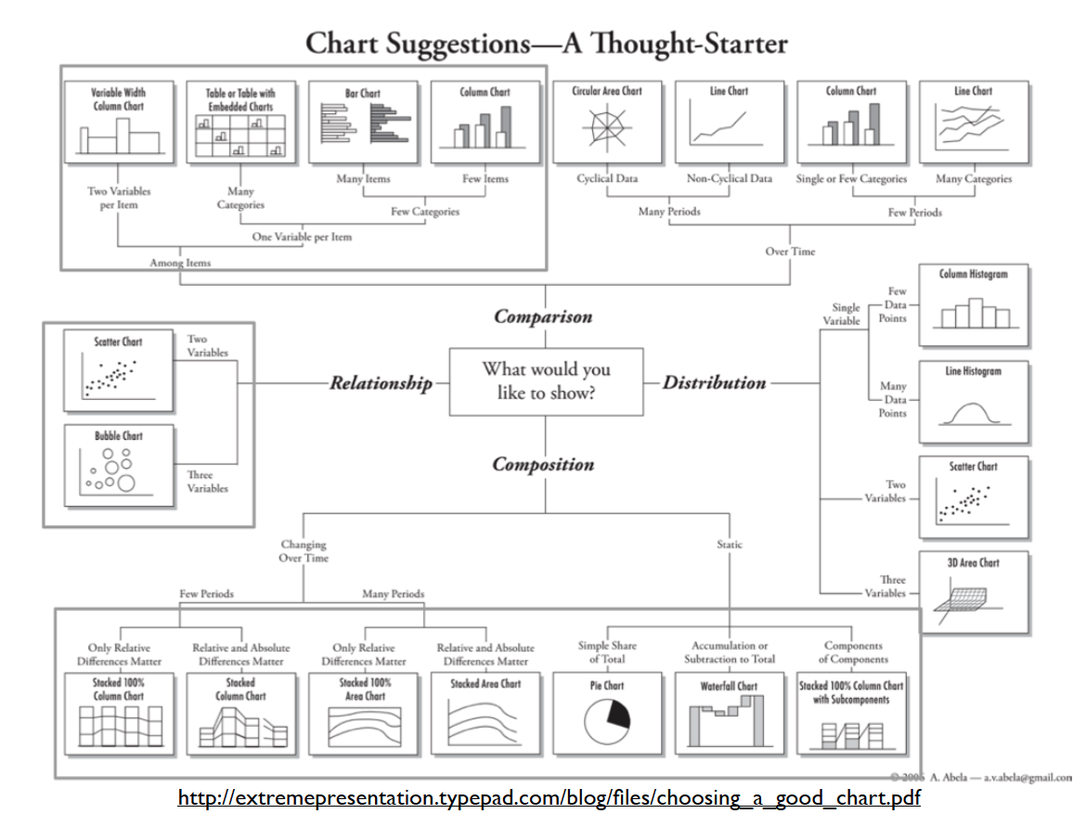
Displays

Slide 51
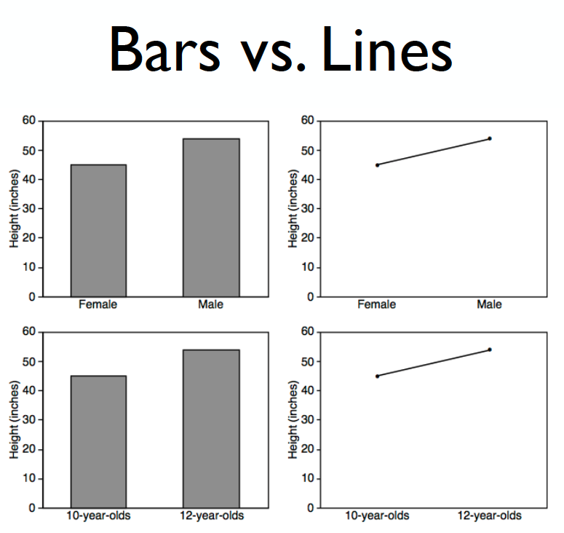
Displays: comparisons

Slide 52
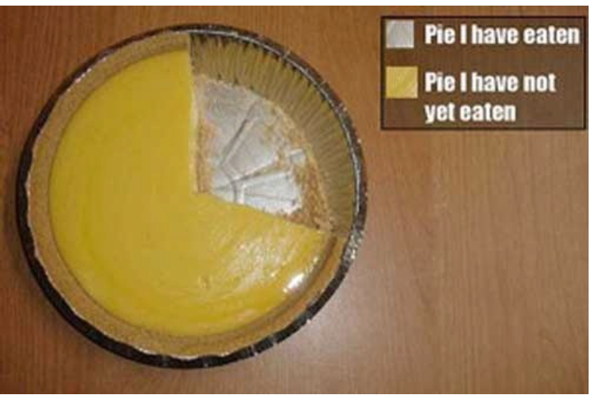
Displays: proportions

Slide 53
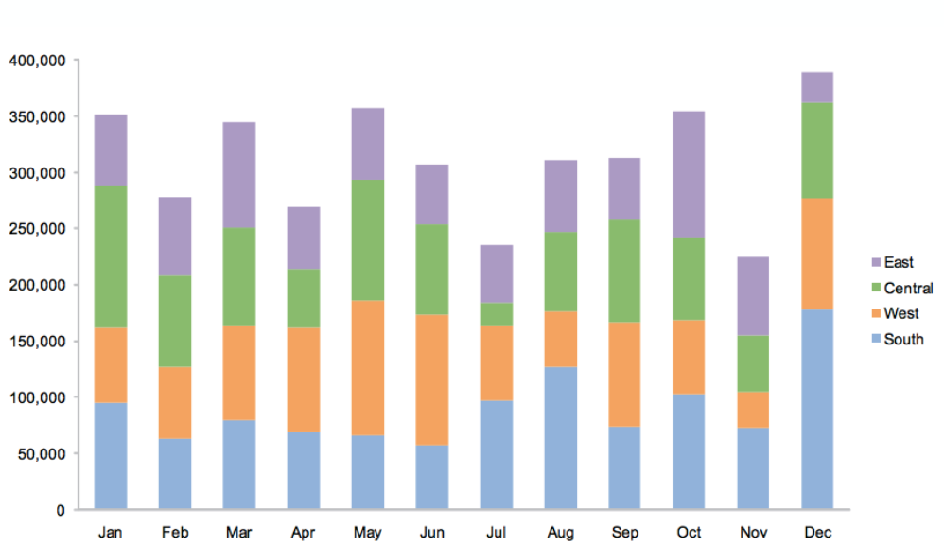
Displays: proportions

Slide 54
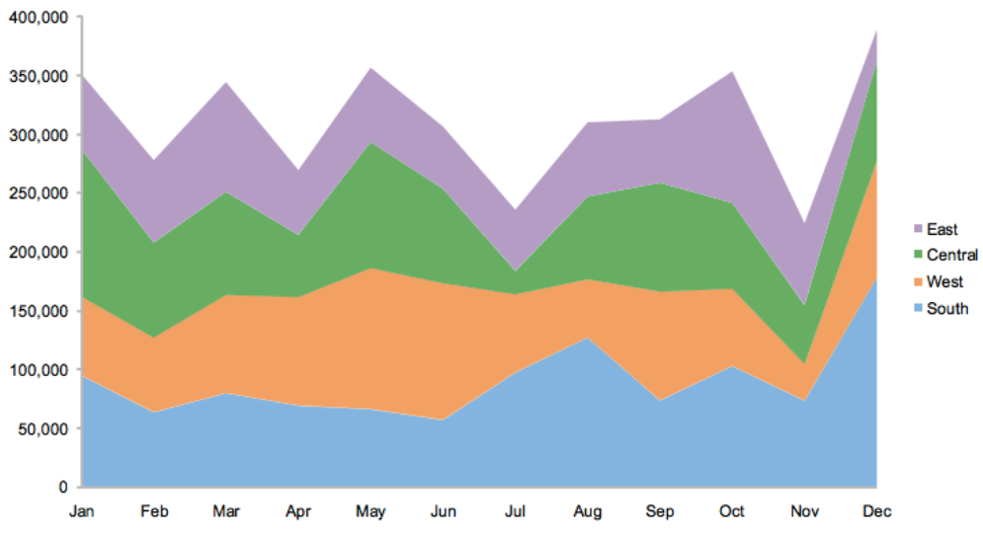
Displays: proportions

Slide 55
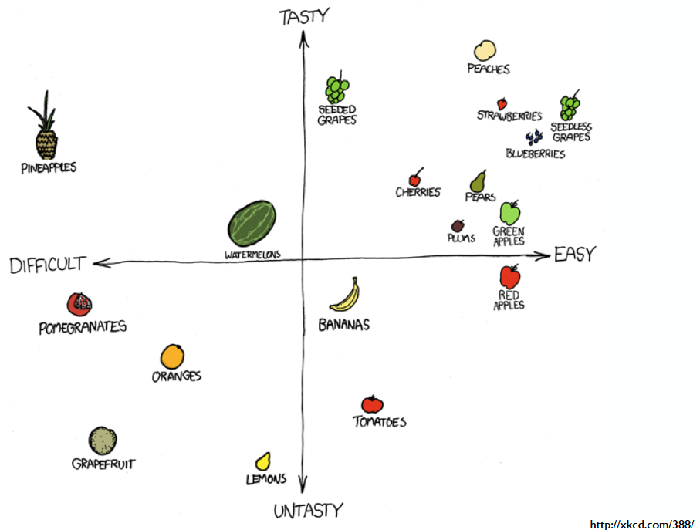
Displays: proportions

Slide 56
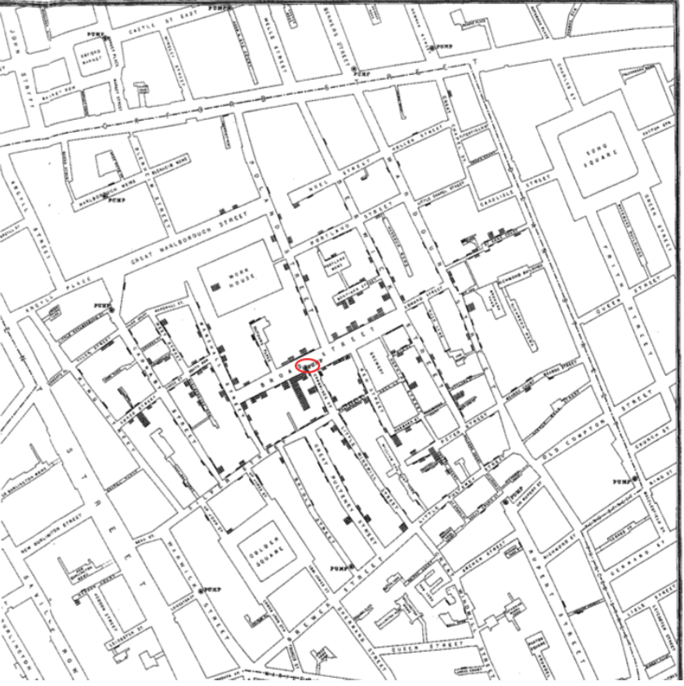
Displays: proportions
London Cholera Epidemic
-- Edward Tufte,
Visual and Statistical Thinking
Notes:
QUESTION< what is wrong w/ this?

Slide 57
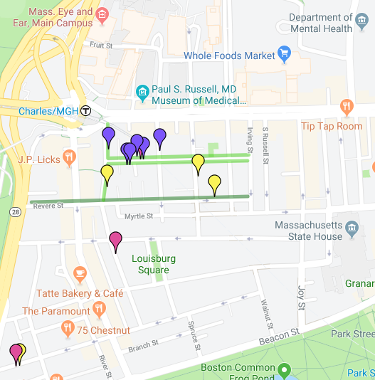
Displays: proportions
Notes:
QUESTION< what is wrong w/ this?

Slide 58
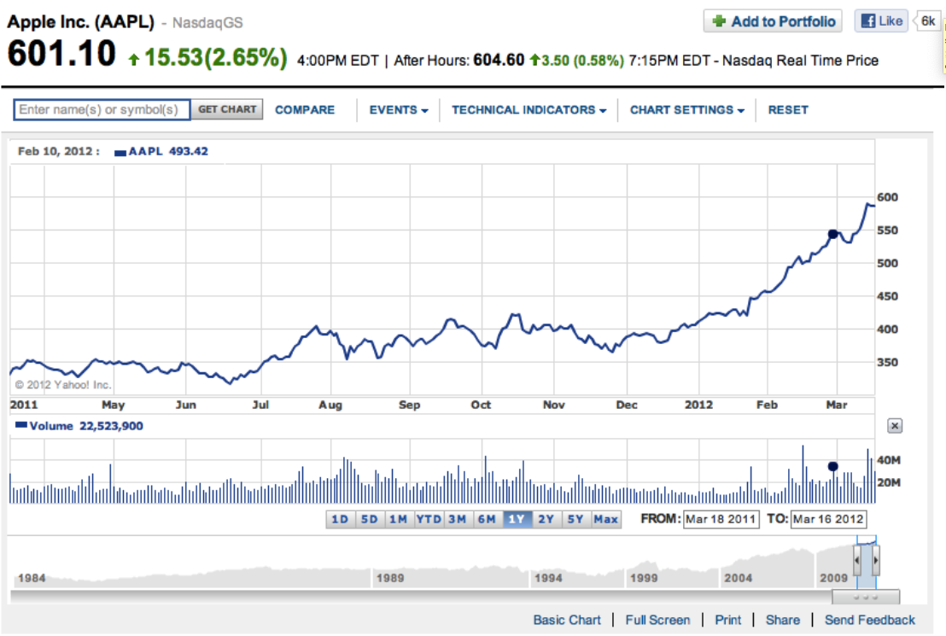
Displays: trends
Notes:
QUESTION< what is wrong w/ this?

Slide 59
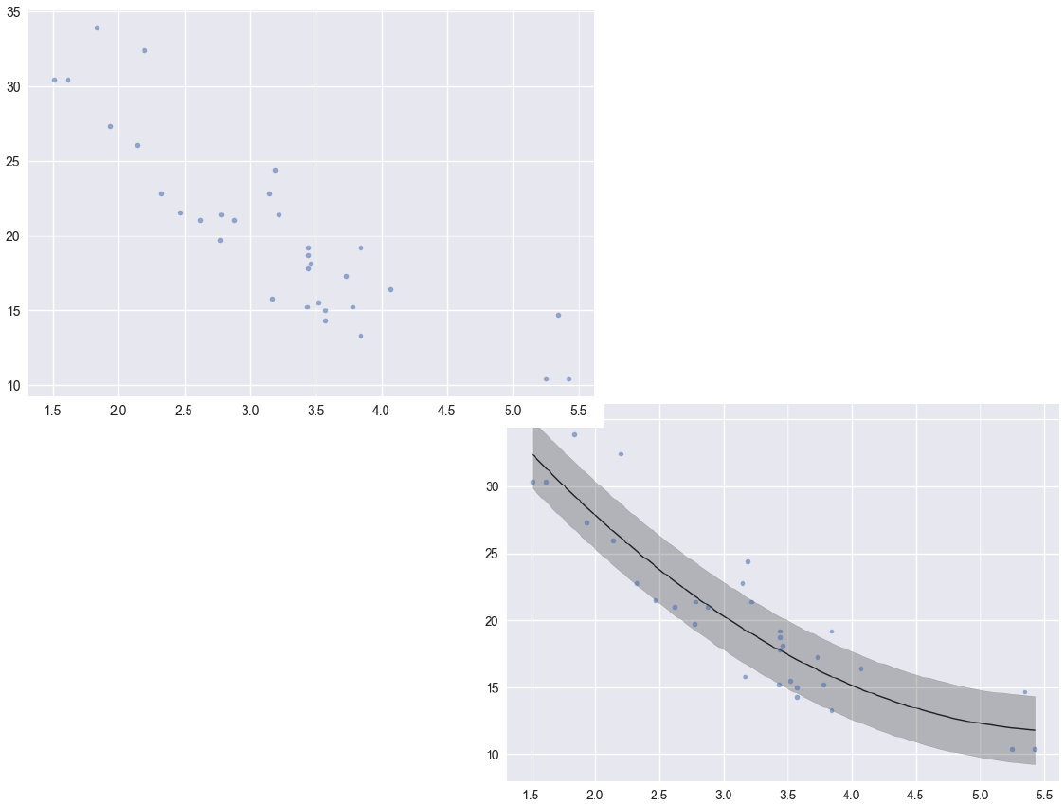
Displays: trends
Notes:
QUESTION< what is wrong w/ this?

Slide 60
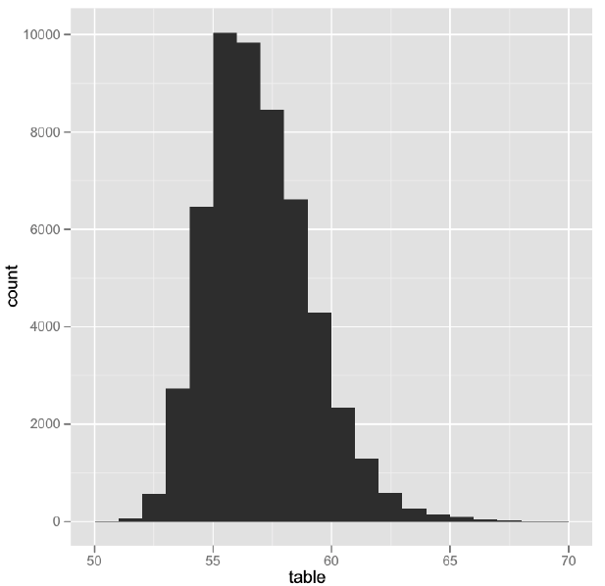
Displays: distributions
Notes:
QUESTION< what is wrong w/ this?

Slide 61
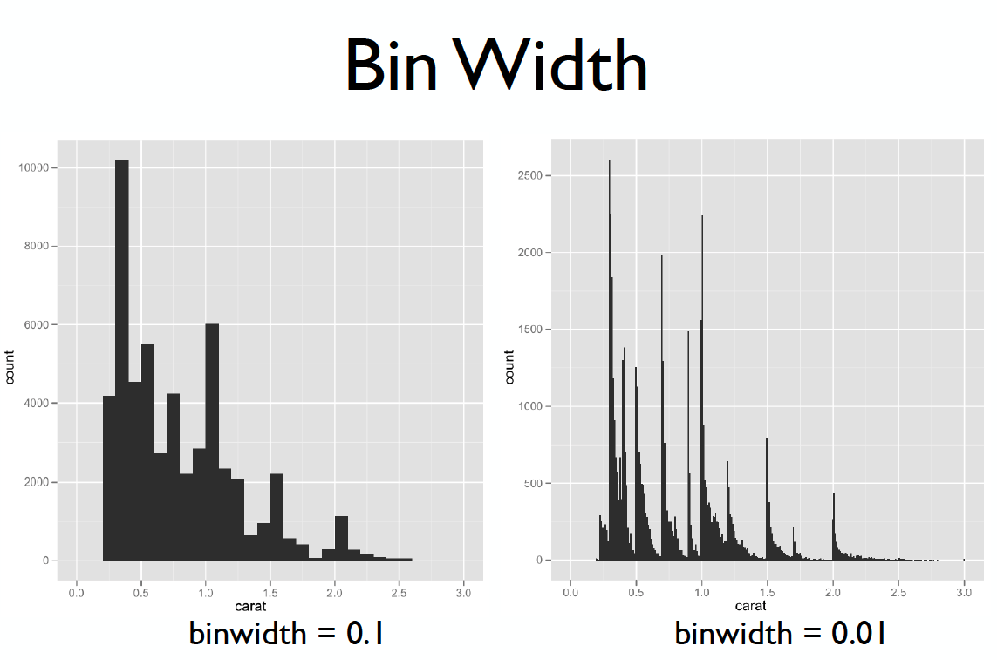
Displays: distributions
Notes:
QUESTION< what is wrong w/ this?

Slide 62
Displays: density plots
Notes:
QUESTION< what is wrong w/ this?

Slide 63
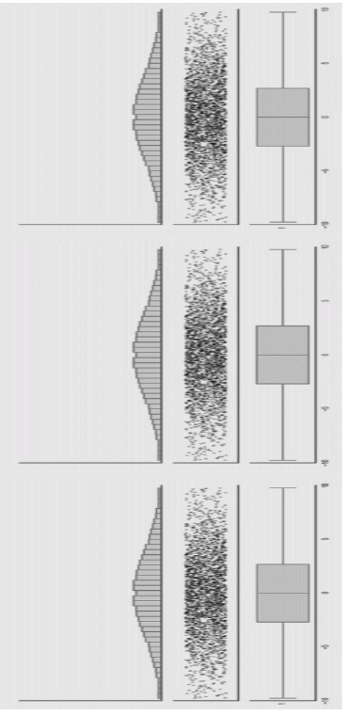
Displays: density plots

Slide 64
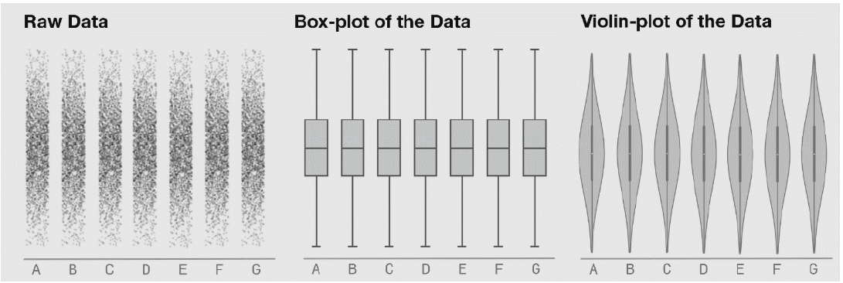
Displays: density plots

Slide 65
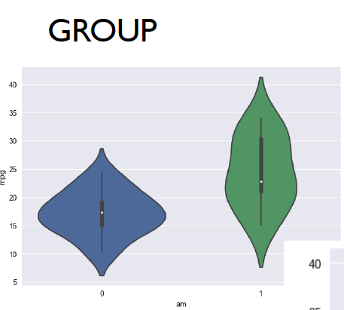
Displays: density plots

Slide 66
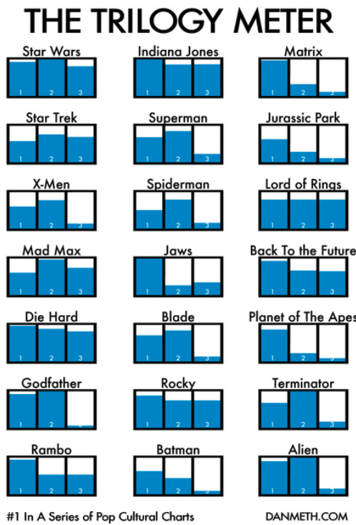
Displays: small multiples

Slide 67
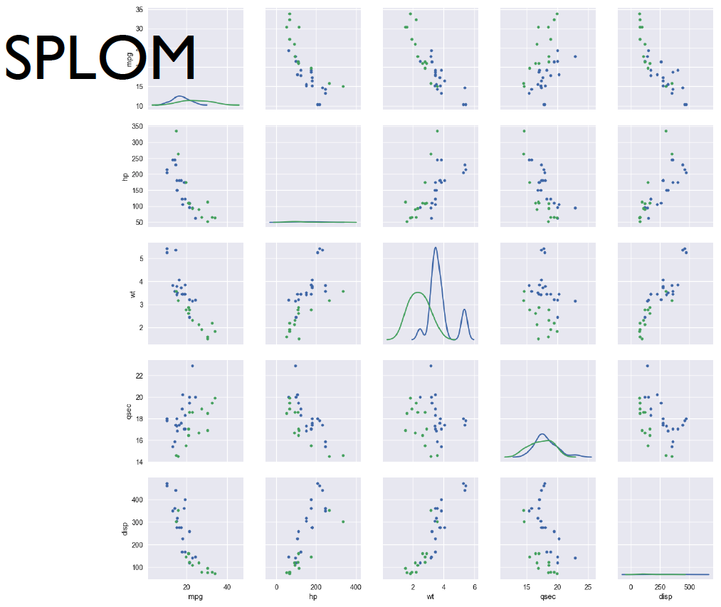
Displays: scatter plot matrix

Slide 68
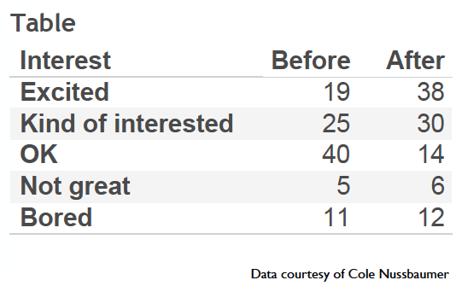
Displays: hands-on exercise
How do you feel about doing science?

Slide 69
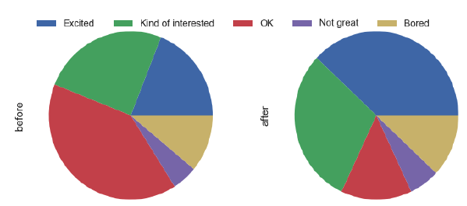
Displays: exercise options
Notes:
QUESTION< what is wrong w/ this?

Slide 70
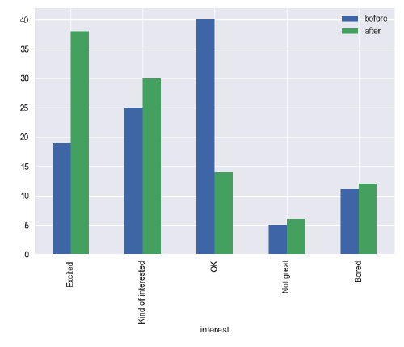
Displays: exercise options
Notes:
QUESTION< what is wrong w/ this?

Slide 71
Displays: exercise options
Notes:
QUESTION< what is wrong w/ this?

Slide 72
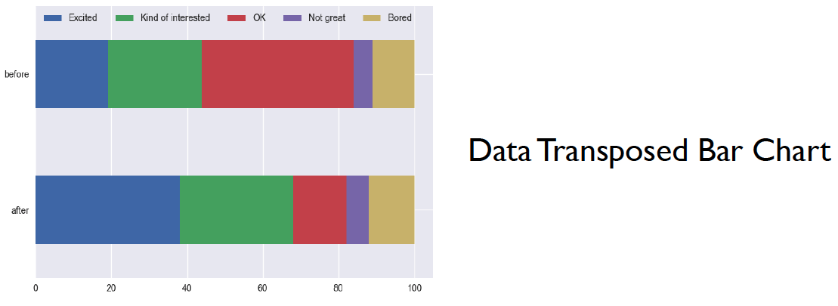
Displays: exercise options
Notes:
QUESTION< what is wrong w/ this?

Slide 73
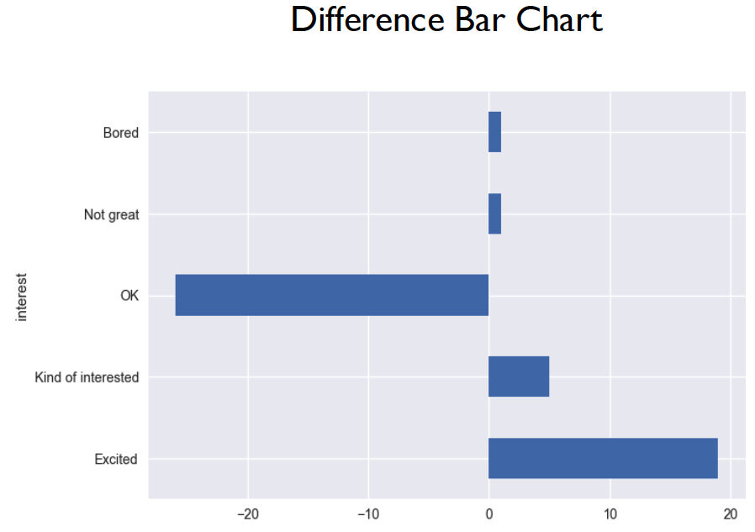
Displays: exercise options
Notes:
QUESTION< what is wrong w/ this?

Slide 74
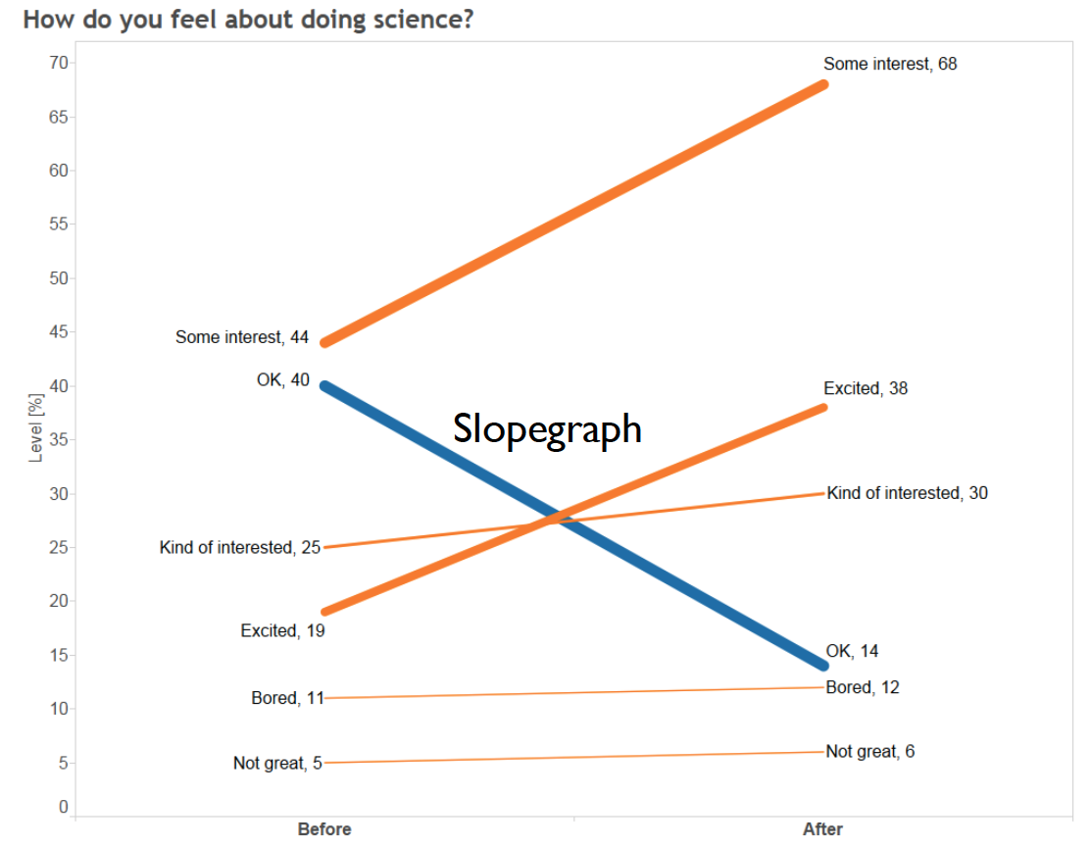
Displays: exercise options
Notes:
QUESTION< what is wrong w/ this?

Slide 75
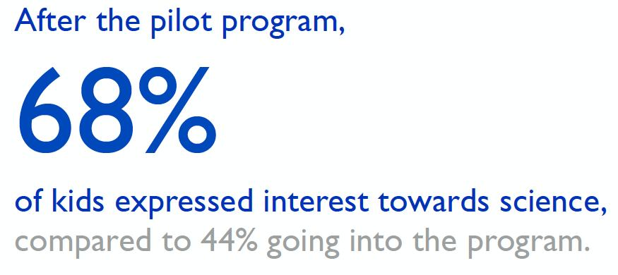
Displays: exercise options
Notes:
QUESTION< what is wrong w/ this?

Slide 76
Displays: perceptual effectiveness
Notes:
QUESTION< what is wrong w/ this?

Slide 77
Displays: perceptual effectiveness
4x
Notes:
QUESTION< what is wrong w/ this?

Slide 78
Displays: perceptual effectiveness
Notes:
QUESTION< what is wrong w/ this?

Slide 79
Displays: perceptual effectiveness
4x
Notes:
QUESTION< what is wrong w/ this?

Slide 80
Displays: perceptual effectiveness
Notes:
QUESTION< what is wrong w/ this?

Slide 81
Displays: perceptual effectiveness
10x
Notes:
QUESTION< what is wrong w/ this?

Slide 82
Displays: perceptual effectiveness
Notes:
QUESTION< what is wrong w/ this?

Slide 83
Displays: perceptual effectiveness
2x
Notes:
QUESTION< what is wrong w/ this?

Slide 84
Displays: perceptual effectiveness
Notes:
QUESTION< what is wrong w/ this?

Slide 85
Displays: perceptual effectiveness
4x
Notes:
QUESTION< what is wrong w/ this?

Slide 86
Displays: perceptual effectiveness
Notes:
QUESTION< what is wrong w/ this?

Slide 87
Displays: perceptual effectiveness
Notes:
QUESTION< what is wrong w/ this?

Slide 88
Displays: perceptual effectiveness
Notes:
QUESTION< what is wrong w/ this?

Slide 89
Displays: perceptual effectiveness
Notes:
QUESTION< what is wrong w/ this?

Slide 90
Lecture Outline
EDA Refresher
Effective Visualization
Graphical Integrity
Scope
Displays
Sensible Design
Communication
Motivation
Key Considerations

Slide 91
Lecture Outline
EDA Refresher
Effective Visualization
Graphical Integrity
Scope
Displays
Sensible Design
Communication
Motivation
Key Considerations

Slide 92
Sensible Design: colors
Notes:
QUESTION< what is wrong w/ this?

Slide 93
Sensible Design: colors
Notes:
QUESTION< what is wrong w/ this?

Slide 94
Sensible Design: colors
Notes:
QUESTION< what is wrong w/ this?

Slide 95
Sensible Design: colors
Notes:
QUESTION< what is wrong w/ this?

Slide 96
Sensible Design: colors
Notes:
QUESTION< what is wrong w/ this?

Slide 97
Sensible Design: colors
Notes:
QUESTION< what is wrong w/ this?

Slide 98
Sensible Design: colors
Notes:
QUESTION< what is wrong w/ this?

Slide 99
Sensible Design: colors
Notes:
QUESTION< what is wrong w/ this?

Slide 100
Sensible Design: colors
Great sites for selecting color schemes:
http://colorbrewer2.org
https://coolors.co/
Notes:
QUESTION< what is wrong w/ this?

Slide 101
Sensible Design: colors
Notes:
QUESTION< what is wrong w/ this?

Slide 102
Sensible Design: colors
Notes:
QUESTION< what is wrong w/ this?

Slide 103
Sensible Design: colors
Notes:
QUESTION< what is wrong w/ this?

Slide 104
Sensible Design: colors
Notes:
QUESTION< what is wrong w/ this?

Slide 105
Sensible Design: fonts
How much do you trust this text?
How much do you trust this text?
How much do you trust this text?
How much do you trust this text?
Notes:
QUESTION< what is wrong w/ this?

Slide 106
Sensible Design: intuitive
The everyday items that are designed the best are the ones that we never have to think about how to use/interact with it.
Can you think of examples?
Notes:
QUESTION< what is wrong w/ this?

Slide 107
Sensible Design
Lesson: design matters

Slide 108
Lecture Outline
EDA Refresher
Effective Visualization
Graphical Integrity
Scope
Displays
Sensible Design
Communication
Motivation
Key Considerations

Slide 109
Lecture Outline
EDA Refresher
Effective Visualization
Graphical Integrity
Scope
Displays
Sensible Design
Communication
Motivation
Key Considerations

Slide 110
Lecture Outline
EDA Refresher
Effective Visualization
Graphical Integrity
Scope
Displays
Sensible Design
Communication
Motivation
Key Considerations

Slide 111
Analysis vs Communication
Analyze (Exploratory)
Explore the data
Assess a situation
Determine how to proceed
Decide what to do
Communicate (Explanatory)
Present data and ideas
Explain and inform
Provide evidence and support
Influence and persuade

Slide 113
Communicate: Motivation

Slide 116
Lecture Outline
EDA Refresher
Effective Visualization
Graphical Integrity
Scope
Displays
Sensible Design
Communication
Motivation
Key Considerations

Slide 117
Communication
Key Considerations
Who is your audience
What questions are you answering?
Why should the audience care?
What are your major insights and surprises?
What change do you want to affect?

Slide 118
Communication

Slide 119
Communication

Slide 120
Communication

Slide 121
Communication

Slide 122
Communication

Slide 123
Communication
Final Takeaways
How you choose to display your data greatly influences how people interpret the data
Humans are visual, emotional creations; make graphs that don’t make others feel confused, insulted, etc
Your graphs should illicit good feelings and effectively convey your narrative

