Slide 1
Lecture 8: EDA

Slide 2
Lecture Outline
Data Science Process Example
Dataset considerations
Comprehensive vs Sampled
Biases
Visualization
Exploration (EDA)
Communication
Notes:
multi-linear regression
Polynomial regression
Cycle back and talk more about the earlier stages of the data science process, so that you can better make use of data and the models that you’ll learn

Slide 3
Lecture Outline
Data Science Process Example
Dataset considerations
Comprehensive vs Sampled
Biases
Visualization
Exploration (EDA)
Communication

Slide 4
Example
Let’s say that we are interested in the English Premier League (football/soccer) and want to build a model to predict a player’s market value.
Question
Does age affect one’s market value?

Slide 5
Example
What do we do?

Slide 6
Example
Ask an interesting question
What do we do?
Get the Data
Explore the Data
Model the Data
Communicate/Visualize the Results

Slide 7
Dataset Considerations
What data is necessary to answer our question?
Is the source credible/authoritative? (.com, .net, .org, .gov, .name)
How difficult is it to analyze the dataset? (photos, videos, text?)
What is the allowed usage of data under its license?
Who collected the data?
When was the data collected?

Slide 8
Dataset Considerations (continued)
How was the data collected?
How is the data formatted?
Confidentiality concerns
Does your data collection procedures need to be approved by an IRB?
Comprehensive data vs sampled data?
Biases

Slide 9
Dataset Considerations (continued)
How was the data collected?
How is the data formatted?
Confidentiality concerns
Does your data collection procedures need to be approved by an IRB?
Comprehensive data vs sampled data?
Biases

Slide 10
Lecture Outline
Data Science Process Example
Dataset considerations
Comprehensive vs Sampled
Biases
Visualization
Exploration (EDA)
Communication

Slide 11
Dataset Considerations: Comprehensive Data
We have access to all the data points that exist, which is usually a lot
Collected and digitized as part of generalized procedures of an institution
13 million articles
~500 million tweets per day
100,000s votes per year
Notes:
ALL DATA COLLECTED

Slide 12
Dataset Considerations: Sampled Data
When collecting individual data is relatively expensive
Only a portion of the population is sampled
Not just restricted to polling or surveys

Slide 13
Lecture Outline
Data Science Process Example
Dataset considerations
Comprehensive vs Sampled
Biases
Visualization
Exploration (EDA)
Communication

Slide 14
Dataset Considerations: Biases
A bias in sampled data occurs when a procedure causes the sample to overrepresent a subpopulation
Biases may not necessarily be intentional
Even if you don’t think over-representation of a subpopulation will bias the dataset with regard to your question, it’s still a bias
Always strive to minimize any biases in your data collection procedures

Slide 15
Dataset Considerations: Biases
Gallup Polls
Randomly calls two groups of ~500 people a day by sampling among all possible phone numbers
For landlines, asks for household member who has the next birthday
Calls people living in all 50 states
Tries to assure 70% cellphone, 30% landlines
Weights data to reflect the demographics of the general population

Slide 16
Dataset Considerations: Biases
IMDb Movie Ratings
Registered users rate films 1-10 stars; they are an overrepresented subpopulation relative to the general population
Registered users who rate movies in their free time further over represents a specific segment of the general population
“Men Are Sabotaging The Online Reviews Of TV Shows Aimed At Women¹”
60% who rated Sex in the City were women. Women gave it a 8.1, men gave it 5.8.
¹ fivethirtyeight.com
Notes:
Q-scores

Slide 17
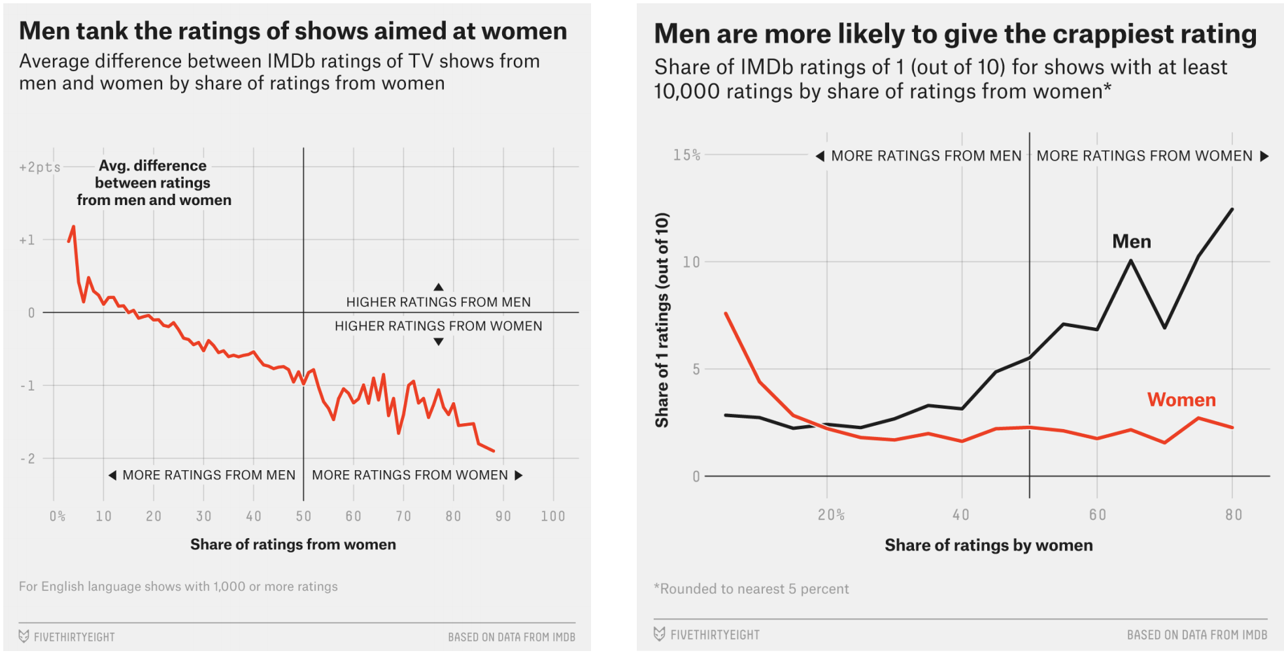
Dataset Considerations: Biases
IMDb Movie Ratings
Notes:
Avg men ratings – avg women ratings

Slide 18
Dataset Considerations: Biases
Yelp Reviews
Registered users rate businesses on a 1-5 star scale
Registered users tend to represent a certain subset of the population (those who are more social media inclined and opinionated)
Customers with extreme experiences are more likely to voice their opinions

Slide 19
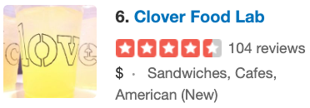
Dataset Considerations: Biases
Yelp Reviews

Slide 20
Dataset Considerations: Biases
Yelp Reviews
Longwood Medical
Harvard Square

Slide 21
Back to our example…
Let’s say that we are interested in the English Premier League (football/soccer) and want to build a model to predict a player’s market value.
Question
Does age affect one’s market value?

Slide 22
Example: Get the data
name
club
age
position
market value
Alexis Sanchez
Arsenal
28
LW
65
Mesut Ozil
Arsenal
28
AM
50
Petr Cech
Arsenal
35
GK
7
Theo Walcott
Arsenal
28
RW
20
Laurent Koscielny
Arsenal
31
CB
22
from www.transfermarkt.us

Slide 23
Example: Get the data
name
club
age
position
market value
Alexis Sanchez
Arsenal
28
LW
65
Mesut Ozil
Arsenal
28
AM
50
Petr Cech
Arsenal
35
GK
7
Credible/Trustworthy?
Possibly subjective market values?
Sampled data
Theo Walcott
Arsenal
28
RW
20
Laurent Koscielny
Arsenal
31
CB
22
from www.transfermarkt.us

Slide 24
Example
name
club
age
position
market value
Alexis Sanchez
Arsenal
28
LW
65
Mesut Ozil
Arsenal
28
AM
50
Petr Cech
Arsenal
35
GK
7
Theo Walcott
Arsenal
28
RW
20
Laurent Koscielny
Arsenal
31
CB
22

Slide 25
Example: Explore the Data
name
club
age
position
market value
Alexis Sanchez
Arsenal
28
LW
65
Mesut Ozil
Arsenal
28
AM
50
Petr Cech
Arsenal
35
GK
7
Theo Walcott
Arsenal
28
RW
20
Laurent Koscielny
Arsenal
31
CB
22
Does it contain the necessary information?
Notes:
So let’s go deeper

Slide 26
Example: Explore the Data
name
club
age
position
market value
Alexis Sanchez
Arsenal
28
LW
65
Mesut Ozil
Arsenal
28
AM
50
Petr Cech
Arsenal
35
GK
7
Theo Walcott
Arsenal
28
RW
20
Laurent Koscielny
Arsenal
31
CB
22
Missing data? Imputation needed?

Slide 27
Example: Explore the Data
name
club
age
position
market value
Alexis Sanchez
Arsenal
28
LW
65
Mesut Ozil
Arsenal
28
AM
50
Petr Cech
Arsenal
35
GK
7
Theo Walcott
Arsenal
28
RW
20
Laurent Koscielny
Arsenal
31
CB
22
Are the data types okay (df.dtypes)? Should be casted?
Notes:
If it’s not homogeneous, then it would report that the data type is an object

Slide 28
Example: Explore the Data
name
club
age
position
market value
Alexis Sanchez
Arsenal
28
LW
65
Mesut Ozil
Arsenal
28
AM
50
Petr Cech
Arsenal
35
GK
7
Theo Walcott
Arsenal
28
RW
20
Laurent Koscielny
Arsenal
31
CB
22
Are the values reasonable? DataFrame.describe() …

Slide 29
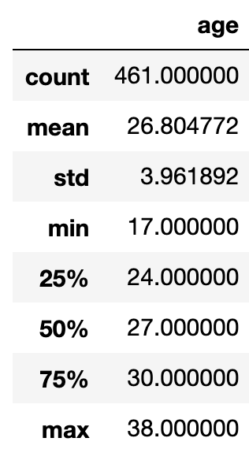
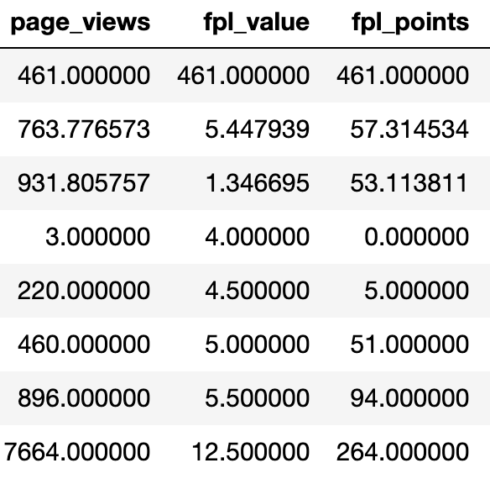
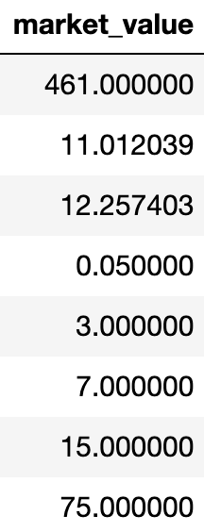
Example: Explore the Data
Are the values reasonable? DataFrame.describe() …

Slide 30
Example: Explore the Data
Summary statistics can only reveal so much
Notes:
The summary statistics just provide a very high-level snapshot of the data, whereas if we plot all of the data, it can allow us to see …. The big picture [horrible pun]

Slide 31
Lecture Outline
Data Science Process Example
Dataset considerations
Comprehensive vs Sampled
Biases
Visualization
Exploration (EDA)
Communication

Slide 32
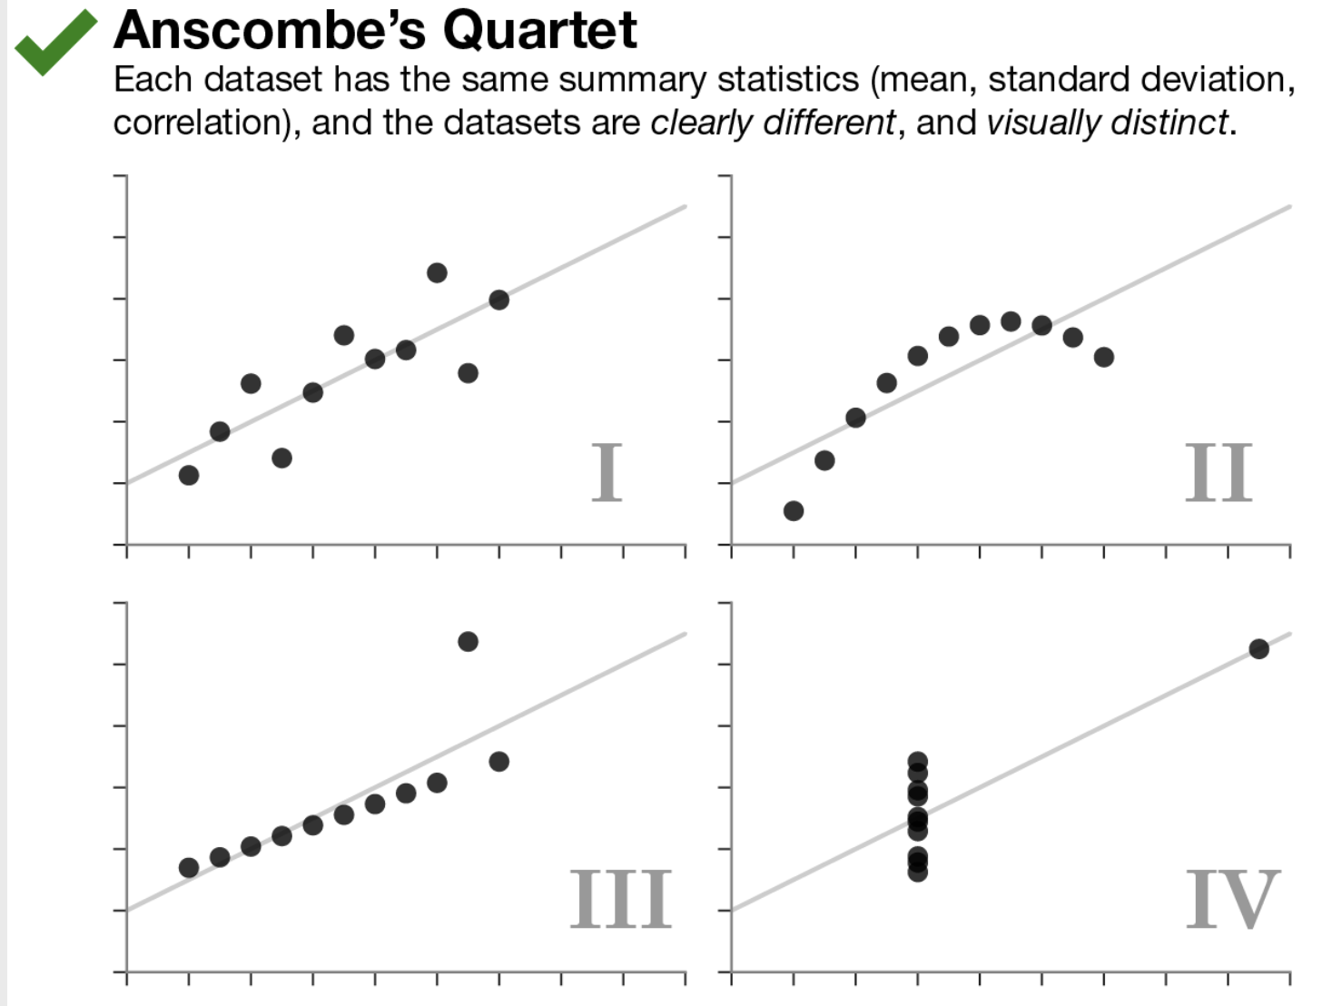
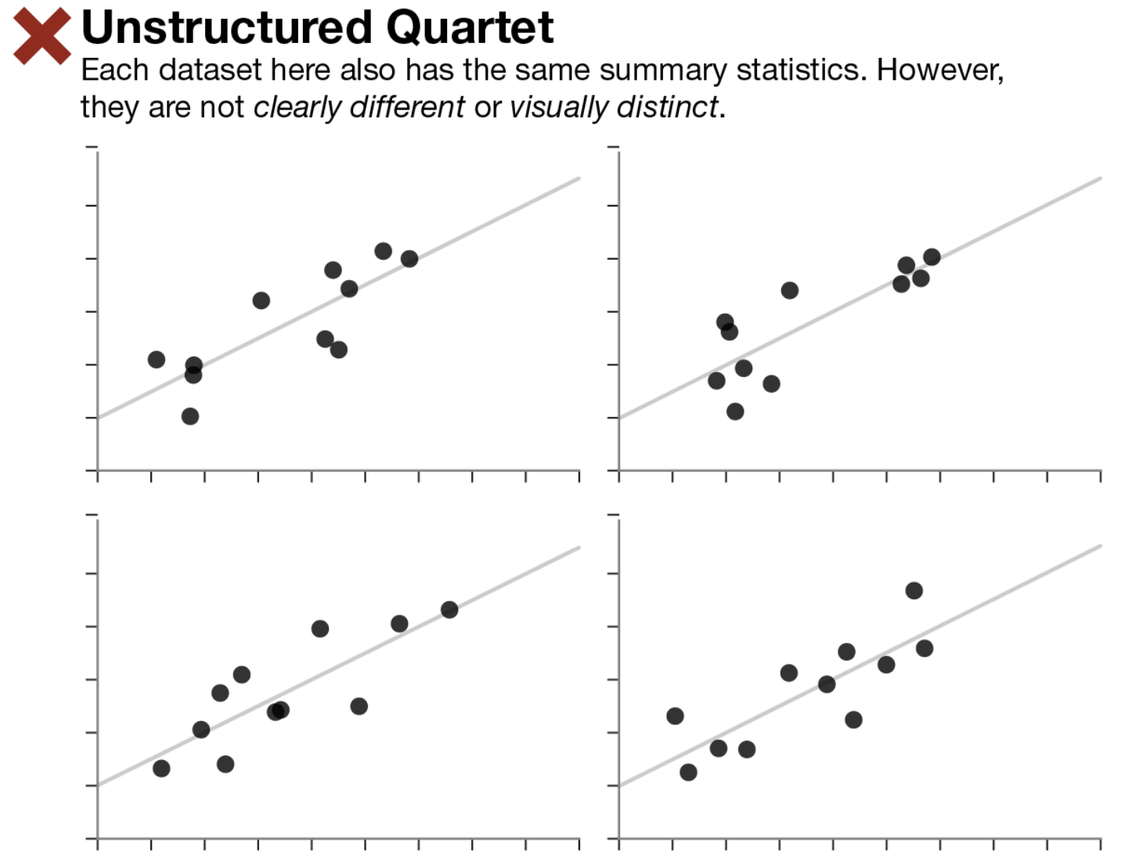
Visualization
Same stats do not imply same graphs
Same graphs do not imply same stats
Notes:
Visualizations should supplement your data analysis. It’s not always better than looking at just the statistics; it’s added information.

Slide 33
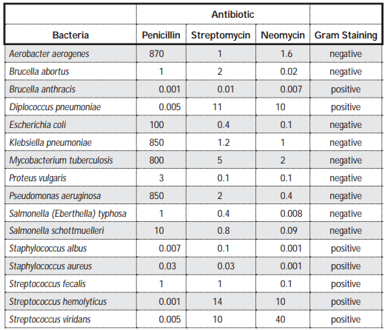
Visualization
Notes:
Put dark purple dye on the bacteria –
Decolorize it (put a solvent on it to remove the dye)
Some bacteria will bind to the dye (irreversibly so the dye cant wash off, others wont)
The ones that do bind to it are gram positive. The ones that don’t are pink and are called gram negative.
It tells you something about the structure of the cell wall.
Some antibiotics only work on gram positive or gram negative – so a main point of gram staining is that it’s a quick way of letting you know which types of bacteria it might be, and thus antibiotics may be effective

Slide 34
Visualization
Notes:
Put dark purple dye on the bacteria –
Decolorize it (put a solvent on it to remove the dye)
Some bacteria will bind to the dye (irreversibly so the dye cant wash off, others wont)
The ones that do bind to it are gram positive. The ones that don’t are pink and are called gram negative.
It tells you something about the structure of the cell wall.
Some antibiotics only work on gram positive or gram negative – so a main point of gram staining is that it’s a quick way of letting you know which types of bacteria it might be, and thus antibiotics may be effective

Slide 35
Visualization
What are some questions we could ask?

Slide 36
Visualization
Q: How effective are the antibiotics?

Slide 37
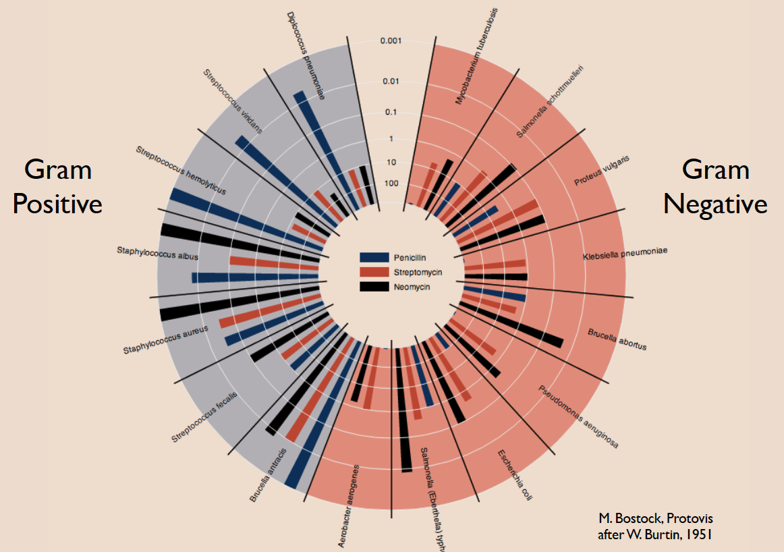

Slide 38
If bacteria is gram positive, Penicillin & Neomycin are most effective
If bacteria is gram negative, Neomycin is most effective

Slide 39
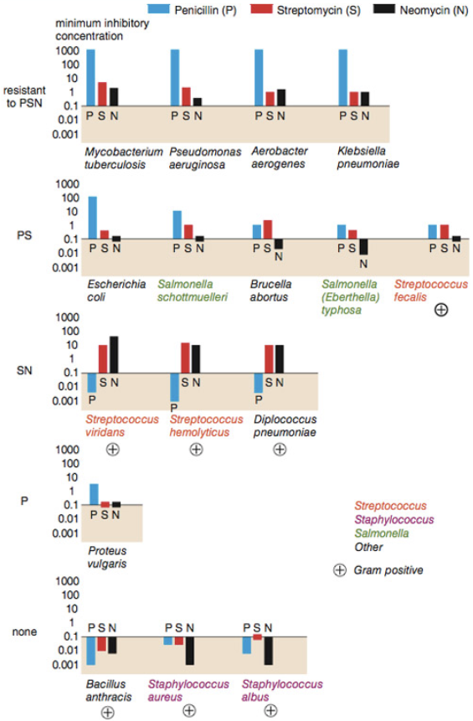
How do the bacteria compare?
Wainer & Lysen, “That’s funny...”
American Scientist, 2009
Adapted from Brian Schmotzer

Slide 40
How do the bacteria compare?
Wainer & Lysen, “That’s funny...”
American Scientist, 2009
Adapted from Brian Schmotzer

Slide 41
How do the bacteria compare?
Not a streptococcus! (realized ~30 years later)
Actually a streptococcus! (realized ~20 years later)
Wainer & Lysen, “That’s funny...”
American Scientist, 2009
Adapted from Brian Schmotzer

Slide 42
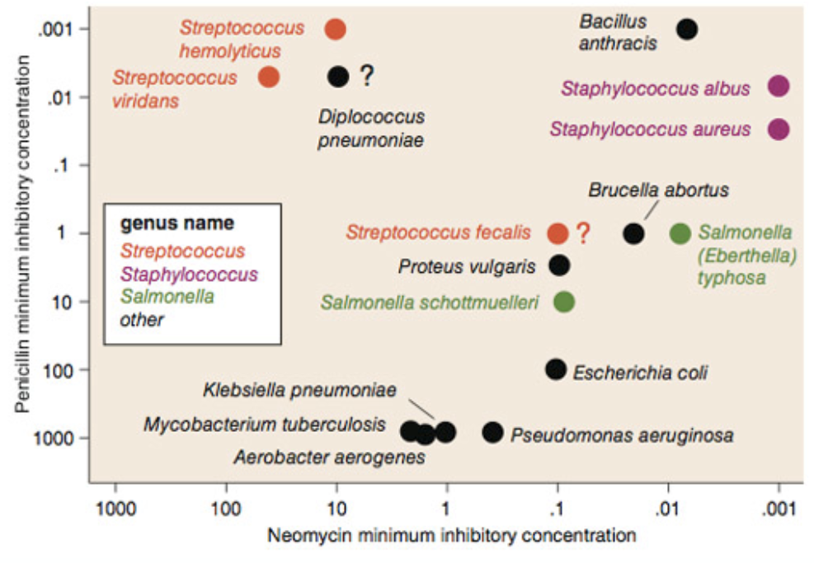
Wainer & Lysen, “That’s funny...”
American Scientist, 2009

Slide 43
Wainer & Lysen, “That’s funny...”
American Scientist, 2009

Slide 44
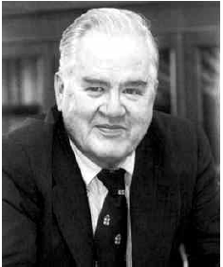
Visualization
“The greatest value of a picture is when it forces us to notice what we never expected to see.”
John Tukey
Notes:
The summary statistics just provide a very high-level snapshot of the data, whereas if we plot all of the data, it can allow us to see …. The big picture [horrible pun]

Slide 45
Visualization Goals
Communicate (explanatory)
Present data and ideas
Explain and inform
Provide evidence and support
Influence and persuade
Analyze (exploratory)
Explore the data
Assess a situation
Determine how to proceed
Decide what to do
Notes:
When you’re exploring, you might have similar questions

Slide 46
Visualization Goals
Communicate (explanatory)
Present data and ideas
Explain and inform
Provide evidence and support
Influence and persuade
Analyze (exploratory)
Explore the data
Assess a situation
Determine how to proceed
Decide what to do
You’re essentially communicating drafts to yourself
Notes:
When you’re exploring, you might have similar questions

Slide 47
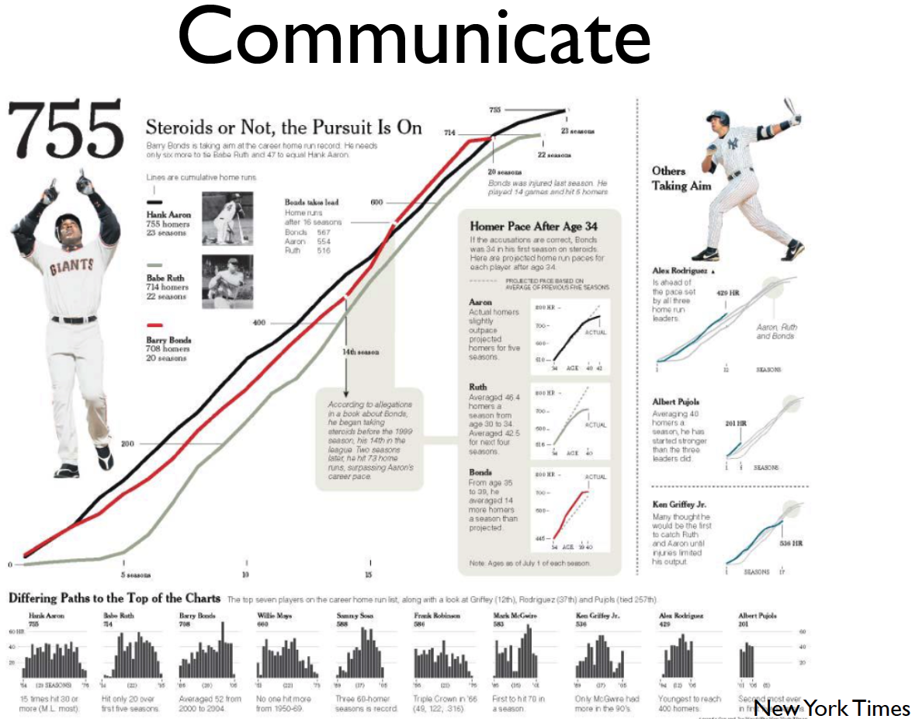
Notes:
When you’re exploring, you might have similar questions

Slide 48
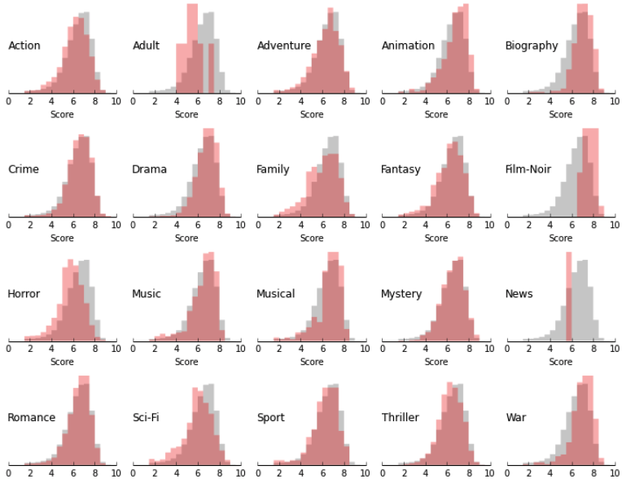
Explore
Notes:
When you’re exploring, you might have similar questions

Slide 49
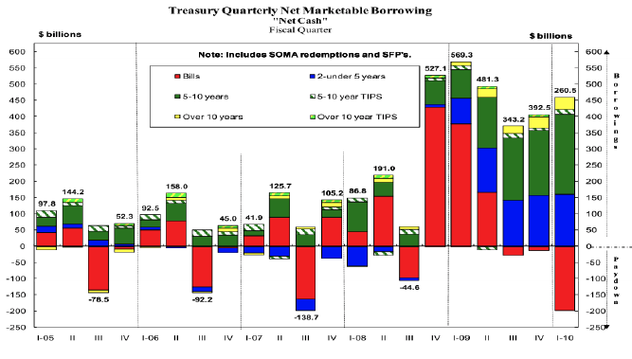
Not Effective
Notes:
When you’re exploring, you might have similar questions

Slide 50
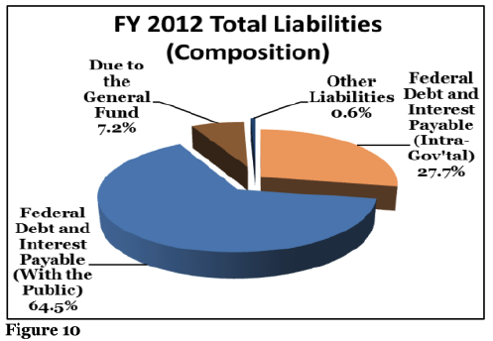
Not Effective
Notes:
When you’re exploring, you might have similar questions

Slide 51
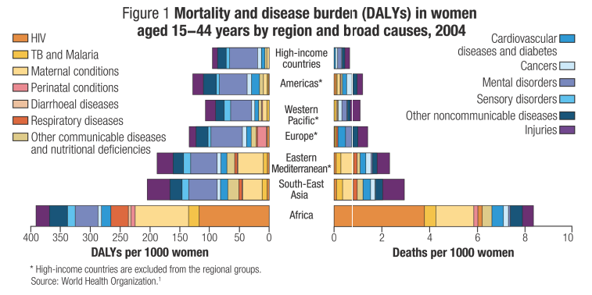
Not Effective
Notes:
When you’re exploring, you might have similar questions

Slide 52
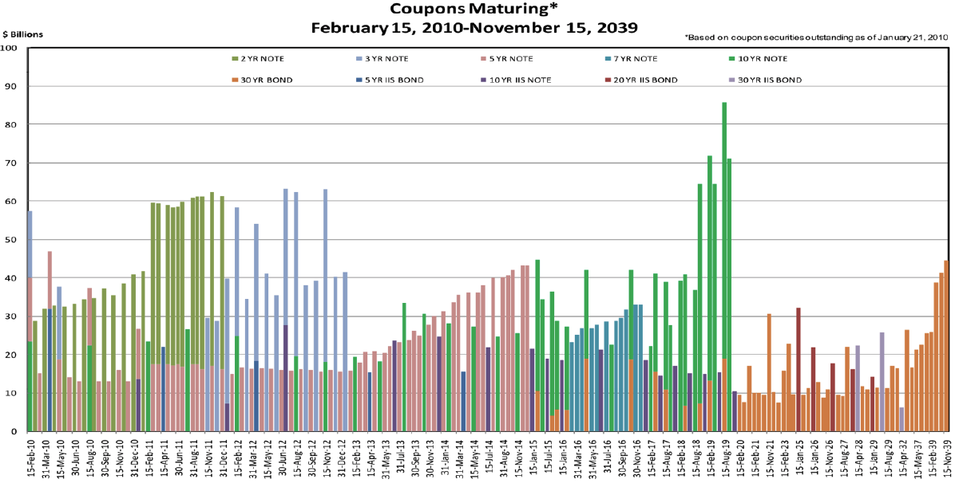
Not Effective
Notes:
When you’re exploring, you might have similar questions

Slide 53
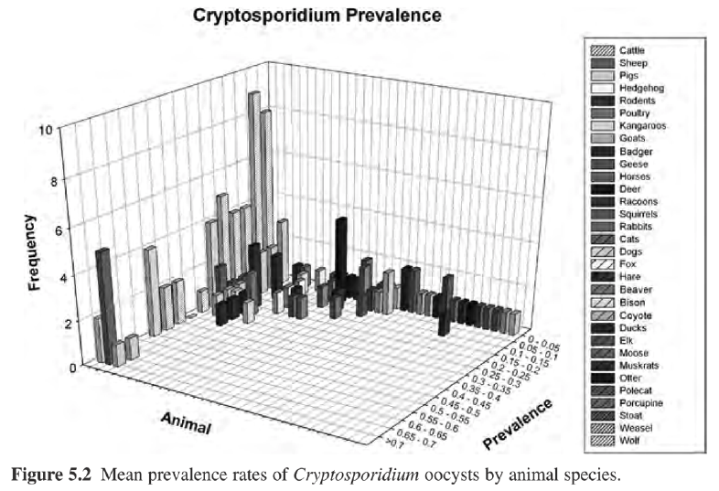
Not Effective
Notes:
When you’re exploring, you might have similar questions

Slide 54
Visualization
Let’s say that we are interested in the English Premier League (football/soccer) and want to build a model to predict a player’s market value.
Question
Does age affect one’s market value?
What type of visualization would help us explore this question?

