Slide 1
Credit: Toronto Zoo

Slide 2
Lecture #3: Getting our hands dirty: pandas and web scraping

Slide 3
ANNOUNCEMENTS
Standard Sections:
Fridays (start 9/13) @ 10:30am (1 Story St Room 306)
Mondays (start 9/16) @ 4:30pm (Science Center 110)
Advanced Sections (A-Sections):
Wednesday (start 9/18) @ 4:30pm (TBD)
Homework 0 isn’t graded for accuracy; however,
Homework 1 is, and it’ll be released today @ 3pm.
Inclusion & Diversity Statements and Academic Honesty documents are now on syllabus. Read them!

Slide 4
ANNOUNCEMENTS
Ed is where the discussions and quizzes reside
Quizzes are under the ‘Sway’ tab
If you can’t connect to Ed, try logging out of Canvas, then back into Canvas
We are looking to change our lecture room, due to current space limitations.

Slide 5
ANNOUNCEMENTS
Access GitHub for all content (“git clone” and “git pull” are your friends)

Slide 6
BACKGROUND

Slide 7
Background
So far, we’ve learned:
Lecture 1
Lectures 1 & 2
Lecture 2
Lecture 2
This lecture
Future lectures
What is Data Science?
The Data Science Process
Data: types, formats, issues, etc.
Visualization (briefly)
How to quickly prepare data and scrape the web
How to model data

Slide 8
Background
The Data Science Process:
Ask an interesting question
Get the Data
Explore the Data
Model the Data
Communicate/Visualize the Results

Slide 9
Background
The Data Science Process:
Ask an interesting question
Get the Data
This lecture
Explore the Data
Model the Data
Communicate/Visualize the Results

Slide 10
Lecture Outline
Exploratory Data Analysis (EDA):
Without Pandas (part 1) – These slides
With Pandas (part 2) – Mostly Jupyter Notebook
Data concerns (part 3) – These slides
Web Scraping with Beautiful Soup (part 4) – Mix
Notes:
This is an Intro on EDA, with a primary focus on how to use Pandas

Slide 11
Exploratory Data Analysis (EDA)
Why?
EDA encompasses the “explore data” part of the data science process
EDA is crucial but often overlooked:
If your data is bad, your results will be bad
Conversely, understanding your data well can help you create smart, appropriate models

Slide 12
Exploratory Data Analysis (EDA)
What?
Store data in data structure(s) that will be convenient for exploring/processing (Memory is fast. Storage is slow)
Clean/format the data so that:
Each row represents a single object/observation/entry
Each column represents an attribute/property/feature of that entry
Values are numeric whenever possible
Columns contain atomic properties that cannot be further decomposed*
* Unlike food waste, which can be composted. Please consider composting food scraps.

Slide 13
Exploratory Data Analysis (EDA)
What? (continued)
Explore global properties: use histograms, scatter plots, and aggregation functions to summarize the data
Explore group properties: group like-items together to compare subsets of the data (are the comparison results reasonable/expected?)
This process transforms your data into a format which is easier to work with, gives you a basic overview of the data's properties, and likely generates several questions for you to follow-up in subsequent analysis.

Slide 14
EDA: without Pandas
Say we have a small dataset of the top 50 most-streamed Spotify songs, globally, for 2019.

Slide 15
EDA: without Pandas
Say we have a small dataset of the top 50 most-streamed Spotify songs, globally, for 2019.
NOTE: The following music data are used purely for illustrative, educational purposes. The data, including song titles, may include explicit language. Harvard, including myself and the rest of the CS109 staff, does not endorse any of the entailed contents or the songs themselves, and we apologize if it is offensive to anyone in anyway.

Slide 16
EDA: without Pandas
top50.csv
Each row represents a distinct song. The columns are:
ID: a unique ID (i.e., 1-50)
TrackName: Name of the Track
ArtistName: Name of the Artist
Genre: the genre of the track
BeatsPerMinute: The tempo of the song.
Energy: The energy of a song - the higher the value, the more energetic.
Danceability: The higher the value, the easier it is to dance to this song.
Loudness: The higher the value, the louder the song.
Liveness: The higher the value, the more likely the song is a live recording.
Valence: The higher the value, the more positive mood for the song.
Length: The duration of the song (in seconds).
Acousticness: The higher the value, the more acoustic the song is.
Speechiness: The higher the value, the more spoken words the song contains.
Popularity: The higher the value, the more popular the song is.

Slide 17
EDA: without Pandas
top50.csv
.
.
.
Q1: What are some ways we can store this file into data structure(s) using regular Python (not the Pandas library).

Slide 18
EDA: without Pandas
top50.csv
.
.
.
Possible Solution #1: A 2D array (i.e., matrix)
Weaknesses:
What are the row and column names? Need separate lists for them – clumsy.
Lists are O(N). We’d need 2 dictionaries just for column names
data = [][]
col_name -> index
index -> col_name

Slide 19
EDA: without Pandas
top50.csv
.
.
.
Possible Solution #2: A list of dictionaries
list
Item 1
=
{“Track.Name”: “Senorita”, “Artist.Name”: “Shawn Mendes”, “Genre”: “Canadian pop”, …}
Item 2
=
{“Track.Name”: “China”, “Artist.Name”: “Anuel AA”, “Genre”: “reggaetón flow”, … }
Item 3
=
{“Track.Name”: “Ariana Grande”, “Artist.Name”: “boyfriend”, “Genre”: “dance pop”, … }

Slide 20
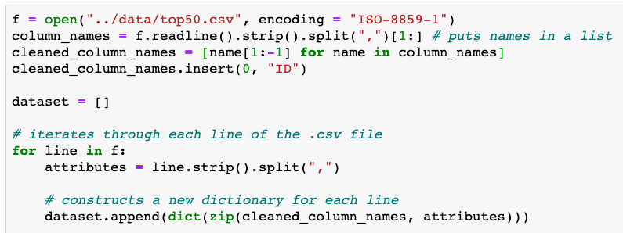
EDA: list of dictionaries
Possible Solution #2: A list of dictionaries
From lecture3.ipynb

Slide 21
EDA: list of dictionaries
Possible Solution #2: A list of dictionaries
Q2: Write code to print all songs (Artist and Track name) that are longer than 4 minutes (240 seconds):
From lecture3.ipynb

Slide 22
EDA: list of dictionaries
Possible Solution #2: A list of dictionaries
Q3: Write code to print the most popular song (artist and track) – if ties, show all ties.
From lecture3.ipynb

Slide 23
EDA: list of dictionaries
Possible Solution #2: A list of dictionaries
Q4: Write code to print the songs (and their attributes), if we sorted by their popularity (highest scoring ones first).

Slide 24
EDA: list of dictionaries
Possible Solution #2: A list of dictionaries
Q4: Write code to print the songs (and their attributes), if we sorted by their popularity (highest scoring ones first).
list
Item 1
=
{“Track.Name”: “Senorita”, “Artist.Name”: “Shawn Mendes”, “Genre”: “Canadian pop”, …}
Item 2
=
{“Track.Name”: “China”, “Artist.Name”: “Anuel AA”, “Genre”: “reggaetón flow”, … }
Item 3
=
{“Track.Name”: “Ariana Grande”, “Artist.Name”: “boyfriend”, “Genre”: “dance pop”, … }
Cumbersome to move dictionaries around in a list. Problematic even if we don’t move the dictionaries.

Slide 25
EDA: list of dictionaries
Possible Solution #2: A list of dictionaries
Q5: How could you check for null/empty entries? This is only 50 entries. Imagine if we had 500,000.
list
Item 1
=
{“Track.Name”: “Senorita”, “Artist.Name”: “Shawn Mendes”, “Genre”: “Canadian pop”, …}
Item 2
=
{“Track.Name”: “China”, “Artist.Name”: “Anuel AA”, “Genre”: “reggaetón flow”, … }
Item 3
=
{“Track.Name”: “Ariana Grande”, “Artist.Name”: “boyfriend”, “Genre”: “dance pop”, … }

Slide 26
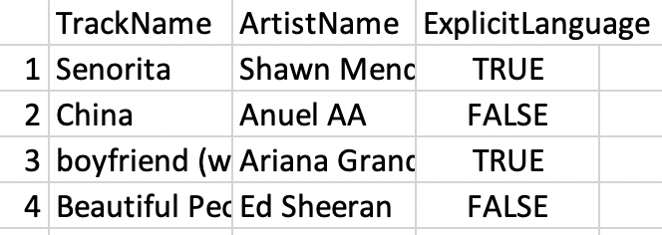
EDA: list of dictionaries
Possible Solution #2: A list of dictionaries
Q6: Imagine we had another table* below (i.e., .csv file). How could we combine its data with our already-existing dataset?
spotify_aux.csv
* 3rd column is made-up by me. Random values. Pretend they’re accurate.

Slide 27
EDA: with Pandas!
Kung Fu Panda is property of DreamWorks and Paramount Pictures

Slide 28
Lecture Outline
Exploratory Data Analysis (EDA):
Without Pandas (part 1) – These slides
With Pandas (part 2) – Mostly Jupyter Notebook
Data concerns (part 3) – These slides
Web Scraping with Beautiful Soup (part 4) – Mix

Slide 29
EDA: with Pandas
What / Why?
Pandas is an open-source Python library (anyone can contribute)
Allows for high-performance, easy-to-use data structures and data analysis
Unlike NumPy library which provides multi-dimensional arrays, Pandas provides 2D table object called DataFrame (akin to a spreadsheet with column names and row labels).
Used by a lot of people

Slide 30
EDA: with Pandas
How
import pandas library (convenient to rename it)
Use read_csv() function

Slide 31
EDA: with Pandas
Common Panda functions
High-level viewing:
head() – first N observations
tail() – last N observations
columns() – names of the columns
describe() – statistics of the quantitative data
dtypes() – the data types of the columns

Slide 32
EDA: with Pandas
Common Panda functions
Accessing/processing:
df[“column_name”]
Df.column_name
.max(), .min(), .idxmax(), .idxmin()
<dataframe> <conditional statement>
.loc[] – label-based accessing
.iloc[] – index-based accessing
.sort_values()
.isnull(), .notnull()

Slide 33
EDA: with Pandas
Common Panda functions
Grouping/Splitting/Aggregating:
groupby(), .get_groups()
.merge()
.concat()
.aggegate()
.append()

Slide 34
EDA: with Pandas
Now, let’s open the lecture3.ipynb notebook for some real-time practice.

Slide 35
Lecture Outline
Exploratory Data Analysis (EDA):
Without Pandas (part 1) – These slides
With Pandas (part 2) – Mostly Jupyter Notebook
Data concerns (part 3) – These slides
Web Scraping with Beautiful Soup (part 4) – Mix

Slide 36
Data Concerns
When determining if a dataset is sound to use, it can be useful to think about these four questions:
Did it come from a trustworthy, authoritative source?
Is the data a complete sample?
Does the data seem correct?
(optional) Is the data stored efficiently or does it have redundancies?

Slide 37
Data Concerns: the format
Often times, there may not exist a single dataset that contains all of the information we are interested in.
May need to merge existing datasets
Important to do so in a sound and efficient format

Slide 38
Data Concerns: the format
For example, say we have two datasets:
Dataset 1
Dataset 2
Top 200 most-frequent streams per day (for June 2019)
Top 50 most streamed in 2019, so far
SpotifySongID, # of Streams, Date
SpotifySongID, Artist, Track, [10 acoustic features]
2789179, 42003, 06-01
2789179, Billie Eilish, bad guy, 3.2, 5.9, …
.
.
200
.
.
50
3819390, 89103, 06-01
3901829, Outkast, Elevators, 9.3, 5,1, …
4492014, 52923, 06-02
.
50 x 13
200
.
8593013, 189145, 06-02
6,000 x 3

Slide 39
Data Concerns: the format
For example, say we have two datasets:
Dataset 1
Dataset 2
Top 200 most-frequent streams per day (for June 2019)
Top 50 most streamed in 2019, so far
SpotifySongID, # of Streams, Date
SpotifySongID, Artist, Track, [10 acoustic features]
We are interested in determining if songs with high danceability are more popular during the weekends of June than weekdays in June. What should our merged table look like? Concerns?
2789179, 42003, 06-01
2789179, Billie Eilish, bad guy, 3.2, 5.9, …
.
.
200
.
.
50
3819390, 89103, 06-01
3901829, Outkast, Elevators, 9.3, 5,1, …
4492014, 52923, 06-02
.
50 x 13
200
.
8593013, 189145, 06-02
6,000 x 3

Slide 40
Data Concerns: the format
This is wasteful, as it has 10 acoustic features, artist, and track repeated many times for each unique song.
Datasets Merged (poorly)
SpotifySongID, # of Streams, Date,
Artist, Track, [10 acoustic features]
2789179, 42003, 06-01
Billie Eilish, bad guy, 3.2, 5.9, …
.
200
.
3819390, 89103, 06-01
Outkast, Elevators, 9.3, 5,1, …
4492014, 52923, 06-02
.
200
.
8593013, 189145, 06-02
6,000 x 15 ➔ 90,000 cells

Slide 41
Data Concerns: the format
Some rows may have null values for # of Streams (if the song wasn’t popular in June)
Datasets Merged (better)
SpotifySongID, Artist, Track, [10 acoustic features], 06-01 Streams, 06-02 Streams
2789179, Billie Eilish, bad guy, 3.2, 5.9, …, 42003, 42831, 43919
.
.
50
3901829, Outkast, Elevators, 9.3, 5,1, … 29109, 27193, 25982
50 x 70 ➔ 3,500 cells

Slide 42
Data Concerns: the format
Is the data correctly constructed (or are values wrong)?
Is there redundant data in our merged table?
Missing values?

Slide 43
Lecture Outline
Exploratory Data Analysis (EDA):
Without Pandas (part 1) – These slides
With Pandas (part 2) – Mostly Jupyter Notebook
Data concerns (part 3) – These slides
Web Scraping with Beautiful Soup (part 4) – Mix

Slide 44
Sources of data
Data can come from:
You curate it
Someone else provides it, all pre-packaged for you
Someone else provides an API
Someone else has available content, and you try to take it (web scraping)

Slide 45
Web scraping
Web servers
A server is a long-running process (also called a daemon) which listens on a pre-specified port(s)
It responds to requests, which is sent using a protocol called HTTP (HTTPS is secure)
Our browser sends these requests and downloads the content, then displays it
2– request was successful, 4– client error, often `page not found`; 5– server error (often that your request was incorrectly formed)

Slide 46
Web scraping
Using programs to download or otherwise get data from online
Often much faster than manually copying data!
Transfer the data into a form that is compatible with your code
Legal and moral issues (per Lecture 2)

Slide 47
Web scraping
Requests (Python library): gets a webpage for you
Requests.get(url)
BeautifulSoup library parses webpages (.html content) for you!
Use BeautifulSoup to find all the text or all the links on a page
Documentation: http://crummy.com/software/BeautifulSoup

Slide 48
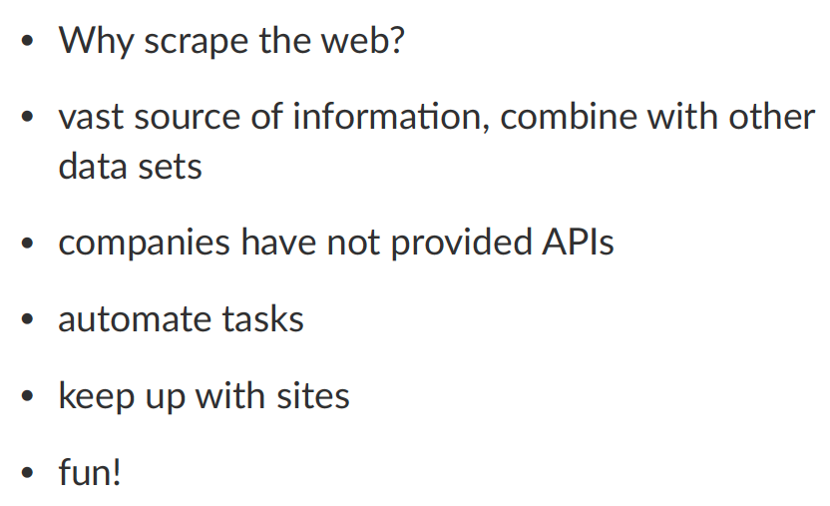
Web scraping

Slide 49
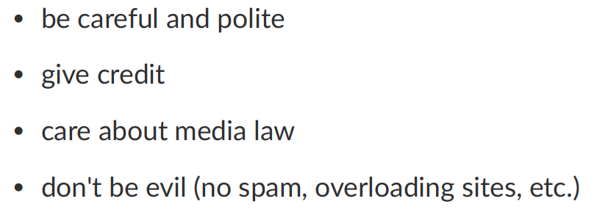
Web scraping

Slide 50
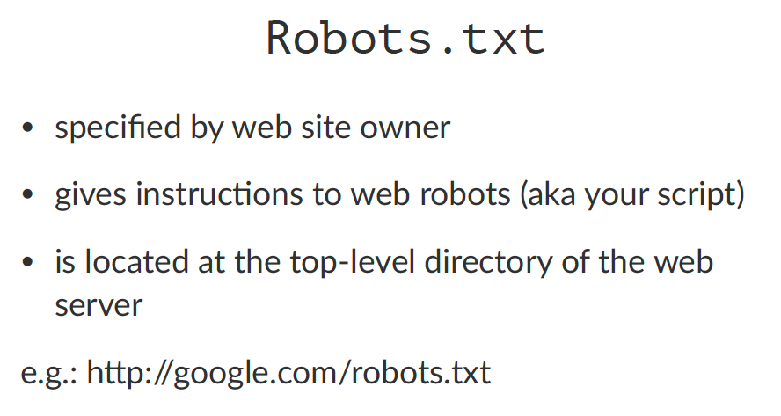
Web scraping

Slide 51
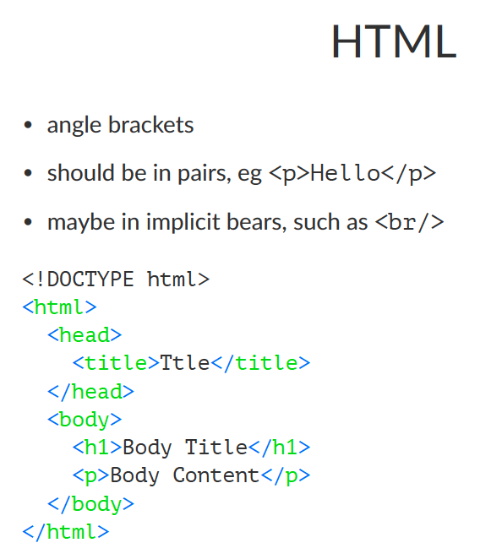
Web scraping

Slide 52
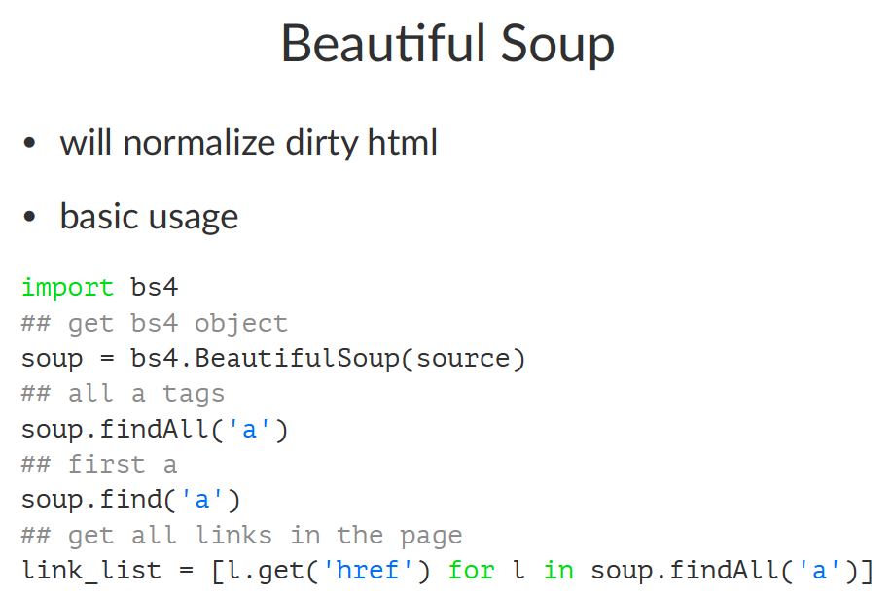
Web scraping

Slide 53
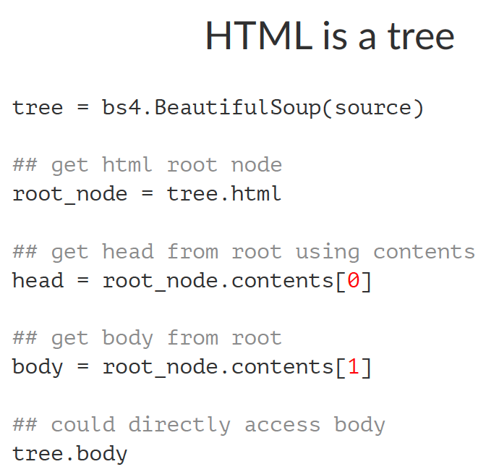
Web scraping

Slide 54
Web scraping
Question: how can we get a list of all image URLs?
Question: how can we navigate through subsequent pages (i.e., crawler) recursively.
Question: could we crawl the entire web?

