Slide 1
Lecture 21: Optimization and Regularization

Slide 2
ANNOUNCEMENTS
Homework 7 OH:
For conceptual questions: Kevin and Chris will continue their office hours.
If you have problems with TensorFlow please let us know on ED. We will arrange special OH to help if necessary.
Project:
Milestone3 due on Wed. EDA and base model

Slide 3
Outline
Optimization
Regularization of NN

Slide 4
Outline
Optimization
Challenges in Optimization
Momentum
Adaptive Learning Rate
Parameter Initialization
Batch Normalization
Regularization of NN
Norm Penalties
Early Stopping
Data Augmentation
Sparse Representation
Dropout

Slide 5
Outline
Optimization
Challenges in Optimization
Momentum
Adaptive Learning Rate
Parameter Initialization
Batch Normalization
Regularization of NN
Norm Penalties
Early Stopping
Data Augmentation
Sparse Representation
Dropout

Slide 6
Learning vs. Optimization
Goal of learning: minimize generalization error, or the loss function
$$𝓛\left(W\right)=𝔼_{\left(x,y\right)\sim p_{data}}\left[L(f\left(x,W\right), y\right]$$
In practice, empirical risk minimization:
$$ℒ\left(W\right)=\sum_{i}{\left[L(f\left(x_{i};W\right), y_{i}\right]}$$
f is the neural network
Quantity optimized different from the quantity we care about

Slide 7
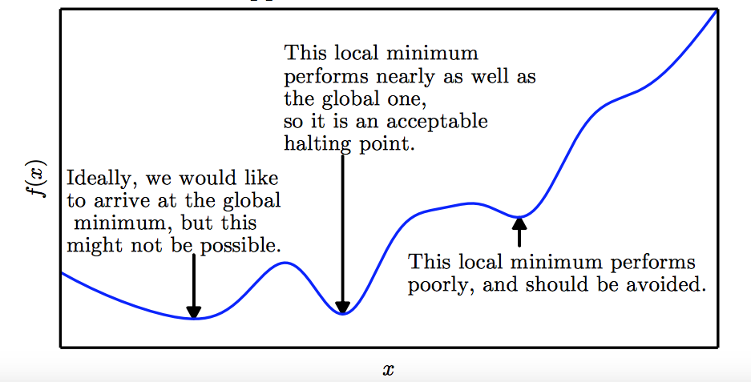
Local Minima
Goodfellow et al. (2016)

Slide 8
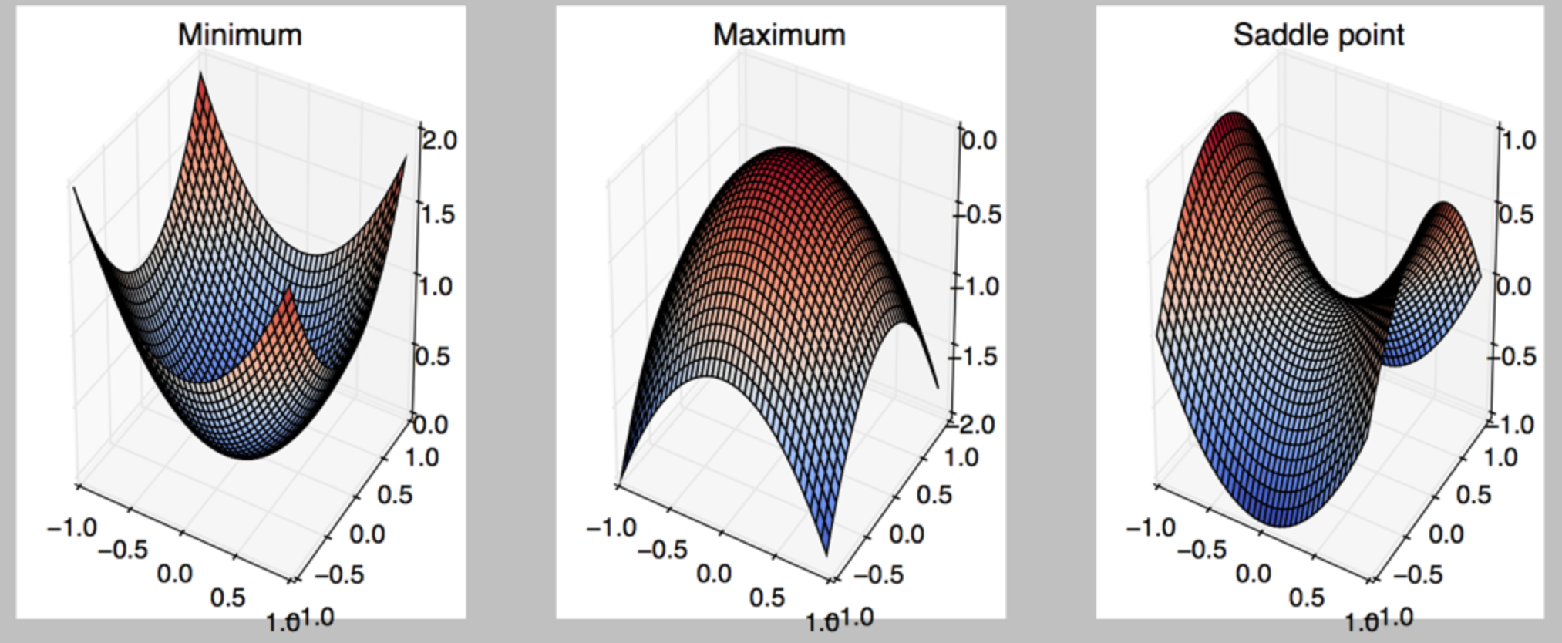
Critical Points
Points with zero gradient
2nd-derivate (Hessian) determines curvature
Goodfellow et al. (2016)

Slide 9
Local Minima
Old view: local minima is major problem in neural network training
Recent view:
For sufficiently large neural networks, most local minima incur low cost
Not important to find true global minimum

Slide 10
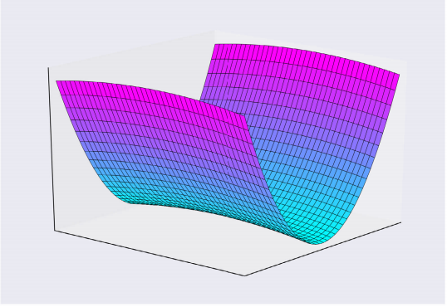
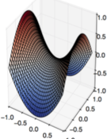
Saddle Points
Both local min and max
Recent studies indicate that in high dim, saddle points are more likely than local min
Gradient can be very small near saddle points
Goodfellow et al. (2016)

Slide 11
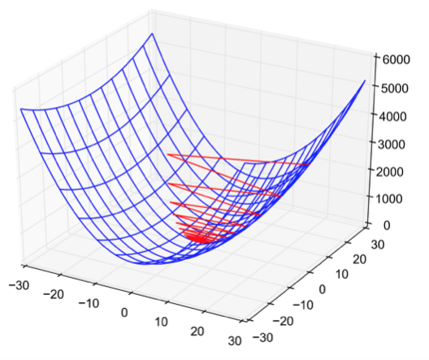
Poor Conditioning
Poorly conditioned Hessian matrix
High curvature: small steps leads to huge increase
Learning is slow despite strong gradients
Oscillations slow down progress

Slide 12
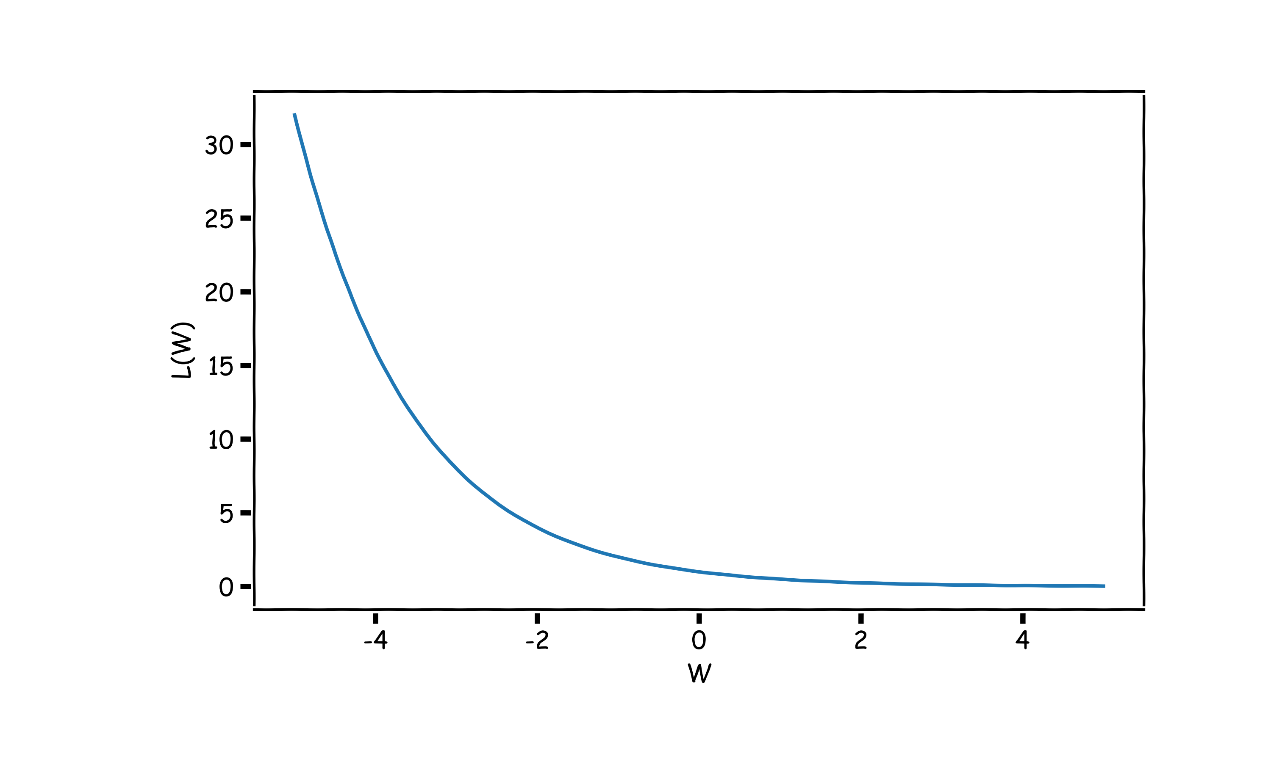
No Critical Points
Some cost functions do not have critical points. In particular classification.
WHY?

Slide 13
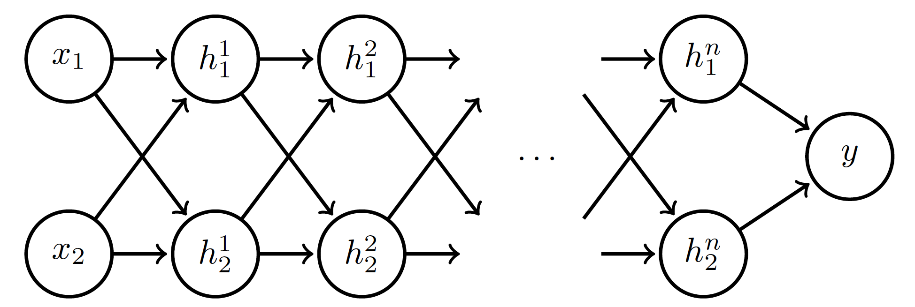
Exploding and Vanishing Gradients
Linear activation
$$h_{i}=Wx$$
$$h_{i}=Wh_{i−1}, i=2,…,n$$
deeplearning.ai

Slide 14
Exploding and Vanishing Gradients

Slide 15
Exploding and Vanishing Gradients
Explodes!
Vanishes!

Slide 16
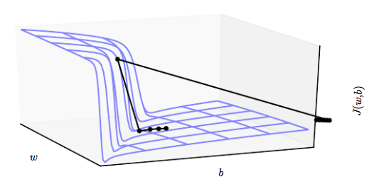
Exploding and Vanishing Gradients
Exploding gradients lead to cliffs
Can be mitigated using gradient clipping
$$if \left\|g\right\|>u$$
$$g⟵\frac{gu}{\left\|g\right\|}$$
Goodfellow et al. (2016)

Slide 17
Outline
Optimization
Challenges in Optimization
Momentum
Adaptive Learning Rate
Parameter Initialization
Batch Normalization
Regularization of NN
Norm Penalties
Early Stopping
Data Augmentation
Sparse Representation
Dropout

Slide 18
Momentum
Oscillations because updates do not exploit curvature information
Average gradient presents faster path to optimal: vertical components cancel out
$$L(W)$$
$$W_{2}$$
$$W_{1}$$
Notes:
https://distill.pub/2017/momentum/

Slide 19
Momentum
Question: Why not this?
$$L(W)$$
$$W_{2}$$
$$W_{1}$$
Notes:
https://distill.pub/2017/momentum/

Slide 20
Momentum
Let us figure out an algorithm which will lead us to the minimum faster.
$$L(W)$$
$$W_{2}$$
$$W_{1}$$
Notes:
https://distill.pub/2017/momentum/

Slide 21
Momentum
Look each component at a time
$$L(W)$$
$$W_{2}$$
$$W_{1}$$
Notes:
https://distill.pub/2017/momentum/

Slide 22
Momentum
Let us figure out an algorithm
$$L(W)$$
$$W_{2}$$
$$W_{1}$$
Notes:
https://distill.pub/2017/momentum/

Slide 23
Momentum
Let us figure out an algorithm
$$L(W)$$
$$W_{2}$$
$$W_{1}$$
Notes:
https://distill.pub/2017/momentum/

Slide 24
Momentum
Let us figure out an algorithm
$$L(W)$$
$$W_{2}$$
$$W_{1}$$
Notes:
https://distill.pub/2017/momentum/

Slide 25
Momentum
Let us figure out an algorithm
$$L(W)$$
$$W_{2}$$
$$W_{1}$$
Notes:
https://distill.pub/2017/momentum/

Slide 26
Momentum
$f$is the Neural Network
Old gradient descent:
New gradient descent with momentum:
$$g= \frac{1}{m}\sum_{i}{∇_{W}L(f\left(x_{i};W\right),y_{i})}$$
$$W^{∗}=W−λg$$
$$g=g+average g from before$$
$$ν=αν+(1−α) g$$
$$W^{∗}=W−λν$$
controls how quickly effect of past gradients decay

Slide 27
Nesterov Momentum
Apply an interim update:
Perform a correction based on gradient at the interim point:
$$\tilde{W}=W+ ν$$
$$g= \frac{1}{m}\sum_{i}{∇_{W}L(f\left(x_{i};\tilde{W}\right), y_{i})}$$
Momentum based on look-ahead slope

Slide 28
Notes:
LiveSlide Site
https://distill.pub/2017/momentum/

Slide 29
Outline
Optimization
Challenges in Optimization
Momentum
Adaptive Learning Rate
Parameter Initialization
Batch Normalization
Regularization of NN
Norm Penalties
Early Stopping
Data Augmentation
Sparse Representation
Dropout

Slide 30
Adaptive Learning Rates
$$L(W)$$
$$W_{2}$$
Slow
Fast
$$W_{1}$$
Oscillations along vertical direction
Learning must be slower along parameter 2
Use a different learning rate for each parameter?

Slide 31
Adaptive Learning Rates
$$L(W)$$
$$W_{2}$$
Slow
Fast
$$W_{1}$$
Oscillations along vertical direction
Learning must be slower along parameter 2
Use a different learning rate for each parameter?

Slide 32
Adaptive Learning Rates
$$L(W)$$
$$W_{2}$$
Slow
Fast
$$W_{1}$$
Oscillations along vertical direction
Learning must be slower along parameter 2
Use a different learning rate for each parameter?

Slide 33
Adaptive Learning Rates
$$L(W)$$
$$W_{2}$$
Slow
Fast
$$W_{1}$$
Oscillations along vertical direction
Learning must be slower along parameter 2
Use a different learning rate for each parameter?

Slide 34
Adaptive Learning Rates
$$L(W)$$
$$W_{2}$$
Slow
Fast
$$W_{1}$$
Oscillations along vertical direction
Learning must be slower along parameter 2
Use a different learning rate for each parameter?

Slide 35
AdaGrad
Accumulate squared gradients:
Update each parameter:
Greater progress along gently sloped directions
$g$is the gradient
Inversely proportional to cumulative squared gradient

Slide 36
AdaGrad
$δ$ is a small number, making sure this does not become too large
Old gradient descent:
$$g= \frac{1}{m}\sum_{i}{∇_{W}L(f\left(x_{i};W\right),y_{i})}$$
$$W^{∗}=W−λg$$
We would like $λ^{′}s$ not to be the same and inversely proportional to the${|g}_{i}|$
$$W_{i}^{∗}=W_{i}−λ_{i}g_{i}$$
$$λ_{i}∝\frac{1}{{|g}_{i}|}=\frac{1}{δ+|g_{i}|}$$
New gradient descent with adaptive learning rate:
$$W_{i}^{∗}=W_{i}−\frac{ε}{δ+\sqrt{r_{i}}}g_{i}$$
$$r_{i}^{∗}=r_{i}+g_{i}^{2}$$

Slide 37
RMSProp
For non-convex problems, AdaGrad can prematurely decrease learning rate
Use exponentially weighted average for gradient accumulation

Slide 38
Adam
RMSProp + Momentum
Estimate first moment:
Estimate second moment:
Update parameters:
Also applies bias correction to v and r
Works well in practice, is fairly robust to hyper-parameters

Slide 39
Outline
Optimization
Challenges in Optimization
Momentum
Adaptive Learning Rate
Parameter Initialization
Batch Normalization
Regularization of NN
Norm Penalties
Early Stopping
Data Augmentation
Sparse Representation
Dropout

Slide 40
Parameter Initialization
Goal: break symmetry between units
so that each unit computes a different function
Initialize all weights (not biases) randomly
Gaussian or uniform distribution
Scale of initialization?
Large -> grad explosion, Small -> grad vanishing

Slide 41
Xavier Initialization
Heuristic for all outputs to have unit variance
For a fully-connected layer with m inputs:
For ReLU units, it is recommended:

Slide 42
Normalized Initialization
Fully-connected layer with m inputs, n outputs:
Heuristic trades off between initialize all layers have same activation and gradient variance
Sparse variant when m is large
Initialize k nonzero weights in each unit

Slide 43
Notes:
LiveSlide Site
http://ruder.io/optimizing-gradient-descent/index.html#adam

Slide 44
Outline
Optimization
Challenges in Optimization
Momentum
Adaptive Learning Rate
Parameter Initialization
Batch Normalization
Regularization of NN
Norm Penalties
Early Stopping
Data Augmentation
Sparse Representation
Dropout

Slide 45
Feature Normalization
Good practice to normalize features before applying learning algorithm:
Features in same scale: mean 0 and variance 1
Speeds up learning
Feature vector
Vector of mean feature values
Vector of SD of feature values

Slide 46
Feature Normalization
$$L(W)$$
Before normalization
After normalization

Slide 47
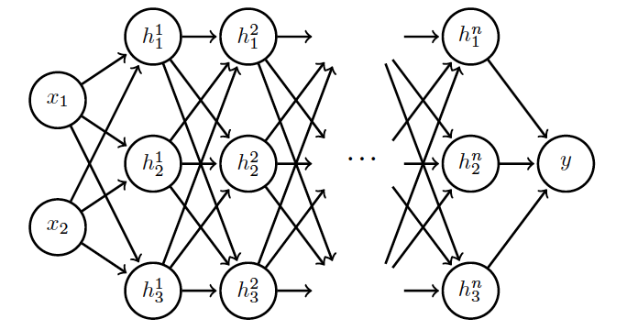
Internal Covariance Shift
Each hidden layer changes distribution of inputs to next layer: slows down learning
…
Normalize inputs to layer 2
Normalize inputs to layer n

Slide 48
Batch Normalization
Training time:
Mini-batch of activations for layer to normalize
K hidden layer activations
N data points in mini-batch

Slide 49
Batch Normalization
Training time:
Mini-batch of activations for layer to normalize
where
Vector of mean activations across mini-batch
Vector of SD of each unit across mini-batch

Slide 50
Batch Normalization
Training time:
Normalization can reduce expressive power
Instead use:
Allows network to control range of normalization
Learnable parameters

Slide 51
Batch Normalization
Batch 1
…..
Add normalization operations for layer 1
Batch N

Slide 52
Batch Normalization
Batch 1
…..
Add normalization operations for layer 2 and so on …
Batch N

Slide 53
Batch Normalization
Differentiate the joint loss for N mini-batches
Back-propagate through the norm operations
Test time:
Model needs to be evaluated on a single example
Replace μ and σ with running averages collected during training

Slide 55
Outline
Optimization
Challenges in Optimization
Momentum
Adaptive Learning Rate
Parameter Initialization
Batch Normalization
Regularization of NN
Norm Penalties
Early Stopping
Data Augmentation
Sparse Representation
Dropout

Slide 56
Regularization
Regularization is any modification we make to a learning algorithm that is intended to reduce its generalization error but not its training error.

Slide 57
Outline
Optimization
Challenges in Optimization
Momentum
Adaptive Learning Rate
Parameter Initialization
Batch Normalization
Regularization of NN
Norm Penalties
Early Stopping
Data Augmentation
Sparse Representation
Dropout

Slide 58
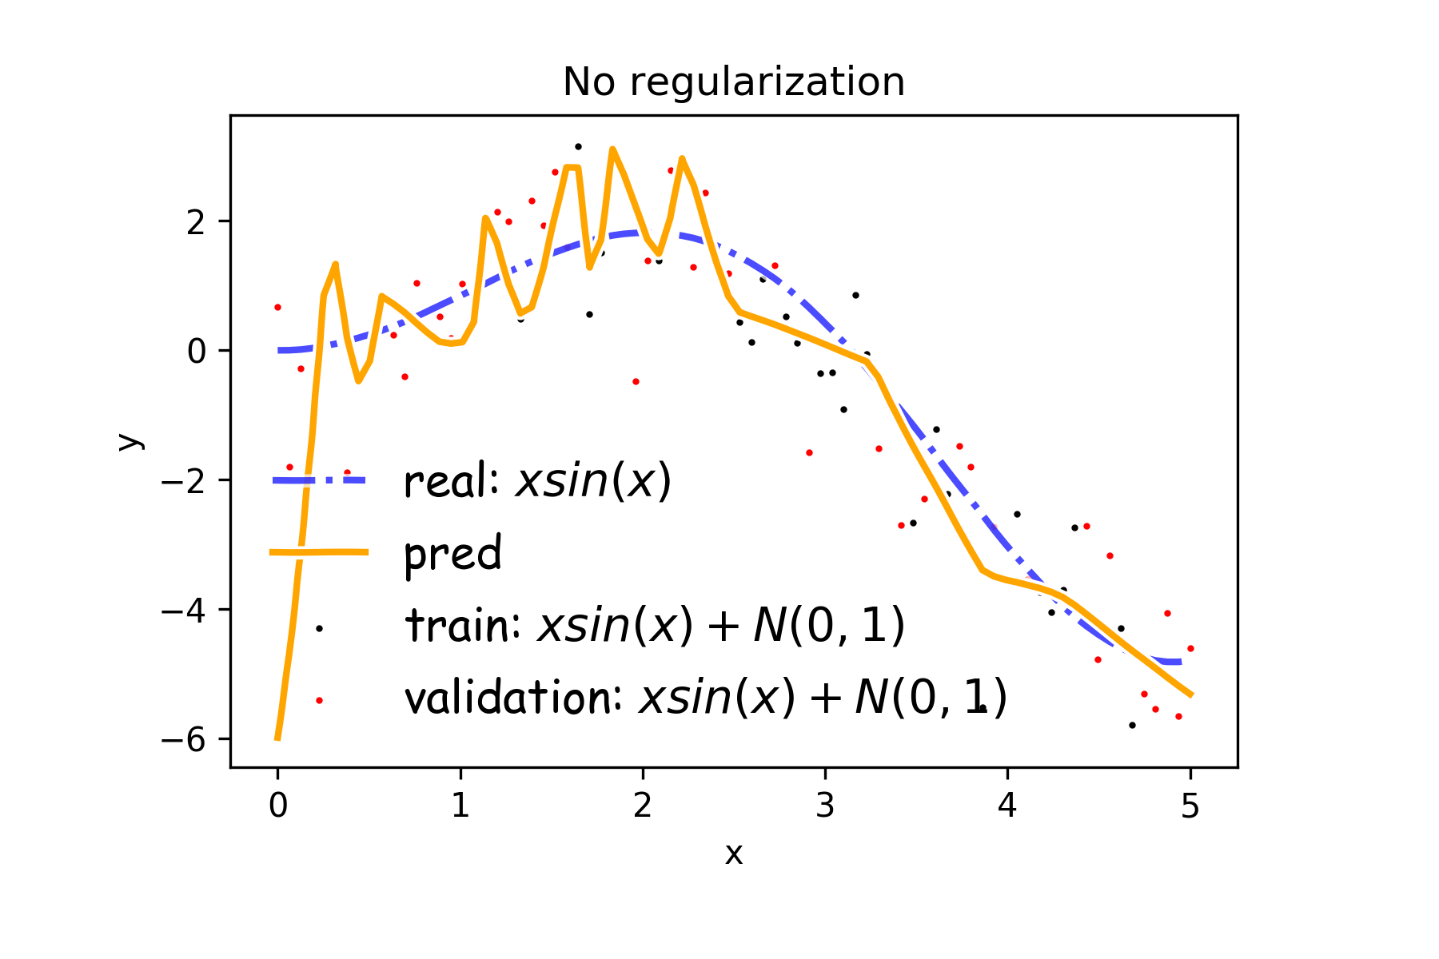
Overfitting
Fitting a deep neural network with 5 layers and 100 neurons per layer can lead to a very good prediction on the training set but poor prediction on validations set.

Slide 59
Norm Penalties
We used to optimize:
$$L\left(W;X, y\right)$$
Change to …
$$L_{R}\left(W;X,y\right)=L\left(W;X, y\right)+αΩ(W)$$
L₂ regularization:
Weights decay
MAP estimation with Gaussian prior
L₁ regularization:
encourages sparsity
MAP estimation with Laplacian prior
Biases not penalized
$$Ω\left(W\right)=\frac{1}{2}∥W∥_{2}^{2}$$
$$Ω\left(W\right)=\frac{1}{2}∥W∥_{1}$$

Slide 60
Norm Penalties
Weights decay in proportion to size
We used to optimize:
$$L\left(W;X, y\right)$$
Change to …
$$L_{R}\left(W;X,y\right)=L\left(W;X, y\right)+αΩ(W)$$
L₂ regularization:
Decay of weights
MAP estimation with Gaussian prior
L₁ regularization:
encourages sparsity
MAP estimation with Laplacian prior
$$W^{(i+1)}=W^{(i)}−λ\frac{∂L}{∂W} \\ L_{R}\left(W;X,y\right)=L\left(W;X, y\right)+\frac{1}{2}αW^{2} \\ W^{(i+1)}=W^{(i)}−λ\frac{∂L}{∂W}−λα W$$
Biases not penalized
$$Ω\left(W\right)=\frac{1}{2}∥W∥_{2}^{2}$$
$$Ω\left(W\right)=\frac{1}{2}∥W∥_{1}$$

Slide 61
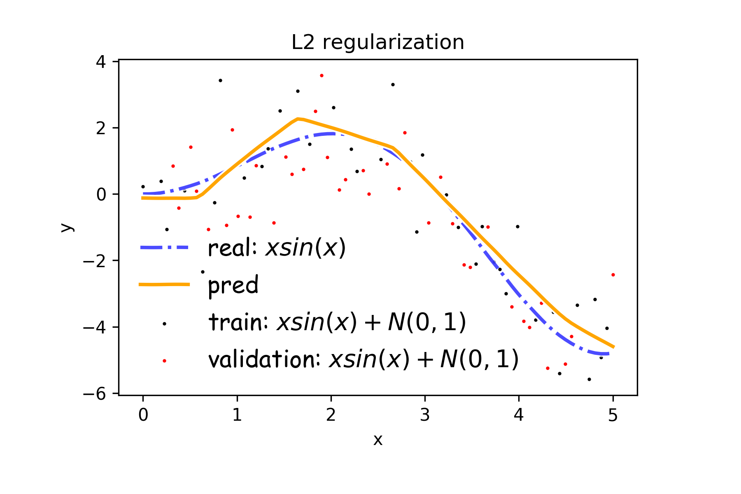
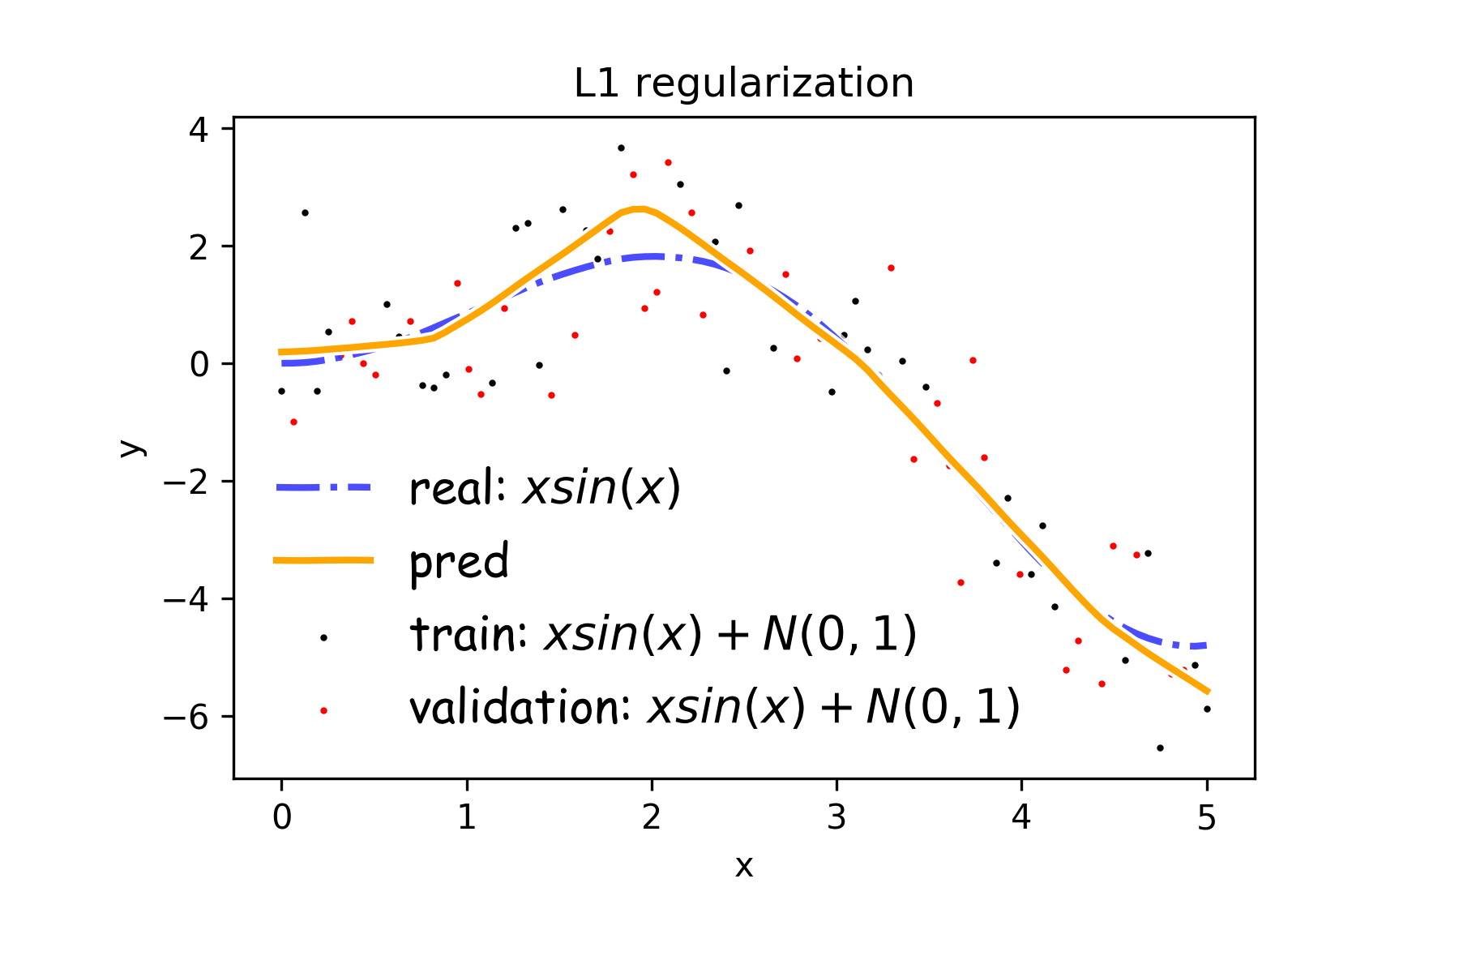
Norm Penalties
$$Ω\left(W\right)=\frac{1}{2}∥W∥_{2}^{2}$$
$$Ω\left(W\right)=\frac{1}{2}∥W∥_{1}$$

Slide 62
Norm Penalties as Constraints
$$\min_{Ω\left(W\right)≤K}{J(W;X,y)}$$
Useful if K is known in advance
Optimization:
Construct Lagrangian and apply gradient descent
Projected gradient descent

Slide 63
Outline
Optimization
Challenges in Optimization
Momentum
Adaptive Learning Rate
Parameter Initialization
Batch Normalization
Regularization of NN
Norm Penalties
Early Stopping
Data Augmentation
Sparse Representation
Dropout

Slide 64
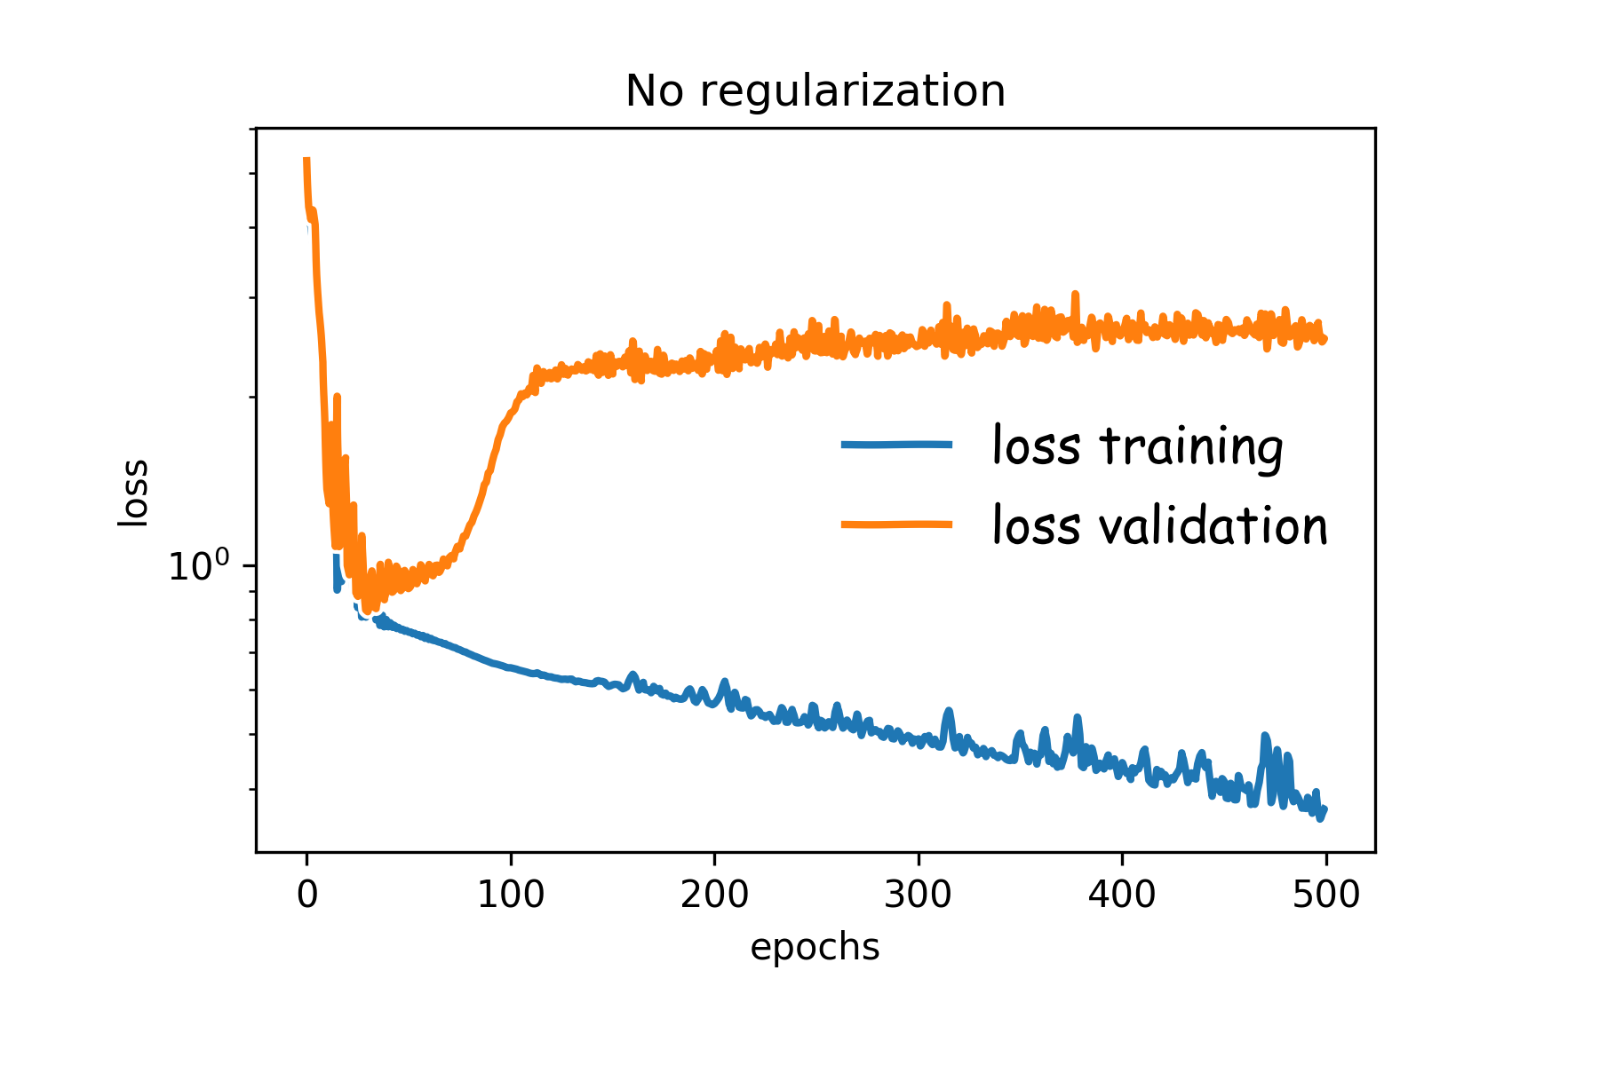
Early Stopping
Early stopping: terminate while validation set performance is better
Training time can be treated as a hyperparameter

Slide 65
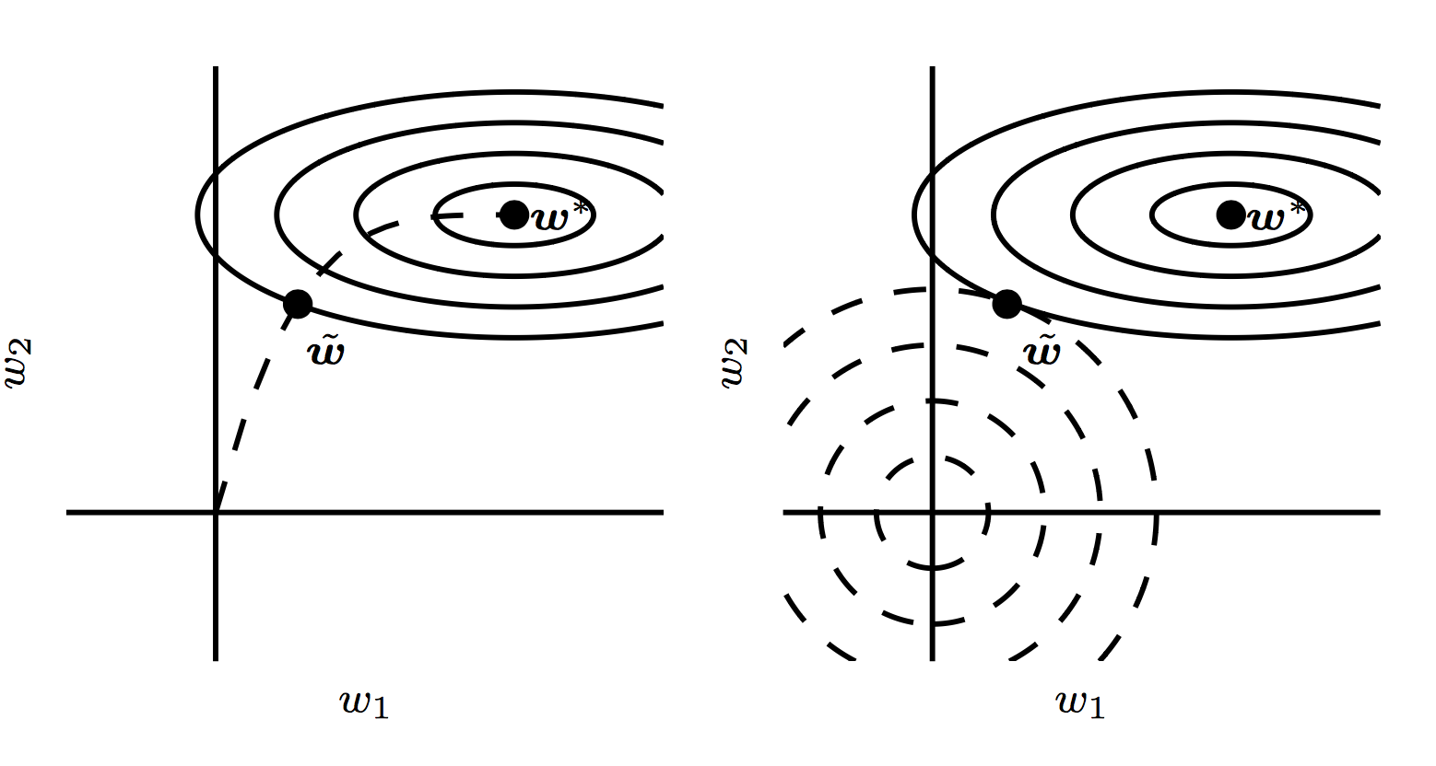
Early Stopping

Slide 66
Outline
Optimization
Challenges in Optimization
Momentum
Adaptive Learning Rate
Parameter Initialization
Batch Normalization
Regularization of NN
Norm Penalties
Early Stopping
Data Augmentation
Sparse Representation
Dropout

Slide 67
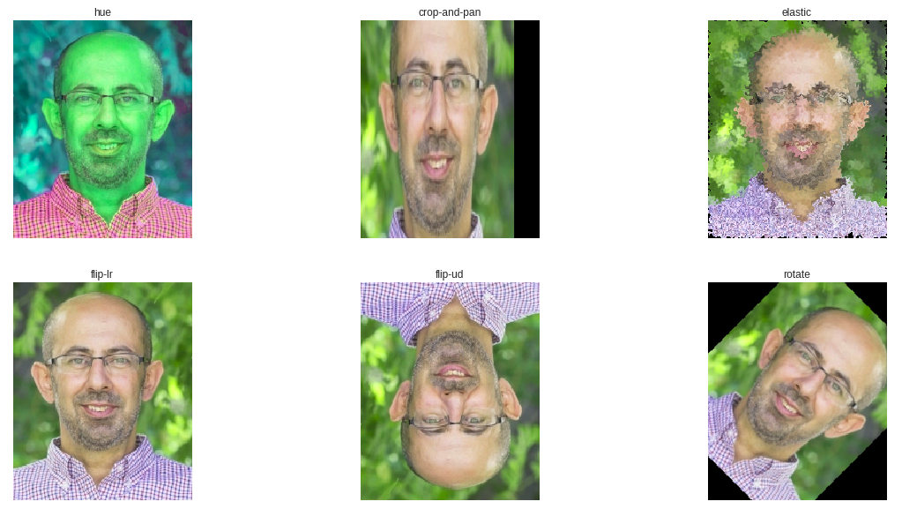
Data Augmentation

Slide 68
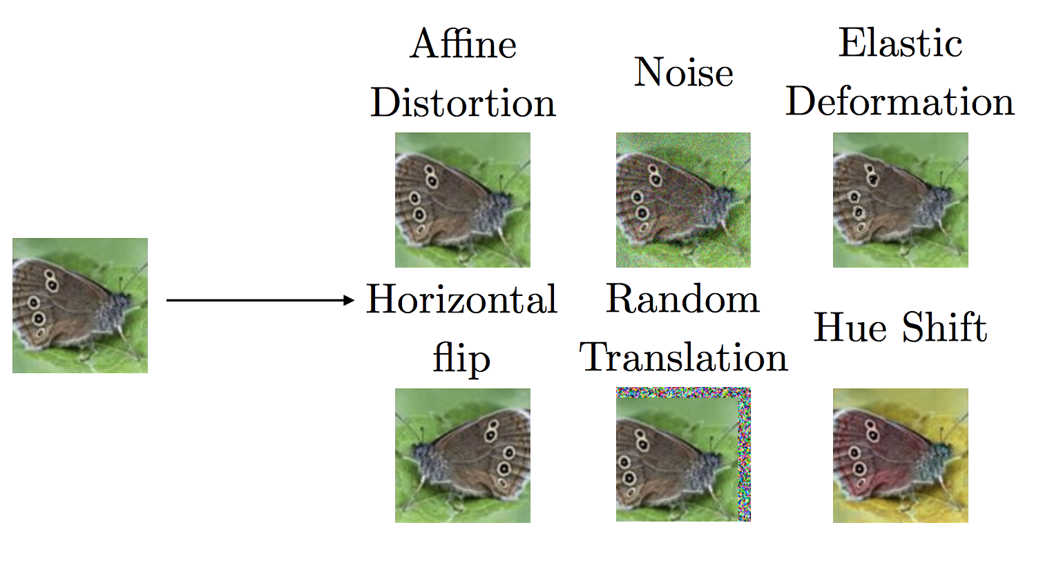
Data Augmentation

Slide 69
Outline
Optimization
Challenges in Optimization
Momentum
Adaptive Learning Rate
Parameter Initialization
Batch Normalization
Regularization of NN
Norm Penalties
Early Stopping
Data Augmentation
Sparse Representation
Dropout

Slide 70
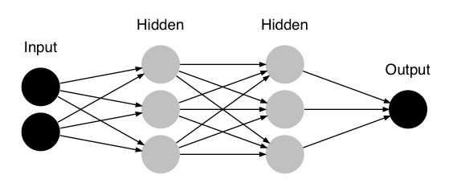
Sparse Representation
$$W_{1}$$
$$W_{4}$$
$$W_{2}$$
$$W_{5}$$
$$W_{7}$$
$$Y$$
$$W_{3}$$
$$W_{6}$$
$$L\left(θ;X, y\right)$$
$$\left[4.34\right]=\left[\begin{matrix}3.2 & 2.0 & 1.8\end{matrix}\right] \left[\begin{aligned}2 \\ −2.2 \\ 1.3\end{aligned}\right]$$
$$W_{7}$$

Slide 71
Sparse Representation
$$W_{1}$$
$$W_{4}$$
$$W_{2}$$
$$W_{5}$$
$$W_{7}$$
$$Y$$
$$W_{3}$$
$$W_{6}$$
$$L_{R}\left(W;X,y\right)=L\left(θ;X, y\right)+αΩ(W)$$
$$\left[0.69\right]=\left[\begin{matrix}0.5 & .2 & 0.1\end{matrix}\right] \left[\begin{aligned}2 \\ −2.2 \\ 1.3\end{aligned}\right]$$
$$W_{7}$$
Weights in output layer

Slide 72
Sparse Representation
$$h_{31}$$
$$h_{32}$$
$$W_{7}$$
$$Y$$
$$h_{33}$$
$$L\left(θ;X, y\right)$$
$$\left[4.34\right]=\left[\begin{matrix}3.2 & 2 & 1\end{matrix}\right] \left[\begin{aligned}2 \\ −2.2 \\ 1.3\end{aligned}\right]$$
$$h_{31},h_{32},h_{33}$$

Slide 73
Sparse Representation
$$h_{31}$$
$$h_{32}$$
$$h_{33}$$
$$L_{R}\left(W;X,y\right)=L\left(θ;X, y\right)+αΩ(h)$$
$$\left[1.3\right]=\left[\begin{matrix}3.2 & 2 & 1\end{matrix}\right] \left[\begin{aligned}0 \\ −0.2 \\ .9\end{aligned}\right]$$
$$h_{31},h_{32},h_{33}$$
Output of hidden layer

Slide 74
Outline
Optimization
Challenges in Optimization
Momentum
Adaptive Learning Rate
Parameter Initialization
Batch Normalization
Regularization of NN
Norm Penalties
Early Stopping
Data Augmentation
Sparse Representation
Dropout

Slide 75
Noise Robustness
Random perturbation of network weights
Gaussian noise: Equivalent to minimizing loss with regularization term
Encourages smooth function: small perturbation in weights leads to small changes in output
Injecting noise in output labels
Better convergence: prevents pursuit of hard probabilities

Slide 76
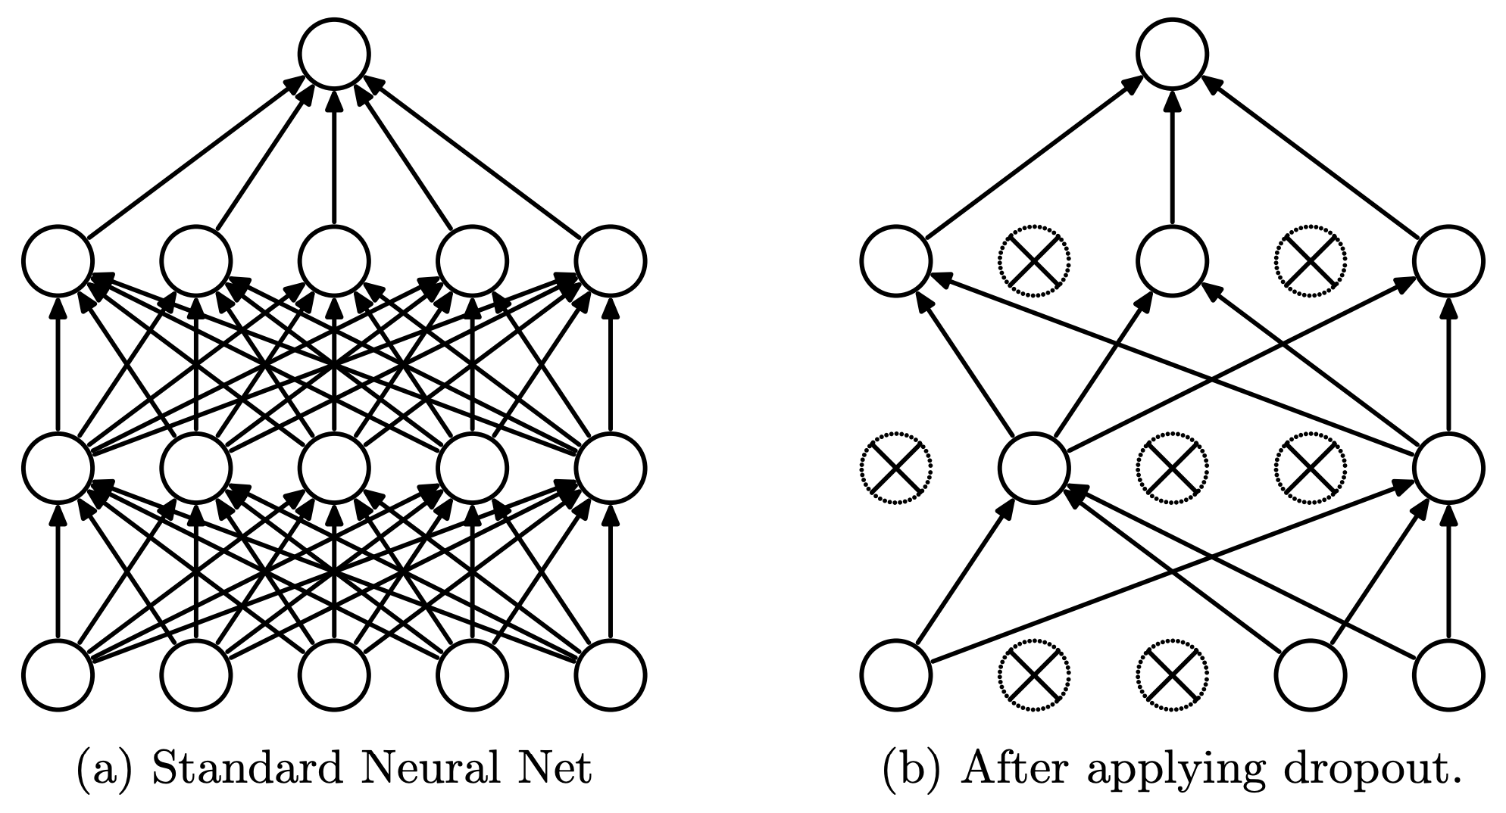
Dropout
Randomly set some neurons and their connections to zero (i.e. “dropped”)
Prevent overfitting by reducing co-adaptation of neurons
Like training many random sub-networks

Slide 77
Dropout
Widely used and highly effective
Proposed as an alternative to ensembling, which is too expensive for neural nets
Test error for different architectures with and without dropout. The networks have 2 to 4 hidden layers each with 1024 to 2048 units.
http://jmlr.org/papers/volume15/srivastava14a/srivastava14a.pdf

Slide 78
Dropout: Stochastic GD
For each new example/mini-batch:
Randomly sample a binary mask μ independently, where μ_{i} indicates if input/hidden node i is included
Multiply output of node i with μ_{i}, and perform gradient update
Typically, an input node is included with prob=0.8, hidden node with prob=0.5.

Slide 79
Dropout: Weight Scaling
We can think of dropout as training many of sub-networks
At test time, we can “aggregate” over these sub-networks by reducing connection weights in proportion to dropout probability, p
Notes:
https://chatbotslife.com/regularization-in-deep-learning-f649a45d6e0

Slide 80
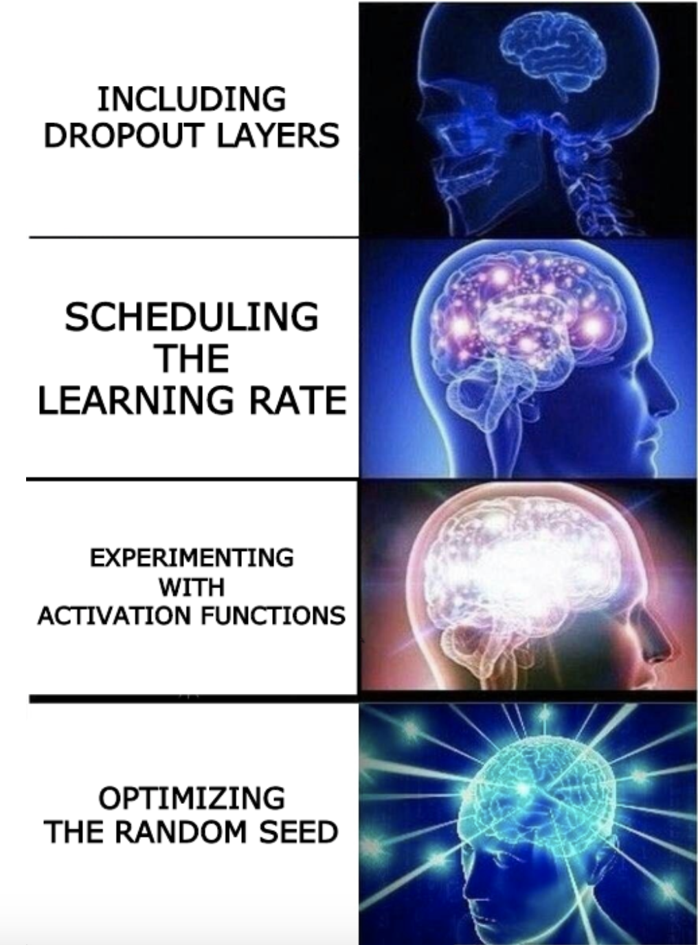

Slide 81
Uncertainty in model and prediction
Cross validation
Overfitting: Variance & Bias
Pandas
NumPy
Scikit-Learn
PCA & dimensionality reduction
Statistical Learning
Computing Tools
Matplotlib
Methods of regularization:
Lasso and Ridge
Regression
Classification
Logistic
Linear
Trees
KNN
Neural Networks
Experimental Design & Causal Inference

