Slide 1
Lecture 20: Back Propagation

Slide 2
Outline
Back Propagation
Optimizers

Slide 3
Outline
Back Propagation
Optimizers

Slide 4
Learning the coefficients
Start with Regression or Logistic Regression
Classification
Regression
f(X)$=\frac{1}{{1+e}^{−W^{T}X}}$
f$\left(X\right)=W^{T}X$
$$W^{T}=\left[W_{0},W_{1},…, W_{4}\right]$$
$= [β_{0}, β_{1},…, β_{4}]$
$$x_{1}$$
$$x_{2}$$
$$Y=f(β_{0}+β_{1}x_{1}+β_{2}x_{2}+β_{3}x_{3}+β_{4}x_{4})$$
$$x_{3}$$
$$x_{4}$$
Intercept or Bias
Coefficients or Weights

Slide 5
But what is the idea?
Start with all randomly selected weights. Most likely it will perform horribly.
For example, in our heart data, the model will be giving us the wrong answer.
$$MaxHR=197$$
Correct
$$Age=53$$
$$\hat{p}=0.9→Yes$$
y=No
$$Sex=Male$$
$$Chol=152$$
Bad Computer

Slide 6
But what is the idea?
Start with all randomly selected weights. Most likely it will perform horribly.
For example, in our heart data, the model will be giving us the wrong answer.
$$MaxHR=170$$
Correct
$$Age=42$$
$$\hat{p}=0.4→No$$
y=Yes
$$Sex=Male$$
$$Chol=342$$
Bad Computer

Slide 7
But what is the idea?
Loss Function: Takes all of these results and averages them and tells us how bad or good the computer or those weights are.
Telling the computer how bad or good is, does not help.
You want to tell it how to change those weights so it gets better.
Loss function: $ℒ\left(w_{0},w_{1},w_{2},w_{3},w_{4}\right)$
For now let’s only consider one weight, $ℒ\left(w_{1}\right)$

Slide 8
Minimizing the Loss function
Ideally we want to know the value of $w_{1}$ that gives the minimal $ℒ\left(W\right)$
To find the optimal point of a function $ℒ\left(W\right)$
And find the $W$ that satisfies that equation. Sometimes there is no explicit solution for that.
$$\frac{dℒ(W)}{dW}=0$$

Slide 9
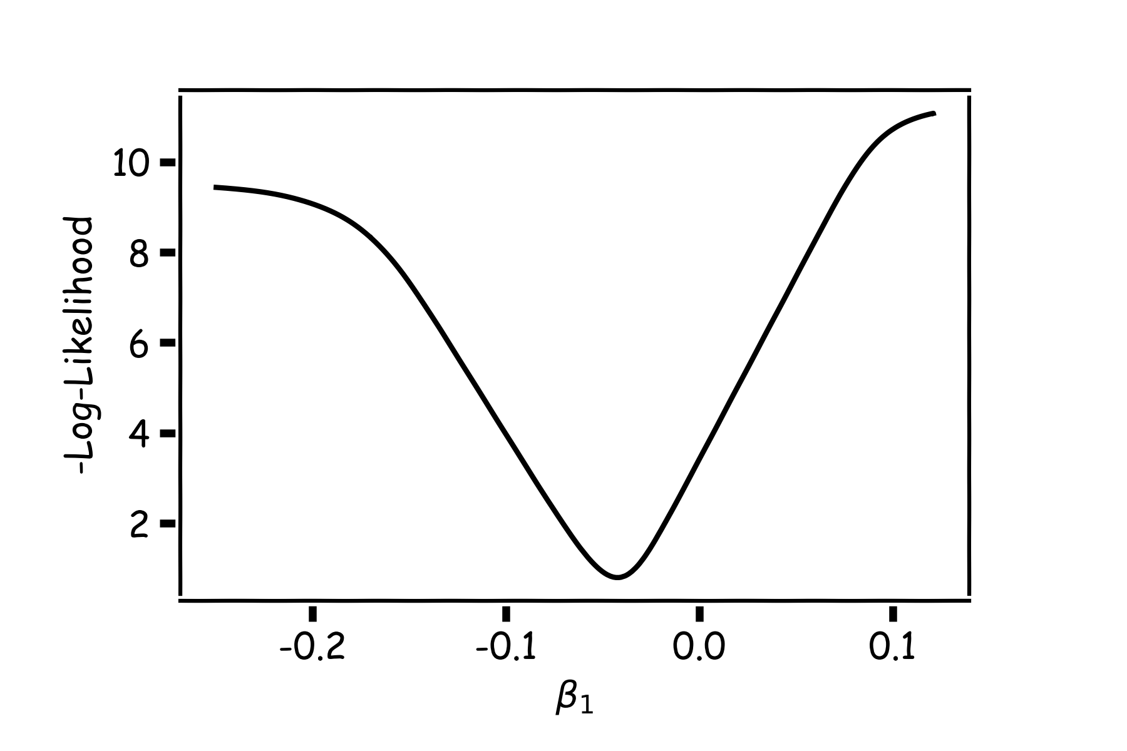
Estimate of the regression coefficients: gradient descent
A more flexible method is
Start from a random point
Determine which direction to go to reduce the loss (left or right)
Compute the slope of the function at this point and step to the right if slope is negative or step to the left if slope is positive
Goto to #1

Slide 10
Minimization of the Loss Function
Question: What is the mathematical function that describes the slope?
Derivative
Question: How do we generalize this to more than one predictor?
Take the derivative with respect to each coefficient and do the same sequentially
Question: What do you think is a good approach for telling the model how to change (what is the step size) to become better?

Slide 11
Gradient Descent (cont.)
If the step is proportional to the slope then you avoid overshooting the minimum. How?
$$\frac{dℒ(W)}{dW}$$
$$\frac{dℒ(W)}{dW}$$
$$\frac{dℒ(W)}{dW}$$

Slide 12
Let’s play the Pavlos game
We know that we want to go in the opposite direction of the derivative and we know we want to be making a step proportional to the derivative.
Making a step means:
Step size is proportional to derivative
$${w^{new}=w}^{old}+step$$
Opposite direction of the derivative means:
$${w^{new}=w}^{old}−λ\frac{dℒ}{dw}$$
Learning Rate
Change to more conventional notation:
$${w^{(i+1)}=w}^{(i)}−λ\frac{dℒ}{dw}$$

Slide 13
Gradient Descent
Algorithm for optimization of first order to finding a minimum of a function.
It is an iterative method.
L is decreasing much faster in the direction of the negative derivative.
The learning rate is controlled by the magnitude of $λ$.
$${w^{(i+1)}=w}^{(i)}−λ\frac{dℒ}{dw}$$
L
-
+
w

Slide 14
Considerations
We still need to calculate the derivatives.
We need to know what is the learning rate or how to set it.
Local vs global minima.
The full likelihood function includes summing up all individual ‘errors’. Unless you are a statistician, sometimes this includes hundreds of thousands of examples.

Slide 15
Considerations
We still need to calculate the derivatives.
We need to know what is the learning rate or how to set it.
Local vs global minima.
The full likelihood function includes summing up all individual ‘errors’. Unless you are a statistician, sometimes this includes hundreds of thousands of examples.

Slide 16
Calculate the Derivatives
Can we do it?
Wolfram Alpha can do it for us!
We need a formalism to deal with these derivatives.
Example: Logistic Regression derivatives

Slide 17
Chain Rule
Chain rule for computing gradients:
$y=g\left(x\right) z=f\left(y\right)=f\left(g\left(x\right)\right)$
For longer chains:
$$y=g\left(x \right) z=f\left(y\right)=f\left(g\left(x \right)\right)$$
$$\frac{∂z}{∂x_{i}}=\sum_{j}{\frac{∂z}{∂y_{j}}\frac{∂y_{j}}{∂x_{i}}}$$
$$\frac{∂z}{∂x}=\frac{∂z}{∂y}\frac{∂y}{∂x}$$

Slide 18
Logistic Regression derivatives
For logistic regression, the –ve log of the likelihood is:
$$ℒ=\sum_{i}{ℒ_{i}}=−\sum_{i}{\log{L_{i}}}{=−\sum_{i}{[y_{i}\log{p_{i}+\left(1−y_{i}\right)\log{(1−p_{i})]}}}}$$
$$ℒ_{i}={−y}_{i}\log{\frac{1}{1+e^{−W^{T}X}}−\left(1−y_{i}\right)\log{(1−\frac{1}{1+e^{−W^{T}X}})}}$$
To simplify the analysis let us split it into two parts,
$$ℒ_{i}=ℒ_{i}^{A}+ℒ_{i}^{B}$$
So the derivative with respect to W is:
$\frac{∂ℒ}{∂W}=\sum_{i}{\frac{∂ℒ_{i}}{∂W}}=\sum_{i}{(}\frac{∂ℒ_{i}^{A}}{∂W}$+ $\frac{∂ℒ_{i}^{B}}{∂W}$)

Slide 19
$$ℒ_{i}^{A}={−y}_{i}\log{\frac{1}{1+e^{−W^{T}X}}}$$
Variables | Partial derivatives | Partial derivatives
$$ξ_{1}=−W^{T}X$$ | $$\frac{∂ξ_{1}}{∂W}=−X$$ | $$\frac{∂ξ_{1}}{∂W}=−X$$
$$ξ_{2}={e^{ξ_{1}}=e}^{−W^{T}X}$$ | $$\frac{∂ξ_{2}}{∂ξ_{1}}=e^{ξ_{1}}$$ | $$\frac{∂ξ_{2}}{∂ξ_{1}}=e^{−W^{T}X}$$
$$ξ_{3}=1+ξ_{2}=1+e^{−W^{T}X}$$ | $$\frac{∂ξ_{3}}{∂ξ_{2}}=1$$ | $\frac{∂ξ_{3}}{∂ξ_{2}}=$1
$$ξ_{4}=\frac{1}{ξ_{3}}=\frac{1}{1+e^{−W^{T}X}}=p$$ | $$\frac{∂ξ_{4}}{∂ξ_{3}}=−\frac{1}{ξ_{3}^{2}}$$ | $$\frac{∂ξ_{4}}{∂ξ_{3}}=−\frac{1}{{\left(1+e^{−W^{T}X}\right)}^{2}}$$
$$ξ_{5}=\log{ξ_{4}=\log{p =}\log{\frac{1}{1+e^{−W^{T}X}}}}$$ | $$\frac{∂ξ_{5}}{∂ξ_{4}}=\frac{1}{ξ_{4}}$$ | $$\frac{∂ξ_{5}}{∂ξ_{4}}=1+e^{−W^{T}X}$$
$$ℒ_{i}^{A}=−yξ_{5}$$ | $$\frac{∂ℒ}{∂ξ_{5}}=−y$$ | $$\frac{∂ℒ}{∂ξ_{5}}=−y$$
$$\frac{∂ℒ_{i}^{A}}{∂W}=\frac{∂ℒ_{i}}{∂ξ_{5}}\frac{∂ξ_{5}}{∂ξ_{4}}\frac{∂ξ_{4}}{∂ξ_{3}}\frac{∂ξ_{3}}{∂ξ_{2}}\frac{∂ξ_{2}}{∂ξ_{1}}\frac{∂ξ_{1}}{∂W}$$ |  | $${\frac{∂ℒ_{i}^{A}}{∂W}=−yXe}^{−W^{T}X}\frac{1}{{\left(1+e^{−W^{T}X}\right)}^{}}$$

Slide 20
$$ℒ_{i}^{B}={−(1−y}_{i})\log{[1−\frac{1}{1+e^{−W^{T}X}}]}$$
Variables | derivatives | Partial derivatives wrt to X,W
$$ξ_{1}=−W^{T}X$$ | $$\frac{∂ξ_{1}}{∂W}=−X$$ | $$\frac{∂ξ_{1}}{∂W}=−X$$
$$ξ_{2}={e^{ξ_{1}}=e}^{−W^{T}X}$$ | $$\frac{∂ξ_{2}}{∂ξ_{1}}=e^{ξ_{1}}$$ | $$\frac{∂ξ_{2}}{∂ξ_{1}}=e^{−W^{T}X}$$
$$ξ_{3}=1+ξ_{2}=1+e^{−W^{T}X}$$ | $$\frac{∂ξ_{3}}{∂ξ_{2}}=1$$ | $\frac{∂ξ_{3}}{∂2}=$1
$$ξ_{4}=\frac{1}{ξ_{3}}=\frac{1}{1+e^{−W^{T}X}}=p$$ | $$\frac{∂ξ_{4}}{∂ξ_{3}}=−\frac{1}{ξ_{3}^{2}}$$ | $$\frac{∂ξ_{4}}{∂ξ_{3}}=−\frac{1}{{\left(1+e^{−W^{T}X}\right)}^{2}}$$
$$ξ_{5}=1−ξ_{4}=1−\frac{1}{1+e^{−W^{T}X}}$$ | $$\frac{∂ξ_{5}}{∂ξ_{4}}=−1$$ | $\frac{∂ξ_{5}}{∂ξ_{4}}=$-1
$$ξ_{6}=\log{ξ_{5}=\log{(1−p) =}\log{\frac{1}{1+e^{−W^{T}X}}}}$$ | $$\frac{∂ξ_{6}}{∂ξ_{5}}=\frac{1}{ξ_{5}}$$ | $$\frac{∂ξ_{6}}{∂ξ_{5}}=\frac{1+e^{−W^{T}X} }{e^{−W^{T}X}}$$
$$ℒ_{i}^{B}=(1−y)ξ_{6}$$ | $$\frac{∂ℒ}{∂ξ_{6}}=1−y$$ | $$\frac{∂ℒ}{∂ξ_{6}}=1−y$$
$$\frac{∂ℒ_{i}^{B}}{∂W}=\frac{∂ℒ_{i}^{B}}{∂ξ_{6}}\frac{∂ξ_{6}}{∂ξ_{5}}\frac{∂ξ_{5}}{∂ξ_{4}}\frac{∂ξ_{4}}{∂ξ_{3}}\frac{∂ξ_{3}}{∂ξ_{2}}\frac{∂ξ_{2}}{∂ξ_{1}}\frac{∂ξ_{1}}{∂W}$$ |  | $$\frac{∂ℒ_{i}^{B}}{∂W}=(1−y)X\frac{1}{{\left(1+e^{−W^{T}X}\right)}^{}}$$

Slide 21
Considerations
We still need to calculate the derivatives.
We need to know what is the learning rate or how to set it.
Local vs global minima.
The full likelihood function includes summing up all individual ‘errors’. Unless you are a statistician, sometimes this includes hundreds of thousands of examples.

Slide 22
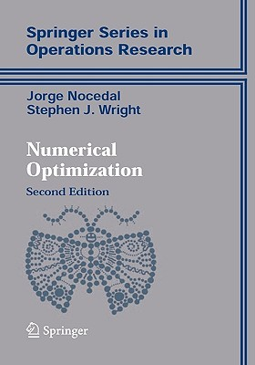
Learning Rate
Trial and Error.
There are many alternative methods which address how to set or adjust the learning rate, using the derivative or second derivatives and or the momentum. To be discussed in the next lectures on NN.
J. Nocedal y S. Wright, “Numerical optimization”, Springer, 1999 🔗
TLDR: J. Bullinaria, “Learning with Momentum, Conjugate Gradient Learning”, 2015 🔗

Slide 23
Considerations
We still need to calculate the derivatives.
We need to know what is the learning rate or how to set it.
Local vs global minima.
The full likelihood function includes summing up all individual ‘errors’. Unless you are a statistician, sometimes this includes hundreds of thousands of examples.

Slide 24
Local vs Global Minima
L
𝛉

Slide 25
Local vs Global Minima
L
𝛉

Slide 26
Local vs Global Minima
No guarantee that we get the global minimum.
Question: What would be a good strategy?

Slide 27
Considerations
We still need to calculate the derivatives.
We need to know what is the learning rate or how to set it.
Local vs global minima.
The full likelihood function includes summing up all individual ‘errors’. Unless you are a statistician, sometimes this includes hundreds of thousands of examples.

Slide 28
Batch and Stochastic Gradient Descent
$$ℒ=−\sum_{i}{[y_{i}\log{p_{i}+\left(1−y_{i}\right)\log{(1−p_{i})]}}}$$
Instead of using all the examples for every step, use a subset of them (batch).
For each iteration k, use the following loss function to derive the derivatives:
which is an approximation to the full loss function.
$$ℒ^{k}=−\sum_{i∈b^{k}}{[y_{i}\log{p_{i}+\left(1−y_{i}\right)\log{(1−p_{i})]}}}$$

Slide 29
Batch and Stochastic Gradient Descent
Full Likelihood:
L
Batch Likelihood:
𝛉

Slide 30
Batch and Stochastic Gradient Descent
Full Likelihood:
L
Batch Likelihood:
𝛉

Slide 31
Batch and Stochastic Gradient Descent
Full Likelihood:
L
Batch Likelihood:
𝛉

Slide 32
Batch and Stochastic Gradient Descent
Full Likelihood:
L
Batch Likelihood:
𝛉

Slide 33
Batch and Stochastic Gradient Descent
Full Likelihood:
L
Batch Likelihood:
𝛉

Slide 34
Batch and Stochastic Gradient Descent
Full Likelihood:
L
Batch Likelihood:
𝛉

Slide 35
Batch and Stochastic Gradient Descent
Full Likelihood:
L
Batch Likelihood:
𝛉

Slide 36
Batch and Stochastic Gradient Descent
Full Likelihood:
L
Batch Likelihood:
𝛉

Slide 37
Batch and Stochastic Gradient Descent
Full Likelihood:
L
Batch Likelihood:
𝛉

Slide 38
Backpropagation

Slide 39
Backpropagation: Logistic Regression Revisited
Affine
Activation
Loss Fun
$$ℒ(β)=\sum_{i}^{n}{ℒ_{i}\left(β\right)}$$
$$p=\frac{1}{1+e^{−h}}$$
$$X$$
$$h=β_{0}+β_{1}X$$
$\frac{∂ℒ}{∂p}$ $\frac{∂p}{∂h}$ $\frac{∂h}{∂β}$
$\frac{∂ℒ}{∂p}$ $\frac{∂p}{∂h}$
$$\frac{∂ℒ}{∂p}$$
$$\frac{∂h}{∂β_{1}}=X,\frac{dℒ}{dβ_{0}}=1$$
$$\frac{∂p}{∂h}=σ(h)(1−σ\left(h\right))$$
$$\frac{∂ℒ}{∂p}=−y\frac{1}{p}−\left(1−y\right)\frac{1}{1−p}$$
$$\frac{∂ℒ}{∂β_{1}}=−Xσ\left(h\right)\left(1−σ\left(h\right)\right)[y\frac{1}{p}+\left(1−y\right)\frac{1}{1−p}]$$
$$\frac{∂ℒ}{∂β_{0 }}=−σ\left(h\right)\left(1−σ\left(h\right)\right)[ y\frac{1}{p}+\left(1−y\right)\frac{1}{1−p}]$$

Slide 40
Backpropagation
Derivatives need to be evaluated at some values of X, y and W.
But since we have an expression, we can build a function that takes as input X, y, W and returns the derivatives and then we can use gradient descent to update.
This approach works well but it does not generalize. For example if the network is changed, we need to write a new function to evaluate the derivatives.
For example this network will need a different function for the derivatives
W₁
$$W_{3}$$
$$X$$
$$Y$$
W₂

Slide 41
Backpropagation
Derivatives need to be evaluated at some values of X, y and W.
But since we have an expression, we can build a function that takes as input X, y, W and returns the derivatives and then we can use gradient descent to update.
This approach works well but it does not generalize. For example if the network is changed, we need to write a new function to evaluate the derivatives.
For example this network will need a different function for the derivatives
W₁
$$W_{3}$$
$$W_{5}$$
$$X$$
$$Y$$
W₂
$$W_{4}$$

Slide 42
Backpropagation. Pavlos game #456
Need to find a formalism to calculate the derivatives of the loss w.r.t. weights that is:
Flexible enough that adding a node or a layer or changing something in the network won’t require to re-derive the functional form from scratch.
It is exact.
It is computationally efficient.
Hints:
Remember we only need to evaluate the derivatives at $X_{i}, y_{i}$ and $W^{(k)}.$
We should take advantage of the chain rule we learned before

Slide 43
Idea 1: Evaluate the derivative at: X={3}, y=1, W=3
Variables | derivatives | Value of the variable | Value of the partial derivative | $$\frac{dξ_{n}}{dW}$$
$$ξ_{1}=−W^{T}X$$ | $$\frac{∂ξ_{1}}{∂W}=−X$$ | $$−9$$ | -3 | -3
$$ξ_{2}={e^{ξ_{1}}=e}^{−W^{T}X}$$ | $$\frac{∂ξ_{2}}{∂ξ_{1}}=e^{ξ_{1}}$$ | $$e^{−9}$$ | $$e^{−9}$$ | -3$e^{−9}$
$$ξ_{3}=1+ξ_{2}=1+e^{−W^{T}X}$$ | $$\frac{∂ξ_{3}}{∂ξ_{2}}=1$$ | 1+$e^{−9}$ | 1 | -3$e^{−9}$
$$ξ_{4}=\frac{1}{ξ_{3}}=\frac{1}{1+e^{−W^{T}X}}=p$$ | $$\frac{∂ξ_{4}}{∂ξ_{3}}=−\frac{1}{ξ_{3}^{2}}$$ | $$\frac{1}{1+e^{−9}}$$ | $${\left(\frac{1}{1+e^{−9}}\right)}^{2}$$ | -3$e^{−9}{\left(\frac{1}{1+e^{−9}}\right)}^{2}$
$$ξ_{5}=\log{ξ_{4}=\log{p =}\log{\frac{1}{1+e^{−W^{T}X}}}}$$ | $$\frac{∂ξ_{5}}{∂ξ_{4}}=\frac{1}{ξ_{4}}$$ | $$\log{\frac{1}{1+e^{−9}}}$$ | $$1+e^{−9}$$ | -3$e^{−9}{\left(\frac{1}{1+e^{−9}}\right)}^{}$
$$ℒ_{i}^{A}=−yξ_{5}$$ | $$\frac{∂ℒ}{∂ξ_{5}}=−y$$ | $$−\log{\frac{1}{1+e^{−9}}}$$ | $$−1$$ | 3$e^{−9}{\left(\frac{1}{1+e^{−9}}\right)}^{}$
$$\frac{∂ℒ_{i}^{A}}{∂W}=\frac{∂ℒ_{i}}{∂ξ_{5}}\frac{∂ξ_{5}}{∂ξ_{4}}\frac{∂ξ_{4}}{∂ξ_{3}}\frac{∂ξ_{3}}{∂ξ_{2}}\frac{∂ξ_{2}}{∂ξ_{1}}\frac{∂ξ_{1}}{∂W}$$ |  |  | $$−3$$ | 0.00037018372

Slide 44
Basic functions
We still need to derive derivatives ☹
Variables | derivatives | Value of the variable | Value of the partial derivative | $$\frac{dξ_{n}}{dW}$$
$$ξ_{1}=−W^{T}X$$ | $$\frac{∂ξ_{1}}{∂W}=−X$$ | $$−9$$ | -3 | -3
$$ξ_{2}={e^{ξ_{1}}=e}^{−W^{T}X}$$ | $$\frac{∂ξ_{2}}{d∂ξ_{1}}=e^{ξ_{1}}$$ | $$e^{−9}$$ | $$e^{−9}$$ | -3$e^{−9}$
$$ξ_{3}=1+ξ_{2}=1+e^{−W^{T}X}$$ | $$\frac{∂ξ_{3}}{∂ξ_{2}}=1$$ | 1+$e^{−9}$ | 1 | -3$e^{−9}$
$$ξ_{4}=\frac{1}{ξ_{3}}=\frac{1}{1+e^{−W^{T}X}}=p$$ | $$\frac{∂ξ_{4}}{∂ξ_{3}}=−\frac{1}{ξ_{3}^{2}}$$ | $$\frac{1}{1+e^{−9}}$$ | $${\left(\frac{1}{1+e^{−9}}\right)}^{2}$$ | -3$e^{−9}{\left(\frac{1}{1+e^{−9}}\right)}^{2}$
$$ξ_{5}=\log{ξ_{4}=\log{p =}\log{\frac{1}{1+e^{−W^{T}X}}}}$$ | $$\frac{∂ξ_{5}}{∂ξ_{4}}=\frac{1}{ξ_{4}}$$ | $$\log{\frac{1}{1+e^{−9}}}$$ | $$1+e^{−9}$$ | -3$e^{−9}{\left(\frac{1}{1+e^{−9}}\right)}^{}$
$$ℒ_{i}^{A}=−yξ_{5}$$ | $$\frac{∂ℒ}{∂ξ_{5}}=−y$$ | $$−\log{\frac{1}{1+e^{−9}}}$$ | $$−1$$ | 3$e^{−9}{\left(\frac{1}{1+e^{−9}}\right)}^{}$
$$\frac{∂ℒ_{i}^{A}}{∂W}=\frac{∂ℒ_{i}}{∂ξ_{5}}\frac{∂ξ_{5}}{∂ξ_{4}}\frac{∂ξ_{4}}{∂ξ_{3}}\frac{∂ξ_{3}}{∂ξ_{2}}\frac{∂ξ_{2}}{∂ξ_{1}}\frac{∂ξ_{1}}{∂W}$$ |  |  | $$−3$$ | 0.00037018372

Slide 45
Basic functions
Notice though those are basic functions that my grandparent can do
$$ξ_{0}=X$$ | $$\frac{∂ξ_{0}}{∂X}=1$$ | def x0(x): return X | def derx0(): return 1
$$ξ_{1}=−W^{T}ξ_{0}$$ | $$\frac{∂ξ_{1}}{∂W}=−X$$ | def x1(a,x): return –a*X | def derx1(a,x): return -a
$$ξ_{2}=e^{ξ_{1}}$$ | $$\frac{∂ξ_{2}}{∂ξ_{1}}=e^{ξ_{1}}$$ | def x2(x): return np.exp(x) | def derx2(x): return np.exp(x)
$$ξ_{3}=1+ξ_{2}$$ | $$\frac{∂ξ_{3}}{∂ξ_{2}}=1$$ | def x3(x): return 1+x | def derx3(x): return 1
$$ξ_{4}=\frac{1}{ξ_{3}}$$ | $$\frac{∂ξ_{4}}{∂ξ_{3}}=−\frac{1}{ξ_{3}^{2}}$$ | def der1(x): return 1/(x) | def derx4(x): return -(1/x)**(2)
$$ξ_{5}=\log{ξ_{4}}$$ | $$\frac{∂ξ_{5}}{∂ξ_{4}}=\frac{1}{ξ_{4}}$$ | def der1(x): return np.log(x) | def derx5(x) return 1/x
$$ℒ_{i}^{A}=−yξ_{5}$$ | $$\frac{∂ℒ}{∂ξ_{5}}=−y$$ | def der1(y,x): return –y*x | def derL(y): return -y

Slide 46
Putting it altogether
1. We specify the network structure
W₁
$$W_{3}$$
$$X$$
$$W_{5}$$
$$Y$$
W₂
$$W_{4}$$
2. Following the computational graph …
What is computational graph?

Slide 47
$$ξ_{5}=log{\frac{1}{1+e^{−W^{T}X}}}$$
Computational Graph
$$ξ_{4}=\frac{1}{1+e^{−W^{T}X}}$$
$$÷$$
Log
$$ξ_{7}=log(1−{\frac{1}{1+e^{−W^{T}X}})}$$
$$ξ_{3}={1+e}^{−W^{T}X}$$
$$+$$
log
-
1
$$exp$$
$$ξ_{6}=1−{\frac{1}{1+e^{−W^{T}X}}}$$
1-y
$$ξ_{2}=e^{−ξ_{1}} \\ ξ_{2}^{′}={−e}^{−ξ_{1}}$$
$$−$$
$$×$$
$$ξ_{1}=W^{T}X$$ $ξ_{1}^{′}$=X
y
$$×$$
$$×$$
$$ξ_{8}=\left(1−y\right)log(1−{\frac{1}{1+e^{−W^{T}X}})}$$
$$ξ_{9}=ylog({\frac{1}{1+e^{−W^{T}X}})}$$
W
X
$$+$$
$$ξ_{0}=W$$
$$−ℒ=ξ_{9}=ylog({\frac{1}{1+e^{−W^{T}X}})}+ \left(1−y\right)log(1−{\frac{1}{1+e^{−W^{T}X}})}$$

Slide 48
Putting it altogether
1. We specify the network structure
W₁
$$W_{3}$$
$$X$$
$$W_{5}$$
$$Y$$
W₂
$$W_{4}$$
Envision the computational graph (only needed for the reverse mode).
At each node of the graph we build two functions: the evaluation of the variable and its partial derivative with respect to the previous variable (as shown in the table 3 slides back)
Now we can either go forward or backward depending on the situation. In general, forward is easier to implement and to understand. The difference is clearer when there are multiple nodes per layer.

Slide 49
Forward mode: Evaluate the derivative at: X={3}, y=1, W=3
Variables | derivatives | Value of the variable | Value of the partial derivative | $$\frac{dℒ}{dξ_{n}}$$
$$ξ_{1}=−W^{T}X$$ | $$\frac{∂ξ_{1}}{∂W}=−X$$ | $$−9$$ | -3 | -3
$$ξ_{2}={e^{ξ_{1}}=e}^{−W^{T}X}$$ | $$\frac{∂ξ_{2}}{∂ξ_{1}}=e^{ξ_{1}}$$ | $$e^{−9}$$ | $$e^{−9}$$ | -3$e^{−9}$
$$ξ_{3}=1+ξ_{2}=1+e^{−W^{T}X}$$ | $$\frac{∂ξ_{3}}{∂ξ_{2}}=1$$ | 1+$e^{−9}$ | 1 | -3$e^{−9}$
$$ξ_{4}=\frac{1}{ξ_{3}}=\frac{1}{1+e^{−W^{T}X}}=p$$ | $$\frac{∂ξ_{4}}{∂ξ_{3}}=−\frac{1}{ξ_{3}^{2}}$$ | $$\frac{1}{1+e^{−9}}$$ | $${\left(\frac{1}{1+e^{−9}}\right)}^{2}$$ | -3$e^{−9}{\left(\frac{1}{1+e^{−9}}\right)}^{2}$
$$ξ_{5}=\log{ξ_{4}=\log{p =}\log{\frac{1}{1+e^{−W^{T}X}}}}$$ | $$\frac{∂ξ_{5}}{∂ξ_{4}}=\frac{1}{ξ_{4}}$$ | $$\log{\frac{1}{1+e^{−9}}}$$ | $$1+e^{−9}$$ | -3$e^{−9}{\left(\frac{1}{1+e^{−9}}\right)}^{}$
$$ℒ_{i}^{A}=−yξ_{5}$$ | $$\frac{∂ℒ}{∂ξ_{5}}=−y$$ | $$−\log{\frac{1}{1+e^{−9}}}$$ | $$−1$$ | 3$e^{−9}{\left(\frac{1}{1+e^{−9}}\right)}^{}$
$$\frac{∂ℒ_{i}^{A}}{∂W}=\frac{∂ℒ_{i}}{∂ξ_{5}}\frac{∂ξ_{5}}{∂ξ_{4}}\frac{∂ξ_{4}}{∂ξ_{3}}\frac{∂ξ_{3}}{∂ξ_{2}}\frac{∂ξ_{2}}{∂ξ_{1}}\frac{∂ξ_{1}}{∂W}$$ |  |  | $$−3$$ | 0.00037018372

Slide 50
Backward mode: Evaluate the derivative at: X={3}, y=1, W=3
Variables | derivatives | Value of the variable | Value of the partial derivative
$$ξ_{1}=−W^{T}X$$ | $$\frac{∂ξ_{1}}{∂W}=−X$$ | $$−9$$ | -3
$$ξ_{2}={e^{ξ_{1}}=e}^{−W^{T}X}$$ | $$\frac{∂ξ_{2}}{∂ξ_{1}}=e^{ξ_{1}}$$ | $$e^{−9}$$ | $$e^{−9}$$
$$ξ_{3}=1+ξ_{2}=1+e^{−W^{T}X}$$ | $$\frac{∂ξ_{3}}{∂ξ_{2}}=1$$ | 1+$e^{−9}$ | 1
$$ξ_{4}=\frac{1}{ξ_{3}}=\frac{1}{1+e^{−W^{T}X}}=p$$ | $$\frac{∂ξ_{4}}{∂ξ_{3}}=−\frac{1}{ξ_{3}^{2}}$$ | $$\frac{1}{1+e^{−9}}$$ | $${\left(\frac{1}{1+e^{−9}}\right)}^{2}$$
$$ξ_{5}=\log{ξ_{4}=\log{p =}\log{\frac{1}{1+e^{−W^{T}X}}}}$$ | $$\frac{∂ξ_{5}}{∂ξ_{4}}=\frac{1}{ξ_{4}}$$ | $$\log{\frac{1}{1+e^{−9}}}$$ | $$1+e^{−9}$$
$$ℒ_{i}^{A}=−yξ_{5}$$ | $$\frac{∂ℒ}{∂ξ_{5}}=−y$$ | $$−\log{\frac{1}{1+e^{−9}}}$$ | $$−1$$
$$\frac{∂ℒ_{i}^{A}}{∂W}=\frac{∂ℒ_{i}}{∂ξ_{5}}\frac{∂ξ_{5}}{∂ξ_{4}}\frac{∂ξ_{4}}{∂ξ_{3}}\frac{∂ξ_{3}}{∂ξ_{2}}\frac{∂ξ_{2}}{∂ξ_{1}}\frac{∂ξ_{1}}{∂W}$$
Store all these values

Slide 51
Optimizers

Slide 52
Learning vs. Optimization
Goal of learning: minimize generalization error, or the loss function
$$𝓛\left(W\right)=𝔼_{\left(x,y\right)\sim p_{data}}\left[L(f\left(x,W\right), y\right]$$
In practice, empirical risk minimization:
$$ℒ\left(W\right)=\sum_{i}{\left[L(f\left(x_{i};W\right), y_{i}\right]}$$
f is the neural network
Quantity optimized different from the quantity we care about

Slide 53
Outline
Optimization
Challenges in Optimization
Momentum
Adaptive Learning Rate
Parameter Initialization
Batch Normalization

Slide 54
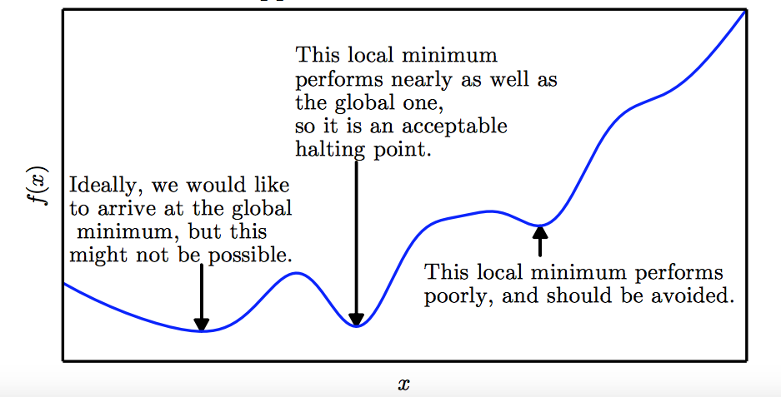
Local Minima
Goodfellow et al. (2016)

Slide 55
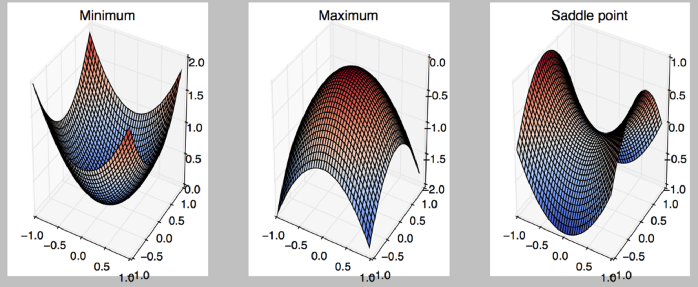
Critical Points
Points with zero gradient
2nd-derivate (Hessian) determines curvature
Goodfellow et al. (2016)

Slide 56
Local Minima
Old view: local minima is major problem in neural network training
Recent view:
For sufficiently large neural networks, most local minima incur low cost
Not important to find true global minimum

Slide 57
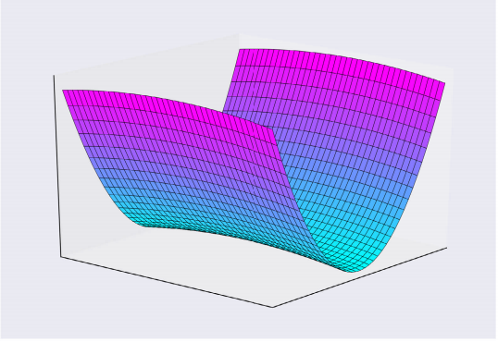
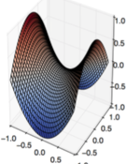
Saddle Points
Both local min and max
Recent studies indicate that in high dim, saddle points are more likely than local min
Gradient can be very small near saddle points
Goodfellow et al. (2016)

Slide 58
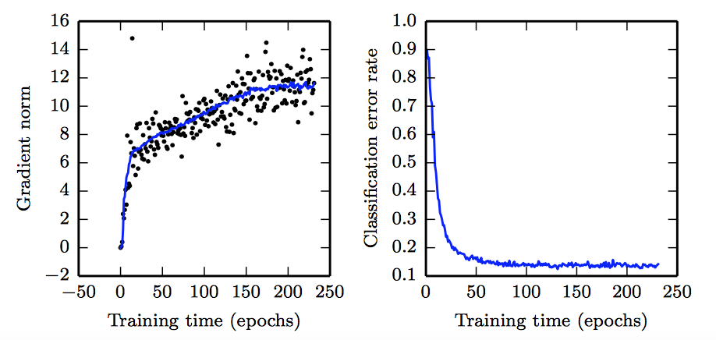
No Critical Points
Gradient norm increases, but validation error decreases
Convolution Nets for Object Detection
Goodfellow et al. (2016)

Slide 59
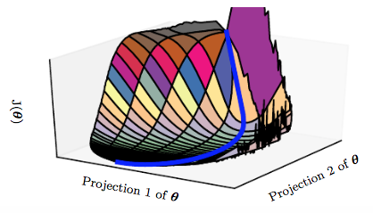
Saddle Points
SGD is seen to escape saddle points
Moves down-hill, uses noisy gradients
Second-order methods get stuck
solves for a point with zero gradient
Goodfellow et al. (2016)

Slide 60
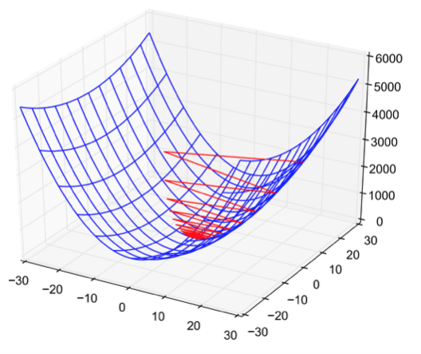
Poor Conditioning
Poorly conditioned Hessian matrix
High curvature: small steps leads to huge increase
Learning is slow despite strong gradients
Oscillations slow down progress

Slide 61
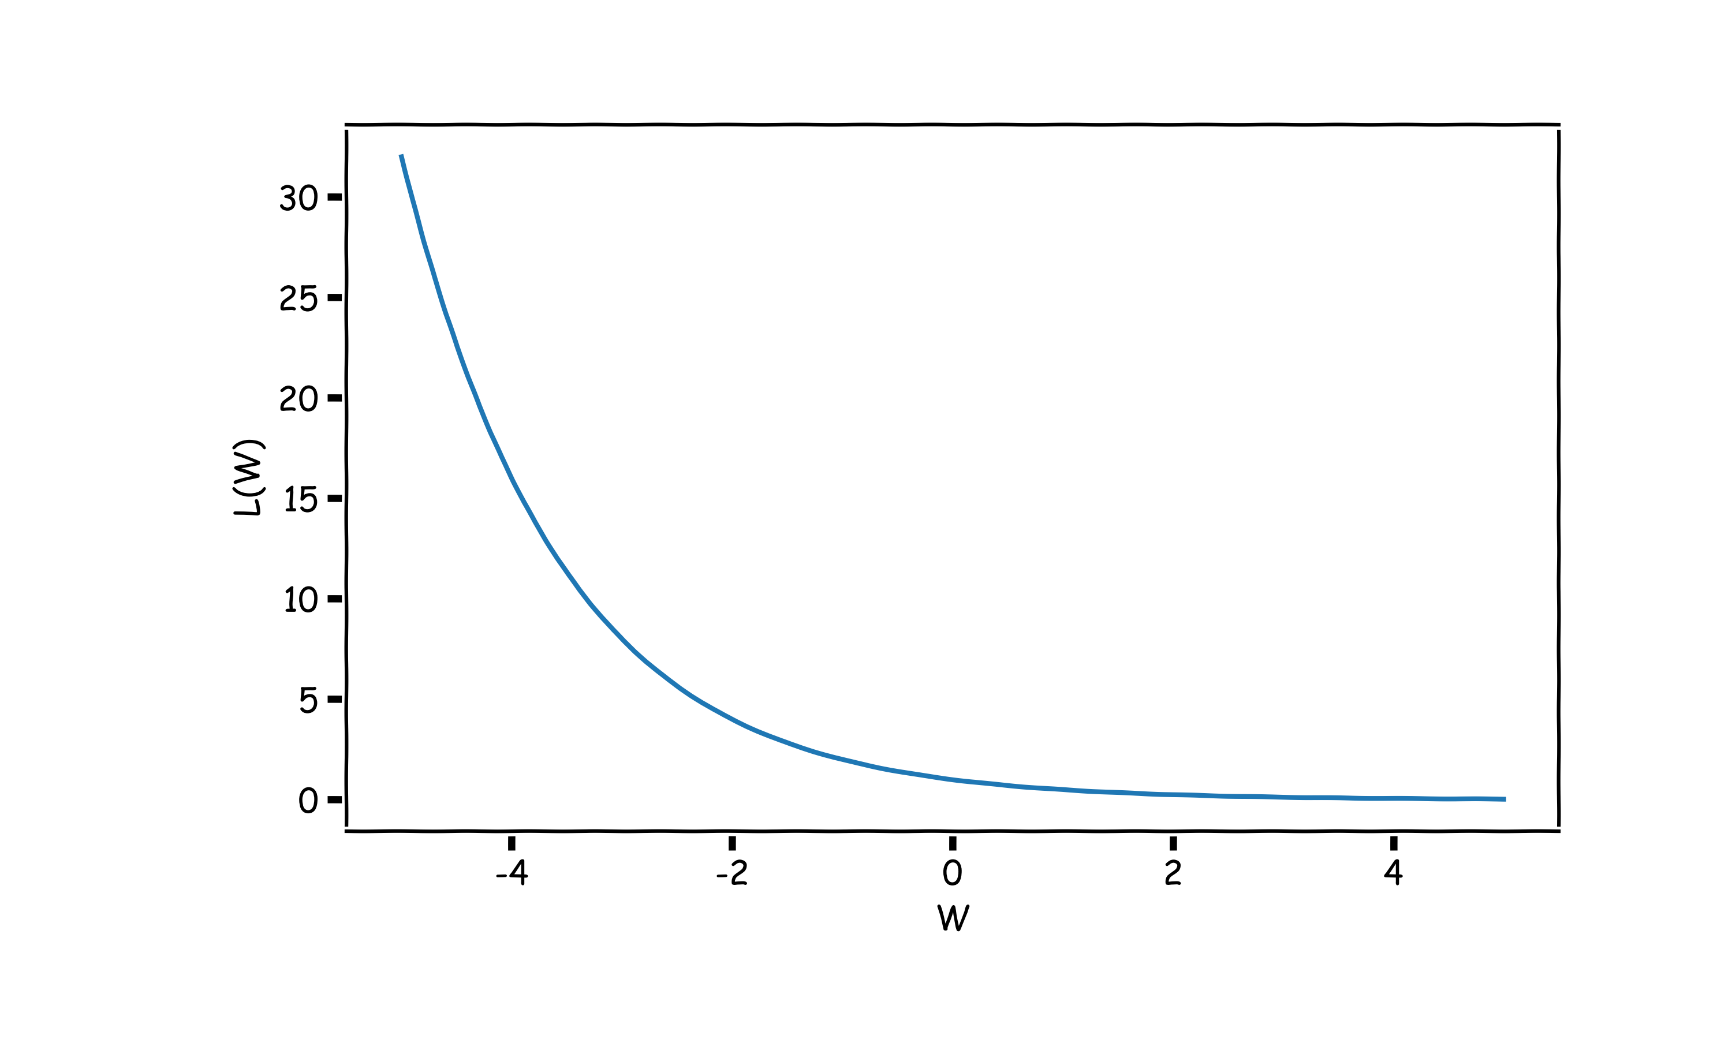
No Critical Points
Some cost functions do not have critical points. In particular classification.
WHY?

Slide 62
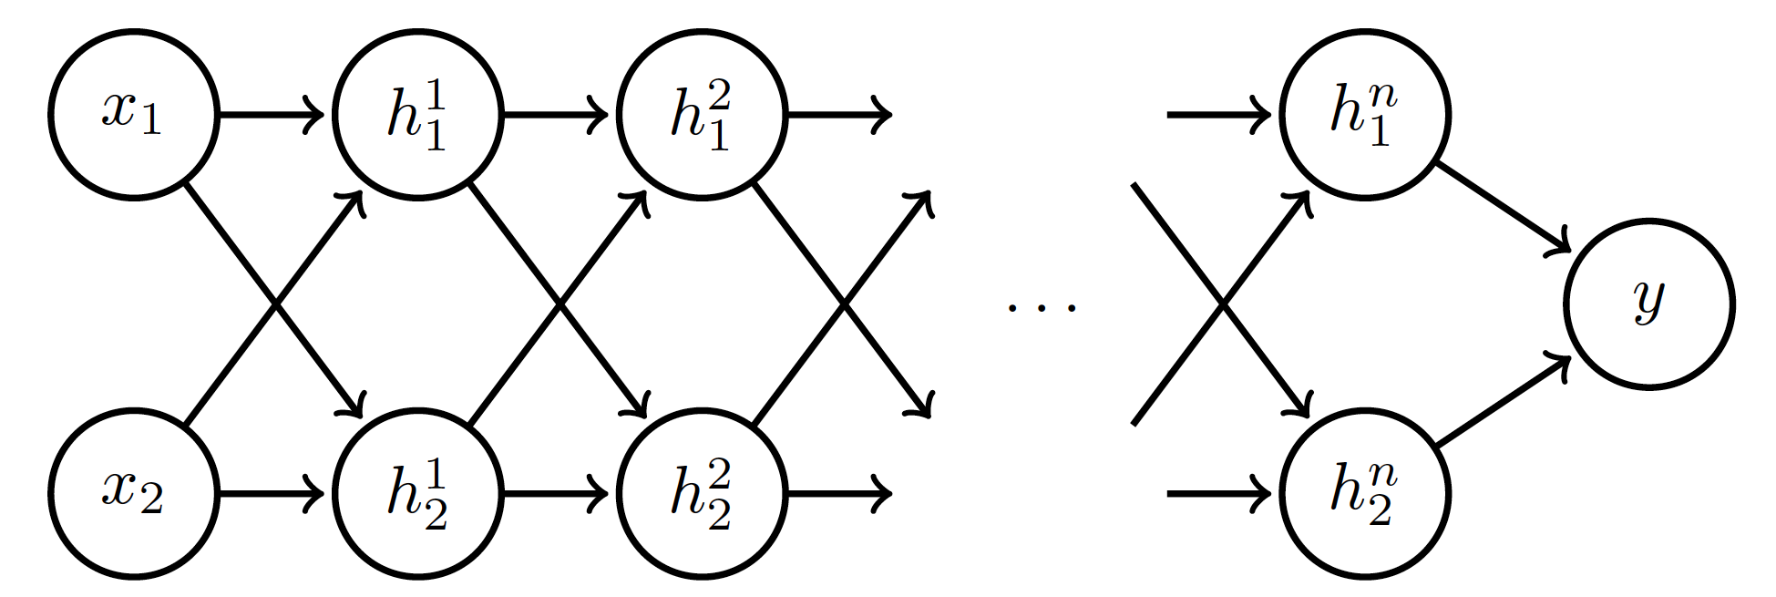
Exploding and Vanishing Gradients
Linear activation
$$h_{i}=Wx$$
$$h_{i}=Wh_{i−1}, i=2,…,n$$
deeplearning.ai

Slide 63
Exploding and Vanishing Gradients

Slide 64
Exploding and Vanishing Gradients
Explodes!
Vanishes!

Slide 65
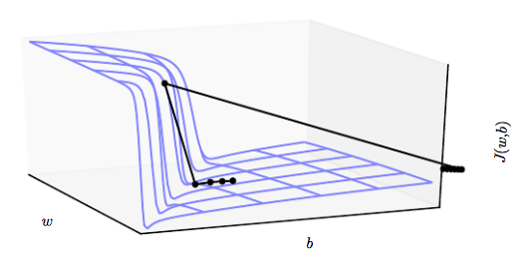
Exploding and Vanishing Gradients
Exploding gradients lead to cliffs
Can be mitigated using gradient clipping
$$if \left\|g\right\|>u$$
$$g⟵\frac{gu}{\left\|g\right\|}$$
Goodfellow et al. (2016)

Slide 66
Outline
Optimization
Challenges in Optimization
Momentum
Adaptive Learning Rate
Parameter Initialization
Batch Normalization

Slide 67
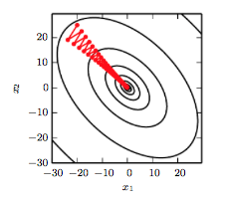
Stochastic Gradient Descent
$$L(W)$$
Oscillations because updates do not exploit curvature information
$$W_{2}$$
$$W_{1}$$
Goodfellow et al. (2016)

Slide 68
Momentum
SGD is slow when there is high curvature
Average gradient presents faster path to optimal: vertical components cancel out
$$L(W)$$
$$W_{2}$$
$$W_{1}$$
Notes:
https://distill.pub/2017/momentum/

Slide 69
Momentum
Uses past gradients for update
Maintains a new quantity: ‘velocity’
Exponentially decaying average of gradients:
$f$is the Neural Network
$$g= \frac{1}{m}\sum_{i}{∇_{W}L(f\left(x_{i};W\right),y_{i})}$$
Current gradient update
controls how quickly effect of past gradients decay

Slide 70
Momentum
Compute gradient estimate:
Update velocity:
Update parameters:
$$g= \frac{1}{m}\sum_{i}{∇_{W}L(f\left(x_{i};W\right),y_{i})}$$
$$ν=αν−εg$$
$$W=W+ ν$$

Slide 71
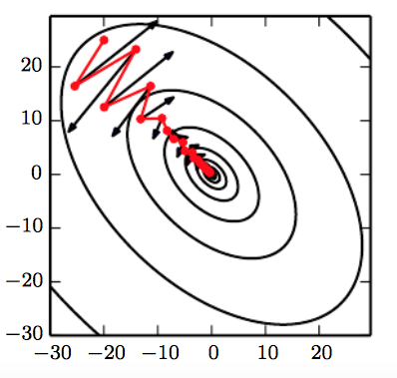
Momentum
$$L(W)$$
Damped oscillations:
gradients in opposite directions get cancelled out
Goodfellow et al. (2016)

Slide 72
Nesterov Momentum
Apply an interim update:
Perform a correction based on gradient at the interim point:
$$\tilde{W}=W+ ν$$
$$g= \frac{1}{m}\sum_{i}{∇_{W}L(f\left(x_{i};\tilde{W}\right), y_{i})}$$
Momentum based on look-ahead slope

Slide 73
Notes:
LiveSlide Site
https://distill.pub/2017/momentum/

Slide 74
Outline
Optimization
Challenges in Optimization
Momentum
Adaptive Learning Rate
Parameter Initialization
Batch Normalization

Slide 75
Adaptive Learning Rates
$$L(W)$$
$$W_{2}$$
Slow
Fast
$$W_{1}$$
Oscillations along vertical direction
Learning must be slower along parameter 2
Use a different learning rate for each parameter?

Slide 76
AdaGrad
Accumulate squared gradients:
Update each parameter:
Greater progress along gently sloped directions
$g$is the gradient
Inversely proportional to cumulative squared gradient

Slide 77
RMSProp
For non-convex problems, AdaGrad can prematurely decrease learning rate
Use exponentially weighted average for gradient accumulation

Slide 78
Adam
RMSProp + Momentum
Estimate first moment:
Estimate second moment:
Update parameters:
Also applies bias correction to v and r
Works well in practice, is fairly robust to hyper-parameters

Slide 79
Outline
Optimization
Challenges in Optimization
Momentum
Adaptive Learning Rate
Parameter Initialization
Batch Normalization

Slide 80
Parameter Initialization
Goal: break symmetry between units
so that each unit computes a different function
Initialize all weights (not biases) randomly
Gaussian or uniform distribution
Scale of initialization?
Large -> grad explosion, Small -> grad vanishing

Slide 81
Xavier Initialization
Heuristic for all outputs to have unit variance
For a fully-connected layer with m inputs:
For ReLU units, it is recommended:

Slide 82
Normalized Initialization
Fully-connected layer with m inputs, n outputs:
Heuristic trades off between initialize all layers have same activation and gradient variance
Sparse variant when m is large
Initialize k nonzero weights in each unit

Slide 83
Bias Initialization
Output unit bias
Marginal statistics of the output in the training set
Hidden unit bias
Avoid saturation at initialization
E.g. in ReLU, initialize bias to 0.1 instead of 0
Units controlling participation of other units
Set bias to allow participation at initialization

Slide 84
Notes:
LiveSlide Site
http://ruder.io/optimizing-gradient-descent/index.html#adam

Slide 85
Outline
Challenges in Optimization
Momentum
Adaptive Learning Rate
Parameter Initialization
Batch Normalization

Slide 86
Feature Normalization
Good practice to normalize features before applying learning algorithm:
Features in same scale: mean 0 and variance 1
Speeds up learning
Feature vector
Vector of mean feature values
Vector of SD of feature values

Slide 87
Feature Normalization
$$L(W)$$
Before normalization
After normalization

Slide 88
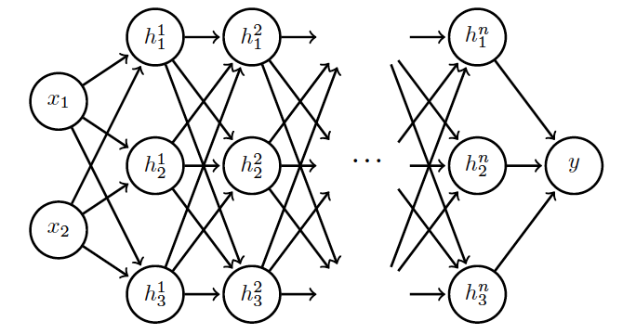
Internal Covariance Shift
Each hidden layer changes distribution of inputs to next layer: slows down learning
…
Normalize inputs to layer 2
Normalize inputs to layer n

Slide 89
Batch Normalization
Training time:
Mini-batch of activations for layer to normalize
K hidden layer activations
N data points in mini-batch

Slide 90
Batch Normalization
Training time:
Mini-batch of activations for layer to normalize
where
Vector of mean activations across mini-batch
Vector of SD of each unit across mini-batch

Slide 91
Batch Normalization
Training time:
Normalization can reduce expressive power
Instead use:
Allows network to control range of normalization
Learnable parameters

Slide 92
Batch Normalization
Batch 1
…..
Add normalization operations for layer 1
Batch N

Slide 93
Batch Normalization
Batch 1
…..
Add normalization operations for layer 2 and so on …
Batch N

Slide 94
Batch Normalization
Differentiate the joint loss for N mini-batches
Back-propagate through the norm operations
Test time:
Model needs to be evaluated on a single example
Replace μ and σ with running averages collected during training

