Slide 1
Lecture #2: Data aka STAT121A, AC209A, CSCIE-109A

Slide 2
Lecture Outline: Data, Summaries, and Visuals
What are Data?
Data Exploration
Descriptive Statistics
Visualizations
An Example
Reading: Ch. 1 in An Introduction to Statistical Learning (ISLR)

Slide 3
What are Data?

Slide 4
The Data Science Process
Recall the data science process.
Today we will begin introducing the data collection and data exploration steps.
Ask an interesting question
Get the Data
Explore the Data
Model the Data
Communicate/Visualize the Results

Slide 5
What are data?
“A datum is a single measurement of something on a scale that is understandable to both the recorder and the reader. Data are multiple such measurements.”
Claim: everything is (can be) data!

Slide 6
Where do data come from?
Internal sources: already collected by or is part of the overall data collection of you organization. For example: business-centric data that is available in the organization data base to record day to day operations; scientific or experimental data.
Existing External Sources: available in ready to read format from an outside source for free or for a fee. For example: public government databases, stock market data, Yelp reviews, [your favorite sport]-reference.
External Sources Requiring Collection Efforts: available from external source but acquisition requires special processing. For example: data appearing only in print form, or data on websites.

Slide 7
Ways to gather online data
How to get data generated, published or hosted online:
API (Application Programming Interface): using a prebuilt set of functions developed by a company to access their services. Often pay to use. For example: Google Map API, Facebook API, Twitter API
RSS (Rich Site Summary): summarizes frequently updated online content in standard format. Free to read if the site has one. For example: news-related sites, blogs
Web scraping: using software, scripts or by-hand extracting data from what is displayed on a page or what is contained in the HTML file (often in tables).

Slide 8
Web scraping
Why do it? Older government or smaller news sites might not have APIs for accessing data, or publish RSS feeds or have databases for download. Or, you don’t want to pay to use the API or the database.
How do you do it? See HW1 (beautifulsoup)
Should you do it?
You just want to explore: Are you violating their terms of service? Privacy concerns for website and their clients?
You want to publish your analysis or product: Do they have an API or fee that you are bypassing? Are they willing to share this data? Are you violating their terms of service? Are there privacy concerns?

Slide 9
Types of data
What kind of values are in your data (data types)?
Simple or atomic:
Numeric: integers, floats
Boolean: binary or true false values
Strings: sequence of symbols

Slide 10
Data types
What kind of values are in your data (data types)? Compound, composed of a bunch of atomic types:
Date and time: compound value with a specific structure
Lists: a list is a sequence of values
Dictionaries: A dictionary is a collection of key-value pairs, a pair of values x : y where x is usually a string called the key representing the “name” of the entry, and y is a value of any type.
Example: Student record: what are x and y?
First: Kevin
Last: Rader
Classes: [CS-109A, STAT139]

Slide 11
Data storage
How is your data represented and stored (data format)?
Tabular Data: a dataset that is a two-dimensional table, where each row typically represents a single data record, and each column represents one type of measurement (csv, dat, xlsx, etc.).
Structured Data: each data record is presented in a form of a [possibly complex and multi-tiered] dictionary (json, xml, etc.)
Semistructured Data: not all records are represented by the same set of keys or some data records are not represented using the key-value pair structure.

Slide 12
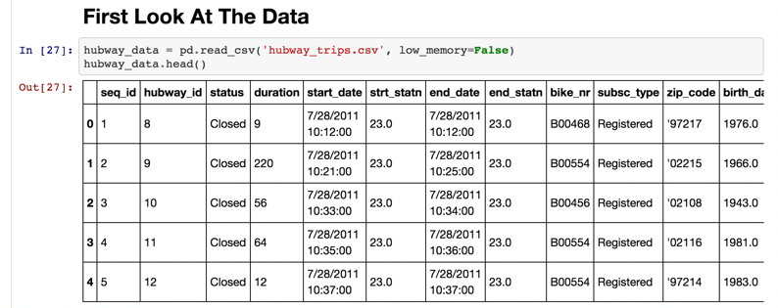
Tabular Data
In tabular data, we expect each record or observation to represent a set of measurements of a single object or event. We’ve ‘seen’ this already in Lecture 1:

Slide 13
Tabular Data
Each type of measurement is called a variable or an attribute of the data (e.g. seq_id, status and duration are variables or attributes). The number of attributes is called the dimension. These are often called features.
We expect each table to contain a set of records or observations of the same kind of object or event (e.g. our table above contains observations of rides/checkouts).

Slide 14
Types of Data
We’ll see later that it’s important to distinguish between classes of variables or attributes based on the type of values they can take on.
Quantitative variable: is numerical and can be either:
discrete - a finite number of values are possible in any bounded interval. For example: “Number of siblings” is a discrete variable
continuous - an infinite number of values are possible in any bounded interval. For example: “Height” is a continuous variable
Categorical variable: no inherent order among the values For example: “What kind of pet you have” is a categorical variable

Slide 15
Common Issues
Common issues with data:
Missing values: how do we fill in?
Wrong values: how can we detect and correct?
Messy format
Not usable: the data cannot answer the question posed

Slide 16
Messy Data
The following is a table accounting for the number of produce deliveries over a weekend.
What are the variables in this dataset? What object or event are we measuring?
What’s the issue? How do we fix it?

Slide 17
Messy Data
We’re measuring individual deliveries; the variables are Time, Day, Number of Produce.
Problem: each column header represents a single value rather than a variable. Row headers are “hiding” the Day variable. The values of the variable, “Number of Produce”, is not recorded in a single column.

Slide 18
Fixing Messy Data
We need to reorganize the information to make explicit the event we’re observing and the variables associated to this event.

Slide 19
Tabular = Happy Pavlos ☺
Common causes of messiness are:
Column headers are values, not variable names
Variables are stored in both rows and columns
Multiple variables are stored in one column/entry
Multiple types of experimental units stored in same table
In general, we want each file to correspond to a dataset, each column to represent a single variable and each row to represent a single observation.
We want to tabularize the data. This makes Python happy.

Slide 20
Data Exploration: Descriptive Statistics

Slide 21
Basics of Sampling
Population versus sample:
A population is the entire set of objects or events under study. Population can be hypothetical “all students” or all students in this class.
A sample is a “representative” subset of the objects or events under study. Needed because it’s impossible or intractable to obtain or compute with population data.
Biases in samples:
Selection bias: some subjects or records are more likely to be selected
Volunteer/nonresponse bias: subjects or records who are not easily available are not represented
Examples?

Slide 22
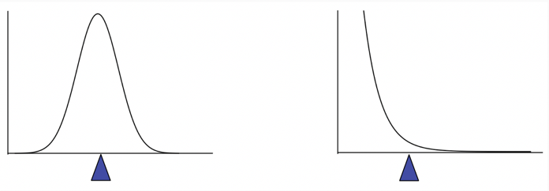
Sample mean
The mean of a set of n observations of a variable is denoted $\overline{x}$ and is defined as:
The mean describes what a “typical” sample value looks like, or where is the “center” of the distribution of the data.
Key theme: there is always uncertainty involved when calculating a sample mean to estimate a population mean.
$$\overline{x}=\frac{x_{1}+x_{2}+…+x_{n}}{n}=\frac{1}{n}\sum_{i=1}^{n}{x_{i}}$$

Slide 23
Sample median
The median of a set of n number of observations in a sample, ordered by value, of a variable is is defined by
Example (already in order): Ages: 17, 19, 21, 22, 23, 23, 23, 38
Median = (22+23)/2 = 22.5
The median also describes what a typical observation looks like, or where is the center of the distribution of the sample of observations.

Slide 24
Mean vs. Median
The mean is sensitive to extreme values (outliers)

Slide 25
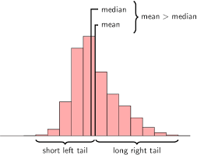
Mean, median, and skewness
The mean is sensitive to outliers:
The above distribution is called right-skewed since the mean is greater than the median. Note: skewness often “follows the longer tail”.

Slide 26
Computational time
How hard (in terms of algorithmic complexity) is it to calculate
the mean?
at most O(n)
the median?
at most O(n) or O(n log n)
Note: Practicality of implementation should be considered!

Slide 27
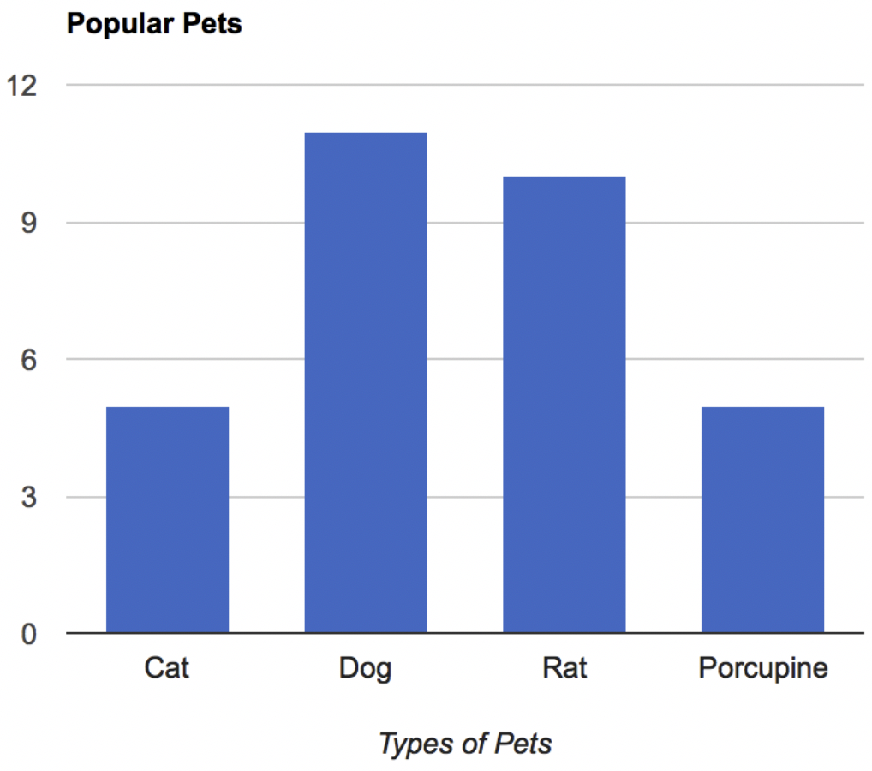
Regarding Categorical Variables...
For categorical variables, neither mean or median make sense. Why?
The mode might be a better way to find the most “representative” value.

Slide 28
Measures of Spread: Range
The spread of a sample of observations measures how well the mean or median describes the sample.
One way to measure spread of a sample of observations is via the range.
Range = Maximum Value - Minimum Value

Slide 29
Measures of Spread: Variance
The (sample) variance, denoted s², measures how much on average the sample values deviate from the mean:
Note: the term ${|x}_{i}−\overline{x}|$measures the amount by which each $x_{i}$ deviates from the mean $\overline{x}$. Squaring these deviations means that s² is sensitive to extreme values (outliers).
Note: s² doesn’t have the same units as the $x_{i}$ :(
What does a variance of 1,008 mean? Or 0.0001?
$$s^{2}=\frac{1}{n−1}\sum_{i=1}^{n}{{{|x}_{i}−\overline{x}|}^{2} }$$

Slide 30
Measures of Spread: Standard Deviation
The (sample) standard deviation, denoted s, is the square root of
the variance
Note: s does have the same units as the $x_{i}$. Phew!
$$s=\sqrt{s^{2}}= \sqrt{\frac{1}{n−1}\sum_{i=1}^{n}{{{|x}_{i}−\overline{x}|}^{2} }}$$

Slide 31
Data Exploration: Visualizations

Slide 32
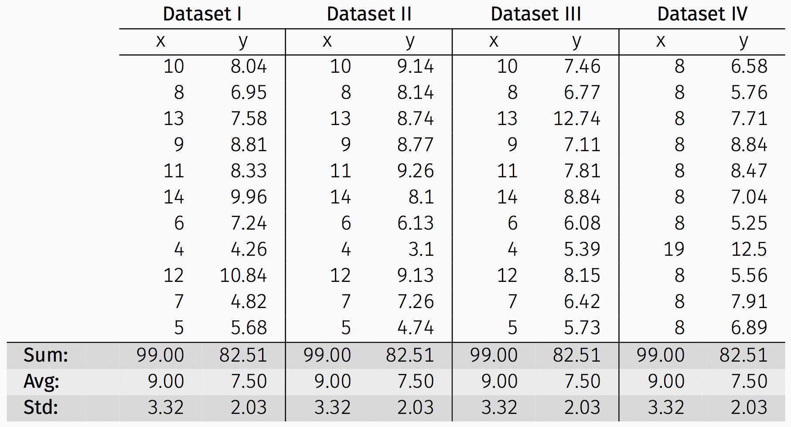
Anscombe’s Data
The following four data sets comprise the Anscombe’s Quartet; all four sets of data have identical simple summary statistics.

Slide 33
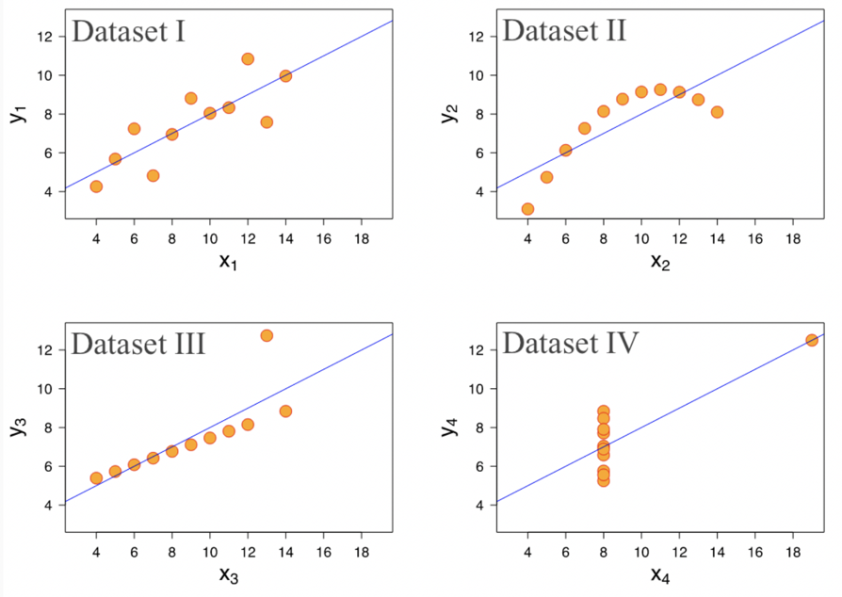
Anscombe’s Data (cont.)
Summary statistics clearly don’t tell the story of how they differ. But a picture can be worth a thousand words:

Slide 34
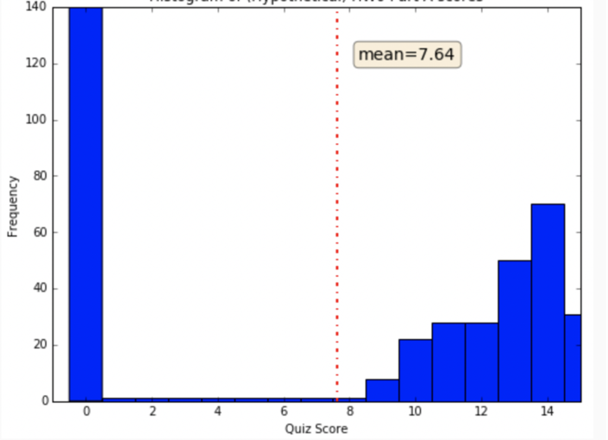
More Visualization Motivation
If I tell you that the average score for Homework 0 was: 7.64/15 = 50.9% last year, what does that suggest?
And what does the graph suggest?

Slide 35
More Visualization Motivation
Visualizations help us to analyze and explore the data. They help to:
Identify hidden patterns and trends
Formulate/test hypotheses
Communicate any modeling results
Present information and ideas succinctly
Provide evidence and support
Influence and persuade
Determine the next step in analysis/modeling

Slide 36
Types of Visualizations
What do you want your visualization to show about your data?
Distribution: how a variable or variables in the dataset distribute over a range of possible values.
Relationship: how the values of multiple variables in the dataset relate
Composition: how the dataset breaks down into subgroups
Comparison: how trends in multiple variable or datasets compare

Slide 37
Histograms to visualize distribution
A histogram is a way to visualize how 1-dimensional data is distributed across certain values.
Note: Trends in histograms are sensitive to number of bins.

Slide 38
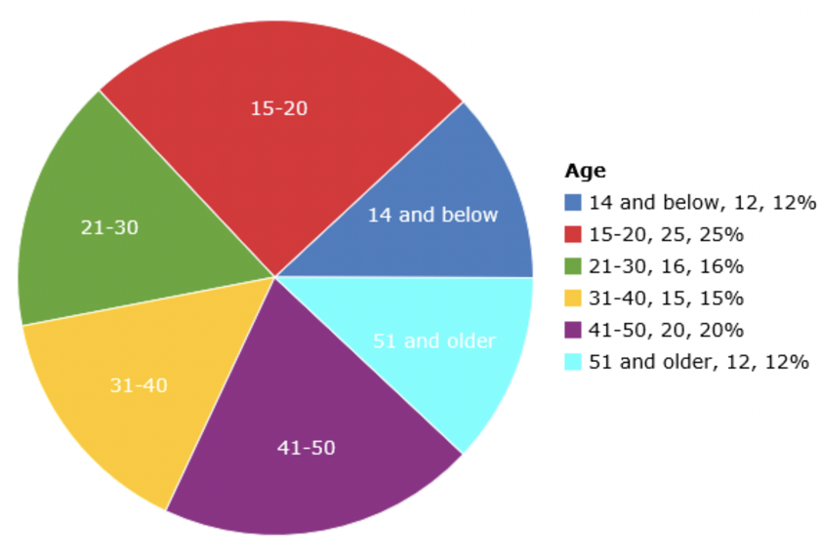
Pie chart for a categorical variable?
A pie chart is a way to visualize the static composition (aka, distribution) of a variable (or single group).
Pie charts are often frowned upon (and bar charts are used instead). Why?

Slide 39
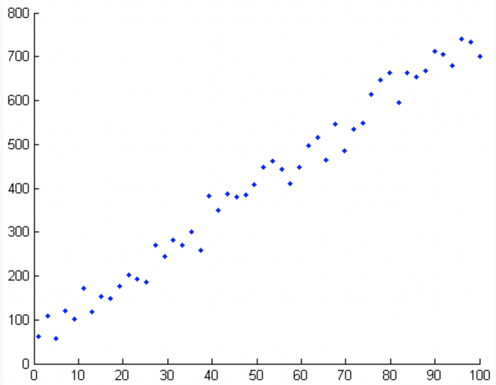
Scatter plots to visualize relationships
A scatter plot is a way to visualize the relationship between two different attributes of multi-dimensional data.

Slide 40
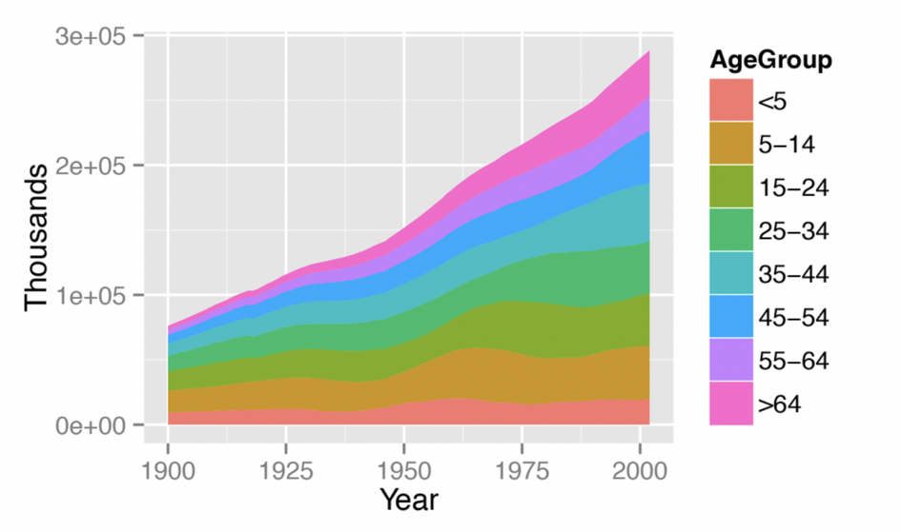
Stacked area graph to show trend over time
A stacked area graph is a way to visualize the composition of a group as it changes over time (or some other quantitative variable). This shows the relationship of a categorical variable (AgeGroup) to a quantitative variable (year).

Slide 41
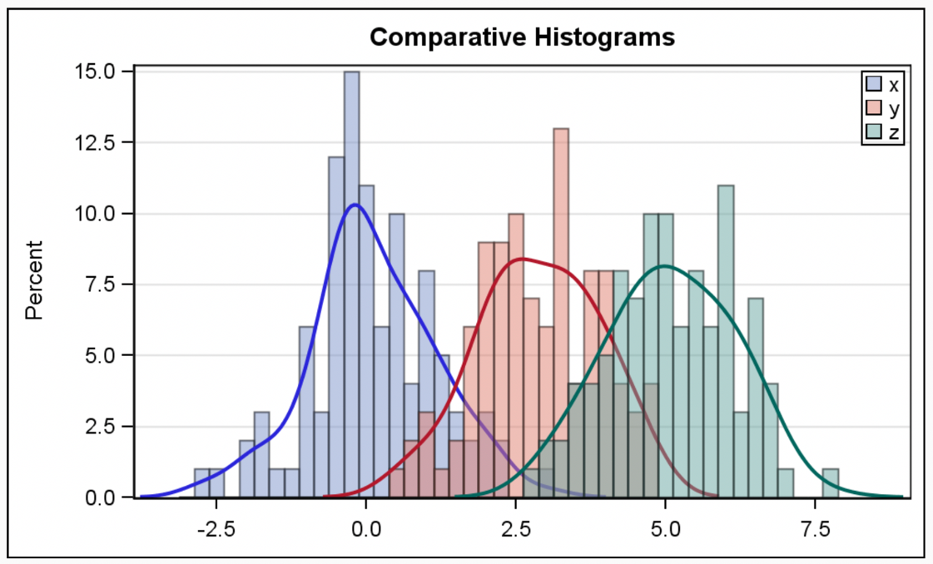
Multiple histograms
Plotting multiple histograms (and kernel density estimates of the distribution, here) on the same axes is a way to visualize how different variables compare (or how a variable differs over specific groups).

Slide 42
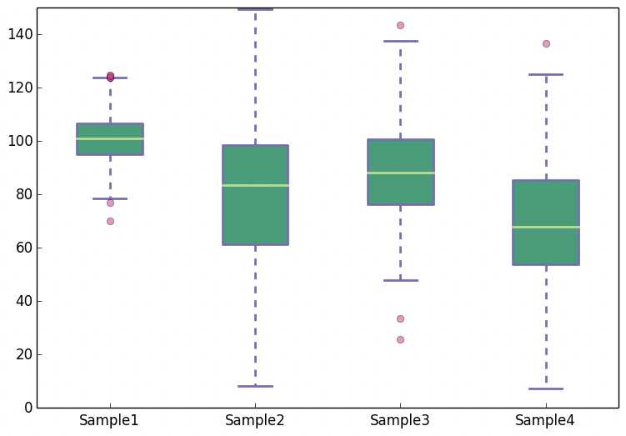
Boxplots
A boxplot is a simplified visualization to compare a quantitative variable across groups. It highlights the range, quartiles, median and any outliers present in a data set.

Slide 43
[Not] Anything is possible!
Often your dataset seem too complex to visualize:
Data is too high dimensional (how do you plot 100 variables on the same set of axes?)
Some variables are categorical (how do you plot values like Cat or No?)

Slide 44
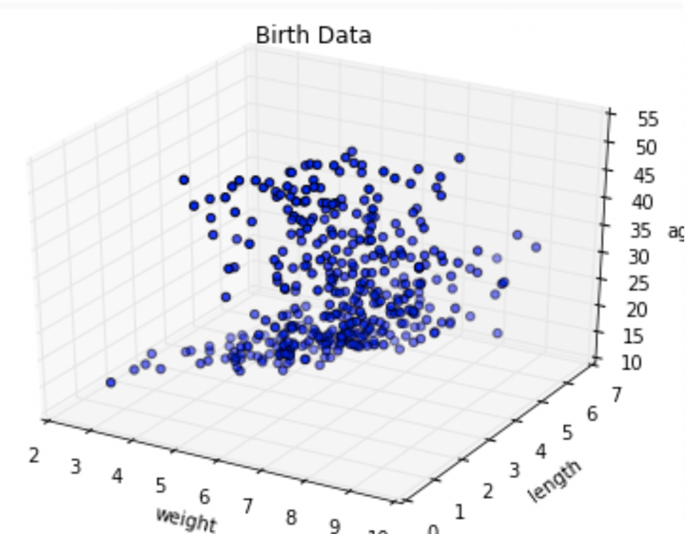
More dimensions not always better
When the data is high dimensional, a scatter plot of all data attributes can be impossible or unhelpful

Slide 45
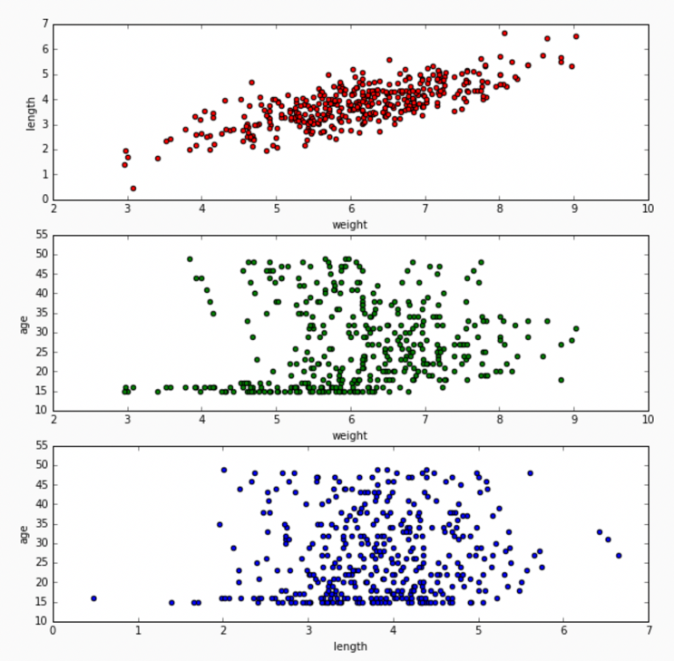
Reducing complexity
Relationships may be easier to spot by producing multiple plots of lower dimensionality.

Slide 46
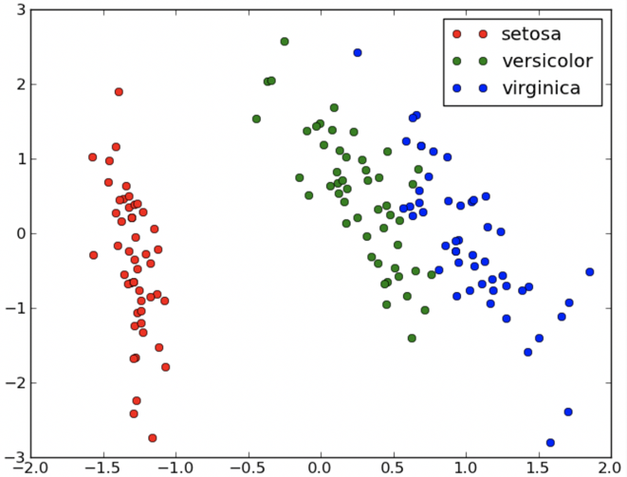
Reducing complexity
For 3D data, color coding a categorical attribute can be “effective”
Except when it’s not effective. What could be a better choice?
This visualizes a set of Iris measurements. The variables are: petal length, sepal length, Iris type (setosa, versicolor, virginica).

Slide 47
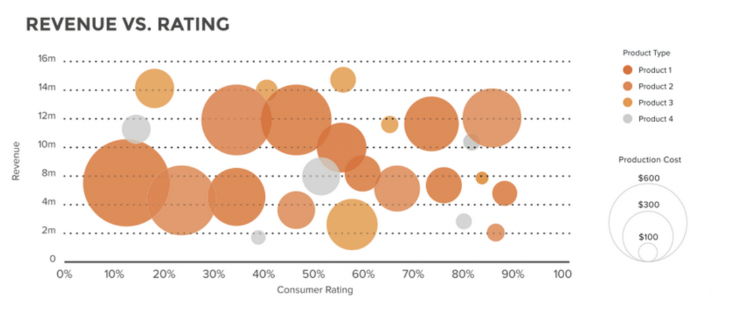
3D can work
For 3D data, a quantitative attribute can be encoded by size in a bubble chart.
The above visualizes a set of consumer products. The variables are: revenue, consumer rating, product type and product cost.

Slide 48
An Example: The Data Science Process

Slide 49
What?
The Data Science Process is similar to the scientific process - one of observation, model building, analysis, and conclusion:
Note: This process is by no means linear!
Ask an interesting question
Get the Data
Explore the Data
Model the Data
Communicate/Visualize the Results

Slide 50
Analyzing Hubway Data
Introduction: Hubway is metro-Boston’s public bike share program, with more than 1600 bikes at 160+ stations across the Greater Boston area. Hubway is owned by four municipalities in the area.
By 2016, Hubway operated 185 stations and 1750 bicycles, with 5 million ride since launching in 2011.
The Data: In April 2017, Hubway held a Data Visualization Challenge at the Microsoft NERD Center in Cambridge, releasing 5 years of trip data.
The Question: What does the data tell us about the ride share program?

Slide 51
The Data Exploration/Question Refinement Cycle
Our original question: ‘What does the data tell us about the ride share program?’ is a reasonable slogan to promote a hackathon. It is not good for guiding scientific investigation.
Before we can refine the question, we have to look at the data!
Based on the data, what kind of questions can we ask?

Slide 52
The Data Exploration/Question Refinement Cycle
Who? Who’s using the bikes?
Refine into specific hypotheses:
More men or more women?
Older or younger people?
Subscribers or one time users?

Slide 53
The Data Exploration/Question Refinement Cycle
Where? Where are bikes being checked out?
Refine into specific hypotheses:
More in Boston than Cambridge?
More in commercial or residential?
More around tourist attractions?
Sometimes the data is given to you in pieces and must be merged!

Slide 54
The Data Exploration/Question Refinement Cycle
When? When are the bikes being checked out?
Refine into specific hypotheses:
More during the weekend than on the weekdays?
More during rush hour?
More during the summer than the fall?
Sometimes the feature you want to explore doesn’t exist in the data, and must be engineered!

Slide 55
The Data Exploration/Question Refinement Cycle
Why? For what reasons/activities are people
checking out bikes?
Refine into specific hypotheses:
More bikes are used for recreation than commute?
More bikes are used for touristic purposes?
Bikes are use to bypass traffic?
Do we have the data to answer these questions with reasonable certainty?
What data do we need to collect in order to answer these questions?

Slide 56
The Data Exploration/Question Refinement Cycle
How? Questions that combine variables.
How does user demographics impact the duration the bikes are being used? Or where they are being checked out?
How does weather or traffic conditions impact bike usage?
How do the characteristics of the station location affect the number of bikes being checked out?
How questions are about modeling relationships between different variables.

Slide 57
Inspirations for Data Viz/Exploration
So how well did we do in formulating creative hypotheses and manipulating the data for answers?
Check out the winners of the Hubway Challenge:
http://hubwaydatachallenge.org

