Slide 1
Lecture 14: High Dimensionality & PCA

Slide 2
Lecture Outline
Interaction Terms and Unique Parameterizations
Big Data and High Dimensionality
Principal Component Analysis (PCA)
Principal Component Regression (PCR)

Slide 3
Interaction Terms and Unique Parameterizations

Slide 4
NYC Taxi vs. Uber
We’d like to compare Taxi and Uber rides in NYC (for example, how much the fare costs based on length of trip, time of day, location, etc.).
A public dataset has 1.9 million Taxi and Uber trips. Each trip is described by p = 23 useable predictors (and 1 response variable).

Slide 5
Interaction Terms: A Review
Recall that an interaction term between predictors $X_{1}$ and $X_{2}$ can be incorporated into a regression model by including the multiplicative (i.e. cross) term in the model, for example
$Y=β_{0}+β_{1}X_{1} +β_{2}X_{2}+β_{3}{(X}_{1}+X_{2})+ε$
Suppose $X_{1}$ is a binary predictor indicating whether a NYC ride pickup is a taxi or an Uber, $X_{2}$ is the length of the trip, and $Y$ is the fare for the ride.
What is the interpretation of $β_{3}$?

Slide 6
Including Interaction Terms in Models
Recall that to avoid overfitting, we sometimes elect to exclude a number of terms in a linear model.
It is standard practice to always include the main effects in the model. That is, we always include the terms involving only one predictor, $β_{1}X_{1}$, $β_{2}X_{2}$etc.
Question: Why are the main effects important?
Question: In what type of model would it make sense to include the interaction term without one of the main effects?

Slide 7
How would you parameterize these model?
$$\hat{Y}=β_{0}+β_{1}⋅I(X≥13)$$
$$\hat{Y}=β_{0}+β_{1}X+β_{2}⋅(X−13)⋅I(X≥13))$$

Slide 8
How Many Interaction Terms?
This NYC taxi and Uber dataset has 1.9 million Taxi and Uber trips. Each trip is described by p = 23 useable predictors (and 1 response variable). How many interaction terms are there?
Two-way interactions: $\left(\begin{matrix}p \\ 2\end{matrix}\right)=\frac{p(p−1)}{2}=253$
Three-way interactions: $\left(\begin{matrix}p \\ 3\end{matrix}\right)=\frac{p(p−1)(p−2)}{6}=1771$
Etc.
The total number of all possible interaction terms (including main effects) is.
What are some problems with building a model that includes all possible interaction terms?
$\sum_{k=0}^{p}{\left(\begin{matrix}p \\ k\end{matrix}\right)}=2^{p}≈8.3$million

Slide 9
How Many Interaction Terms?
In order to wrangle a data set with over 1 billion observations, we could use random samples of 100k observations from the dataset to build our models. If we include all possible interaction terms, our model will have 8.3 mil parameters. We will not be able to uniquely determine 8.3 mil parameters with only 100k observations. In this case, we call the model unidentifiable.
In practice, we can:
increase the number of observation
consider only scientifically important interaction terms
perform variable selection
perform another dimensionality reduction technique like PCA

Slide 10
Big Data and High Dimensionality

Slide 11
What is ‘Big Data’?
In the world of Data Science, the term Big Data gets thrown around a lot. What does Big Data mean?
A rectangular data set has two dimensions: number of observations (n) and the number of predictors (p). Both can play a part in defining a problem as a Big Data problem.
What are some issues when:
n is big (and p is small to moderate)?
p is big (and n is small to moderate)?
n and p are both big?

Slide 12
When n is big
When the sample size is large, this is typically not much of an issue from the statistical perspective, just one from the computational perspective.
Algorithms can take forever to finish. Estimating the coefficients of a regression model, especially one that does not have closed form (like LASSO), can take a while. Wait until we get to Neural Nets!
If you are tuning a parameter or choosing between models (using CV), this exacerbates the problem.
What can we do to fix this computational issue?
Perform ‘preliminary’ steps (model selection, tuning, etc.) on a subset of the training data set. 10% or less can be justified

Slide 13
Keep in mind, big n doesn’t solve everything
The era of Big Data (aka, large n) can help us answer lots of interesting scientific and application-based questions, but it does not fix everything.
Remember the old adage: “crap in = crap out”. That is to say, if the data are not representative of the population, then modeling results can be terrible. Random sampling ensures representative data.
Xiao-Li Meng does a wonderful job describing the subtleties involved (WARNING: it’s a little technical, but digestible): https://www.youtube.com/watch?v=8YLdIDOMEZs

Slide 14
When p is big
When the number of predictors is large (in any form: interactions, polynomial terms, etc.), then lots of issues can occur.
Matrices may not be invertible (issue in OLS).
Multicollinearity is likely to be present
Models are susceptible to overfitting
This situation is called High Dimensionality, and needs to be accounted for when performing data analysis and modeling.
What techniques have we learned to deal with this?

Slide 15
When Does High Dimensionality Occur?
The problem of high dimensionality can occur when the number of parameters exceeds or is close to the number of observations. This can occur when we consider lots of interaction terms, like in our previous example. But this can also happen when the number of main effects is high.
For example:
When we are performing polynomial regression with a high degree and a large number of predictors.
When the predictors are genomic markers (and possible interactions) in a computational biology problem.
When the predictors are the counts of all English words appearing in a text.

Slide 16
How Does sklearn handle unidentifiability?
In a parametric approach: if we have an over-specified model (p > n), the parameters are unidentifiable: we only need n – 1 predictors to perfectly predict every observation (n – 1 because of the intercept.
So what happens to the ‘extra’ parameter estimates (the extra $β$’s)?
the remaining p – (n – 1) predictors’ coefficients can be estimated to be anything. Thus there are an infinite number of sets of estimates that will give us identical predictions. There is not one unique set of $\hat{β}$’s.
What would be reasonable ways to handle this situation? How does sklearn handle this? When is another situation in which the parameter estimates are unidentifiable? What is the simplest case?

Slide 17
Perfect Multicollinearity
The p > n situation leads to perfect collinearity of the predictor set. But this can also occur with a redundant predictors (ex: putting $X_{j}$ twice into a model). Let’s see what sklearn in this simplified situation:
How does this generalize into the high-dimensional situation?

Slide 18
A Framework For Dimensionality Reduction
One way to reduce the dimensions of the feature space is to create a new, smaller set of predictors by taking linear combinations of the original predictors.
We choose Z₁, Z₂,…, Z_{m}, where $m≤p$ and where each Z_{i} is a linear combination of the original p predictors
$$Z_{i}=\sum_{j=1}^{p}{φ_{ji}X_{j}}$$
for fixed constants $φ_{ji}$. Then we can build a linear regression regression model using the new predictors
$$Y=β_{0}+β_{1}Z_{1}+…+β_{m}Z_{m}+ε$$
Notice that this model has a smaller number (m+1 < p+1) of parameters.

Slide 19
A Framework For Dimensionality Reduction (cont.)
A method of dimensionality reduction includes 2 steps:
Determine a optimal set of new predictors Z₁,…, Z_{m}, for m < p.
Express each observation in the data in terms of these new predictors. The transformed data will have m columns rather than p.
Thereafter, we can fit a model using the new predictors.
The method for determining the set of new predictors (what do we mean by an optimal predictors set?) can differ according to application. We will explore a way to create new predictors that captures the essential variations in the observed predictor set.

Slide 20
You’re Gonna Have a Bad Time…

Slide 21
Principal Components Analysis (PCA)

Slide 22
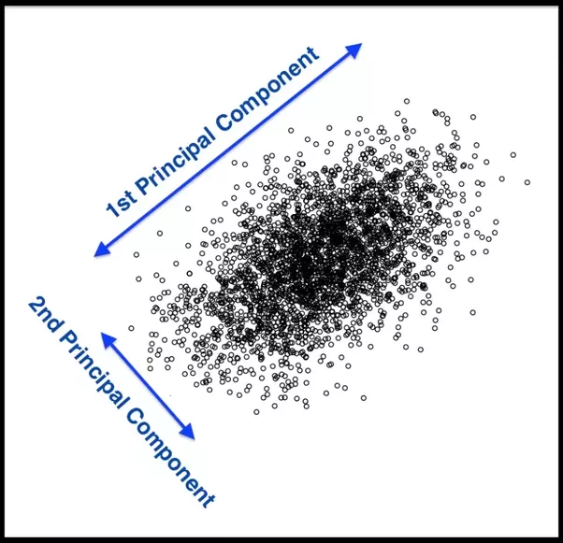
Principal Components Analysis (PCA)
Principal Components Analysis (PCA) is a method to identify a new set of predictors, as linear combinations of the original ones, that captures the `maximum amount' of variance in the observed data.

Slide 23
PCA (cont.)
Principal Components Analysis (PCA) produces a list of p principle components Z₁,…, Z_{p} such that
Each Z_{i} is a linear combination of the original predictors, and it's vector norm is 1
The Z_{i} 's are pairwise orthogonal
The Z_{i} 's are ordered in decreasing order in the amount of captured observed variance.
That is, the observed data shows more variance in the direction of Z₁ than in the direction of Z₂.
To perform dimensionality reduction we select the top m principle components of PCA as our new predictors and express our observed data in terms of these predictors.

Slide 24
The Intuition Behind PCA
Top PCA components capture the most of amount of variation (interesting features) of the data.
Each component is a linear combination of the original predictors - we visualize them as vectors in the feature space.

Slide 25
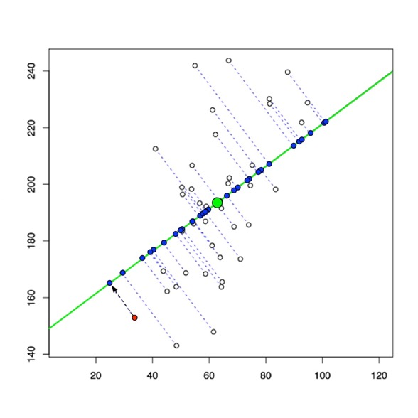
The Intuition Behind PCA (cont.)
Transforming our observed data means projecting our dataset onto the space defined by the top m PCA components, these components are our new predictors.

Slide 26
The Math behind PCA
PCA is a well-known result from linear algebra. Let Z be the n x p matrix consisting of columns Z₁,…, Z_{p} (the resulting PCA vectors), X be the n x p matrix of X₁,…, X_{p} of the original data variables (each standardized to have mean zero and variance one, and without the intercept), and let W be the p x p matrix whose columns are the eigenvectors of the square matrix X$T$X, then:

Slide 27
Implementation of PCA using linear algebra
To implement PCA yourself using this linear algebra result, you can perform the following steps:
Standardize each of your predictors (so they each have mean = 0, var = 1).
Calculate the eigenvectors of the matrix and create the matrix with those columns, W, in order from largest to smallest eigenvalue.
Use matrix multiplication to determine .
Note: this is not efficient from a computational perspective. This can be sped up using Cholesky decomposition.
However, PCA is easy to perform in Python using the decomposition.PCA function in the sklearn package.

Slide 28
PCA example in sklearn

Slide 29
PCA example in sklearn
A common plot is to look at the scatterplot of the first two principal components, shown below for the Heart data:
What do you notice?

Slide 30
What’s the difference: Standardize vs. Normalize
What is the difference between Standardizing and Normalizing a variable?
Normalizing means to bound your variable’s observations between zero and one. Good when interpretations of “percentage of max value” makes sense.
Standardizing means to re-center and re-scale your variable’s observations to have mean zero and variance one. Good to put all of your variables on the same scale (have same weight) and to turn interpretations into “changes in terms of standard deviation.”
Warning: the term “normalize” gets incorrectly used all the time (online, especially)!

Slide 31
When to Standardize vs. Normalize
When should you do each?
Normalizing is only for improving interpretation (and dealing with numerically very large or small measures). Does not improve algorithms otherwise.
Standardizing can be used for improving interpretation and should be used for specific algorithms. Which ones? Regularization and PCA (so far)!
*Note: you can standardize without assuming things to be [approximately] Normally distributed! It just makes the interpretation nice if they are Normally distributed.

Slide 32
PCA for Regression (PCR)

Slide 33
PCA for Regression (PCR)
PCA is easy to use in Python, so how do we then use it for regression modeling in a real-life problem?
If we use all p of the new Z_{j}, then we have not improved the dimensionality. Instead, we select the first M PCA variables, Z₁,...,Z_{M}, to use as predictors in a regression model.
The choice of M is important and can vary from application to application. It depends on various things, like how collinear the predictors are, how truly related they are to the response, etc...
What would be the best way to check for a specified problem?
Cross Validation!!!

Slide 34
A few notes on using PCA
PCA is an unsupervised algorithm. Meaning? It is done independent of the outcome variable.
Note: the components as predictors might not be ordered from best to worst!
PCA is not so good because:
Direct Interpretation of coefficients in PCR is completely lost. So do not do if interpretation is important.
Will not improve predictive ability of a model.
PCA is great for:
Reducing dimensionality in very high dimensional settings.
Visualizing how predictive your features can be of your response, especially in the classification setting.
Reducing multicollinearity, and thus may improve the computational time of fitting models.

Slide 35
Interpreting the Results of PCR
A PCR can be interpreted in terms of original predictors…very carefully.
Each estimated $β$ coefficient in the PCR can be distributed across the predictors via the associated component vector, w. An example is worth a thousand words:
So how can this be transformed back to the original variables?
$\hat{Y}={\hat{β}}_{0}+{\hat{β}}_{1}Z_{1}=$ ${\hat{β}}_{0}+{\hat{β}}_{1}\left({\vec{w}}_{1}^{T}\text{X}\right)= {\hat{β}}_{0}+{\hat{β}}_{1}{\vec{w}}_{1}^{T}\left(\text{X}\right)$
$=−0.1162+0.00351\left(0.0384X_{1}+0.0505X_{2}+0.998X_{3}−0.0037X_{4}\right)$
$=−0.1162+0.000135(X_{1})+0.000177(X_{2})+0.0035{(X}_{3}) −0.000013{(X}_{4})$

Slide 36
As more components enter the PCR…
This algorithm can be continued by adding in more and more components into the PCR.
This plot was done on non-standardized predictors. How would it look different if they were all standardized (both in PCA and plotted here in standardized form of X)?

Slide 37
The same plot with standardized predictors in PCA

