Slide 1
Lab #10: Demonstration of AdaBoost

Slide 2
Our Data
Training Data
Chest Pain | Blocked Arteries | Patient Weight | Heart Disease
Yes | Yes | 205 | Yes
No | Yes | 180 | Yes
Yes | No | 210 | Yes
Yes | Yes | 167 | Yes
No | Yes | 156 | No
No | Yes | 125 | No
Yes | No | 168 | No
Yes | Yes | 172 | No

Slide 3
Bagging
Training Data
Chest Pain | Blocked Arteries | Patient Weight | Heart Disease
Yes | Yes | 205 | Yes
No | Yes | 180 | Yes
Yes | No | 210 | Yes
Yes | Yes | 167 | Yes
No | Yes | 156 | No
No | Yes | 125 | No
Yes | No | 168 | No
Yes | Yes | 172 | No
Shuffle (i.e., bootstrap the data)
Train a new decision tree T_{i}

Slide 4
Bagging
Training Data
Do N times
Chest Pain | Blocked Arteries | Patient Weight | Heart Disease
Yes | Yes | 205 | Yes
No | Yes | 180 | Yes
Yes | No | 210 | Yes
Yes | Yes | 167 | Yes
No | Yes | 156 | No
No | Yes | 125 | No
Yes | No | 168 | No
Yes | Yes | 172 | No
Shuffle (i.e., bootstrap the data)
Train a new decision tree T_{i}
We have {T₁, T₂, T₃, …, T_{N}}

Slide 5
Bagging
Training Data
Do N times
Chest Pain | Blocked Arteries | Patient Weight | Heart Disease
Yes | Yes | 205 | Yes
No | Yes | 180 | Yes
Yes | No | 210 | Yes
Yes | Yes | 167 | Yes
No | Yes | 156 | No
No | Yes | 125 | No
Yes | No | 168 | No
Yes | Yes | 172 | No
Shuffle (i.e., bootstrap the data)
Train a new decision tree T_{i}
We have {T₁, T₂, T₃, …, T_{N}}
Testing Data
Chest Pain | Blocked Arteries | Patient Weight | Heart Disease
No | Yes | 158 | ?

Slide 6
Bagging
Training Data
Do N times
Chest Pain | Blocked Arteries | Patient Weight | Heart Disease
Yes | Yes | 205 | Yes
No | Yes | 180 | Yes
Yes | No | 210 | Yes
Yes | Yes | 167 | Yes
No | Yes | 156 | No
No | Yes | 125 | No
Yes | No | 168 | No
Yes | Yes | 172 | No
Shuffle (i.e., bootstrap the data)
Train a new decision tree T_{i}
We have {T₁, T₂, T₃, …, T_{N}}
Testing Data
Chest Pain | Blocked Arteries | Patient Weight | Heart Disease
No | Yes | 158 | ?
Take a majority vote from {T₁, T₂, T₃, …, T_{N}}

Slide 7
Boosting
Training Data
Chest Pain | Blocked Arteries | Patient Weight | Heart Disease
Yes | Yes | 205 | Yes
No | Yes | 180 | Yes
Yes | No | 210 | Yes
Yes | Yes | 167 | Yes
No | Yes | 156 | No
No | Yes | 125 | No
Yes | No | 168 | No
Yes | Yes | 172 | No
Shuffle (i.e., bootstrap the data)
Select a random subset of P_{i} features
Train a new decision tree T_{i}

Slide 8
Boosting
Training Data
Do N times
Chest Pain | Blocked Arteries | Patient Weight | Heart Disease
Yes | Yes | 205 | Yes
No | Yes | 180 | Yes
Yes | No | 210 | Yes
Yes | Yes | 167 | Yes
No | Yes | 156 | No
No | Yes | 125 | No
Yes | No | 168 | No
Yes | Yes | 172 | No
Shuffle (i.e., bootstrap the data)
Select a random subset of P_{i} features
Train a new decision tree T_{i}
We have {T₁, T₂, T₃, …, T_{N}}

Slide 9
Boosting
Training Data
Do N times
Chest Pain | Blocked Arteries | Patient Weight | Heart Disease
Yes | Yes | 205 | Yes
No | Yes | 180 | Yes
Yes | No | 210 | Yes
Yes | Yes | 167 | Yes
No | Yes | 156 | No
No | Yes | 125 | No
Yes | No | 168 | No
Yes | Yes | 172 | No
Shuffle (i.e., bootstrap the data)
Select a random subset of P_{i} features
Train a new decision tree T_{i}
We have {T₁, T₂, T₃, …, T_{N}}
Testing Data
Chest Pain | Blocked Arteries | Patient Weight | Heart Disease
No | Yes | 158 | ?
Take a majority vote from {T₁, T₂, T₃, …, T_{N}}

Slide 10
Ideas
Training Data
Chest Pain | Blocked Arteries | Patient Weight | Heart Disease
Yes | Yes | 205 | Yes
No | Yes | 180 | Yes
Yes | No | 210 | Yes
Yes | Yes | 167 | Yes
No | Yes | 156 | No
No | Yes | 125 | No
Yes | No | 168 | No
Yes | Yes | 172 | No
We have {T₁, T₂, T₃, …, T_{N}}
“Fool me once, shame on … shame on you. Fool me – you can’t get fooled again” –George W. Bush
“Fool me once, shame on you; fool me twice, shame on me” –Proverb

Slide 11
Ideas
Training Data
Chest Pain | Blocked Arteries | Patient Weight | Heart Disease
Yes | Yes | 205 | Yes
No | Yes | 180 | Yes
Yes | No | 210 | Yes
Yes | Yes | 167 | Yes
No | Yes | 156 | No
No | Yes | 125 | No
Yes | No | 168 | No
Yes | Yes | 172 | No
We have {T₁, T₂, T₃, …, T_{N}}
“Fool me once, shame on … shame on you. Fool me – you can’t get fooled again” –George W. Bush
“Fool me once, shame on you; fool me twice, shame on me” –Proverb
_{Let’s learn from our mistakes!}

Slide 12
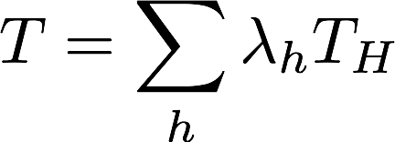
Gradient Boosting
Training Data
Chest Pain | Blocked Arteries | Patient Weight | Heart Disease
Yes | Yes | 205 | Yes
No | Yes | 180 | Yes
Yes | No | 210 | Yes
Yes | Yes | 167 | Yes
No | Yes | 156 | No
No | Yes | 125 | No
Yes | No | 168 | No
Yes | Yes | 172 | No
We have {T₁, T₂, T₃, …, T_{N}}

Slide 13
Gradient Boosting
Training Data
Chest Pain | Blocked Arteries | Patient Weight | Heart Disease
Yes | Yes | 205 | Yes
No | Yes | 180 | Yes
Yes | No | 210 | Yes
Yes | Yes | 167 | Yes
No | Yes | 156 | No
No | Yes | 125 | No
Yes | No | 168 | No
Yes | Yes | 172 | No
We have {T₁, T₂, T₃, …, T_{N}}
Each T_{h} is:
a ”weak”/simple decision tree
built after the previous tree
tries to learn the shortcomings (the errors/residuals) from the previous tree’s predictions

Slide 14
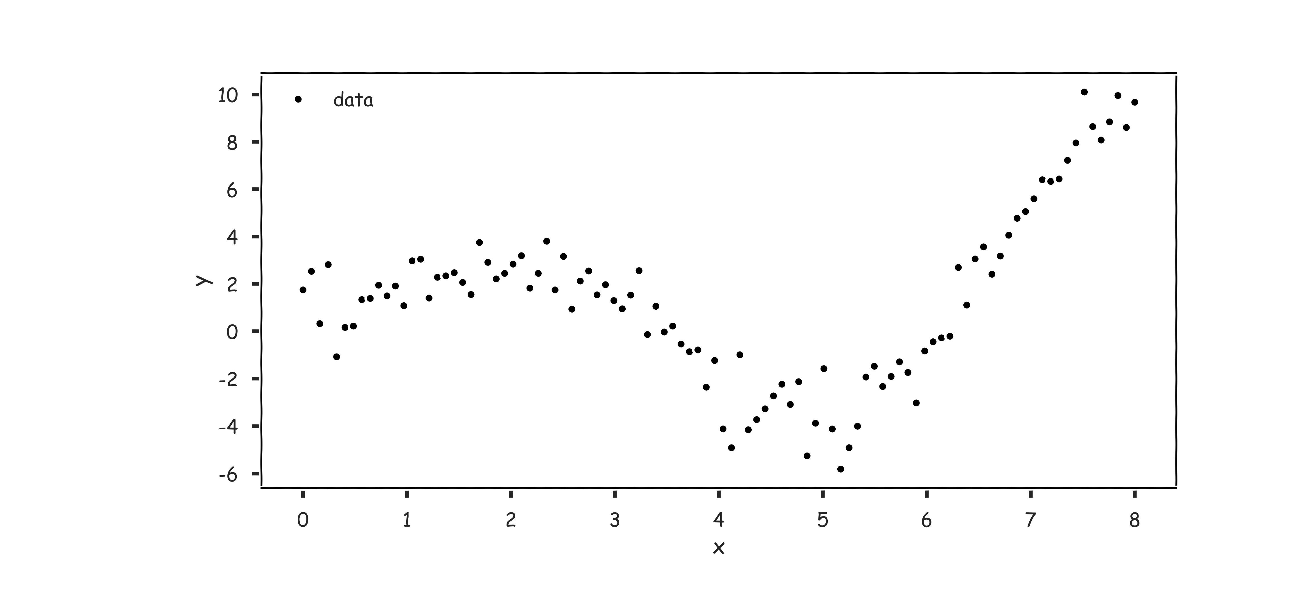
Gradient Boosting: illustration

Slide 15
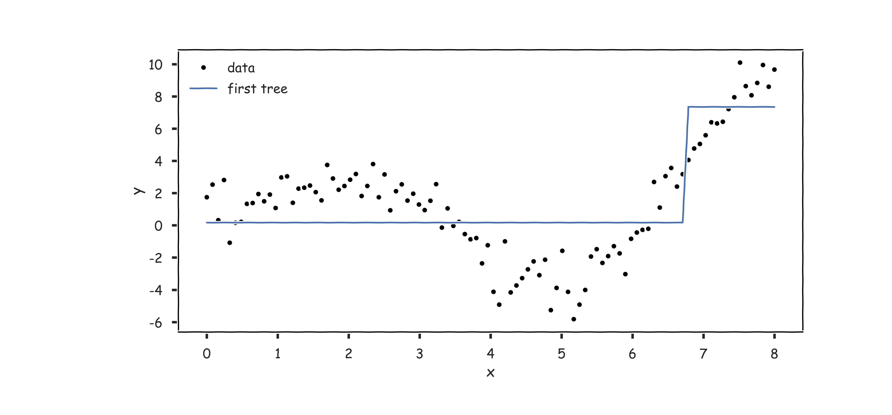
Gradient Boosting: illustration

Slide 16
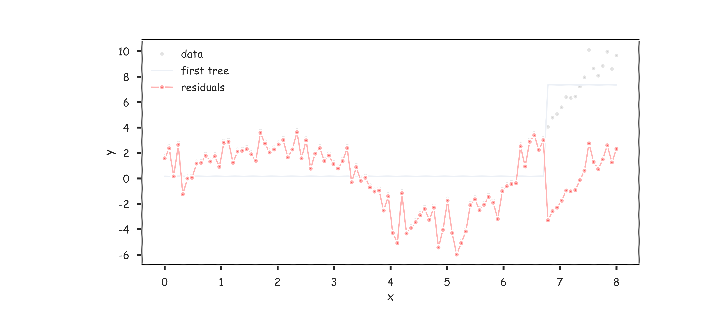
Gradient Boosting: illustration

Slide 17
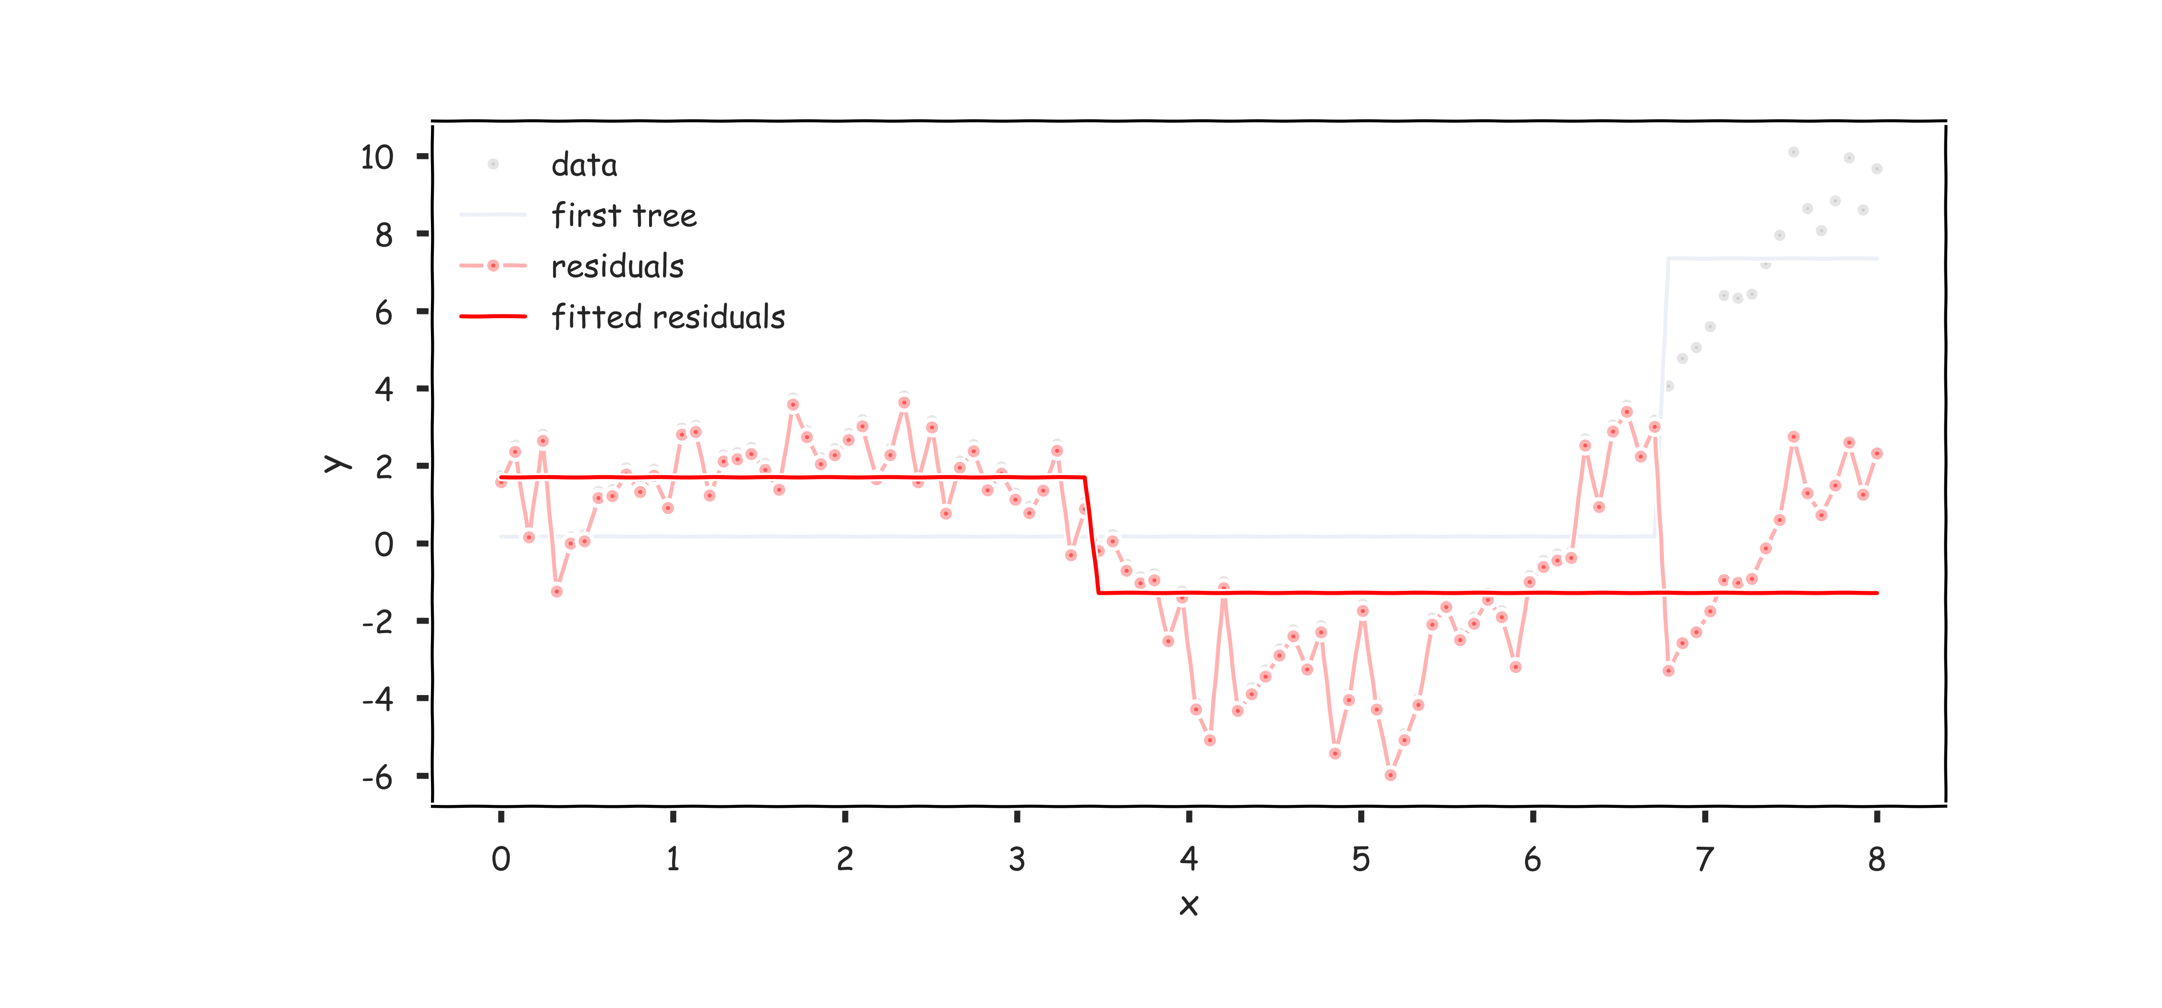
Gradient Boosting: illustration

Slide 18
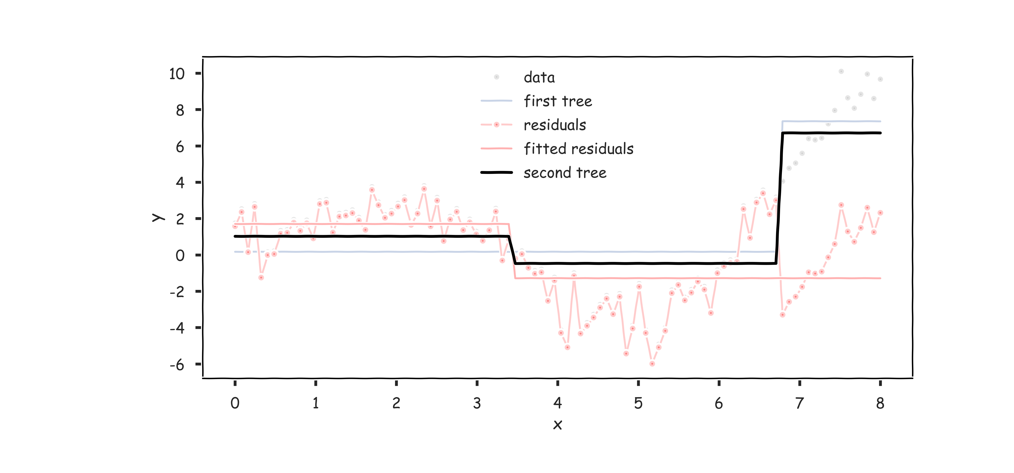
Gradient Boosting: illustration

Slide 19
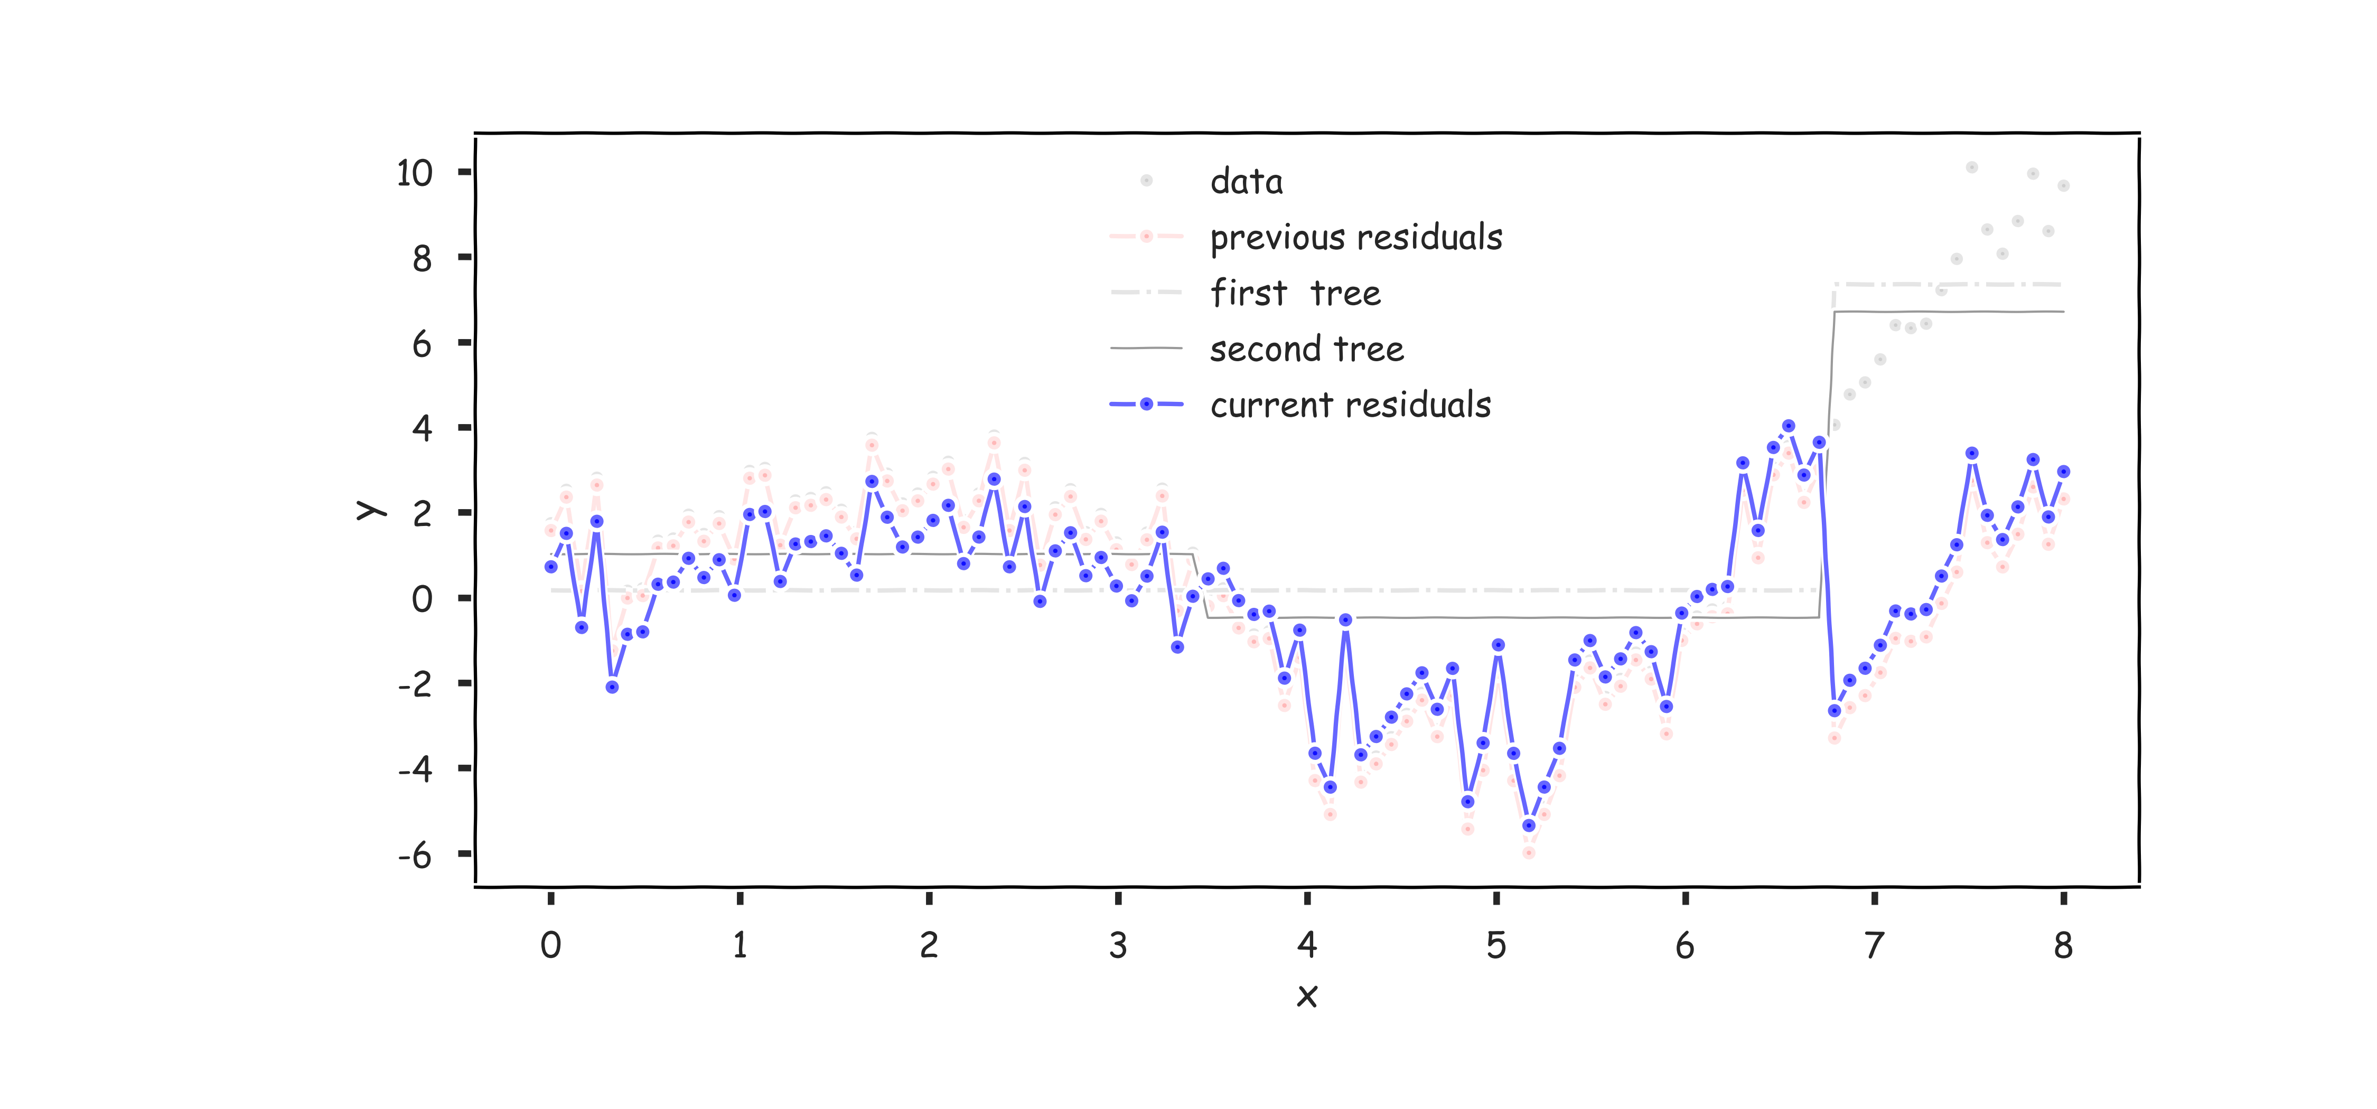
Gradient Boosting: illustration

Slide 20
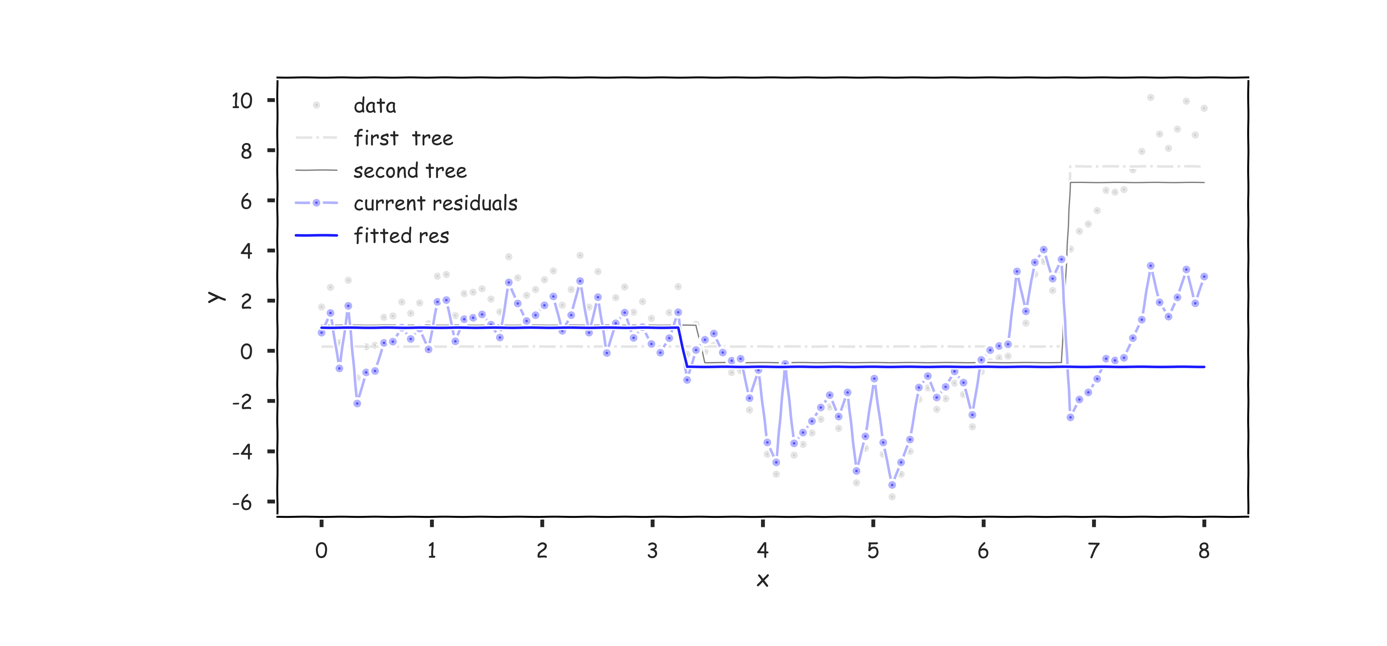
Gradient Boosting: illustration

Slide 21
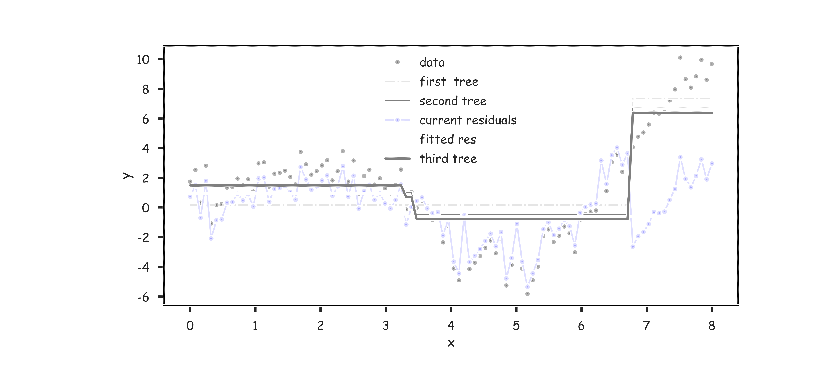
Gradient Boosting: illustration

Slide 22
Gradient Boosting
Training Data
Chest Pain | Blocked Arteries | Patient Weight | Heart Disease
Yes | Yes | 205 | Yes
No | Yes | 180 | Yes
Yes | No | 210 | Yes
Yes | Yes | 167 | Yes
No | Yes | 156 | No
No | Yes | 125 | No
Yes | No | 168 | No
Yes | Yes | 172 | No
We have {T₁, T₂, T₃, …, T_{N}}
We can determine each
$λ$_{h}
by using gradient descent.

Slide 23
Idea
Training Data
Chest Pain | Blocked Arteries | Patient Weight | Heart Disease
Yes | Yes | 205 | Yes
No | Yes | 180 | Yes
Yes | No | 210 | Yes
Yes | Yes | 167 | Yes
No | Yes | 156 | No
No | Yes | 125 | No
Yes | No | 168 | No
Yes | Yes | 172 | No
If we have categorical data (not a regression task), we can use AdaBoost

Slide 24
Idea
Training Data
Chest Pain | Blocked Arteries | Patient Weight | Heart Disease
Yes | Yes | 205 | Yes
No | Yes | 180 | Yes
Yes | No | 210 | Yes
Yes | Yes | 167 | Yes
No | Yes | 156 | No
No | Yes | 125 | No
Yes | No | 168 | No
Yes | Yes | 172 | No
If we have categorical data (not a regression task), we can use AdaBoost
Train a single weak (stump) Decision Tree T_{i}
Calculate the total error of your predictions
Use this error ( ) to determine how much stock to place in that Tree
Update the weights of each observation
Update our running model T
$λ$_{i}

Slide 25
AdaBoost
With a minor adjustment to the exponential loss function, we have the algorithm for gradient descent:
1. Choose an initial distribution over the training data, $w_{n}=1/N$.
2. At the i^{th} step, fit a simple classifier T^{(i)} on weighted training data
3. Update the weights:
where Z is the normalizing constant for the collection of updated weights
4. Update $T:T←T+λ^{(i)}T^{(i)}$
where $λ$ is the learning rate.
$$\{\left(x_{1},w_{1}y_{1}\right),…,(x_{N},w_{N}y_{N})\}$$

Slide 26
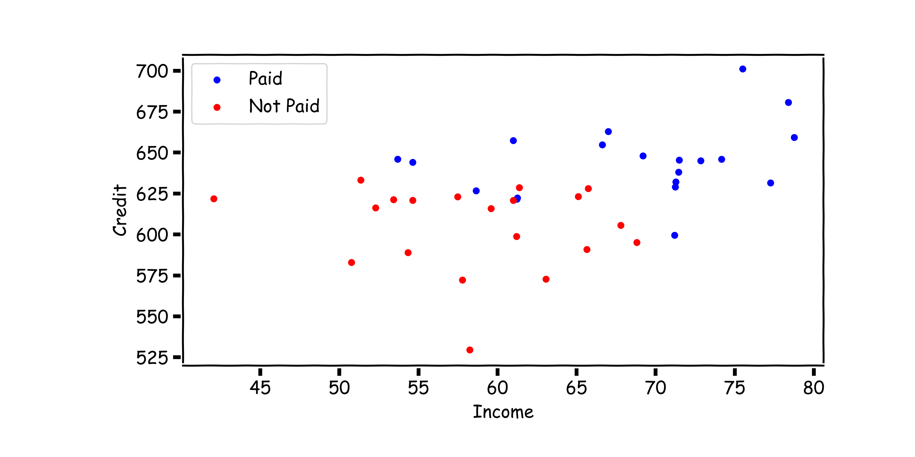
AdaBoost: start with equal weights

Slide 27
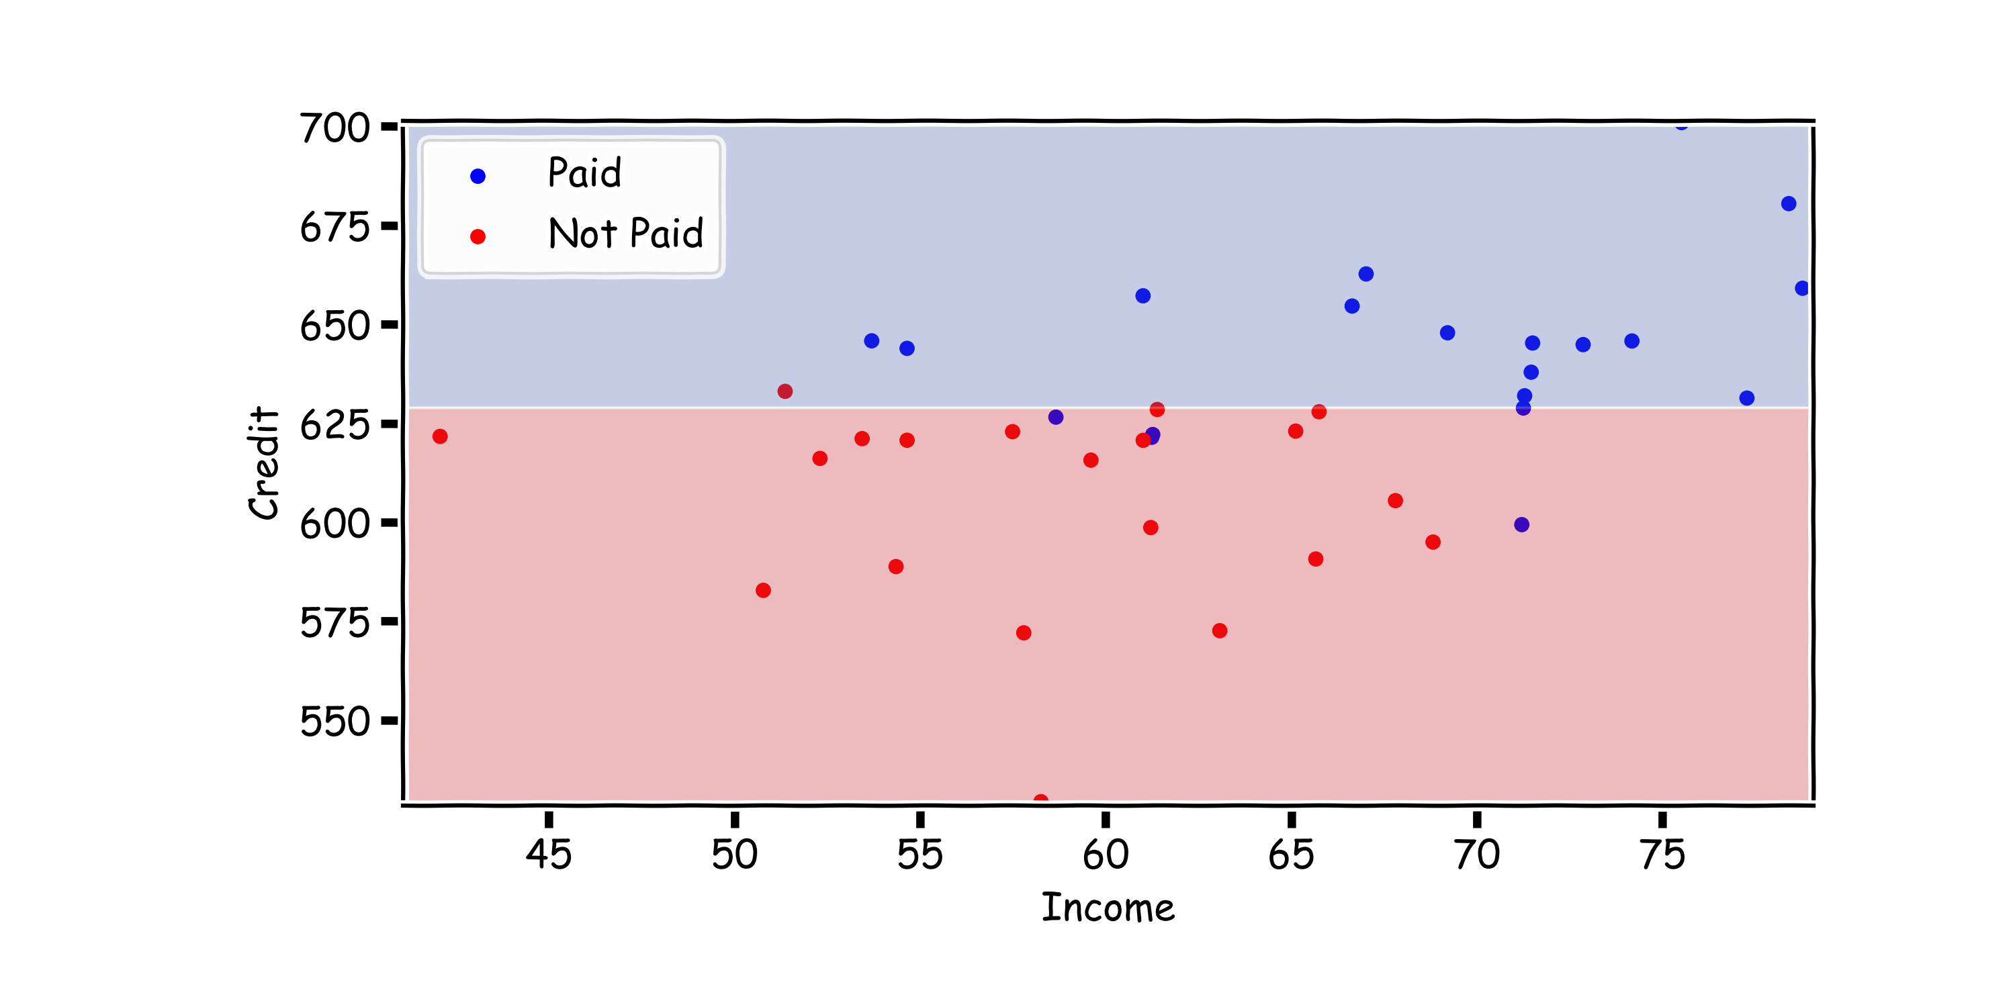
AdaBoost: fit a simple decision tree

Slide 28
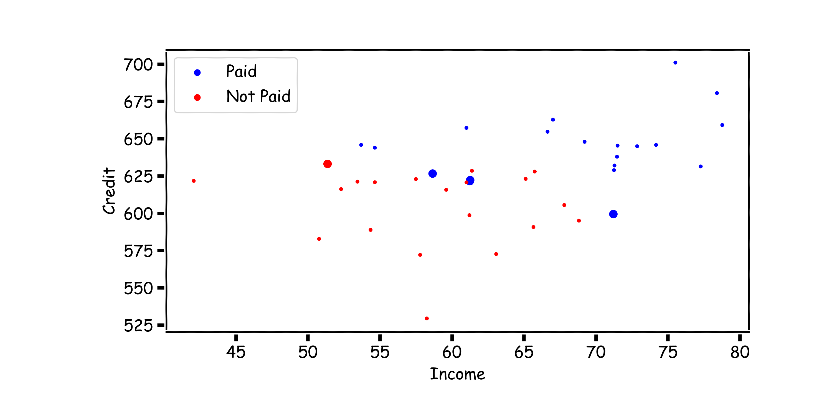
AdaBoost: update the weights

Slide 29
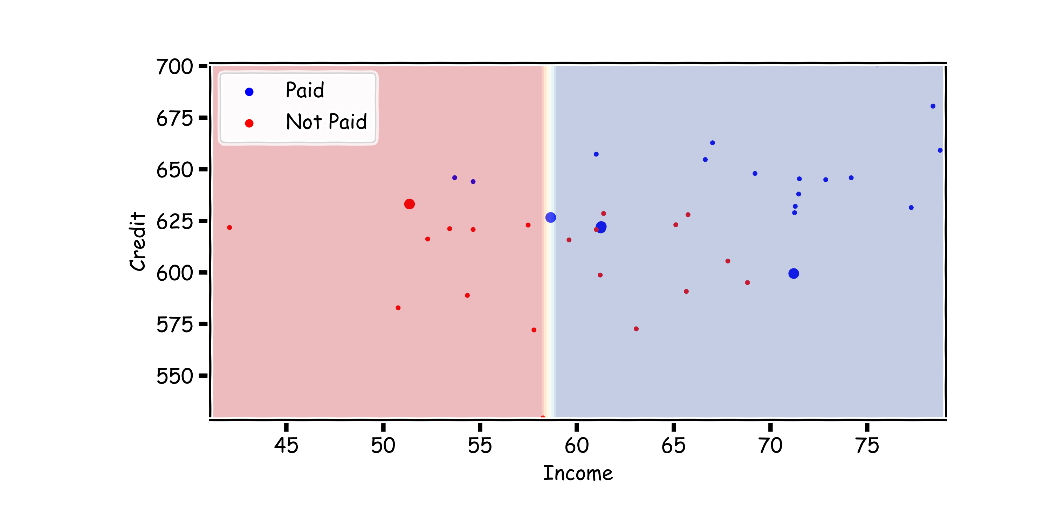
AdaBoost: fit another simple decision tree on re-weighted data

Slide 30
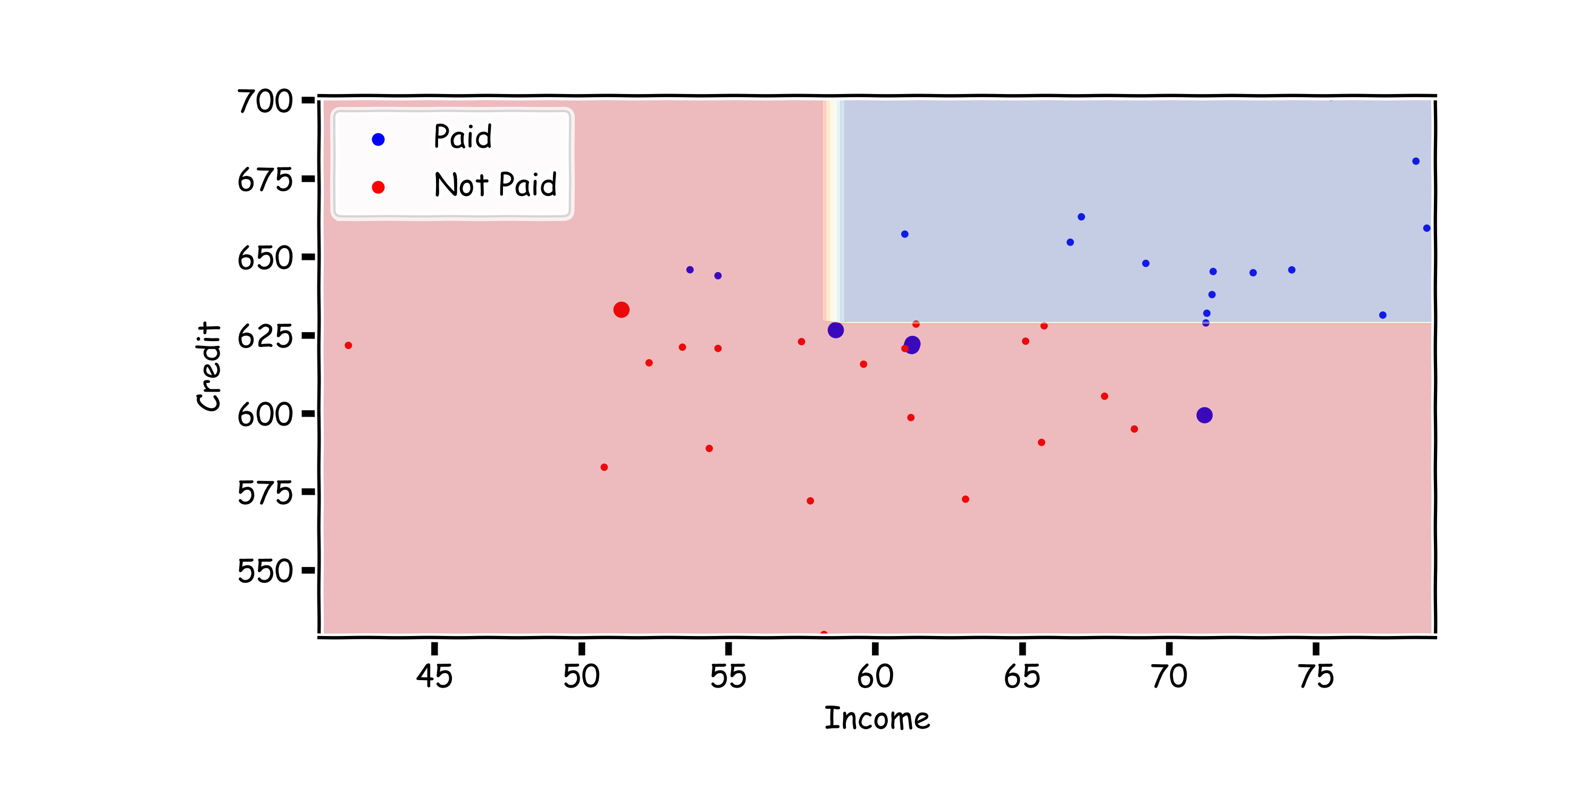
AdaBoost: add the new model to the ensemble
$$T←T+λ^{(i)}T^{(i)}$$

Slide 31
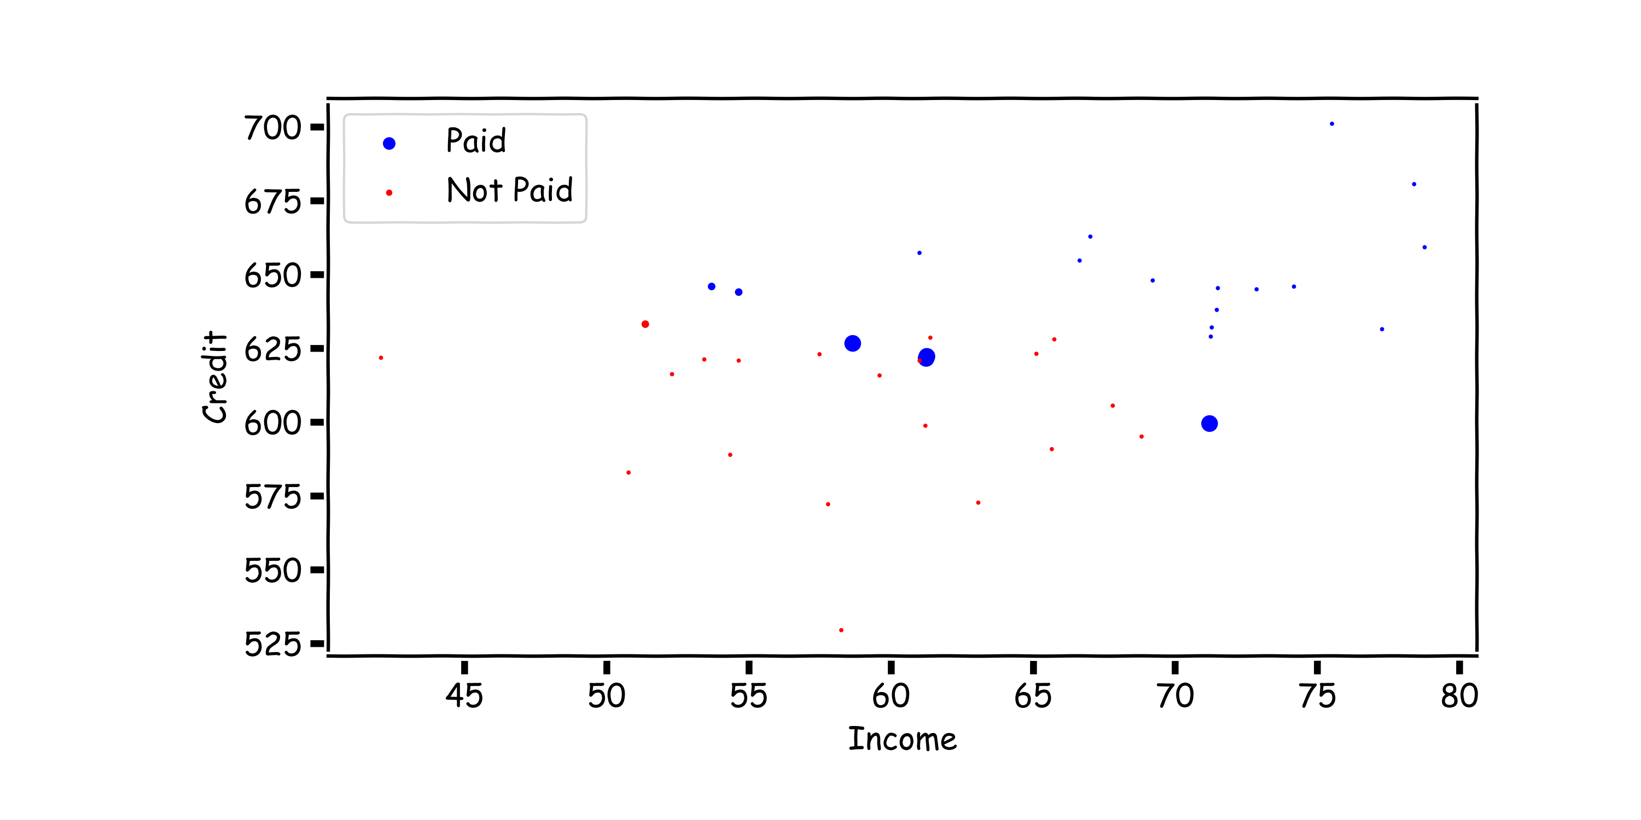
AdaBoost: update the weights

Slide 32
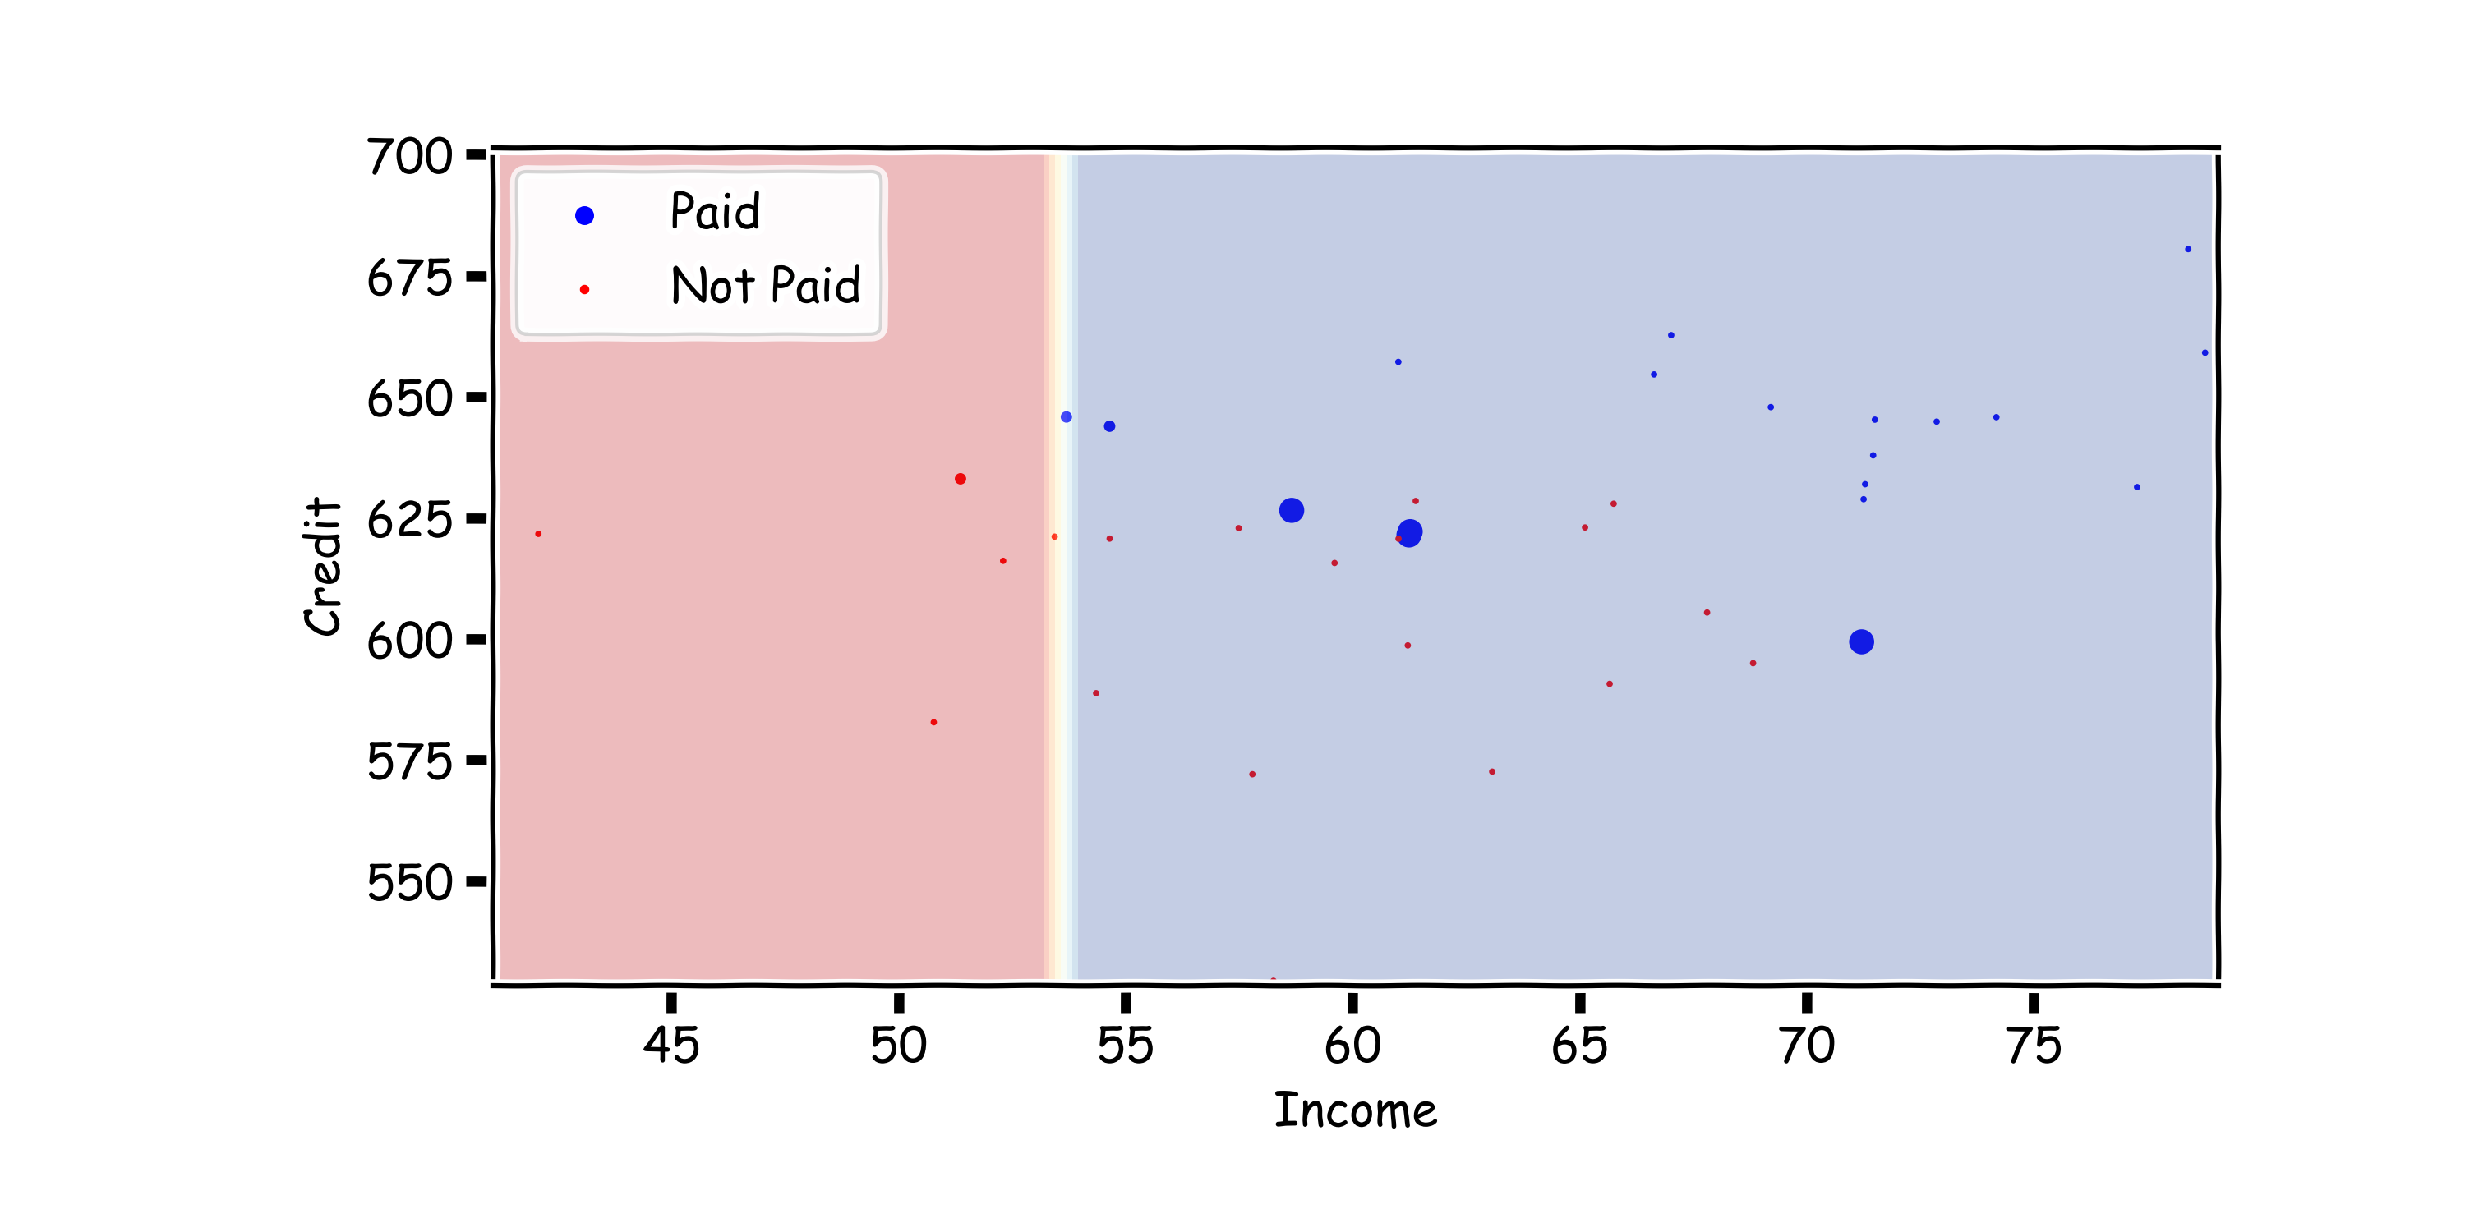
AdaBoost: fit a third, simple decision tree on re-weighted data

Slide 33
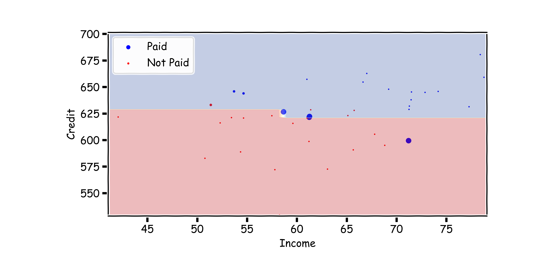
AdaBoost: add the new model to the ensemble, repeat…
$$T←T+λ^{(i)}T^{(i)}$$

Slide 34
Choosing the Learning Rate
Unlike in the case of gradient boosting for regression, we can analytically solve for the optimal learning rate for AdaBoost, by optimizing:
Doing so, we get that

