Slide 1
Advanced Section #6: Convexity, Subgradients, Stochastic Gradient Descent
Cedric Flamant

Slide 2
Outline
Introduction:
Convex sets and convex functions
Stochastic Gradient Descent
Foundation
Subgradients
Lipschitz continuity
Convergence of Gradient Descent
Gradient Descent Algorithms

Slide 3
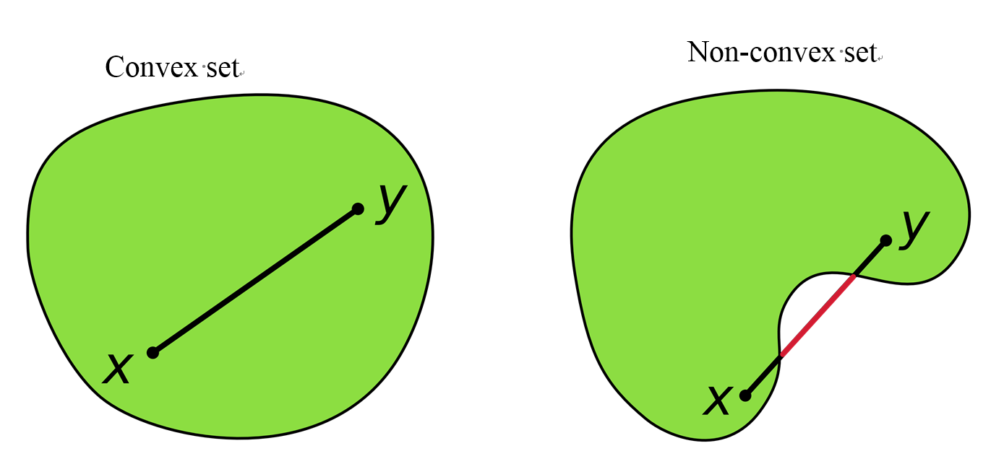
Convexity
https://www.quora.com/Why-might-a-set-of-points-equidistant-from-a-center-point-form-a-round-shape
A convex set does not have any dents on its boundary, and contains no holes.
Mathematically, given a convex set, the line between any two points in the set is also contained in the set.

Slide 4
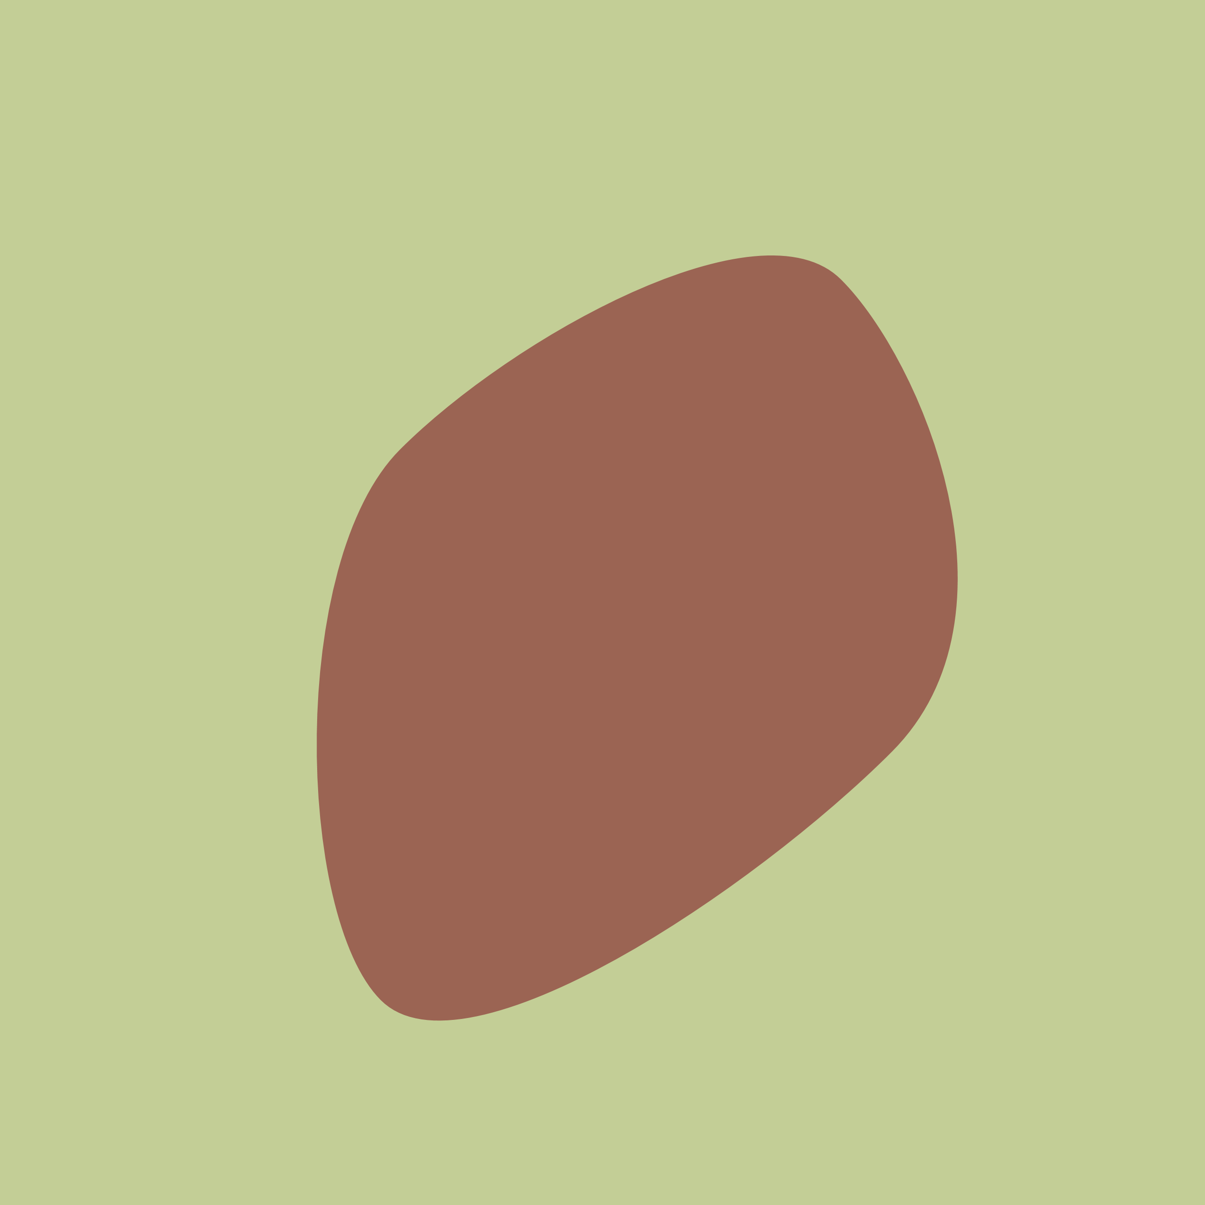
Is This Convex?
https://ghehehe.nl/the-daily-blob/

Slide 5
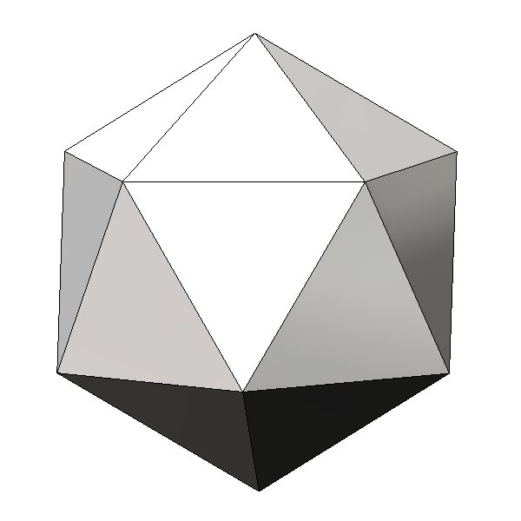
Is This Convex?
https://radiganengineering.com/2016/04/platonic-solids-in-solidworks/

Slide 6
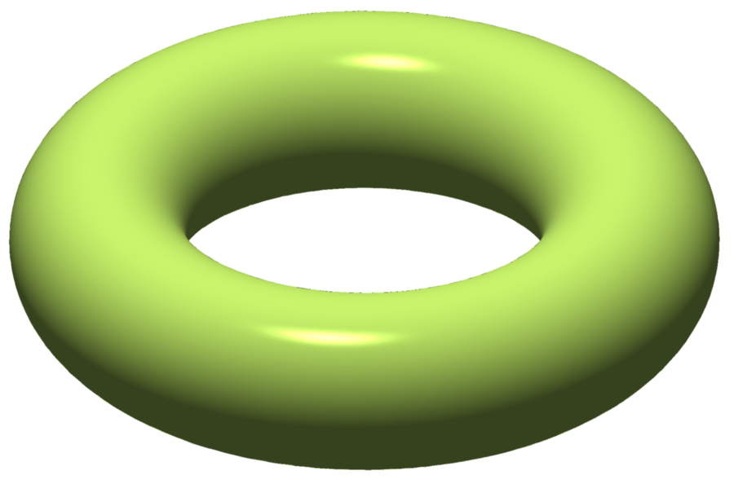
Is This Convex?
https://en.wikipedia.org/wiki/Solid_torus

Slide 7
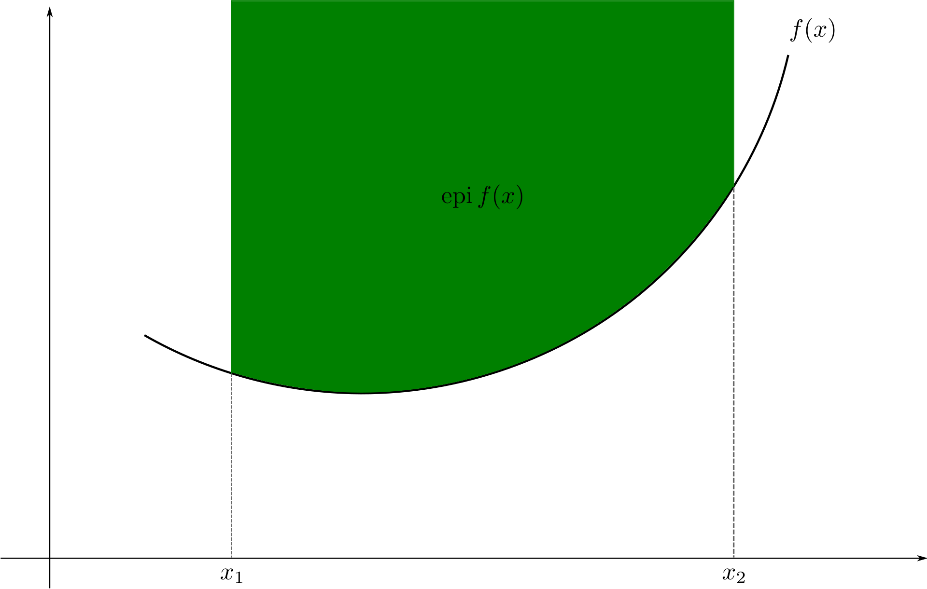
Convex Functions
Convex functions “curve upward”
The area above a convex function (the epigraph) is a convex set
Convex functions must have a domain that is a convex set (by definition)
In this case, the domain is
, which is convex.
Eli Osherovich https://en.wikipedia.org/wiki/Convex_function

Slide 8
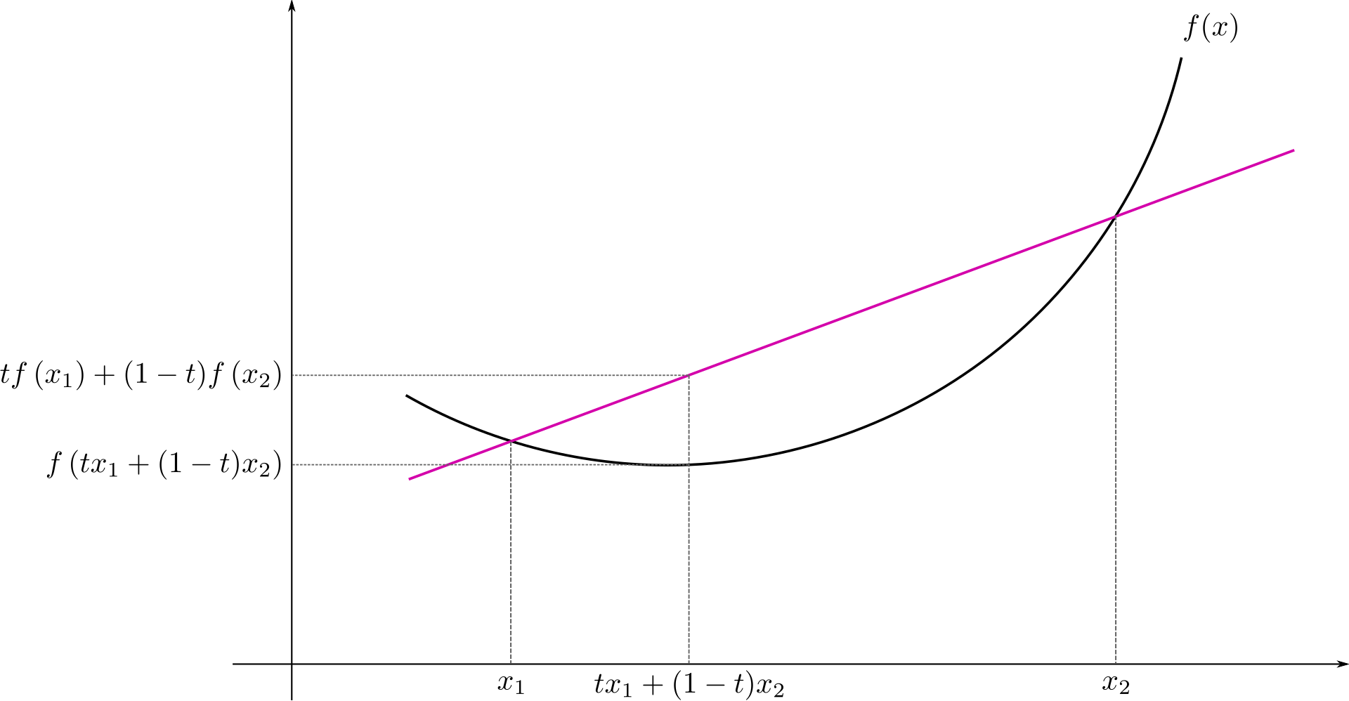
Convex Functions
Definition of Convex Function:
i.e. the line connecting two points on the curve of the function is not below the function
Eli Osherovich https://en.wikipedia.org/wiki/Convex_function

Slide 9
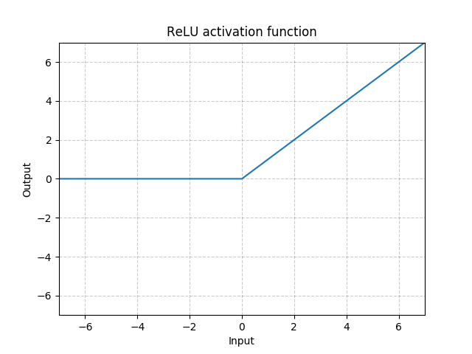
Is This a Convex Function?
https://pytorch.org/docs/stable/nn.html

Slide 10
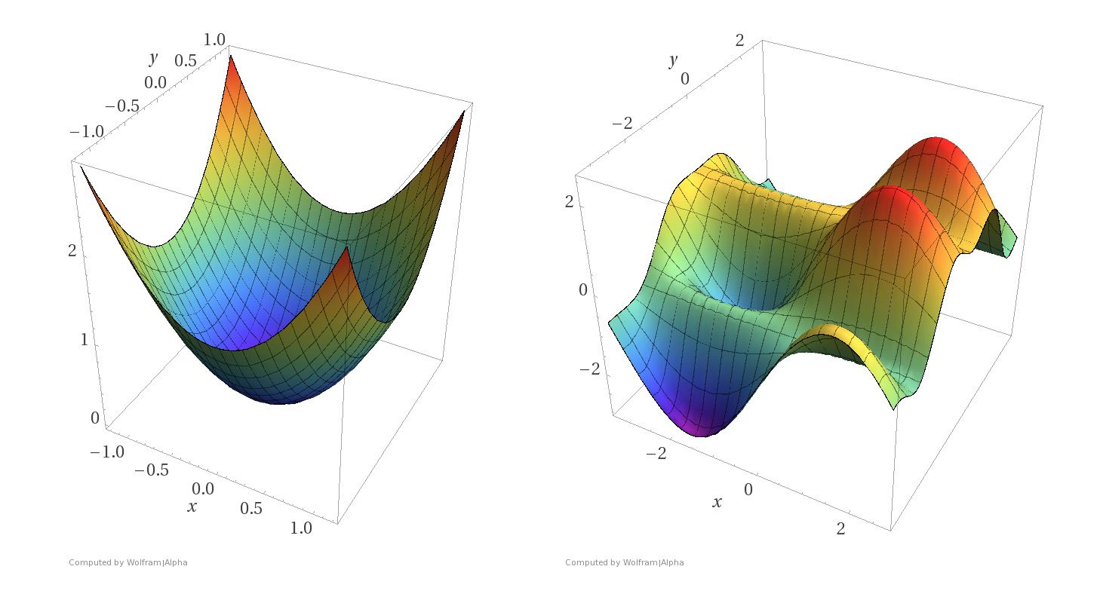
Why do we care about convex functions?
Convex Optimization:
Every local minimum is a global minimum
Gradient Descent is guaranteed to find a global minimum (with appropriate step size)
Heavily relied on in proofs in machine learning papers
O’Reilly Media

Slide 11
Gradient Descent
We move in the opposite direction of the gradient, with a step size (learning rate) of , If is a loss, then with every step we try to decrease it.
can be very complex, like a neural network.
Because the gradient of a neural network is easily computable through backpropagation, it’s not overstating the matter to say deep learning was built on gradient descent

Slide 12
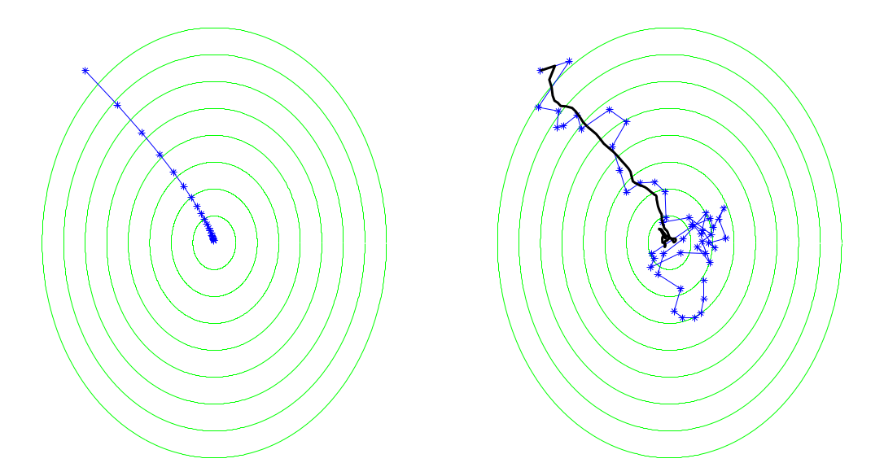
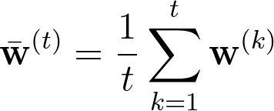
Stochastic Gradient Descent
In SGD we only require that the expected value at each iteration will equal the gradient direction
In black we have Ruppert-Polyak averaging, a well-known way to minimize asymptotic variance of SGD:
Gradient Descent
SGD
Understanding Machine Learning, Shalev-Shwartz, Ben-David

Slide 13
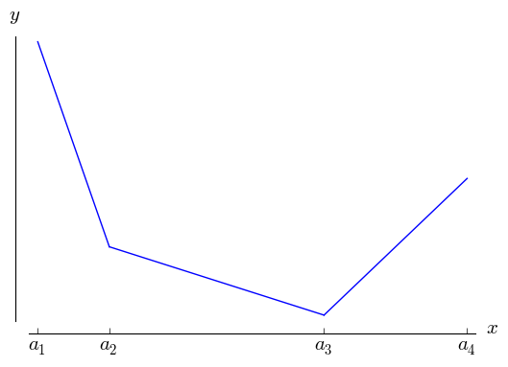
Subdifferentiation and Subgradients
We also want to apply gradient descent to some functions that aren’t differentiable:
It would be nice if we could have a generalization of the derivative to help with problematic points.

Slide 14
Subdifferentiation and Subgradients
For a convex function the following can be proven:
This is basically saying that a convex function is everywhere above any of its tangent lines.
We use this to generalize the notion of a gradient:
Any vector satisfying this inequality is called a subgradient of the function at , and the set of these subgradients is called the differential set and denoted .
This allows us to perform stochastic subgradient descent.

Slide 15
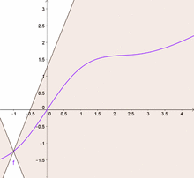
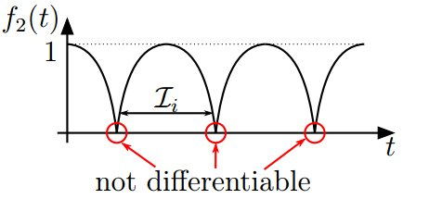
Lipschitz Continuity
Another important term in analyzing convergence in ML problems is Lipschitz continuity. This is a subset of the set of continuous functions that is one step weaker than continuous differentiability
Basically, can the function be excluded from a double-cone at every point.
Can you see how this might be related to subgradients when applied to convex functions?
https://www.reddit.com/r/math/comments/3f6x5d/is_fx_abscosx_lipschitz_continuous_or_just/

Slide 16
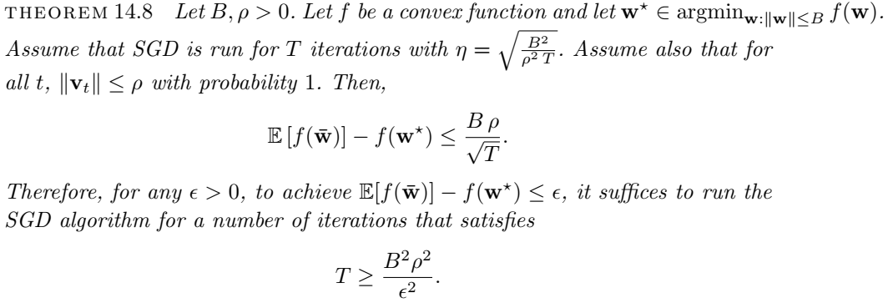
Convergence of Ruppert-Polyak SGD
and
Understanding Machine Learning: http://www.cs.huji.ac.il/~shais/UnderstandingMachineLearning
Things to note:
We get an expectation of how close we are to the true minimum
Time to get there depends on how much the function can vary
Assumes convexity! But deep neural networks aren’t generally convex.

Slide 17
SGD for Risk Minimization
How is SGD applied in practice? How do we obtain , which is supposed to have an expected value equal to the gradient of the true loss function?
Remember, we want to minimize
Where is the loss given random data point .
Then,
So, simply taking the gradient of the loss given one or a few points (i.e. on-line or minibatches) provides an unbiased estimate of the true loss.

Slide 18
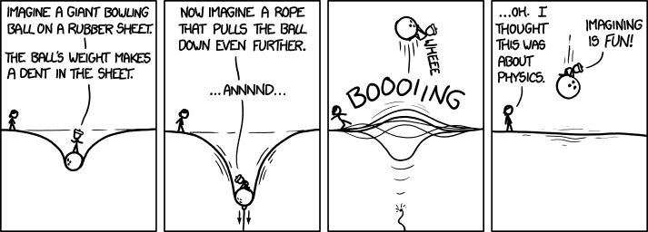
SGD vs Batch Gradient Descent
Imagine each data point pulling a rubber sheet, and a ball rolling on this surface.
When all are considered, you have a very accurate understanding of the true loss
Batch gradient descent. Good but computationally expensive – consider every point before taking a step!
When just a few are considered, you get a rough idea of the true loss
SGD. Much cheaper but the ball will change directions as different points are drawn each step.

Slide 19
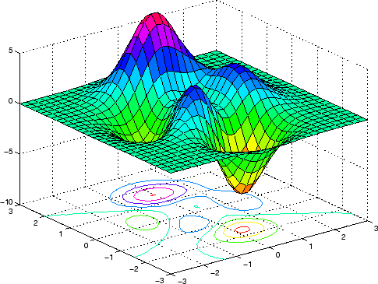
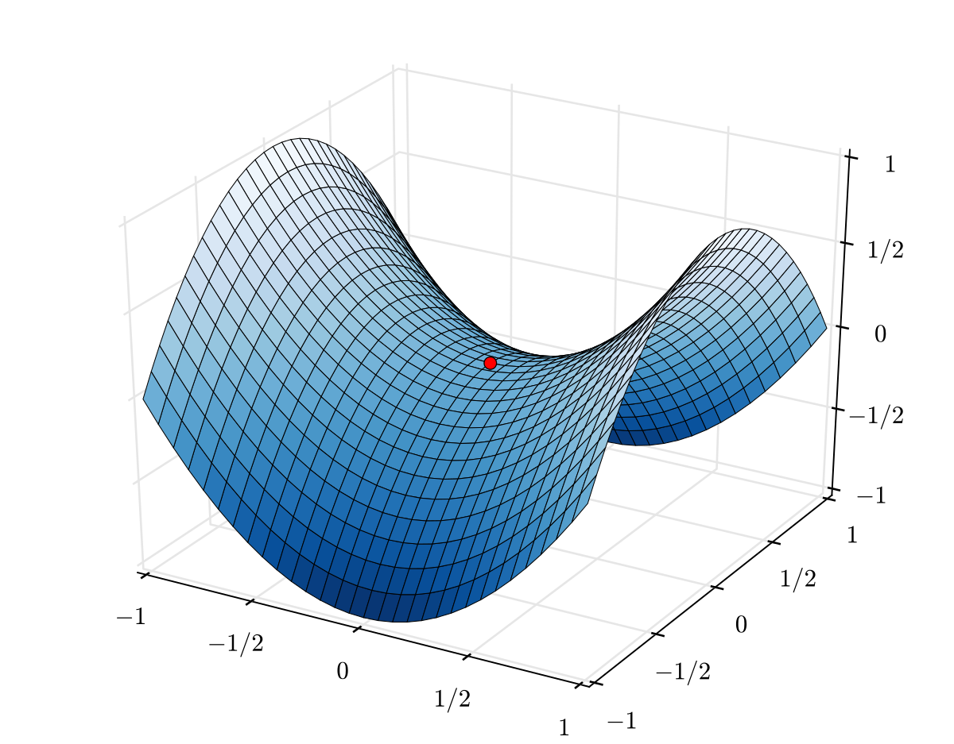
Local Minima in Non-Convex Functions
SGD assumes convexity, but we know that this doesn’t hold for neural networks with hidden layers. How do we deal with local minima?
Turns out we don’t need to.
In large N-dimensional domains, local minima are extremely rare.
Intuitively – the eigenvalues of the Hessian have 0.5 probability of being positive or negative (Wigner’s semicircle law)
What is the chance of getting heads N times in a row?
Saddle points are very common in high-dimensional spaces. Plain SGD is good at convex functions, how do we modify it to deal with non-convex ones filled with saddle points?
https://stackoverflow.com/questions/31805560/how-to-create-surface-plot-from-greyscale-image-with-matplotlib
https://en.wikipedia.org/wiki/Saddle_point

Slide 20
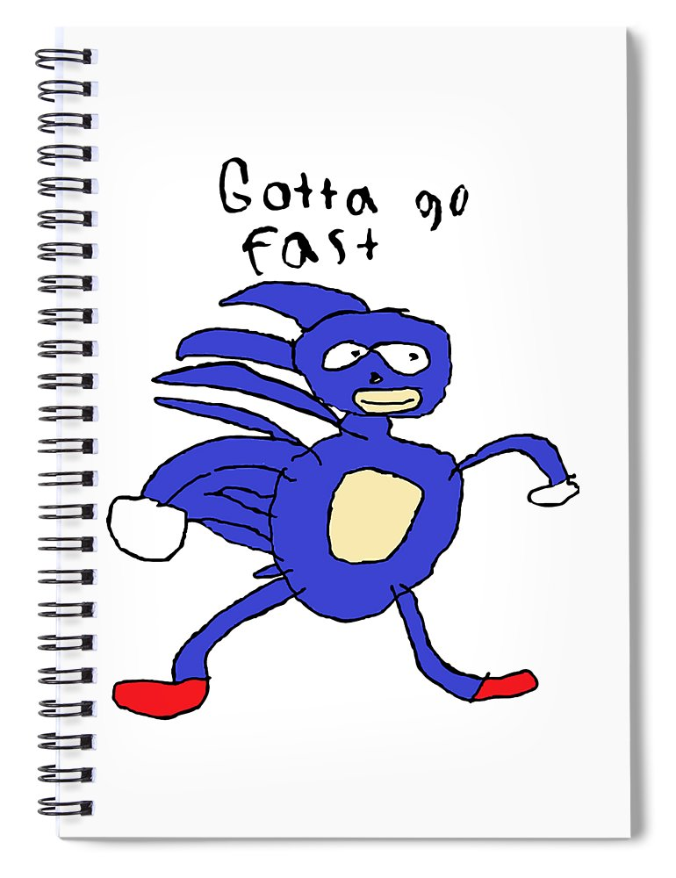
Escaping Saddle Points
Somewhat counterintuitively, the best way to escape saddle points is to just move in any direction, quickly.
Then we can get somewhere with more substantial curvature for a more informed update.
Rubick Runner

Slide 21
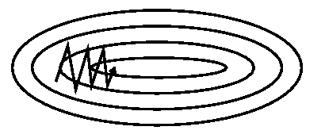
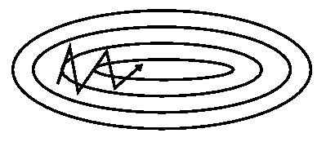
SGD with Momentum
Maintain some of the previous “velocity”. The larger the , the heavier the ball (or the less friction).
SGD
SGD with momentum
https://ruder.io/optimizing-gradient-descent/index.html#momentum

Slide 22
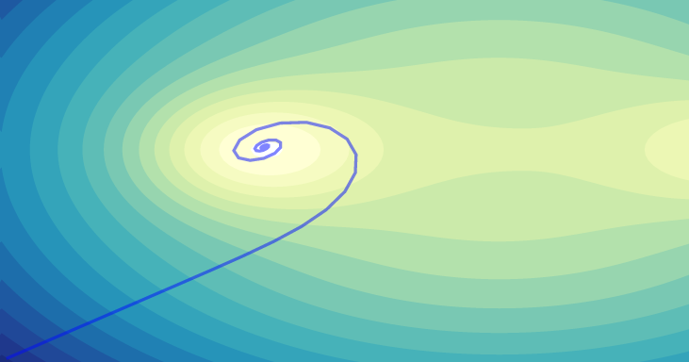
SGD with Momentum
Maintain some of the previous “velocity”. The larger the , the heavier the ball (or the less friction).
Spiraling can happen though
https://emiliendupont.github.io/2018/01/24/optimization-visualization/

Slide 23
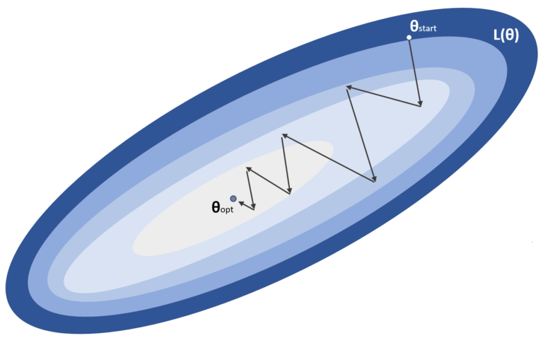
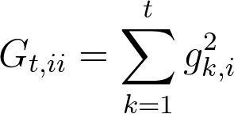
Adagrad
We’d like to adapt the gradient in each dimension – i.e. large steps in flatter directions, careful steps in steep directions.
i.e. to avoid this:
https://www.bonaccorso.eu/2017/10/03/a-brief-and-comprehensive-guide-to-stochastic-gradient-descent-algorithms/
We see that in directions where derivatives are large, we shrink the learning rate.
But, it just keeps shrinking – after a while the learning rate will be infinitely small!

Slide 24
RMSprop
A way to counteract the vanishing learning rates by using a decaying average of past squared gradients.
Now, if there were large gradients in the past, their contribution to the average will decay exponentially with the timesteps.
If we were taking careful steps in a steep area, once we get to a flat region this allows us to crank up the speed again.

Slide 25
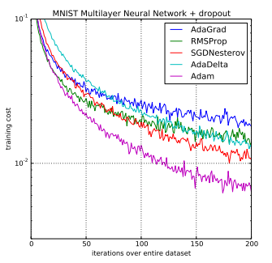
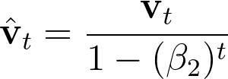
Adam
Currently the most popular gradient descent algorithm.
Stands for Adaptive Moment Estimation. Basically combines the ideas of momentum with exponentially-decaying squared past gradients.
Average gradient (momentum)
Average squared gradient
Bias correction
Update
Adam: A Method for Stochastic Optimization, 2015

Slide 26
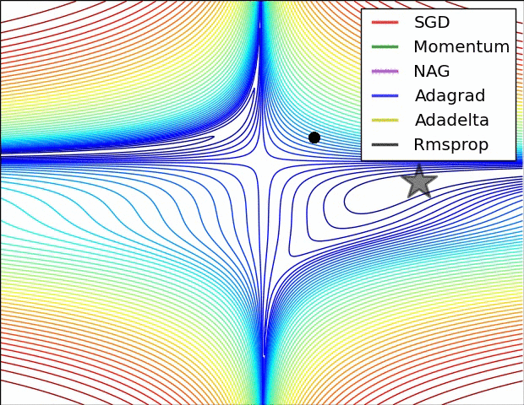
Animated Comparison
https://ruder.io/optimizing-gradient-descent/index.html

Slide 27
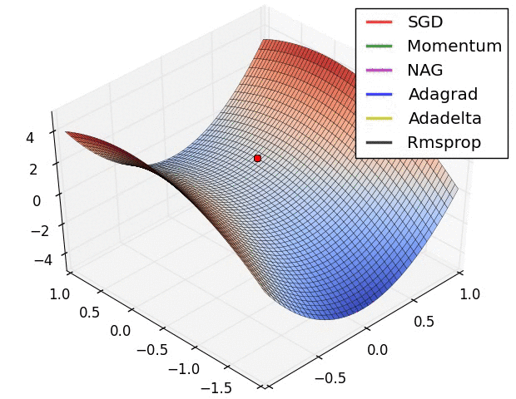
Animated Comparison
https://ruder.io/optimizing-gradient-descent/index.html

Slide 28
Not everything is great with the new algos
https://emiliendupont.github.io/2018/01/24/optimization-visualization/

Slide 29
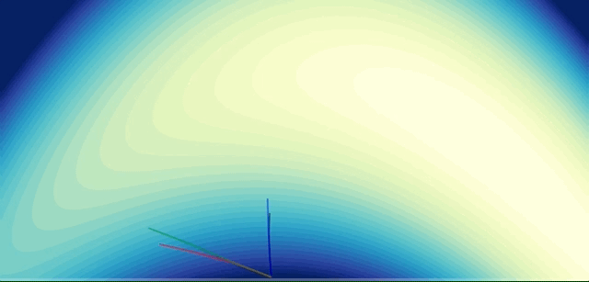
Not everything is great with the new algos
https://emiliendupont.github.io/2018/01/24/optimization-visualization/

Slide 30
Adam Limitations
Adam generally performs very well compared to other methods, but recent research has found that it can sometimes converge to suboptimal solutions (such as in image classification tasks)
In fact, the original proof of convergence on convex functions had a few errors, which in 2018 was demonstrated to great effect with examples of simple convex functions on which Adam does not converge to the minimum.
Ironically, Keskar and Socher present a paper called
“Improving Generalization Performance by Switching from Adam to SGD”

Slide 31
So, which algorithm should you use?
There is no simple answer; a whole zoo of algorithms exist:
SGD
SGD with momentum
Nesterov
Adagrad
Adadelta
RMSprop
Adam
Adamax
Nadam
Each has their advantages and disadvantages.
If you have sparse data, an adaptive gradient method can help you take large steps in flat dimensions
SGD can be robust, but slow.
Ultimately, the choice of gradient descent algorithm can be treated as a hyperparameter.

Slide 32
Additional Notes
It can be useful to use a learning rate scheduler where you decrease your learning rate as a function of iteration.
Shuffle data within an epoch to reduce optimization bias
Curriculum learning is when you train your network with simpler examples first to get the weights in the right region before training it on more subtle cases.
Batch Normalization can be used to improve convergence in deep networks. It discourages neurons from activating very high or very low by subtracting the batch mean and dividing my the batch standard deviation. Allows each layer to learn a little more independently from the rest.
“Early stopping is beautiful free lunch,” Geoff Hinton. When the validation error is at its minimum, stop.

Slide 33
Summary
Convex functions are important to optimization
But most of the ones we want to optimize aren’t convex
Good for proofs though.
There are many approaches to gradient descent
However, it is basically an art form at the present. Pick your favorite, but when things don’t work, try others!

