Slide 1
Advanced Section #1: Linear Algebra and Hypothesis Testing
Presentation prepared by Will Claybaugh for CS109A 2018

Slide 2
Advanced Section 1
WARNING
This deck uses animations to focus attention and break apart complex concepts.
Either watch the section video or read the deck in Slide Show mode.

Slide 3
Advanced Section 1
Today’s topics:
Linear Algebra (Math 21b, 8 weeks)
Maximum Likelihood Estimation (Stat 111/211, 4 weeks)
Hypothesis Testing (Stat 111/211, 4 weeks)
Our time limit: 75 minutes
We will move fast
You are only expected to catch the big ideas
Much of the deck is intended as notes
I will give you the TL;DR of each slide
We will recap the big ideas at the end of each section

Slide 4
Linear Algebra
(The Highlights)

Slide 5
Interpreting the dot product
What does a dot product mean?
$$\left(1,5,2\right)∙\left(3,−2,4\right)=1∙\left(3\right)+5∙\left(−2\right)+2∙\left(4\right)$$
Weighted sum: We weight the entries of one vector by the entries of the other
Either vector can be seen as weights
Pick whichever is more convenient in your context
Measure of Length: A vector dotted with itself gives the squared distance from (0,0,0) to the given point
$\left(1,5,2\right)∙\left(1,5,2\right)=1∙\left(1\right)+5∙\left(5\right)+2∙\left(2\right)={\left(1−0\right)}^{2}+{\left(5−0\right)}^{2}+{\left(2−0\right)}^{2}=28$
$\left(1,5,2\right)$ thus has length $\sqrt{28}$
Measure of orthogonality: For vectors of fixed length, $a∙b$ is biggest when $a$ and $b$ point are in the same direction, and zero when they are at a 90° angle
Making a vector longer (multiplying all entries by c) scales the dot product by the same amount
Question: how could we get a true measure of orthogonality (one that ignores length?)

Slide 6
Dot Product for Matrices
2 | -1 | 3
1 | 5 | 2
-1 | 1 | 3
6 | 4 | 9
2 | 2 | 1
20 | -11
1 | 32
7 | 0
46 | 16
6 | 14
3 | 1
-2 | 7
4 | -2
3
-2
4
1 | 5 | 2
1
$$\left(1,5,2\right)∙\left(3,−2,4\right)$$
$$∙$$
$$=$$
$$\left(2,2,1\right)∙\left(1,7,−2\right)$$
5 by 3
3 by 2
5 by 2
Matrix multiplication is a bunch of dot products
In fact, it is every possible dot product, nicely organized
Matrices being multiplied must have the shapes ($n,m)x (m,p)$ and the result is of size ($n,p)$
(the middle dimensions have to match, and then drop out)

Slide 7
Column by Column
2 | -1 | 3
1 | 5 | 2
-1 | 1 | 3
6 | 4 | 9
2 | 2 | 1
3 | 1
-2 | 7
4 | -2
20 | -11
1 | 32
7 | 0
46 | 16
6 | 14
2 | -1 | 3
1 | 5 | 2
-1 | 1 | 3
6 | 4 | 9
2 | 2 | 1
2
1
-1
6
2
-1
5
1
4
2
3
2
3
9
1
20
1
7
46
6
3
-2
4
$$=$$
$$∙$$
$$=$$
3
$$∙$$
+
-2
$$∙$$
+
4
$$∙$$
Since matrix multiplication is a dot product, we can think of it as a weighted sum
We weight each column as specified, and sum them together
This produces the first column of the output
The second column of the output combines the same columns under different weights
Rows?

Slide 8
Row by Row
2 | -1 | 3
1 | 5 | 2
-1 | 1 | 3
6 | 4 | 9
2 | 2 | 1
3 | 1
-2 | 7
4 | -2
20 | -11
1 | 32
7 | 0
46 | 16
6 | 14
1
$$∙$$
3 | 1
+
$$∙$$
3 | 1
-2 | 7
4 | -2
$$=$$
5
$$∙$$
-2 | 7
$$=$$
1 | 5 | 2
1 | 32
+
2
$$∙$$
4 | -2
Apply a row of A as weights on the rows B to get a row of output

Slide 9
Linear Algebra
Span
(The Highlights)

Slide 10
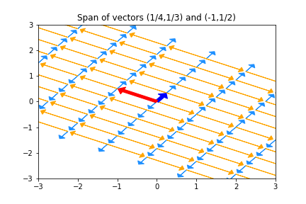
Span and Column Space
2
1
-1
6
2
-1
4
1
4
2
3
2
3
9
1
$$β_{1}$$
$$∙$$
+
$$β_{2}$$
$$∙$$
+
$$β_{3}$$
$$∙$$
Span: every possible linear combination of some vectors
If vectors are the columns of a matrix call it the column space of that matrix
If vectors are the rows of a matrix it is the row space of that matrix
Q: what is the span of {(-2,3), (5,1)}? What is the span of {(1,2,3), (-2,-4,-6), (1,1,1)}

Slide 11
Linear Algebra
Bases
(The Highlights)

Slide 12
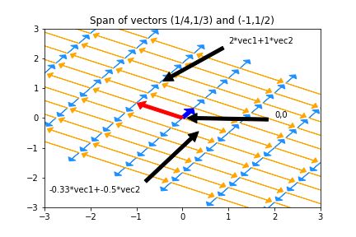
Basis Basics
Given a space, we’ll often want to come up with a set of vectors that span it
If we give a minimal set of vectors, we’ve found a basis for that space
A basis is a coordinate system for a space
Any element in the space is a weighted sum of the basis elements
Each element has exactly one representation in the basis
The same space can be viewed in any number of bases - pick a good one

Slide 13
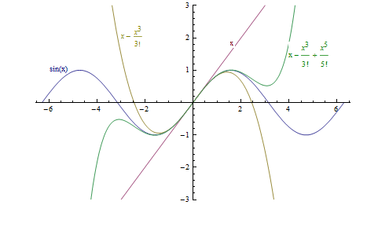
Function Bases
Bases can be quite abstract:
Taylor polynomials express any analytic function in the infinite basis $\left(1,x,x^{2},x^{3},…\right)$
The Fourier transform expresses many functions in a basis built on sines and cosines
Radial Basis Functions express functions in yet another basis
In all cases, we get an ‘address’ for a particular function
In the Taylor basis, $sin⁡(x) = (0,1,0,\frac{1}{6},0,\frac{1}{120},…)$
Bases become super important in feature engineering
Y may depend on some transformation of x, but we only have x itself
We can include features $\left(1,x,x^{2},x^{3},…\right)$ to approximate
Taylor approximations to y=sin(x)

Slide 14
Linear Algebra
Interpreting Transpose and Inverse
(The Highlights)

Slide 15
Transpose
3
2
3
9
3 | 1
2 | -1
3 | 2
9 | 7
3 | 2 | 3 | 9
1 | -1 | 2 | 7
$$x=$$
$$x^{T}=$$
3 | 2 | 3 | 9
$$A=$$
$$A^{T}=$$
Transposes switch columns and rows. Written $A^{T}$
Better dot product notation: $a∙b$ is often expressed as $a^{T}b$
Interpreting: The matrix multiplilcation $AB$ is rows of A dotted with columns of B
$A^{T}B$ is columns of $A$ dotted with columns of $B$
${AB}^{T}$ is rows of $A$ dotted with rows of $B$
Transposes (sort of) distribute over multiplication and addition:
${\left(AB\right)}^{T}=B^{T}A^{T}$ ${\left(A+B\right)}^{T}=A^{T}+B^{T}$ ${\left(A^{T}\right)}^{T}=A$
Notes:
Note: AB is rows dotted with columns, that order. If a transpose is there, switch that part of the phrase from rows to columns

Slide 16
Inverses
Algebraically, ${AA}^{−1}=A^{−1}A=1$
Geometrically, $A^{−1}$ writes an arbitrary point $b$ in the coordinate system provided by the columns of $A$
Proof (read this later):
Consider $Ax=b$. We’re trying to find weights $x$ that combine $A$’s columns to make $b$
Solution $x=A^{−1}b$ means that when $A^{−1}$ multiplies a vector we get that vector’s coordinates in A’s basis
Matrix inverses exist iff columns of the matrix form a basis
1 Million other equivalents to invertibility: Invertible Matrix Theorem
How do we write (-2,1) in this basis?
Just multiply $A^{−1}$ by (-2,1)

Slide 17
Linear Algebra
Eigenvalues and Eigenvectors
(The Highlights)

Slide 18
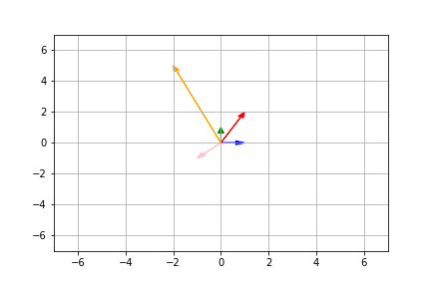
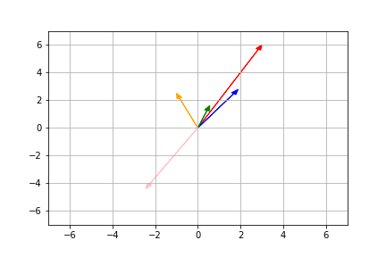
Eigenvalues
Original vectors:
Sometimes, multiplying a vector by a matrix just scales the vector
The red vector’s length triples
The orange vector’s length halves
All other vectors point in new directions
The vectors that simply stretch are called egienvectors. The amount they stretch is their eigenvalue
Anything along the given axis is an eigenvector; Here, (-2,5) is an eigenvector so (-4,10) is too
We often pick the version with length 1
When they exist, eigenvectors/eigenvalues can be used to understand what a matrix does
After multiplying by 2x2 matrix A:
Notes:
Spoiler alert: matrices stretch and rotate space

Slide 19
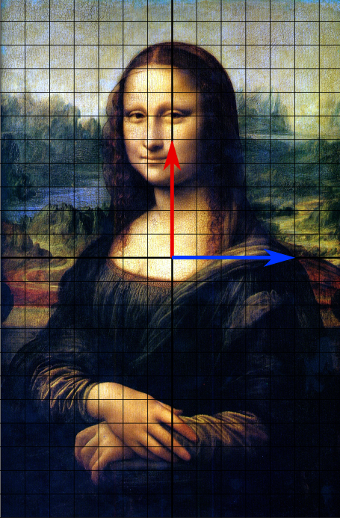
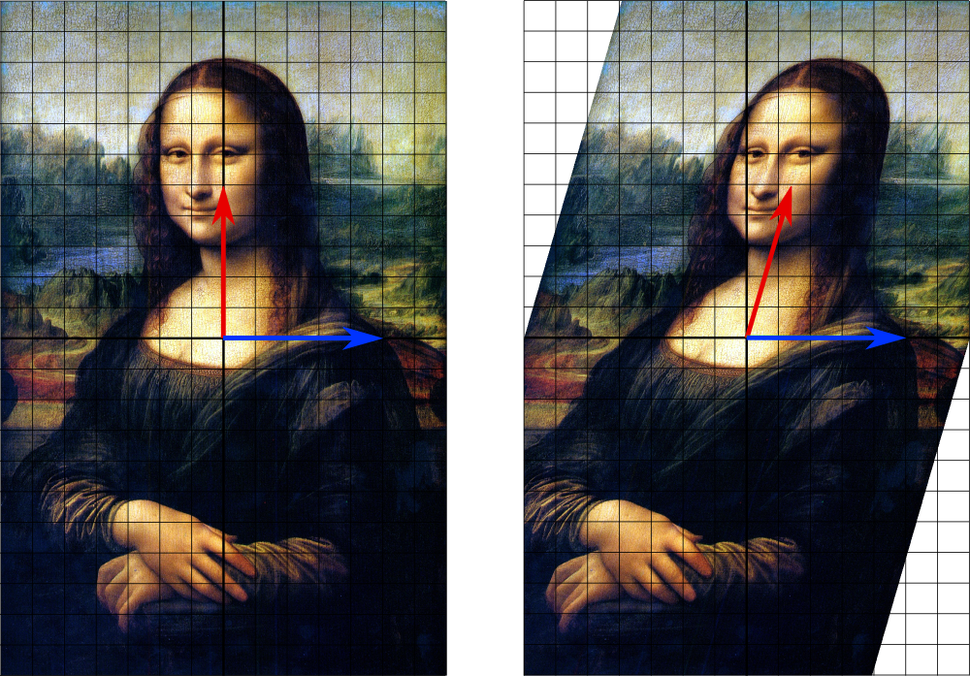
Interpreting Eigenthings
Warnings and Examples:
Eigenvalues/Eigenvectors only apply to square matrices
Eigenvalues may be 0 (indicating some axis is removed entirely)
Eigenvalues may be complex numbers (indicating the matrix applies a rotation)
Eigenvalues may be repeat, with one eigenvector per repetition (the matrix may scales some n-dimension subspace)
Eigenvalues may repeat, with some eigenvectors missing (shears)
If we have a full set of eigenvectors, we know everything about the given matrix S, and $S=QDQ^{−1}$
Q’s columns are eigenvectors, D is diagonal matrix of eigenvalues
Question: how can we interpret this equation?
Notes:
This says: write all points in terms of the eigenvectors. Scale everything. Convert back to the original coordinate system.

Slide 20
Calculating Eigenvalues
Eigenvalues can be found by:
A computer program
But what if we need to do it on a blackboard?
The definition $Ax=λx$
This says that for special vectors x, multiplying by the matrix A is the same as just scaling by $λ$ (x is then an eigenvector matching eigenvalue $λ$)
The equation $\det\left(A−λI_{n}\right)=0$
$I_{n}$ is the n by n identity matrix of size n by n. In effect, we subtract lambda from the diagonal of A
Determinants are tedious to write out, but this produces a polynomial in $λ$ which can be solved to find eigenvalues
Eigenvectors matching known eigenvalues can be found by solving $\left(A−λI_{n}\right)x=0$ for x

Slide 21
Linear Algebra
Matrix Decomposition
(The Highlights)

Slide 22
Matrix Decompositions
Eigenvalue Decomposition: Some square matrices can be decomposed into scalings along particular axes
Symbolically: $S=QDQ^{−1}$; D diagonal matrix of eigenvalues; Q made up of eigenvectors, but possibly wild (unless S was symmetric; then Q is orthonormal)
Polar Decomposition: Every matrix M can be expressed as a rotation (which may introduce or remove dimensions) and a stretch
Symbolically: M = UP or M=PU; P positive semi-definite, U’s columns orthonormal
Singular Value Decomposition: Every matrix M can be decomposed into a rotation in the original space, a scaling, and a rotation in the final space
Symbolically: $M=UΣV^{T}$; U and V orthonormal, $Σ$ diagonal (though not square)
Notes:
Polar: stretch is in the smaller space, rotation may introduce or remove dimensions
PSD: no reflection. All vectors end up within the same side of their normal plane

Slide 23
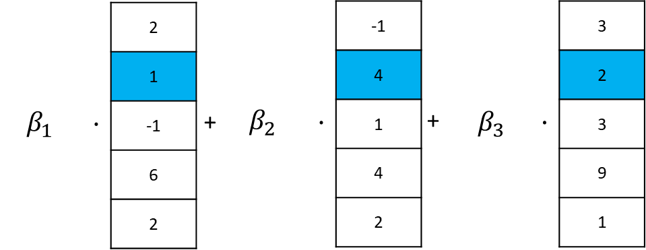
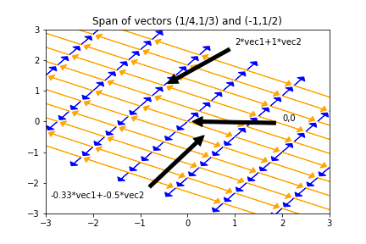
Where we’ve been
Vector and Matrix dot product
2 | -1 | 3
1 | 5 | 2
-1 | 1 | 3
6 | 4 | 9
2 | 2 | 1
3 | 1
-2 | 7
4 | -2
20 | -11
1 | 32
7 | 0
46 | 16
6 | 14
Span
Other decompositions
M = UP or M=PU
$$M=UΣV^{T}$$
Basis as a coordinate system for a space
Eigenvalues
$$Ax=λx$$
$$S=QDQ^{−1}$$
Invertibility
$Ax=b$ ; $x=A^{−1}b$

Slide 24
Reading
What about all the facts about inverses and dot products I’ve forgotten since undergrad? [Matrix Cookbook] [Linear Algebra Formulas]

Slide 25
Linear Algebra
(Summary)

Slide 26
Notes
Matrix multiplication: every dot product between rows of A and columns of B
Important special case: a matrix times a vector is a weighted sum of the matrix columns
Dot products measure similarity between two vectors: 0 is extremely un-alike, bigger is pointing in the same direction and/or longer
Alternatively, a dot product is a weighted sum
Bases: a coordinate system for some space. Everything in the space has a unique address
Matrix Factorization: all matrices are rotations and stretches. We can decompose ‘rotation and stretch’ in different ways
Sometimes, re-writing a matrix into factors helps us with algebra
Matrix Inverses don’t always exist. The ‘stretch’ part may collapse a dimension. $M^{−1}$ can be thought of as the matrix that expresses a given point in terms of columns of M
Span and Row/Column Space: every weighted sum of given vectors
Linear (In)Dependence is just “can some vector in the collection be represented as a weighted sum of the others” if not, vectors are Linearly Independent

Slide 27
Linear Regression

Slide 28
Review and Practice: Linear Regression
In linear regression, we’re trying to write our response data y as a linear function of our [augmented] features X
$response=β_{1}{feature}_{1}+ β_{2}{feature}_{2}+β_{3}{feature}_{3}+$…
$$y=Xβ$$
Our response isn’t actually a linear function of our features, so we instead find betas that produce a column $\hat{y}$ that is as close as possible to $y$ (in Euclidean distance)
$\min_{β}{\sqrt{{(y−\hat{y})}^{T}(y−\hat{y})}}=$ $\min_{β}{\sqrt{{(y−Xβ)}^{T}(y−Xβ)}}$
Goal: find that the optimal $β={\left(X^{T}X\right)}^{−1}X^{T}y$
Steps:
Drop the sqrt [why is that legal?]
Distribute the transpose
Distribute/FOIL all terms
Take the derivative with respect to $β$ (Matrix Cookbook (69) and (81): derivative of $β^{T}a$ is $a^{T}$, …)
Simplify and solve for beta

Slide 29
Interpreting LR: Algebra
The best possible betas, $\hat{β}={\left(X^{T}X\right)}^{−1}X^{T}y$ can be viewed in two parts:
Numerator ($X^{T}y$): columns of X dotted with (the) column of y; how related are the feature vectors and y?
Denominator ($X^{T}X$): columns of X dotted with columns of X; how related are the different features?
If the variables have mean zero and variances are ones, “how related” is literally “correlation”
Roughly, our solution assigns big values to features that predict y, but punishes features that are similar to (combinations of) other features
Bad things happen if $X^{T}X$ is uninvertible (or nearly so)
$$\hat{β}={\left(X^{T}X\right)}^{−1}X^{T}y$$

Slide 30
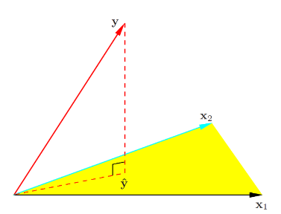
Interpreting LR: Geometry
Observed response values
Best we can do with a
linear combination of features
$$\hat{y}=X\hat{β}=X{\left(X^{T}X\right)}^{−1}X^{T}y$$
The only points that CAN be expressed as $Xβ$ are those in the span/column space of $X$.
By minimizing distance, we’re finding the point in the column space that is closest to the actual y vector
The point $X\hat{β}$ is the projection of the observed y values onto the things linear regression can express
Warnings:
Adding more columns (features) can only make the span bigger and the fit better
If some features are very similar, results will be unstable

Slide 31
Statistics: Hypothesis Testing
OR: WHAT PARAMETERS EXPLAIN THE DATA
Notes:
What did our assumptions buy us?

Slide 32
A Popper’s Grave
It’s impossible to prove a model is correct
In fact, there are many correct models
Can you prove increasing a parameter by .0000001% is incorrect?
We can only rule models out.
The great tragedy is that we often simplify the problem to rule out just ONE model, and then quit.

Slide 33
Model Rejection
Important: a ‘model’ is a (probabilistic) story about how the data came to be, complete with specified values of every parameter.
The model could produce many possible datasets
We only have one observed dataset
How can we tell if a model is wrong?
If the model is unlikely to reproduce the aspects of the data that we care about and observe, it has to go
Therefore, we have some real-number summary of the dataset (a ‘statistic’) by which we’ll compare model-generated datasets and our observed dataset
If the statistics produced by the model are clearly different than the one from the real data, we reject the model
Model
Dataset A
Dataset B
Dataset C
Dataset D
Stat A
Stat B
Stat C
Stat D
Frequency
Value of Statistic
Obs. Dataset
Obs.
Stat
Notes:
This model: accept or reject?

Slide 34
Recap: How to understand any statistical test
A statistical test typically specifies:
A ‘hypothesized’ (probabilistic) data generating process
A summary we’ll use to compress/summarize a dataset
A rule for comparing the observed and the simulated summaries
Example: t-test
The y data are generated via the estimated line/plane, plus Normal(0, σ²) noise,
EXCEPT a particular coefficient is assumed to actually be zero!
The coefficient we’d calculate for that dataset (minus 0), over the SE of the coefficient
t statistic = $\frac{{\hat{β}}_{0bserved}−0}{\hat{SE}{(\hat{β}}_{0bserved})}$
Declare the model bad if the observed result is in the top/bottom α/2 of simulated results (commonly top/bottom 2.5%)
(Jargon: the null hypothesis)
(Jargon: a statistic)

Slide 35
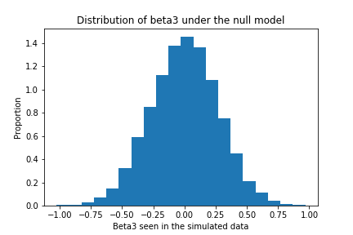
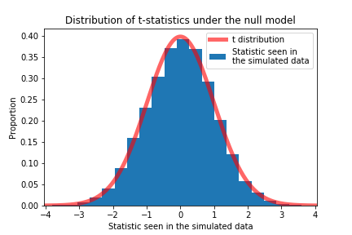
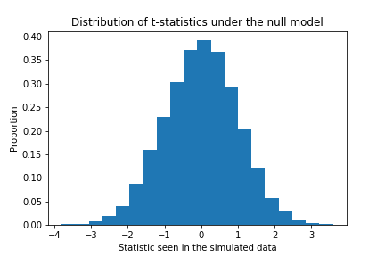
The t-test
Walkthrough:
We set a particular $β$(or set of $β$’s) we care about to zero (call them$β_{null}$).
We simulate 10,000 new datasets using $β_{null}$ as truth.
In each of the 10,000 datasets, fit a regression against X and plot the values of the $β$ we care about (the one we set to zero).
Plotting the t statistic in each simulation is a little nicer
The t statistic calculated from the observed data was 17.8. Do we think the proposed model generated our data?
T-test for $β_{2}$ = 0
$$β_{MLE}=[2.2, 5, 3, 1.6]$$
$$β_{null}=[2.2, 5, 0, 1.6]$$
$$σ_{MLE}$$
$$X_{obs}$$
Simulate y values y=N($Xβ$, $σ$)
$$y_{sim1}$$
$$y_{sim2}$$
$$y_{sim3}$$
…
$$y_{sim10,000}$$
Fit linear regression y_sim = XB
$$β_{sim1}$$
$$β_{sim2}$$
$$β_{sim3}$$
…
$$β_{sim10,000}$$
One more thing: Amazingly, ‘Student’ knew what results we’d get from the simulation. He must have drunk a lot of Guinness.
Notes:
Important: how do we set the SE

Slide 36
The Value of Assumptions
Student’s clever set-up let’s us skip the simulation
In fact, all classical tests are built around working out what distribution the results will follow, without simulating
Student’s work lets us take infinite samples at almost no cost
These shortcuts were vital before computers, and are still important today
Even so, via simulation we’re freer to test and reject more diverse models and use wilder summaries
However, the summaries and rules we choose still require thought: some are much better than others
Define Model
Get Simulated Datasets/Statistics
Compare to Observed Data
Decision

Slide 37
p-values
Hypothesis (model) testing leads to comparing a distribution against a specific value
A natural way to summarize: report what percentage of results are more extreme than the observed data
Basically, could the model frequently produce data that looks like ours?
This is the p value: p=0.031 means that your observed data is in the top 3.1% of extreme results under this model (using our statistic)
There is some ambiguity about what ‘extreme’ should mean
Jargon: p-values are “the probability, assuming the null model is true, of seeing a value of [your statistic] as extreme or more extreme than what was seen in the observed data”
Distribution of Simulation Results
Results from observed dataset
Frequency
?
Results From Simulation
Simulations more extreme than the observed data
Notes:
Statistical significance

Slide 38
p Value Warnings
p values are just one possible measure of the evidence against a model
Rejecting a model when p<threshold is only one possible decision rule
Get a book on Decision Theory for more
Even if the null model is exactly true, 5% of the time, we’ll get a dataset with p<.05
p<.05 doesn’t prove the null model is wrong, it just suggests it.
It does mean that anyone who wants to believe in the null must explain with why something unlikely happened

Slide 39
Recap
We can’t rule models in (it’s difficult); we can only rule them out (much easier)
We rule models out when the data they produce is different from the observed data
We pick a particular candidate (null) model
A statistic summarizes the simulated and observed datasets
We compare the statistic on the observed data to the [simulated or theoretical] sampling distribution of statistics the null model produces
We rule out the null model if the observed data doesn’t seem to come from the model (disagrees with the sampling distribution).
A p value summarizes the level of evidence against a particular null
“The observed data are in the top 1% of results produced by this model… what’s more reasonable: we got lucky, or the model was wrong?

Slide 40
Statistics: Hypothesis Testing
CONFIDENCE INTERVALS AND COMPOSITE HYPOTHESES

Slide 41
Recap
Dawn of Time
β = -.4
β = -.3
β = -.2
β = -.1
β = 0
β = .1
β = .2
β = .3
β = -.4
Our Data
Let’s talk about what we just did
That t-test was ONLY testing the model where the coefficient in question is set to zero
Ruling out this model makes it more likely that other models are true, but doesn’t tell us which ones
If the null is β = 0, getting p<.05 only rules out THAT ONE model
When would it make sense to stop after ruling out β = 0, without testing β = .1?

Slide 42
Composite Hypotheses: Multiple Models
Often, we’re interested in trying out more than one candidate model
E.g. Can we disprove all models with a negative value of beta?
This amounts to simulating data from each of those models (but there are infinitely many…)
Sometimes, ruling out the nearest model is enough; we know that the other models have to be worse
If a method claims it can test θ<0, this is how
Can we rule these out?
β
β=0
β=MLE
β=0 will be closer to matching the data (in terms of t statistic) than any other model in the set*; we only need to test β=0
* Non-trivial; true for student’s t but not for other measures

Slide 43
THE Null vs A Null
Dawn of Time
β = -.4
β = -.3
β = -.2
β = -.1
β = 0
β = .1
β = .2
β = .3
β = -.4
Our Data
What if we tested LOTS of possible values of beta?
Special conditions must hold to avoid multiple-testing issues; again, the t test model+statistic pass them
We end up with a set/interval of surviving values, e.g. [.1,.3]
Sometimes, we can directly calculate what the endpoints would be from probability theory
Since each beta was tested under the rule “reject this beta if the observed results are in the top 5% of weird datasets under this model”, we have [.1,.3] as a 95% confidence interval
Notes:
Criteria: how much do you know about the results of the next test, given results (data?) from all previous tests

Slide 44
Confidence Interval Warnings
WARNING: This kind of accept/reject confidence interval is rare
Most confidence intervals do not map accept/reject regions of a (useful) hypothesis test
A confidence interval that excludes zero does not usually mean a result is statistically significant
Statistically significant: The data resulting from an experiment/data collection have p<.05 (or some other threshold) against a no-effect model, meaning we reject the no-effect model
It depends on how that confidence interval was built
A confidence interval’s only promise: if you were to repeatedly re-collect the data and build 95% CIs, (assuming our story about data generation is correct) 95% of the intervals would contain the true value

Slide 45
Confidence Interval Warnings
WARNING: A 95% confidence interval DOES NOT have a 95% chance of holding the true value
There may be no such thing as “the true value”, b/c the model is wrong
Even if the model is true, a “95% chance” statement requires prior assumptions about how nature sets the true value

Slide 46
HW Preview
The 209 homework touches on another kind of confidence interval
Class: “How well have I estimated beta?”
HW: “How well can I estimate the mean response at each X?”
Bonus: “How well can I estimate the possible responses at each X”?

Slide 47
Remember those assumptions?
Dawn of Time
World is not linear
Dawn of Time
World is linear w/ MLE Gaussian noise
World has non-Gaussian noise
All other betas have their MLE values
Other betas have different values
Dawn of Time
β = -.2
β = -.1
β = 0
β = .1
β = .2
β = -.2
β = -.1
β = 0
β = .1
β = .2
Our Data
Our Data
We rejected the null model(s) as tested, not the idea that β=0 – assumptions matter

Slide 48
Review
Ruling out a single model isn’t much
Sometimes, ruling out a single model is enough to rule out a whole class of models
Assumptions our model makes are weak points that should be justified and checked for accuracy
Confidence intervals give a reasonable idea of what some unknown value might be
Any single confidence intervals cannot give a probability
Statistical significance is 99% unrelated to confidence intervals

Slide 49
Statistics: Review
You made it!

Slide 50
Review
To test a particular model (a particular set of parameters) we must:
Specify a data generating process
Pick a way to measure whether our data plausibly comes from the process
Pick a rule for when a model cannot be trusted (when is the range of simulated results too different from the observed data?)
What features make for a good test?
We want to make as few assumptions as possible, and choose a measure that is sensitive to deviations from the model
If we’re clever, we might get math that lets us skip simulating from the model
Tension: more assumptions make math easier, fewer assumptions make results broader
There is no such thing as THE null hypothesis. It’s only A null hypothesis.
A p value only tests one null hypothesis, and is rarely enough

Slide 51
Going forward
As the course moves on, we’ll see
Flexible assumptions about the data generating process
Generalized Linear Models
Ways of making fewer assumptions about the data generating process:
Bootstrapping
Permutation tests
Easier questions: Instead of ‘find a model that explains the world’, ‘pick the model that predicts best’
Validation sets and cross validation

