Slide 1
Lecture 7: Regularization

Slide 2
Announcements
Sections: Due to low attendance, Monday evening section is canceled. Instead we add one extra OH on Wednesday 5:30 – 7 (high demand).
Office Hours for 209: You can use Pavlos and Kevin’s OH for 209 material.
Homeworks:
Minor correction in the language for HW3.
HW4 will be released on Tuesday 11:59pm.
Two weeks
individual
Piazza only private messages.
Projects:
Milestone 1 due on Oct 3

Slide 3
Lecture Outline
Overfitting
Bias vs Variance
Regularization: LASSO and Ridge
Regularization Methods: A Comparison

Slide 4
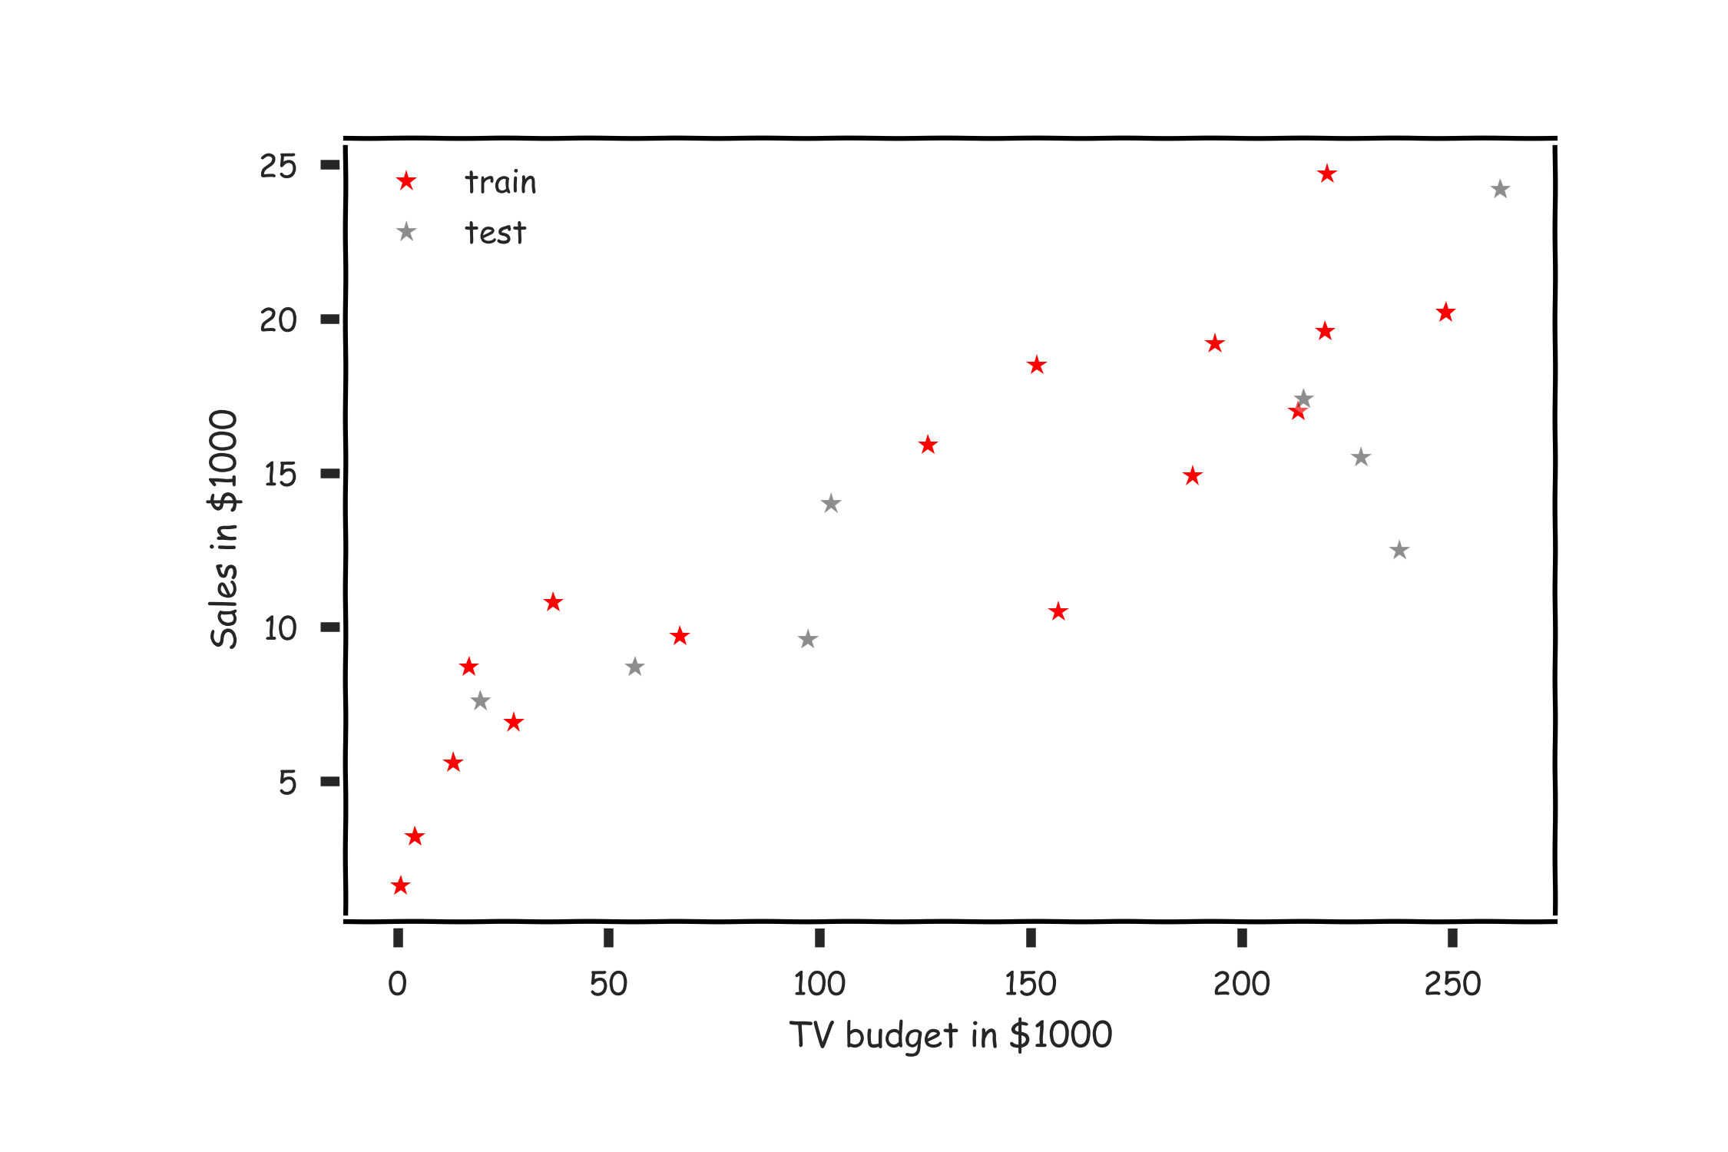
Overfitting

Slide 5
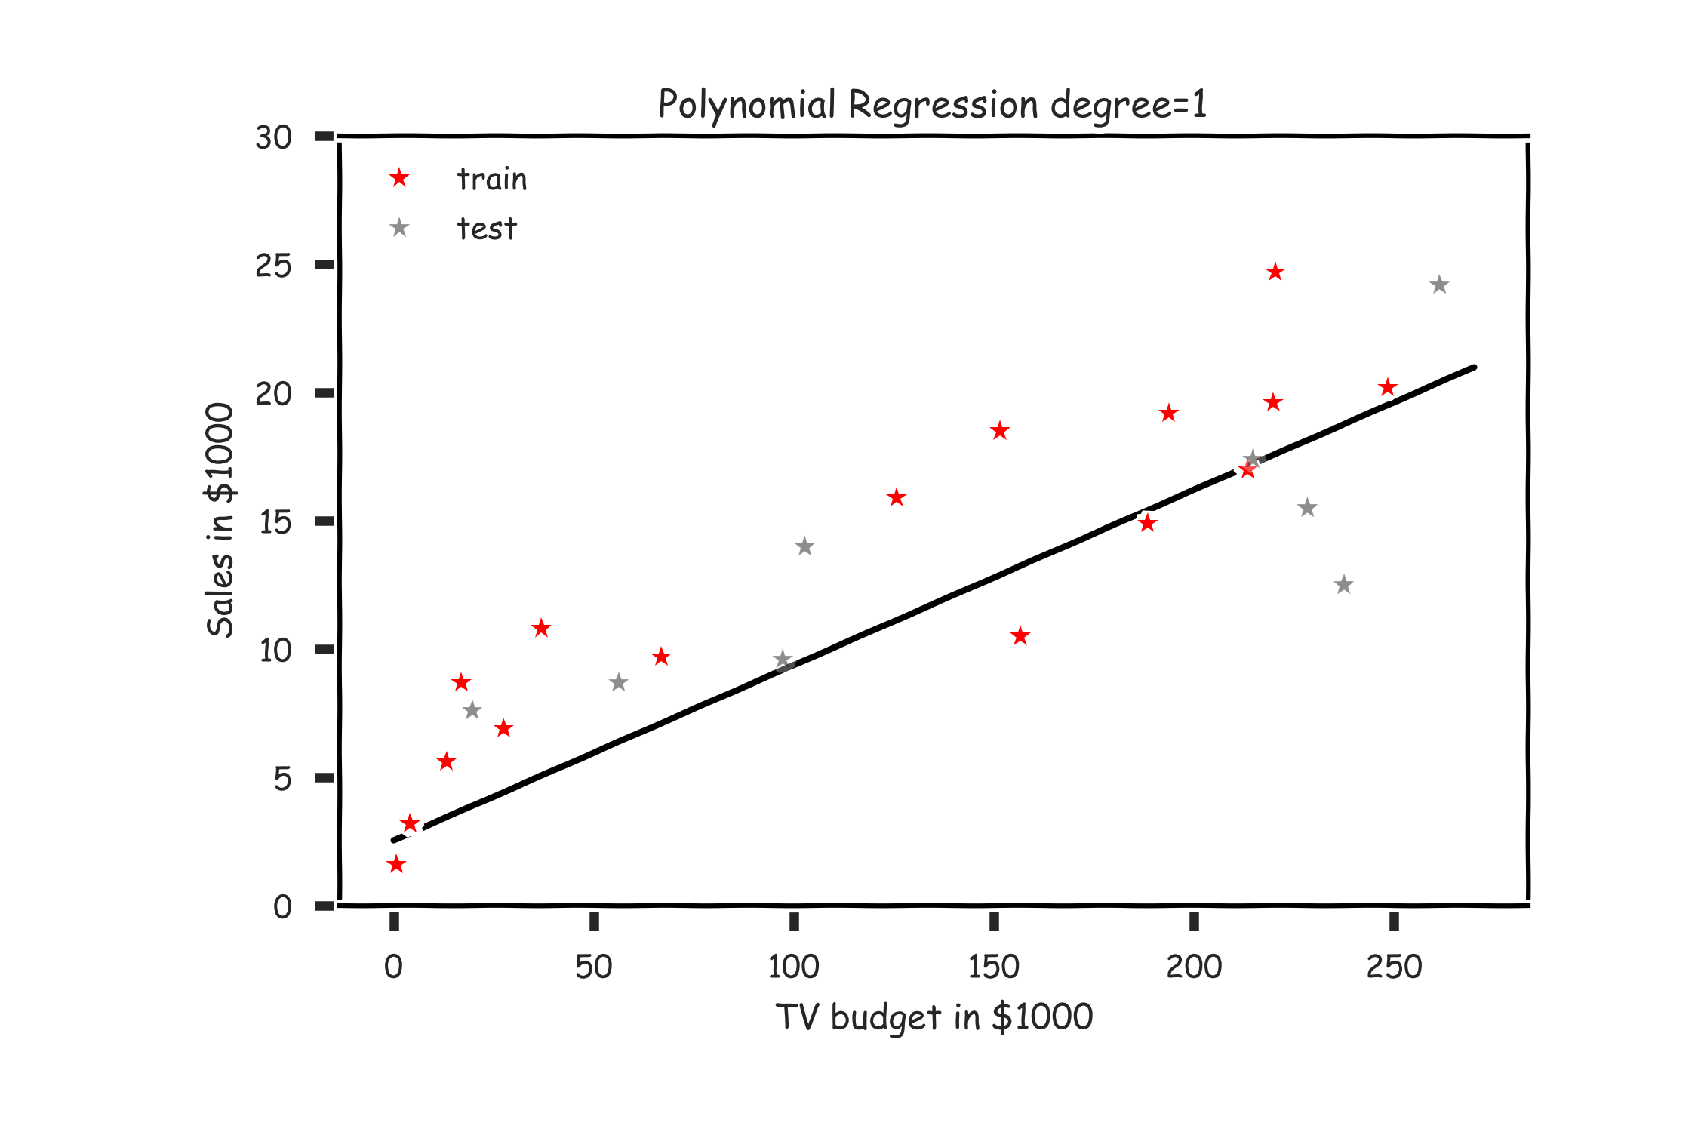
Overfitting

Slide 6
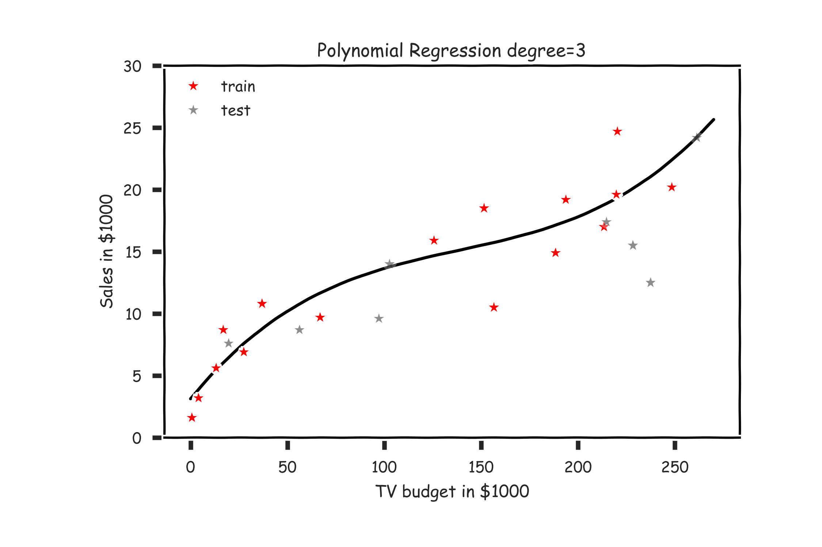
Overfitting

Slide 7
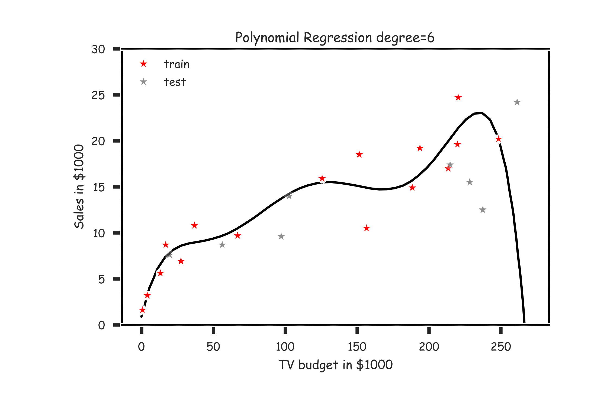
Overfitting

Slide 8
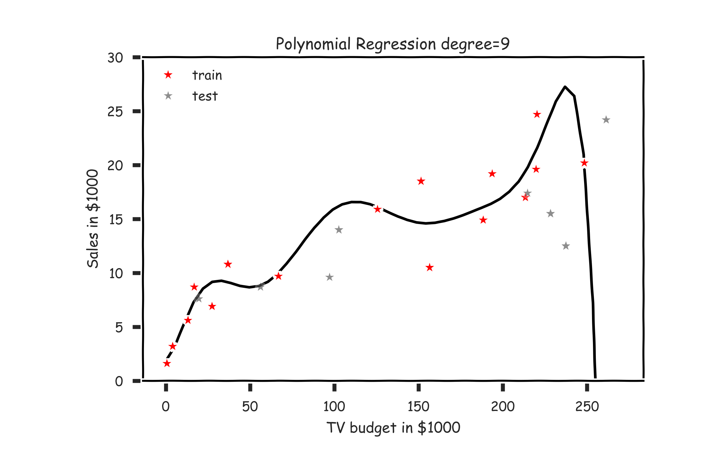
Overfitting

Slide 9
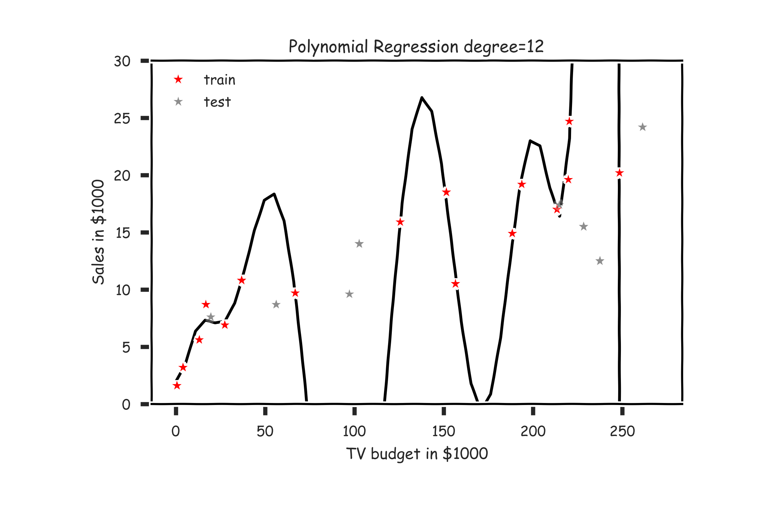
Overfitting

Slide 10
Model Selection
Model selection is the application of a principled method to determine the complexity of the model, e.g. choosing a subset of predictors, choosing the degree of the polynomial model etc.
A strong motivation for performing model selection is to avoid overfitting, which we saw can happen when:
there are too many predictors:
  the feature space has high dimensionality
  the polynomial degree is too high
  too many cross terms are considered
the coefficients values are too extreme

Slide 11
Stepwise Variable Selection and Cross Validation
Last time, we addressed the issue of selecting optimal subsets of predictors (including choosing the degree of polynomial models) through:
stepwise variable selection - iteratively building an optimal subset of predictors by optimizing a fixed model evaluation metric each time,
Today we will see selecting an optimal model by cross validation - evaluating each model on multiple validation sets.
And also today, we will also address the issue of discouraging extreme values in model parameters

Slide 12
Stepwise Variable Selection Computational Complexity
How many models did we evaluate?
1st step, J Models
2nd step, J-1 Models (add 1 predictor out of J-1 possible)
3rd step, J-2 Models (add 1 predictor out of J-2 possible)
…

Slide 13
Cross Validation

Slide 14
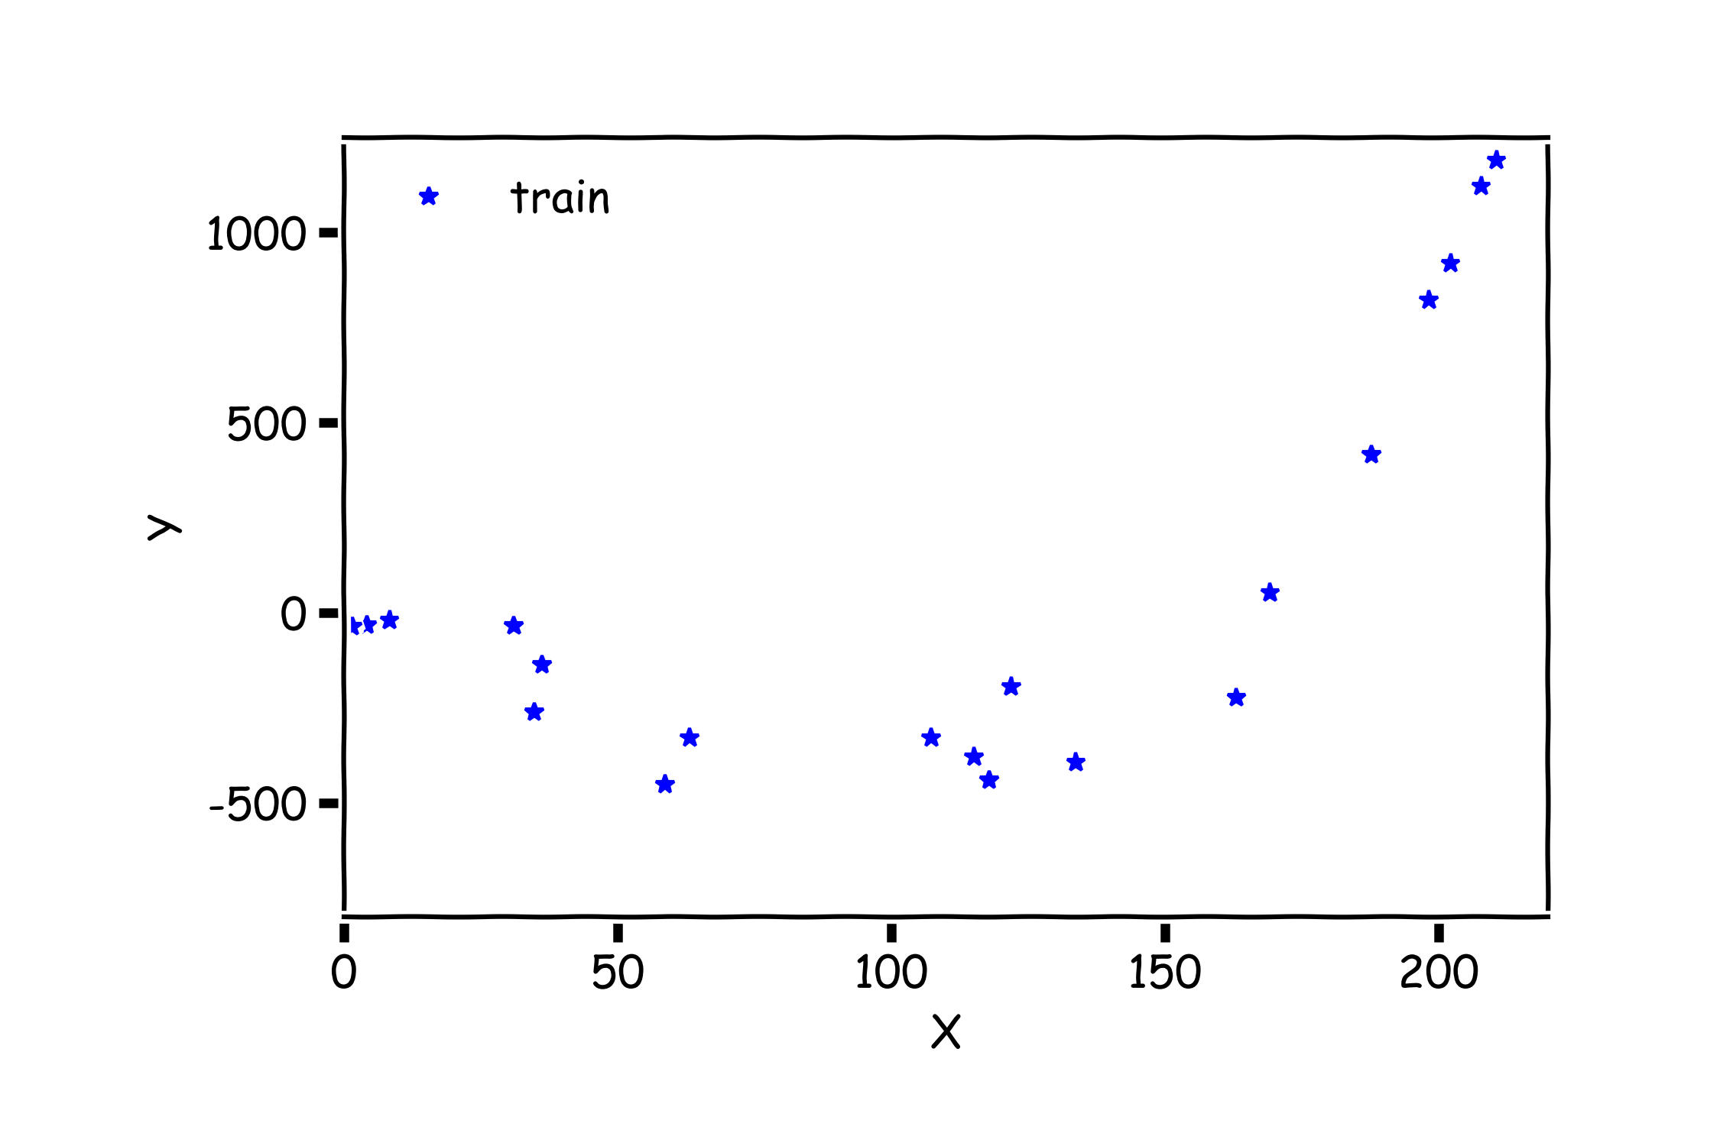
Cross Validation

Slide 15
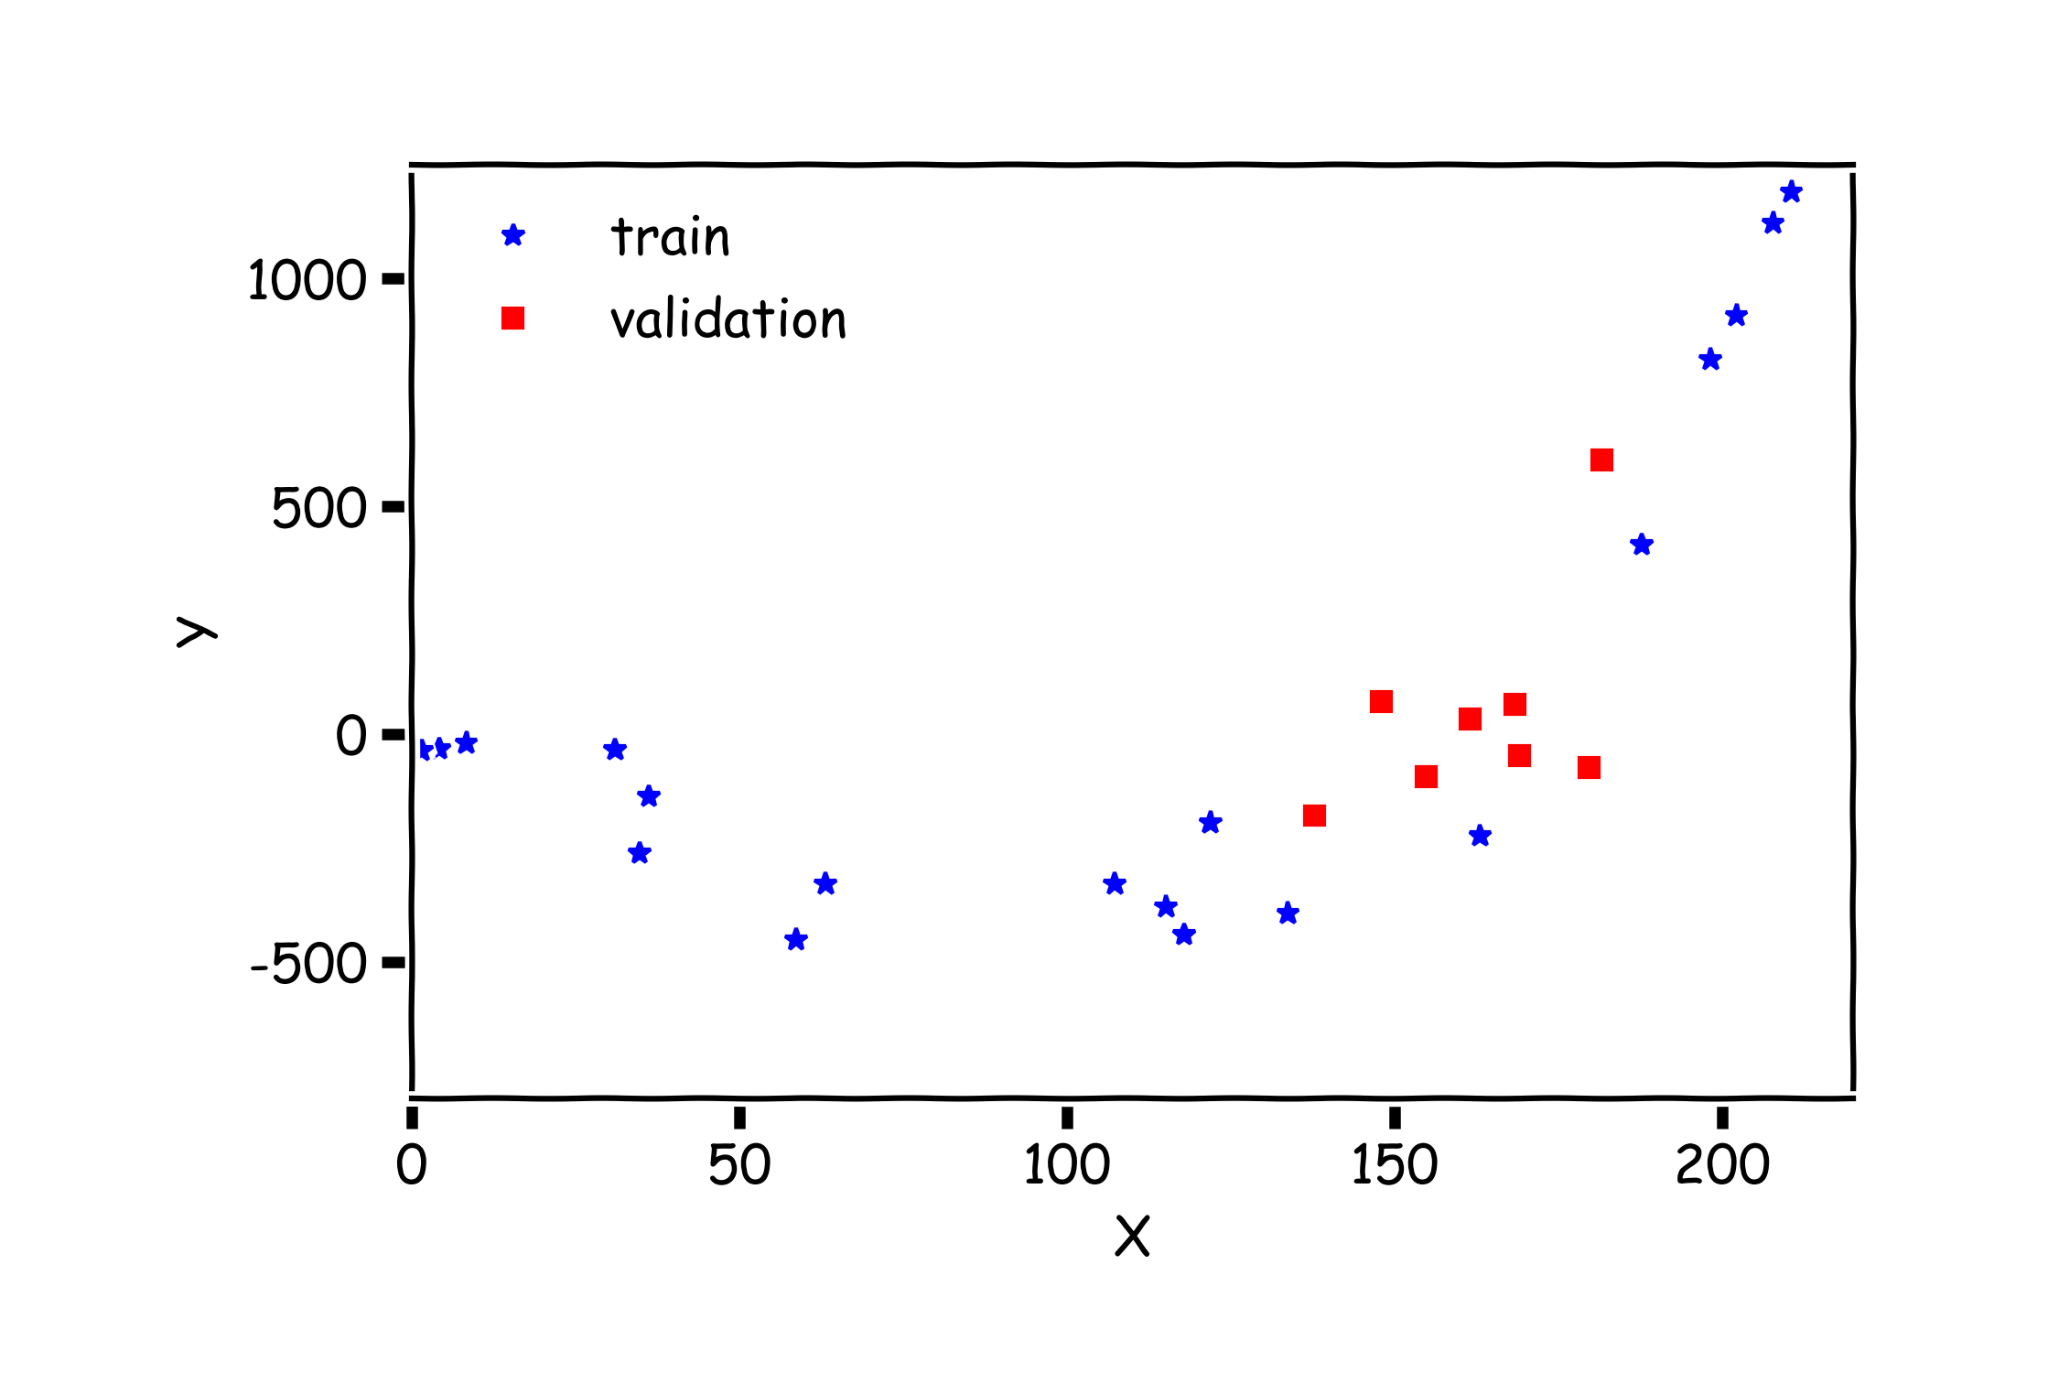
Cross Validation

Slide 16
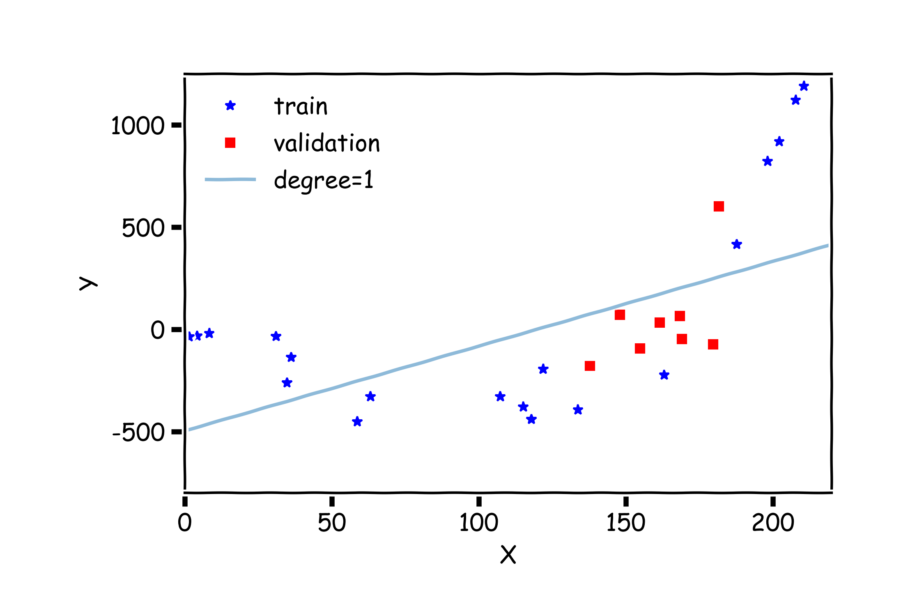
Cross Validation

Slide 17
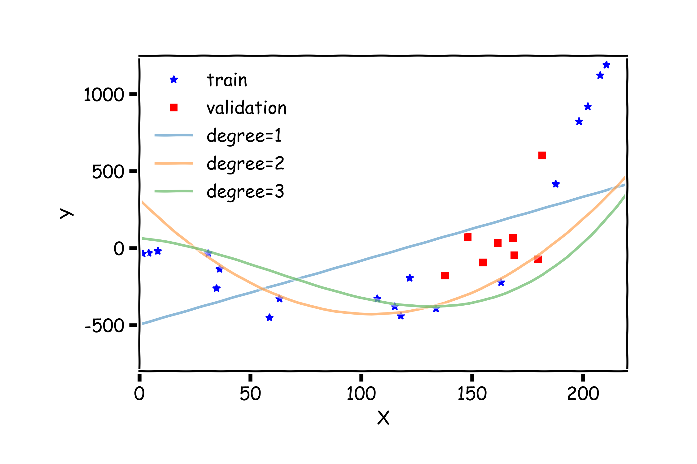
Cross Validation

Slide 18
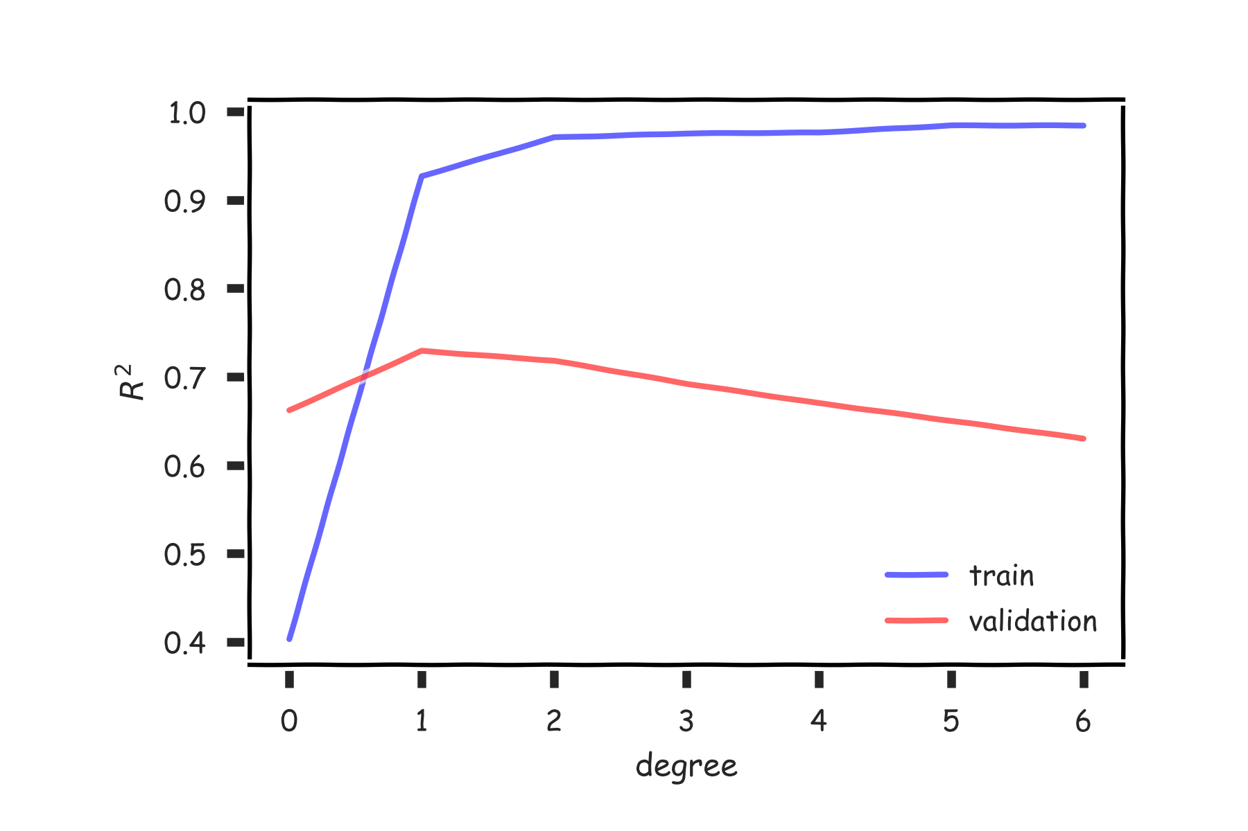
Validation

Slide 19
Cross Validation: Motivation
Using a single validation set to select amongst multiple models can be problematic - there is the possibility of overfitting to the validation set.
One solution to the problems raised by using a single validation set is to evaluate each model on multiple validation sets and average the validation performance.
One can randomly split the training set into training and validation multiple times but randomly creating these sets can create the scenario where important features of the data never appear in our random draws.

Slide 20
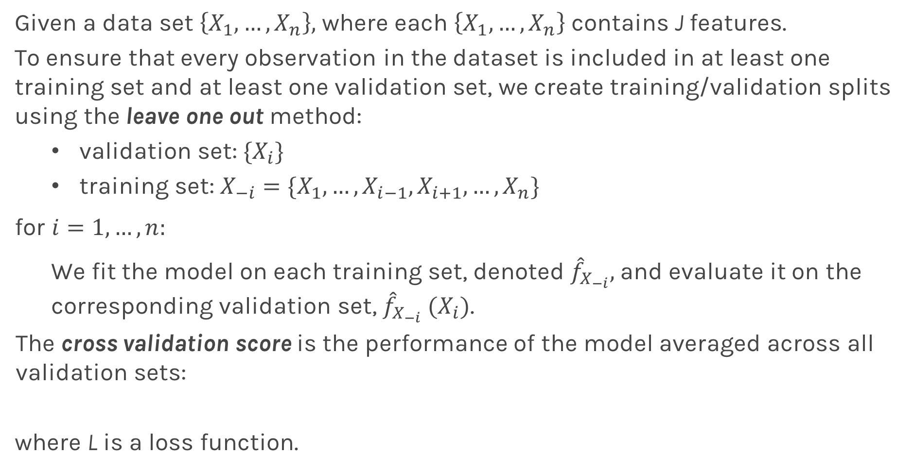
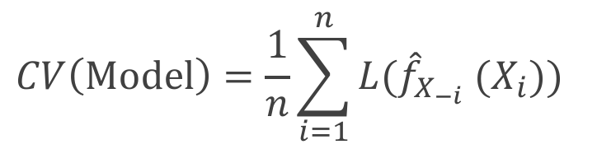
Leave-One-Out
Given a data set $\left\{X_{1},…,X_{n}\right\},$ where each $\left\{X_{1},…,X_{n}\right\}$ contains J features.
To ensure that every observation in the dataset is included in at least one training set and at least one validation set, we create training/validation splits using the leave one out method:
  validation set: ${\{X}_{i}\}$
  training set: $X_{−i}=\{X_{1}, …,X_{i−1},X_{i+1}, …, X_{n}\}$
for ${i=1,…,n: }_{}$
We fit the model on each training set, denoted ${\hat{f}}_{X_{−i}},$and evaluate it on the corresponding validation set, ${\hat{f}}_{X_{−i}} (X_{i})$.
The cross validation score is the performance of the model averaged across all validation sets:
where L is a loss function.
$$CV\left(Model\right)=\frac{1}{n}\sum_{i=1}^{n}{{L(\hat{f}}_{X_{−i}} (X_{i})\text{)} }$$

Slide 21
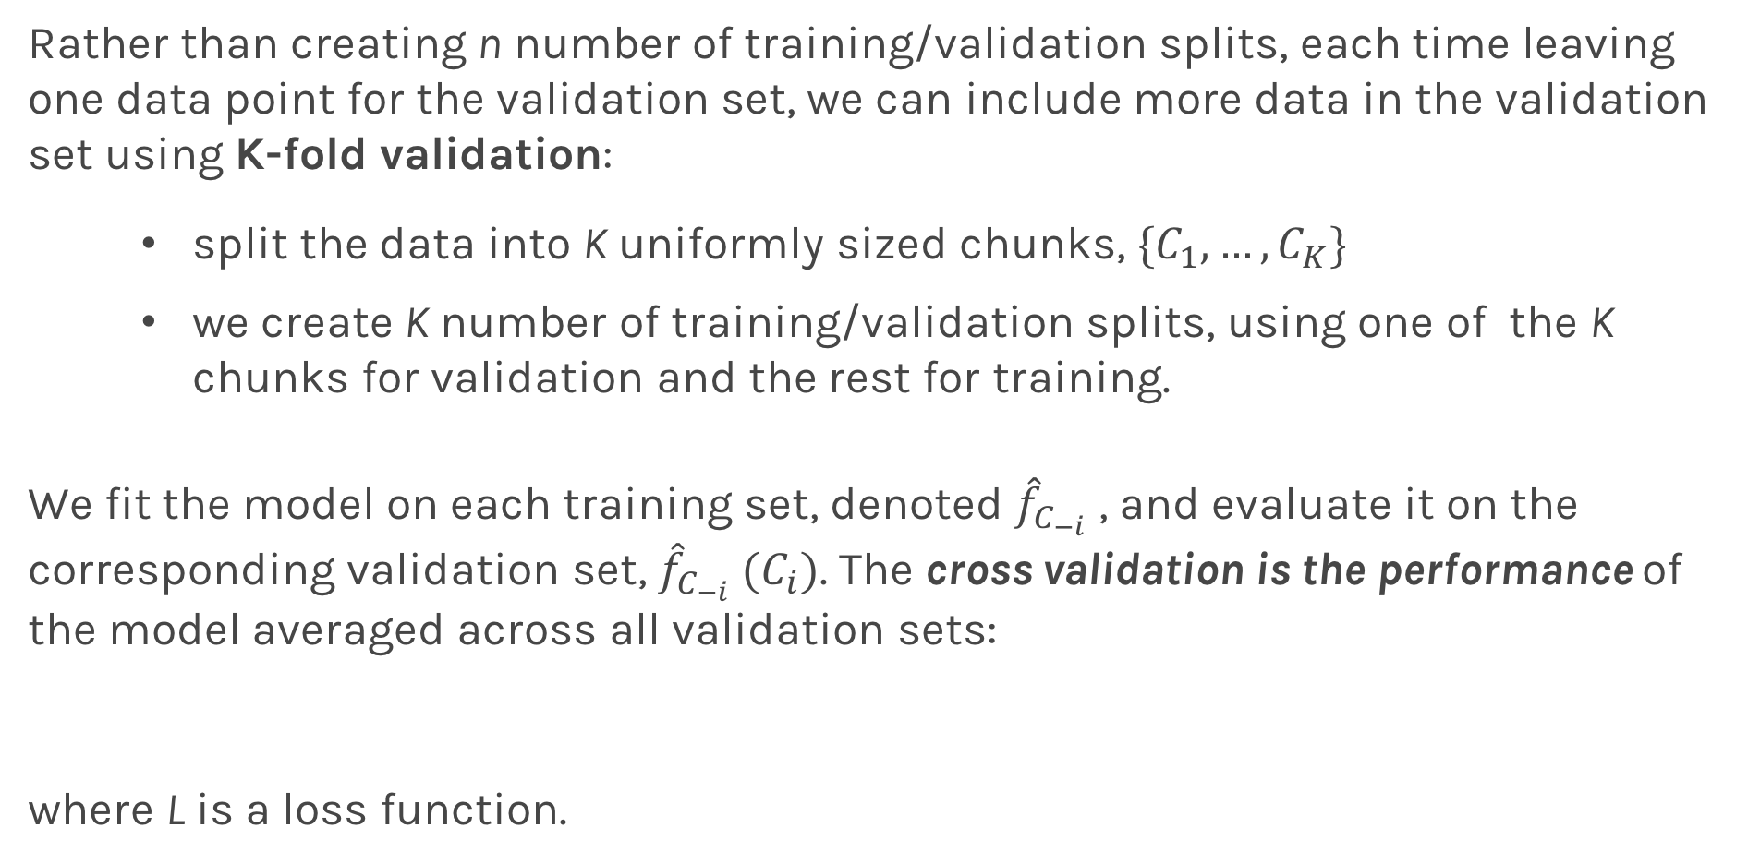
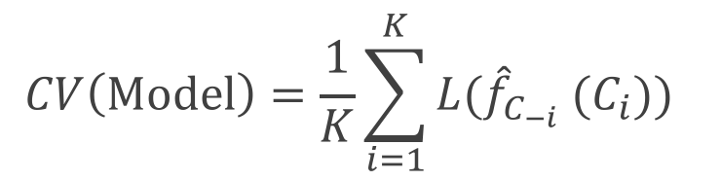
K-Fold Cross Validation
Rather than creating n number of training/validation splits, each time leaving one data point for the validation set, we can include more data in the validation set using K-fold validation:
  split the data into K uniformly sized chunks, $\{C_{1},…,C_{K}\}$
  we create K number of training/validation splits, using one of the K chunks for validation and the rest for training.
We fit the model on each training set, denoted ${\hat{f}}_{C_{−i}}$ , and evaluate it on the corresponding validation set, ${\hat{f}}_{C_{−i}} (C_{i})$. The cross validation is the performance of the model averaged across all validation sets:
where L is a loss function.
$$CV\left(Model\right)=\frac{1}{K}\sum_{i=1}^{K}{{L(\hat{f}}_{C_{−i}} (C_{i})\text{)} }$$

Slide 22
Cross Validation

Slide 23
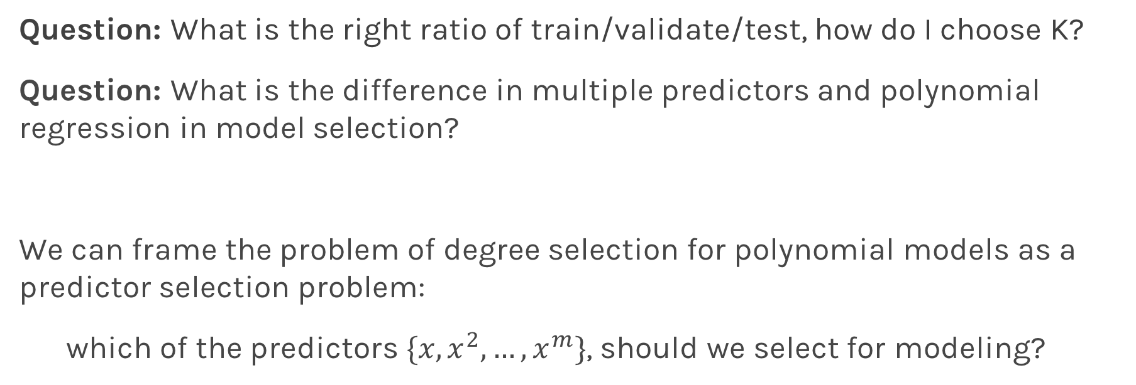
Predictor Selection: Cross Validation
Question: What is the right ratio of train/validate/test, how do I choose K?
Question: What is the difference in multiple predictors and polynomial regression in model selection?
We can frame the problem of degree selection for polynomial models as a predictor selection problem:
which of the predictors $\{x, x^{2},…, x^{m}\}$, should we select for modeling?

Slide 24
kNN Revisited
Recall our first simple, intuitive, non-parametric model for regression - the kNN model. We saw that it is vitally important to select an appropriate k for the data.
If the k is too small then the model is very sensitive to noise (since a new prediction is based on very few observed neighbors), and if the k is too large, the model tends towards making constant predictions.

Slide 25
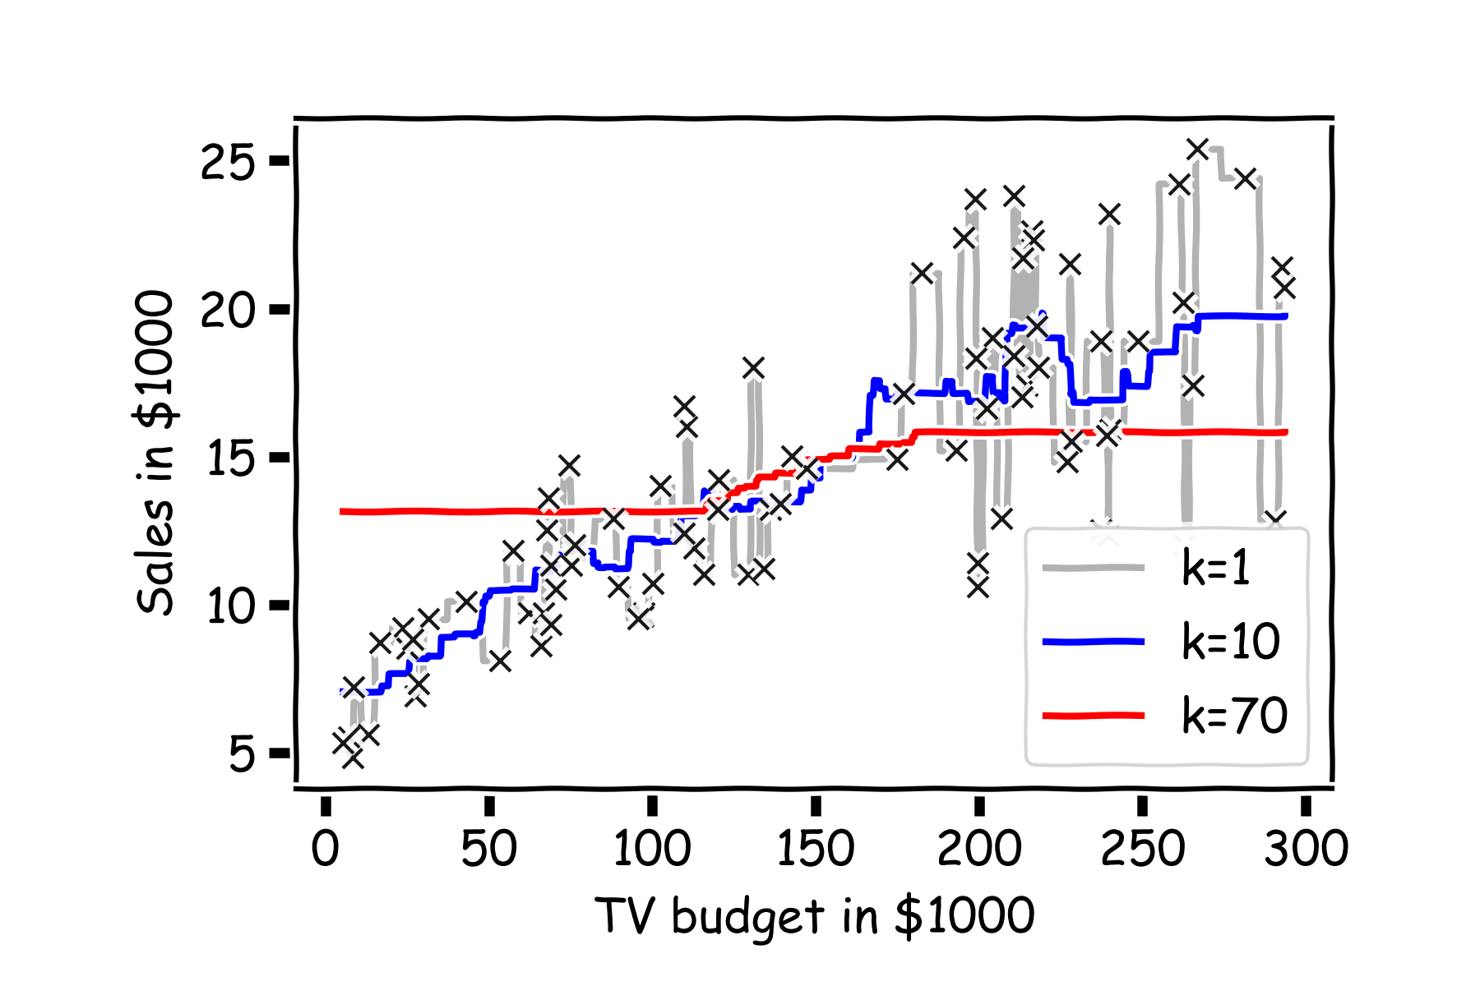
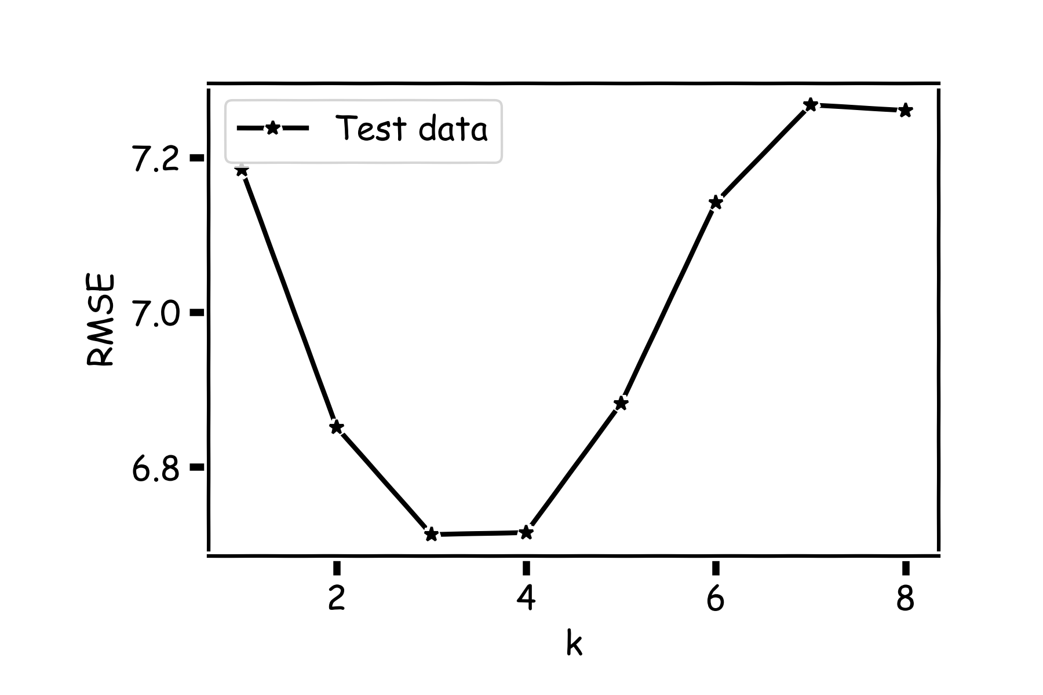
kNN Revisited

Slide 26
kNN Revisited
Recall our first simple, intuitive, non-parametric model for regression - the kNN model. We saw that it is vitally important to select an appropriate k for the data.
If the k is too small then the model is very sensitive to noise (since a new prediction is based on very few observed neighbors), and if the k is too large, the model tends towards making constant predictions.
A principled way to choose k is through K-fold cross validation.

Slide 27
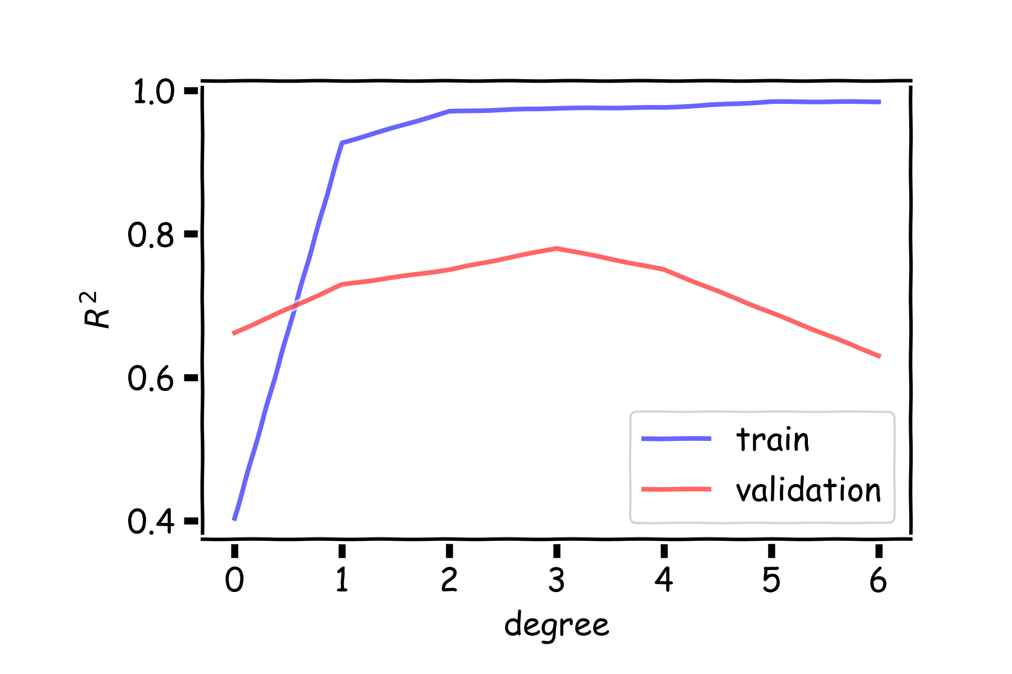
K-Fold with k=100

Slide 28
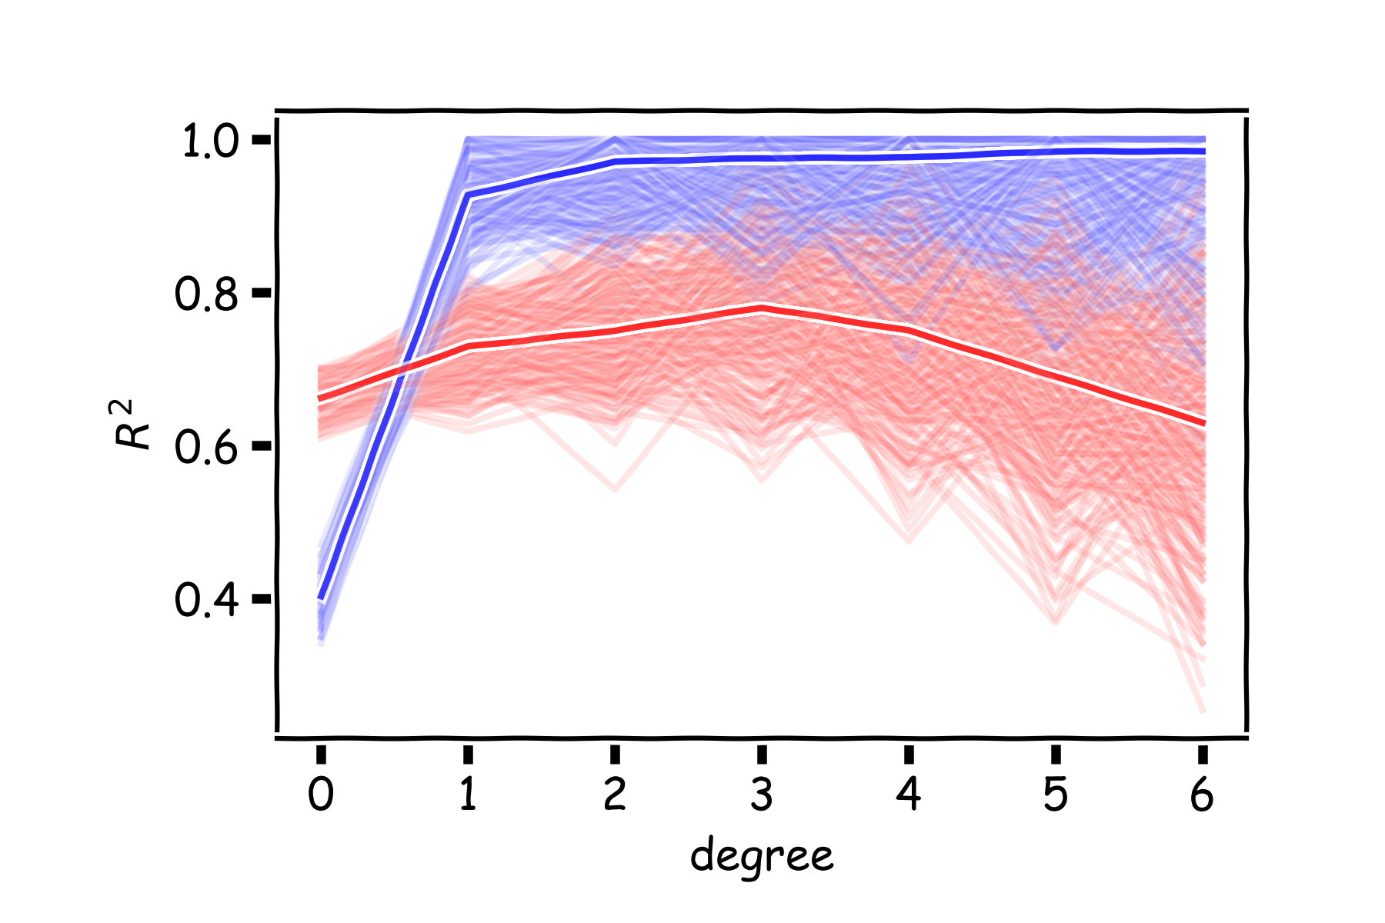
K-fold with k=100

Slide 29
Bias vs Variance

Slide 32
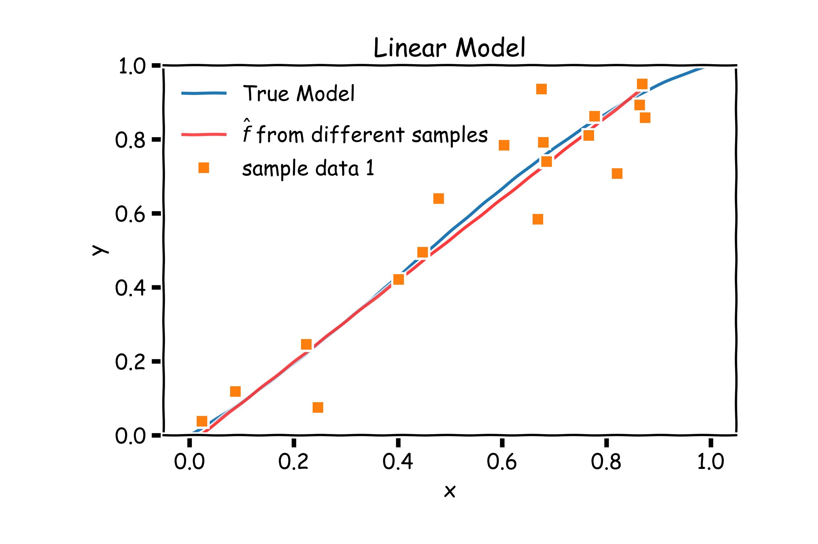
Bias vs Variance

Slide 33
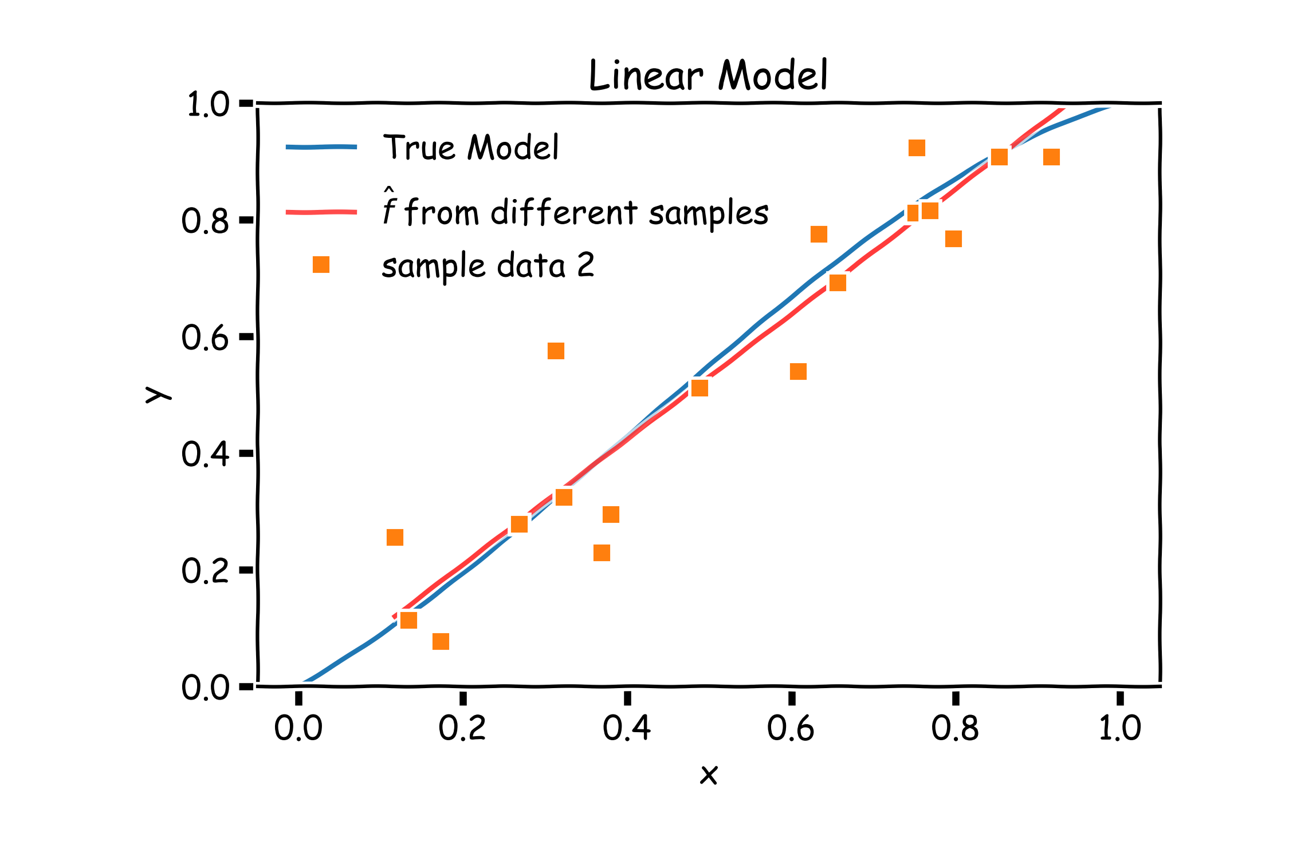
Bias vs Variance

Slide 34
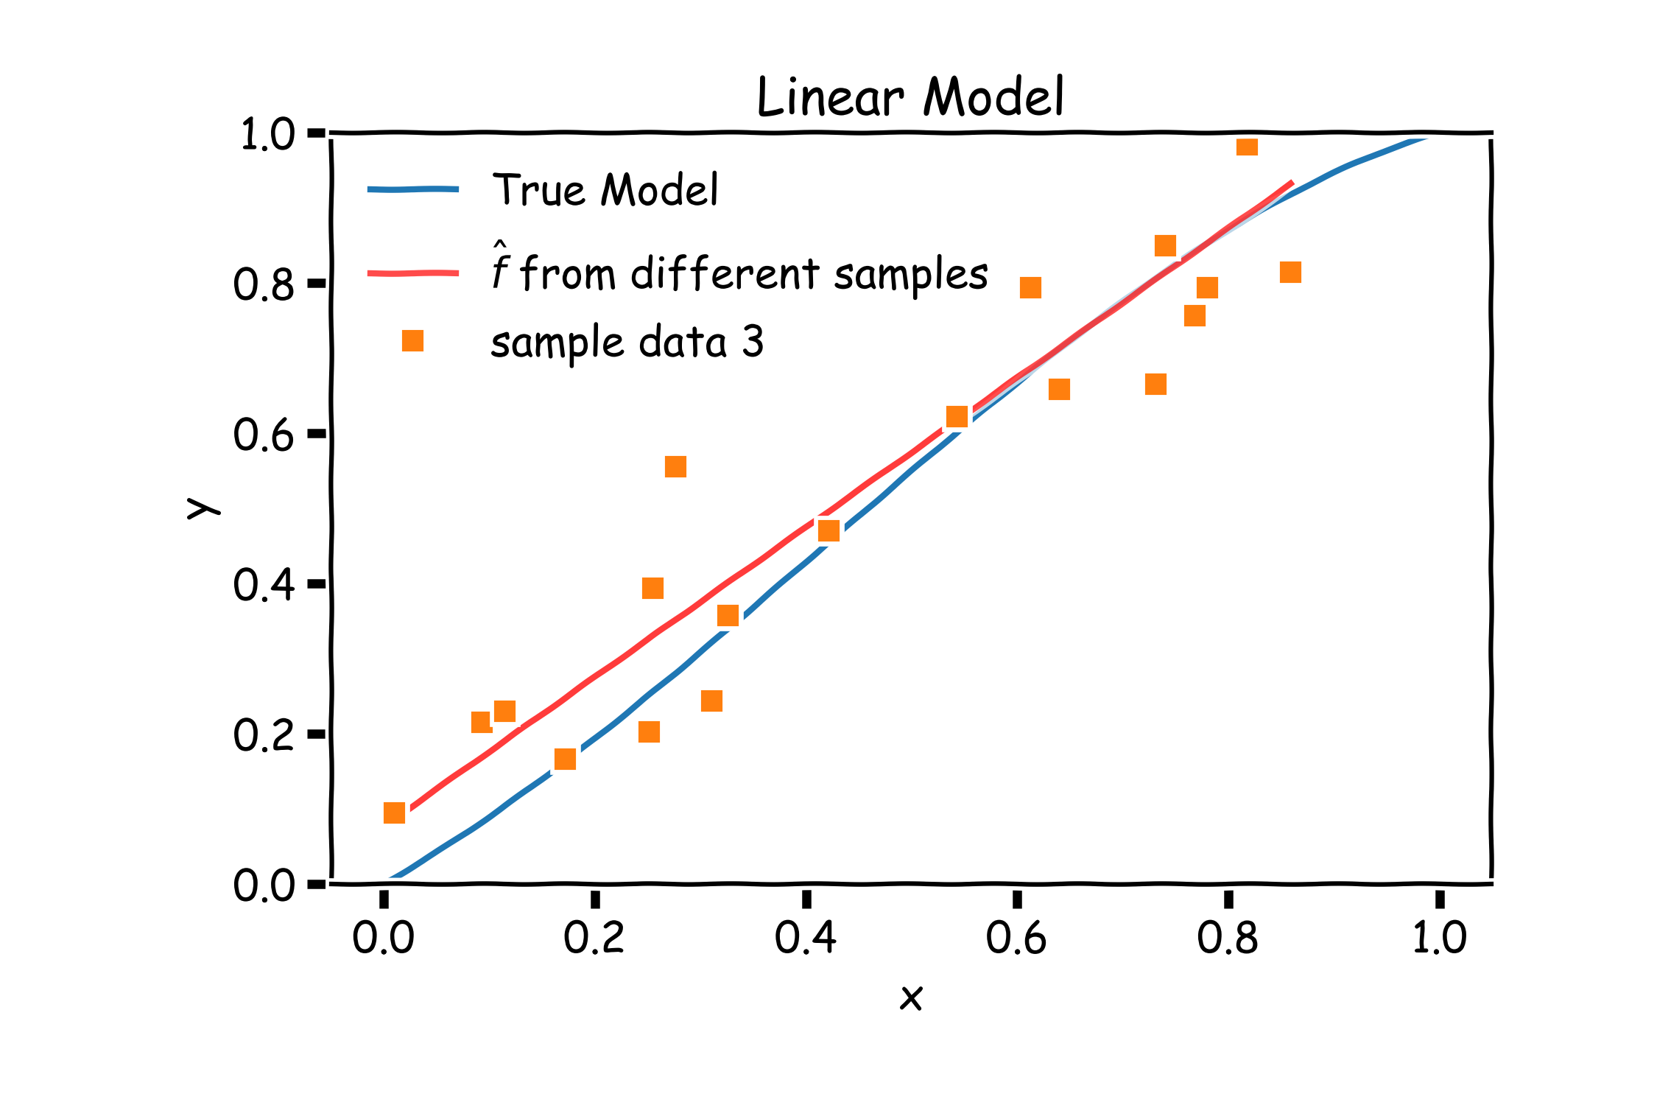
Bias vs Variance

Slide 35
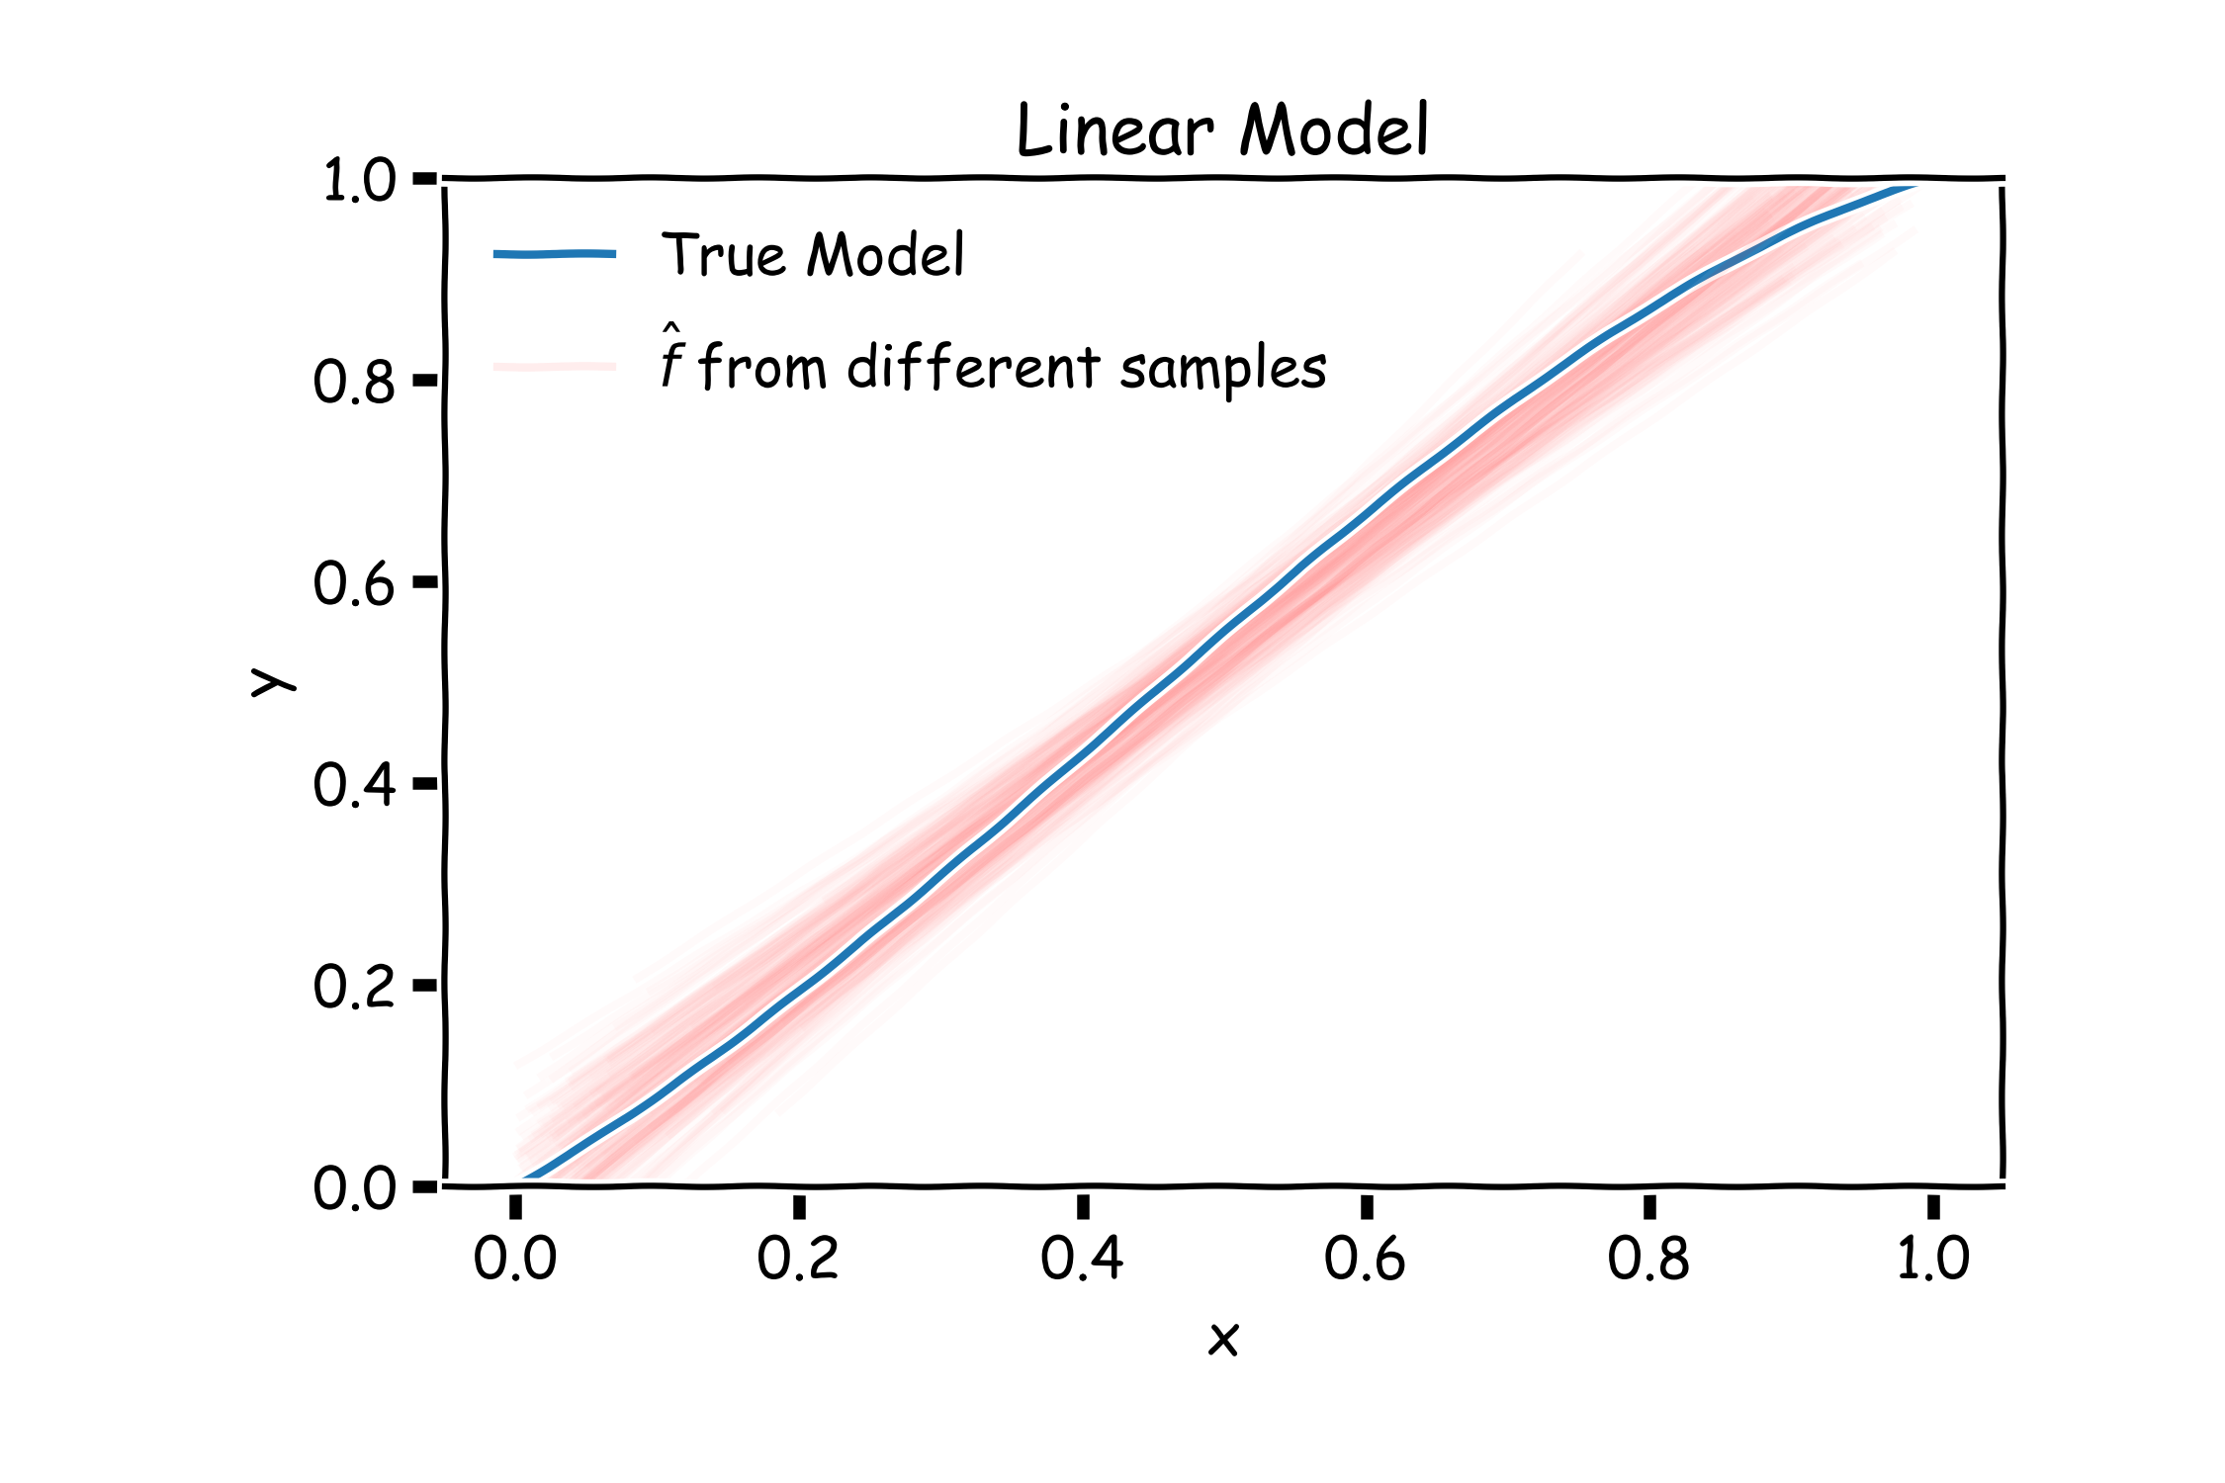
Linear models: 20 data points per line 2000 simulations

Slide 36
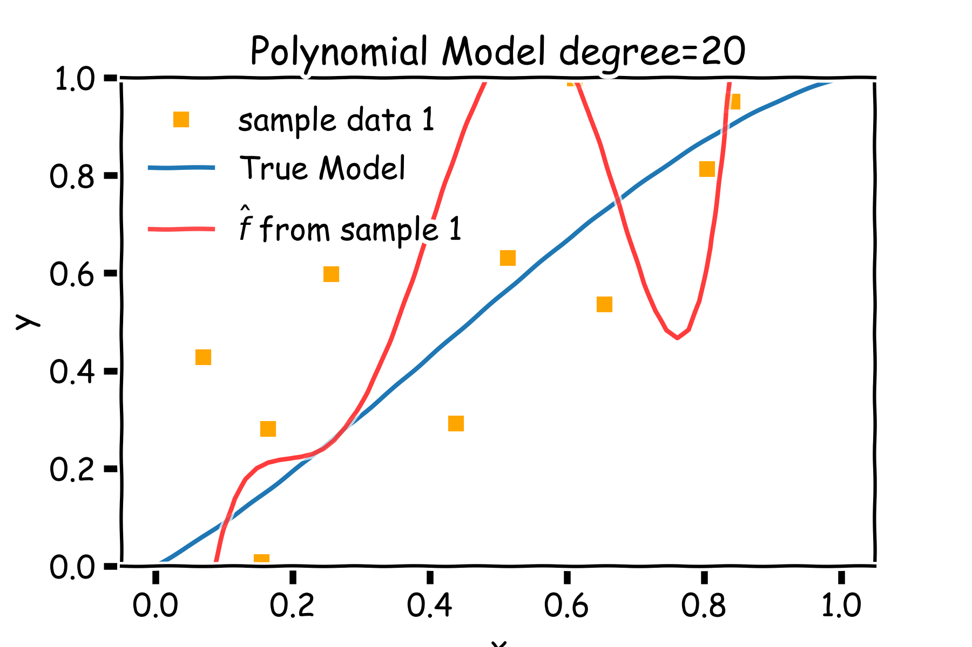
Bias vs Variance

Slide 37
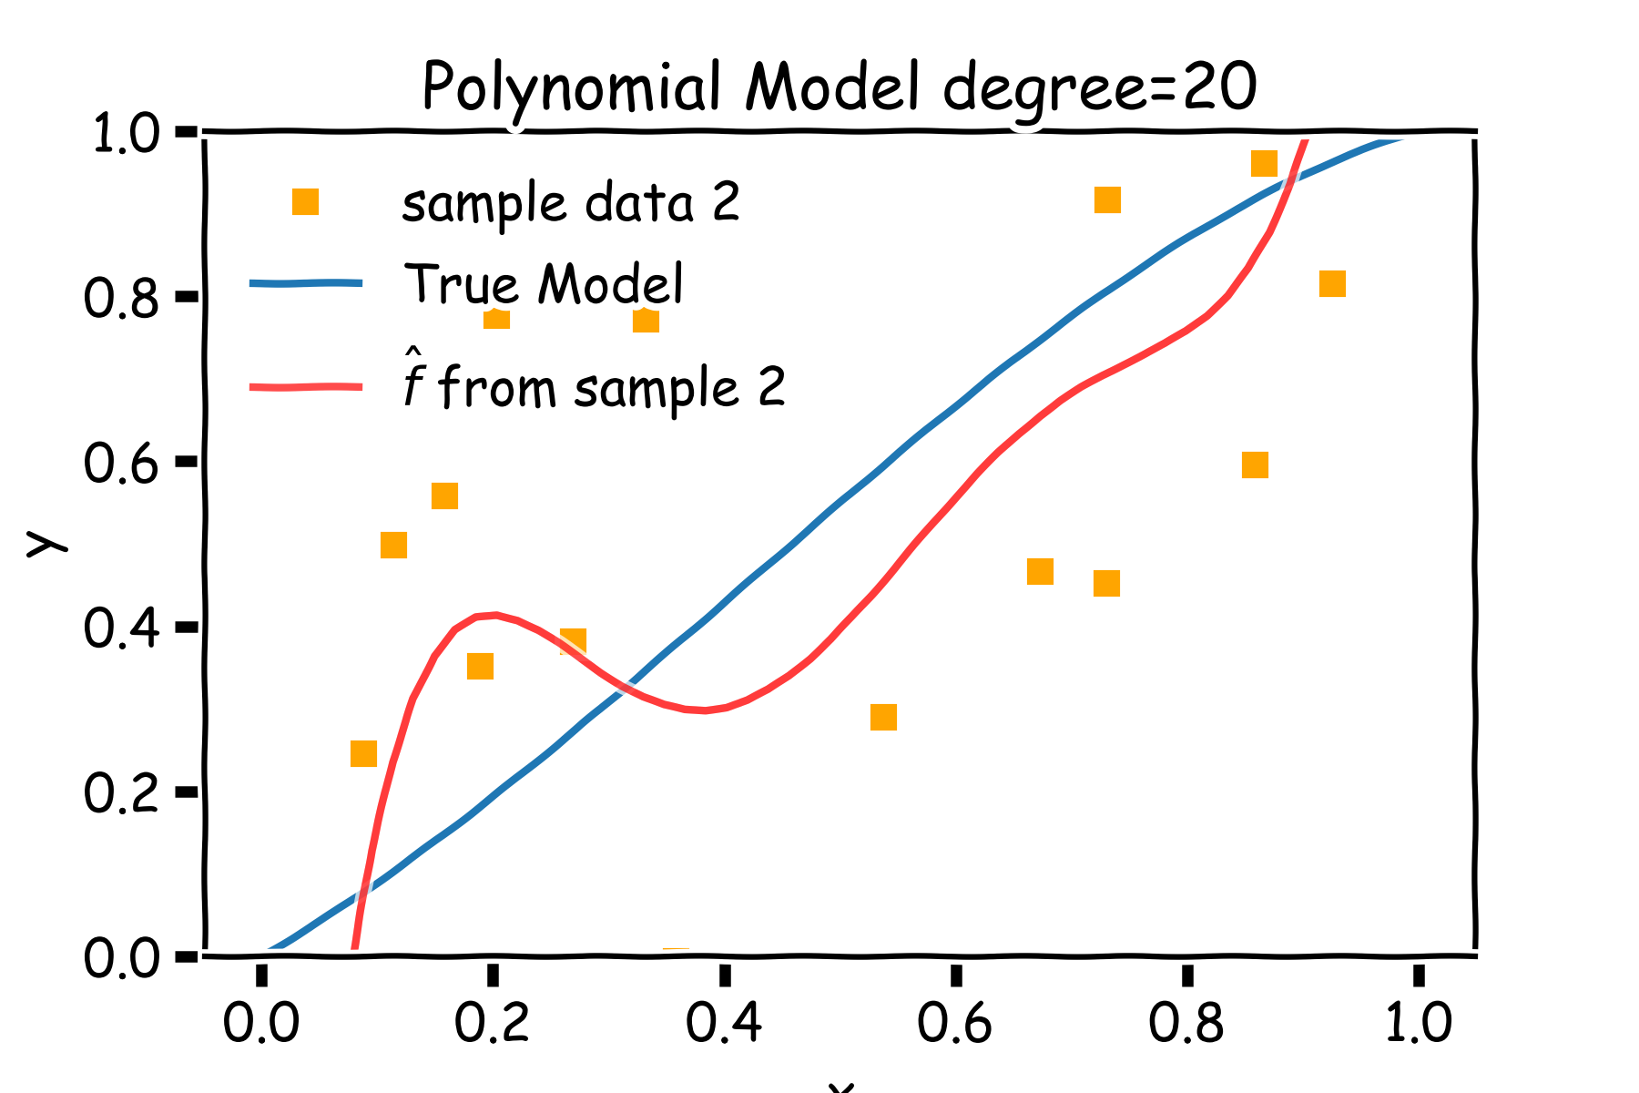
Bias vs Variance

Slide 38
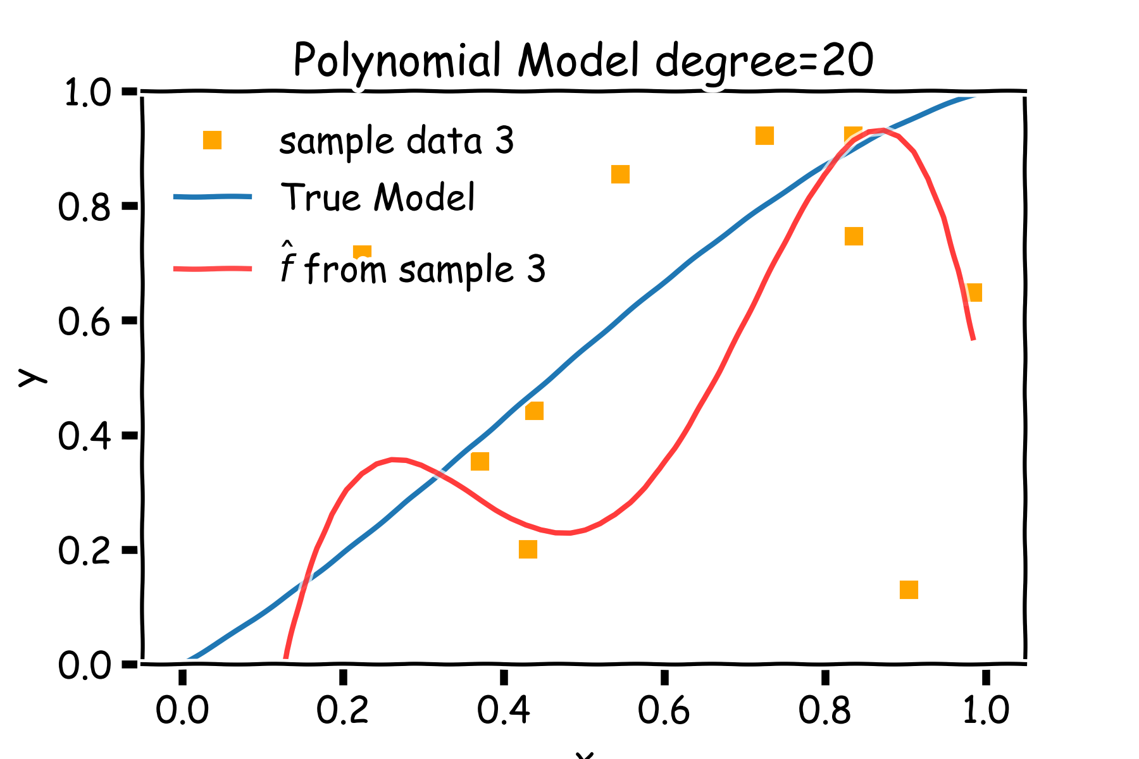
Bias vs Variance

Slide 39
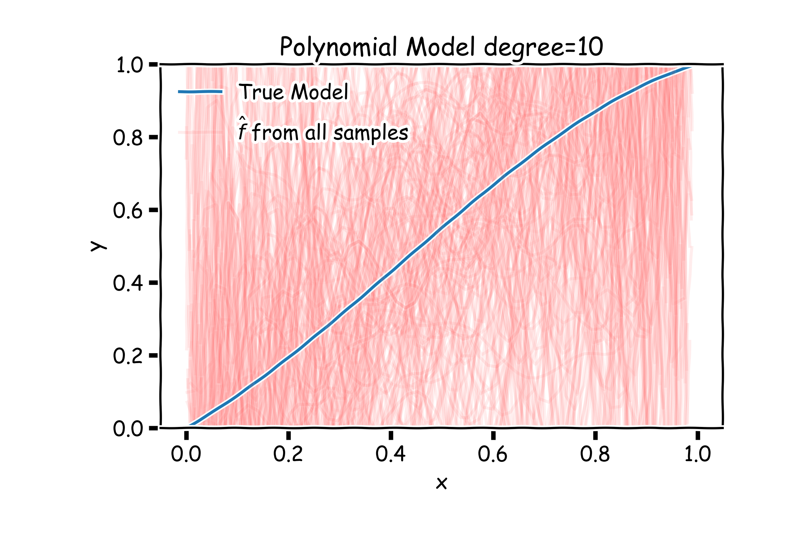
Poly 10 degree models : 20 data points per line 2000 simulations

Slide 40
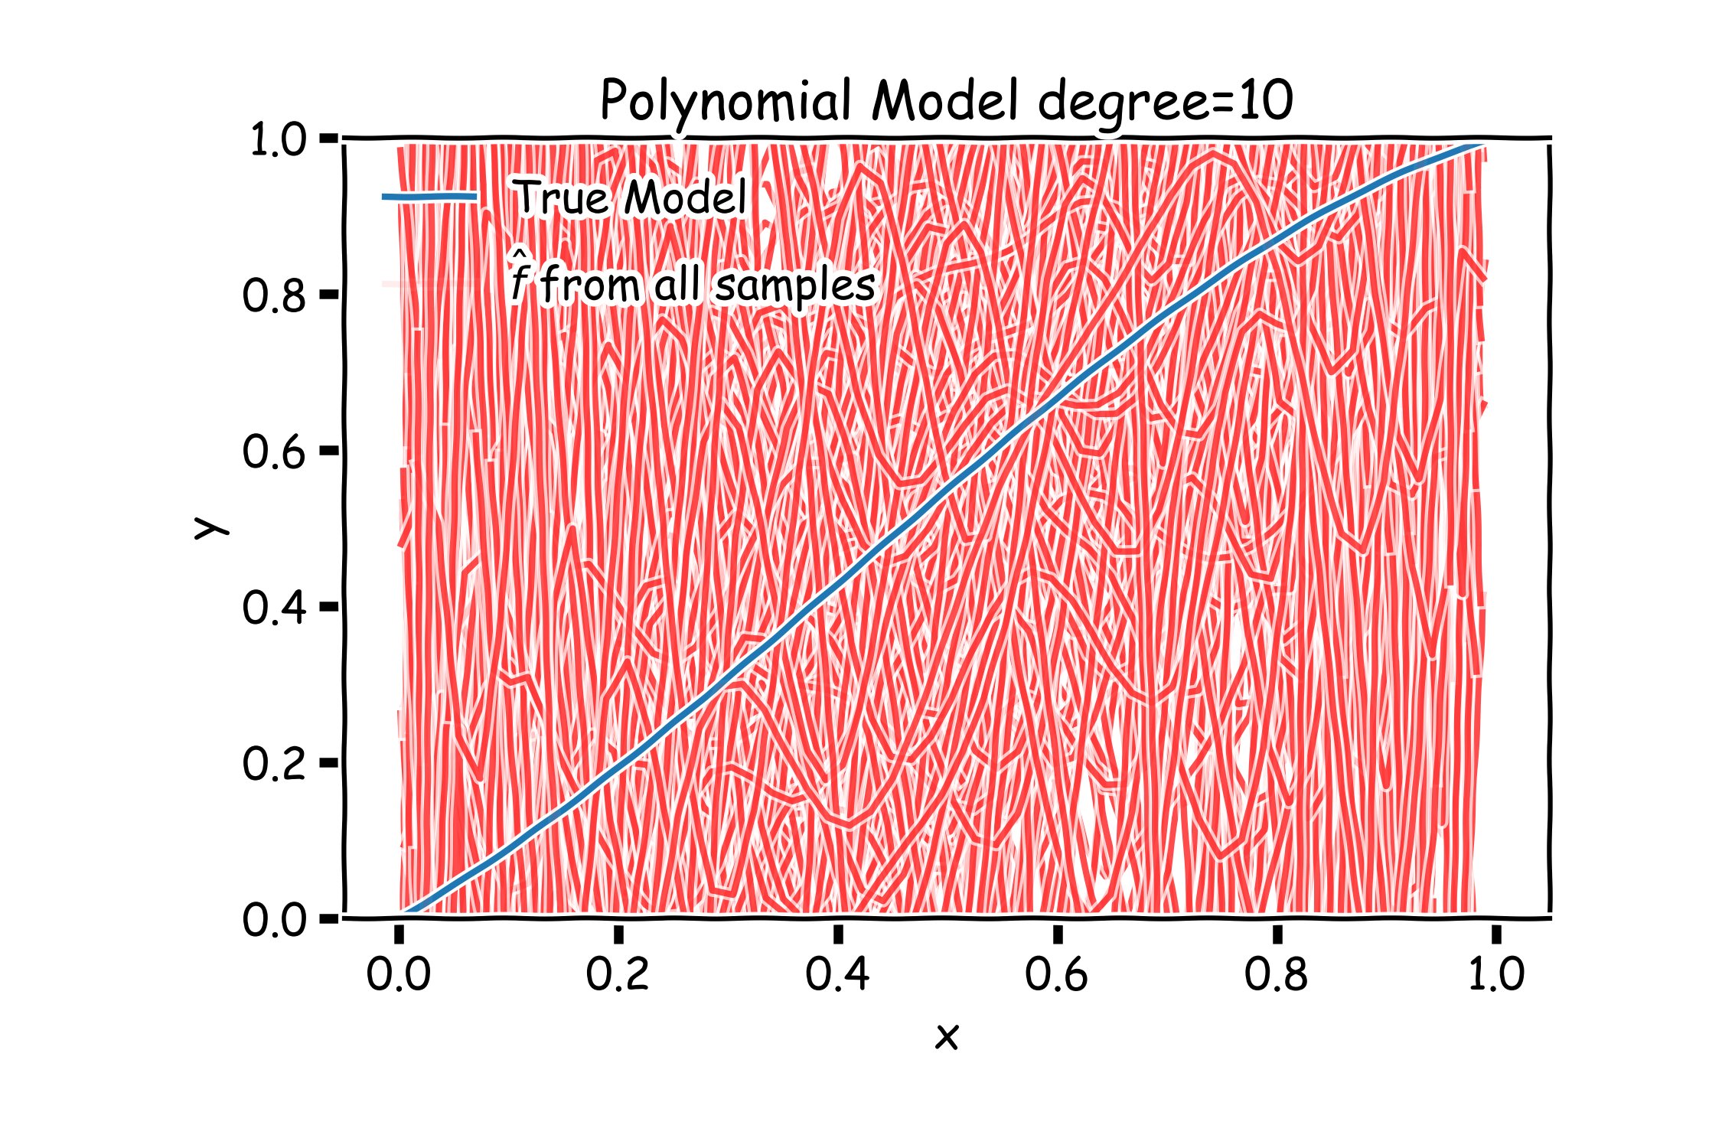
Spaghetti plot

Slide 41
Bias vs Variance
Left: 2000 best fit straight lines, each fitted on a different 20 point training set.
Right: Best-fit models using degree 10 polynomial

Slide 42
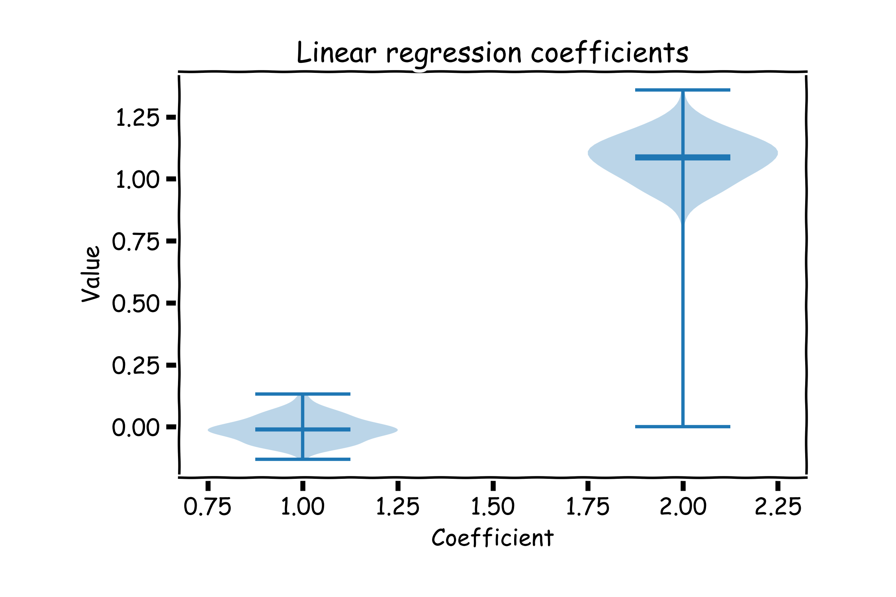
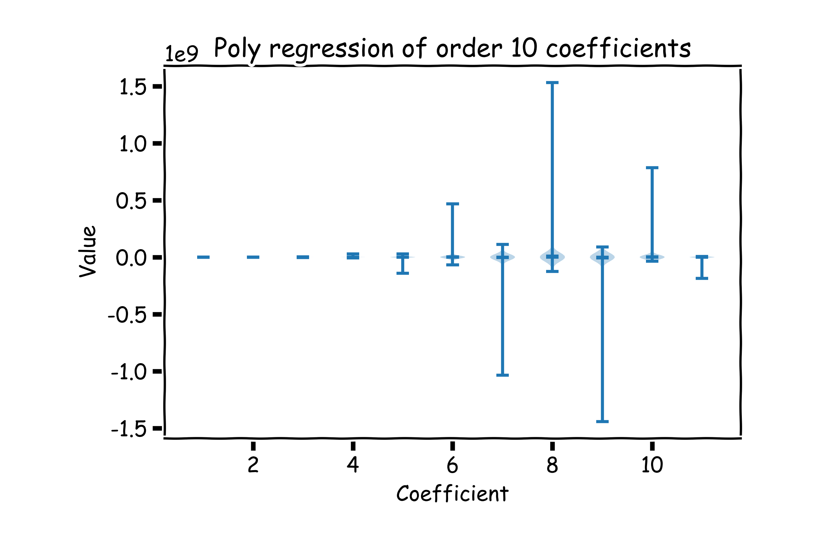
Bias vs Variance
Left: Linear regression coefficients
Right: Poly regression of order 10 coefficients

Slide 43
Regularization: LASSO and Ridge

Slide 44
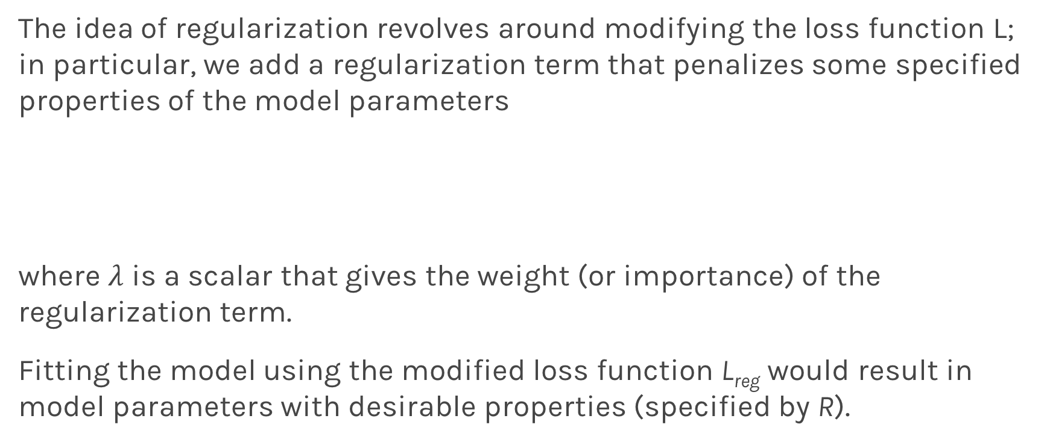
Regularization: An Overview
The idea of regularization revolves around modifying the loss function L; in particular, we add a regularization term that penalizes some specified properties of the model parameters
where $λ$ is a scalar that gives the weight (or importance) of the regularization term.
Fitting the model using the modified loss function L_{reg} would result in model parameters with desirable properties (specified by R).

Slide 45
LASSO Regression
Since we wish to discourage extreme values in model parameter, we need to choose a regularization term that penalizes parameter magnitudes. For our loss function, we will again use MSE.
Together our regularized loss function is:
Note that is the l₁ norm of the vector β

Slide 46
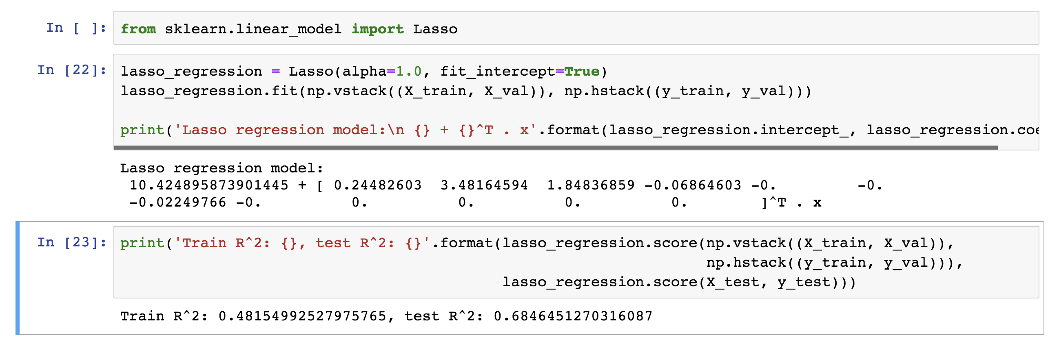
LASSO Regression
Hence, we often say that L_{LASSO} is the loss function for l₁ regularization.
Finding the model parameters β_{LASSO} that minimize the l₁ regularized loss function is called LASSO regression.

Slide 47
Ridge Regression
Alternatively, we can choose a regularization term that penalizes the squares of the parameter magnitudes. Then, our regularized loss function is:
Note that is the l₂ norm of the vector β

Slide 48
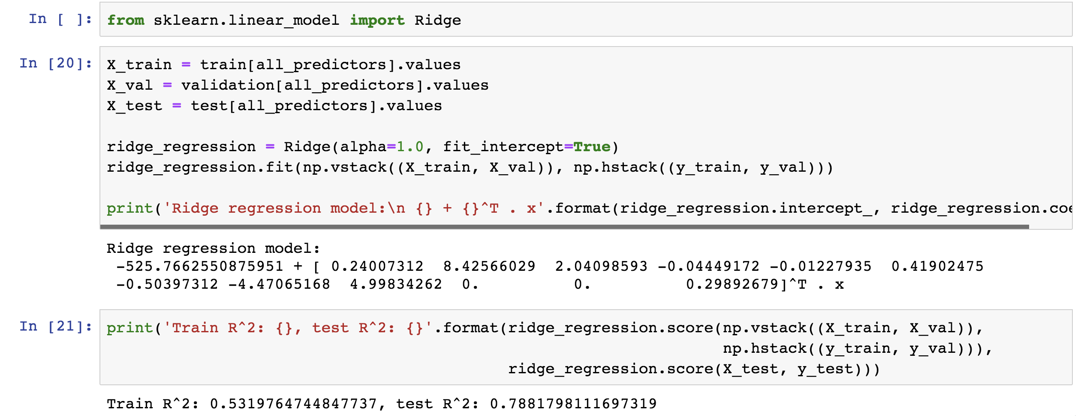
Ridge Regression
Hence, we often say that L_{ridge} is the loss function for l₂ regularization.
Finding the model parameters β_{ridge} that minimize the l₂ regularized loss function is called ridge regression.

Slide 49
Choosing λ
In both ridge and LASSO regression, we see that the larger our choice of the regularization parameter λ, the more heavily we penalize large values in β,
If λ is close to zero, we recover the MSE, i.e. ridge and LASSO regression is just ordinary regression.
If λ is sufficiently large, the MSE term in the regularized loss function will be insignificant and the regularization term will force β_{ridge} and β_{LASSO} to be close to zero.
To avoid ad-hoc choices, we should select λ using cross-validation.

Slide 50
Ridge - Computational complexity
Solution to ridge regression:
The solution of the Ridge/Lasso regression involves three steps
Select λ
Find the minimum of the ridge/Lasso regression cost function (using linear algebra) as with the multiple regression and record the R² on the test set.
Find the λ that gives the largest R²

Slide 51


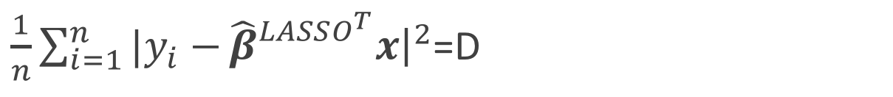





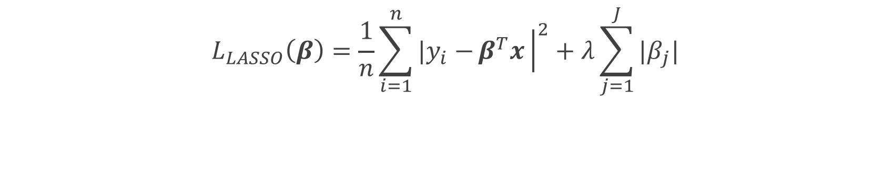
The Geometry of Regularization (LASSO)
$$L_{LASSO}\left(β\right)=\frac{1}{n}\sum_{i=1}^{n}{|y_{i}−}β^{T}x{\left.​\right|}^{2}+λ\sum_{j=1}^{J}{|β_{j}|}$$
$${\hat{β}}^{LASSO}=argmin{L_{LASSO}\left(β\right)}$$
$$λ\sum_{j=1}^{J}{\left| {\hat{β}}_{j}^{LASSO}\right|=C}$$
$\frac{1}{n}\sum_{i=1}^{n}{|y_{i}−}{\hat{β}}_{}^{LASSO^{T}}x{\left.​\right|}^{2}$=D
$$β_{2}$$
$$β_{2}$$
C
$${\hat{β}}^{MSE}$$
MSE=D
C
$$β_{1}$$
$$β_{1}$$

Slide 52

The Geometry of Regularization (LASSO)
$$β_{2}$$
$$β_{2}$$
$$β_{2}$$
$${\hat{β}}^{MSE}$$
MSE=D
C
C
$${\hat{β}}^{MSE}$$
MSE=D
C
C
$$β_{1}$$
$$β_{1}$$
$$β_{1}$$

Slide 53
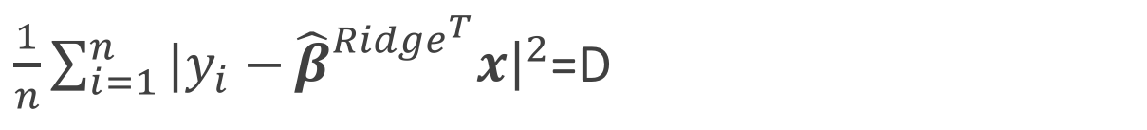



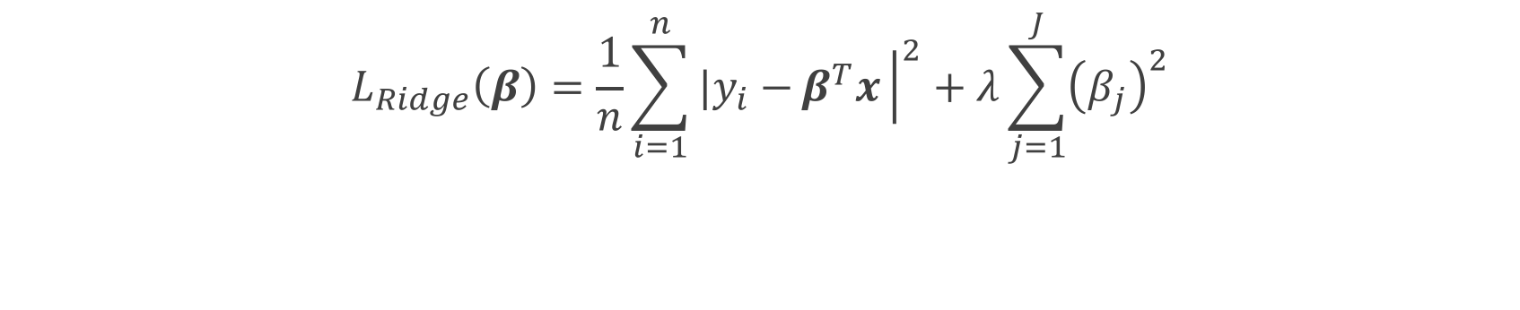
The Geometry of Regularization (Ridge)
$$L_{Ridge}\left(β\right)=\frac{1}{n}\sum_{i=1}^{n}{|y_{i}−}β^{T}x{\left.​\right|}^{2}+λ\sum_{j=1}^{J}{{\left(β_{j}\right)}^{2}}$$
$${\hat{β}}^{Ridge}=argmin{L_{Ridge}\left(β\right)}$$
$$λ\sum_{j=1}^{J}{{\left|{\hat{β}}_{j}^{Ridge}\right|}^{2}=C}$$
$\frac{1}{n}\sum_{i=1}^{n}{|y_{i}−}{\hat{β}}_{}^{{Ridge}^{T}}x{\left.​\right|}^{2}$=D
$$β_{2}$$
$$β_{2}$$
$${\hat{β}}^{MSE}$$
MSE=D
C
$$β_{1}$$
$$β_{1}$$

Slide 54

The Geometry of Regularization (Ridge)
$$β_{2}$$
$${\hat{β}}^{MSE}$$
MSE=D
C
$$β_{1}$$

Slide 55


The Geometry of Regularization
$$β_{2}$$
$$β_{2}$$
$${\hat{β}}^{MSE}$$
MSE=D
$${\hat{β}}^{MSE}$$
MSE=D
C
C
C
$$β_{1}$$
$$β_{1}$$

Slide 56
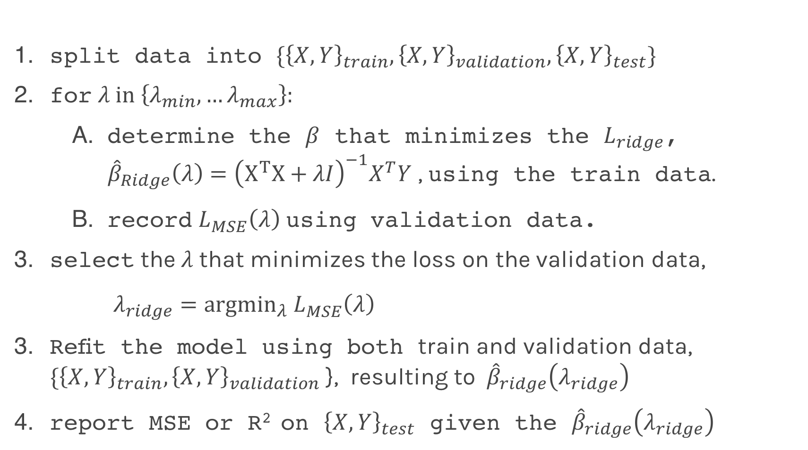
Ridge regularization with validation only: step by step
split data into $\{{\left\{X,Y\right\}}_{train},{\left\{X,Y\right\}}_{validation},{\left\{X,Y\right\}}_{test}\}$
for $λ in \left\{λ_{min},…λ_{max}\right\}:$
  determine the $β$ that minimizes the $L_{ridge}$, ${\hat{β}}_{Ridge}\left(λ\right)={\left(X^{T}X+λI\right)}^{−1}X^{T}Y$ , using the train data.
  record $L_{MSE}^{}\left(λ\right)$ using validation data.
select the $λ$that minimizes the loss on the validation data,
$λ_{ridge}={argmin}_{λ} L_{MSE}^{}\left(λ\right)$
Refit the model using both train and validation data, $\{{\left\{X,Y\right\}}_{train},{\left\{X,Y\right\}}_{validation}$ }, resulting to ${\hat{β}}_{ridge}\left(λ_{ridge}\right)$
report MSE or R² on ${\left\{X,Y\right\}}_{test}$ given the ${\hat{β}}_{ridge}\left(λ_{ridge}\right)$

Slide 57
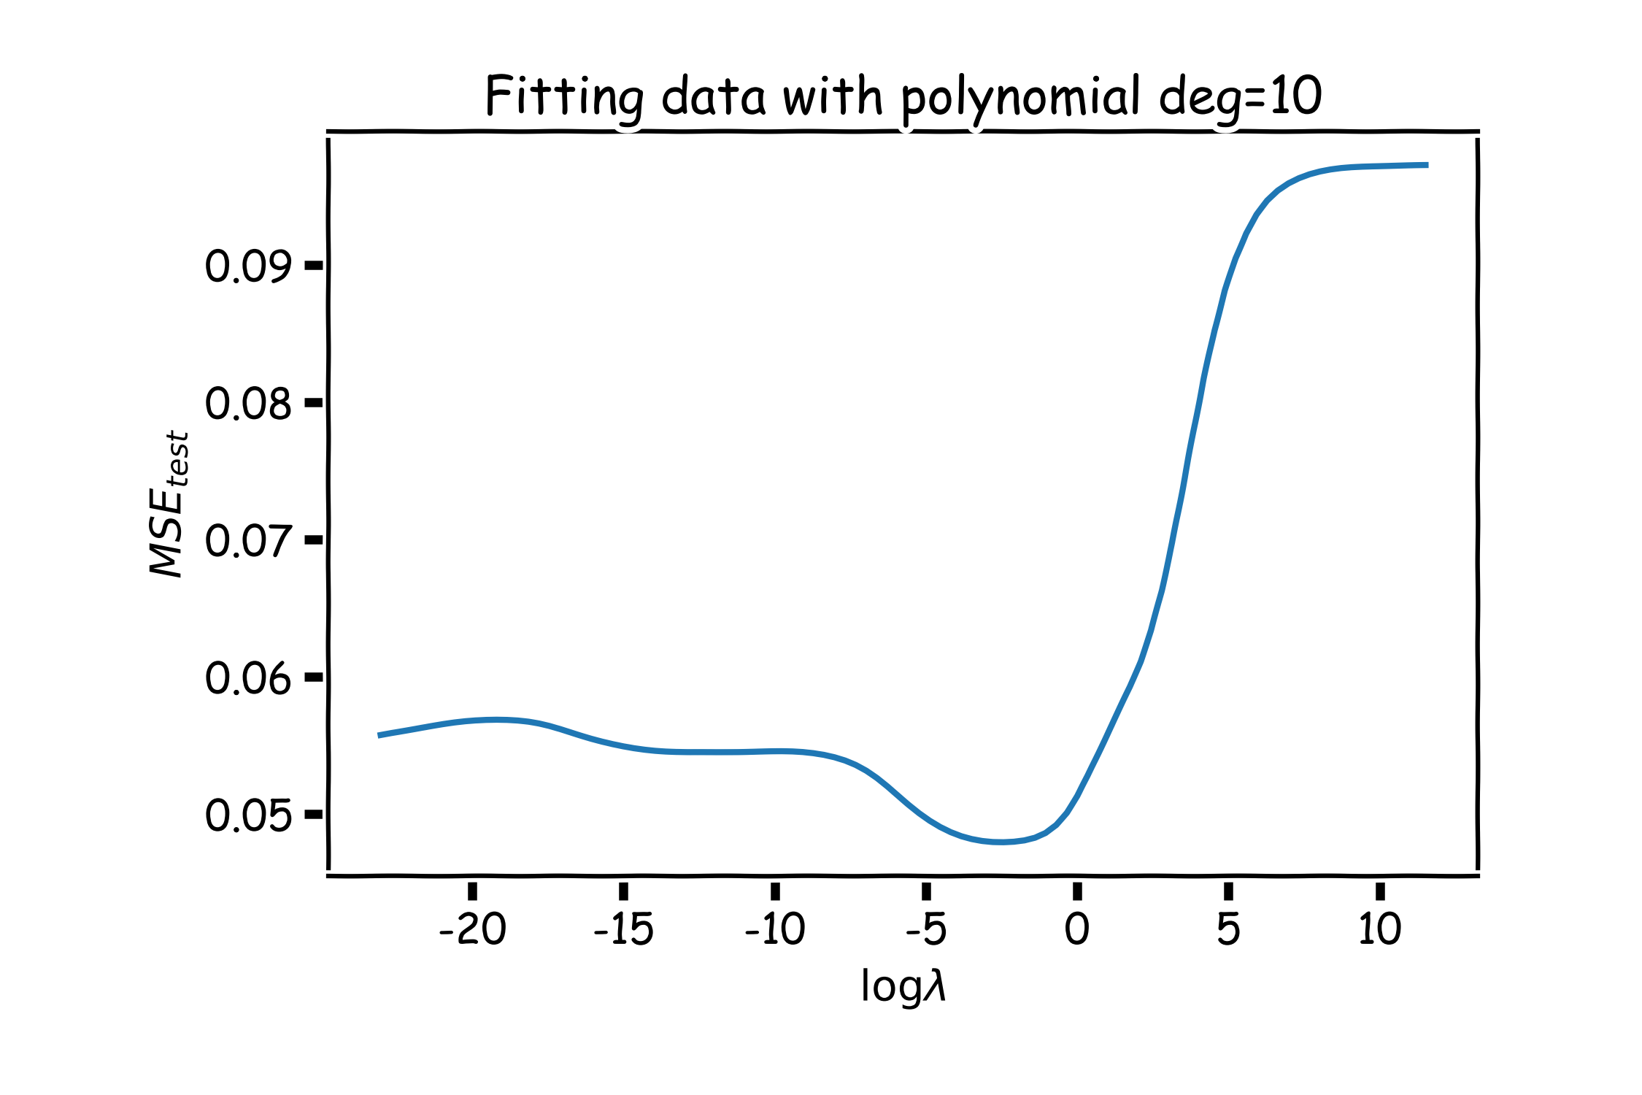
Ridge regularization with validation only: step by step

Slide 58
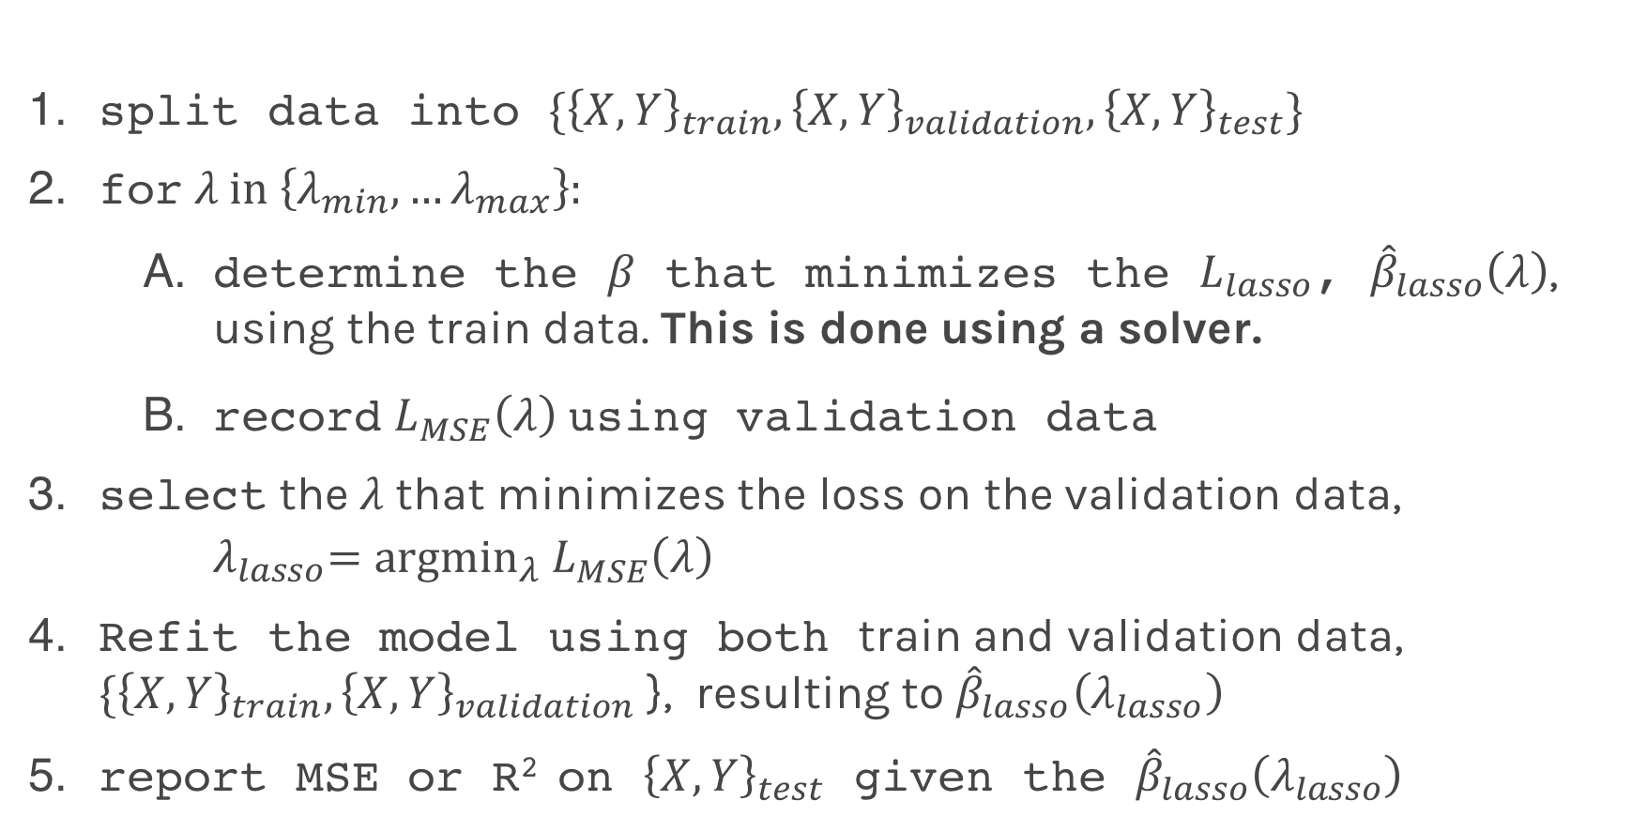
Lasso regularization with validation only: step by step
split data into $\{{\left\{X,Y\right\}}_{train},{\left\{X,Y\right\}}_{validation},{\left\{X,Y\right\}}_{test}\}$
for $λ in \left\{λ_{min},…λ_{max}\right\}:$
  determine the $β$ that minimizes the $L_{lasso}$, ${\hat{β}}_{lasso}\left(λ\right)$, using the train data. This is done using a solver.
  record $L_{MSE}^{}\left(λ\right)$ using validation data
select the $λ$that minimizes the loss on the validation data, ${ λ}_{lasso}={argmin}_{λ} L_{MSE}^{}\left(λ\right)$
Refit the model using both train and validation data, $\{{\left\{X,Y\right\}}_{train},{\left\{X,Y\right\}}_{validation}$ }, resulting to ${\hat{β}}_{lasso}\left(λ_{lasso}\right)$
report MSE or R² on ${\left\{X,Y\right\}}_{test}$ given the ${\hat{β}}_{lasso}\left(λ_{lasso}\right)$

Slide 59
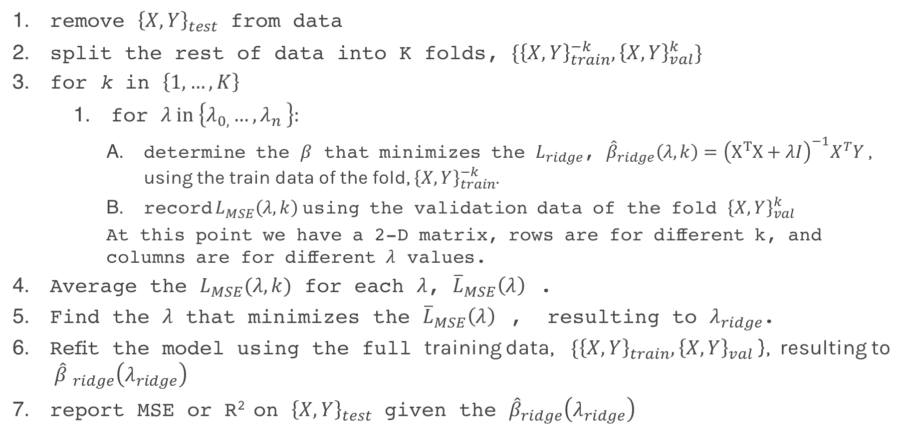
Ridge regularization with CV: step by step
remove ${\left\{X,Y\right\}}_{test}$ from data
split the rest of data into K folds, $\{{\left\{X,Y\right\}}_{train}^{−k},{\left\{X,Y\right\}}_{val}^{k}\}$
for k in $\left\{1,…,K\right\}$
  for $λ in \left\{λ_{0,}…{, λ}_{n}\right\}:$
    determine the $β$ that minimizes the $L_{ridge}$, ${\hat{β}}_{ridge}\left(λ,k\right)={\left(X^{T}X+λI\right)}^{−1}X^{T}Y$ , using the train data of the fold, ${\left\{X,Y\right\}}_{train}^{−k}$.
    record $L_{MSE}^{}\left(λ,k\right)$ using the validation data of the fold ${\left\{X,Y\right\}}_{val}^{k}$
    At this point we have a 2-D matrix, rows are for different k, and columns are for different $λ$ values.
Average the $L_{MSE}(λ,k)$ for each $λ$, ${{\overline{L}}_{MSE}\left(λ\right)}_{}$.
Find the $λ$ that minimizes the ${{\overline{L}}_{MSE}\left(λ\right)}_{}$, resulting to $λ_{ridge}$.
Refit the model using the full training data, $\{{\left\{X,Y\right\}}_{train},{\left\{X,Y\right\}}_{val}$ }, resulting to ${\hat{β} }_{ridge}\left(λ_{ridge}\right)$
report MSE or R² on ${\left\{X,Y\right\}}_{test}$ given the ${\hat{β}}_{ridge}\left(λ_{ridge}\right)$

Slide 60
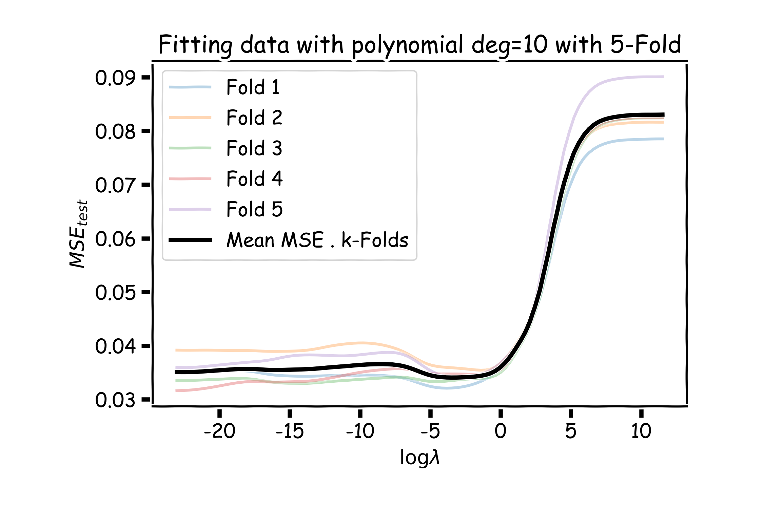
Ridge regularization with validation only: step by step

Slide 61
Variable Selection as Regularization
Since LASSO regression tend to produce zero estimates for a number of model parameters - we say that LASSO solutions are sparse - we consider LASSO to be a method for variable selection.
Many prefer using LASSO for variable selection (as well as for suppressing extreme parameter values) rather than stepwise selection, as LASSO avoids the statistic problems that arises in stepwise selection.
Question: What are the pros and cons of the two approaches?

Slide 62
Behind Ordinary Least Squares, AIC, BIC

Slide 63
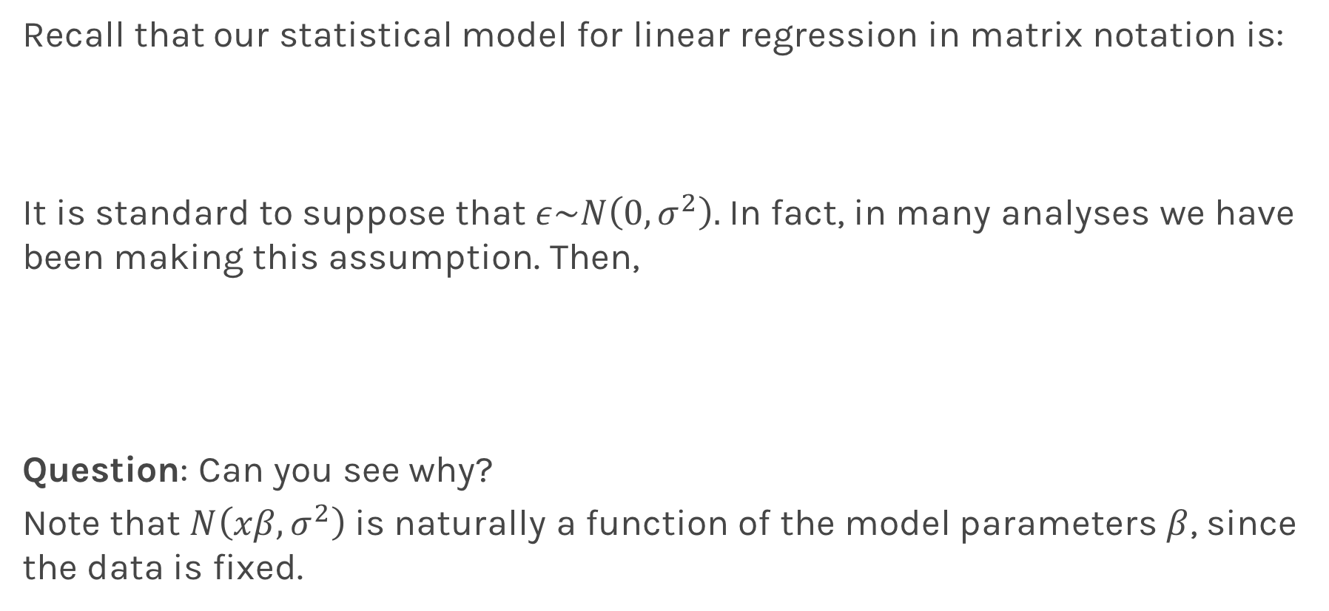
Likelihood Functions
Recall that our statistical model for linear regression in matrix notation is:
It is standard to suppose that $ε\sim N\left(0,σ^{2}\right).$In fact, in many analyses we have been making this assumption. Then,
Question: Can you see why?
Note that $N\left(xβ,σ^{2}\right)$ is naturally a function of the model parameters $β$, since the data is fixed.

Slide 64
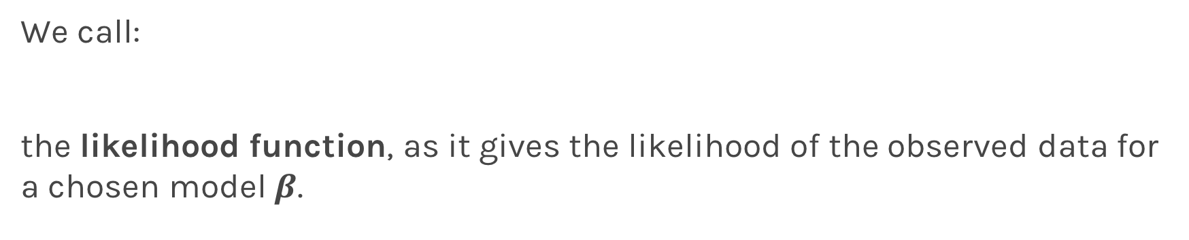
Likelihood Functions
We call:
the likelihood function, as it gives the likelihood of the observed data for a chosen model $β$.

Slide 65
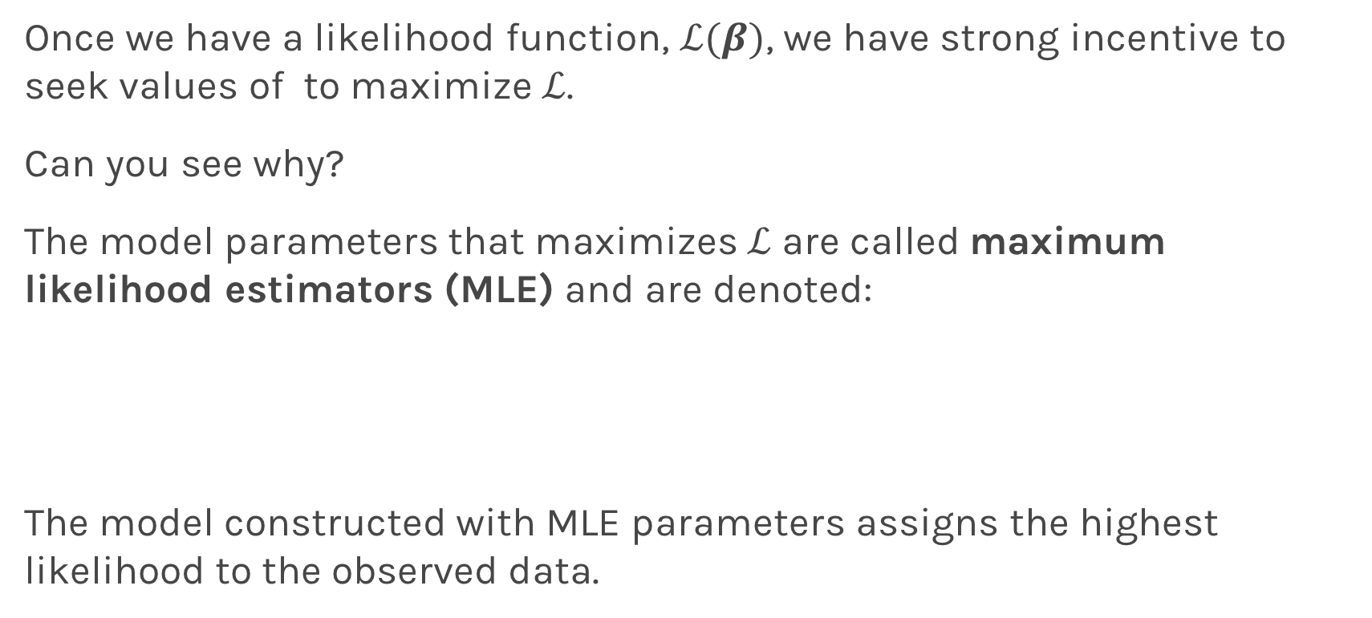
Maximum Likelihood Estimators
Once we have a likelihood function, $ℒ(β)$, we have strong incentive to seek values of to maximize $ℒ$.
Can you see why?
The model parameters that maximizes $ℒ$ are called maximum likelihood estimators (MLE) and are denoted:
The model constructed with MLE parameters assigns the highest likelihood to the observed data.

Slide 66
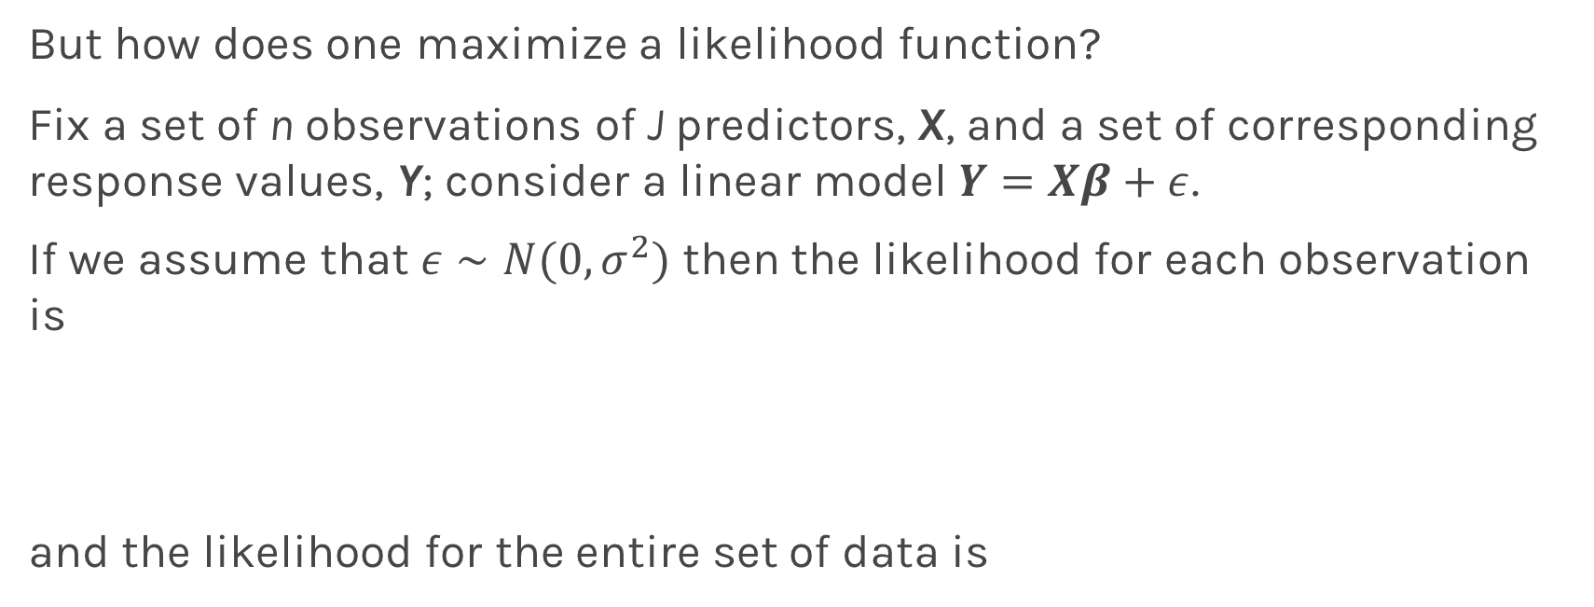
Maximum Likelihood Estimators
But how does one maximize a likelihood function?
Fix a set of n observations of J predictors, X, and a set of corresponding response values, Y; consider a linear model $Y=Xβ+ε$.
If we assume that $ε∼Ν(0,σ^{2})$ then the likelihood for each observation is
and the likelihood for the entire set of data is

Slide 67
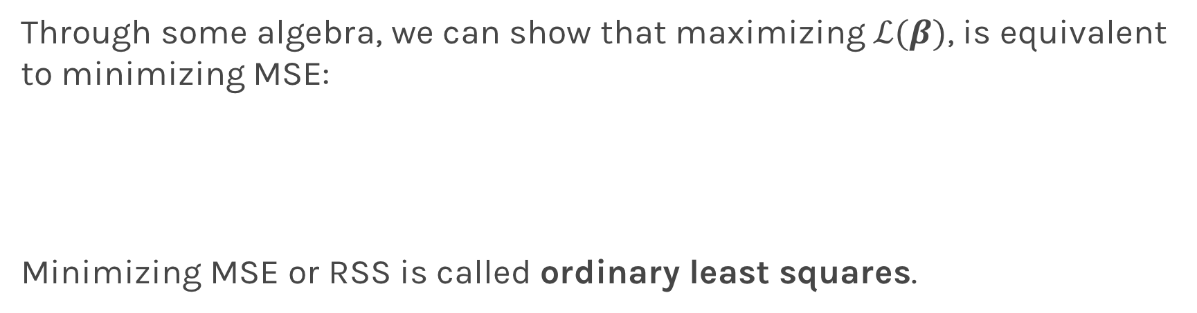
Maximum Likelihood Estimators
Through some algebra, we can show that maximizing $ℒ(β)$, is equivalent to minimizing MSE:
Minimizing MSE or RSS is called ordinary least squares.

