Slide 1
Lecture 24: Wrap-Up

Slide 2
Course Review (and a brief 109B preview)

Slide 3
HW 9 Winners!
Student Reserve test set Accuracy
Jake Seaton 98.9
Zeeshan Ali 98.8
David Gibson 98.4
Edgardo Hernandez 98.3
Joe Davison 98.3
Georgina Gibson 98.3
Jinsoo Kim 98.1
Pavlos 98.0

Slide 4
Modules
The semester has been organized into 4 major ‘modules’:
Module 0: Intro to Data and Data Science (and Python)
Module 1: Regression
Module 2: Classification
Module 3: Ensemble Methods
We have learned various approaches to perform both predictions and inferences within each of these frameworks.

Slide 5
Module 1: Regression Methods
When is it appropriate to perform a regression method? What regression models have we learned?
Linear Regression (simple, multiple, polynomial, interactions, model selection, Ridge & Lasso, etc...)
k-NN
Regression Trees
What is the main difference between these two types of models?

Slide 6
Module 2: Classification Methods
When is it appropriate to perform a classification method? What classification models have we learned?
Logistic Regression: same details as linear regression apply
k-NN
Discriminant Analysis: LDA/QDA
Classification Trees
What is the main difference between these two types of models (advantages and disadvantages)? When should you use each method?

Slide 7
Module 3: Ensemble Methods
What does it mean for a model to be an ensemble method?
Bagging Trees
Random Forests
Boosting Models
Stacking Models
Neural Networks
What approach does each model take to improve prediction accuracy?

Slide 8
Choosing between Models
How can we choose between our various methods/models to answer a question at hand? What approaches/measures can we use to make this determination?
In-sample: AIC, BIC
Out-of-sample: Cross-Validation
What measure(s) should we use when we perform cross-validation?

Slide 9
Dealing with Data Issues
What issues have arisen when dealing with real data? How have we handled them?
Categorical Predictors: might make sense to one-hot encode
Missing Data: might make sense to impute
High Dimensionality: might make sense to use a data reduction technique.
Too many observations: do preliminary analysis on a subset
How are predictions affected? How are inferences affected?

Slide 10
Dealing with High Dimensionality
What does ‘high dimensionality’ mean? What issues arise when this happens? How can we handle it?
Model Selection: subset variable selection
Regularization: LASSO and Ridge like approaches (penalize the loss function)
PCA: create new predictor variables that encapsulate the ‘essence’ of all your predictor data with a minimal number of variables.
How can we compare methods to determine which approach is best?

Slide 11
Other things we’ve learned
Scraping, Data Gathering, Data Wrangling
EDA: Visualization and Summary Statistics
t-tests and p-values: probabilistic/ approaches to perform inferences
Bootstrapping: empirical approach to perform inferences
Misclassification Rates, Types of Errors, Confusion Matrices/Tables, and ROC Curves
Bias-Variance Trade-off
Train vs. Test vs. Validation
Standardization vs. Normalization. When should we do it?
Anything lingering questions or thoughts?

Slide 12
Other things we haven’t discussed
There are lots of topics we have not covered in one semester…some are covered in 109B in the Spring:
Support Vector Machines (SVMs)
Unsupervised Classification/Clustering
Smoothers
Bayesian Data Analysis
Reinforcement Learning
Other versions of Neural Networks (and ‘Deep Learning’)
Interactive Visualizations
Database Management
And much, much more…

Slide 14
Courses Related to Data Science
CS 109B: Advanced Topics in Data Science
CS 171: Visualizations
CS 181: Machine Learning
CS 182: Artificial Intelligence (AI)
CS 205: Distributive Computing
Stat 110: Probability Theory
Stat 111: Statistical Inference
Stat 139: Linear Models
Stat 149: Generalized Linear Models
Stat 195: Intro to Statistical Machine Learning
This list is not exhaustive!

Slide 15
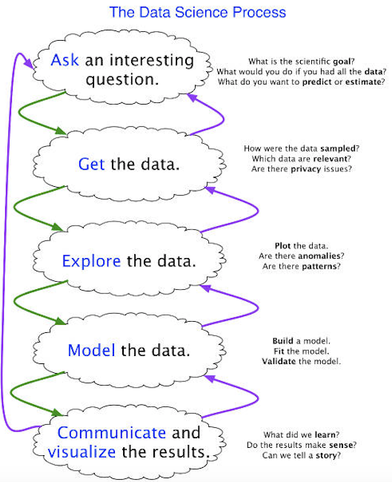
The Data Science Process
Don’t forget what everything is all about:

Slide 16
Thanks for all your hard work!
It’s been a long semester for everyone involved. Thank you for your patience, your hard work, and your commitment to data science!
It’s sad to see you go...

