Slide 1
Lecture 17: Boosting

Slide 2
CS109B, STAT121B, AC209B

Slide 3
Outline
Review of Ensemble Methods
Finish Random Forest
Boosting
Gradient Boosting
Set-up and intuition
Connection to Gradient Descent
The Algorithm
AdaBoost

Slide 4
Bags and Forests of Trees
Last time we examined how the short-comings of single decision tree models can be overcome by ensemble methods - making one model out of many trees.
We focused on the problem of training large trees, these models have low bias but high variance.
We compensated by training an ensemble of full decision trees and then averaging their predictions - thereby reducing the variance of our final model.

Slide 5
Bags and Forests of Trees (cont.)
Bagging:
create an ensemble of trees, each trained on a bootstrap sample of the training set
average the predictions.
Random forest:
create an ensemble of trees, each trained on a bootstrap sample of the training set
in each tree and each split, randomly select a subset of predictors, choose a predictor from this subset for splitting
average the predictions
Note that the ensemble building aspects of both methods are embarrassingly parallel!

Slide 6
Tuning Random Forests
Random forest models have multiple hyper-parameters to tune:
the number of predictors to randomly select at each split
the total number of trees in the ensemble
the minimum leaf node size
In theory, each tree in the random forest is full, but in practice this can be computationally expensive (and added redundancies in the model), thus, imposing a minimum node size is not unusual.

Slide 7
Tuning Random Forests
There are standard (default) values for each of random forest hyper-parameters recommended by long time practitioners, but generally these parameters should be tuned through OOB (making them data and problem dependent).
e.g. number of predictors to randomly select at each split:
$√N_{j}$ for classification
$\frac{N}{3}$ for regression
Using out-of-bag errors, training and cross validation can be done in a single sequence - we cease training once the out-of-bag error stabilizes

Slide 8
Variable Importance for RF
Same as with Bagging:
Calculate the total amount that the RSS (for regression) or Gini index (for classification) is decreased due to splits over a given predictor, averaged over all $B$ trees.

Slide 9
Variable Importance for RF
Alternative:
Record the prediction accuracy on the oob samples for each tree.
Randomly permute the data for column $j$in the oob samples the record the accuracy again.
The decrease in accuracy as a result of this permuting is averaged over all trees, and is used as a measure of the importance of variable $j$ in the random forest.

Slide 10
Variable Importance for RF
100 trees, max_depth=10

Slide 11
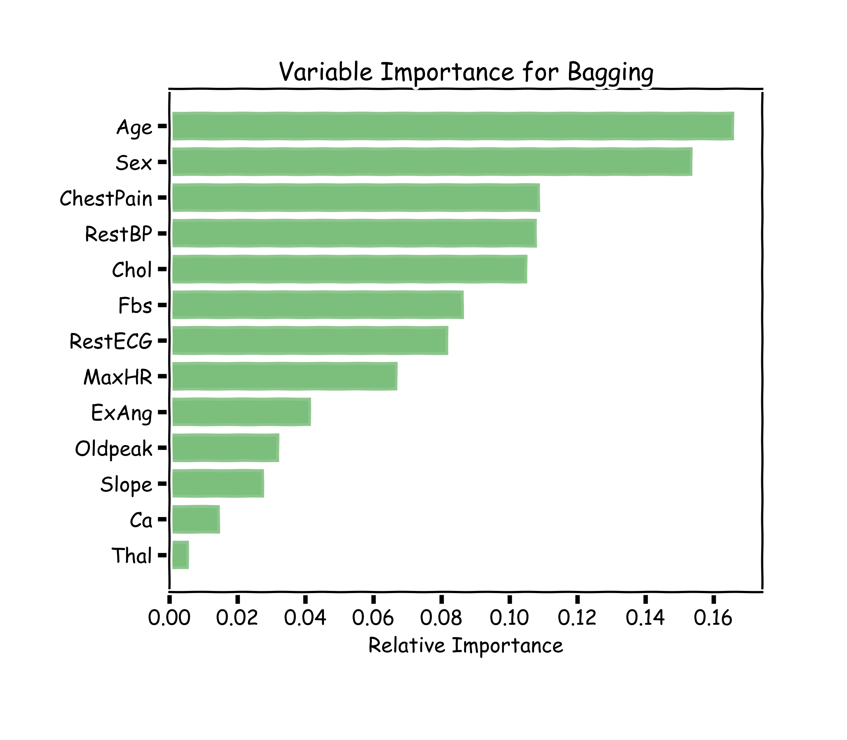
Variable Importance for RF
100 trees, max_depth=10

Slide 12
Final Thoughts on Random Forests
When the number of predictors is large, but the number of relevant predictors is small, random forests can perform poorly.
Question: Why?
In each split, the chances of selected a relevant predictor will be low and hence most trees in the ensemble will be weak models.

Slide 13
Final Thoughts on Random Forests (cont.)
Increasing the number of trees in the ensemble generally does not increase the risk of overfitting.
Again, by decomposing the generalization error in terms of bias and variance, we see that increasing the number of trees produces a model that is at least as robust as a single tree.
However, if the number of trees is too large, then the trees in the ensemble may become more correlated, increase the variance.

Slide 14
Final Thoughts on Random Forests (cont.)
Probabilities:
Random Forrest Classifier (and bagging) can return probabilities.
Question: How?
More questions
Unbalance dataset?
Weighted samples?
Categorical data?
Missing data?
Different implementations?
GO TO THE ADVANCED TOPICS LATER TODAY

Slide 15
Boosting

Slide 16
Motivation for Boosting
Question: Could we address the shortcomings of single decision trees models in some other way?
For example, rather than performing variance reduction on complex trees, can we decrease the bias of simple trees - make them more expressive?
A solution to this problem, making an expressive model from simple trees, is another class of ensemble methods called boosting.

Slide 17
Boosting Algorithms

Slide 18
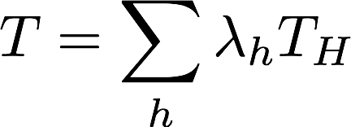
Gradient Boosting
The key intuition behind boosting is that one can take an ensemble of simple models {T_{h}}_{h∈H} and additively combine them into a single, more complex model.
Each model T_{h} might be a poor fit for the data, but a linear combination of the ensemble
can be expressive/flexible.
Question: But which models should we include in our ensemble? What should the coefficients or weights in the linear combination be?

Slide 19
Gradient Boosting: the algorithm
Gradient boosting is a method for iteratively building a complex regression model T by adding simple models. Each new simple model added to the ensemble compensates for the weaknesses of the current ensemble.
1. Fit a simple model $T^{(0)}$ on the training data
$\{\left(x_{1}, y_{1}\right),…,(x_{N},y_{N})\}$
Set$T←T^{(0)}$ . Compute the residuals {r₁ , . . . , r_{N} } for T.
2. Fit a simple model, $T^{(1)}$ , to the current residuals, i.e. train using
$\{\left(x_{1}, r_{1}\right),…,(x_{N},r_{N})\}$
3. Set ${T←T+λT}^{(1)}$
4. Compute residuals, set $r_{n}←r_{n}−λT^{i}\left(x_{n}\right), n=1,…,N$
5. Repeat steps 2-4 until stopping condition met.
where $λ$ is a constant called the learning rate.

Slide 20
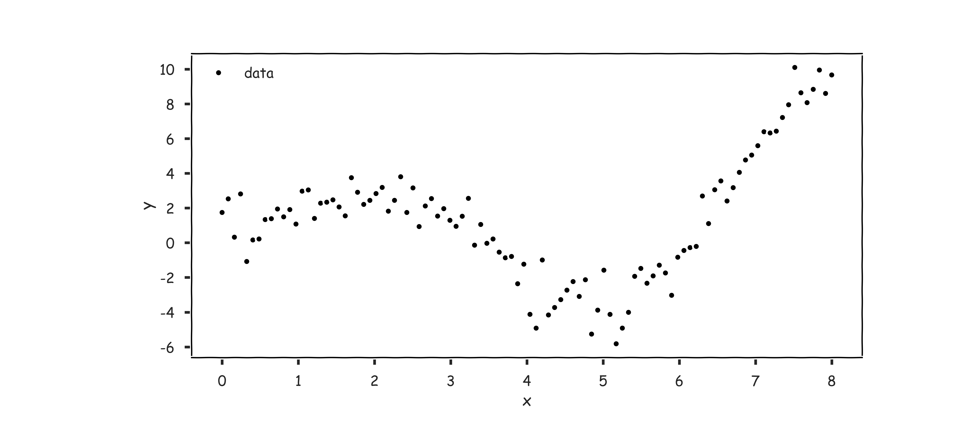
Gradient Boosting: illustration

Slide 21
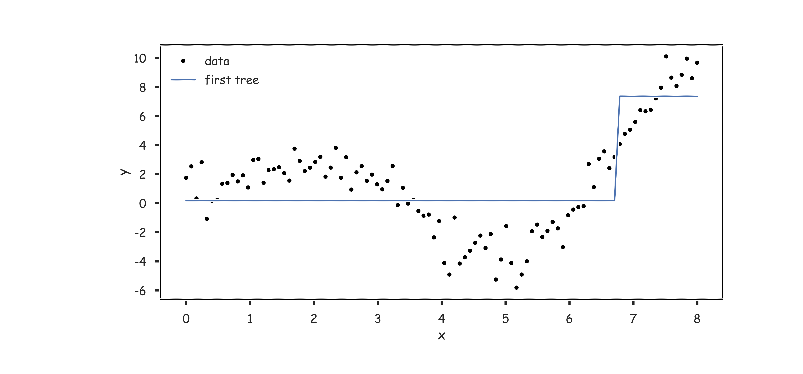
Gradient Boosting: illustration

Slide 22
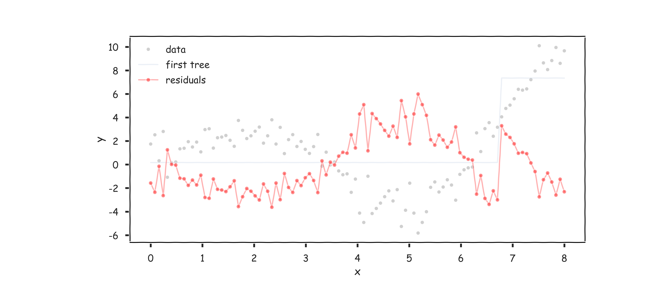
Gradient Boosting: illustration

Slide 23
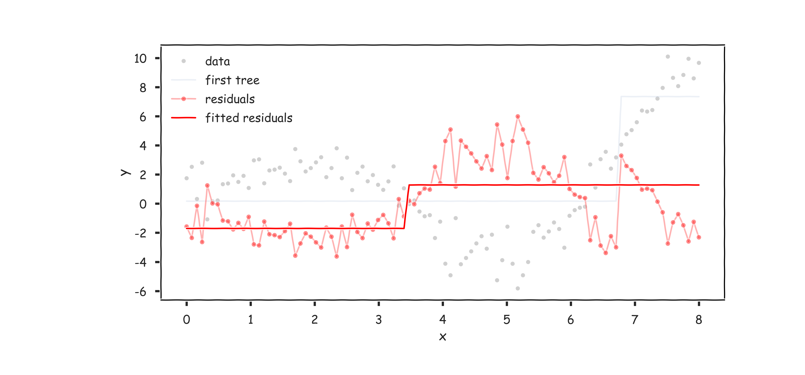
Gradient Boosting: illustration

Slide 24
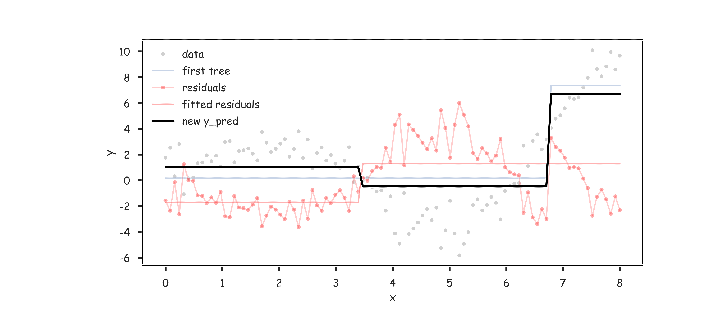
Gradient Boosting: illustration

Slide 25
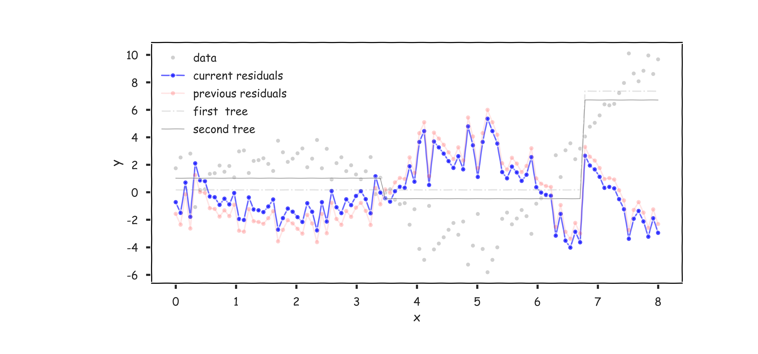
Gradient Boosting: illustration

Slide 26
Why Does Gradient Boosting Work?
Intuitively, each simple model T^{(i)} we add to our ensemble model T, models the errors of T.
Thus, with each addition of T^{(i)}, the residual is reduced
$$r_{n}−λT^{\left(i\right)}(x_{n})$$
Note that gradient boosting has a tuning parameter, $λ$.
If we want to easily reason about how to choose $λ$ and investigate the effect of $λ$ on the model T, we need a bit more mathematical formalism.
In particular, how can we effectively descend through this optimization via an iterative algorithm?
We need to formulate gradient boosting as a type of gradient descent.

Slide 27
Review: A Brief Sketch of Gradient Descent
In optimization, when we wish to minimize a function, called the objective function, over a set of variables, we compute the partial derivatives of this function with respect to the variables.
If the partial derivatives are sufficiently simple, one can analytically find a common root - i.e. a point at which all the partial derivatives vanish; this is called a stationary point.
If the objective function has the property of being convex, then the stationary point is precisely the min.

Slide 28
Review: A Brief Sketch of Gradient Descent the Algorithm
In practice, our objective functions are complicated and analytically find the stationary point is intractable.
Instead, we use an iterative method called gradient descent:
Initialize the variables at any value:
Take the gradient of the objective function at the current variable values:
Adjust the variables values by some negative multiple of the gradient:
The factor $λ$ is often called the learning rate.

Slide 29
Why Does Gradient Descent Work?
Claim: If the function is convex, this iterative methods will eventually move x close enough to the minimum, for an appropriate choice of $λ$.
Why does this work? Recall, that as a vector, the gradient at at point gives the direction for the greatest possible rate of increase.

Slide 30
Why Does Gradient Descent Work?
Subtracting a $λ$ multiple of the gradient from x, moves x in the opposite direction of the gradient (hence towards the steepest decline) by a step of size $λ$.
If f is convex, and we keep taking steps descending on the graph of f, we will eventually reach the minimum.

Slide 31
Gradient Boosting as Gradient Descent
Often in regression, our objective is to minimize the MSE
Treating this as an optimization problem, we can try to directly minimize the MSE with respect to the predictions
The update step for gradient descent would look like

Slide 32
Gradient Boosting as Gradient Descent (cont.)
There are two reasons why minimizing the MSE with respect to ${\hat{y}}_{n}$’s is not interesting:
We know where the minimum MSE occurs: ${\hat{y}}_{n}=y_{n}$, for every n.
Learning sequences of predictions,${\hat{y}}_{n}^{1},…,{\hat{y}}_{n}^{i},…$, does not produce a model. The predictions in the sequences do not depend on the predictors!

Slide 33
Gradient Boosting as Gradient Descent (cont.)
The solution is to change the update step in gradient descent. Instead of using the gradient - the residuals - we use an approximation of the gradient that depends on the predictors:
$$\hat{y}←{\hat{y}}_{n}+λ {\hat{r}}_{n}\left(x_{n}\right), n=1,…,N$$ In gradient boosting, we use a simple model to approximate the residuals, ${{\hat{r}}_{n}(x}_{n})$, in each iteration.
Motto: gradient boosting is a form of gradient descent with the MSE as the objective function.
Technical note: note that gradient boosting is descending in a space of models or functions relating $x_{n}$ to $y_{n}$!

Slide 34
Gradient Boosting as Gradient Descent (cont.)
But why do we care that gradient boosting is gradient descent?
By making this connection, we can import the massive amount of techniques for studying gradient descent to analyze gradient boosting.
For example, we can easily reason about how to choose the learning rate $λ$ in gradient boosting.

Slide 35
Choosing a Learning Rate
Under ideal conditions, gradient descent iteratively approximates and converges to the optimum.
When do we terminate gradient descent?
We can limit the number of iterations in the descent. But for an arbitrary choice of maximum iterations, we cannot guarantee that we are sufficiently close to the optimum in the end.
If the descent is stopped when the updates are sufficiently small (e.g. the residuals of T are small), we encounter a new problem: the algorithm may never terminate!
Both problems have to do with the magnitude of the learning rate, $λ$.

Slide 36
Choosing a Learning Rate
For a constant learning rate, $λ$, if $λ$ is too small, it takes too many iterations to reach the optimum.
If $λ$ is too large, the algorithm may ‘bounce’ around the optimum and never get sufficiently close.

Slide 37
Choosing a Learning Rate
Choosing $λ$:
If $λ$ is a constant, then it should be tuned through cross validation.
For better results, use a variable $λ$. That is, let the value of $λ$ depend on the gradient
where is the magnitude of the gradient, . So
around the optimum, when the gradient is small, $λ$ should be small
far from the optimum, when the gradient is large, $λ$ should be larger

Slide 38
AdaBoost

Slide 39
Motivation for AdaBoost
Using the language of gradient descent also allow us to connect gradient boosting for regression to a boosting algorithm often used for classification, AdaBoost.
In classification, we typically want to minimize the classification error:
Naively, we can try to minimize Error via gradient descent, just like we did for MSE in gradient boosting.
Unfortunately, Error is not differentiable with respect to the predictions, ${\hat{y}}_{n}$☹

Slide 40
Motivation for AdaBoost (cont.)
Our solution: we replace the Error function with a differentiable function that is a good indicator of classification error.
The function we choose is called exponential loss
Exponential loss is differentiable with respect to ${\hat{y}}_{n}$and it is an upper bound of Error.

Slide 41
Gradient Descent with Exponential Loss
We first compute the gradient for ExpLoss:
It’s easier to decompose each $y_{n}exp\left(−y_{n}{\hat{y}}_{n}\right)$as ${w_{n}y}_{n}$, where $$w_{n}=\exp\left(−y_{n}{\hat{y}}_{n}\right).$$
This way, we see that the gradient is just a re-weighting applied the target values
Notice that when $y_{n}={\hat{y}}_{n}$, the weight $w_{n}$ is small; when $y_{n}≠{\hat{y}}_{n}$, the weight is larger.

Slide 42
Gradient Descent with Exponential Loss
The update step in the gradient descent is
Just like in gradient boosting, we approximate the gradient, ${{λw}_{n}y}_{n}$with a simple model, T^{(i)}, that depends on $x_{n}$.
This means training T^{(i)} on a re-weighted set of target values,
$$\{\left(x_{1},w_{1}y_{1}\right),…,(x_{N},w_{N}y_{N})\}$$
That is, gradient descent with exponential loss means iteratively training simple models that focuses on the points misclassified by the previous model.
$${\hat{y}}_{n}←{\hat{y}}_{n}+λw_{n}y_{n}, n=1,…, N$$

Slide 43
AdaBoost
With a minor adjustment to the exponential loss function, we have the algorithm for gradient descent:
1. Choose an initial distribution over the training data, $w_{n}=1/N$.
2. At the i^{th} step, fit a simple classifier T^{(i)} on weighted training data
3. Update the weights:
where Z is the normalizing constant for the collection of updated weights
4. Update $T:T←T+λ^{(i)}T^{(i)}$
where $λ$ is the learning rate.
$$\{\left(x_{1},w_{1}y_{1}\right),…,(x_{N},w_{N}y_{N})\}$$

Slide 44
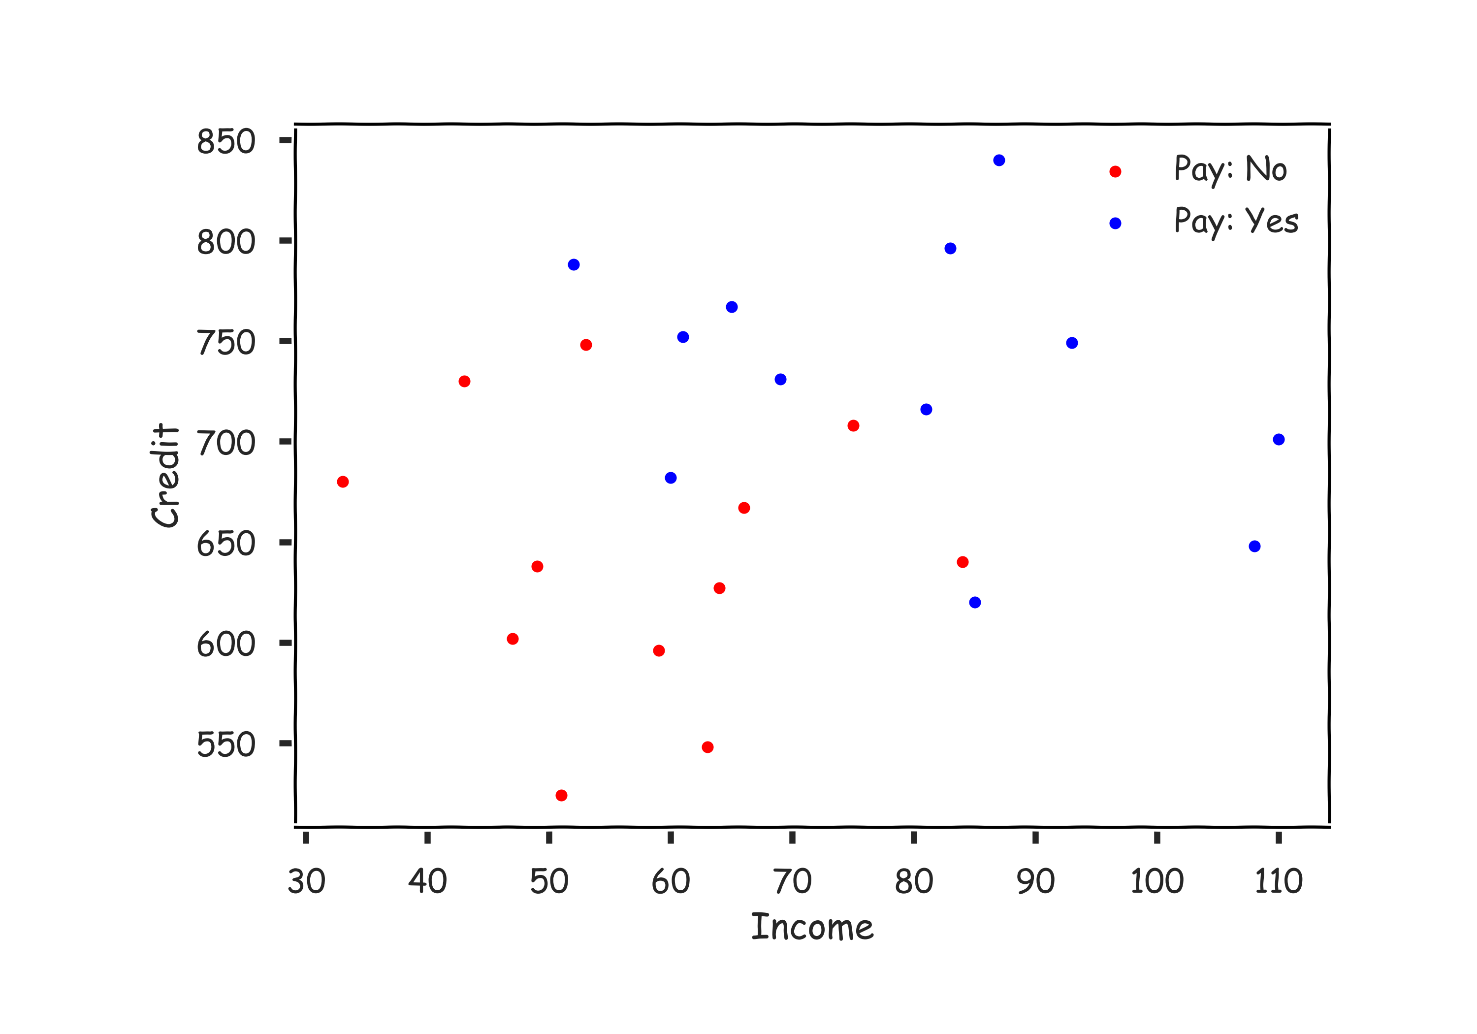
AdaBoost: illustration, start with lending data

Slide 45
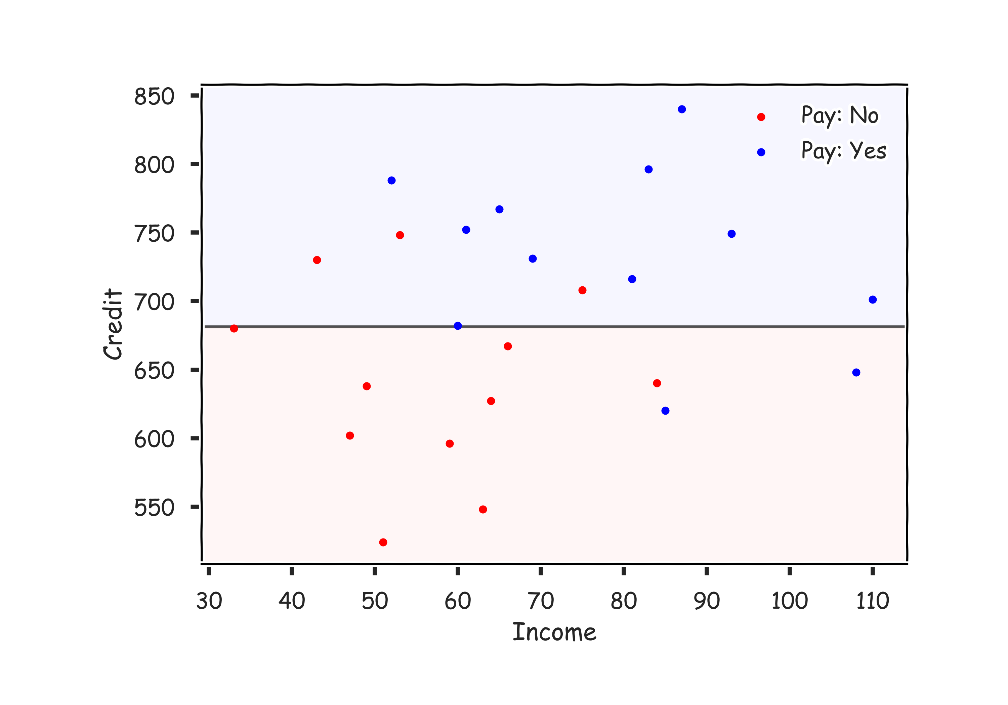
AdaBoost: illustration, simple decision tree

Slide 46
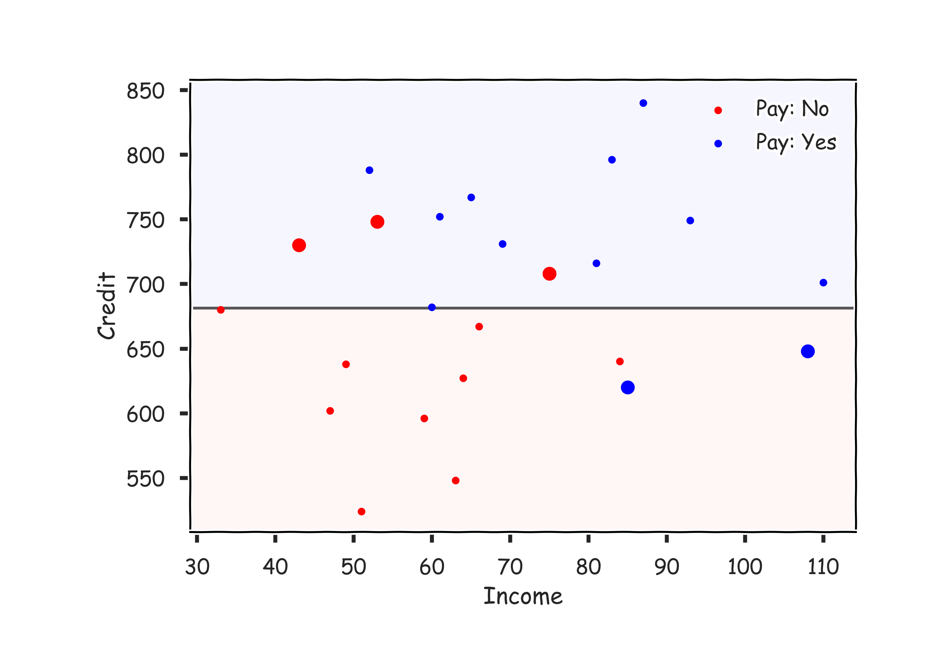
AdaBoost: illustration, errors are weighted higher

Slide 47
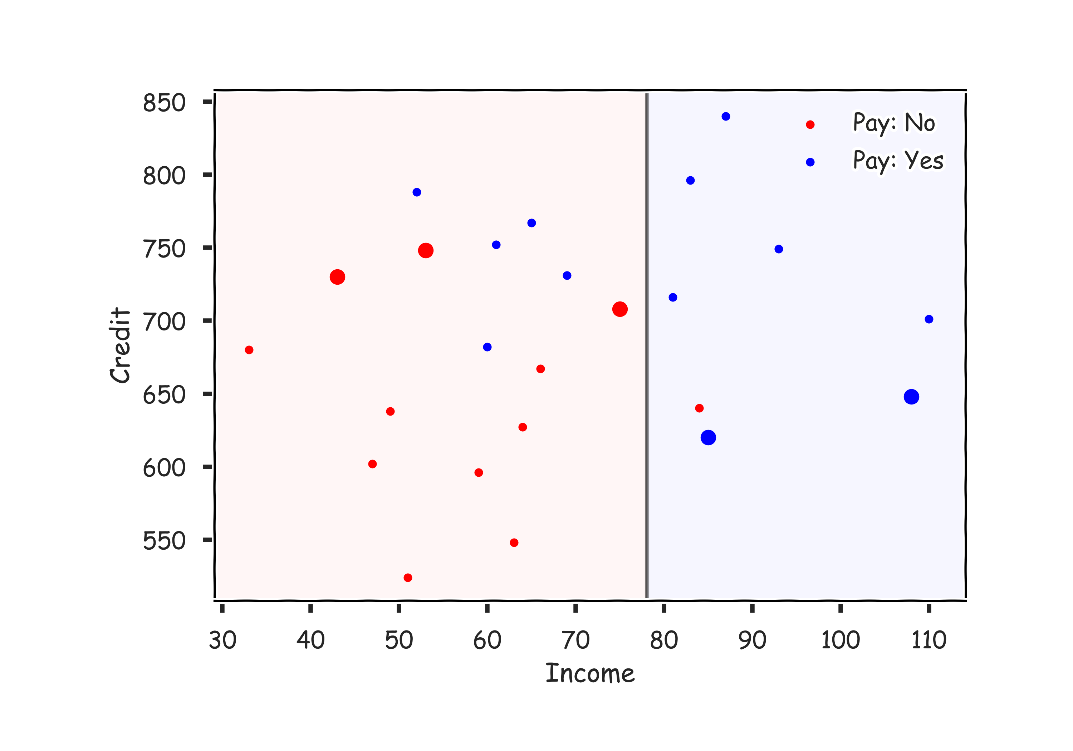
AdaBoost: illustration, 2nd tree with weighted points

Slide 48
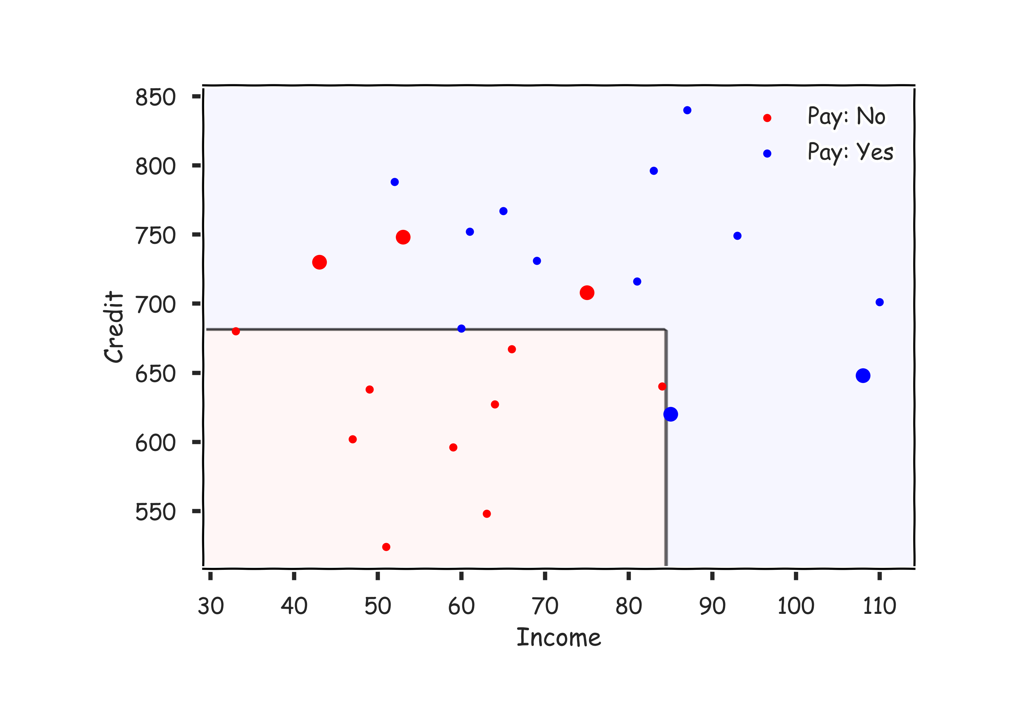
AdaBoost: illustration, combine the trees

Slide 49
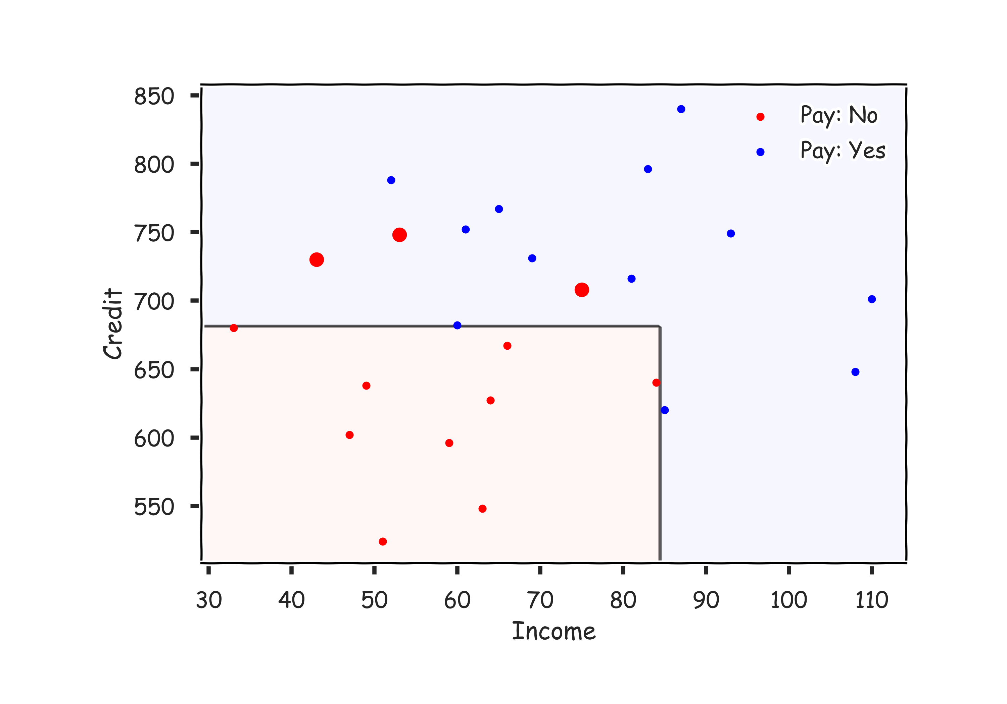
AdaBoost: illustration, re-weight points

Slide 50
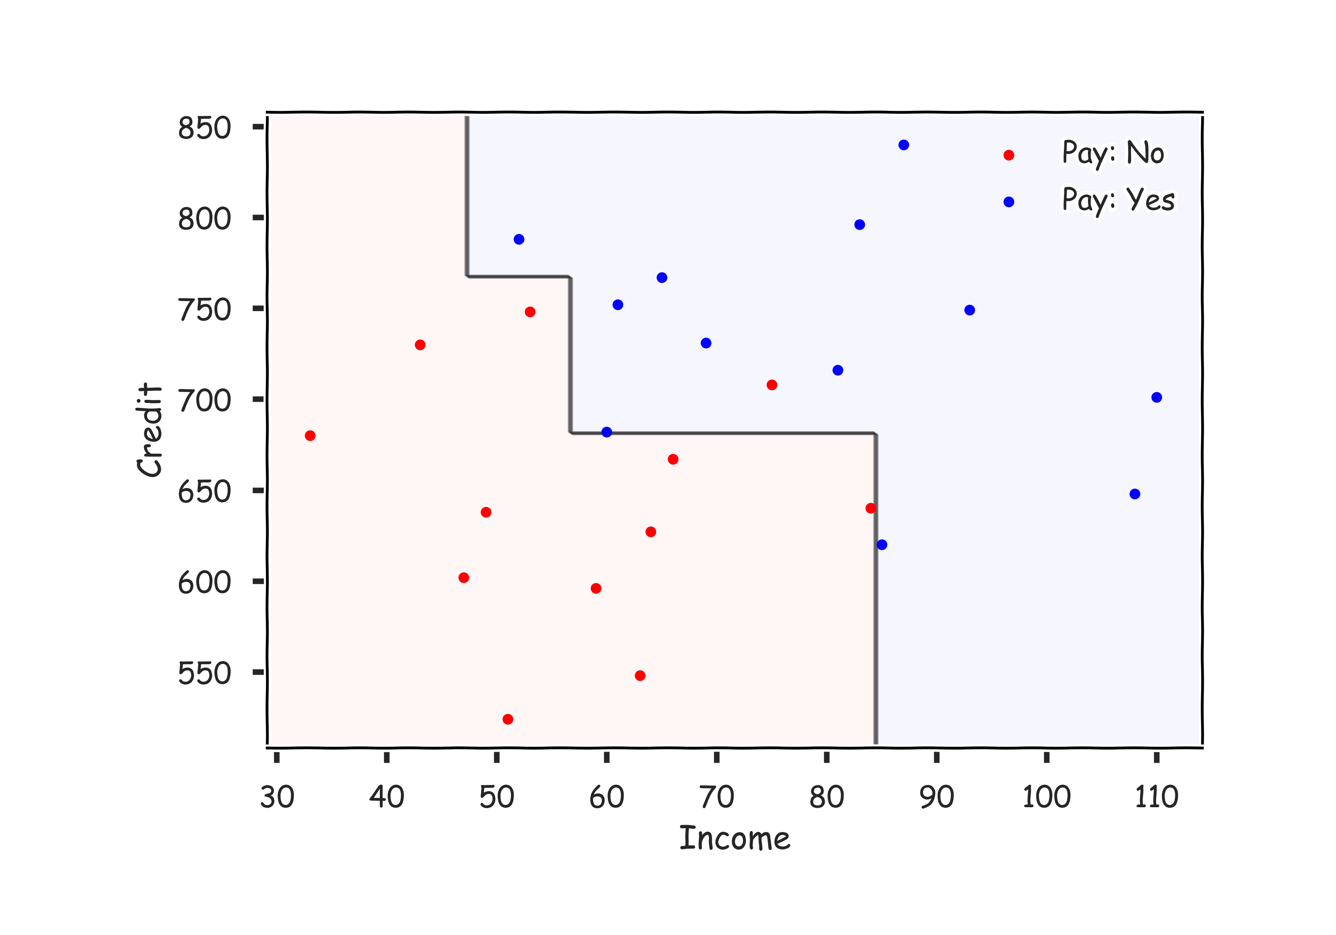
AdaBoost: illustration, etc

Slide 51
Choosing the Learning Rage
Unlike in the case of gradient boosting for regression, we can analytically solve for the optimal learning rate for AdaBoost, by optimizing:
Doing so, we get that

Slide 52
Final thoughts on Boosting
There are few implementations on boosting:
XGBoost: An efficient Gradient Boosting Decision
LGBM: Light Gradient Boosted Machines. It is a library for training GBMs developed by Microsoft, and it competes with XGBoost
CatBoost: A new library for Gradient Boosting Decision Trees, offering appropriate handling of categorical features
ADVANCED TOPICS

Slide 53
Final thoughts on Boosting
Increasing the number of trees can lead to overfitting.
Question: Why?

Slide 54
Boosting in sklearn
Python has boosting algorithms implemented for you:
sklearn.ensemble.AdaBoostClassifier
sklearn.ensemble.AdaBoostRegressor
With arguments of base_estimator (what models to use), n_estimators (max number of models to use), learning_rate ($λ$), etc…

