Slide 1
Lecture 15: Entity Linking
Discourse, Pragmatics, and Knowledge Graphs
Harvard
AC295/CS287r/CSCI E-115B
Chris Tanner

Slide 2
ENTITY

Slide 3
ANNOUNCEMENTS
HW4 has been released!
HW2 and Phase 2 and Quiz 5 are being graded
Research Project Phase 3 due Oct 28 (Thurs) @ 11:59pm
I was able to get $100 AWS credit for each student (it must be used exclusively for research or HW in this course)
Some of today’s slides are inspired from, based on, or directly from:
Laura Dietz (UNH)
Alan Black & David Mortensen (CMU)

Slide 4
Outline
What is entity linking?
Data and metrics
Workshop time
Modern approaches

Slide 5
Outline
What is entity linking?
Data and metrics
Workshop time
Modern approaches

Slide 6
Discourse & Pragmatics
Regarding language, we have mostly learned about:
Individual words (representation and modelling)
Large chunks of text (representation and modelling)
Yet, there’s tons of nuanced, interconnected elements we wish to capture and model

Slide 7
Multiple levels* to language
Flashback to Lecture 2
Discourse
Pragmatics
Semantics
Syntax
Lexemes
Morphology
Understands structures and effects of interweaving dialog
Understands how context affects meaning
*
phonology
orthography
phonetics
text
speech

Slide 8
Discourse & Pragmatics
Pragmatics is a branch of linguistics dealing with language use in context (non-local meaning phenomena)
Ex 1:
Ex 2:
Ex 3:
Ex 4:
Can you pass the salt?
“Is he 21?” “Yea, he’s 25”
“Are we still going out tonight?” “If I can get off by 5”
Key and Peele – Text Message Confusion (skit)
Too explicit for me to show in class

Slide 9
Discourse & Pragmatics
What does ”context” mean?
Social context:
Social identities, relationships, and setting
Physical context:
Where? What objects are present? What actions?
Linguistic context:
Conversation history, discourse context
Other:
Shared knowledge, common knowledge

Slide 10
Discourse & Pragmatics
Discourse concerns the structures and effects in related sequences of sentences. Essential for dialogues, multi-party conversations.
Ex 1:
Ex 2:
“I said the blue shoes.” “Oh, blue!”
“Can we discuss this later today?”
“When did you have in mind?”
“Does the afternoon work?”
“Well, I’m free after lunch”
“Shall we plan for 2pm?”
“That works”

Slide 11
Discourse & Pragmatics
Types of referring expressions
Indefinite noun phrases:
I saw an incredible oak tree today
Definite noun phrases:
I read about it in the New York Times
Pronominal mentions:
Emily aced the quiz, as she expected
Nominal mentions and names:
The amazing marathoner, Des Linden, is a true inspiration
Demonstratives:
These pretzels are making me thirsty.
This, that, these, those

Slide 12
Discourse & Pragmatics
Types of referring expressions
Indefinite noun phrases:
I saw an incredible oak tree today
Definite noun phrases:
I read about it in the New York Times
Pronominal mentions:
Emily aced the quiz, as she expected
Nominal mentions and names:
The amazing marathoner, Des Linden, is a true inspiration
Demonstratives:
These pretzels are making me thirsty.
Remember, in NLP, we devise feasible tasks to approximate the phenomenon (e.g., understanding discourse and pragmatics) we hope to eventually capture

Slide 13
Discourse & Pragmatics
Types of referring expressions
Indefinite noun phrases:
I saw an incredible oak tree today
Definite noun phrases:
I read about it in the New York Times
Pronominal mentions:
Emily aced the quiz, as she expected
Nominal mentions and names:
The amazing marathoner, Des Linden, is a true inspiration
Demonstratives:
These pretzels are making me thirsty.

Slide 14
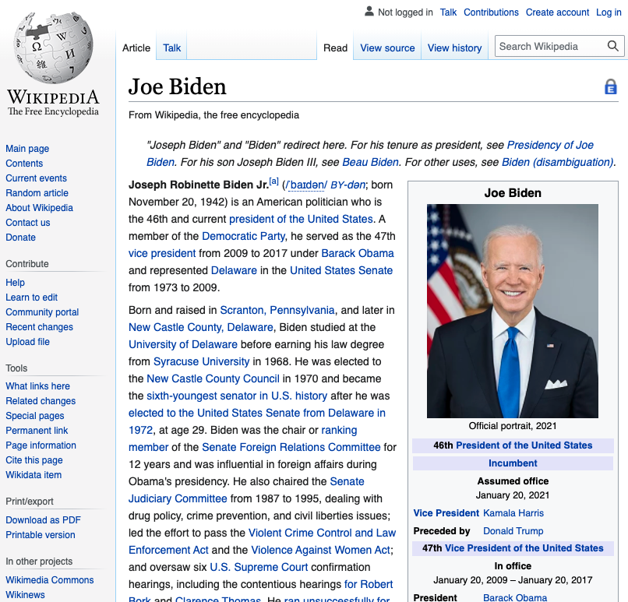
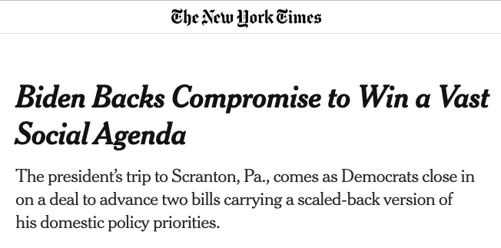
Entity Linking

Slide 15
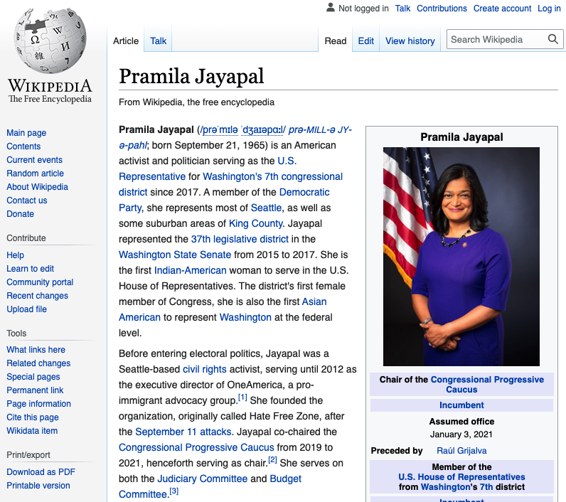
Entity Linking

Slide 16
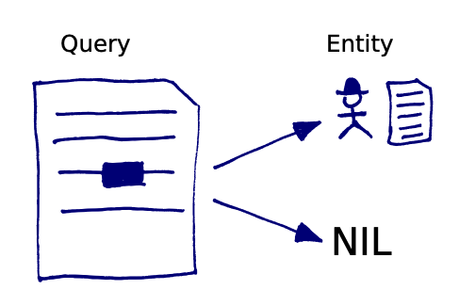
Entity Linking
Identify all named mentions (not nominal mentions) and disambiguate them by linking each of them to an external knowledge graph (KG) (e.g., Wikipedia’s KG)

Slide 17
Entity Linking
Entity Linking is also called Named Entity Disambiguation
Identify all named mentions (not nominal mentions) and disambiguate them by linking each of them to an external knowledge graph (KG) (e.g., Wikipedia’s KG)

Slide 18
Entity Linking
iPhone
manufacturer_of
Task Definition:
Determine which named mentions refer to which underlying real-world entities
(within a knowledge graph).
Apple
cofounder_of
located_in
city_in
Steve Jobs
cofounder_of
San Jose
born_in
partners_with
Steve
Wozniak
married_to
settled_in
alumnus_of

Slide 19
Entity Linking
Michael Jordan, born in 1956, spoke with the Associated Press today after he announced a new $10M college scholarship fund
Document #271

Slide 20
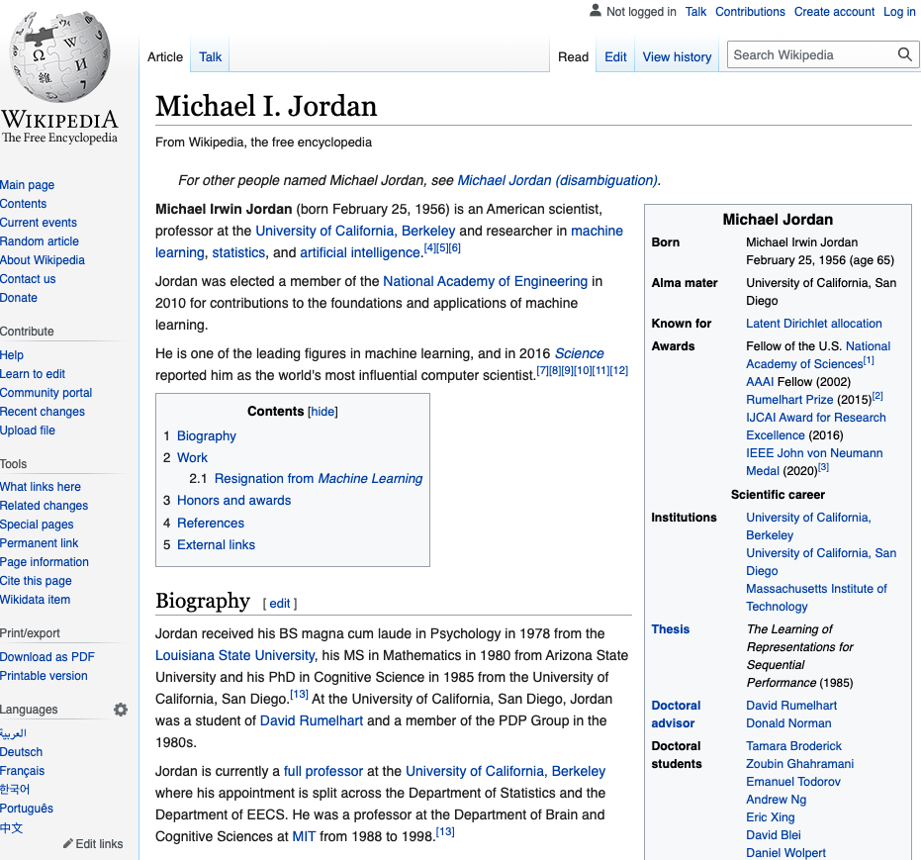
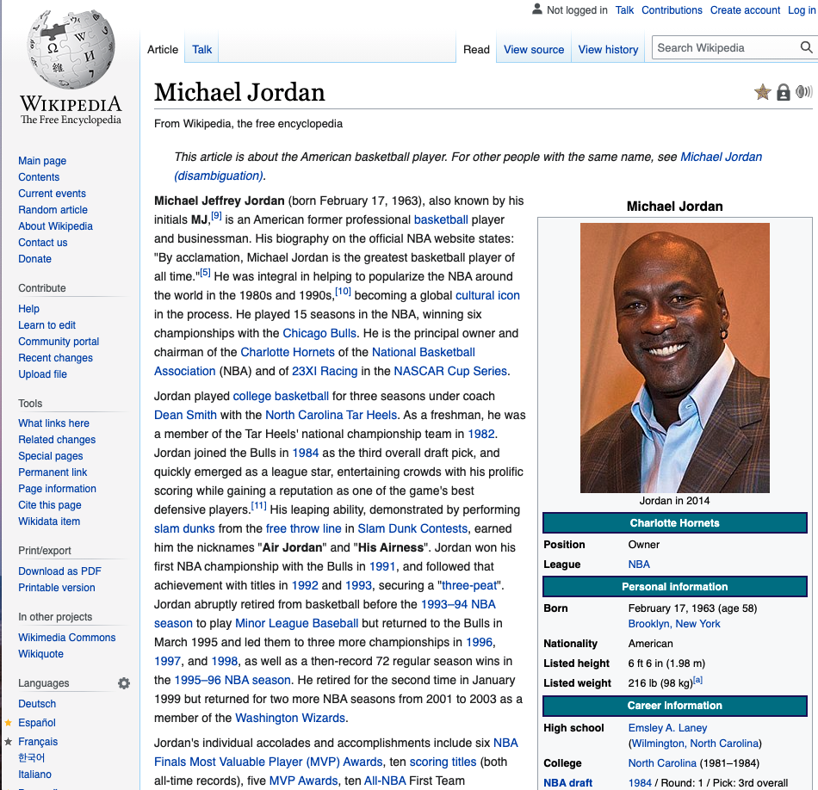
Entity Linking
Michael Jordan, born in 1956, spoke with the Associated Press today after he announced a new $10M college scholarship fund
Document #271

Slide 21
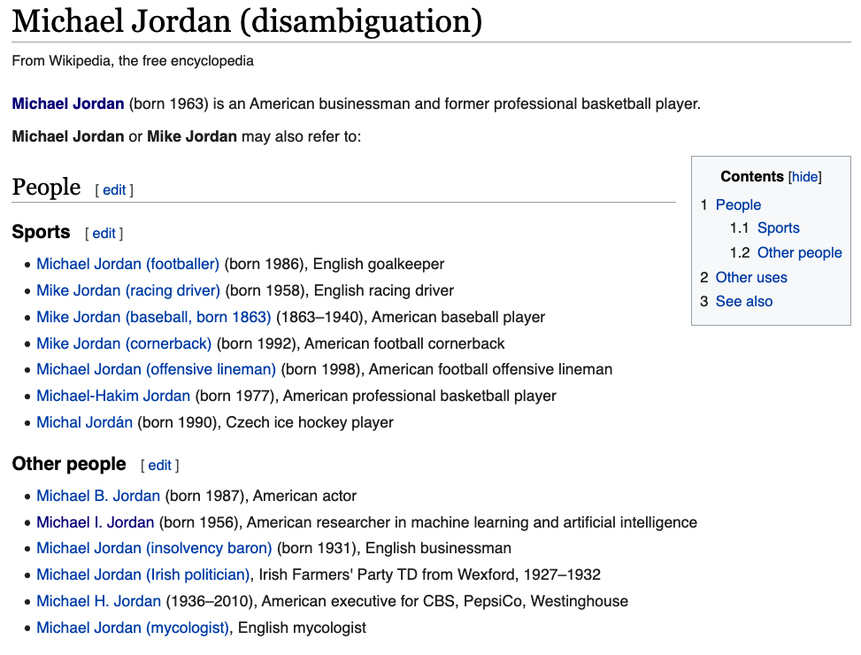
Entity Linking

Slide 22
Entity Linking
“Entity Linking” is a two-stage process!
Mention detection (some people work on this exclusively)
Entity Linking

Slide 23
Outline
What is entity linking?
Data and metrics
Workshop time
Modern approaches

Slide 24
Outline
What is entity linking?
Data and metrics
Workshop time
Modern approaches

Slide 25
Annotations
Q1: What if our document only had “Michael”, not “Michael Jordan”?
Q2: What if our document mentions his name 10 times in the same doc?
Q3: What if our document contains an unpopular name, like Chris Tanner?

Slide 26
Annotations
Q1: What if our document only had “Michael”, not “Michael Jordan”?
A1: Only annotate the mentions that have sufficient context to make the task meaningful

Slide 27
Annotations
Q2: What if our document mentions his name 10 times in the same doc?
A2: Only annotate the first occurrence

Slide 28
Annotations
Q3: What if our document contains an unpopular name, like Chris Tanner?
A3: Can only annotate mentions that are present in the KG

Slide 29
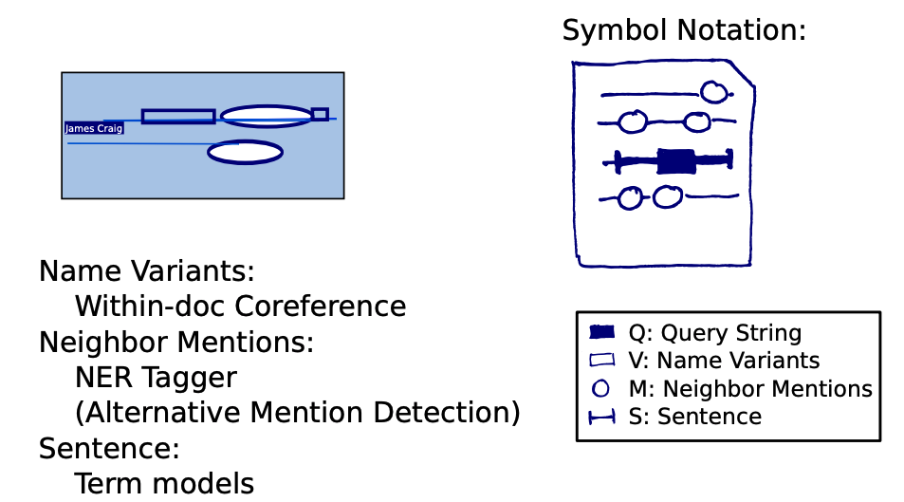
Annotations

Slide 30
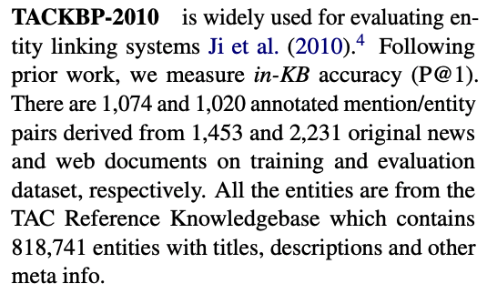
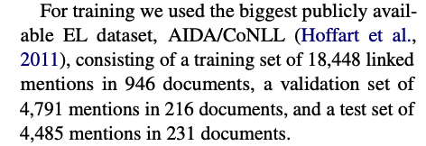
Datasets
TAC KBP 2010
AIDA/CoNLL

Slide 31
Metrics
Accuracy
Recall @ N
Micro F1
Macro F1

Slide 32
Outline
What is entity linking?
Data and metrics
Workshop time
Modern approaches

Slide 33
Outline
What is entity linking?
Data and metrics
Workshop time
Modern approaches

Slide 34
Workshop time
How would you attempt entity linking?
Create a baseline system

Slide 35
Workshop time

Slide 36
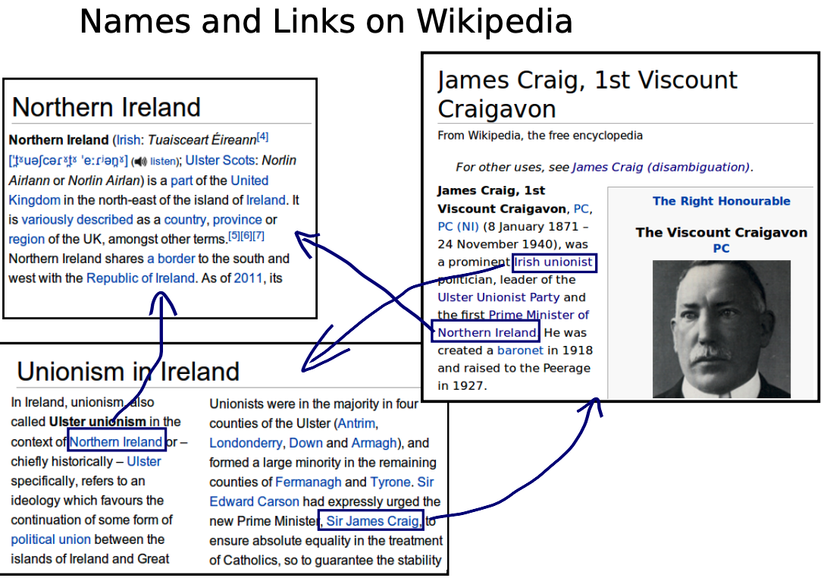

Slide 39
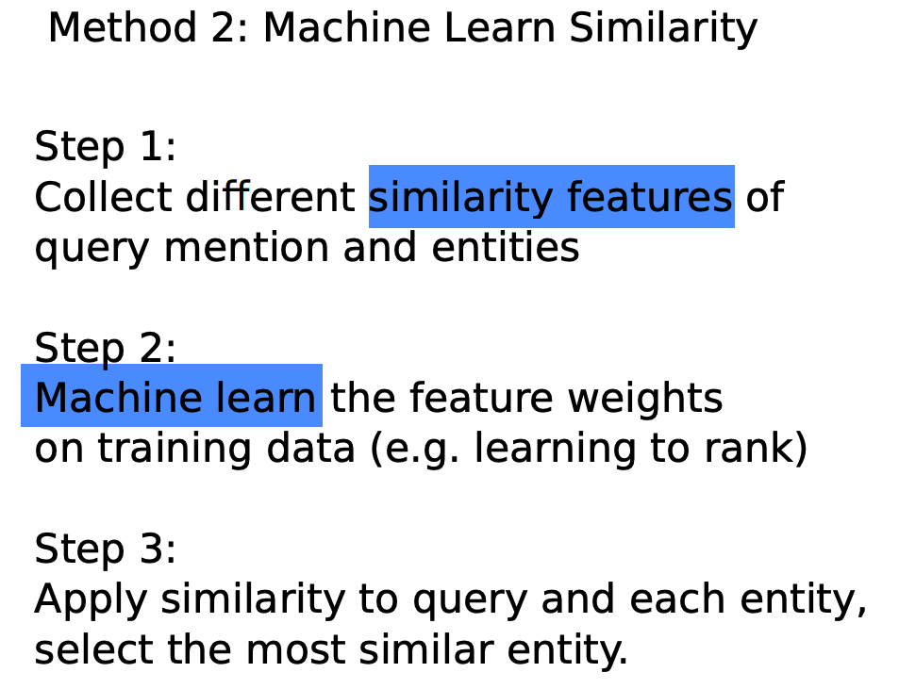

Slide 43
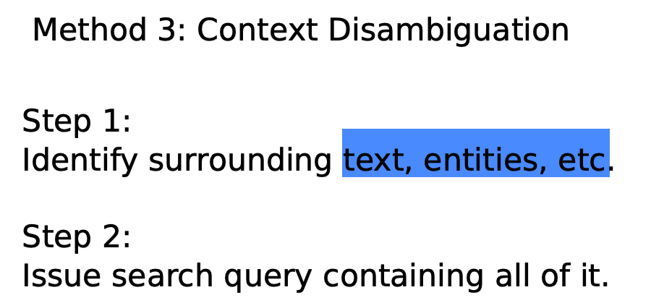

Slide 45
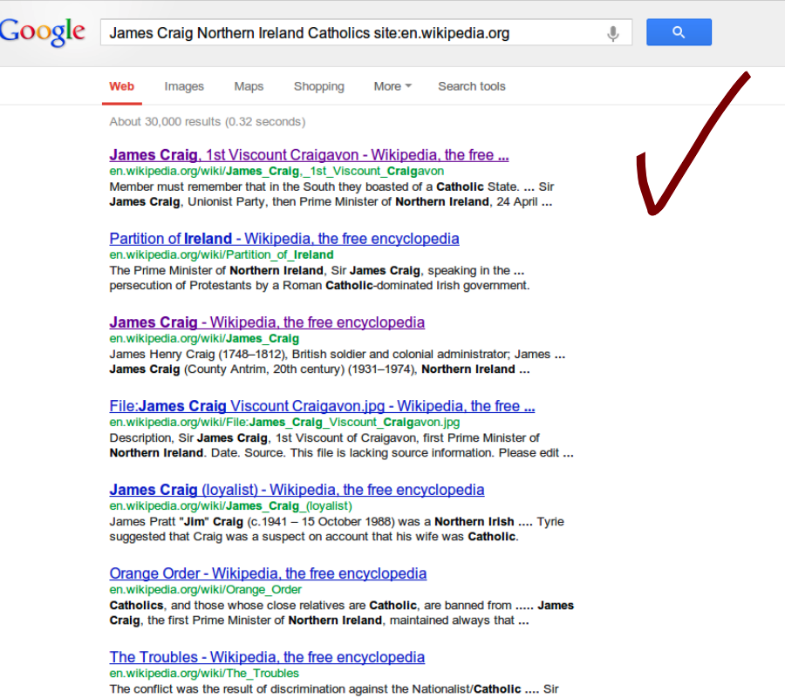

Slide 46
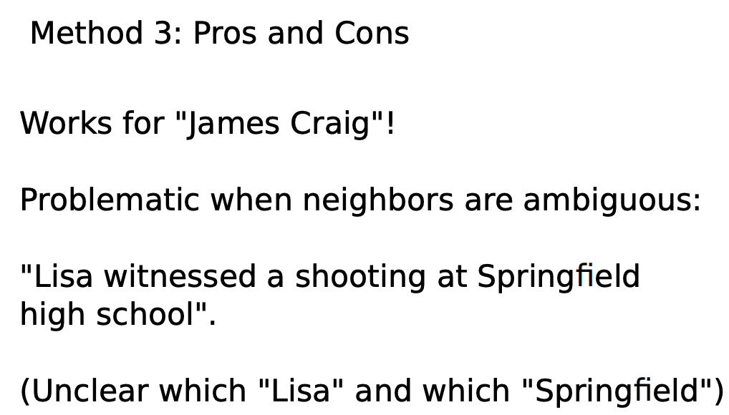

Slide 48
Workshop time
These approaches seem kind of manual and kludgy.
How can we use Deep Learning?

Slide 49
Outline
What is entity linking?
Data and metrics
Workshop time
Modern approaches

Slide 50
Outline
What is entity linking?
Data and metrics
Workshop time
Modern approaches

Slide 51
Outline
What is entity linking?
Data and metrics
Workshop time
Modern approaches

Slide 52
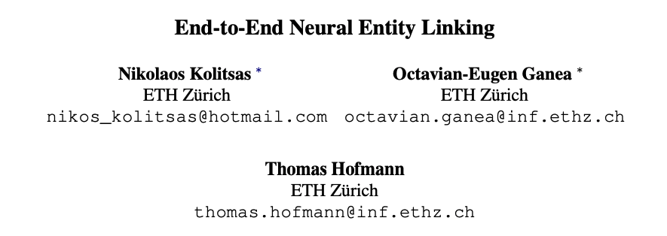
Modern approach
Motivation:

Slide 53
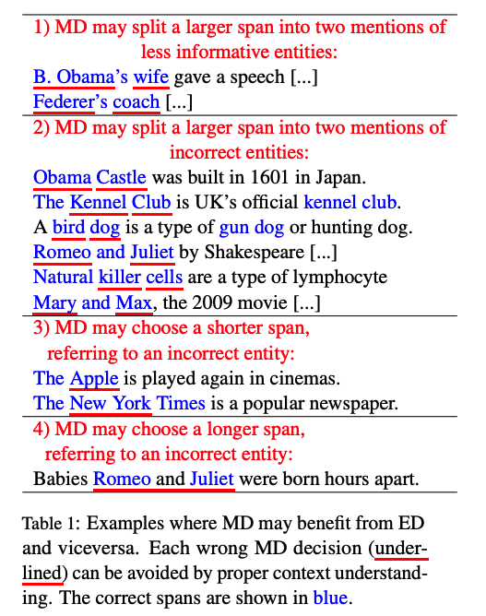

Slide 54
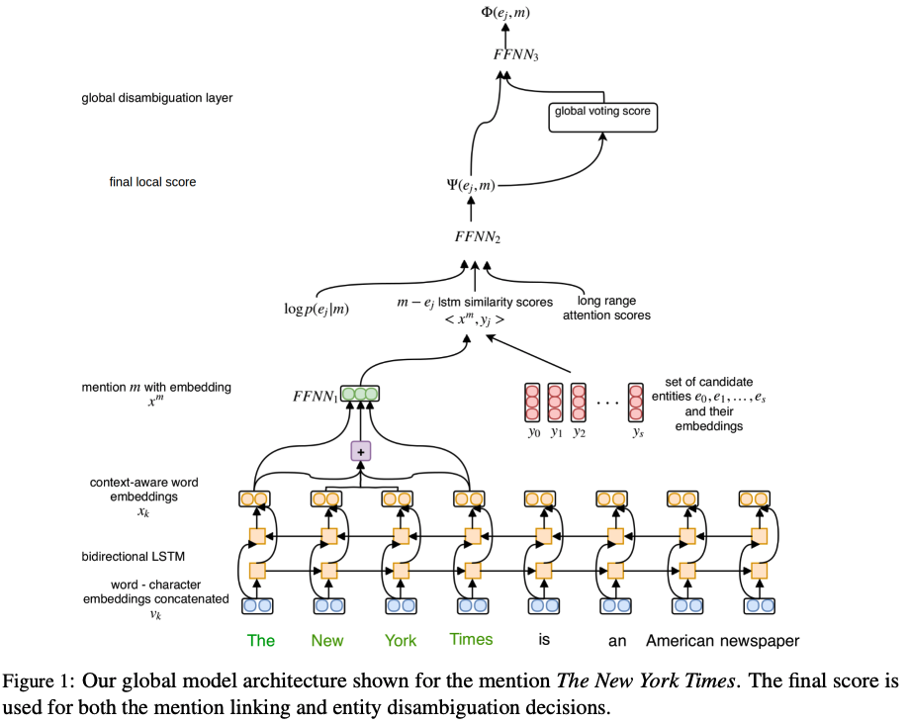

Slide 55
Modern approach

Slide 56
