Slide 1
Lecture 14: Summarization
An exercise in quickly reading and experimenting
Harvard
AC295/CS287r/CSCI E-115B
Chris Tanner

Slide 2
“Imma let you finish, but lecture 13 had some of the most important info of all time” – Kanye
SUMMARIZATION

Slide 3
ANNOUNCEMENTS
HW3 is due tonight @ 11:59pm!
HW2 and Phase 2 are being graded
Research Project Phase 3 due Oct 28 (Thurs) @ 11:59pm
Some slides were largely inspired by, based on, or directly from:
Dan Jurafsky (Stanford)
Chan Young Park (CMU)
Pengfei Liu (CMU)

Slide 4
Outline
What is summarization?
Data and metrics
Workshop time
Modern approaches

Slide 5
Outline
What is summarization?
Data and metrics
Workshop time
Modern approaches

Slide 6
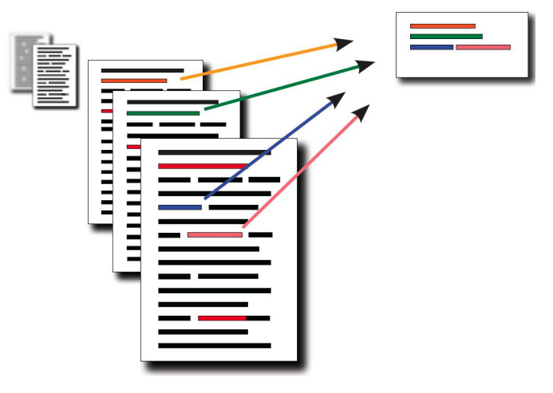
What is it?
Task: produce an abridged version of a text while retaining the key, relevant information

Slide 7
What is it?
Useful for creating:
outlines or abstracts of any document, article, etc
summaries of chat and email
action items from a meeting
simplifying text by compressing sentences

Slide 8
What is it?
Input:
single document summarization (SDS)
multiple-document summarization (MDS)
Output:
extractive
abstractive
Focus:
generic (unconditioned)
query-focused (conditioned)
Approach:
supervised
unsupervised

Slide 9
What is it?
Single-document summarization
Given a single doc, produce:
Abstract
Outline
Headline
Multiple-document summarization
Given a group of docs, produce:
Series of news stories on the same event
Set of web pages about some topic or question

Slide 10
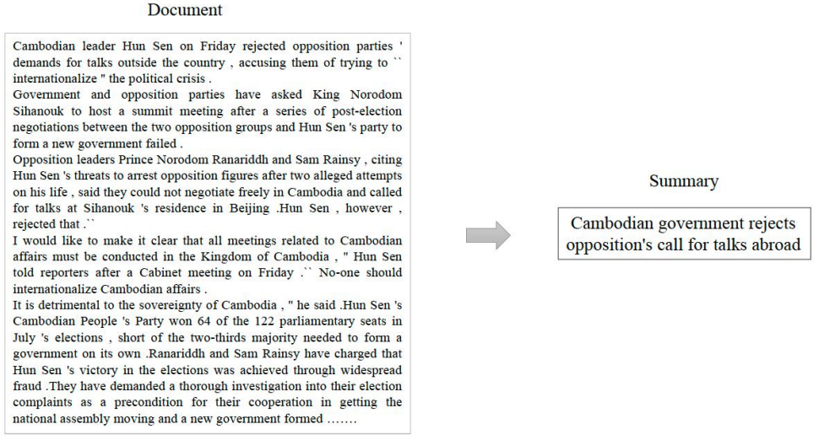
Single-doc summarization

Slide 11
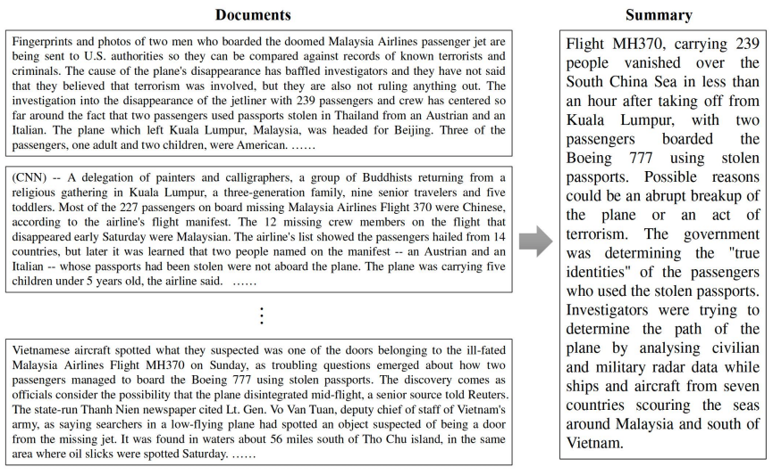
Multi-doc summarization

Slide 12
Output
Extractive summarization
Select from the source text spans that capture the key information
Abstractive summarization
Generate new text that encapsulates the key information from the source text

Slide 13
Focus
Generic summarization
Summarize the content of the doc(s)
Query-focused summarization
Summarize a doc w.r.t. a user’s query
Complex question-answering (answer a question by summarizing a doc that has the information to construct the answer)

Slide 14
Query-focused summarization: snippets

Slide 15
Query-focused summarization: snippets
Create answers to complex questions, summarizing multiple documents
Instead of giving a snippet for each document, create a cohesive answer that combines information from multiple documents
Q: does this seem like a job for extractive or abstractive summarization?

Slide 16
Outline
What is summarization?
Data and metrics
Workshop time
Modern approaches

Slide 17
Outline
What is summarization?
Data and metrics
Workshop time
Modern approaches

Slide 18
Data and metrics
Q: How to find the list of commonly used datasets?
A: Look at the recent SOTA papers

Slide 19
Data and metrics
Q: How to find the list of commonly used datasets?
A: Look at the recent SOTA papers
Q: How to find the SOTA papers?
A:
nlpprogress.com
paperswithcode.com/sota
connectedpapers.com

Slide 20
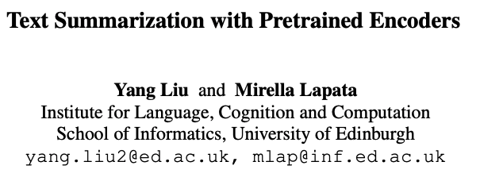
Data and metrics

Slide 21
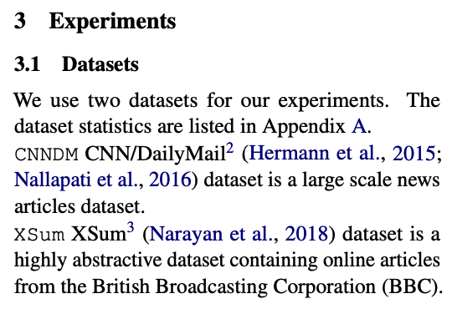
Data and metrics

Slide 22
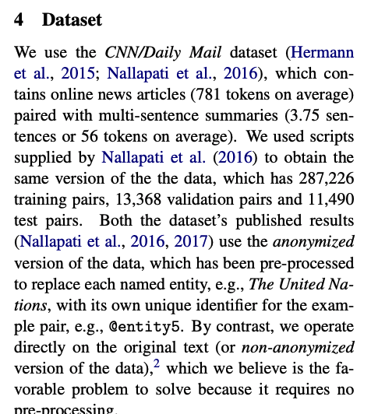
Data and metrics

Slide 23
CNN/DailyMail

Slide 24
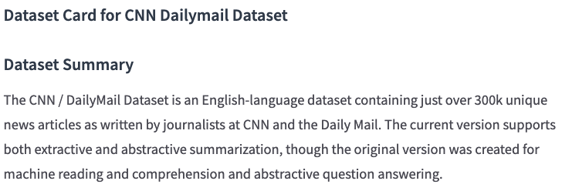
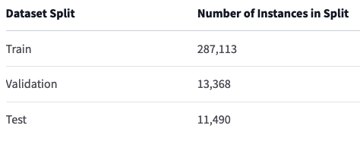
CNN/DailyMail
https://huggingface.co/datasets/cnn_dailymail

Slide 25
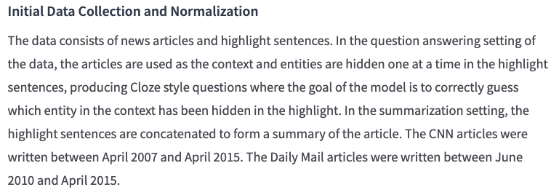
CNN/DailyMail
https://huggingface.co/datasets/cnn_dailymail

Slide 26
XSum
Let’s follow the trail…

Slide 27
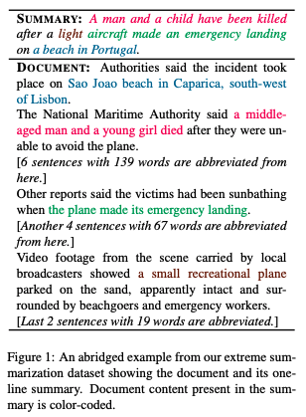
XSum

Slide 28
Metrics: ROUGE-N
Intrinsic metric for automatically evaluating summaries
Based on BLEU (remember, MT)
Not as good as human evaluation (of course)
Given a document D, and an automated summary X:
Get N humans to produce a set of reference summaries of D
Run model to produce X

Slide 29
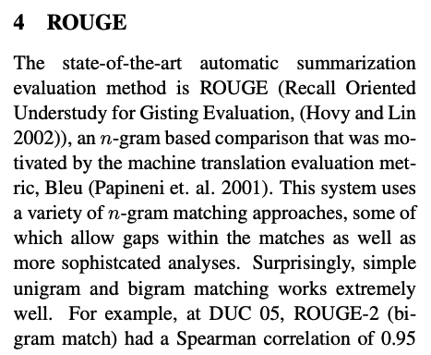
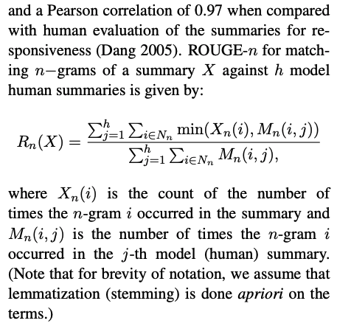
Metrics: ROUGE-N
https://dl.acm.org/doi/pdf/10.5555/1273073.1273093

Slide 30
Metrics: ROUGE-N
Query: “What is water spinach?”
Model’s output: “Water spinach is a leaf vegetable commonly eaten in tropical areas of Asia.”
Human Summaries (gold truth):

Slide 31
Outline
What is summarization?
Data and metrics
Workshop time
Modern approaches

Slide 32
Outline
What is summarization?
Data and metrics
Workshop time
Modern approaches

Slide 33
Workshop time
How would you attempt summarization?
Create a baseline system

Slide 34
Unsupervised extractive approaches

Slide 35
Unsupervised extractive approaches

Slide 36
Signature-based content selection with queries

Slide 37
Graph-based ranking algorithms

Slide 38
Outline
What is summarization?
Data and metrics
Workshop time
Modern approaches

Slide 39
Outline
What is summarization?
Data and metrics
Workshop time
Modern approaches

Slide 40
Modern approaches

Slide 41
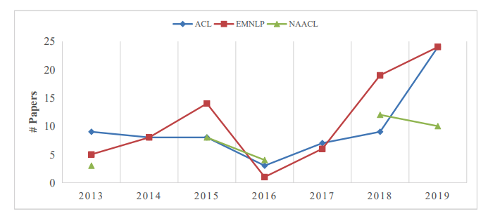
Modern approaches

Slide 42
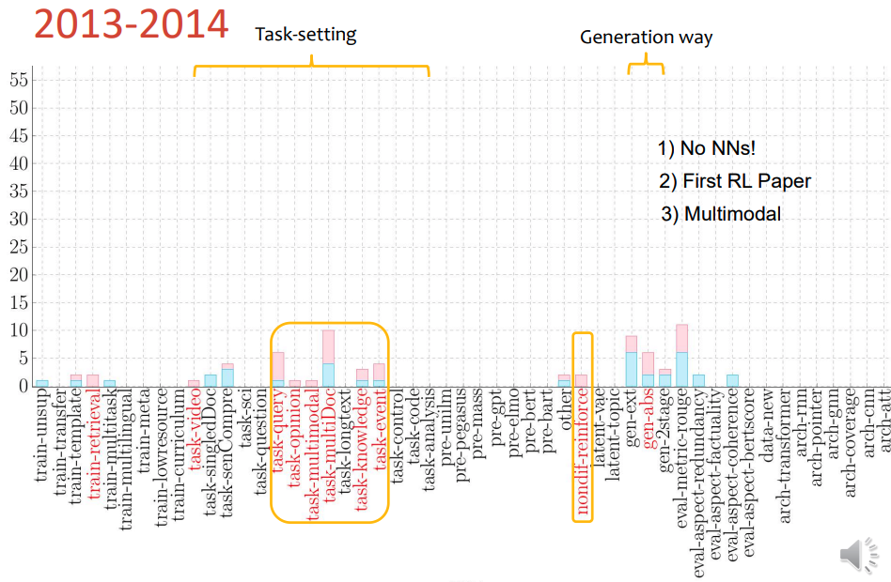
Modern approaches

Slide 43
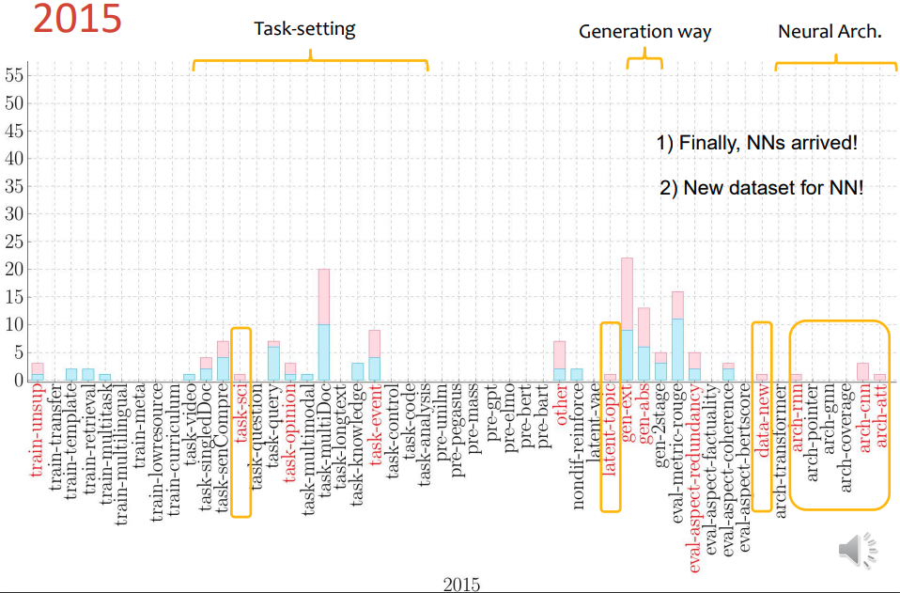
Modern approaches

Slide 44
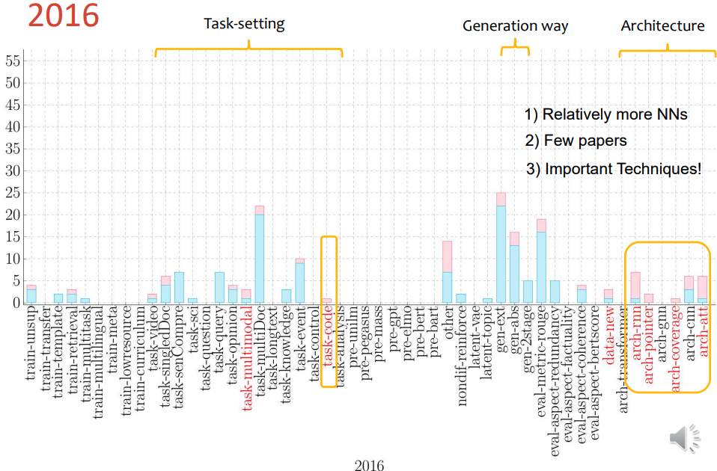
Modern approaches

Slide 45
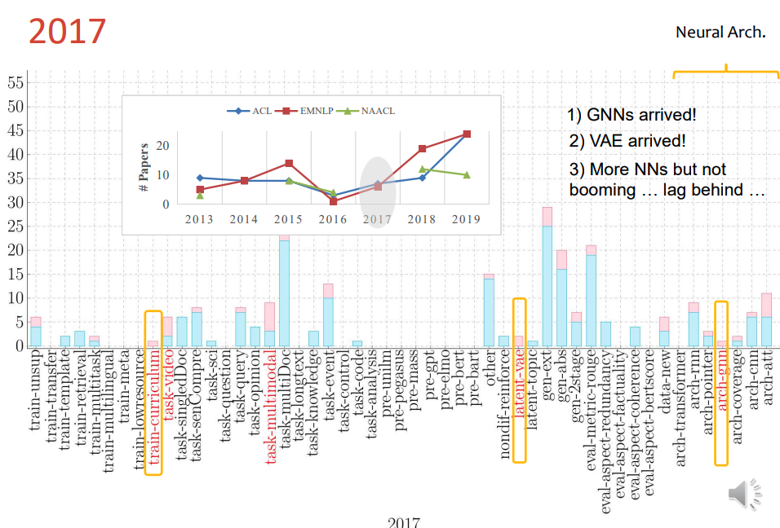
Modern approaches

Slide 46
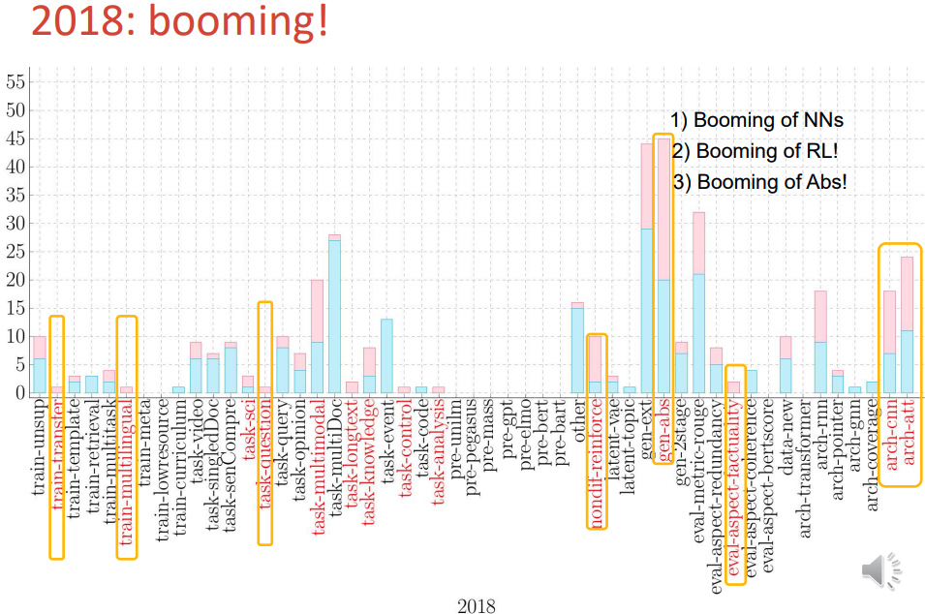
Modern approaches

Slide 47
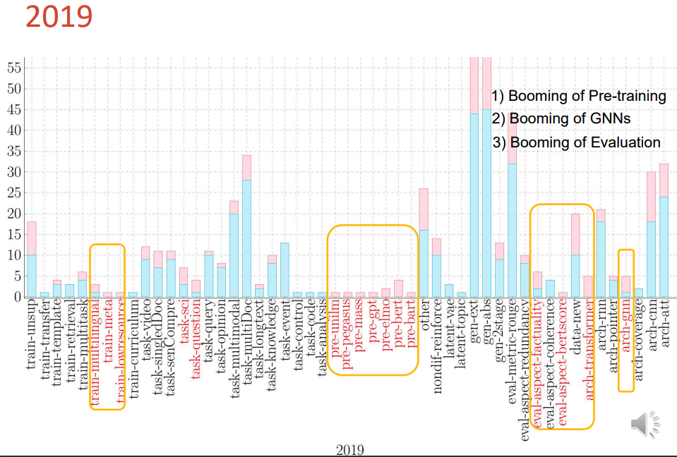
Modern approaches

Slide 48
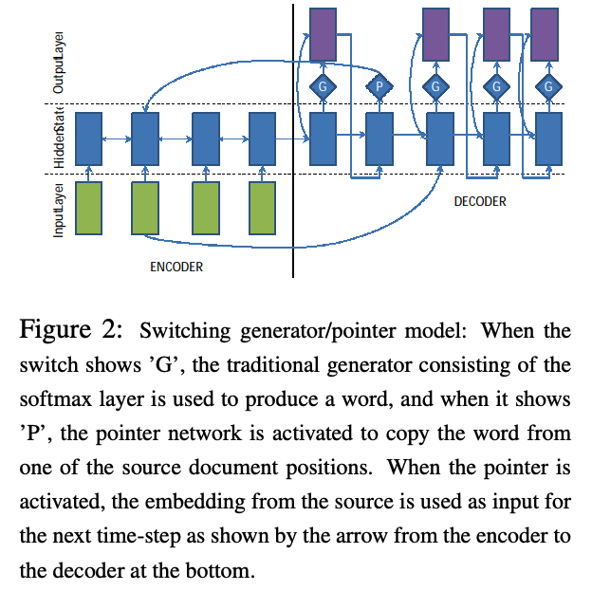
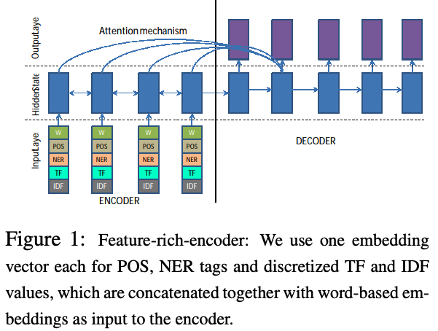
Abstractive Text Summarization using seq-to-seq RNNs

Slide 49
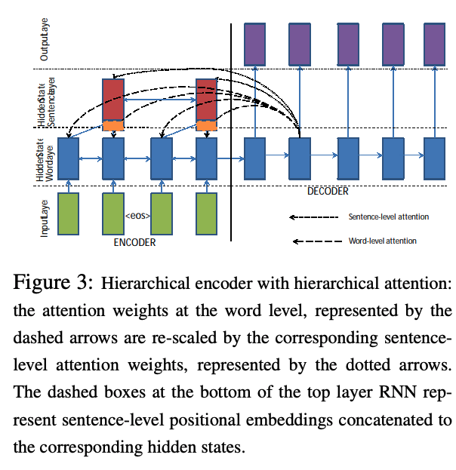
Abstractive Text Summarization using seq-to-seq RNNs

Slide 50
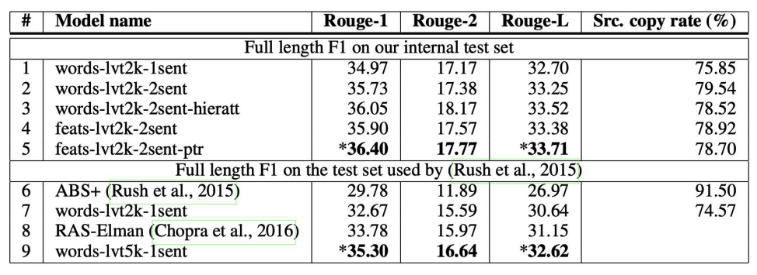
Abstractive Text Summarization using seq-to-seq RNNs

Slide 51
Copy mechanism

Slide 52
Copy mechanism

Slide 53
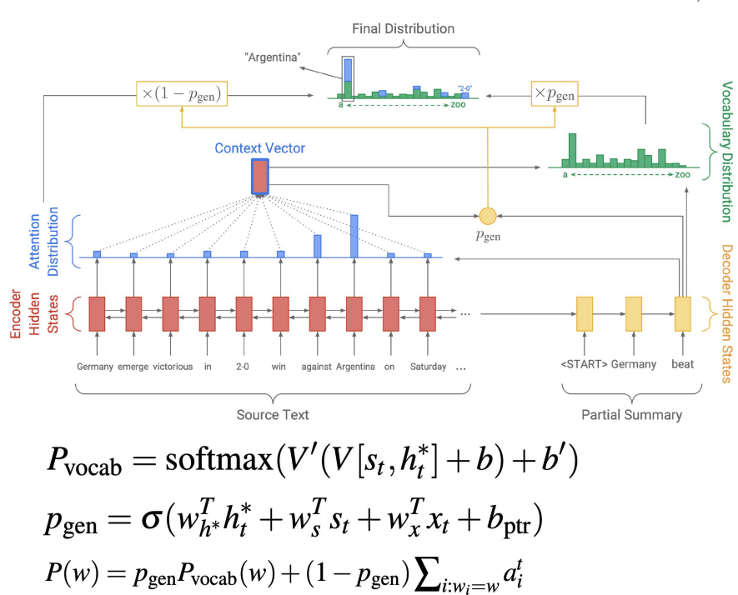
Copy mechanism

Slide 54
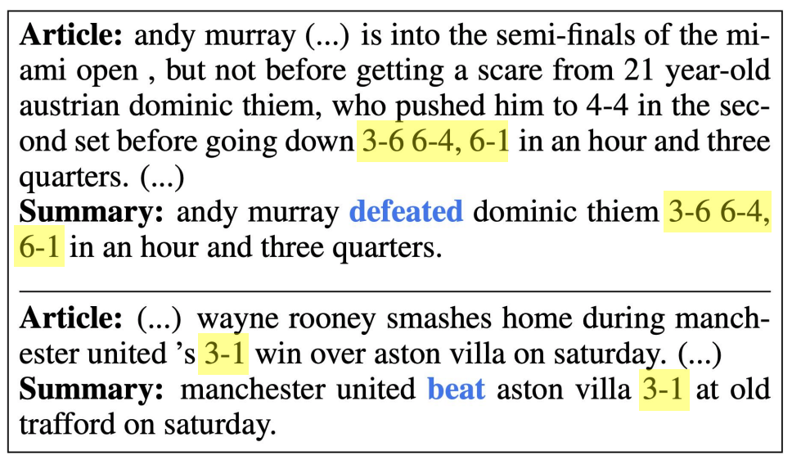
Copy mechanism

Slide 55
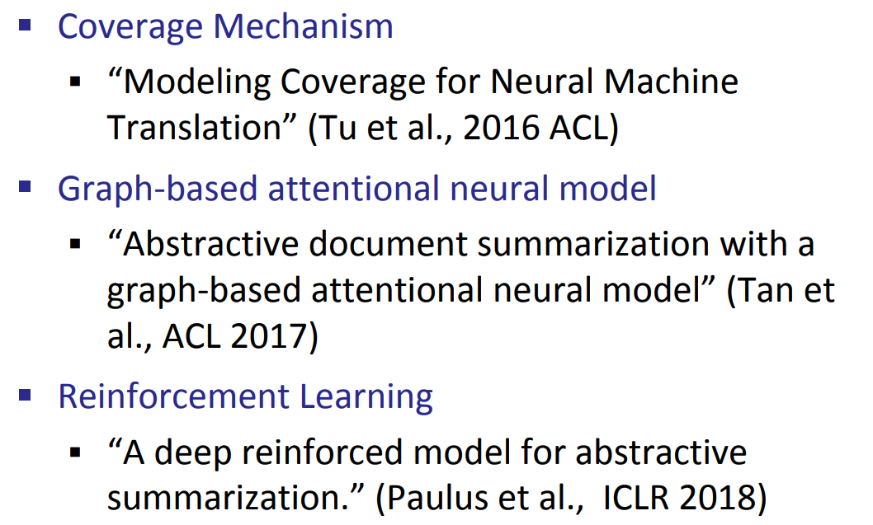
Other lines of research

Slide 56
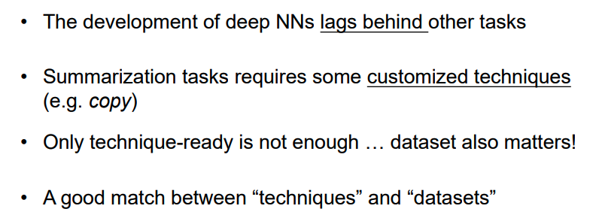
Historical Overview

Slide 57
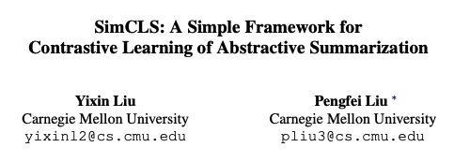
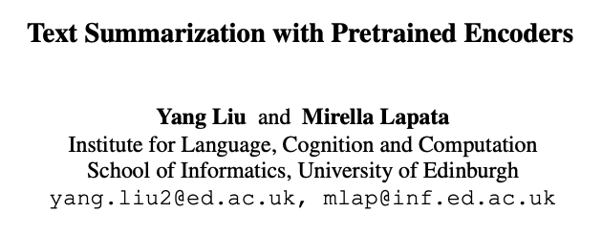
Let’s explore
In this paper, we showcase how BERT can be usefully applied in text summarization and propose a general framework for both extractive and abstractive models. We introduce a novel document-level encoder based on BERT which is able to express the semantics of a document and obtain representations for its sentences. Our extractive model is built on top of this encoder by stacking several inter-sentence Transformer layers. For abstractive summarization, we propose a new fine-tuning schedule which adopts different optimizers for the encoder and the decoder as a means of alleviating the mismatch between the two (the former is pretrained while the latter is not).
In this paper, we present a conceptually simple while empirically powerful framework for abstractive summarization, SIMCLS, which can bridge the gap between the learning objective and evaluation metrics resulting from the currently dominated sequence-to-sequence learning framework by formulating text generation as a reference-free evaluation problem (i.e., quality estimation) assisted by contrastive learning

