Slide 1
Embedding Bias
Man is to computer programmer as woman is to x
Ellie Lasater-Guttmann
Lecture 13

Slide 2
Which would you rather be?
Brilliant
Beautiful
or

Slide 3
What does bias look like?

Slide 4
How would you like to spend your day?
Building Things
Fixing things
Meal prepping
Music making
Camping
Fishing
Swimming
Boating
Space exploring
Pretend play
Dolls and stuffed animals
Dollhouses
Playhouses
Fun with pets
Hair and nail salon
Fun fitness
Reading
Jewelry making
or
Thanks to FatherMag.com

Slide 5
Bias - do you have more examples?

Slide 6
Bias - what are we talking about?

Slide 7
Signs of bias in the world
Different treatment depending on identity
Different ideas about someone depending on identity
Different expectations about someone depending on identity
Different representation depending on identity

Slide 8
Gender Bias in AI

Slide 9
Gender Bias in AI

Slide 10
So, what’s the harm?
What is wrong with the examples we’ve seen here?

Slide 11
Representational Harms
A representational harm occurs when a system reinforces the subordination of some groups along identity lines.

Slide 12
What is an example of a representational harm?

Slide 13
What is an example of a representational harm?

Slide 14
What about this type of bias?
Air conditioning temperatures are set according to the resting metabolic rate of a 154-pound, 40 year-old man. This overestimates women’s metabolic rates by 35%+
As office temperatures get warmer, women perform better on cognitive tasks while men perform worse
https://www.nature.com/articles/nclimate2741
https://journals.plos.org/plosone/article/authors?id=10.1371/journal.pone.0216362

Slide 15
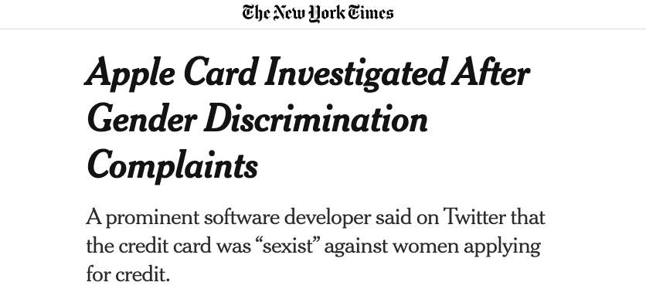
What about this type of bias?

Slide 16
So, what’s the harm?
What is wrong with the examples we’ve seen here?

Slide 17
Allocative Harms
An allocative harm is when a system allocates or withholds certain identity groups an opportunity or a resource.

Slide 18
What is an example of an allocative harm?

Slide 19
What is an example of an allocative harm?

Slide 20
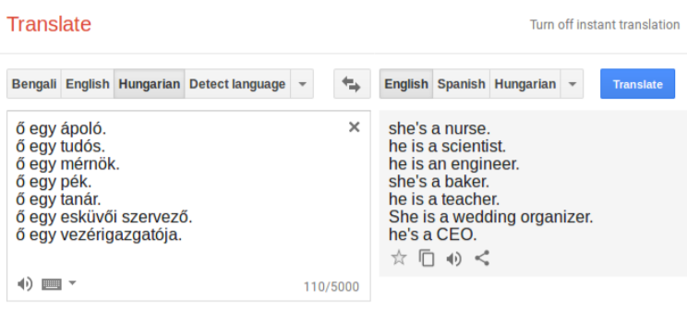
Gender Bias in NLP

Slide 21
What’s the harm with this example?

Slide 22
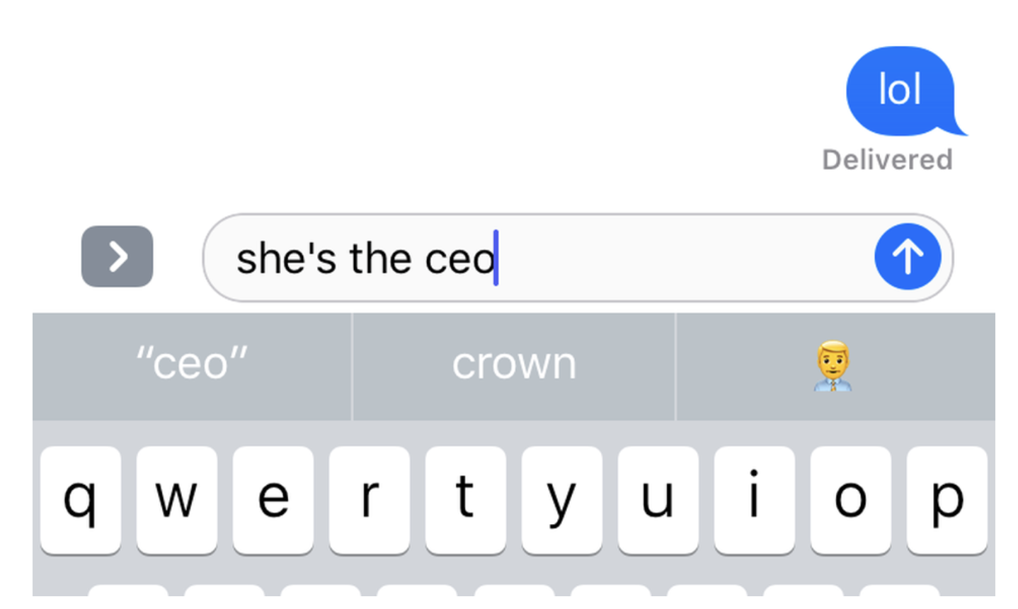
Gender Bias in AI

Slide 23
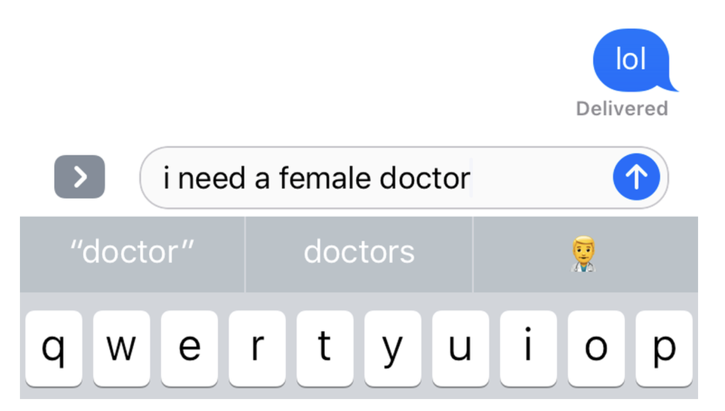
What’s the harm?

Slide 24
Gender Bias in Word Embeddings

Slide 25
Can anyone describe the embedding model discussed in the reading?
Word2Vec: word-embedding model, learning associations between words in the corpus
Corpus in question: Google News
w2vNEWS: Word2Vec trained on Google News

Slide 26
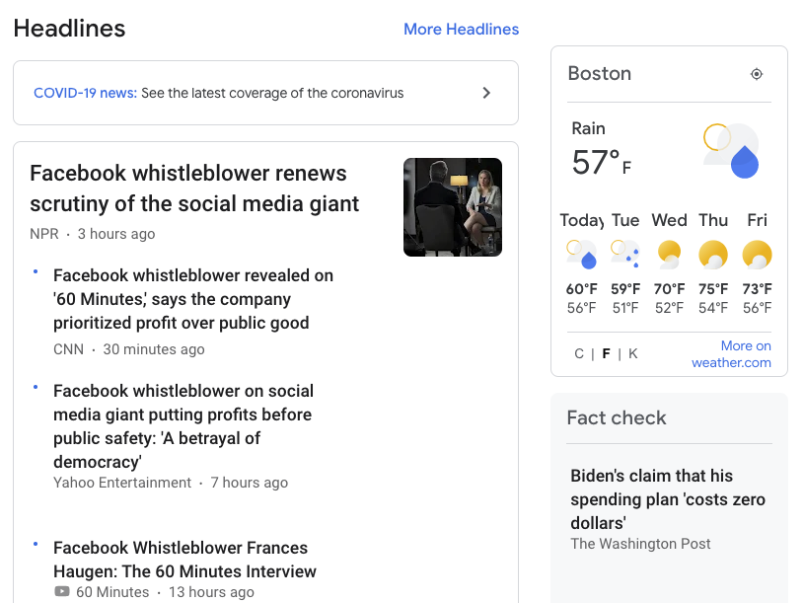
Google News

Slide 27
What happened in w2vNEWS?

Slide 28
What happened in w2vNEWS?
Man is to computer programmer as woman is to homemaker.

Slide 29
What are word embeddings used for?

Slide 30
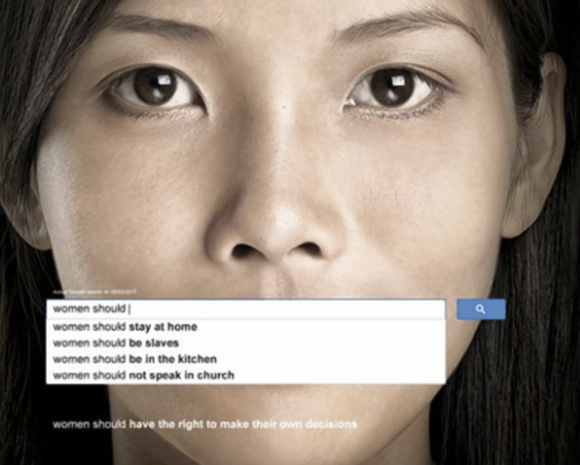
Gender Bias in Word Embeddings

Slide 31
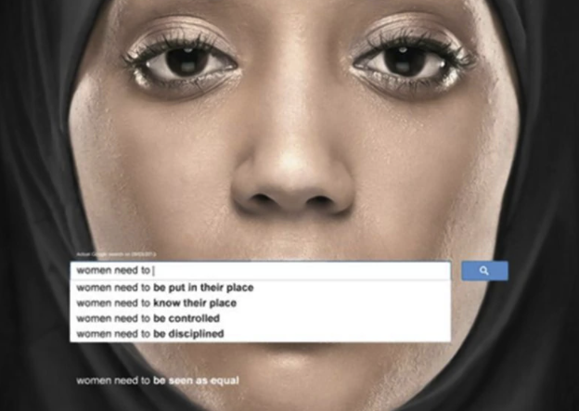
Gender Bias in Word Embeddings

Slide 32
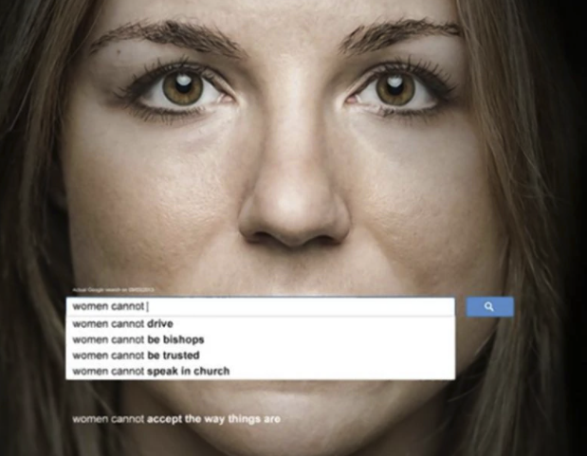
Gender Bias in Word Embeddings

Slide 33
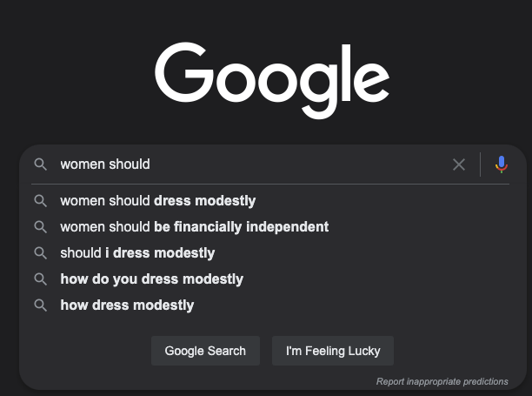
Gender Bias in Word Embeddings

Slide 34
So… what’s the harm?
Break yourselves into groups of 3 to brainstorm what types of harm are caused by word embedding models being biased in this way.
You’ll chat for 5 minutes and then we’ll debrief for 5 minutes.

Slide 35
BIG TAKEAWAY
NLP plays a role in representing people and allocating resources to them.

Slide 36
Should we do anything about our biased word embeddings?

Slide 37
Should we do anything about our biased word embeddings?
A possible answer: No, it reflects the bias in the corpus.

Slide 38
Should we do anything about our biased word embeddings?
Another possible answer: Yes, because applications exacerbate the problems in the corpus

Slide 39
BIG TAKEAWAYS
If we do nothing, our models will perpetuate representational and allocative harms.

Slide 40
How to debias…?
Organize yourself into groups of 3 to answer the following questions, using our reading(s) as a springboard. You’ll be reporting back!:
What would a unbiased word embedding model look like?
Could an unbiased word embedding model cause representational or allocative harms?
What steps would you take to design an unbiased model?

Slide 41
What would debiased embeddings look like?
One definition of a debiased model: One cannot determine the gender association of a word by looking at its projection on any gendered pair.
Eg. “Nurse” is equidistant from “man” and “woman”
But remember… “mother” should not be equidistant from “man” and “woman”

Slide 42
What would debiased embeddings look like?
But… even when “nurse” is equidistant to “man” and “woman”...
“Nurse” is close to “receptionist,” “caregiver,” and “teacher”

Slide 43
Debiasing - Strategy 1 - Post-processing
Reduce the bias for all words that are not inherently gendered (eg. “mother”)
They do that by zeroing the gender projection of each word on a predefined gender direction. (eg. similarity to the woman-man direction)
This is an attempt at debiasing at the post-processing stage

Slide 44
Debiasing - Strategy 2 - Pre-processing
Encourage gender to be represented in the final coordinate of each vector, so it can be excluded explicitly
This is an attempt at debiasing at the training stage

Slide 45
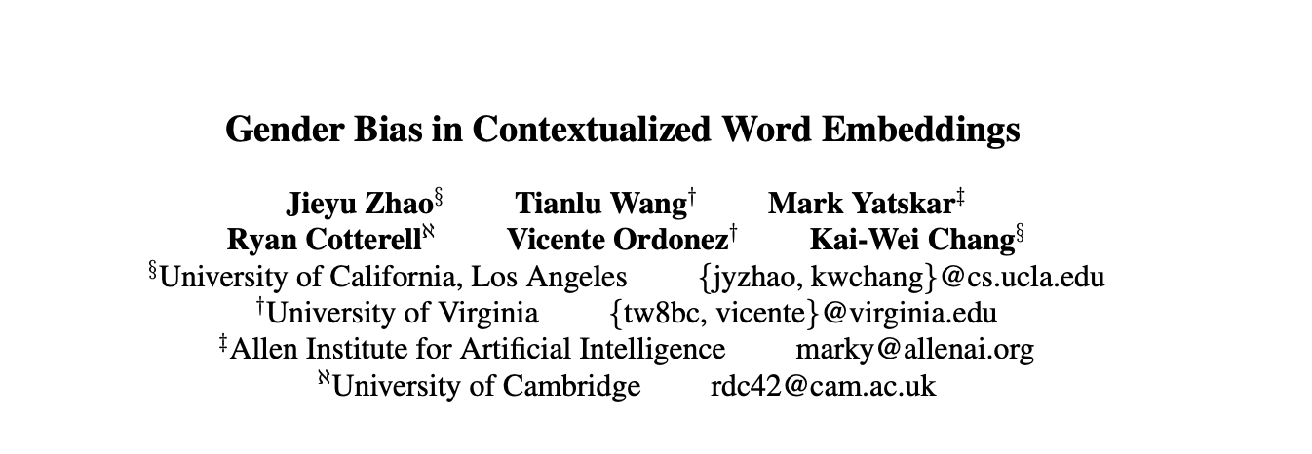
Contextualized Embeddings

Slide 46
BIG TAKEAWAYS
NLP plays a role in representing people and allocating resources to them. If we do nothing, our models will perpetuate representational and allocative harms.
But debiasing is hard!

Slide 47
Please take this survey!
https://tinyurl.com/AC295F21

