Slide 1
Lecture 12: GPT-2
Generative pre-training
Harvard
AC295/CS287r/CSCI E-115B
Chris Tanner

Slide 2
“Are you down with [GPT]? Yea, you know me!”

Slide 3
ANNOUNCEMENTS
HW3 has been released! Due Oct 19 (Tues) @ 11:59pm.
Research Project Phase 2 due Oct 14 (Thurs) @ 11:59pm
Read “Man is to Computer Programmer as Woman is to Homemaker? Debiasing Word Embeddings” before Oct 14 (Thurs)
International Collegiate Programming Contest (ICPC) news

Slide 4
ICPC
The last International Collegiate Programming Contest has hosted over 60,000 students from 3,514 universities in 115 countries that span the globe. October 5, more than 100 teams competed in logic, mental speed, and strategic thinking at Russia’s main Manege Central Conference Hall.

Slide 5
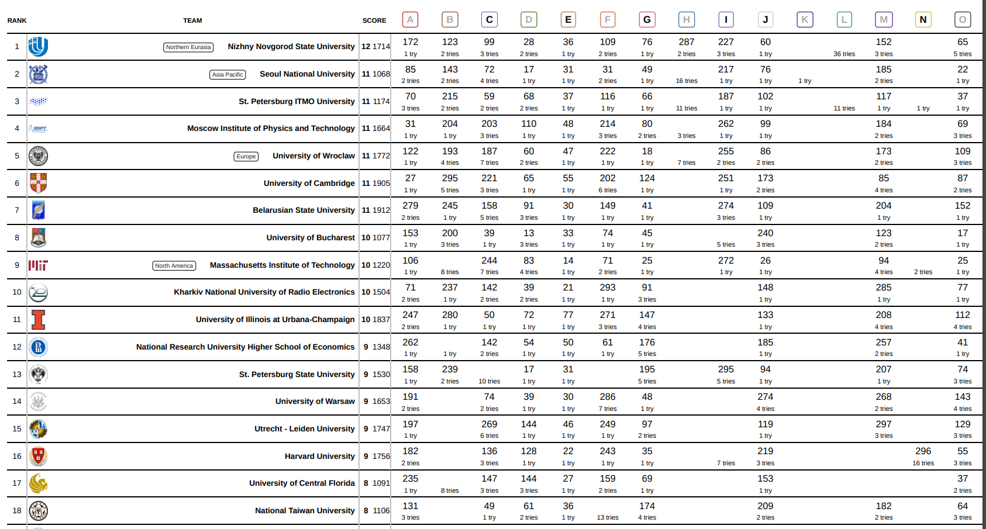
ICPC

Slide 6
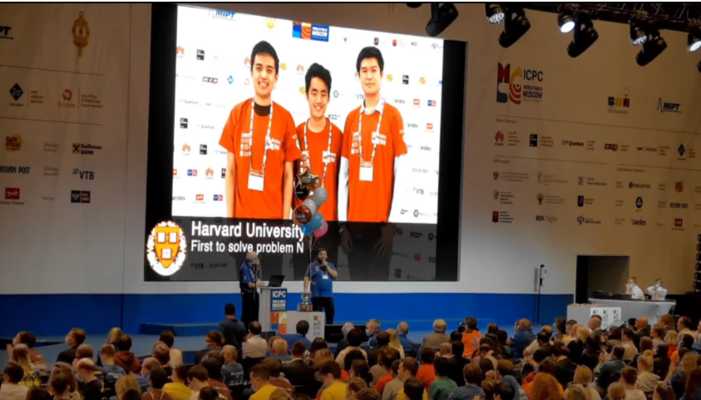

Slide 7
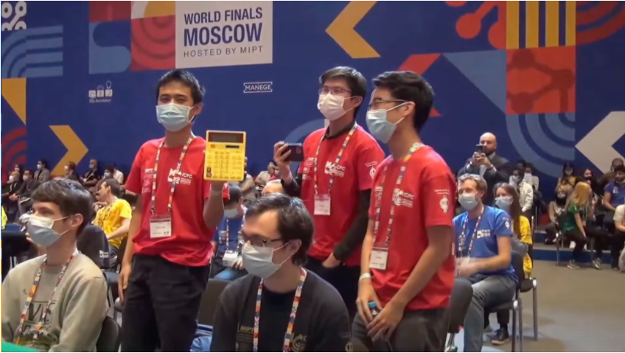

Slide 8
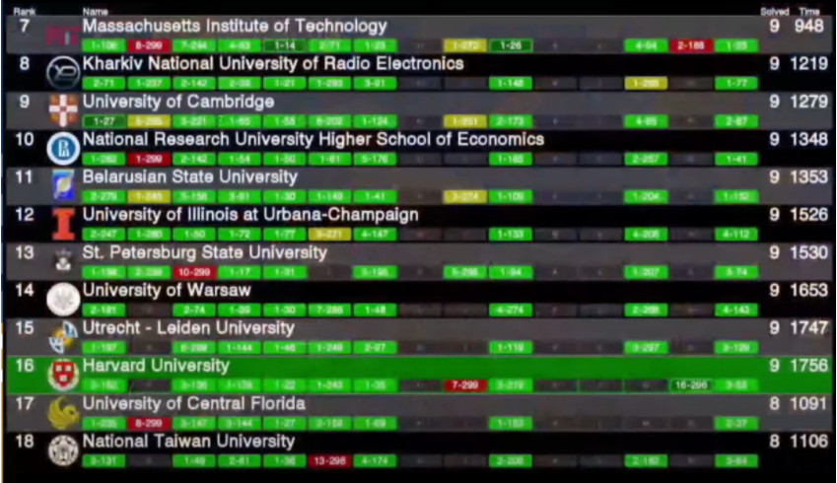

Slide 9
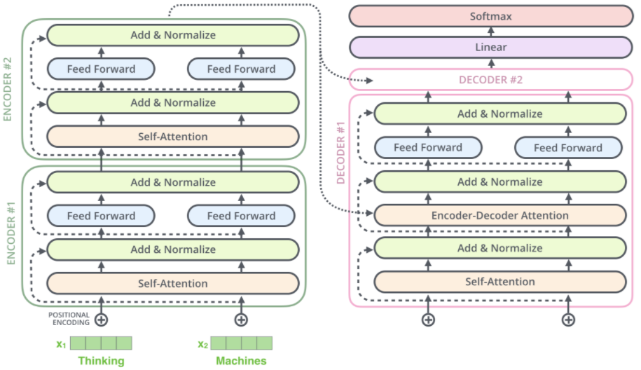
RECAP: L10
The vanilla Transformer model has an Encoder and Decoder, and was used in a seq2seq manner.
https://jalammar.github.io/illustrated-transformer/

Slide 10
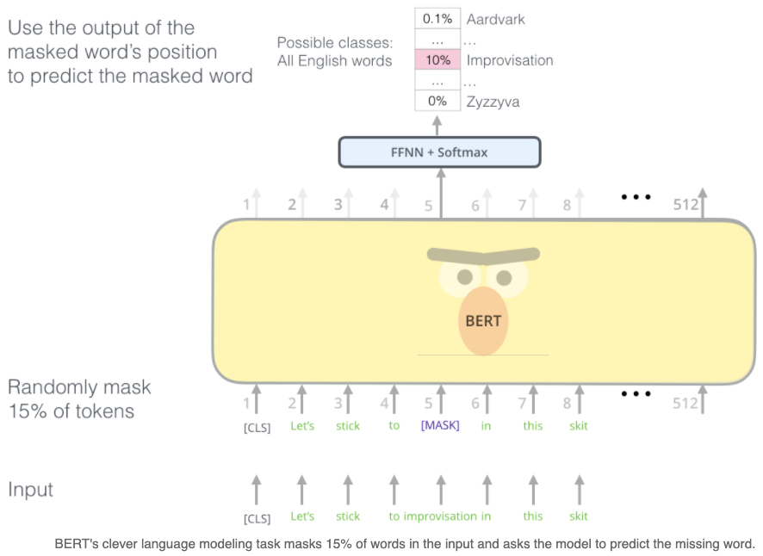
RECAP: L11
MLM objective
BERT
Model: several Transformer Encoders. Input sentence or sentence pairs, [CLS] token, subword embeddings
Objective: MLM and next-sentence prediction
Data: BooksCorpus and Wikipedia
https://jalammar.github.io/illustrated-transformer/

Slide 11
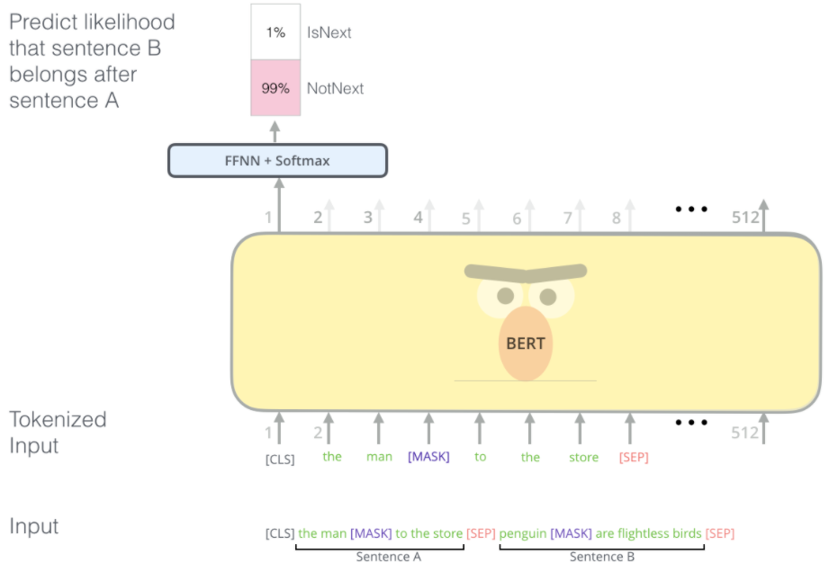
RECAP: L11
Next sentence objective
BERT
Model: several Transformer Encoders. Input sentence or sentence pairs, [CLS] token, subword embeddings
Objective: MLM and next-sentence prediction
Data: BooksCorpus and Wikipedia
https://jalammar.github.io/illustrated-transformer/

Slide 12
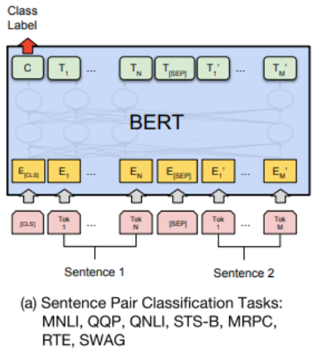
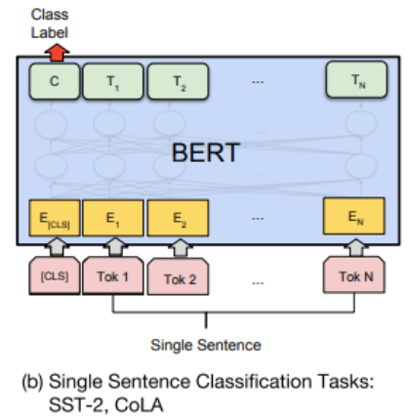
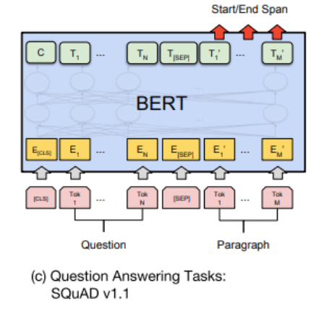
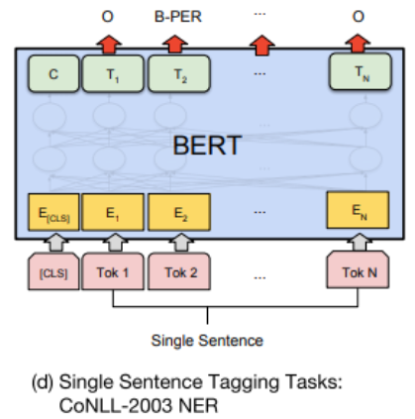
RECAP: L11
BERT is easy to fine-tune on any other classification task
replace the top layer
ensure your inputs are tokenized the same way as training, and no OOV tokens
usually best to allow the original BERT weights to adjust, too (don’t freeze)
https://jalammar.github.io/illustrated-transformer/

Slide 13
Outline
BERT (finishing up)
GPT-2
Issues and remaining work

Slide 14
Outline
BERT (finishing up)
GPT-2
Issues and remaining work

Slide 15
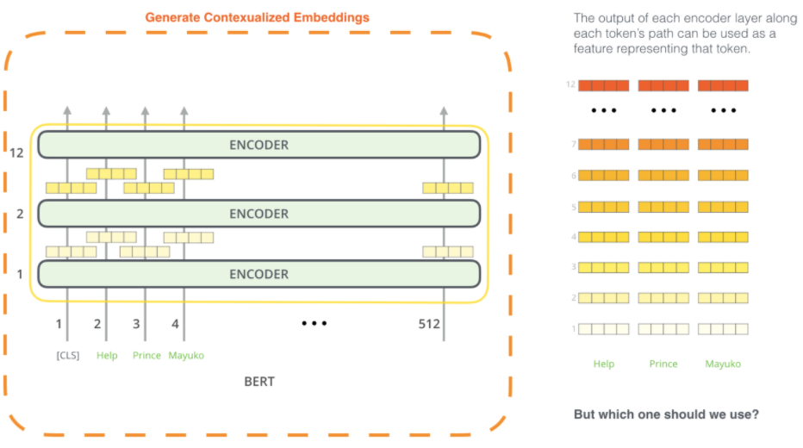
BERT
Instead of fine-tuning, one could extract the contextualized embeddings
Picture: https://jalammar.github.io/illustrated-bert/

Slide 16
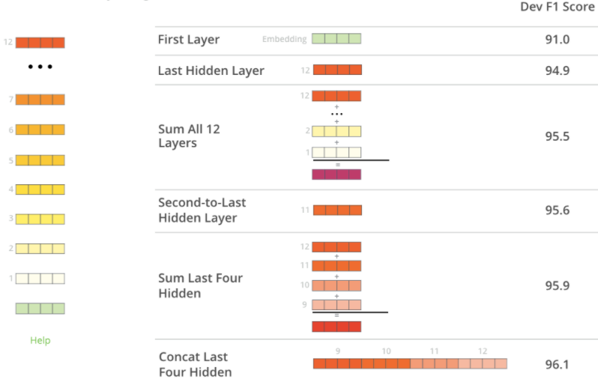
BERT
Later layers have the best contextualized embeddings
(compared to the fine-tuned model which achieved a score of 96.4)
Picture: https://jalammar.github.io/illustrated-bert/

Slide 17
BERT
BERT yielded state-of-the-art (SOTA) results on many tasks
Source: original BERT paper: https://arxiv.org/pdf/1810.04805.pdf

Slide 18
BERT (a Transformer variant)
Takeaway BERT is incredible for learning contextualized embeddings of words and using transfer learning for other tasks (e.g., classification).
Can’t generate new sentences though, due to no decoders.
y
Typically, one uses BERT’s awesome embeddings to fine-tune toward a different NLP task (this is called Sequential Transfer Learning)
r₁
r₂
r₃
r₄
Encoder #8
Encoder #1
The
brown
dog
ran
x₁
x₂
x₃
x₄

Slide 19
Extensions
Transformer-Encoders
BERT
ALBERT (A Lite BERT …)
RoBERTa (A Robustly Optimized BERT …)
DistilBERT (small BERT)
ELECTRA (Pre-training Text Encoders as Discriminators not Generators)
Longformer (Long-Document Transformer)

Slide 20
Extensions
Autoregressive
GPT (Generative Pre-training)
CTRL (Conditional Transformer LM for Controllable Generation)
Reformer
XLNet

Slide 21
Outline
BERT (finishing up)
GPT-2
Issues and remaining work

Slide 22
Outline
BERT (finishing up)
GPT-2
Issues and remaining work

Slide 23
Transformer
What if we want to generate a new output sequence?
GPT-2 model to the rescue!
Generative Pre-trained Transformer 2

Slide 24
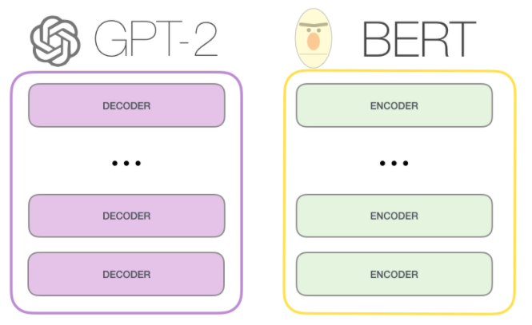
GPT-2 (a Transformer)
GPT-2 uses only Transformer Decoders (no Encoders) to generate new sequences from scratch or from a starting sequence
Image by http://jalammar.github.io/illustrated-gpt2/

Slide 25
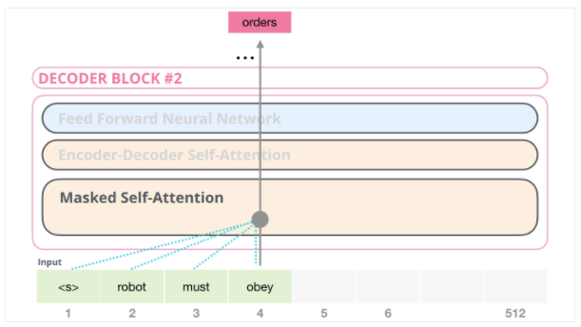
GPT-2 (a Transformer)
There is no Attention (since there is no Transformer Encoder to attend to). So, there is only Self-Attention.
As it processes each word/token, it masks the “future” words and conditions on and attends to the previous words
Image by http://jalammar.github.io/illustrated-gpt2/

Slide 26
GPT-2 (a Transformer)
As it processes each word/token, it masks the “future” words and conditions on and attends to the previous words
Image by http://jalammar.github.io/illustrated-gpt2/

Slide 27
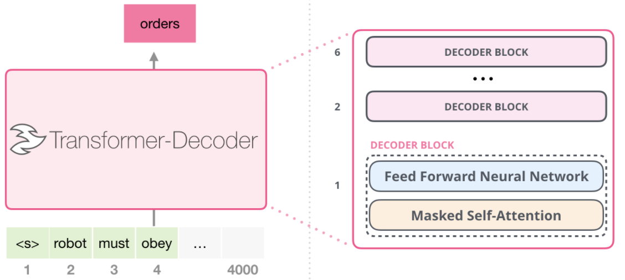
GPT-2 (a Transformer)
Image by http://jalammar.github.io/illustrated-gpt2/

Slide 28
GPT-2 (a Transformer)
Technically, it doesn’t use words as input but Byte Pair Encodings (sub-words), similar to BERT’s WordPieces.
Includes positional embeddings as part of the input, too.
Easy to fine-tune on your own dataset (language)

Slide 29
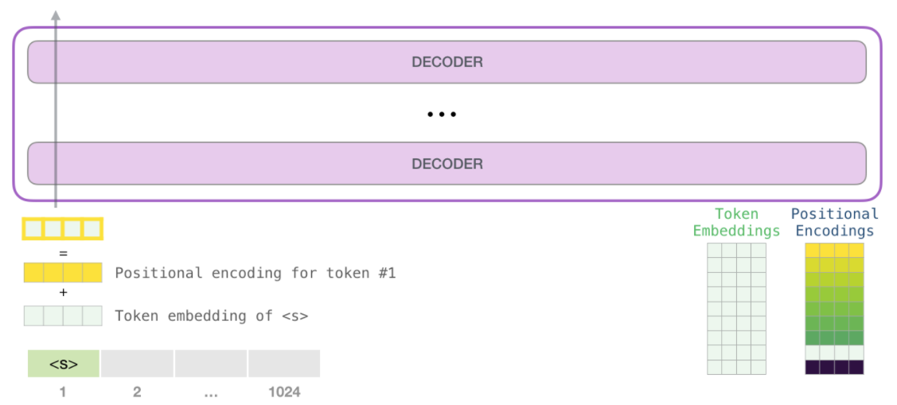
GPT-2 (a Transformer)
Image by http://jalammar.github.io/illustrated-gpt2/

Slide 30
Byte Pair Encodings (BPE)
Invented in 1994 (Gage) and updated in 2015 (Sennrich et al.)
Looks at the individual symbols (e.g., characters) and repeated merges the most frequent pairs (a la agglomerative clustering)
Stop after N merges (you specify N). GPT uses N =40k
Philip Gage. 1994. A New Algorithm for Data Compression. C Users J., 12(2):23–38, February
R. Sennrich, B. Haddow, and A. Birch. Neural machine translation of rare words with subword units. arXiv preprint arXiv:1508.07909, 2015

Slide 31
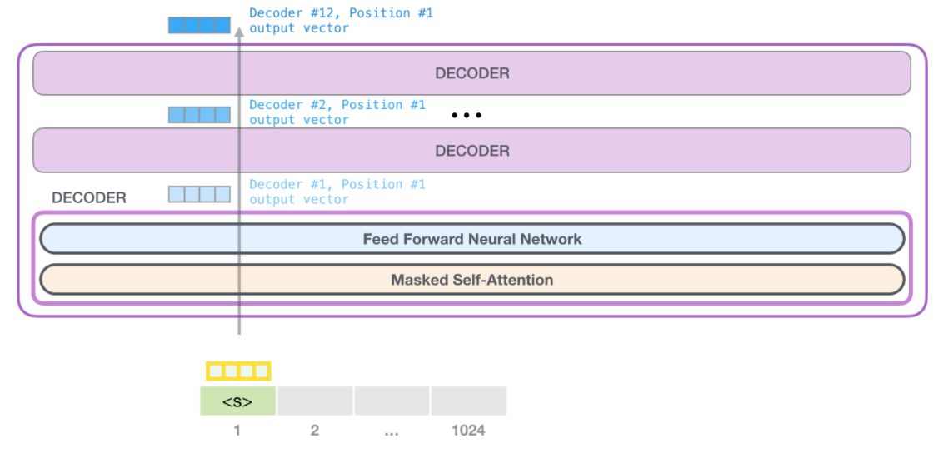
GPT-2 (a Transformer)
Image by http://jalammar.github.io/illustrated-gpt2/

Slide 32
GPT-2’s Masked Attention
For efficiency, we can still calculate all query-key calculations with matrix multiplications, then mask before softmax’ing.
Image by http://jalammar.github.io/illustrated-gpt2/

Slide 33
GPT-2’s Masked Attention
For efficiency, we can still calculate all query-key calculations with matrix multiplications, then mask before softmax’ing.
Image by http://jalammar.github.io/illustrated-gpt2/

Slide 34
GPT-2’s Masked Attention
For efficiency, we can still calculate all query-key calculations with matrix multiplications, then mask before softmax’ing.
Image by http://jalammar.github.io/illustrated-gpt2/

Slide 35
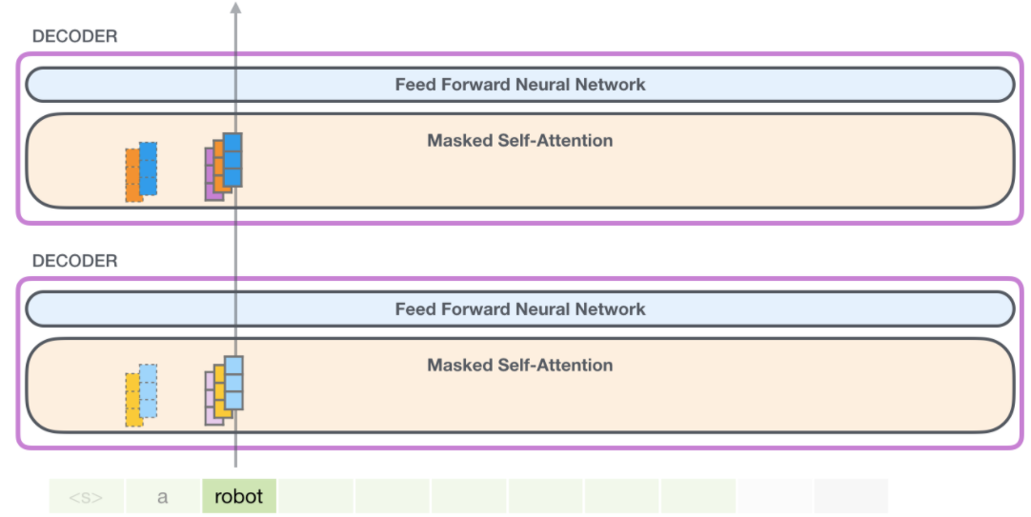
GPT-2’s
Representations are propagated upwards through the network
Image by http://jalammar.github.io/illustrated-gpt2/

Slide 36
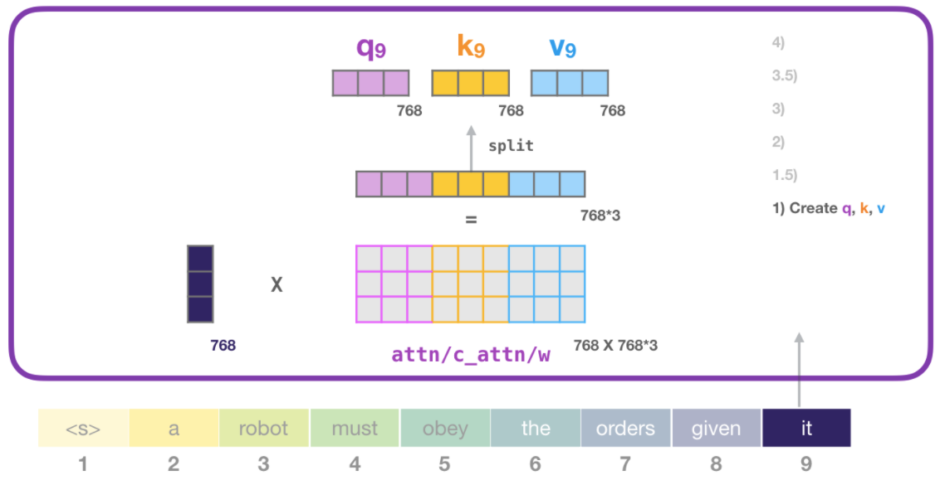
GPT-2’s
Self-attention is otherwise identical to what we saw in BERT
Image by http://jalammar.github.io/illustrated-gpt2/

Slide 37
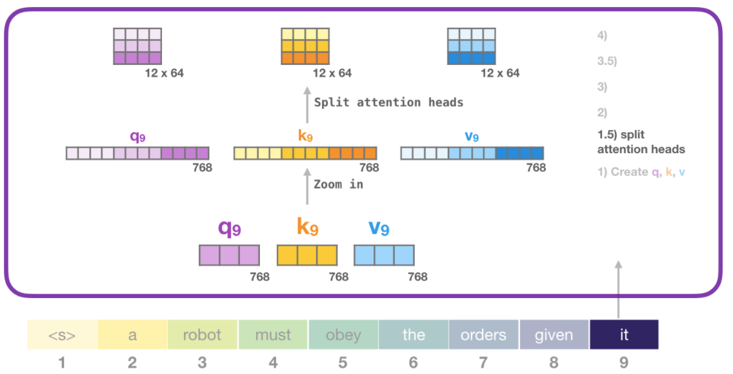
GPT-2’s
Can have Multiple Self-Attention heads
Image by http://jalammar.github.io/illustrated-gpt2/

Slide 38
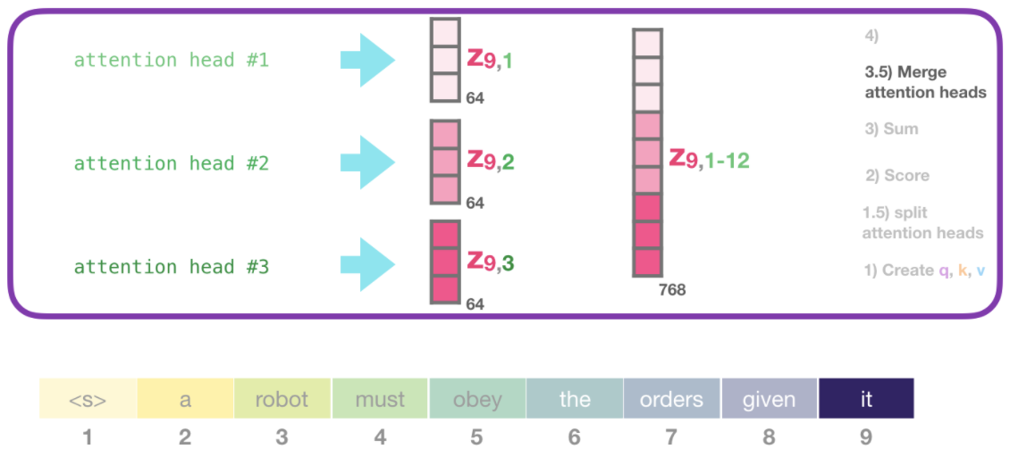
GPT-2’s
Each Self-Attention head is responsible for exactly 1 resulting, output embedding
Image by http://jalammar.github.io/illustrated-gpt2/

Slide 39
GPT-2’s
Remember, these Masked Self-Attention layers are fed into a FFNN
Image by http://jalammar.github.io/illustrated-gpt2/

Slide 40
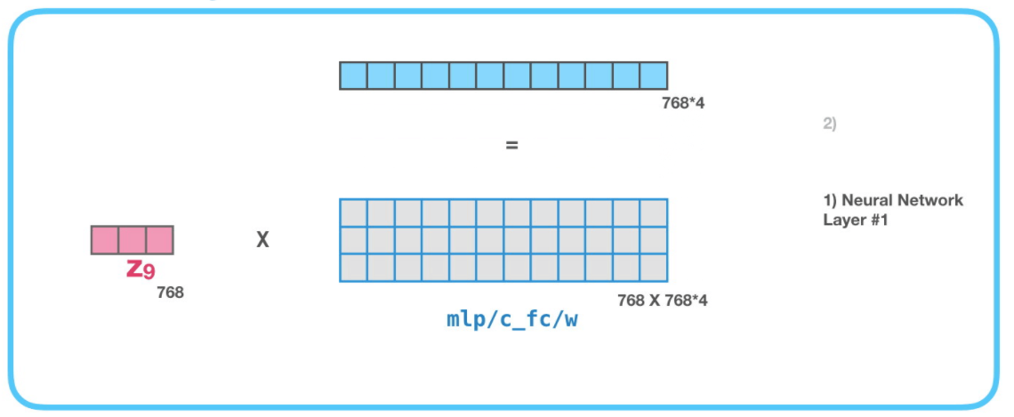
GPT-2’s
Remember, these Masked Self-Attention layers are fed into a FFNN
First hidden layer expands to 4x in size of the input
Image by http://jalammar.github.io/illustrated-gpt2/

Slide 41
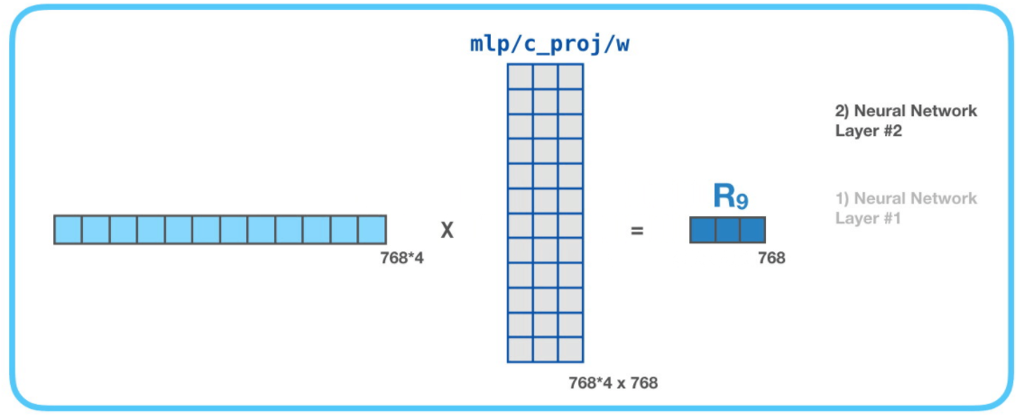
GPT-2’s
2nd (final) layer of the FFNN projects it back to the original size
Image by http://jalammar.github.io/illustrated-gpt2/

Slide 42
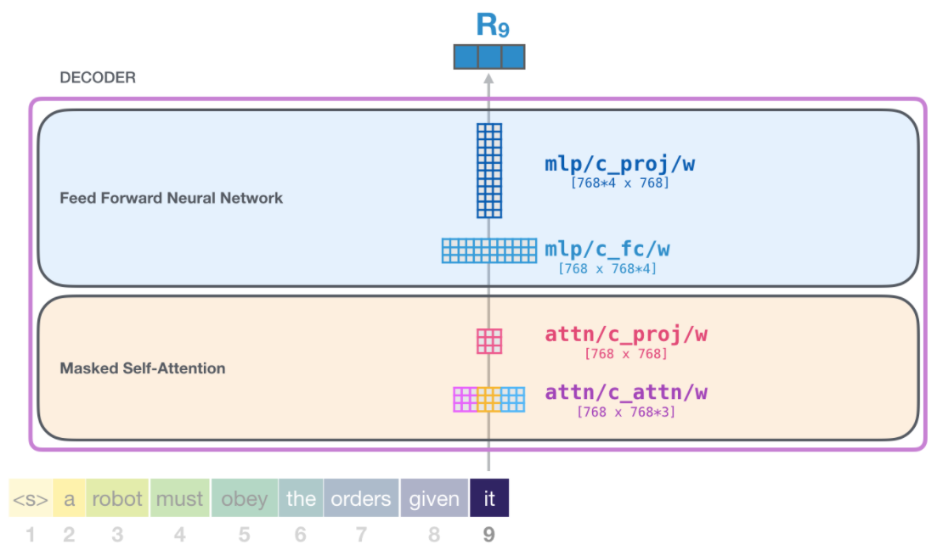
GPT-2’s
Image by http://jalammar.github.io/illustrated-gpt2/

Slide 43
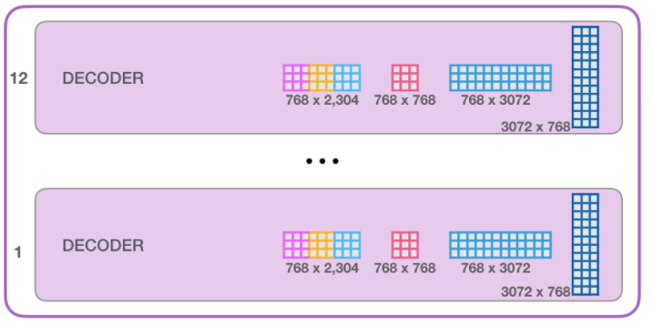
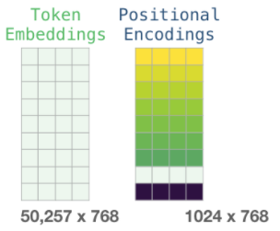
Each Decoder block has its own weights (e.g., $W_{k}, W_{q}, W_{v}$)
But the entire model only has 1 token-embedding weight matrix and positional encoding weight matrix. This helps all the blocks to work together and supplement their captured aspects
Image by http://jalammar.github.io/illustrated-gpt2/

Slide 44
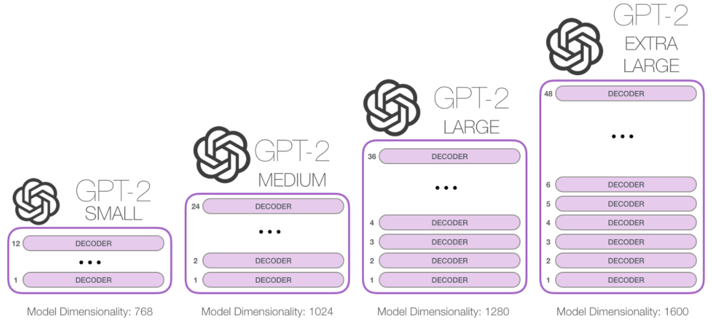
The authors of GPT-2 created 4 different version (sizes) of the model
Image by http://jalammar.github.io/illustrated-gpt2/

Slide 45
GPT-1
Model: Transformer Decoders we just described
Objective: next word prediction (cross-entropy loss)
Data: BooksCorpus (7k books from a variety of genres, such as Adventure, Fantasy, and Romance)

Slide 46
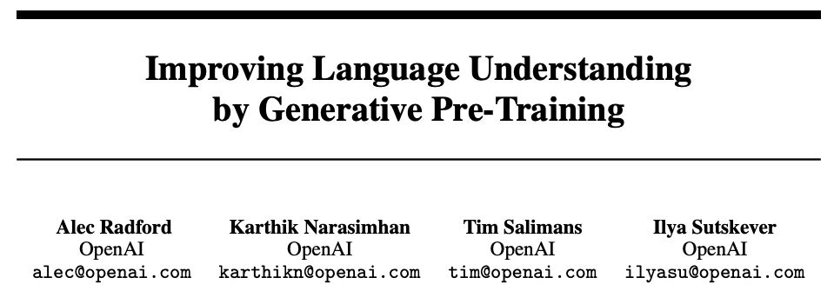
GPT-1
Authors were primarily focused on demonstrating that you could fine-tune this LM on supervised tasks and get SOTA results

Slide 47
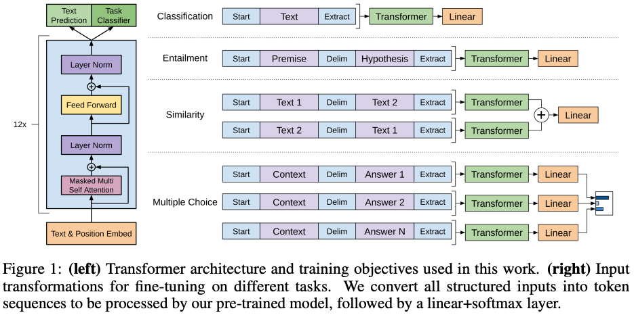
https://s3-us-west-2.amazonaws.com/openai-assets/research-covers/language-unsupervised/language_understanding_paper.pdf

Slide 48
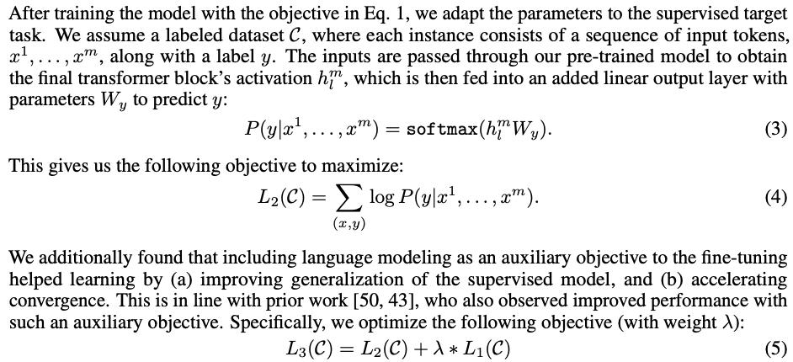
https://s3-us-west-2.amazonaws.com/openai-assets/research-covers/language-unsupervised/language_understanding_paper.pdf

Slide 49
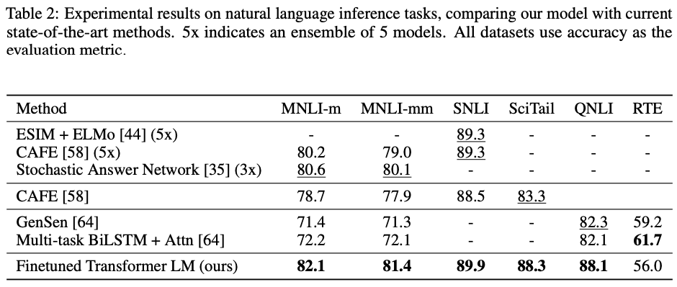
GPT-1
NLI is when you predict if the hypothesis phrase is entailed, neutral, or contradicts the preceding premise phrase.
https://s3-us-west-2.amazonaws.com/openai-assets/research-covers/language-unsupervised/language_understanding_paper.pdf

Slide 50
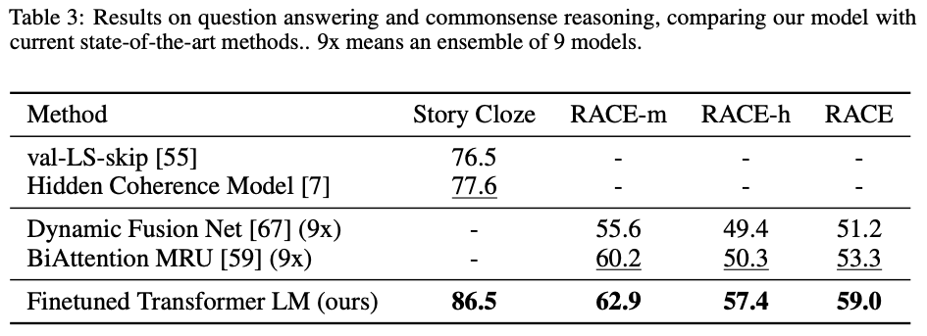
GPT-1
Story Cloze is like MLM, by predicting the blank
https://s3-us-west-2.amazonaws.com/openai-assets/research-covers/language-unsupervised/language_understanding_paper.pdf

Slide 51
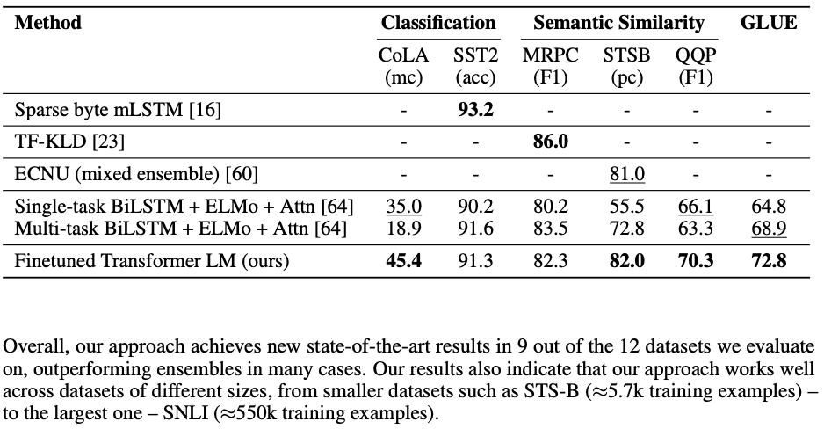
GPT-1
https://s3-us-west-2.amazonaws.com/openai-assets/research-covers/language-unsupervised/language_understanding_paper.pdf

Slide 52
GPT-2 is identical to GPT-1, but:
has Layer normalization in between each sub-block (as we’ve already seen)
Vocab extended to 50,257 tokens and context size increased from 512 to 1024
Data: 8 million docs from the web (Common Crawl), minus Wikipedia

Slide 53
You can finagle the system to yield synthetic predictions.
Children’s Book Test (CBT) is a classification task. Fill-in-the-blank, and you predict which of the 10 possible choices is correct.
You can compute the probability of each choice + its ending.

Slide 54
You can finagle the system to yield synthetic predictions.
LAMBADA dataset tests model’s ability to understand long-range dependencies.
Task: predict the final word of sentences which humans need 50+ tokens of context in order to accurately predict.

Slide 55
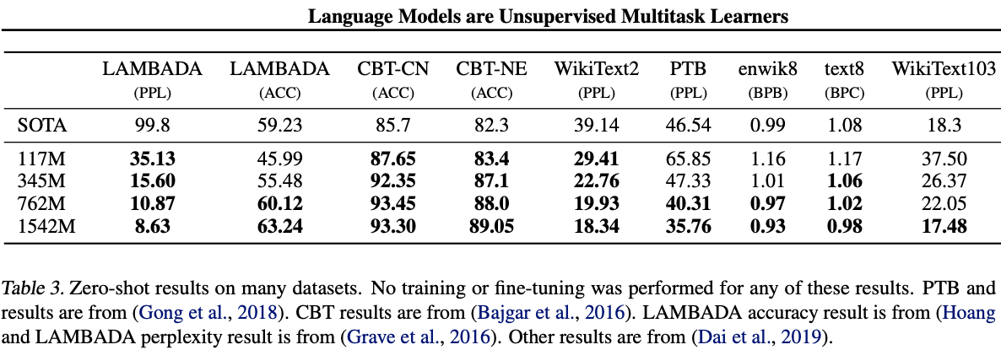
GPT-2 Results

Slide 56
You can finagle the system to yield synthetic predictions.
Summarization. The add the text “TL;DR:” after an article, then generate 100 tokens with top-2 random sampling, then extract the first 3 sentences.

Slide 57
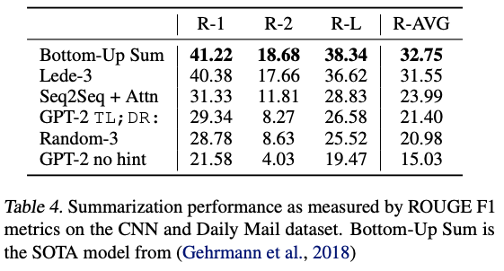
GPT-2 Results

Slide 58
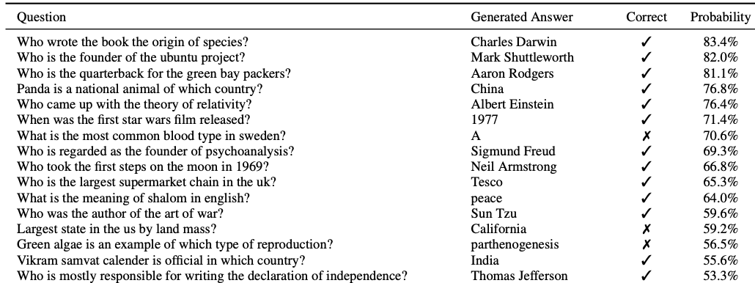
GPT-2 Results

Slide 59
GPT-2 Results
Easy to fine-tune on your own dataset (language)
SYSTEM PROMPT (HUMAN-WRITTEN)
A train carriage containing controlled nuclear materials was stolen in Cincinnati today. Its whereabouts are unknown.
MODEL COMPLETION (MACHINE-WRITTEN, FIRST TRY)
The incident occurred on the downtown train line, which runs from Covington and Ashland stations.
In an email to Ohio news outlets, the U.S. Department of Energy said it is working with the Federal Railroad Administration to find the thief.
“The theft of this nuclear material will have significant negative consequences on public and environmental health, our workforce and the economy of our nation,” said Tom Hicks, the U.S. Energy Secretary, in a statement. “Our top priority is to secure the theft and ensure it doesn’t happen again.”
The stolen material was taken from the University of Cincinnati’s Research Triangle Park nuclear research site, according to a news release from Department officials.
The Nuclear Regulatory Commission did not immediately release any information.

Slide 60
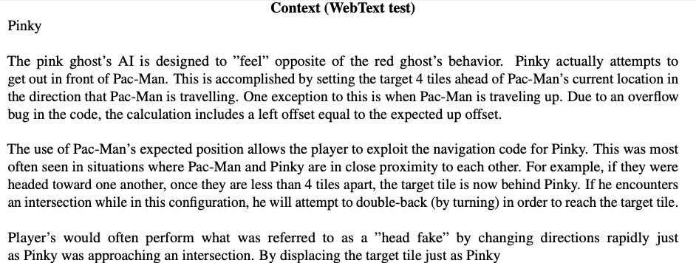

Slide 61
was about to cross the intersection, Pac-Man would be able to dodge the ghosts’ projectiles and return to the safe location of the safe house. Buster The yellow ghost’s AI is specifically designed to try to avoid Pac-Man from leaving the safe house. The player must press the SPACE bar to reveal the safe house’s doors, then go into them to find the yellow ghost hiding in the next room. The player must also note that the ghost will not attempt to exit the safe house if it sees Pac-Man already there. In fact, the ghost will not attempt an exit in the first place unless they’re already in the safe house. These two behaviors are based on the fact that the player does not always attempt to reach the safe house before Pac-Man (or Blinky). The player must also beware of this glitch if a ghost (or another player) is already in the safe house and attempting to get out as soon as Pac-Man or Blinky is gone.

Slide 62
LIVE DEMO

Slide 63
BERT (a Transformer Encoder)
BERT is trained on a lot of text data:
BooksCorpus (800M words)
English Wikipedia (2.5B words)
BERT-Base model has 12 transformer blocks, 12 attention heads, 110M parameters!
BERT-Large model has 24 transformer blocks, 16 attention heads, 340M parameters!
Yay, for transfer learning!

Slide 64
GPT-2 (a Transformer Decoder)
GPT-2 is:
trained on 40GB of text data (8M webpages)!
1.5B parameters
GPT-3 is an even bigger version (175B parameters) of GPT-2, but isn’t open-source
Yay, for transfer learning!

Slide 65
Outline
BERT (finishing up)
GPT-2
Issues and remaining work

Slide 66
Outline
BERT (finishing up)
GPT-2
Issues and remaining work

Slide 67
Concerns
There are several issues to be aware of:
It is very costly to train these large models. The companies who develop these models easily spend an entire month training one model, which uses incredible amounts of electricity.
BERT alone is estimated to cost over $1M for their final models
Source: https://arxiv.org/pdf/2004.08900.pdf

Slide 68
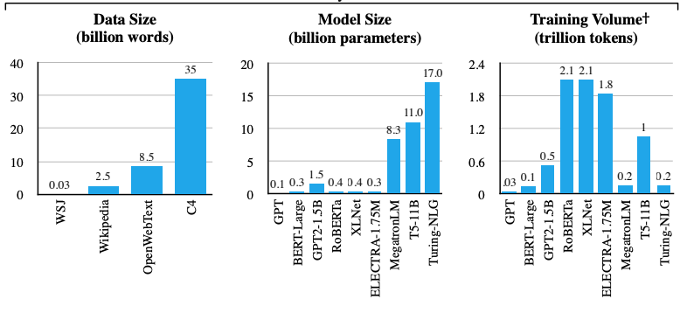
Concerns
It is very costly to train these large models.
Source: https://arxiv.org/pdf/2004.08900.pdf

Slide 69
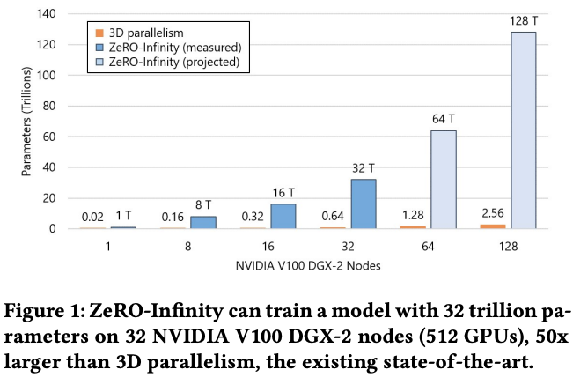
Concerns

Slide 70
Concerns
Further, these very large language models have been shown to be biased (e.g., in terms of gender, race, sex, etc).
Converting from one language to another often converts gender neutral pronouns to sexist stereotypes
Using these powerful LMs comes with risks of producing such text and/or evaluating/predicting tasks based on these biased assumptions.
People are researching how to improve this

Slide 71
Concerns
As computer-generated text starts to become indistinguishable from authentic, human-generated text, consider the ethical impact of fraudulently claiming text to be from a particular author.
If used maliciously, it can easily contribute toward the problem of Fake News

Slide 72
Summary
There has been significant NLP progress in the past few years.
Some of the complex models are incredible, but rely on having a lot of data and computational resources (e.g., Transformers)
With all data science and machine learning, it’s best to understand your data and task very well, clean your data, and start with a simple model (instead of jumping to the most complex model)

Slide 73
Summary
NLP is incredibly fun, with infinite number of problems to work on
Neural models allow us to easily represent words as distributed representations
Input unique word (or sub-words) as tokens
Recurrent models can be for capturing the sequential nature, but it puts too much responsibility on the model to keep track of the entire meaning and to pass it onwards

Slide 74
Summary
Transformers allow for more complete, free access to everything (unless masked) at once
It’s very useful to pre-train a large unsupervised/self-supervised LM then fine-tune on your particular task (replace the top layer, so that it can work)

Slide 75
Outstanding Questions
What is the model actually learning → probing tasks/interpretability
biases exist within data & model. How can we improve this? → debiasing
How can we make models faster, smaller, more robust? → distillation, robustness
Can we better understand the sensitivity of models and protect against vulnerabilities? → adversarial NLP
How can we better handle low-resource/scarce/unlabelled data?
How can we get better at complex tasks? (e.g., coreference resolution, tasks that require commonsense reasoning and leveraging real-world knowledge)
How can we get better at long-form documents, mixed-mediums? (e.g., tabular data, images, structured text such as scientific papers)

