Slide 1
Lecture 11: BERT
The Power of Transformer Encoders
Harvard
AC295/CS287r/CSCI E-115B
Chris Tanner

Slide 3
ANNOUNCEMENTS
HW3 has been released! Due Oct 19 (Tues) @ 11:59pm.
Research Project Selection (Google Form) is now closed.
We’re making selections now!
Read “Man is to Computer Programmer as Woman is to Homemaker? Debiasing Word Embeddings” before Oct 14 (Thurs)

Slide 4
Outline
Transformer Decoder
Learning/Data/Tasks
BERT
BERT Fine-Tuning
Extensions

Slide 5
Outline
Transformer Decoder
Learning/Data/Tasks
BERT
BERT Fine-Tuning
Extensions

Slide 6
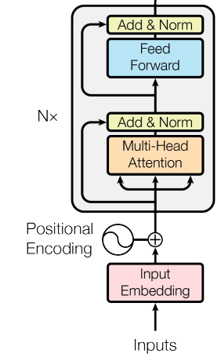
RECAP: L10
r₁
r₂
r₃
r₄
Encoder
FFNN
=
+ x Residual Connections +LayerNorm
z_{1A}
z_{1B}
z_{1C}
z_{2A}
z_{2B}
z_{2C}
z_{3A}
z_{3B}
z_{3C}
z_{4A}
z_{4B}
z_{4C}
Self-attention Head
The
brown
dog
ran
x₁
x₂
x₃
x₄

Slide 7
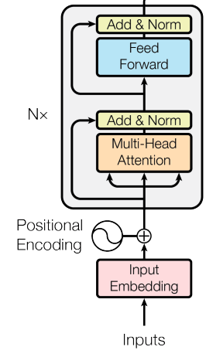
RECAP: L10
r₁
r₂
r₃
r₄
=
Encoder #3
Encoder #2
Encoder #1
The
brown
dog
ran
x₁
x₂
x₃
x₄

Slide 8
RECAP: L10
The original Transformer model was intended for Machine Translation, so it had Decoders, too

Slide 9
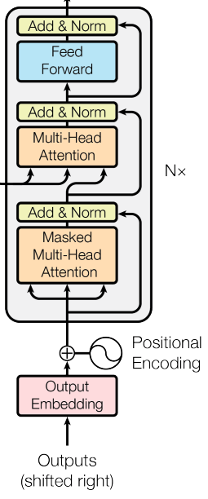
Transformer Decoder
r₁
r₂
r₃
r₄
Decoder
FFNN
=
+ x Residual Connections +LayerNorm
z_{1A}
z_{1B}
z_{1C}
z_{2A}
z_{2B}
z_{2C}
z_{3A}
z_{3B}
z_{3C}
z_{4A}
z_{4B}
z_{4C}
Masked Self-attention Head
<s>
El
perro
marrón
x₁
x₂
x₃
x₄

Slide 10
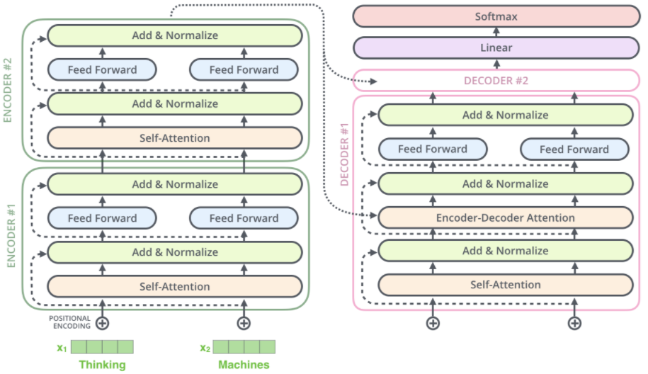
https://jalammar.github.io/illustrated-transformer/

Slide 11
Three ways to Attend
Encoder-Decoder Attention
Encoder Self-Attention
Decoder Masked Self-Attention

Slide 12
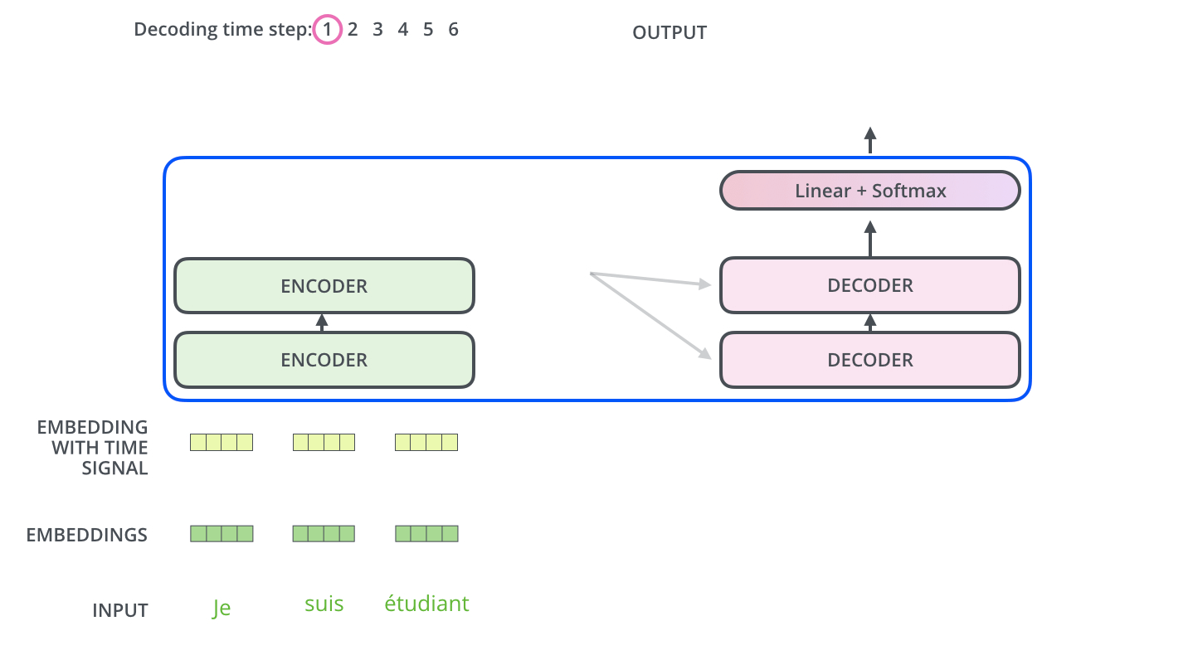
https://jalammar.github.io/illustrated-transformer/

Slide 13
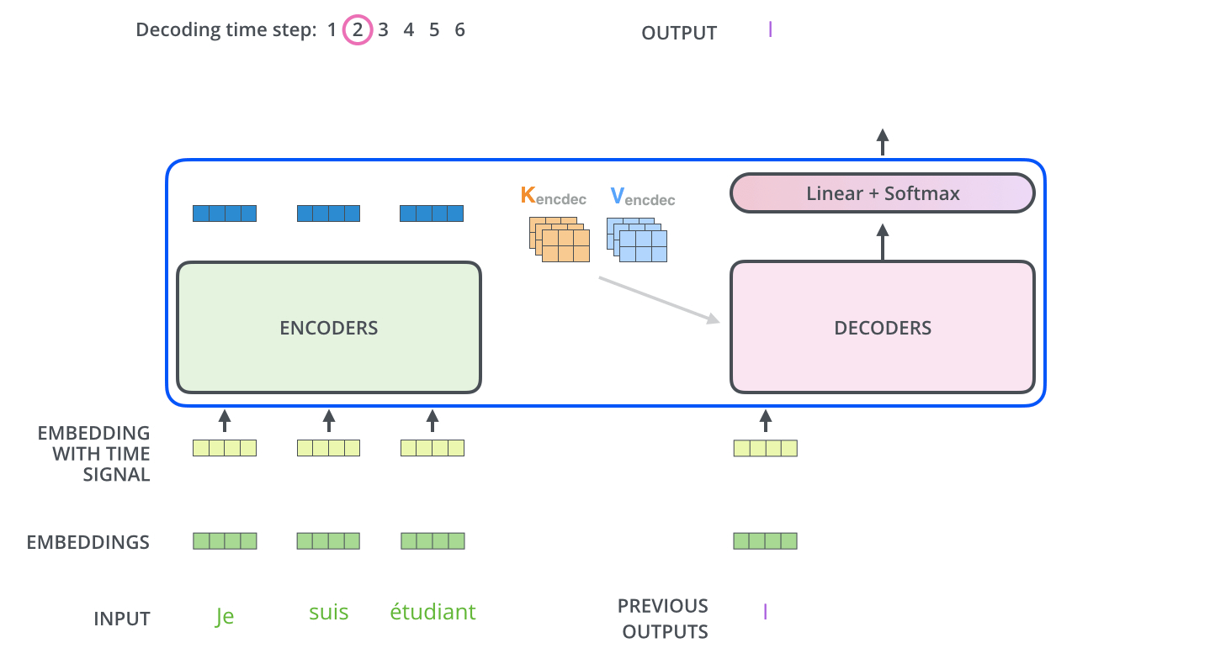
https://jalammar.github.io/illustrated-transformer/

Slide 14
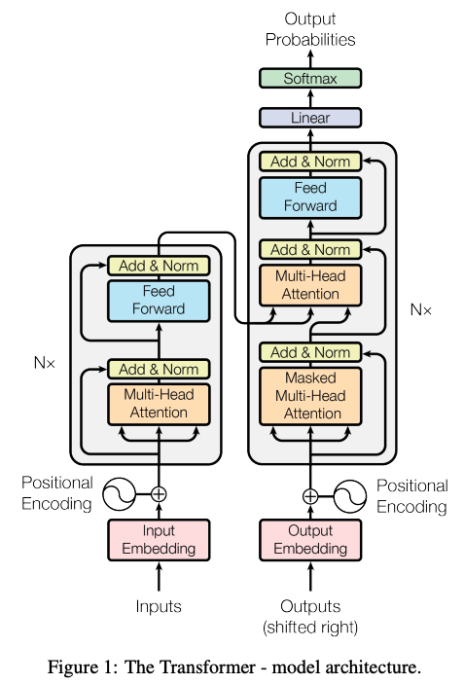
Attention is All you Need (2017) https://arxiv.org/pdf/1706.03762.pdf

Slide 15
Loss Function: cross-entropy (predicting translated word)
Training Time: ~4 days on (8) GPUs

Slide 16
n = sequence length
d = length of representation (vector)
Q: Is the complexity of self-attention good?

Slide 17
Important: when learning dependencies b/w words, you don’t want long paths. Shorter is better.
Self-attention connects all positions with a constant # of sequentially executed operations, whereas RNNs require $O(n).$
https://arxiv.org/pdf/1706.03762.pdf

Slide 18
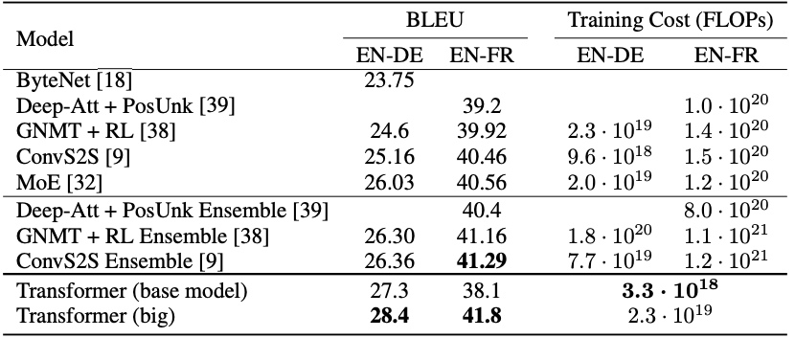
Machine Translation results: state-of-the-art (at the time)
:

Slide 19
Machine Translation results: state-of-the-art (at the time)
You can train to translate from Language A to Language B.
Then train it to translate from Language B. to Language C.
Then, without training, it can translate from Language A to Language C

Slide 20
What if we don’t want to decode/translate?
Just want to perform a particular task (e.g., classification)
Want even more robust, flexible, rich representation!
Want to explicitly capture fluency, somehow.

Slide 21
Outline
Transformer Decoder
Learning/Data/Tasks
BERT
BERT Fine-Tuning
Extensions

Slide 22
Outline
Transformer Decoder
Learning/Data/Tasks
BERT
BERT Fine-Tuning
Extensions

Slide 23
Everything we’ve discussed so far
GOALS/TASKS:
Learn distributed representations
word2vec (type-based word embeddings)
RNNs/LSTMs (token-based contextualized)
Machine Translation
Text classification
MODELS:
n-gram (not neural)
RNNs/LSTMs
seq2seq
Transformer Encoder/Decoder

Slide 24
Everything we’ve discussed so far
GOALS/TASKS:
Learn distributed representations
word2vec (type-based word embeddings)
RNNs/LSTMs (token-based contextualized)
Machine Translation
Text classification
MODELS:
n-gram (not neural)
RNNs/LSTMs
seq2seq
Transformer Encoder/Decoder
Aside from text classification (e.g., IMDb sentiments), we’ve only worked with unlabelled, naturally occurring data so far.
There’s a vast ocean of interesting tasks that require labelled data, and we often perform different types of learning in order to better leverage our limited labelled data.

Slide 25
Types of Data
UNLABELLED
Raw text (e.g., web pages)
Parallel corpora (e.g., for translations)
LABELLED
Linear/unstructured
N-to-1 (e.g., sentiment analysis)
N-to-N (e.g., POS tagging)
N-to-M (e.g., summarization)
Structured
Dependency parse trees
Constituency parse trees
Semantic Role Labelling

Slide 26
Types of Data
UNLABELLED
Raw text (e.g., web pages)
Parallel corpora (e.g., for translations)
LABELLED
Linear/unstructured
N-to-1 (e.g., sentiment analysis)
N-to-N (e.g., POS tagging)
N-to-M (e.g., summarization)
Structured
Dependency parse trees
Constituency parse trees
Semantic Role Labelling
We most often about this type of data

Slide 27
Types of Data
Labelled data is a scarce commodity.
How can we get more of it?
How can we leverage more plentiful, other data (either labelled or unlabelled) so as to make better use of our limited labelled data?

Slide 28
Types of Learning
One axis that refers to our style of using/learning our data:
Multi-task Learning
Transfer Learning
Pre-training
One axis that hinges upon the type of data we have:
Supervised Learning
Unsupervised Learning
Self-supervised Learning
Semi-supervised Learning

Slide 29
Types of Learning
One axis that refers to our style of using/learning our data:
Multi-task Learning = general term for training on multiple tasks
Transfer Learning = type of multi-task learning where we only care about one of the tasks
Pre-training = type of transfer learning where we first focus on one objective
See chalkboard for example

Slide 30
Multi-task heuristics
Ideally, your tasks should be closely related (e.g., constituency parsing and dependency parsing)
Multi-task learning may help improve the task that has limited data
General domain → specific domain (e.g., all of the web’s text -> law text)
High-resourced language → low-resourced language (e.g., English -> Igbo)
Unlabelled text → labelled text (e.g., language model -> named entity recognition)
Inspired by or based on http://www.phontron.com/class/anlp2021/assets/slides/anlp-08-pretraining.pdf

Slide 31
Outline
Transformer Decoder
Learning/Data/Tasks
BERT
BERT Fine-Tuning
Extensions

Slide 32
Outline
Transformer Decoder
Learning/Data/Tasks
BERT
BERT Fine-Tuning
Extensions

Slide 33
BERT
Bidirectional Encoder Representations from Transformers

Slide 34
BERT
Bidirectional Encoder Representations from Transformers
Like Bidirectional LSTMs, let’s look in both directions

Slide 35
BERT
Bidirectional Encoder Representations from Transformers
Let’s only use Transformer Encoders, no Decoders

Slide 36
BERT
Bidirectional Encoder Representations from Transformers
It’s a language model that builds rich representations

Slide 37
Naming convention
Many deep learning models, including pre-trained ones with cute names (e.g., ELMo, BERT, ALBERT, GPT-3), refer to an exact combination of:
The model’s architecture
The training objective to pre-train (e.g., MLM prediction)
The data (e.g., Google BooksCorpus, Wikipedia)
Many people abuse the terms and swap out components.

Slide 38
BERT
brown
lazy
playful
0.92
0.05
0.03
BERT:
BERT
Model: several Transformer Encoders. Input sentence or sentence pairs, [CLS] token, subword embeddings
Objective: MLM and next-sentence prediction
Data: BooksCorpus and Wikipedia
Encoder #6
Encoder #2
Encoder #1
<CLS>
The
brown
dog
x₁
x₂
x₃
x₄

Slide 39
BERT
brown
lazy
playful
0.92
0.05
0.03
BERT has 2 training objectives:
BERT
1. Predict the Masked word (a la CBOW)
15% of all input words are randomly masked.
80% become [MASK]
10% become revert back
10% become are deliberately corrupted as wrong words
Encoder #6
Encoder #2
Encoder #1
<CLS>
The
brown
dog
x₁
x₂
x₃
x₄

Slide 40
BERT
BERT has 2 training objectives:
isNext
notNext
0.98
0.02
BERT
2. Two sentences are fed in at a time. Predict the if the second sentence of input truly follows the first one or not.
Encoder #6
Encoder #2
Encoder #1
<CLS>
The
brown
dog
ran […] [SEP] Fido came home [SEP]
x₁
x₂
x₃
x₄

Slide 41
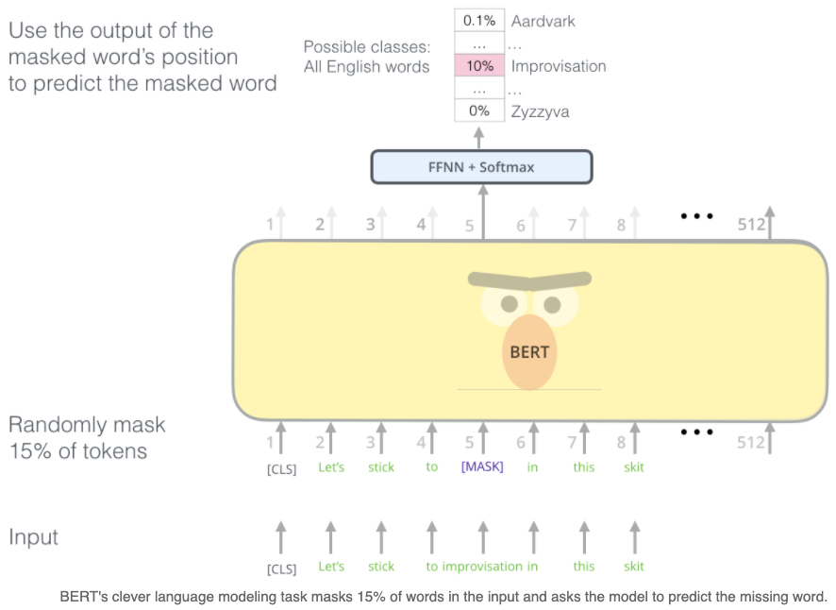
BERT (alternate view)
https://jalammar.github.io/illustrated-bert/

Slide 42
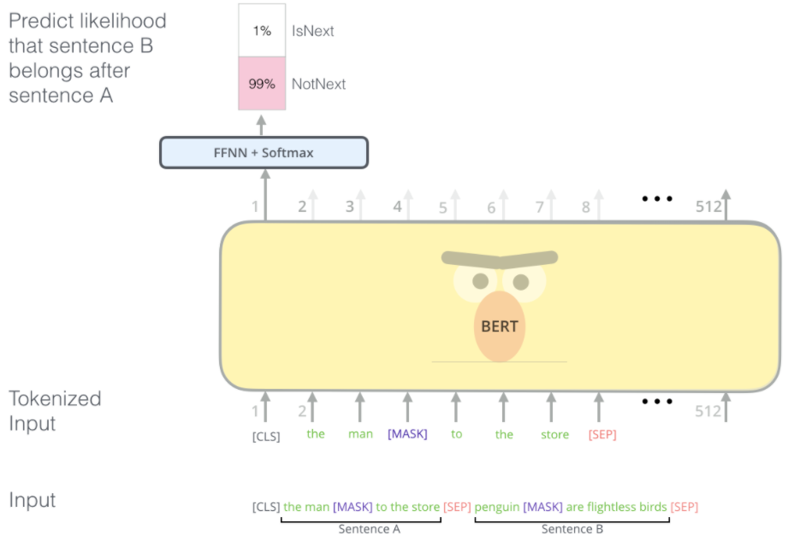
BERT (alternate view)
https://jalammar.github.io/illustrated-bert/

Slide 43
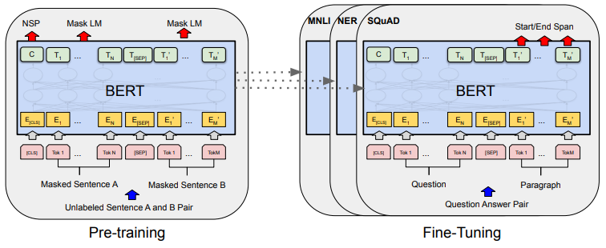
BERT
The two sentences are separated by a <SEP> token.
50% of the time, the 2nd sentence is a randomly selected sentence from the corpus.
50% of the time, it truly follows the first sentence in the corpus.
Source: original BERT paper: https://arxiv.org/pdf/1810.04805.pdf

Slide 44
BERT
NOTE: BERT also embeds the inputs by their WordPiece embeddings.
WordPiece is a sub-word tokenization learns to merge and use characters based on which pairs maximize the likelihood of the training data if added to the vocab.
Source: original BERT paper: https://arxiv.org/pdf/1810.04805.pdf

Slide 45
BERT’s inputs
https://arxiv.org/pdf/1810.04805.pdf

Slide 46
Outline
Transformer Decoder
Learning/Data/Tasks
BERT
BERT Fine-Tuning
Extensions

Slide 47
Outline
Transformer Decoder
Learning/Data/Tasks
BERT
BERT Fine-Tuning
Extensions

Slide 48
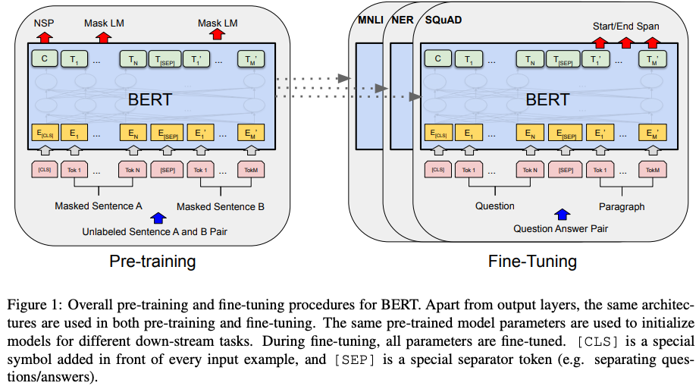
https://aclanthology.org/N19-1423.pdf

Slide 49
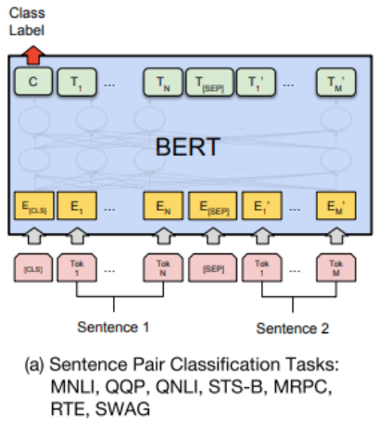
BERT fine-tuning

Slide 50
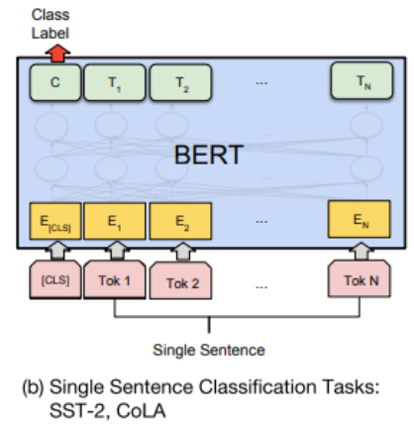
BERT fine-tuning

Slide 51
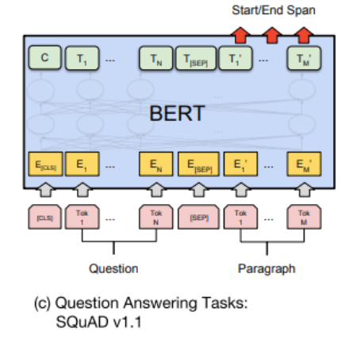
BERT fine-tuning

Slide 52
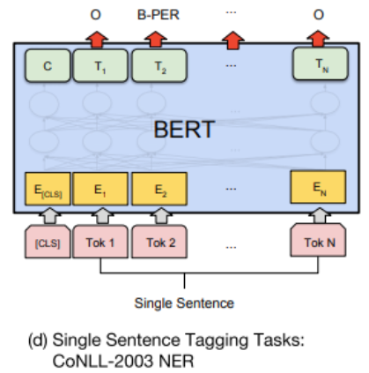
BERT fine-tuning

Slide 53
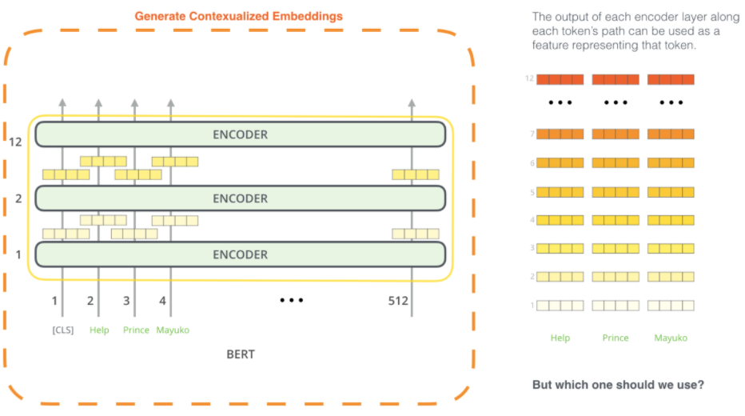
BERT
Or, one could extract the contextualized embeddings
Picture: https://jalammar.github.io/illustrated-bert/

Slide 54
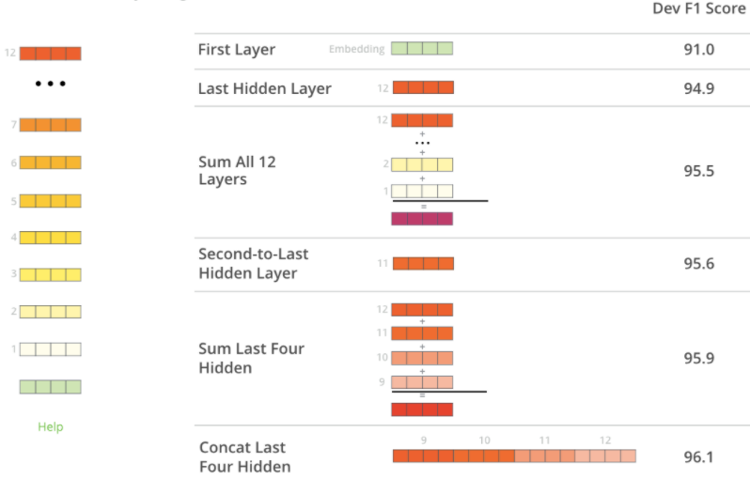
BERT
Later layers have the best contextualized embeddings
Picture: https://jalammar.github.io/illustrated-bert/

Slide 55
BERT
BERT yields state-of-the-art (SOTA) results on many tasks
Source: original BERT paper: https://arxiv.org/pdf/1810.04805.pdf

Slide 56
BERT (a Transformer variant)
Takeaway BERT is incredible for learning contextualized embeddings of words and using transfer learning for other tasks (e.g., classification).
Can’t generate new sentences though, due to no decoders.
y
Typically, one uses BERT’s awesome embeddings to fine-tune toward a different NLP task (this is called Sequential Transfer Learning)
r₁
r₂
r₃
r₄
Encoder #8
Encoder #1
The
brown
dog
ran
x₁
x₂
x₃
x₄

Slide 57
Outline
Transformer Decoder
Learning/Data/Tasks
BERT
BERT Fine-Tuning
Extensions

Slide 58
Outline
Transformer Decoder
Learning/Data/Tasks
BERT
BERT Fine-Tuning
Extensions

Slide 59
Extensions
Transformer-Encoders
BERT
ALBERT (A Lite BERT …)
RoBERTa (A Robustly Optimized BERT …)
DistilBERT (small BERT)
ELECTRA (Pre-training Text Encoders as Discriminators not Generators)
Longformer (Long-Document Transformer)

Slide 60
Extensions
Autoregressive
GPT (Generative Pre-training)
CTRL (Conditional Transformer LM for Controllable Generation)
Reformer
XLNet

Slide 61
ICPC

Slide 62
ICPC
The last International Collegiate Programming Contest has hosted over 60,000 students from 3,514 universities in 115 countries that span the globe. October 5 more than 100 teams will compete in logic, mental speed, and strategic thinking at Russia’s main Manege Central Conference Hall.

Slide 63
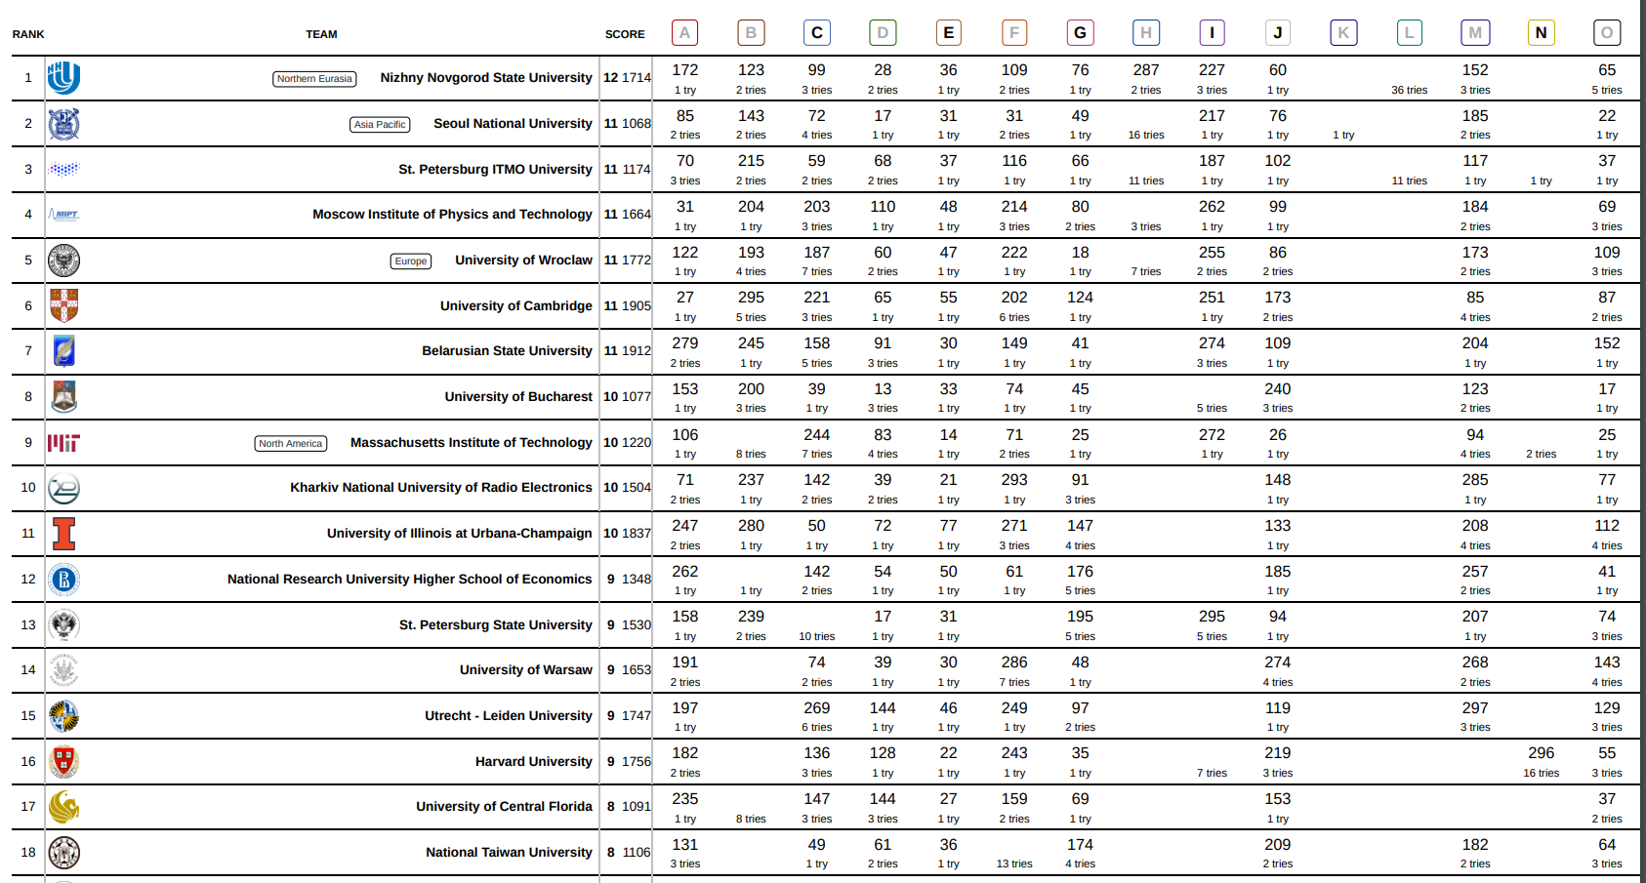
ICPC

Slide 64
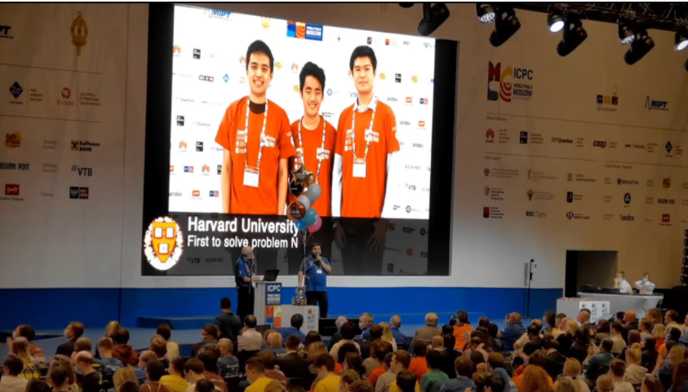

Slide 65
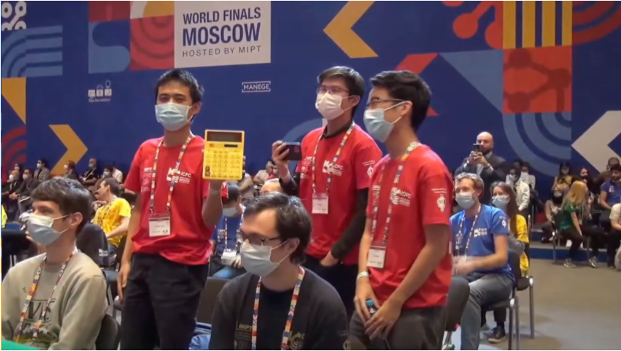

Slide 66
