Slide 1
Lecture 10: Transformers
From Self-Attention to Transformers
Harvard
AC295/CS287r/CSCI E-115B
Chris Tanner

Slide 3
ANNOUNCEMENTS
HW1 is graded (few remaining). Solutions are posted on Canvas -> Files
HW2 is due tonight @ 11:59pm!
HW3 will be released tonight @ 11:59pm! The shortest assignment yet.
Candidate Research Projects have been announced.
Read them on `Research Brainstorming` spreadsheet.
Indicate your preferences on the Google Form (see Ed post) by Wed 11:59pm
Tonight @ 8pm, Zoom will be open for anyone who wishes to discuss projects

Slide 4
RESEARCH PROJECTS
Phase II is due Oct 14 @ 11:59pm. See website for full expectations.
Abstract + Related Works + Introduction (this will improve over time).

Slide 5
Outline
Self-Attention
Transformer Encoder
Transformer Decoder
BERT

Slide 6
Outline
Self-Attention
Transformer Encoder
Transformer Decoder
BERT

Slide 7
Self-Attention
Under the hood, each x_{i} has 3 small, associated vectors. For example, x₁ has:
Query q₁
Key k₁
Value v₁
Step 1: Our Self-Attention Head l has just 3 weight matrices W_{q}, W_{k}, W_{v} in total. These same 3 weight matrices are multiplied by each x_{i} to create all vectors:
q_{i} = w_{q} x_{i}
k_{i} = w_{k} x_{i}
v_{i} = w_{v} x_{i}
q₁
k₁
v₁
q₂
k₂
v₂
q₃
k₃
v₃
q₄
k₄
v₄
The
brown
dog
ran
x₁
x₂
x₃
x₄

Slide 8
Self-Attention
Step 2: For word x₂, let’s calculate the scores s₁, s₂, s₃, s₄, which represent how much attention to pay to each respective ”word” v_{i}
s₁ = q₂$⋅$k₁ = 92
q₁
k₁
v₁
q₂
k₂
v₂
q₃
k₃
v₃
q₄
k₄
v₄
The
brown
dog
ran
x₁
x₂
x₃
x₄

Slide 9
Self-Attention
Step 2: For word x₂, let’s calculate the scores s₁, s₂, s₃, s₄, which represent how much attention to pay to each respective ”word” v_{i}
s₂ = q₂$⋅$k₂ = 124
s₁ = q₂$⋅$k₁ = 92
q₁
k₁
v₁
q₂
k₂
v₂
q₃
k₃
v₃
q₄
k₄
v₄
The
brown
dog
ran
x₁
x₂
x₃
x₄

Slide 10
Self-Attention
Step 2: For word x₂, let’s calculate the scores s₁, s₂, s₃, s₄, which represent how much attention to pay to each respective ”word” v_{i}
s₃ = q₂$⋅$k₃ = 22
s₂ = q₂$⋅$k₂ = 124
s₁ = q₂$⋅$k₁ = 92
q₁
k₁
v₁
q₂
k₂
v₂
q₃
k₃
v₃
q₄
k₄
v₄
The
brown
dog
ran
x₁
x₂
x₃
x₄

Slide 11
Self-Attention
Step 2: For word x₂, let’s calculate the scores s₁, s₂, s₃, s₄, which represent how much attention to pay to each respective ”word” v_{i}
s₄ = q₂$⋅$k₄ = 8
s₃ = q₂$⋅$k₃ = 22
s₂ = q₂$⋅$k₂ = 124
s₁ = q₂$⋅$k₁ = 92
q₁
k₁
v₁
q₂
k₂
v₂
q₃
k₃
v₃
q₄
k₄
v₄
The
brown
dog
ran
x₁
x₂
x₃
x₄

Slide 12
Self-Attention
Step 3: Our scores s₁, s₂, s₃, s₄ don’t sum to 1. Let’s divide by $√len(k_{i})$ and softmax it
s₄ = q₂$⋅$k₄ = 8
a₄ = $σ(s_{4}/8)$ = 0
s₃ = q₂$⋅$k₃ = 22
$\text{a}\text{3}\text{ =} σ(s_{3}/8)$ = .01
s₂ = q₂$⋅$k₂ = 124
a₂ = $σ(s_{2}/8)$ = .91
s₁ = q₂$⋅$k₁ = 92
a₁ = $σ(s_{1}/8)$ = .08
q₁
k₁
v₁
q₂
k₂
v₂
q₃
k₃
v₃
q₄
k₄
v₄
The
brown
dog
ran
x₁
x₂
x₃
x₄

Slide 13
Self-Attention
Step 3: Our scores s₁, s₂, s₃, s₄ don’t sum to 1. Let’s divide by $√len(k_{i})$ and softmax it
s₄ = q₂$⋅$k₄ = 8
a₄ = $σ(s_{4}/8)$ = 0
Instead of these a_{i} values directly weighting our original x_{i} word vectors, they directly weight our v_{i} vectors.
s₃ = q₂$⋅$k₃ = 22
$\text{a}\text{3}\text{ =} σ(s_{3}/8)$ = .01
s₂ = q₂$⋅$k₂ = 124
a₂ = $σ(s_{2}/8)$ = .91
s₁ = q₂$⋅$k₁ = 92
a₁ = $σ(s_{1}/8)$ = .08
q₁
k₁
v₁
q₂
k₂
v₂
q₃
k₃
v₃
q₄
k₄
v₄
The
brown
dog
ran
x₁
x₂
x₃
x₄

Slide 14
Self-Attention
Step 4: Let’s weight our v_{i} vectors and simply sum them up!
z₂
z₂ = a₁$⋅$v₁ + a₂$⋅$v₂ + a₃$⋅$v₃ + a₄$⋅$v₄
= 0.08$⋅$v₁ + 0.91$⋅$v₂ + 0.01$⋅$v₃ + 0$⋅$v₄
q₁
k₁
v₁
q₂
k₂
v₂
q₃
k₃
v₃
q₄
k₄
v₄
The
brown
dog
ran
x₁
x₂
x₃
x₄

Slide 15
Self-Attention
Tada! Now we have great, new representations z_{i} via a self-attention head
z₁
z₂
z₃
z₄
Self-attention Head
q₁
k₁
v₁
q₂
k₂
v₂
q₃
k₃
v₃
q₄
k₄
v₄
The
brown
dog
ran
x₁
x₂
x₃
x₄

Slide 16
Self-Attention
Tada! Now we have great, new representations z_{i} via a self-attention head
Takeaway:
Self-Attention is powerful; allows us to create great, context-aware representations
z₁
z₂
z₃
z₄
q₁
k₁
v₁
q₂
k₂
v₂
q₃
k₃
v₃
q₄
k₄
v₄
The
brown
dog
ran
x₁
x₂
x₃
x₄

Slide 17
Self-Attention may seem strikingly like Attention in seq2seq models
Q: What are the key, query, value vectors in the Attention setup?

Slide 18
$$h_{1}^{D}$$
s₄ =
$${∗h}_{4}^{E}$$
a₄ = $σ(s_{4})$
Attention
s₃ =
$$h_{1}^{D}$$
$${∗h}_{3}^{E}$$
$$\text{a}\text{3}\text{ =} σ(s_{3})$$
$$h_{1}^{D}$$
s₂ =
$${∗h}_{2}^{E}$$
a₂ = $σ(s_{2})$
s₁ =
$$h_{1}^{D}$$
$${∗h}_{1}^{E}$$
a₁ = $σ(s_{1})$
$$h_{1}^{E}$$
$$h_{2}^{E}$$
$$h_{3}^{E}$$
$$h_{4}^{E}$$
$$h_{1}^{D}$$
The
brown
dog
ran
<s>
ENCODER RNN
DECODER RNN

Slide 19
$$h_{1}^{D}$$
s₄ =
$${∗h}_{4}^{E}$$
a₄ = $σ(s_{4})$
Attention
s₃ =
$$h_{1}^{D}$$
$${∗h}_{3}^{E}$$
$$\text{a}\text{3}\text{ =} σ(s_{3})$$
$$h_{1}^{D}$$
s₂ =
$${∗h}_{2}^{E}$$
a₂ = $σ(s_{2})$
s₁ =
$$h_{1}^{D}$$
$${∗h}_{1}^{E}$$
a₁ = $σ(s_{1})$
$$h_{1}^{E}$$
$$h_{2}^{E}$$
$$h_{3}^{E}$$
$$h_{4}^{E}$$
$$h_{1}^{D}$$
We multiply each encoder’s hidden layer by its $a_{i}^{1}$attention weights to create a context vector $c_{1}^{D}$
The
brown
dog
ran
<s>
ENCODER RNN
DECODER RNN

Slide 20
$$h_{1}^{D}$$
s₄ =
$${∗h}_{4}^{E}$$
a₄ = $σ(s_{4})$
Attention
s₃ =
$$h_{1}^{D}$$
$${∗h}_{3}^{E}$$
$$\text{a}\text{3}\text{ =} σ(s_{3})$$
$$h_{1}^{D}$$
s₂ =
$${∗h}_{2}^{E}$$
a₂ = $σ(s_{2})$
s₁ =
$$h_{1}^{D}$$
$${∗h}_{1}^{E}$$
a₁ = $σ(s_{1})$
$$h_{1}^{E}$$
$$h_{2}^{E}$$
$$h_{3}^{E}$$
$$h_{4}^{E}$$
$$h_{1}^{D}$$
We multiply each encoder’s hidden layer by its $a_{i}^{1}$attention weights to create a context vector $c_{1}^{D}$
$c_{1}^{D}$ = a₁$⋅$h₁E + a₂$⋅$ h₂E + a₃$⋅$ h₃E + a₄$⋅$ h₄E
The
brown
dog
ran
<s>
ENCODER RNN
DECODER RNN

Slide 21
s₄ = q₂$⋅$k₄
a₄ = $σ(s_{4}/8)$
Self-Attention
s₃ = q₂$⋅$k₃
$$\text{a}\text{3}\text{ =} σ(s_{3}/8)$$
s₂ = q₂$⋅$k₂
a₂ = $σ(s_{2}/8)$
s₁ = q₂$⋅$k₁
a₁ = $σ(s_{1}/8)$
q₁
k₁
v₁
$$h_{1}^{E}$$
$$h_{2}^{E}$$
$$h_{3}^{E}$$
$$h_{4}^{E}$$
We multiply each word’s value vector by its $a_{i}^{1}$attention weights to create a better vector z₁
z₁ = a₁$⋅$v₁E + a₂$⋅$ v₂E + a₃$⋅$ v₃E + a₄$⋅$ v₄E
The
brown
dog
ran
ENCODER RNN

Slide 22
s₄ = q₂$⋅$k₄
a₄ = $σ(s_{4}/8)$
Self-Attention
Self-Attention
s₃ = q₂$⋅$k₃
Attention
Description
$$\text{a}\text{3}\text{ =} σ(s_{3}/8)$$
s₂ = q₂$⋅$k₂
q_{i}
$$h_{i}^{D}$$
a₂ = $σ(s_{2}/8)$
the probe
s₁ = q₂$⋅$k₁
a₁ = $σ(s_{1}/8)$
k_{i}
$$h_{i}^{E}$$
item being compared
q₁
k₁
v₁
v_{i}
$$h_{i}^{E}$$
item being weighted
We multiply each word’s value vector by its $a_{i}^{1}$attention weights to create a better vector z₁
$$h_{1}^{E}$$
$$h_{2}^{E}$$
$$h_{3}^{E}$$
$$h_{4}^{E}$$
z₁ = a₁$⋅$v₁E + a₂$⋅$ v₂E + a₃$⋅$ v₃E + a₄$⋅$ v₄E
The
brown
dog
ran
ENCODER RNN

Slide 23
s₄ = q₂$⋅$k₄
a₄ = $σ(s_{4}/8)$
Self-Attention
Self-Attention
s₃ = q₂$⋅$k₃
Attention
Description
$$\text{a}\text{3}\text{ =} σ(s_{3}/8)$$
s₂ = q₂$⋅$k₂
q_{i}
$$h_{i}^{D}$$
a₂ = $σ(s_{2}/8)$
the probe
s₁ = q₂$⋅$k₁
a₁ = $σ(s_{1}/8)$
k_{i}
$$h_{i}^{E}$$
item being compared
q₁
k₁
v₁
v_{i}
$$h_{i}^{E}$$
item being weighted
We multiply each word’s value vector by its $a_{i}^{1}$attention weights to create a better vector z₁
$$h_{1}^{E}$$
$$h_{2}^{E}$$
$$h_{3}^{E}$$
$$h_{4}^{E}$$
All of these are like surrogates/proxies/abstractions.
This provides flexibility and fewer constraints. More room for rich abstractions.
z₁ = a₁$⋅$v₁E + a₂$⋅$ v₂E + a₃$⋅$ v₃E + a₄$⋅$ v₄E
The
brown
dog
ran
ENCODER RNN

Slide 24
Outline
Self-Attention
Transformer Encoder
Transformer Decoder
BERT

Slide 25
Outline
Self-Attention
Transformer Encoder
Transformer Decoder
BERT

Slide 26
Self-Attention
Let’s further pass each z_{i} through a FFNN
z₁
z₂
z₃
z₄
Self-attention Head
The
brown
dog
ran
x₁
x₂
x₃
x₄

Slide 27
Self-Attention + FFNN
r₁
r₂
r₃
r₄
Let’s further pass each z_{i} through a FFNN
FFNN
z₁
z₂
z₃
z₄
Self-attention Head
The
brown
dog
ran
x₁
x₂
x₃
x₄
Notes:
We can further add a non-linearity by passing it through a FFNN. It may not seem necessary for now, but soon you’ll see why it’s useful.

Slide 28
Self-Attention + FFNN
r₁
r₂
r₃
r₄
Let’s further pass each z_{i} through a FFNN
We concat w/ a residual connection to help ensure relevant info is getting forward passed.
We perform LayerNorm to stabilize the network and allow for proper gradient flow. You should do this after the FFNN, too.
FFNN
+ x Residual Connections +LayerNorm
z₁
z₂
z₃
z₄
Self-attention Head
The
brown
dog
ran
x₁
x₂
x₃
x₄

Slide 29
Self-Attention + FFNN
r₁
r₂
r₃
r₄
Let’s further pass each z_{i} through a FFNN
We concat w/ a residual connection to help ensure relevant info is getting forward passed.
We perform LayerNorm to stabilize the network and allow for proper gradient flow. You should do this after the FFNN, too.
Each z_{i} can be computed in parallel, unlike LSTMs!
FFNN
+ x Residual Connections +LayerNorm
z₁
z₂
z₃
z₄
Self-attention Head
The
brown
dog
ran
x₁
x₂
x₃
x₄

Slide 30
Transformer Encoder
r₁
r₂
r₃
r₄
Encoder
Yay! Our r_{i} vectors are our new representations, and this entire process is called a Transformer Encoder
FFNN
+ x Residual Connections +LayerNorm
z₁
z₂
z₃
z₄
Self-attention Head
The
brown
dog
ran
x₁
x₂
x₃
x₄
Notes:
This entire block: the self-attention combined w/ the FFNN is a Transformer Encoder

Slide 31
Transformer Encoder
r₁
r₂
r₃
r₄
Encoder
Yay! Our r_{i} vectors are our new representations, and this entire process is called a Transformer Encoder
Problem: there is no concept of positionality. Words are weighted as if a “bag of words”
FFNN
+ x Residual Connections +LayerNorm
z₁
z₂
z₃
z₄
Self-attention Head
The
brown
dog
ran
x₁
x₂
x₃
x₄

Slide 32
Transformer Encoder
r₁
r₂
r₃
r₄
Encoder
Yay! Our r_{i} vectors are our new representations, and this entire process is called a Transformer Encoder
Problem: there is no concept of positionality. Words are weighted as if a “bag of words”
Solution: add to each input word x_{i} a positional encoding $\sim sin\left(i\right)cos⁡(i)$
FFNN
+ x Residual Connections +LayerNorm
z₁
z₂
z₃
z₄
Self-attention Head
The
brown
dog
ran
x₁
x₂
x₃
x₄

Slide 33
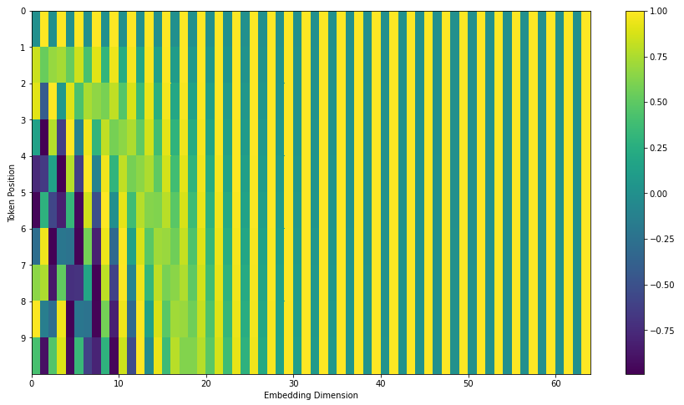
Position Encodings
https://jalammar.github.io/illustrated-transformer/

Slide 34
A Self-Attention Head has just one set of query/key/value weight matrices w_{q,} w_{k,} w_{v}
Words can relate in many ways, so it’s restrictive to rely on just one Self-Attention Head in the system.
Let’s create Multi-headed Self-Attention

Slide 35
Transformer Encoder
r₁
r₂
r₃
r₄
Encoder
Each Self-Attention Head produces a z_{i} vector.
We can, in parallel, use multiple heads and concat the z_{i}‘s.
FFNN
+ x Residual Connections +LayerNorm
z_{1A}
z_{1B}
z_{1C}
z_{2A}
z_{2B}
z_{2C}
z_{3A}
z_{3B}
z_{3C}
z_{4A}
z_{4B}
z_{4C}
Self-attention Head
The
brown
dog
ran
x₁
x₂
x₃
x₄

Slide 36
Transformer Encoder
r₁
r₂
r₃
r₄
Encoder
To recap: all of this looks fancy, but ultimately it’s just producing a very good contextualized embedding r_{i} of each word x_{i}
FFNN
+ x Residual Connections +LayerNorm
z_{1A}
z_{1B}
z_{1C}
z_{2A}
z_{2B}
z_{2C}
z_{3A}
z_{3B}
z_{3C}
z_{4A}
z_{4B}
z_{4C}
Self-attention Head
The
brown
dog
ran
x₁
x₂
x₃
x₄

Slide 37
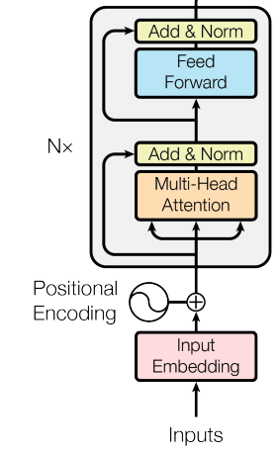
Transformer Encoder
r₁
r₂
r₃
r₄
Encoder
FFNN
=
+ x Residual Connections +LayerNorm
z_{1A}
z_{1B}
z_{1C}
z_{2A}
z_{2B}
z_{2C}
z_{3A}
z_{3B}
z_{3C}
z_{4A}
z_{4B}
z_{4C}
Self-attention Head
The
brown
dog
ran
x₁
x₂
x₃
x₄

Slide 38
Transformer Encoder
To recap: all of this looks fancy, but ultimately it’s just producing a very good contextualized embedding r_{i} of each word x_{i}
r₁
r₂
r₃
r₄
Encoder #1
The
brown
dog
ran
x₁
x₂
x₃
x₄

Slide 39
Transformer Encoder
To recap: all of this looks fancy, but ultimately it’s just producing a very good contextualized embedding r_{i} of each word x_{i}
Why stop with just 1 Transformer Encoder? We could stack several!
r₁
r₂
r₃
r₄
Encoder #1
The
brown
dog
ran
x₁
x₂
x₃
x₄

Slide 40
Transformer Encoder
To recap: all of this looks fancy, but ultimately it’s just producing a very good contextualized embedding r_{i} of each word x_{i}
Why stop with just 1 Transformer Encoder? We could stack several!
r₁
r₂
r₃
r₄
Encoder #3
Encoder #2
Encoder #1
The
brown
dog
ran
x₁
x₂
x₃
x₄

Slide 41
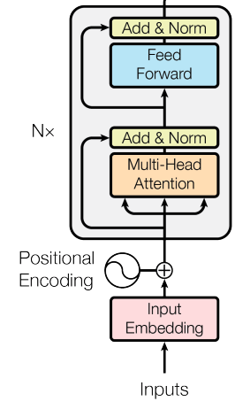
Transformer Encoder
r₁
r₂
r₃
r₄
=
Encoder #3
Encoder #2
Encoder #1
The
brown
dog
ran
x₁
x₂
x₃
x₄

Slide 42
The original Transformer model was intended for Machine Translation, so it had Decoders, too

Slide 43
Outline
Self-Attention
Transformer Encoder
Transformer Decoder
BERT

Slide 44
Outline
Self-Attention
Transformer Encoder
Transformer Decoder
BERT

Slide 45
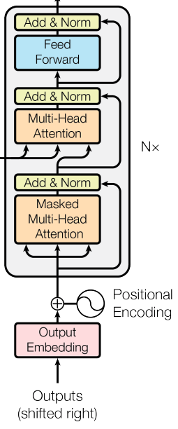
Transformer Decoder
r₁
r₂
r₃
r₄
Decoder
FFNN
=
+ x Residual Connections +LayerNorm
z_{1A}
z_{1B}
z_{1C}
z_{2A}
z_{2B}
z_{2C}
z_{3A}
z_{3B}
z_{3C}
z_{4A}
z_{4B}
z_{4C}
Masked Self-attention Head
<s>
El
perro
marrón
x₁
x₂
x₃
x₄

Slide 46
Transformer Encoders and Decoders
hnědý
pes
běžel
Transformer
Encoder #8
Decoder #8
Transformer Encoders produce contextualized embeddings of each word
Encoder #2
Decoder #2
Transformer Decoders generate new sequences of text
Encoder #1
Decoder #1
The
brown
dog
ran
x₁
x₂
x₃
x₄

Slide 47
Transformer Encoders and Decoders
hnědý
pes
běžel
Transformer
NOTE
Encoder #8
Decoder #8
Transformer Decoders are identical to the Encoders, except they have an additional Attention Head in between the Self-Attention and FFNN layers.
This additional Attention Head focuses on parts of the encoder’s representations.
Encoder #2
Decoder #2
Encoder #1
Decoder #1
The
brown
dog
ran
x₁
x₂
x₃
x₄

Slide 48
Transformer Encoders and Decoders
hnědý
pes
běžel
Transformer
NOTE
Encoder #8
Decoder #8
The query vector for a Transformer Decoder’s Attention Head (not Self-Attention Head) is from the output of the previous decoder layer.
However, the key and value vectors are from the Transformer Encoders’ outputs.
Encoder #2
Decoder #2
Encoder #1
Decoder #1
The
brown
dog
ran
x₁
x₂
x₃
x₄

Slide 49
Transformer Encoders and Decoders
hnědý
pes
běžel
Transformer
NOTE
Encoder #8
Decoder #8
The query, key, and value vectors for a Transformer Decoder’s Self-Attention Head (not Attention Head) are all from the output of the previous decoder layer.
Encoder #2
Decoder #2
Encoder #1
Decoder #1
The
brown
dog
ran
x₁
x₂
x₃
x₄

Slide 50
Transformer Encoders and Decoders
hnědý
pes
běžel
Transformer
IMPORTANT
Encoder #8
Decoder #8
The Transformer Decoders have positional embeddings, too, just like the Encoders.
Critically, each position is only allowed to attend to the previous indices. This masked Attention preserves it as being an auto-regressive LM.
Encoder #2
Decoder #2
Encoder #1
Decoder #1
The
brown
dog
ran
x₁
x₂
x₃
x₄

Slide 51
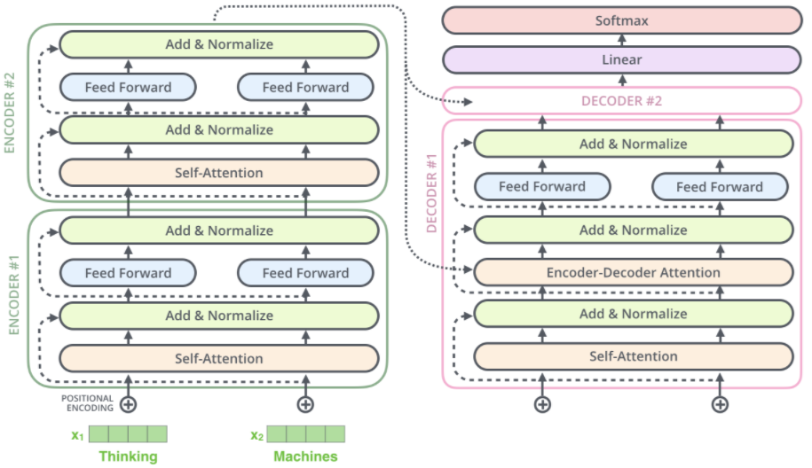
https://jalammar.github.io/illustrated-transformer/

Slide 52
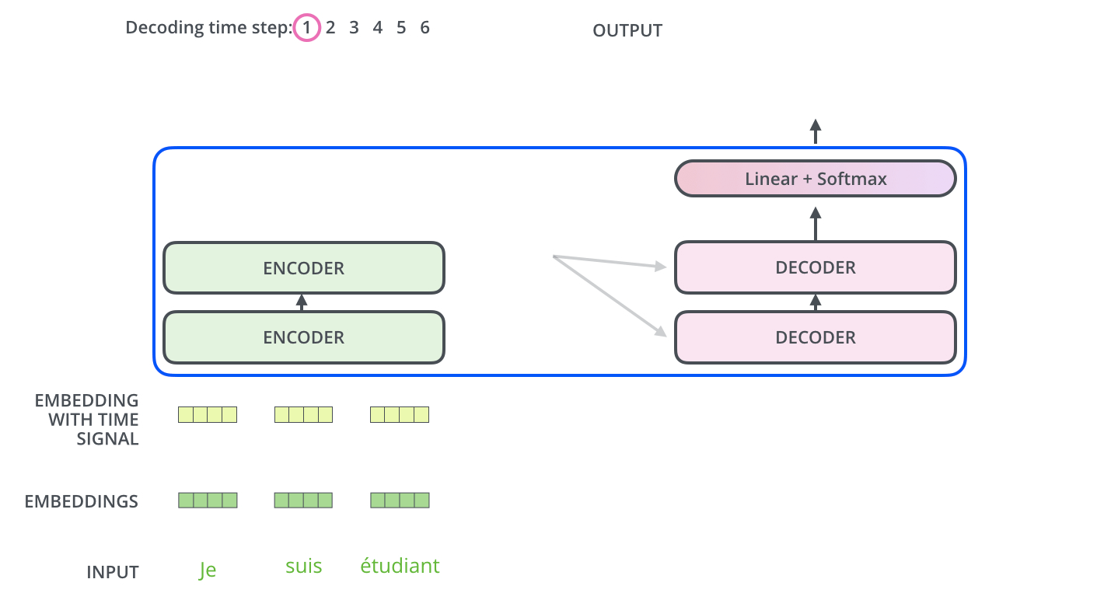
https://jalammar.github.io/illustrated-transformer/

Slide 53
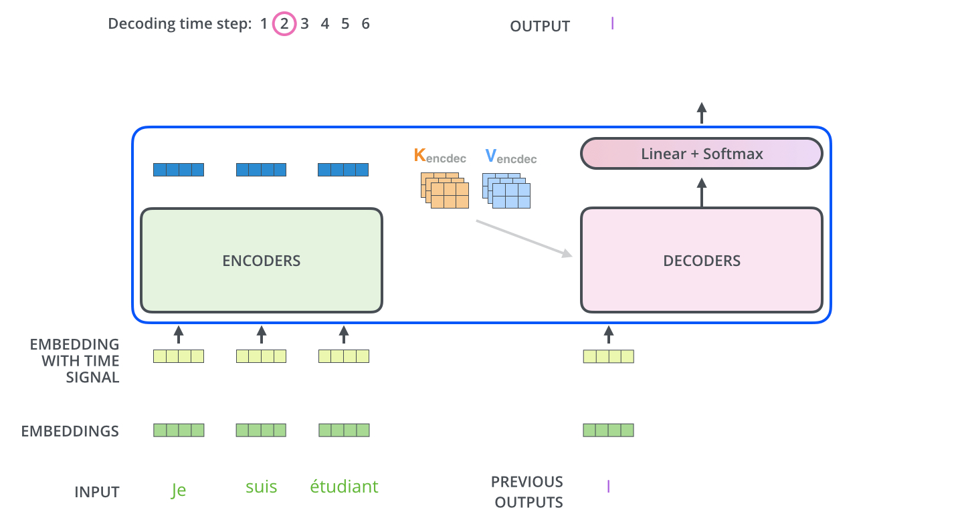
https://jalammar.github.io/illustrated-transformer/

Slide 54
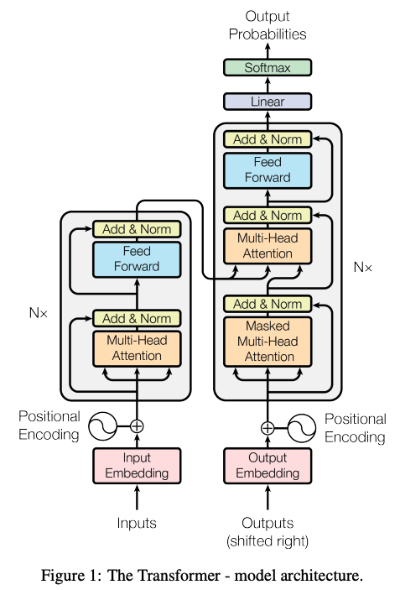
Attention is All you Need (2017) https://arxiv.org/pdf/1706.03762.pdf

Slide 55
Loss Function: cross-entropy (predicting translated word)
Training Time: ~4 days on (8) GPUs

Slide 56
n = sequence length
d = length of representation (vector)
Q: Is the complexity of self-attention good?

Slide 57
Important: when learning dependencies b/w words, you don’t want long paths. Shorter is better.
Self-attention connects all positions with a constant # of sequentially executed operations, whereas RNNs require $O(n).$
https://arxiv.org/pdf/1706.03762.pdf

Slide 58
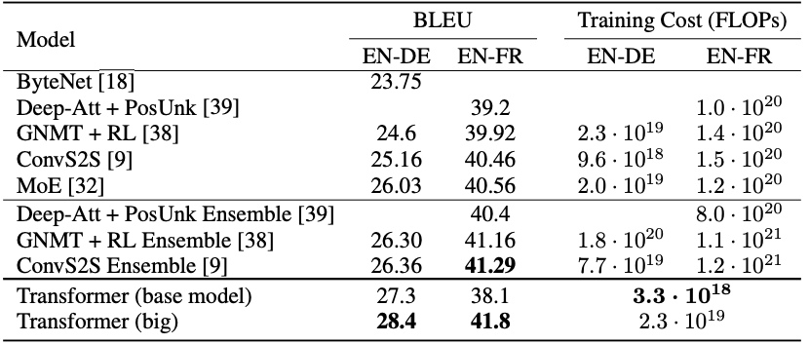
Machine Translation results: state-of-the-art (at the time)
:

Slide 59
Machine Translation results: state-of-the-art (at the time)
You can train to translate from Language A to Language B.
Then train it to translate from Language B. to Language C.
Then, without training, it can translate from Language A to Language C

Slide 60
What if we don’t want to decode/translate?
Just want to perform a particular task (e.g., classification)
Want even more robust, flexible, rich representation!
Want positionality to play a more explicit role, while not being restricted to a particular form (e.g., CNNs)

Slide 61
Outline
Self-Attention
Transformer Encoder
Transformer Decoder
BERT

Slide 62
Outline
Self-Attention
Transformer Encoder
Transformer Decoder
BERT

Slide 63
BERT
Bidirectional Encoder Representations from Transformers

Slide 64
BERT
Bidirectional Encoder Representations from Transformers
Like Bidirectional LSTMs, let’s look in both directions

Slide 65
BERT
Bidirectional Encoder Representations from Transformers
Let’s only use Transformer Encoders, no Decoders

Slide 66
BERT
Bidirectional Encoder Representations from Transformers
It’s a language model that builds rich representations

Slide 67
BERT
brown
lazy
playful
0.92
0.05
0.03
BERT has 2 training objectives:
BERT
1. Predict the Masked word (a la CBOW)
15% of all input words are randomly masked.
80% become [MASK]
10% become revert back
10% become are deliberately corrupted as wrong words
Encoder #8
Encoder #2
Encoder #1
<CLS>
The
brown
dog
x₁
x₂
x₃
x₄

Slide 68
BERT
brown
lazy
playful
0.92
0.05
0.03
BERT has 2 training objectives:
BERT
2. Two sentences are fed in at a time. Predict the if the second sentence of input truly follows the first one or not.
Encoder #8
Encoder #2
Encoder #1
<CLS>
The
brown
dog
x₁
x₂
x₃
x₄

Slide 69
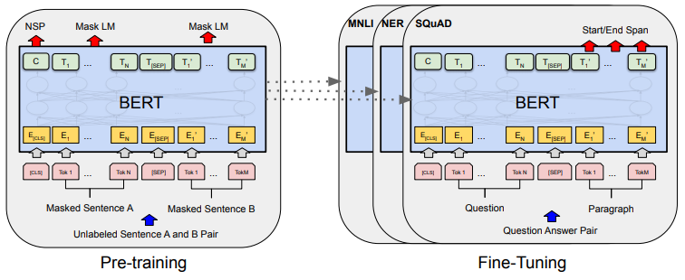
BERT
Every two sentences are separated by a <SEP> token.
50% of the time, the 2nd sentence is a randomly selected sentence from the corpus.
50% of the time, it truly follows the first sentence in the corpus.
Source: original BERT paper: https://arxiv.org/pdf/1810.04805.pdf

Slide 70
BERT
NOTE: BERT also embeds the inputs by their WordPiece embeddings.
WordPiece is a sub-word tokenization learns to merge and use characters based on which pairs maximize the likelihood of the training data if added to the vocab.
Source: original BERT paper: https://arxiv.org/pdf/1810.04805.pdf

Slide 71
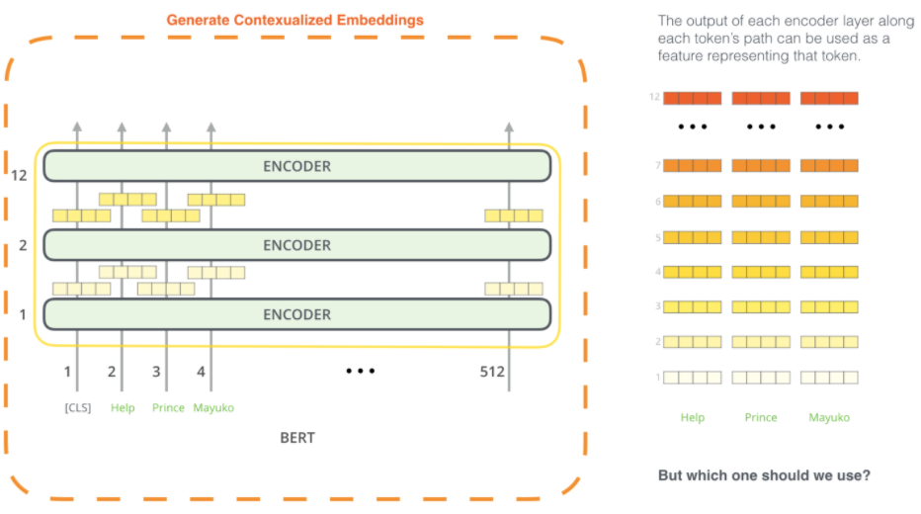
BERT
One could extract the contextualized embeddings
Picture: https://jalammar.github.io/illustrated-bert/

Slide 72
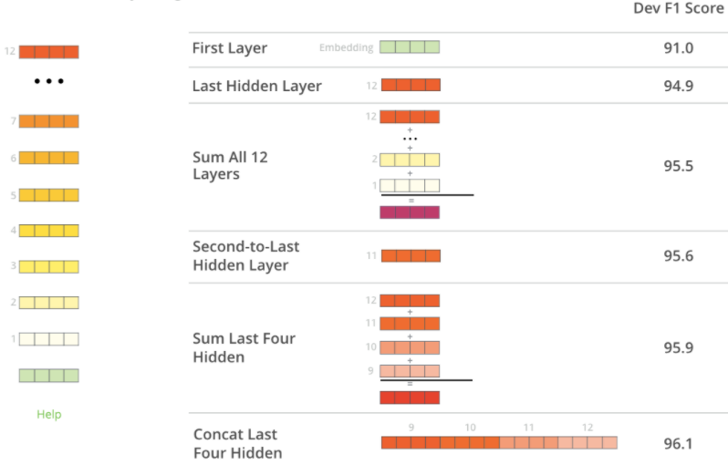
BERT
Later layers have the best contextualized embeddings
Picture: https://jalammar.github.io/illustrated-bert/

Slide 73
BERT
BERT yields state-of-the-art (SOTA) results on many tasks
Source: original BERT paper: https://arxiv.org/pdf/1810.04805.pdf

Slide 74
BERT (a Transformer variant)
Takeaway BERT is incredible for learning contextualized embeddings of words and using transfer learning for other tasks (e.g., classification).
Can’t generate new sentences though, due to no decoders.
y
Typically, one uses BERT’s awesome embeddings to fine-tune toward a different NLP task (this is called Sequential Transfer Learning)
r₁
r₂
r₃
r₄
Encoder #8
Encoder #1
The
brown
dog
ran
x₁
x₂
x₃
x₄

