Slide 1
Lecture 8: Machine Translation
And the power of Attention
Harvard
AC295/CS287r/CSCI E-115B
Chris Tanner

Slide 2
Translation
[SMT] Days are Over (2011)

Slide 3
ANNOUNCEMENTS
Quizzes 1 and 2 have been graded and are logged on Canvas
HW1 is being graded. Solutions are posted on Canvas -> Files
HW2 is due next Tues, Oct 5 @ 11:59pm! Determine your mystery language.
Research Proposals are due Thursday night, Sept 30 @ 11:59pm.
If submitting w/ others, please see the updated Canvas instructions

Slide 4
RECAP: L7
Unconditioned Predictions
Conditioned Predictions

Slide 5
RECAP: L7
Output layer
$${\hat{y}}_{1}$$
$${\hat{y}}_{2}$$
$${\hat{y}}_{3}$$
$${\hat{y}}_{4}$$
Hidden layers provide an abstraction (holds “meaning”).
Stacking hidden layers provides increased abstractions.
Hidden layer #2
$$h_{1}^{L2}$$
$$h_{2}^{L2}$$
$$h_{3}^{L2}$$
$$h_{4}^{L2}$$
Hidden layer #1
$$h_{1}^{L}$$
$$h_{2}^{L}$$
$$h_{3}^{L}$$
$$h_{4}^{L}$$
Input layer
$$x_{1}$$
$$x_{2}$$
$$x_{3}$$
$$x_{4}$$

Slide 6
RECAP: L7
Output layer
$${\hat{y}}_{1}$$
$${\hat{y}}_{2}$$
$${\hat{y}}_{3}$$
$${\hat{y}}_{4}$$
Hidden layers provide an abstraction (holds “meaning”).
Stacking hidden layers provides increased abstractions.
Depending on our assumptions, could add bi-directionality, too.
Hidden layer #2
$$h_{1}^{L2}$$
$$h_{2}^{L2}$$
$$h_{3}^{L2}$$
$$h_{4}^{L2}$$
Hidden layer #1
$$h_{1}^{L}$$
$$h_{2}^{L}$$
$$h_{3}^{L}$$
$$h_{4}^{L}$$
Input layer
$$x_{1}$$
$$x_{2}$$
$$x_{3}$$
$$x_{4}$$

Slide 7
Outline
Machine Translation
seq2seq
seq2seq + Attention
Many slides in the MT section were inspired by or adapted from Abigail See’s Stanford CS224N lecture

Slide 8
Outline
Machine Translation
seq2seq
seq2seq + Attention
Many slides in the MT section were inspired by or adapted from Abigail See’s Stanford CS224N lecture

Slide 9
Machine Translation (MT) is an NLP task that aims to convert text from one language to another.
Thank you for visiting!
Děkujeme za návštěvu!
$$x$$
$$y$$
(source language)
(target language)
Many slides in the MT section were inspired by or adapted from Abigail See’s Stanford CS224N lecture

Slide 10
Machine Translation (MT) is an NLP task that aims to convert text from one language to another.
9th century: Al-Kindi (cryptographer)
17th century: René Descartes theorized about a universal, symbolic language 1946: Warren Weaver had a seminal publication
1950s: First huge efforts; MIT, IBM, US Government. Motivated by the Cold War.
1990s – 2014: Statistical MT.
2014 – present: Neural MT (Deep Learning)

Slide 11
1990s – 2014: Statistical MT
$$\text{argma}{\text{x}}_{\text{y}}P\left(y | x\right)$$
$$\text{ = }\text{argma}{\text{x}}_{\text{y}}P\left(x | y\right)P(y)$$

Slide 12
1990s – 2014: Statistical MT
$$\text{argma}{\text{x}}_{\text{y}}P\left(y | x\right)$$
$$\text{ = }\text{argma}{\text{x}}_{\text{y}}P\left(x | y\right)P(y)$$
Translation
model
Language model

Slide 13
1990s – 2014: Statistical MT
$$\text{argma}{\text{x}}_{\text{y}}P\left(x | y\right)P(y)$$
We estimate $P\left(x | y\right)$ from a parallel corpus.

Slide 14
1990s – 2014: Statistical MT
$$\text{argma}{\text{x}}_{\text{y}}P\left(x | y\right)P(y)$$
We estimate $P\left(x | y\right)$ from a parallel corpus.
Technically, we’re actually interested in:
$$\text{argma}{\text{x}}_{\text{y}}P\left(x, a | y\right)P(y)$$
Def: alignment is the correspondence between particular words in different languages

Slide 15
1990s – 2014: Statistical MT
Some 1-to-0 mappings, 1-to-1 mappings, 1-to-many mappings, etc
See chalkboard for a table view.
The Mathematics of Statistical Machine Translation: Parameter Estimation. Brown et al. ACL 1993.

Slide 16
1990s – 2014: Statistical MT
Alignment is complex and can be based on:
particular words aligning
sentence positions
word “fertility” (the # of words a word spans to)
much more
The Mathematics of Statistical Machine Translation: Parameter Estimation. Brown et al. ACL 1993.

Slide 17
1990s – 2014: Statistical MT
$$\text{argma}{\text{x}}_{\text{y}}P\left(x | y\right)P(y)$$
How in the world can we compute this argmax?! Exploding/infinite $y$’s!

Slide 18
1990s – 2014: Statistical MT
$$\text{argma}{\text{x}}_{\text{y}}P\left(x | y\right)P(y)$$
How in the world can we compute this argmax?! Exploding/infinite $y$’s!
Neural MT (deep learning approach) needs to address this, too.

Slide 19
1990s – 2014: Statistical MT
SUMMARY
SMT was largely successful and useful
SOTA systems were incredibly complex (e.g., Moses and GIZA++)
Ridiculous amounts of manual feature engineering
Relied on external resources like phrase translation tables
RIP: the years 2011-2012 for me

Slide 20
We want to produce a variable-length output (e.g., n → m predictions)
Thank you for visiting!
Děkujeme za návštěvu!

Slide 21
Outline
Machine Translation
seq2seq
seq2seq + Attention
Many slides in the MT section were inspired by or adapted from Abigail See’s Stanford CS224N lecture

Slide 22
Outline
Machine Translation
seq2seq
seq2seq + Attention

Slide 23
Sequence-to-Sequence (seq2seq)
If our input is a sentence in Language A, and we wish to translate it to Language B, it is clearly sub-optimal to translate word by word (like our current models are suited to do).
Instead, let a sequence of tokens be the unit that we ultimately wish to work with (a sequence of length N may emit a sequences of length M)
seq2seq models are comprised of 2 RNNs: 1 encoder, 1 decoder

Slide 24
Types of Conditional Prediction
Many-to-1 classification
$$P\left(y | X\right)$$
Many-to-many classification

Slide 25
Sequence-to-Sequence (seq2seq)
$$h_{1}^{E}$$
$$h_{2}^{E}$$
$$h_{3}^{E}$$
$$h_{4}^{E}$$
Hidden layer
Input layer
The
brown
dog
ran
ENCODER RNN

Slide 26
Sequence-to-Sequence (seq2seq)
The final hidden state of the encoder RNN is the initial state of the decoder RNN
$$h_{1}^{E}$$
$$h_{2}^{E}$$
$$h_{3}^{E}$$
$$h_{4}^{E}$$
Hidden layer
Input layer
The
brown
dog
ran
ENCODER RNN

Slide 27
Sequence-to-Sequence (seq2seq)
The final hidden state of the encoder RNN is the initial state of the decoder RNN
$$h_{1}^{E}$$
$$h_{2}^{E}$$
$$h_{3}^{E}$$
$$h_{4}^{E}$$
$$h_{1}^{D}$$
Hidden layer
Input layer
The
brown
dog
ran
<s>
ENCODER RNN
DECODER RNN

Slide 28
Sequence-to-Sequence (seq2seq)
The final hidden state of the encoder RNN is the initial state of the decoder RNN
Le
$$h_{1}^{E}$$
$$h_{2}^{E}$$
$$h_{3}^{E}$$
$$h_{4}^{E}$$
$$h_{1}^{D}$$
Hidden layer
Input layer
The
brown
dog
ran
<s>
ENCODER RNN
DECODER RNN

Slide 29
Sequence-to-Sequence (seq2seq)
The final hidden state of the encoder RNN is the initial state of the decoder RNN
Le
$$h_{1}^{E}$$
$$h_{2}^{E}$$
$$h_{3}^{E}$$
$$h_{4}^{E}$$
$$h_{1}^{D}$$
$$h_{2}^{D}$$
Hidden layer
Input layer
The
brown
dog
ran
<s>
Le
ENCODER RNN
DECODER RNN

Slide 30
Sequence-to-Sequence (seq2seq)
The final hidden state of the encoder RNN is the initial state of the decoder RNN
Le
chien
$$h_{1}^{E}$$
$$h_{2}^{E}$$
$$h_{3}^{E}$$
$$h_{4}^{E}$$
$$h_{1}^{D}$$
$$h_{2}^{D}$$
Hidden layer
Input layer
The
brown
dog
ran
<s>
Le
ENCODER RNN
DECODER RNN

Slide 31
Sequence-to-Sequence (seq2seq)
The final hidden state of the encoder RNN is the initial state of the decoder RNN
Le
chien
$$h_{1}^{E}$$
$$h_{2}^{E}$$
$$h_{3}^{E}$$
$$h_{4}^{E}$$
$$h_{1}^{D}$$
$$h_{2}^{D}$$
$$h_{3}^{D}$$
Hidden layer
Input layer
The
brown
dog
ran
<s>
Le
chien
ENCODER RNN
DECODER RNN

Slide 32
Sequence-to-Sequence (seq2seq)
The final hidden state of the encoder RNN is the initial state of the decoder RNN
Le
chien
brun
$$h_{1}^{E}$$
$$h_{2}^{E}$$
$$h_{3}^{E}$$
$$h_{4}^{E}$$
$$h_{1}^{D}$$
$$h_{2}^{D}$$
$$h_{3}^{D}$$
Hidden layer
Input layer
The
brown
dog
ran
<s>
Le
chien
ENCODER RNN
DECODER RNN

Slide 33
Sequence-to-Sequence (seq2seq)
The final hidden state of the encoder RNN is the initial state of the decoder RNN
Le
chien
brun
$$h_{1}^{E}$$
$$h_{2}^{E}$$
$$h_{3}^{E}$$
$$h_{4}^{E}$$
$$h_{1}^{D}$$
$$h_{2}^{D}$$
$$h_{3}^{D}$$
$$h_{4}^{D}$$
Hidden layer
Input layer
The
brown
dog
ran
<s>
Le
chien
brun
ENCODER RNN
DECODER RNN

Slide 34
Sequence-to-Sequence (seq2seq)
The final hidden state of the encoder RNN is the initial state of the decoder RNN
Le
chien
brun
a
$$h_{1}^{E}$$
$$h_{2}^{E}$$
$$h_{3}^{E}$$
$$h_{4}^{E}$$
$$h_{1}^{D}$$
$$h_{2}^{D}$$
$$h_{3}^{D}$$
$$h_{4}^{D}$$
Hidden layer
Input layer
The
brown
dog
ran
<s>
Le
chien
brun
ENCODER RNN
DECODER RNN

Slide 35
Sequence-to-Sequence (seq2seq)
The final hidden state of the encoder RNN is the initial state of the decoder RNN
Le
chien
brun
a
$$h_{1}^{E}$$
$$h_{2}^{E}$$
$$h_{3}^{E}$$
$$h_{4}^{E}$$
$$h_{1}^{D}$$
$$h_{2}^{D}$$
$$h_{3}^{D}$$
$$h_{4}^{D}$$
$$h_{5}^{D}$$
Hidden layer
Input layer
The
brown
dog
ran
<s>
Le
chien
brun
a
ENCODER RNN
DECODER RNN

Slide 36
Sequence-to-Sequence (seq2seq)
The final hidden state of the encoder RNN is the initial state of the decoder RNN
Le
chien
brun
a
couru
$$h_{1}^{E}$$
$$h_{2}^{E}$$
$$h_{3}^{E}$$
$$h_{4}^{E}$$
$$h_{1}^{D}$$
$$h_{2}^{D}$$
$$h_{3}^{D}$$
$$h_{4}^{D}$$
$$h_{5}^{D}$$
Hidden layer
Input layer
The
brown
dog
ran
<s>
Le
chien
brun
a
ENCODER RNN
DECODER RNN

Slide 37
Sequence-to-Sequence (seq2seq)
The final hidden state of the encoder RNN is the initial state of the decoder RNN
Le
chien
brun
a
couru
$$h_{1}^{E}$$
$$h_{2}^{E}$$
$$h_{3}^{E}$$
$$h_{4}^{E}$$
$$h_{1}^{D}$$
$$h_{2}^{D}$$
$$h_{3}^{D}$$
$$h_{4}^{D}$$
$$h_{5}^{D}$$
$$h_{6}^{D}$$
Hidden layer
Input layer
The
brown
dog
ran
<s>
Le
chien
brun
a
couru
ENCODER RNN
DECODER RNN

Slide 38
Sequence-to-Sequence (seq2seq)
The final hidden state of the encoder RNN is the initial state of the decoder RNN
Le
chien
brun
a
couru
<s>
$$h_{1}^{E}$$
$$h_{2}^{E}$$
$$h_{3}^{E}$$
$$h_{4}^{E}$$
$$h_{1}^{D}$$
$$h_{2}^{D}$$
$$h_{3}^{D}$$
$$h_{4}^{D}$$
$$h_{5}^{D}$$
$$h_{6}^{D}$$
Hidden layer
Input layer
The
brown
dog
ran
<s>
Le
chien
brun
a
couru
ENCODER RNN
DECODER RNN

Slide 39
Sequence-to-Sequence (seq2seq)
$${\hat{y}}_{1}$$
$${\hat{y}}_{2}$$
$${\hat{y}}_{3}$$
$${\hat{y}}_{4}$$
$${\hat{y}}_{5}$$
$${\hat{y}}_{6}$$
$$h_{1}^{E}$$
$$h_{2}^{E}$$
$$h_{3}^{E}$$
$$h_{4}^{E}$$
$$h_{1}^{D}$$
$$h_{2}^{D}$$
$$h_{3}^{D}$$
$$h_{4}^{D}$$
$$h_{5}^{D}$$
$$h_{6}^{D}$$
Hidden layer
Input layer
The
brown
dog
ran
<s>
Le
chien
brun
a
couru
ENCODER RNN
DECODER RNN

Slide 40
Sequence-to-Sequence (seq2seq)
Training occurs like RNNs typically do; the loss (from the decoder outputs) is calculated, and we update weights all the way to the beginning (encoder)
$${\hat{y}}_{1}$$
$${\hat{y}}_{2}$$
$${\hat{y}}_{3}$$
$${\hat{y}}_{4}$$
$${\hat{y}}_{5}$$
$${\hat{y}}_{6}$$
$$h_{1}^{E}$$
$$h_{2}^{E}$$
$$h_{3}^{E}$$
$$h_{4}^{E}$$
$$h_{1}^{D}$$
$$h_{2}^{D}$$
$$h_{3}^{D}$$
$$h_{4}^{D}$$
$$h_{5}^{D}$$
$$h_{6}^{D}$$
Hidden layer
Input layer
The
brown
dog
ran
<s>
Le
chien
brun
a
couru
ENCODER RNN
DECODER RNN

Slide 41
Sequence-to-Sequence (seq2seq)
Testing generates decoder outputs one word at a time, until we generate a <S> token.
Each decoder’s ${\hat{y}}_{i}$ becomes the input $x_{i+1}$
$${\hat{y}}_{1}$$
$${\hat{y}}_{2}$$
$${\hat{y}}_{3}$$
$${\hat{y}}_{4}$$
$${\hat{y}}_{5}$$
$${\hat{y}}_{6}$$
$$h_{1}^{E}$$
$$h_{2}^{E}$$
$$h_{3}^{E}$$
$$h_{4}^{E}$$
$$h_{1}^{D}$$
$$h_{2}^{D}$$
$$h_{3}^{D}$$
$$h_{4}^{D}$$
$$h_{5}^{D}$$
$$h_{6}^{D}$$
Hidden layer
Input layer
The
brown
dog
ran
<s>
Le
chien
brun
a
couru
ENCODER RNN
DECODER RNN

Slide 42
Greedy Decoding
What’s an issue w/ greedy decoding?

Slide 43
Greedy Decoding
She _____
She went _____
She went to _____
She went to class _____
$$O({\left|V\right|}^{n})$$

Slide 44
Beam Search Decoding
Sequentially consider the best (highest log likelihoods) k translations at each step. Prune before expanding.
See chalkboard.

Slide 45
Beam Search Decoding
We can stop generating candidates when sequences are of length N, or when we have M completed sequences
Must normalize by lengths!

Slide 46
Neural MT
Pros:
Better performance
Uses context more robustly
Better phrases
Single model that can be optimized end-to-end (no subcomponents)
Way less manual, feature engineering

Slide 47
Neural MT
Cons:
Not too interpretable
Hard to control/ force any Language-specific aspect
A vanilla seq2seq approach can have gradient issues

Slide 48
MT Evaluation
BLEU: A similarity metric that compares the generated machine translation to a human-produced translation.
Uses n-gram precision (e.g., n=1,2,3,4,5)
Computer Generated: the dog
Target: the dog ran fast

Slide 49
MT Evaluation
BLEU: A similarity metric that compares the generated machine translation to a human-produced translation.
Uses n-gram precision (e.g., n=1,2,3,4,5)
Computer Generated: the dog
Target: the dog ran fast
Adds a penalty for translations that are too short (akin to recall)

Slide 50
2014 - present: NMT
SUMMARY
Became SOTA in just 2 years
OOV issues still need to be handled
Susceptible to training data, as always (domain mismatch issues)
Long-context is always difficult
Low-resource languages still remains a challenge
Biases from training data

Slide 51
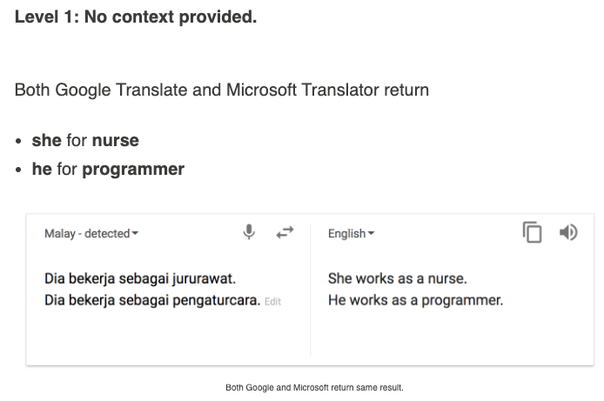
MT Biases
https://hackernoon.com/bias-sexist-or-this-is-the-way-it-should-be-ce1f7c8c683c

Slide 52
Sequence-to-Sequence (seq2seq)
$${\hat{y}}_{1}$$
$${\hat{y}}_{2}$$
$${\hat{y}}_{3}$$
$${\hat{y}}_{4}$$
$${\hat{y}}_{5}$$
$${\hat{y}}_{6}$$
$$h_{1}^{E}$$
$$h_{2}^{E}$$
$$h_{3}^{E}$$
$$h_{4}^{E}$$
$$h_{1}^{D}$$
$$h_{2}^{D}$$
$$h_{3}^{D}$$
$$h_{4}^{D}$$
$$h_{5}^{D}$$
$$h_{6}^{D}$$
Hidden layer
Input layer
The
brown
dog
ran
<s>
Le
chien
brun
a
couru
ENCODER RNN
DECODER RNN

Slide 53
Sequence-to-Sequence (seq2seq)
See any issues with this traditional seq2seq paradigm?

Slide 54
Sequence-to-Sequence (seq2seq)
It’s crazy that the entire “meaning” of the 1st sequence is expected to be packed into this one embedding, and that the encoder then never interacts w/ the decoder again. Hands free.
$${\hat{y}}_{1}$$
$${\hat{y}}_{2}$$
$${\hat{y}}_{3}$$
$${\hat{y}}_{4}$$
$${\hat{y}}_{5}$$
$${\hat{y}}_{6}$$
$$h_{1}^{E}$$
$$h_{2}^{E}$$
$$h_{3}^{E}$$
$$h_{4}^{E}$$
$$h_{1}^{D}$$
$$h_{2}^{D}$$
$$h_{3}^{D}$$
$$h_{4}^{D}$$
$$h_{5}^{D}$$
$$h_{6}^{D}$$
Hidden layer
Input layer
The
brown
dog
ran
<s>
Le
chien
brun
a
couru
ENCODER RNN
DECODER RNN

Slide 55
Outline
Machine Translation
seq2seq
seq2seq + Attention

Slide 56
Outline
Machine Translation
seq2seq
seq2seq + Attention

Slide 57
Sequence-to-Sequence (seq2seq)
Instead, what if the decoder, at each step, pays attention to a distribution of all of the encoder’s hidden states?

Slide 58
Sequence-to-Sequence (seq2seq)
Instead, what if the decoder, at each step, pays attention to a distribution of all of the encoder’s hidden states?
Intuition: when we (humans) translate a sentence, we don’t just consume the original sentence, reflect on the meaning of the last word, then regurgitate in a new language; we continuously think back at the original sentence while focusing on different parts.

Slide 59
Attention
The concept of attention within cognitive neuroscience and psychology dates back to the 1800s. [William James, 1890].
Nadaray-Watson kernel regression proposed in 1964. It locally weighted its predictions.

Slide 60
seq2seq + Attention
Q: How do we determine how much to pay attention to each of the encoder’s hidden layers?
$$.4?$$
$$.3?$$
$$.1?$$
$$.2?$$
$$h_{1}^{E}$$
$$h_{2}^{E}$$
$$h_{3}^{E}$$
$$h_{4}^{E}$$
Hidden layer
Input layer
The
brown
dog
ran
ENCODER RNN

Slide 61
seq2seq + Attention
Q: How do we determine how much to pay attention to each of the encoder’s hidden layers?
A: Let’s base it on our decoder’s current hidden state (our current representation of meaning) and all of the encoder’s hidden layers!
$$h_{1}^{E}$$
$$h_{2}^{E}$$
$$h_{3}^{E}$$
$$h_{4}^{E}$$
$$h_{1}^{D}$$
Hidden layer
Input layer
The
brown
dog
ran
<s>
ENCODER RNN
DECODER RNN

Slide 62
seq2seq + Attention
Q: How do we determine how much to pay attention to each of the encoder’s hidden layers?
A: Let’s base it on our decoder’s current hidden state (our current representation of meaning) and all of the encoder’s hidden layers!
$$h_{1}^{E}$$
$$h_{2}^{E}$$
$$h_{3}^{E}$$
$$h_{4}^{E}$$
$$h_{1}^{D}$$
$$e_{1}$$
$$1.5$$
Hidden layer
$$h_{1}^{E}$$
$$h_{1}^{D}$$
Separate FFNN
Input layer
The
brown
dog
ran
<s>
ENCODER RNN
DECODER RNN

Slide 63
seq2seq + Attention
Q: How do we determine how much to pay attention to each of the encoder’s hidden layers?
A: Let’s base it on our decoder’s current hidden state (our current representation of meaning) and all of the encoder’s hidden layers!
$$h_{1}^{E}$$
$$h_{2}^{E}$$
$$h_{3}^{E}$$
$$h_{4}^{E}$$
$$h_{1}^{D}$$
$$e_{2}$$
$$0.9$$
Hidden layer
$$h_{2}^{E}$$
$$h_{1}^{D}$$
Separate FFNN
Input layer
The
brown
dog
ran
<s>
ENCODER RNN
DECODER RNN

Slide 64
seq2seq + Attention
Q: How do we determine how much to pay attention to each of the encoder’s hidden layers?
A: Let’s base it on our decoder’s current hidden state (our current representation of meaning) and all of the encoder’s hidden layers!
$$h_{1}^{E}$$
$$h_{2}^{E}$$
$$h_{3}^{E}$$
$$h_{4}^{E}$$
$$h_{1}^{D}$$
$$e_{3}$$
$$0.2$$
Hidden layer
$$h_{3}^{E}$$
$$h_{1}^{D}$$
Separate FFNN
Input layer
The
brown
dog
ran
<s>
ENCODER RNN
DECODER RNN

Slide 65
seq2seq + Attention
Q: How do we determine how much to pay attention to each of the encoder’s hidden layers?
A: Let’s base it on our decoder’s current hidden state (our current representation of meaning) and all of the encoder’s hidden layers!
$$h_{1}^{E}$$
$$h_{2}^{E}$$
$$h_{3}^{E}$$
$$h_{4}^{E}$$
$$h_{1}^{D}$$
$$e_{4}$$
$$−0.5$$
Hidden layer
$$h_{4}^{E}$$
$$h_{1}^{D}$$
Separate FFNN
Input layer
The
brown
dog
ran
<s>
ENCODER RNN
DECODER RNN

Slide 66
seq2seq + Attention
Q: How do we determine how much to pay attention to each of the encoder’s hidden layers?
A: Let’s base it on our decoder’s current hidden state (our current representation of meaning) and all of the encoder’s hidden layers!
Attention (raw scores)
$$h_{1}^{E}$$
$$h_{2}^{E}$$
$$h_{3}^{E}$$
$$h_{4}^{E}$$
$$h_{1}^{D}$$
$$e_{1}$$
$$1.5$$
$$e_{2}$$
$$0.9$$
$$e_{3}$$
$$0.2$$
Hidden layer
$$e_{4}$$
$$−0.5$$
Input layer
The
brown
dog
ran
<s>
ENCODER RNN
DECODER RNN

Slide 67
seq2seq + Attention
Q: How do we determine how much to pay attention to each of the encoder’s hidden layers?
A: Let’s base it on our decoder’s current hidden state (our current representation of meaning) and all of the encoder’s hidden layers!
Attention (raw scores)
$$h_{1}^{E}$$
$$h_{2}^{E}$$
$$h_{3}^{E}$$
$$h_{4}^{E}$$
$$h_{1}^{D}$$
$$e_{1}$$
$$1.5$$
$$e_{2}$$
$$0.9$$
$$e_{3}$$
$$0.2$$
Hidden layer
$$e_{4}$$
$$−0.5$$
Attention (softmax’d)
$$a_{i}^{1}=\frac{exp⁡(e_{i})}{\sum_{i}^{N}{{exp⁡(e}_{1})}}$$
Input layer
The
brown
dog
ran
<s>
ENCODER RNN
DECODER RNN

Slide 68
seq2seq + Attention
Q: How do we determine how much to pay attention to each of the encoder’s hidden layers?
A: Let’s base it on our decoder’s current hidden state (our current representation of meaning) and all of the encoder’s hidden layers!
Attention (raw scores)
$$h_{1}^{E}$$
$$h_{2}^{E}$$
$$h_{3}^{E}$$
$$h_{4}^{E}$$
$$h_{1}^{D}$$
$$e_{1}$$
$$1.5$$
$$e_{2}$$
$$0.9$$
$$e_{3}$$
$$0.2$$
Hidden layer
$$e_{4}$$
$$−0.5$$
Attention (softmax’d)
$$a_{1}^{1}=0.51$$
Input layer
The
brown
dog
ran
<s>
$$a_{2}^{1}=0.28$$
$$a_{3}^{1}=0.14$$
ENCODER RNN
DECODER RNN
$$a_{3}^{1}=0.07$$

Slide 69
seq2seq + Attention
$$c_{1}^{D}$$
We multiply each encoder’s hidden layer by its $a_{i}^{1}$attention weights to create a context vector $c_{1}^{D}$
$$a_{1}^{1}$$
$$a_{3}^{1}$$
$$a_{4}^{1}$$
$$a_{2}^{1}$$
$$h_{1}^{E}$$
$$h_{2}^{E}$$
$$h_{3}^{E}$$
$$h_{4}^{E}$$
$$h_{1}^{D}$$
Hidden layer
Attention (softmax’d)
$$a_{1}^{1}=0.51$$
Input layer
The
brown
dog
ran
<s>
$$a_{2}^{1}=0.28$$
$$a_{3}^{1}=0.14$$
ENCODER RNN
DECODER RNN
$$a_{3}^{1}=0.07$$

Slide 70
seq2seq + Attention
REMEMBER: each attention weight $a_{i}^{j}$ is based on the decoder’s current hidden state, too.
$$c_{1}^{D}$$
Le
$${\hat{y}}_{1}$$
$$a_{1}^{1}$$
$$a_{3}^{1}$$
$$a_{4}^{1}$$
$$a_{2}^{1}$$
$$h_{1}^{E}$$
$$h_{2}^{E}$$
$$h_{3}^{E}$$
$$h_{4}^{E}$$
${\text{[}h}_{1}^{D};c_{1}^{D}$]
Hidden layer
Input layer
The
brown
dog
ran
<s>
ENCODER RNN
DECODER RNN

Slide 71
seq2seq + Attention
REMEMBER: each attention weight $a_{i}^{j}$ is based on the decoder’s current hidden state, too.
$$c_{2}^{D}$$
Le
chien
$${\hat{y}}_{1}$$
$${\hat{y}}_{2}$$
$$a_{1}^{2}$$
$$a_{3}^{2}$$
$$a_{4}^{2}$$
$$a_{2}^{2}$$
$$h_{1}^{E}$$
$$h_{2}^{E}$$
$$h_{3}^{E}$$
$$h_{4}^{E}$$
${\text{[}h}_{1}^{D};c_{1}^{D}$]
${\text{[}h}_{2}^{D};c_{2}^{D}$]
Hidden layer
Input layer
The
brown
dog
ran
<s>
Le
ENCODER RNN
DECODER RNN

Slide 72
seq2seq + Attention
REMEMBER: each attention weight $a_{i}^{j}$ is based on the decoder’s current hidden state, too.
$$c_{3}^{D}$$
Le
chien
brun
$${\hat{y}}_{1}$$
$${\hat{y}}_{2}$$
$${\hat{y}}_{3}$$
$$a_{1}^{3}$$
$$a_{3}^{3}$$
$$a_{4}^{3}$$
$$a_{2}^{3}$$
$$h_{1}^{E}$$
$$h_{2}^{E}$$
$$h_{3}^{E}$$
$$h_{4}^{E}$$
${\text{[}h}_{1}^{D};c_{1}^{D}$]
${\text{[}h}_{2}^{D};c_{2}^{D}$]
${\text{[}h}_{3}^{D};c_{3}^{D}$]
Hidden layer
Input layer
The
brown
dog
ran
<s>
Le
chien
ENCODER RNN
DECODER RNN

Slide 73
seq2seq + Attention
REMEMBER: each attention weight $a_{i}^{j}$ is based on the decoder’s current hidden state, too.
$$c_{4}^{D}$$
Le
chien
brun
a
$${\hat{y}}_{1}$$
$${\hat{y}}_{2}$$
$${\hat{y}}_{3}$$
$${\hat{y}}_{4}$$
$$a_{1}^{4}$$
$$a_{3}^{4}$$
$$a_{4}^{4}$$
$$a_{2}^{4}$$
$$h_{1}^{E}$$
$$h_{2}^{E}$$
$$h_{3}^{E}$$
$$h_{4}^{E}$$
${\text{[}h}_{1}^{D};c_{1}^{D}$]
${\text{[}h}_{2}^{D};c_{2}^{D}$]
${\text{[}h}_{3}^{D};c_{3}^{D}$]
${\text{[}h}_{4}^{D};c_{4}^{D}$]
Hidden layer
Input layer
The
brown
dog
ran
<s>
Le
chien
brun
ENCODER RNN
DECODER RNN

Slide 74
seq2seq + Attention
REMEMBER: each attention weight $a_{i}^{j}$ is based on the decoder’s current hidden state, too.
$$c_{5}^{D}$$
Le
chien
brun
a
couru
$${\hat{y}}_{1}$$
$${\hat{y}}_{2}$$
$${\hat{y}}_{3}$$
$${\hat{y}}_{4}$$
$${\hat{y}}_{4}$$
$$a_{1}^{5}$$
$$a_{3}^{5}$$
$$a_{4}^{5}$$
$$a_{2}^{5}$$
$$h_{1}^{E}$$
$$h_{2}^{E}$$
$$h_{3}^{E}$$
$$h_{4}^{E}$$
${\text{[}h}_{1}^{D};c_{1}^{D}$]
${\text{[}h}_{2}^{D};c_{2}^{D}$]
${\text{[}h}_{3}^{D};c_{3}^{D}$]
${\text{[}h}_{4}^{D};c_{4}^{D}$]
${\text{[}h}_{5}^{D};c_{5}^{D}$]
Hidden layer
Input layer
The
brown
dog
ran
<s>
Le
chien
brun
a
ENCODER RNN
DECODER RNN

Slide 75
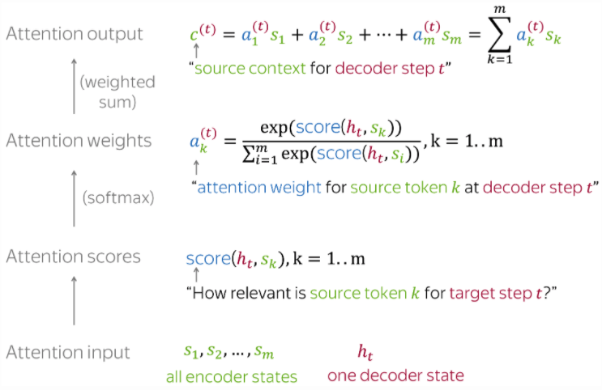
For convenience, here’s the Attention calculation summarized on 1 slide
Photo credit: https://lena-voita.github.io/nlp_course/seq2seq_and_attention.html

Slide 76
For convenience, here’s the Attention calculation summarized on 1 slide
The Attention mechanism that produces scores doesn’t have to be a FFNN like I illustrated. It can be any function you wish.
Photo credit: https://lena-voita.github.io/nlp_course/seq2seq_and_attention.html

Slide 77
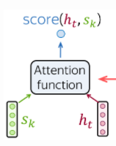
Popular Attention Scoring functions:
Photo credit: https://lena-voita.github.io/nlp_course/seq2seq_and_attention.html

Slide 78
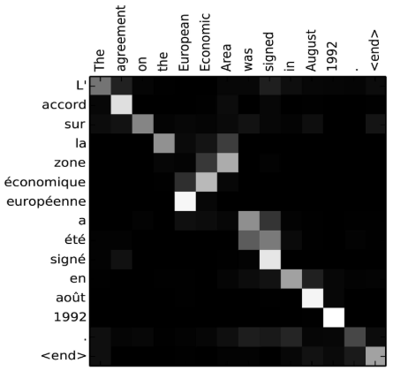
seq2seq + Attention
Attention:
greatly improves seq2seq results
allows us to visualize the contribution each encoding word gave for each decoder’s word
Image source: Fig 3 in Bahdanau et al., 2015

Slide 79
seq2seq + Attention
Takeaway:
Having a separate encoder and decoder allows for n → m length predictions.
Attention is powerful; allows us to conditionally weight our focus
Attention:
greatly improves seq2seq results
allows us to visualize the contribution each encoding word gave for each decoder’s word
Image source: Fig 3 in Bahdanau et al., 2015

Slide 80
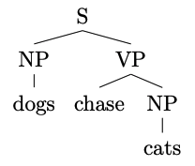
Constituency Parsing
Input: dogs chase cats
Output:
or a flattened representation

Slide 81
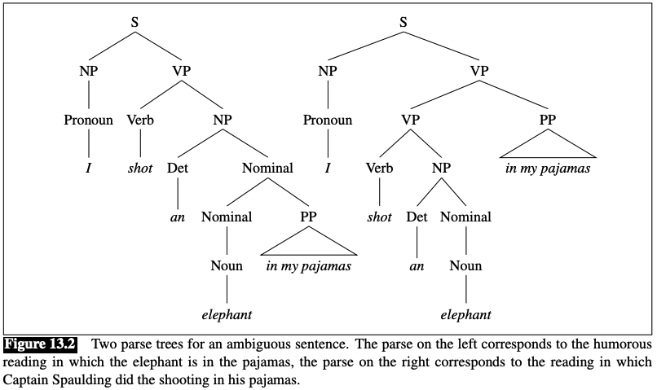
Constituency Parsing
Input: I shot an elephant in my pajamas
Output:
https://web.stanford.edu/~jurafsky/slp3/13.pdf

Slide 82
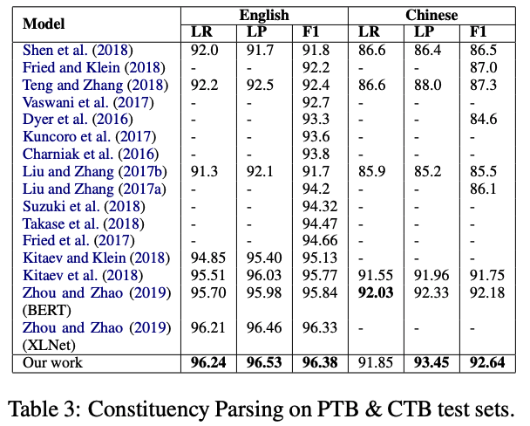
Results
https://aclanthology.org/2020.findings-emnlp.65.pdf

Slide 83
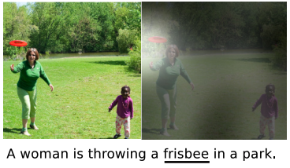
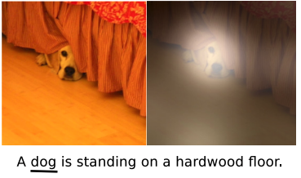
Image Captioning
Input: image
Output: generated text
Show, Attend and Tell: Neural Image Caption Generation with Visual Attention. Xu et al. CVPR (2016)

Slide 84
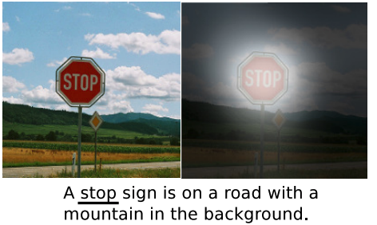
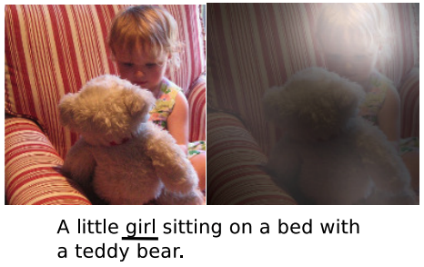
Image Captioning
Input: image
Output: generated text
Show, Attend and Tell: Neural Image Caption Generation with Visual Attention. Xu et al. CVPR (2016)

Slide 85
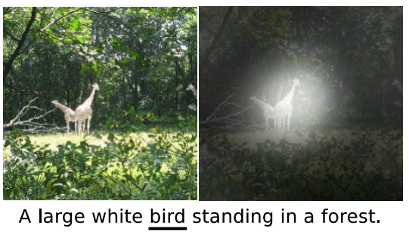
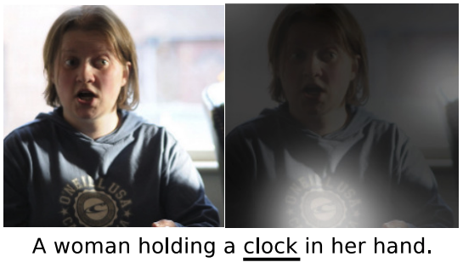
Image Captioning
Show, Attend and Tell: Neural Image Caption Generation with Visual Attention. Xu et al. CVPR (2016)

Slide 86
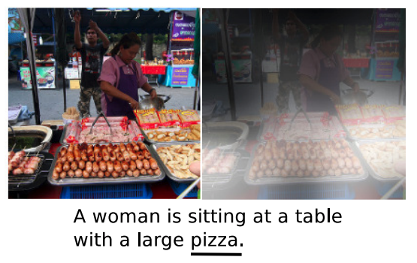
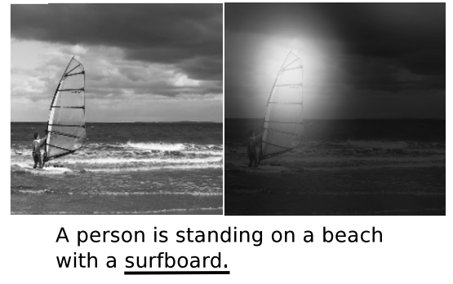
Image Captioning
Show, Attend and Tell: Neural Image Caption Generation with Visual Attention. Xu et al. CVPR (2016)

Slide 87
SUMMARY
LSTMs yielded state-of-the-art results on most NLP tasks (2014-2018)
seq2seq+Attention was an even more revolutionary idea (Google Translate used it)
Attention allows us to place appropriate weight to the encoder’s hidden states
But, LSTMs require us to iteratively scan each word and wait until we’re at the end before we can do anything

