Slide 1
Lecture 7: seq2seq + Attention
Sequence Generation
Harvard
AC295/CS287r/CSCI E-115B
Chris Tanner

Slide 2
ScHoolboy Q
[seq2seq] + Attention (2019)

Slide 3
ANNOUNCEMENTS
HW2 is out! Determine your mystery language.
Research Proposals are due in 7 days, Sept 30.
Office Hours:
Today, my OH will be pushed back: 3:30pm – 5:30pm
Please reserve your coding questions for the TFs and/or EdStem, as I hold office hours solo, and debugging code can easily bottleneck the queue.
Saturday @ 9am, I’ll host & record a review session. Submit questions on Ed’s Sway

Slide 4
QUIZ 2
False. Need to be able to generate the same vocabulary. No guarantee that the 2 different sets of 100 docs had exactly the same words. You’d need to train them on identical training sets in order to fairly evaluate.

Slide 5
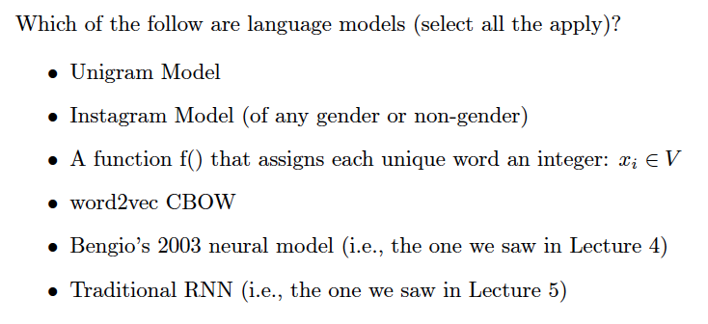
QUIZ 2
Not a proper LM, but it’s a masked language model (MLM)
Auto-regressive LM
Auto-regressive LM

Slide 6
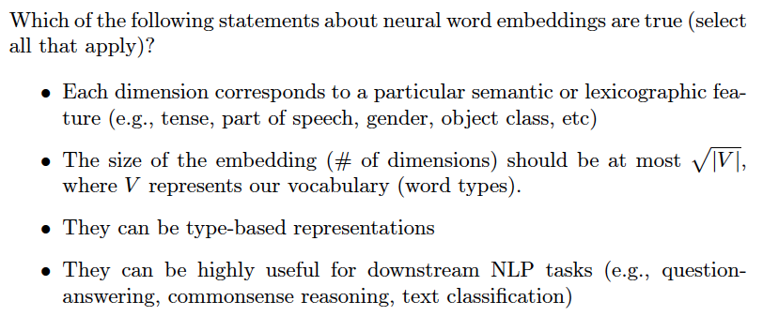
QUIZ 2
e.g., word2vec

Slide 7
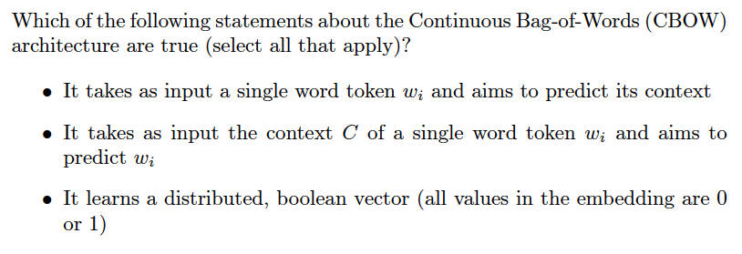
QUIZ 2

Slide 8
RECAP: L5
RNNs help capture more context while avoiding sparsity, storage, and compute issues!
The hidden layer is what we care about. It represents the word’s “meaning”.
Often suffers from vanishing/exploding gradients
$${\hat{y}}_{i}$$
Output layer
$$U$$
$$V$$
Hidden layer
$$W$$
Input layer
$$x_{i}$$

Slide 9
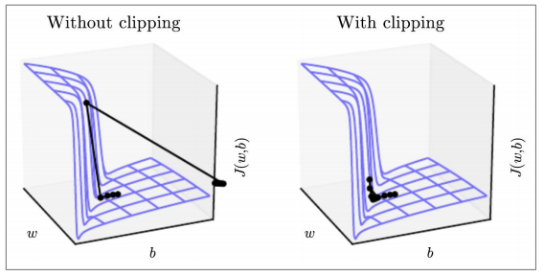
RECAP: L6
Gradient Clipping may help all NNs
LSTMs (1997) are usually much better than vanilla RNNs
Captures long-range dependencies
Doesn’t suffer as much w/ its gradients
Emilia told her project partner Alan about ___ latest idea.
He tends to stress out and put too much pressure on himself

Slide 10
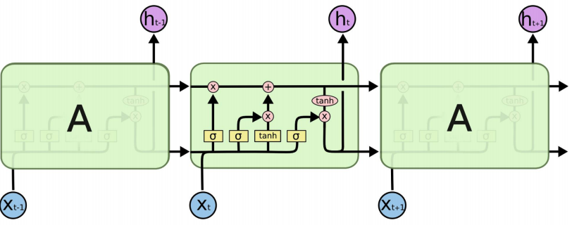
RECAP: L6
some old memories are “forgotten”
some new memories are made
$$C^{t}$$
$$C^{t+1}$$
$$C^{t−1}$$
memory is written, erased, and read by three gates – which are influenced by $x$ and $h$
$$H^{t−1}$$
$$H^{t}$$
$$H^{t+1}$$
a nonlinear weighted version of the long-term memory becomes our short-term memory
Diagram: https://colah.github.io/posts/2015-08-Understanding-LSTMs/

Slide 11
RECAP: L6
Forget Gate
$$C^{t}$$
$$C^{t+1}$$
$$C^{t−1}$$
Input Gate
$$H^{t−1}$$
$$H^{t}$$
$$H^{t+1}$$
Output Gate
Diagram: https://colah.github.io/posts/2015-08-Understanding-LSTMs/

Slide 12
Outline
Long Short-Term Memory (LSTMs)
Bi-LSTM and ELMo
seq2seq
seq2seq + Attention

Slide 13
Outline
Long Short-Term Memory (LSTMs)
Bi-LSTM and ELMo
seq2seq
seq2seq + Attention

Slide 14
LSTMs
They’ve been around for a while, but essentially unused until 2014!

Slide 15
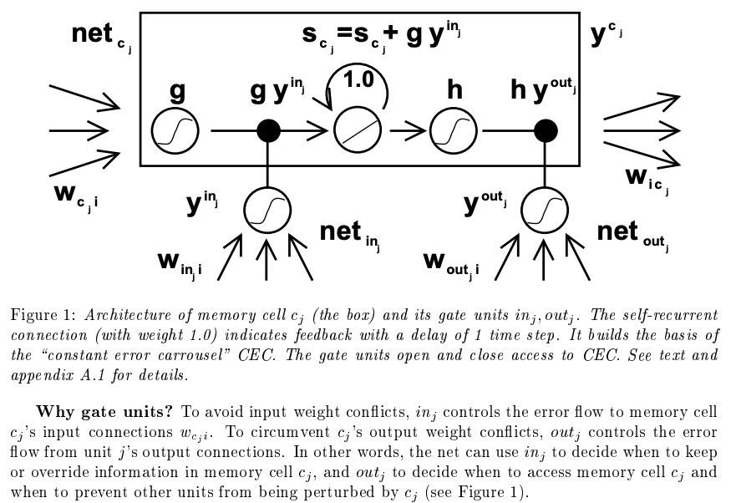
LSTMs
Long short-term memory. Hochreiter and Schmidhuber. Neural Computation (1997).

Slide 16
Sequential Modelling
IMPORTANT
If your goal isn’t to predict the next item in a sequence, you could instead perform classification or regression task using the learned, hidden representations.

Slide 17
Sequential Modelling
Language Modelling
1-to-1 tagging/classification
$$x_{2}$$
$$x_{3}$$
$$x_{4}$$
$$x_{5}$$
$${\hat{y}}_{1}$$
$${\hat{y}}_{2}$$
$${\hat{y}}_{3}$$
$${\hat{y}}_{4}$$
Output layer
Output layer
$$U$$
$$V$$
$$U$$
$$U$$
$$U$$
$$U$$
$$V$$
$$U$$
$$U$$
$$U$$
$$V$$
$$V$$
$$V$$
$$V$$
Hidden layer
Hidden layer
$$W$$
$$W$$
$$W$$
$$W$$
$$W$$
$$W$$
$$W$$
$$W$$
Input layer
Input layer
$$x_{1}$$
$$x_{2}$$
$$x_{3}$$
$$x_{4}$$
$$x_{1}$$
$$x_{2}$$
$$x_{3}$$
$$x_{4}$$
Auto-regressive
Non-Auto-regressive

Slide 18
Sequential Modelling
Language Modelling
1-to-1 tagging/classification
$$x_{2}$$
$$x_{3}$$
$$x_{4}$$
$$x_{5}$$
$${\hat{y}}_{1}$$
$${\hat{y}}_{2}$$
$${\hat{y}}_{3}$$
$${\hat{y}}_{4}$$
If it’s regressive or not depends on if each output is fed back in as the next input.
Output layer
Output layer
$$U$$
$$V$$
$$U$$
$$U$$
$$U$$
$$U$$
$$V$$
$$U$$
$$U$$
$$U$$
$$V$$
$$V$$
$$V$$
$$V$$
Hidden layer
Hidden layer
$$W$$
$$W$$
$$W$$
$$W$$
$$W$$
$$W$$
$$W$$
$$W$$
Input layer
Input layer
$$x_{1}$$
$$x_{2}$$
$$x_{3}$$
$$x_{4}$$
$$x_{1}$$
$$x_{2}$$
$$x_{3}$$
$$x_{4}$$
Auto-regressive
Non-Auto-regressive

Slide 19
Sequential Modelling
Regression
Binary classification
Multi-class classification
Many-to-1 classification
Sentiment score
$${\hat{y}}_{4}$$
Output layer
$$U$$
$$V$$
$$U$$
$$U$$
$$U$$
$$V$$
$$V$$
Hidden layer
$$W$$
$$W$$
$$W$$
$$W$$
Input layer
$$x_{1}$$
$$x_{2}$$
$$x_{3}$$
$$x_{4}$$

Slide 20
Sequential Modelling
Regression
Binary classification
Multi-class classification
Many-to-1 classification
Sentiment score
Output layer
$$U$$
$$V$$
$$U$$
$$U$$
$$U$$
Hidden layer
$$V$$
$$V$$
$$W$$
$$W$$
$$W$$
$$W$$
Input layer
$$x_{1}$$
$$x_{2}$$
$$x_{3}$$
$$x_{4}$$

Slide 21
Types of Prediction
input
output
Regression
I love hiking!
0.9
Binary Classification
I love hiking!
Positive or negative
Multi-class Classification
I love hiking!
Very positive, positive, neutral, negative, or very negative
Structured Prediction
I love hiking!
PRP VBP NN
(difficult scenario when your output has exponential/infinite # of possibilities)

Slide 22
Types of Prediction (an independent axis)
Unconditioned Prediction: predict some single variable. P(X)
Example: language modelling. X = “I like hiking!”
Conditioned Prediction: predict the probability of an output variable, given the input. P(Y|X)
Example: text classification. Y = positive. X = “I like hiking!”

Slide 23
Types of Prediction (an independent axis)
Unconditioned Prediction: predict some single variable. P(X)
Example: language modelling. X = “I like hiking!”
(un)conditioned is referring to if you’re entire model is predicated upon some particular input.
Conditioned Prediction: predict the probability of an output variable, given the input. P(Y|X)
Example: text classification. Y = positive. X = “I like hiking!”

Slide 24
Types of Prediction (an independent axis)
Unconditioned Prediction: predict some single variable. P(X)
Example: language modelling. X = “I like hiking!”
Conditioned Prediction: predict the probability of an output variable, given the input. P(Y|X)
Language modelling is unconditional prediction, but one could do so by making use of conditional probabilities of X
Example: text classification. Y = positive. X = “I like hiking!”

Slide 25
Types of Unconditional Prediction
Slide adapted from or inspired by Graham Neubig’s CMU NLP 2021

Slide 26
Types of Unconditional Prediction
Formally, a language model estimates the probability of a sequence, so this is illegal. It ”cheats”, and we call this style masked language models (not proper probability distribution and they don’t estimate sequences)
Slide adapted from or inspired by Graham Neubig’s CMU NLP 2021

Slide 27
Types of Conditional Prediction
Many-to-1 classification
$$P\left(y | X\right)$$
Many-to-many classification
Slide adapted from or inspired by Graham Neubig’s CMU NLP 2021

Slide 28
This concludes the foundation in sequential representation. Most state-of-the-art advances are based on those core RNN/LSTM ideas. But, with tens of thousands of researchers and hackers exploring deep learning, there are many tweaks that haven proven useful. (aka this is where things get crazy.)

Slide 29
Outline
Long Short-Term Memory (LSTMs)
Bi-LSTM and ELMo
seq2seq
seq2seq + Attention

Slide 30
Outline
Long Short-Term Memory (LSTMs)
Bi-LSTM and ELMo
seq2seq
seq2seq + Attention

Slide 31
RNN Extensions: Bi-directional LSTMs
RNNs/LSTMs use the left-to-right context and sequentially process data.
If you have full access to the data at testing time, why not make use of the flow of information from right-to-left, also?
Notes:
No longer constitutes an auto-regressive LM

Slide 32
RNN Extensions: Bi-directional LSTMs
For brevity, let’s use the follow schematic to represent an RNN
$$h_{1}^{L}$$
$$h_{2}^{L}$$
$$h_{3}^{L}$$
$$h_{4}^{L}$$
Hidden layer
Input layer
$$x_{1}$$
$$x_{2}$$
$$x_{3}$$
$$x_{4}$$

Slide 33
RNN Extensions: Bi-directional LSTMs
For brevity, let’s use the follow schematic to represent an RNN
$$h_{1}^{L}$$
$$h_{2}^{L}$$
$$h_{3}^{L}$$
$$h_{4}^{L}$$
$$h_{1}^{R}$$
$$h_{2}^{R}$$
$$h_{3}^{R}$$
$$h_{4}^{R}$$
Hidden layer
Input layer
$$x_{1}$$
$$x_{2}$$
$$x_{3}$$
$$x_{4}$$
$$x_{1}$$
$$x_{2}$$
$$x_{3}$$
$$x_{4}$$

Slide 34
RNN Extensions: Bi-directional LSTMs
$$h_{1}^{R}$$
$$h_{2}^{R}$$
$$h_{3}^{R}$$
$$h_{4}^{R}$$
Concatenate the hidden layers
$$h_{1}^{L}$$
$$h_{2}^{L}$$
$$h_{3}^{L}$$
$$h_{4}^{L}$$
$$h_{1}^{L}$$
$$h_{2}^{L}$$
$$h_{3}^{L}$$
$$h_{4}^{L}$$
$$h_{1}^{R}$$
$$h_{2}^{R}$$
$$h_{3}^{R}$$
$$h_{4}^{R}$$
Hidden layer
Input layer
$$x_{1}$$
$$x_{2}$$
$$x_{3}$$
$$x_{4}$$
$$x_{1}$$
$$x_{2}$$
$$x_{3}$$
$$x_{4}$$

Slide 35
RNN Extensions: Bi-directional LSTMs
Output layer
$${\hat{y}}_{1}$$
$${\hat{y}}_{2}$$
$${\hat{y}}_{3}$$
$${\hat{y}}_{4}$$
$$h_{1}^{R}$$
$$h_{2}^{R}$$
$$h_{3}^{R}$$
$$h_{4}^{R}$$
Concatenate the hidden layers
$$h_{1}^{L}$$
$$h_{2}^{L}$$
$$h_{3}^{L}$$
$$h_{4}^{L}$$
$$h_{1}^{L}$$
$$h_{2}^{L}$$
$$h_{3}^{L}$$
$$h_{4}^{L}$$
$$h_{1}^{R}$$
$$h_{2}^{R}$$
$$h_{3}^{R}$$
$$h_{4}^{R}$$
Hidden layer
Input layer
$$x_{1}$$
$$x_{2}$$
$$x_{3}$$
$$x_{4}$$
$$x_{1}$$
$$x_{2}$$
$$x_{3}$$
$$x_{4}$$

Slide 36
RNN Extensions: Bi-directional LSTMs
BI-LSTM STRENGTHS?
Usually performs at least as well as uni-directional RNNs/LSTMs
BI-LSTM ISSUES?
Slower to train
Only possible if access to full data is allowed

Slide 37
Type of Unconditional Prediction

Slide 38
RNN Extensions: Stacked LSTMs
Hidden layers provide an abstraction (holds “meaning”).
Stacking hidden layers provides increased abstractions.
Hidden layer #1
$$h_{1}^{L}$$
$$h_{2}^{L}$$
$$h_{3}^{L}$$
$$h_{4}^{L}$$
Input layer
$$x_{1}$$
$$x_{2}$$
$$x_{3}$$
$$x_{4}$$

Slide 39
RNN Extensions: Stacked LSTMs
Hidden layers provide an abstraction (holds “meaning”).
Stacking hidden layers provides increased abstractions.
Hidden layer #2
$$h_{1}^{L2}$$
$$h_{2}^{L2}$$
$$h_{3}^{L2}$$
$$h_{4}^{L2}$$
Hidden layer #1
$$h_{1}^{L}$$
$$h_{2}^{L}$$
$$h_{3}^{L}$$
$$h_{4}^{L}$$
Input layer
$$x_{1}$$
$$x_{2}$$
$$x_{3}$$
$$x_{4}$$

Slide 40
RNN Extensions: Stacked LSTMs
Output layer
$${\hat{y}}_{1}$$
$${\hat{y}}_{2}$$
$${\hat{y}}_{3}$$
$${\hat{y}}_{4}$$
Hidden layers provide an abstraction (holds “meaning”).
Stacking hidden layers provides increased abstractions.
Hidden layer #2
$$h_{1}^{L2}$$
$$h_{2}^{L2}$$
$$h_{3}^{L2}$$
$$h_{4}^{L2}$$
Hidden layer #1
$$h_{1}^{L}$$
$$h_{2}^{L}$$
$$h_{3}^{L}$$
$$h_{4}^{L}$$
Input layer
$$x_{1}$$
$$x_{2}$$
$$x_{3}$$
$$x_{4}$$

Slide 41
ELMo: Stacked Bi-directional LSTMs
General Idea:
Goal is to get highly rich, contextualized embeddings (word tokens)
Use both directions of context (bi-directional), with increasing abstractions (stacked)
Linearly combine all abstract representations (hidden layers) and optimize w.r.t. a particular task (e.g., sentiment classification)

Slide 42
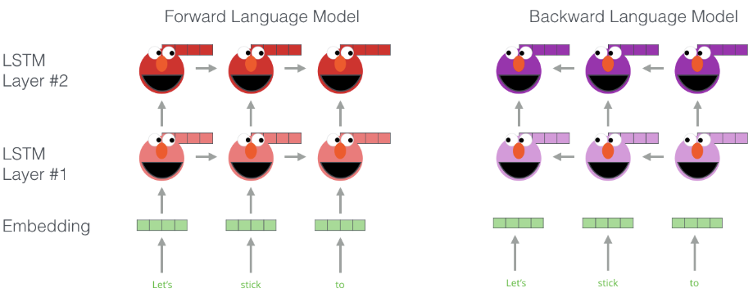
ELMo: Stacked Bi-directional LSTMs
Illustration: http://jalammar.github.io/illustrated-bert/

Slide 43
Illustration: http://jalammar.github.io/illustrated-bert/

Slide 44
ELMo: Stacked Bi-directional LSTMs
Deep contextualized word representations. Peters et al. NAACL 2018.

Slide 45
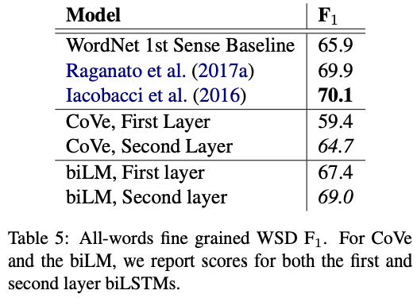
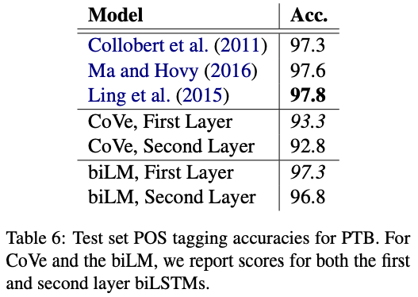
ELMo: Stacked Bi-directional LSTMs
The higher layer seems to learn semantics while the lower layer probably captured syntactic features
Deep contextualized word representations. Peters et al. NAACL 2018.

Slide 46
ELMo: Stacked Bi-directional LSTMs
ELMo yielded incredibly good contextualized embeddings, which yielded SOTA results when applied to many NLP tasks.
Main ELMo takeaway: given enough training data, having tons of explicit connections between your vectors is useful (system can determine how to best use context)
ELMo Slides: https://www.slideshare.net/shuntaroy/a-review-of-deep-contextualized-word-representations-peters-2018

Slide 47
RECAP
Language Modelling may help us for other tasks
LSTMs do a great job of capturing “meaning”, which can be used for almost every task
Given a sequence of N words, we can produce 1 output
Given a sequence of N words, we can produce N outputs

Slide 48
RECAP
Language Modelling may help us for other tasks
LSTMs do a great job of capturing “meaning”, which can be used for almost every task
Given a sequence of N words, we can produce 1 output
Given a sequence of N words, we can produce N outputs
What if we wish to have M outputs?

Slide 49
We want to produce a variable-length output (e.g., n → m predictions)
Thank you for visiting!
Děkujeme za návštěvu!

Slide 50
Outline
Long Short-Term Memory (LSTMs)
Bi-LSTM and ELMo
seq2seq
seq2seq + Attention

Slide 51
Outline
Long Short-Term Memory (LSTMs)
Bi-LSTM and ELMo
seq2seq
seq2seq + Attention

Slide 52
Sequence-to-Sequence (seq2seq)
If our input is a sentence in Language A, and we wish to translate it to Language B, it is clearly sub-optimal to translate word by word (like our current models are suited to do).
Instead, let a sequence of tokens be the unit that we ultimately wish to work with (a sequence of length N may emit a sequences of length M)
seq2seq models are comprised of 2 RNNs: 1 encoder, 1 decoder

Slide 53
Types of Conditional Prediction
Many-to-1 classification
$$P\left(y | X\right)$$
Many-to-many classification

Slide 54
Sequence-to-Sequence (seq2seq)
$$h_{1}^{E}$$
$$h_{2}^{E}$$
$$h_{3}^{E}$$
$$h_{4}^{E}$$
Hidden layer
Input layer
The
brown
dog
ran
ENCODER RNN

Slide 55
Sequence-to-Sequence (seq2seq)
The final hidden state of the encoder RNN is the initial state of the decoder RNN
$$h_{1}^{E}$$
$$h_{2}^{E}$$
$$h_{3}^{E}$$
$$h_{4}^{E}$$
Hidden layer
Input layer
The
brown
dog
ran
ENCODER RNN

Slide 56
Sequence-to-Sequence (seq2seq)
The final hidden state of the encoder RNN is the initial state of the decoder RNN
$$h_{1}^{E}$$
$$h_{2}^{E}$$
$$h_{3}^{E}$$
$$h_{4}^{E}$$
$$h_{1}^{D}$$
Hidden layer
Input layer
The
brown
dog
ran
<s>
ENCODER RNN
DECODER RNN

Slide 57
Sequence-to-Sequence (seq2seq)
The final hidden state of the encoder RNN is the initial state of the decoder RNN
Le
$$h_{1}^{E}$$
$$h_{2}^{E}$$
$$h_{3}^{E}$$
$$h_{4}^{E}$$
$$h_{1}^{D}$$
Hidden layer
Input layer
The
brown
dog
ran
<s>
ENCODER RNN
DECODER RNN

Slide 58
Sequence-to-Sequence (seq2seq)
The final hidden state of the encoder RNN is the initial state of the decoder RNN
Le
$$h_{1}^{E}$$
$$h_{2}^{E}$$
$$h_{3}^{E}$$
$$h_{4}^{E}$$
$$h_{1}^{D}$$
$$h_{2}^{D}$$
Hidden layer
Input layer
The
brown
dog
ran
<s>
Le
ENCODER RNN
DECODER RNN

Slide 59
Sequence-to-Sequence (seq2seq)
The final hidden state of the encoder RNN is the initial state of the decoder RNN
Le
chien
$$h_{1}^{E}$$
$$h_{2}^{E}$$
$$h_{3}^{E}$$
$$h_{4}^{E}$$
$$h_{1}^{D}$$
$$h_{2}^{D}$$
Hidden layer
Input layer
The
brown
dog
ran
<s>
Le
ENCODER RNN
DECODER RNN

Slide 60
Sequence-to-Sequence (seq2seq)
The final hidden state of the encoder RNN is the initial state of the decoder RNN
Le
chien
$$h_{1}^{E}$$
$$h_{2}^{E}$$
$$h_{3}^{E}$$
$$h_{4}^{E}$$
$$h_{1}^{D}$$
$$h_{2}^{D}$$
$$h_{3}^{D}$$
Hidden layer
Input layer
The
brown
dog
ran
<s>
Le
chien
ENCODER RNN
DECODER RNN

Slide 61
Sequence-to-Sequence (seq2seq)
The final hidden state of the encoder RNN is the initial state of the decoder RNN
Le
chien
brun
$$h_{1}^{E}$$
$$h_{2}^{E}$$
$$h_{3}^{E}$$
$$h_{4}^{E}$$
$$h_{1}^{D}$$
$$h_{2}^{D}$$
$$h_{3}^{D}$$
Hidden layer
Input layer
The
brown
dog
ran
<s>
Le
chien
ENCODER RNN
DECODER RNN

Slide 62
Sequence-to-Sequence (seq2seq)
The final hidden state of the encoder RNN is the initial state of the decoder RNN
Le
chien
brun
$$h_{1}^{E}$$
$$h_{2}^{E}$$
$$h_{3}^{E}$$
$$h_{4}^{E}$$
$$h_{1}^{D}$$
$$h_{2}^{D}$$
$$h_{3}^{D}$$
$$h_{4}^{D}$$
Hidden layer
Input layer
The
brown
dog
ran
<s>
Le
chien
brun
ENCODER RNN
DECODER RNN

Slide 63
Sequence-to-Sequence (seq2seq)
The final hidden state of the encoder RNN is the initial state of the decoder RNN
Le
chien
brun
a
$$h_{1}^{E}$$
$$h_{2}^{E}$$
$$h_{3}^{E}$$
$$h_{4}^{E}$$
$$h_{1}^{D}$$
$$h_{2}^{D}$$
$$h_{3}^{D}$$
$$h_{4}^{D}$$
Hidden layer
Input layer
The
brown
dog
ran
<s>
Le
chien
brun
ENCODER RNN
DECODER RNN

Slide 64
Sequence-to-Sequence (seq2seq)
The final hidden state of the encoder RNN is the initial state of the decoder RNN
Le
chien
brun
a
$$h_{1}^{E}$$
$$h_{2}^{E}$$
$$h_{3}^{E}$$
$$h_{4}^{E}$$
$$h_{1}^{D}$$
$$h_{2}^{D}$$
$$h_{3}^{D}$$
$$h_{4}^{D}$$
$$h_{5}^{D}$$
Hidden layer
Input layer
The
brown
dog
ran
<s>
Le
chien
brun
a
ENCODER RNN
DECODER RNN

Slide 65
Sequence-to-Sequence (seq2seq)
The final hidden state of the encoder RNN is the initial state of the decoder RNN
Le
chien
brun
a
couru
$$h_{1}^{E}$$
$$h_{2}^{E}$$
$$h_{3}^{E}$$
$$h_{4}^{E}$$
$$h_{1}^{D}$$
$$h_{2}^{D}$$
$$h_{3}^{D}$$
$$h_{4}^{D}$$
$$h_{5}^{D}$$
Hidden layer
Input layer
The
brown
dog
ran
<s>
Le
chien
brun
a
ENCODER RNN
DECODER RNN

Slide 66
Sequence-to-Sequence (seq2seq)
The final hidden state of the encoder RNN is the initial state of the decoder RNN
Le
chien
brun
a
couru
$$h_{1}^{E}$$
$$h_{2}^{E}$$
$$h_{3}^{E}$$
$$h_{4}^{E}$$
$$h_{1}^{D}$$
$$h_{2}^{D}$$
$$h_{3}^{D}$$
$$h_{4}^{D}$$
$$h_{5}^{D}$$
$$h_{6}^{D}$$
Hidden layer
Input layer
The
brown
dog
ran
<s>
Le
chien
brun
a
couru
ENCODER RNN
DECODER RNN

Slide 67
Sequence-to-Sequence (seq2seq)
The final hidden state of the encoder RNN is the initial state of the decoder RNN
Le
chien
brun
a
couru
<s>
$$h_{1}^{E}$$
$$h_{2}^{E}$$
$$h_{3}^{E}$$
$$h_{4}^{E}$$
$$h_{1}^{D}$$
$$h_{2}^{D}$$
$$h_{3}^{D}$$
$$h_{4}^{D}$$
$$h_{5}^{D}$$
$$h_{6}^{D}$$
Hidden layer
Input layer
The
brown
dog
ran
<s>
Le
chien
brun
a
couru
ENCODER RNN
DECODER RNN

Slide 68
Sequence-to-Sequence (seq2seq)
$${\hat{y}}_{1}$$
$${\hat{y}}_{2}$$
$${\hat{y}}_{3}$$
$${\hat{y}}_{4}$$
$${\hat{y}}_{5}$$
$${\hat{y}}_{6}$$
$$h_{1}^{E}$$
$$h_{2}^{E}$$
$$h_{3}^{E}$$
$$h_{4}^{E}$$
$$h_{1}^{D}$$
$$h_{2}^{D}$$
$$h_{3}^{D}$$
$$h_{4}^{D}$$
$$h_{5}^{D}$$
$$h_{6}^{D}$$
Hidden layer
Input layer
The
brown
dog
ran
<s>
Le
chien
brun
a
couru
ENCODER RNN
DECODER RNN

Slide 69
Sequence-to-Sequence (seq2seq)
Training occurs like RNNs typically do; the loss (from the decoder outputs) is calculated, and we update weights all the way to the beginning (encoder)
$${\hat{y}}_{1}$$
$${\hat{y}}_{2}$$
$${\hat{y}}_{3}$$
$${\hat{y}}_{4}$$
$${\hat{y}}_{5}$$
$${\hat{y}}_{6}$$
$$h_{1}^{E}$$
$$h_{2}^{E}$$
$$h_{3}^{E}$$
$$h_{4}^{E}$$
$$h_{1}^{D}$$
$$h_{2}^{D}$$
$$h_{3}^{D}$$
$$h_{4}^{D}$$
$$h_{5}^{D}$$
$$h_{6}^{D}$$
Hidden layer
Input layer
The
brown
dog
ran
<s>
Le
chien
brun
a
couru
ENCODER RNN
DECODER RNN

Slide 70
Sequence-to-Sequence (seq2seq)
Testing generates decoder outputs one word at a time, until we generate a <S> token.
Each decoder’s ${\hat{y}}_{i}$ becomes the input $x_{i+1}$
$${\hat{y}}_{1}$$
$${\hat{y}}_{2}$$
$${\hat{y}}_{3}$$
$${\hat{y}}_{4}$$
$${\hat{y}}_{5}$$
$${\hat{y}}_{6}$$
$$h_{1}^{E}$$
$$h_{2}^{E}$$
$$h_{3}^{E}$$
$$h_{4}^{E}$$
$$h_{1}^{D}$$
$$h_{2}^{D}$$
$$h_{3}^{D}$$
$$h_{4}^{D}$$
$$h_{5}^{D}$$
$$h_{6}^{D}$$
Hidden layer
Input layer
The
brown
dog
ran
<s>
Le
chien
brun
a
couru
ENCODER RNN
DECODER RNN

Slide 71
Sequence-to-Sequence (seq2seq)
See any issues with this traditional seq2seq paradigm?

Slide 72
Sequence-to-Sequence (seq2seq)
$${\hat{y}}_{1}$$
$${\hat{y}}_{2}$$
$${\hat{y}}_{3}$$
$${\hat{y}}_{4}$$
$${\hat{y}}_{5}$$
$${\hat{y}}_{6}$$
$$h_{1}^{E}$$
$$h_{2}^{E}$$
$$h_{3}^{E}$$
$$h_{4}^{E}$$
$$h_{1}^{D}$$
$$h_{2}^{D}$$
$$h_{3}^{D}$$
$$h_{4}^{D}$$
$$h_{5}^{D}$$
$$h_{6}^{D}$$
Hidden layer
Input layer
The
brown
dog
ran
<s>
Le
chien
brun
a
couru
ENCODER RNN
DECODER RNN

Slide 73
Sequence-to-Sequence (seq2seq)
It’s crazy that the entire “meaning” of the 1st sequence is expected to be packed into this one embedding, and that the encoder then never interacts w/ the decoder again. Hands free.
$${\hat{y}}_{1}$$
$${\hat{y}}_{2}$$
$${\hat{y}}_{3}$$
$${\hat{y}}_{4}$$
$${\hat{y}}_{5}$$
$${\hat{y}}_{6}$$
$$h_{1}^{E}$$
$$h_{2}^{E}$$
$$h_{3}^{E}$$
$$h_{4}^{E}$$
$$h_{1}^{D}$$
$$h_{2}^{D}$$
$$h_{3}^{D}$$
$$h_{4}^{D}$$
$$h_{5}^{D}$$
$$h_{6}^{D}$$
Hidden layer
Input layer
The
brown
dog
ran
<s>
Le
chien
brun
a
couru
ENCODER RNN
DECODER RNN

Slide 74
Outline
Long Short-Term Memory (LSTMs)
Bi-LSTM and ELMo
seq2seq
seq2seq + Attention

Slide 75
Outline
Long Short-Term Memory (LSTMs)
Bi-LSTM and ELMo
seq2seq
seq2seq + Attention

Slide 76
Sequence-to-Sequence (seq2seq)
Instead, what if the decoder, at each step, pays attention to a distribution of all of the encoder’s hidden states?

Slide 77
Sequence-to-Sequence (seq2seq)
Instead, what if the decoder, at each step, pays attention to a distribution of all of the encoder’s hidden states?
Intuition: when we (humans) translate a sentence, we don’t just consume the original sentence, reflect on the meaning of the last word, then regurgitate in a new language; we continuously think back at the original sentence while focusing on different parts.

Slide 78
Attention
The concept of attention within cognitive neuroscience and psychology dates back to the 1800s. [William James, 1890].
Nadaray-Watson kernel regression proposed in 1964. It locally weighted its predictions.

Slide 79
seq2seq + Attention
Q: How do we determine how much to pay attention to each of the encoder’s hidden layers?
$$.4?$$
$$.3?$$
$$.1?$$
$$.2?$$
$$h_{1}^{E}$$
$$h_{2}^{E}$$
$$h_{3}^{E}$$
$$h_{4}^{E}$$
Hidden layer
Input layer
The
brown
dog
ran
ENCODER RNN

Slide 80
seq2seq + Attention
Q: How do we determine how much to pay attention to each of the encoder’s hidden layers?
A: Let’s base it on our decoder’s current hidden state (our current representation of meaning) and all of the encoder’s hidden layers!
$$h_{1}^{E}$$
$$h_{2}^{E}$$
$$h_{3}^{E}$$
$$h_{4}^{E}$$
$$h_{1}^{D}$$
Hidden layer
Input layer
The
brown
dog
ran
<s>
ENCODER RNN
DECODER RNN

Slide 81
seq2seq + Attention
Q: How do we determine how much to pay attention to each of the encoder’s hidden layers?
A: Let’s base it on our decoder’s current hidden state (our current representation of meaning) and all of the encoder’s hidden layers!
$$h_{1}^{E}$$
$$h_{2}^{E}$$
$$h_{3}^{E}$$
$$h_{4}^{E}$$
$$h_{1}^{D}$$
$$e_{1}$$
$$1.5$$
Hidden layer
$$h_{1}^{E}$$
$$h_{1}^{D}$$
Separate FFNN
Input layer
The
brown
dog
ran
<s>
ENCODER RNN
DECODER RNN

Slide 82
seq2seq + Attention
Q: How do we determine how much to pay attention to each of the encoder’s hidden layers?
A: Let’s base it on our decoder’s current hidden state (our current representation of meaning) and all of the encoder’s hidden layers!
$$h_{1}^{E}$$
$$h_{2}^{E}$$
$$h_{3}^{E}$$
$$h_{4}^{E}$$
$$h_{1}^{D}$$
$$e_{2}$$
$$0.9$$
Hidden layer
$$h_{2}^{E}$$
$$h_{1}^{D}$$
Separate FFNN
Input layer
The
brown
dog
ran
<s>
ENCODER RNN
DECODER RNN

Slide 83
seq2seq + Attention
Q: How do we determine how much to pay attention to each of the encoder’s hidden layers?
A: Let’s base it on our decoder’s current hidden state (our current representation of meaning) and all of the encoder’s hidden layers!
$$h_{1}^{E}$$
$$h_{2}^{E}$$
$$h_{3}^{E}$$
$$h_{4}^{E}$$
$$h_{1}^{D}$$
$$e_{3}$$
$$0.2$$
Hidden layer
$$h_{3}^{E}$$
$$h_{1}^{D}$$
Separate FFNN
Input layer
The
brown
dog
ran
<s>
ENCODER RNN
DECODER RNN

Slide 84
seq2seq + Attention
Q: How do we determine how much to pay attention to each of the encoder’s hidden layers?
A: Let’s base it on our decoder’s current hidden state (our current representation of meaning) and all of the encoder’s hidden layers!
$$h_{1}^{E}$$
$$h_{2}^{E}$$
$$h_{3}^{E}$$
$$h_{4}^{E}$$
$$h_{1}^{D}$$
$$e_{4}$$
$$−0.5$$
Hidden layer
$$h_{4}^{E}$$
$$h_{1}^{D}$$
Separate FFNN
Input layer
The
brown
dog
ran
<s>
ENCODER RNN
DECODER RNN

Slide 85
seq2seq + Attention
Q: How do we determine how much to pay attention to each of the encoder’s hidden layers?
A: Let’s base it on our decoder’s current hidden state (our current representation of meaning) and all of the encoder’s hidden layers!
Attention (raw scores)
$$h_{1}^{E}$$
$$h_{2}^{E}$$
$$h_{3}^{E}$$
$$h_{4}^{E}$$
$$h_{1}^{D}$$
$$e_{1}$$
$$1.5$$
$$e_{2}$$
$$0.9$$
$$e_{3}$$
$$0.2$$
Hidden layer
$$e_{4}$$
$$−0.5$$
Input layer
The
brown
dog
ran
<s>
ENCODER RNN
DECODER RNN

Slide 86
seq2seq + Attention
Q: How do we determine how much to pay attention to each of the encoder’s hidden layers?
A: Let’s base it on our decoder’s current hidden state (our current representation of meaning) and all of the encoder’s hidden layers!
Attention (raw scores)
$$h_{1}^{E}$$
$$h_{2}^{E}$$
$$h_{3}^{E}$$
$$h_{4}^{E}$$
$$h_{1}^{D}$$
$$e_{1}$$
$$1.5$$
$$e_{2}$$
$$0.9$$
$$e_{3}$$
$$0.2$$
Hidden layer
$$e_{4}$$
$$−0.5$$
Attention (softmax’d)
$$a_{i}^{1}=\frac{exp⁡(e_{i})}{\sum_{i}^{N}{{exp⁡(e}_{1})}}$$
Input layer
The
brown
dog
ran
<s>
ENCODER RNN
DECODER RNN

Slide 87
seq2seq + Attention
Q: How do we determine how much to pay attention to each of the encoder’s hidden layers?
A: Let’s base it on our decoder’s current hidden state (our current representation of meaning) and all of the encoder’s hidden layers!
Attention (raw scores)
$$h_{1}^{E}$$
$$h_{2}^{E}$$
$$h_{3}^{E}$$
$$h_{4}^{E}$$
$$h_{1}^{D}$$
$$e_{1}$$
$$1.5$$
$$e_{2}$$
$$0.9$$
$$e_{3}$$
$$0.2$$
Hidden layer
$$e_{4}$$
$$−0.5$$
Attention (softmax’d)
$$a_{1}^{1}=0.51$$
Input layer
The
brown
dog
ran
<s>
$$a_{2}^{1}=0.28$$
$$a_{3}^{1}=0.14$$
ENCODER RNN
DECODER RNN
$$a_{3}^{1}=0.07$$

Slide 88
seq2seq + Attention
$$c_{1}^{D}$$
We multiply each encoder’s hidden layer by its $a_{i}^{1}$attention weights to create a context vector $c_{1}^{D}$
$$a_{1}^{1}$$
$$a_{3}^{1}$$
$$a_{4}^{1}$$
$$a_{2}^{1}$$
$$h_{1}^{E}$$
$$h_{2}^{E}$$
$$h_{3}^{E}$$
$$h_{4}^{E}$$
$$h_{1}^{D}$$
Hidden layer
Attention (softmax’d)
$$a_{1}^{1}=0.51$$
Input layer
The
brown
dog
ran
<s>
$$a_{2}^{1}=0.28$$
$$a_{3}^{1}=0.14$$
ENCODER RNN
DECODER RNN
$$a_{3}^{1}=0.07$$

Slide 89
seq2seq + Attention
REMEMBER: each attention weight $a_{i}^{j}$ is based on the decoder’s current hidden state, too.
$$c_{1}^{D}$$
Le
$${\hat{y}}_{1}$$
$$a_{1}^{1}$$
$$a_{3}^{1}$$
$$a_{4}^{1}$$
$$a_{2}^{1}$$
$$h_{1}^{E}$$
$$h_{2}^{E}$$
$$h_{3}^{E}$$
$$h_{4}^{E}$$
${\text{[}h}_{1}^{D};c_{1}^{D}$]
Hidden layer
Input layer
The
brown
dog
ran
<s>
ENCODER RNN
DECODER RNN

Slide 90
seq2seq + Attention
REMEMBER: each attention weight $a_{i}^{j}$ is based on the decoder’s current hidden state, too.
$$c_{2}^{D}$$
Le
chien
$${\hat{y}}_{1}$$
$${\hat{y}}_{2}$$
$$a_{1}^{2}$$
$$a_{3}^{2}$$
$$a_{4}^{2}$$
$$a_{2}^{2}$$
$$h_{1}^{E}$$
$$h_{2}^{E}$$
$$h_{3}^{E}$$
$$h_{4}^{E}$$
${\text{[}h}_{1}^{D};c_{1}^{D}$]
${\text{[}h}_{2}^{D};c_{2}^{D}$]
Hidden layer
Input layer
The
brown
dog
ran
<s>
Le
ENCODER RNN
DECODER RNN

Slide 91
seq2seq + Attention
REMEMBER: each attention weight $a_{i}^{j}$ is based on the decoder’s current hidden state, too.
$$c_{3}^{D}$$
Le
chien
brun
$${\hat{y}}_{1}$$
$${\hat{y}}_{2}$$
$${\hat{y}}_{3}$$
$$a_{1}^{3}$$
$$a_{3}^{3}$$
$$a_{4}^{3}$$
$$a_{2}^{3}$$
$$h_{1}^{E}$$
$$h_{2}^{E}$$
$$h_{3}^{E}$$
$$h_{4}^{E}$$
${\text{[}h}_{1}^{D};c_{1}^{D}$]
${\text{[}h}_{2}^{D};c_{2}^{D}$]
${\text{[}h}_{3}^{D};c_{3}^{D}$]
Hidden layer
Input layer
The
brown
dog
ran
<s>
Le
chien
ENCODER RNN
DECODER RNN

Slide 92
seq2seq + Attention
REMEMBER: each attention weight $a_{i}^{j}$ is based on the decoder’s current hidden state, too.
$$c_{4}^{D}$$
Le
chien
brun
a
$${\hat{y}}_{1}$$
$${\hat{y}}_{2}$$
$${\hat{y}}_{3}$$
$${\hat{y}}_{4}$$
$$a_{1}^{4}$$
$$a_{3}^{4}$$
$$a_{4}^{4}$$
$$a_{2}^{4}$$
$$h_{1}^{E}$$
$$h_{2}^{E}$$
$$h_{3}^{E}$$
$$h_{4}^{E}$$
${\text{[}h}_{1}^{D};c_{1}^{D}$]
${\text{[}h}_{2}^{D};c_{2}^{D}$]
${\text{[}h}_{3}^{D};c_{3}^{D}$]
${\text{[}h}_{4}^{D};c_{4}^{D}$]
Hidden layer
Input layer
The
brown
dog
ran
<s>
Le
chien
brun
ENCODER RNN
DECODER RNN

Slide 93
seq2seq + Attention
REMEMBER: each attention weight $a_{i}^{j}$ is based on the decoder’s current hidden state, too.
$$c_{5}^{D}$$
Le
chien
brun
a
couru
$${\hat{y}}_{1}$$
$${\hat{y}}_{2}$$
$${\hat{y}}_{3}$$
$${\hat{y}}_{4}$$
$${\hat{y}}_{4}$$
$$a_{1}^{5}$$
$$a_{3}^{5}$$
$$a_{4}^{5}$$
$$a_{2}^{5}$$
$$h_{1}^{E}$$
$$h_{2}^{E}$$
$$h_{3}^{E}$$
$$h_{4}^{E}$$
${\text{[}h}_{1}^{D};c_{1}^{D}$]
${\text{[}h}_{2}^{D};c_{2}^{D}$]
${\text{[}h}_{3}^{D};c_{3}^{D}$]
${\text{[}h}_{4}^{D};c_{4}^{D}$]
${\text{[}h}_{5}^{D};c_{5}^{D}$]
Hidden layer
Input layer
The
brown
dog
ran
<s>
Le
chien
brun
a
ENCODER RNN
DECODER RNN

Slide 94
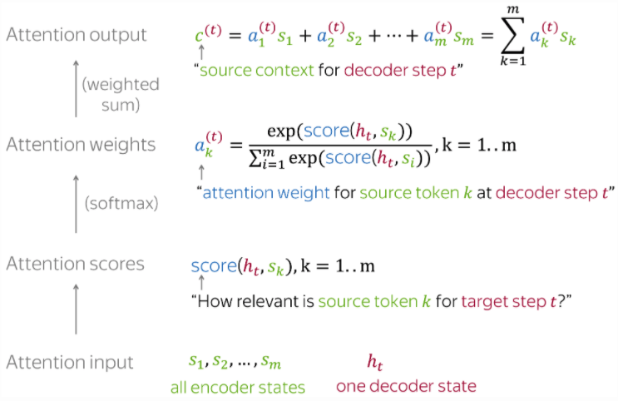
For convenience, here’s the Attention calculation summarized on 1 slide
Photo credit: https://lena-voita.github.io/nlp_course/seq2seq_and_attention.html

Slide 95
For convenience, here’s the Attention calculation summarized on 1 slide
The Attention mechanism that produces scores doesn’t have to be a FFNN like I illustrated. It can be any function you wish.
Photo credit: https://lena-voita.github.io/nlp_course/seq2seq_and_attention.html

Slide 96
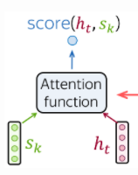
Popular Attention Scoring functions:
Photo credit: https://lena-voita.github.io/nlp_course/seq2seq_and_attention.html

Slide 97
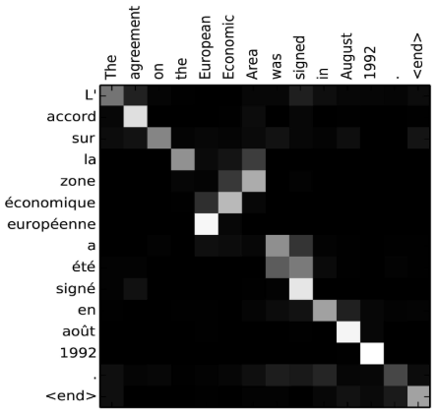
seq2seq + Attention
Attention:
greatly improves seq2seq results
allows us to visualize the contribution each encoding word gave for each decoder’s word
Image source: Fig 3 in Bahdanau et al., 2015

Slide 98
seq2seq + Attention
Takeaway:
Having a separate encoder and decoder allows for n → m length predictions.
Attention is powerful; allows us to conditionally weight our focus
Attention:
greatly improves seq2seq results
allows us to visualize the contribution each encoding word gave for each decoder’s word
Image source: Fig 3 in Bahdanau et al., 2015

Slide 99
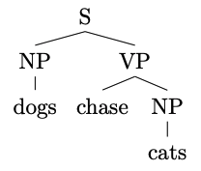
Constituency Parsing
Input: dogs chase cats
Output:
or a flattened representation

Slide 100
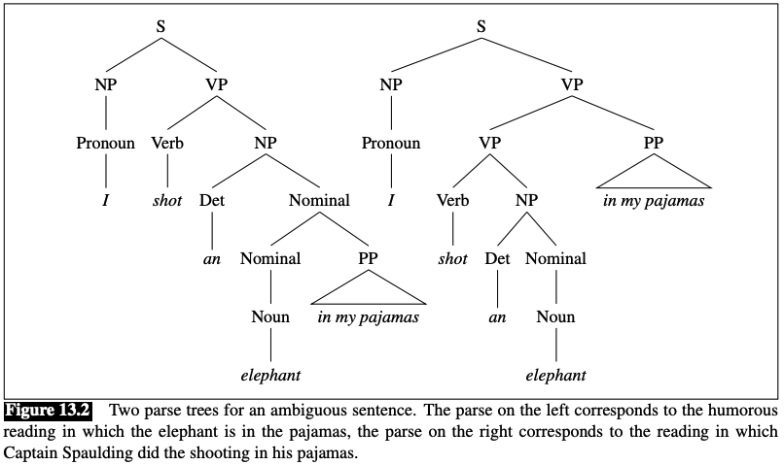
Constituency Parsing
Input: I shot an elephant in my pajamas
Output:
https://web.stanford.edu/~jurafsky/slp3/13.pdf

Slide 101
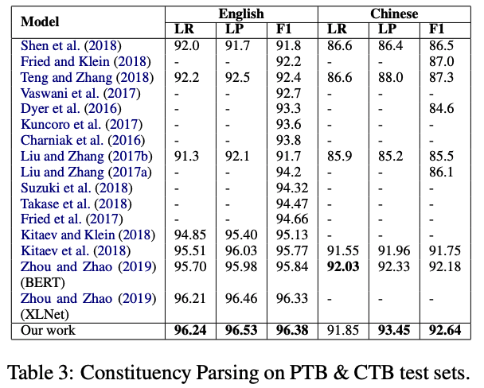
Results
https://aclanthology.org/2020.findings-emnlp.65.pdf

Slide 102
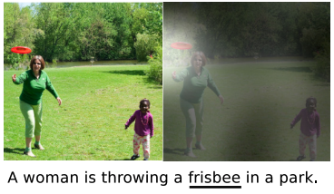
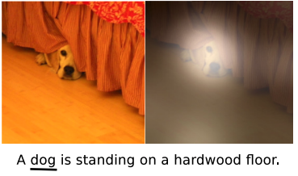
Image Captioning
Input: image
Output: generated text
Show, Attend and Tell: Neural Image Caption Generation with Visual Attention. Xu et al. CVPR (2016)

Slide 103
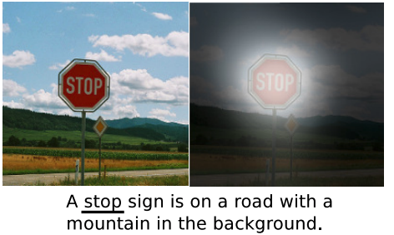
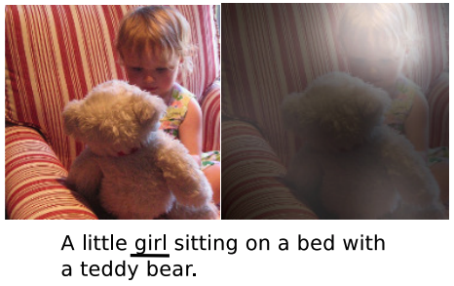
Image Captioning
Input: image
Output: generated text
Show, Attend and Tell: Neural Image Caption Generation with Visual Attention. Xu et al. CVPR (2016)

Slide 104
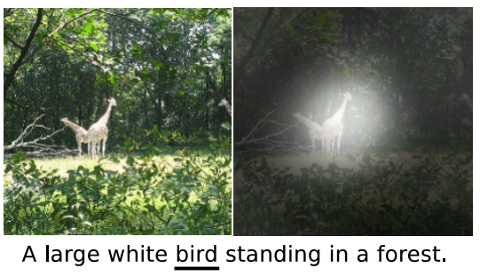
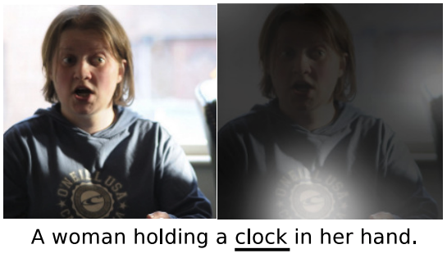
Image Captioning
Show, Attend and Tell: Neural Image Caption Generation with Visual Attention. Xu et al. CVPR (2016)

Slide 105
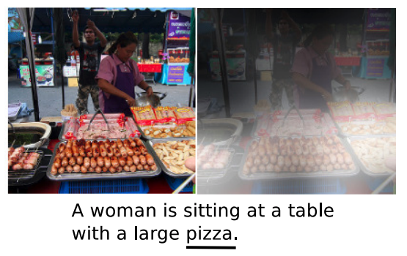
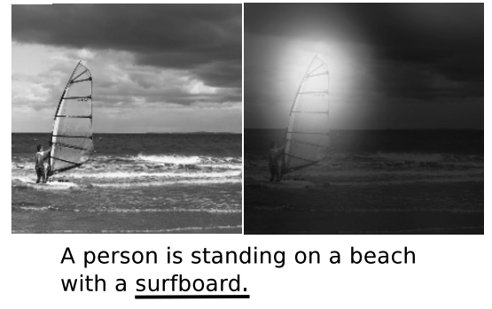
Image Captioning
Show, Attend and Tell: Neural Image Caption Generation with Visual Attention. Xu et al. CVPR (2016)

Slide 106
SUMMARY
LSTMs yielded state-of-the-art results on most NLP tasks (2014-2018)
seq2seq+Attention was an even more revolutionary idea (Google Translate used it)
Attention allows us to place appropriate weight to the encoder’s hidden states
But, LSTMs require us to iteratively scan each word and wait until we’re at the end before we can do anything

Slide 107
BACKUP

