Slide 1
Lecture 6: LSTMs
Contextualized, Token-based Representations
Harvard
AC295/CS287r/CSCI E-115B
Chris Tanner

Slide 2
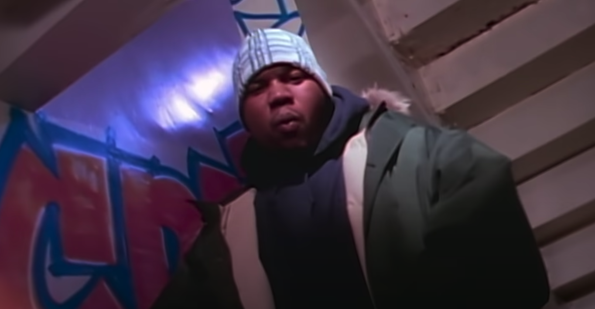
Stayin' alive was no jive […] but it was just a dream for the teen, who was a fiend. Started [hustlin’ at] 16, and runnin' up in [LSTM gates].
-- Raekwon of Wu-Tang (1994)

Slide 3
ANNOUNCEMENTS
HW2 coming very soon. Due in 2 weeks.
Research Proposals are due in 9 days, Sept 30.
Office Hours:
This week, my OH will be pushed back 30 min: 3:30pm – 5:30pm
Please reserve your coding questions for the TFs and/or EdStem, as I hold office hours solo, and debugging code can easily bottleneck the queue.

Slide 4
RECAP: L4
Distributed Representations: dense vectors (aka embeddings) that aim to convey the meaning of tokens:
“word embeddings” refer to when you have type-based representations
“contextualized embeddings” refer to when you have token-based representations

Slide 5
RECAP: L4
An auto-regressive LM is one that only has access to the previous tokens (and the outputs become the inputs). Evaluation: Perplexity
A masked LM can peak ahead, too. It “masks” a word within the context (i.e., center word).
Evaluation: downstream NLP tasks that uses the learned embeddings.
Both of these can produce useful word embeddings.

Slide 6
RECAP: L5
RNNs help capture more context while avoiding sparsity, storage, and compute issues!
The hidden layer is what we care about. It represents the word’s “meaning”.
$${\hat{y}}_{i}$$
Output layer
$$U$$
$$V$$
Hidden layer
$$W$$
Input layer
$$x_{i}$$

Slide 7
Outline
Recurrent Neural Nets (RNNs)
Long Short-Term Memory (LSTMs)
Bi-LSTM and ELMo

Slide 8
Outline
Recurrent Neural Nets (RNNs)
Long Short-Term Memory (LSTMs)
Bi-LSTM and ELMo

Slide 9
RNN
$$CE\left(y^{i},{\hat{y}}^{i}\right)=−\sum_{w∈V}{y_{w}^{i}\text{log}({\hat{y}}_{w}^{i})}$$
Training Process
Error
$$CE\left(y^{1},{\hat{y}}^{1}\right)$$
$${\hat{y}}_{1}$$
Output layer
$$U$$
Hidden layer
$$W$$
Input layer
$$x_{1}$$
She

Slide 10
RNN
$$CE\left(y^{i},{\hat{y}}^{i}\right)=−\sum_{w∈V}{y_{w}^{i}\text{log}({\hat{y}}_{w}^{i})}$$
Training Process
Error
$$CE\left(y^{1},{\hat{y}}^{1}\right)$$
$$CE\left(y^{2},{\hat{y}}^{2}\right)$$
$${\hat{y}}_{1}$$
$${\hat{y}}_{2}$$
Output layer
$$U$$
$$U$$
$$V$$
Hidden layer
$$W$$
$$W$$
Input layer
$$x_{1}$$
$$x_{2}$$
She
went

Slide 11
RNN
$$CE\left(y^{i},{\hat{y}}^{i}\right)=−\sum_{w∈V}{y_{w}^{i}\text{log}({\hat{y}}_{w}^{i})}$$
Training Process
Error
$$CE\left(y^{1},{\hat{y}}^{1}\right)$$
$$CE\left(y^{2},{\hat{y}}^{2}\right)$$
$$CE\left(y^{3},{\hat{y}}^{3}\right)$$
$${\hat{y}}_{1}$$
$${\hat{y}}_{2}$$
$${\hat{y}}_{3}$$
Output layer
$$U$$
$$U$$
$$U$$
$$V$$
$$V$$
Hidden layer
$$W$$
$$W$$
$$W$$
Input layer
$$x_{1}$$
$$x_{2}$$
$$x_{3}$$
She
went
to

Slide 12
RNN
$$CE\left(y^{i},{\hat{y}}^{i}\right)=−\sum_{w∈V}{y_{w}^{i}\text{log}({\hat{y}}_{w}^{i})}$$
Training Process
Error
$$CE\left(y^{1},{\hat{y}}^{1}\right)$$
$$CE\left(y^{2},{\hat{y}}^{2}\right)$$
$$CE\left(y^{3},{\hat{y}}^{3}\right)$$
$$CE\left(y^{4},{\hat{y}}^{4}\right)$$
$${\hat{y}}_{1}$$
$${\hat{y}}_{2}$$
$${\hat{y}}_{3}$$
$${\hat{y}}_{4}$$
Output layer
$$U$$
$$U$$
$$U$$
$$U$$
$$V$$
$$V$$
$$V$$
Hidden layer
$$W$$
$$W$$
$$W$$
$$W$$
Input layer
$$x_{1}$$
$$x_{2}$$
$$x_{3}$$
$$x_{4}$$
She
went
to
class

Slide 13
RNN
$$CE\left(y^{i},{\hat{y}}^{i}\right)=−\sum_{w∈V}{y_{w}^{i}\text{log}({\hat{y}}_{w}^{i})}$$
Training Process
Error
$$CE\left(y^{1},{\hat{y}}^{1}\right)$$
$$CE\left(y^{2},{\hat{y}}^{2}\right)$$
$$CE\left(y^{3},{\hat{y}}^{3}\right)$$
$$CE\left(y^{4},{\hat{y}}^{4}\right)$$
During training, regardless of our output predictions, we feed in the correct inputs
$${\hat{y}}_{1}$$
$${\hat{y}}_{2}$$
$${\hat{y}}_{3}$$
$${\hat{y}}_{4}$$
Output layer
$$U$$
$$U$$
$$U$$
$$U$$
$$V$$
$$V$$
$$V$$
Hidden layer
$$W$$
$$W$$
$$W$$
$$W$$
Input layer
$$x_{1}$$
$$x_{2}$$
$$x_{3}$$
$$x_{4}$$
She
went
to
class

Slide 14
RNN
$$CE\left(y^{i},{\hat{y}}^{i}\right)=−\sum_{w∈V}{y_{w}^{i}\text{log}({\hat{y}}_{w}^{i})}$$
Training Process
Error
$$CE\left(y^{1},{\hat{y}}^{1}\right)$$
$$CE\left(y^{2},{\hat{y}}^{2}\right)$$
$$CE\left(y^{3},{\hat{y}}^{3}\right)$$
$$CE\left(y^{4},{\hat{y}}^{4}\right)$$
went?
over?
class?
after?
Output layer
$$\hat{y}$$
$$U$$
$$U$$
$$U$$
$$U$$
$$V$$
$$V$$
$$V$$
Hidden layer
$$W$$
$$W$$
$$W$$
$$W$$
Input layer
She
went
to
class

Slide 15
RNN
$$CE\left(y^{i},{\hat{y}}^{i}\right)=−\sum_{w∈V}{y_{w}^{i}\text{log}({\hat{y}}_{w}^{i})}$$
Training Process
Error
$$CE\left(y^{1},{\hat{y}}^{1}\right)$$
$$CE\left(y^{2},{\hat{y}}^{2}\right)$$
$$CE\left(y^{3},{\hat{y}}^{3}\right)$$
$$CE\left(y^{4},{\hat{y}}^{4}\right)$$
went?
over?
class?
after?
Output layer
$$\hat{y}$$
$$U$$
$$U$$
$$U$$
$$U$$
$$V$$
$$V$$
$$V$$
Hidden layer
Our total loss is simply the average loss across all $T$ time steps
$$W$$
$$W$$
$$W$$
$$W$$
Input layer
She
went
to
class

Slide 16
RNN
Training Details
To update our weights (e.g. $V$), we calculate the gradient of our loss w.r.t. the repeated weight matrix (e.g., $\frac{∂L}{∂V} ).$
$$CE\left(y^{4},{\hat{y}}^{4}\right)$$
went?
over?
class?
after?
Using the chain rule, we trace the derivative all the way back to the beginning, while summing the results.
Output layer
$$\hat{y}$$
$$U$$
$$U$$
$$U$$
$$U$$
$$V$$
$$V$$
$$V$$
Hidden layer
$$W$$
$$W$$
$$W$$
$$W$$
Input layer
She
went
to
class

Slide 17
RNN
Training Details
$\frac{∂L}{∂V}$
To update our weights (e.g. $V$), we calculate the gradient of our loss w.r.t. the repeated weight matrix (e.g., $\frac{∂L}{∂V} ).$
$$CE\left(y^{4},{\hat{y}}^{4}\right)$$
went?
over?
class?
Using the chain rule, we trace the derivative all the way back to the beginning, while summing the results.
Output layer
$$\hat{y}$$
$$U$$
$$U$$
$$U$$
$$U$$
$$V$$
$$V$$
$$V^{3}$$
Hidden layer
$$W$$
$$W$$
$$W$$
$$W$$
Input layer
She
went
to
class

Slide 18
RNN
Training Details
$\frac{∂L}{∂V}$
To update our weights (e.g. $V$), we calculate the gradient of our loss w.r.t. the repeated weight matrix (e.g., $\frac{∂L}{∂V} ).$
$$CE\left(y^{4},{\hat{y}}^{4}\right)$$
went?
over?
class?
Using the chain rule, we trace the derivative all the way back to the beginning, while summing the results.
Output layer
$$\hat{y}$$
$$U$$
$$U$$
$$U$$
$$U$$
$$V$$
$$V^{2}$$
$$V^{3}$$
Hidden layer
$$W$$
$$W$$
$$W$$
$$W$$
Input layer
She
went
to
class

Slide 19
RNN
Training Details
$\frac{∂L}{∂V}$
To update our weights (e.g. $V$), we calculate the gradient of our loss w.r.t. the repeated weight matrix (e.g., $\frac{∂L}{∂V} ).$
$$CE\left(y^{4},{\hat{y}}^{4}\right)$$
went?
over?
class?
Using the chain rule, we trace the derivative all the way back to the beginning, while summing the results.
Output layer
$$\hat{y}$$
$$U$$
$$U$$
$$U$$
$$U$$
$$V^{1}$$
$$V^{2}$$
$$V^{3}$$
Hidden layer
$$W$$
$$W$$
$$W$$
$$W$$
Input layer
She
went
to
class

Slide 20
RNN
Training Details
This backpropagation through time (BPTT) process is expensive
Instead of updating after every timestep, we tend to do so every $T$ steps (e.g., every sentence or paragraph)
This isn’t equivalent to using only a window size $T$ (a la n-grams) because we still have ‘infinite memory’

Slide 21
RNN: Generation
We can generate the most likely next event (e.g., word) by sampling from $\hat{y}$
Continue until we generate <EOS> symbol.

Slide 22
RNN: Generation
We can generate the most likely next event (e.g., word) by sampling from $\hat{y}$
Continue until we generate <EOS> symbol.
“Sorry”
Output layer
$$U$$
Hidden layer
$$W$$
Input layer
$$x_{1}$$
<START>

Slide 23
RNN: Generation
We can generate the most likely next event (e.g., word) by sampling from $\hat{y}$
Continue until we generate <EOS> symbol.
“Sorry”
Harry
Output layer
$$U$$
$$U$$
$$V$$
Hidden layer
$$W$$
$$W$$
Input layer
$$x_{1}$$
$$x_{2}$$
<START>
“Sorry”

Slide 24
RNN: Generation
We can generate the most likely next event (e.g., word) by sampling from $\hat{y}$
Continue until we generate <EOS> symbol.
“Sorry”
Harry
shouted,
Output layer
$$U$$
$$U$$
$$U$$
$$V$$
$$V$$
Hidden layer
$$W$$
$$W$$
$$W$$
Input layer
$$x_{1}$$
$$x_{2}$$
$$x_{3}$$
<START>
“Sorry”
Harry

Slide 25
RNN: Generation
We can generate the most likely next event (e.g., word) by sampling from $\hat{y}$
Continue until we generate <EOS> symbol.
“Sorry”
Harry
shouted,
panicking
Output layer
$$U$$
$$U$$
$$U$$
$$U$$
$$V$$
$$V$$
$$V$$
Hidden layer
$$W$$
$$W$$
$$W$$
$$W$$
Input layer
$$x_{1}$$
$$x_{2}$$
$$x_{3}$$
$$x_{4}$$
<START>
“Sorry”
Harry
shouted,

Slide 26
RNN: Generation
NOTE: the same input (e.g., “Harry”) can easily yield different outputs, depending on the context (unlike FFNNs and n-grams).
“Sorry”
Harry
shouted,
panicking
Output layer
$$U$$
$$U$$
$$U$$
$$U$$
$$V$$
$$V$$
$$V$$
Hidden layer
$$W$$
$$W$$
$$W$$
$$W$$
Input layer
$$x_{1}$$
$$x_{2}$$
$$x_{3}$$
$$x_{4}$$
<START>
“Sorry”
Harry
shouted,

Slide 27
RNN: Generation
When trained on Harry Potter text, it generates:
Source: https://medium.com/deep-writing/harry-potter-written-by-artificial-intelligence-8a9431803da6

Slide 28
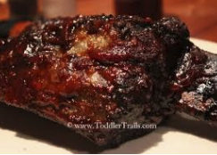
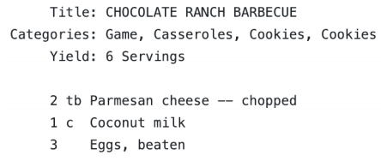
RNN: Generation
When trained on recipes
Source: https://gist.github.com/nylki/1efbaa36635956d35bcc

Slide 29
RNNs: Overview
RNN STRENGTHS?
Can handle infinite-length sequences (not just a fixed-window)
Has a “memory” of the context (thanks to the hidden layer’s recurrent loop)
Same weights used for all inputs, so positionality isn’t wonky/overwritten (like FFNN)
RNN ISSUES?
Slow to train (BPTT)
Due to ”infinite sequence”, gradients can easily vanish or explode
Has trouble actually making use of long-range context

Slide 30
RNNs: Overview
RNN STRENGTHS?
Can handle infinite-length sequences (not just a fixed-window)
Has a “memory” of the context (thanks to the hidden layer’s recurrent loop)
Same weights used for all inputs, so positionality isn’t wonky/overwritten (like FFNN)
RNN ISSUES?
Slow to train (BPTT)
Due to ”infinite sequence”, gradients can easily vanish or explode
Has trouble actually making use of long-range context

Slide 31
RNNs: Vanishing and Exploding Gradients
$\frac{∂L^{4}}{∂V^{1}}$
$\frac{∂L^{4}}{∂V^{1}}= ?$
$$CE\left(y^{4},{\hat{y}}^{4}\right)$$
Output layer
$$\hat{y}$$
$$U$$
$$U$$
$$U$$
$$U$$
$$V^{1}$$
$$V^{2}$$
$$V^{3}$$
Hidden layer
$$W$$
$$W$$
$$W$$
$$W$$
Input layer
She
went
to
class

Slide 32
RNNs: Vanishing and Exploding Gradients
$\frac{∂L^{4}}{∂V^{1}}$
$\frac{∂L^{4}}{∂V^{1}}=\frac{∂L^{4}}{∂V^{3}}$
$$CE\left(y^{4},{\hat{y}}^{4}\right)$$
Output layer
$$\hat{y}$$
$$U$$
$$U$$
$$U$$
$$U$$
$$V^{1}$$
$$V^{2}$$
$$V^{3}$$
Hidden layer
$$W$$
$$W$$
$$W$$
$$W$$
Input layer
She
went
to
class

Slide 33
RNNs: Vanishing and Exploding Gradients
$\frac{∂L^{4}}{∂V^{1}}$
$\frac{∂L^{4}}{∂V^{1}}=\frac{∂L^{4}}{∂V^{3}}\frac{∂V^{3}}{∂V^{2}}$
$$CE\left(y^{4},{\hat{y}}^{4}\right)$$
Output layer
$$\hat{y}$$
$$U$$
$$U$$
$$U$$
$$U$$
$$V^{1}$$
$$V^{2}$$
$$V^{3}$$
Hidden layer
$$W$$
$$W$$
$$W$$
$$W$$
Input layer
She
went
to
class

Slide 34
RNNs: Vanishing and Exploding Gradients
$\frac{∂L^{4}}{∂V^{1}}$
$\frac{∂L^{4}}{∂V^{1}}=\frac{∂L^{4}}{∂V^{3}}\frac{∂V^{3}}{∂V^{2}}$ $\frac{∂V^{2}}{∂V^{1}}$
$$CE\left(y^{4},{\hat{y}}^{4}\right)$$
Output layer
$$\hat{y}$$
$$U$$
$$U$$
$$U$$
$$U$$
$$V^{1}$$
$$V^{2}$$
$$V^{3}$$
Hidden layer
$$W$$
$$W$$
$$W$$
$$W$$
Input layer
She
went
to
class

Slide 35
RNNs: Vanishing and Exploding Gradients
$\frac{∂L^{4}}{∂V^{1}}$
This long path makes it easy for the gradients to become really small or large.
If small, the far-away context will be ”forgotten.”
If large, recency bias and no context.
$\frac{∂L^{4}}{∂V^{1}}=\frac{∂L^{4}}{∂V^{3}}\frac{∂V^{3}}{∂V^{2}}$ $\frac{∂V^{2}}{∂V^{1}}$
$$CE\left(y^{4},{\hat{y}}^{4}\right)$$
Output layer
$$\hat{y}$$
$$U$$
$$U$$
$$U$$
$$U$$
$$V^{1}$$
$$V^{2}$$
$$V^{3}$$
Hidden layer
$$W$$
$$W$$
$$W$$
$$W$$
Input layer
She
went
to
class

Slide 36
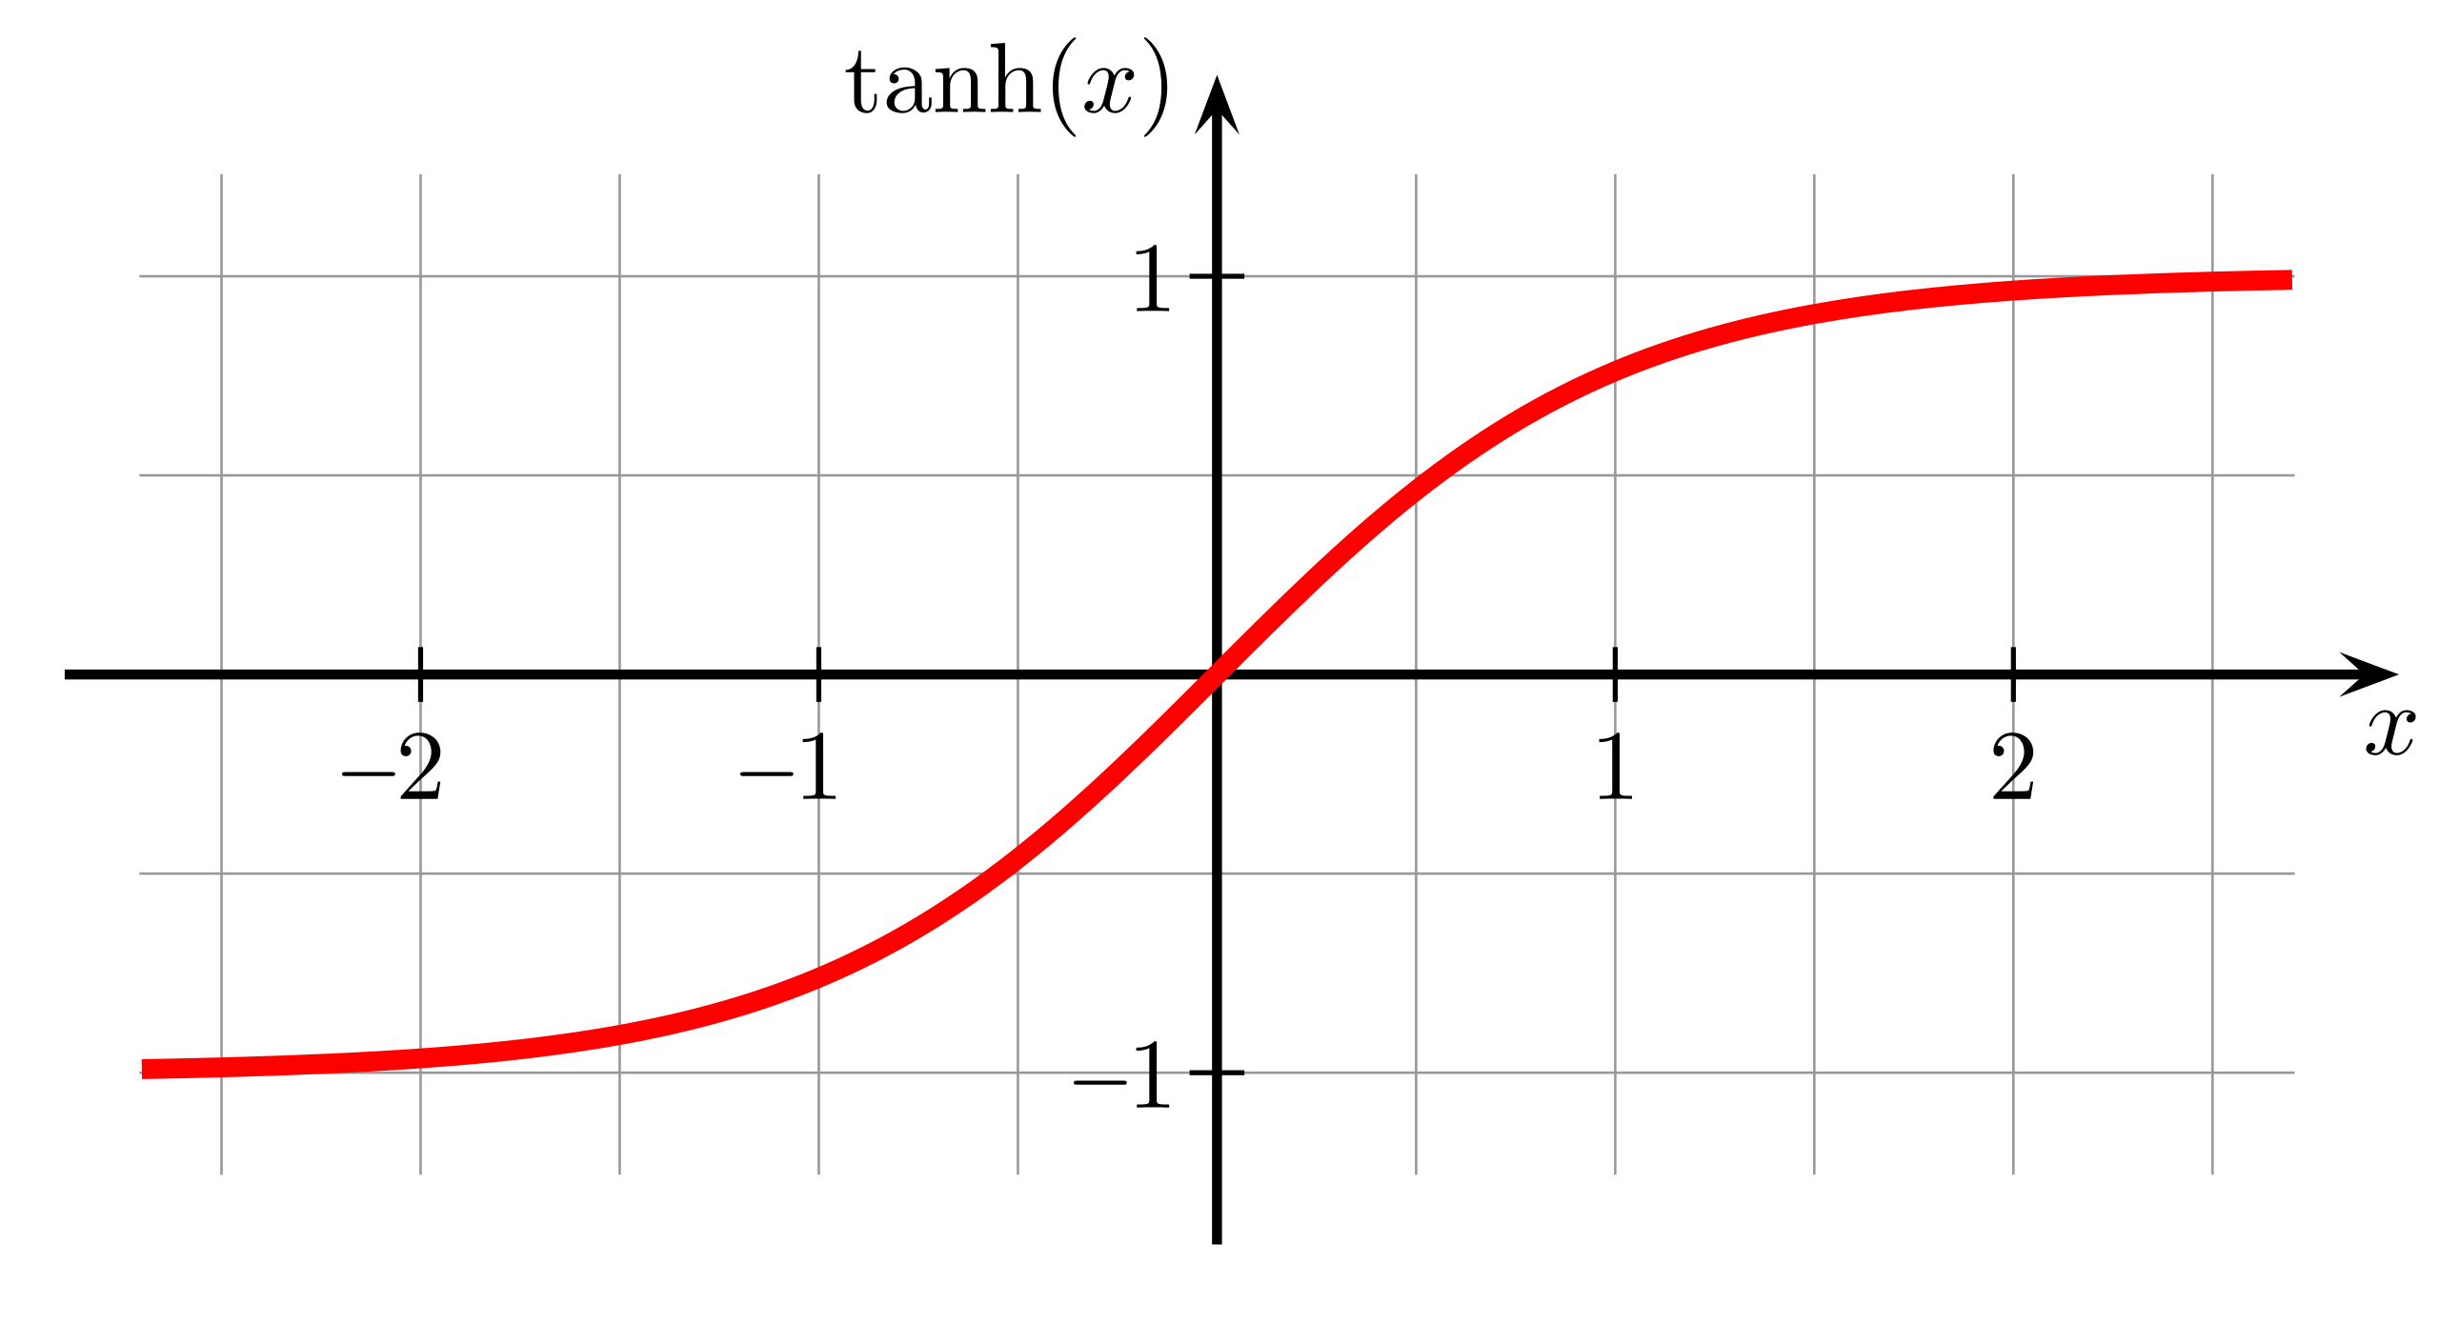
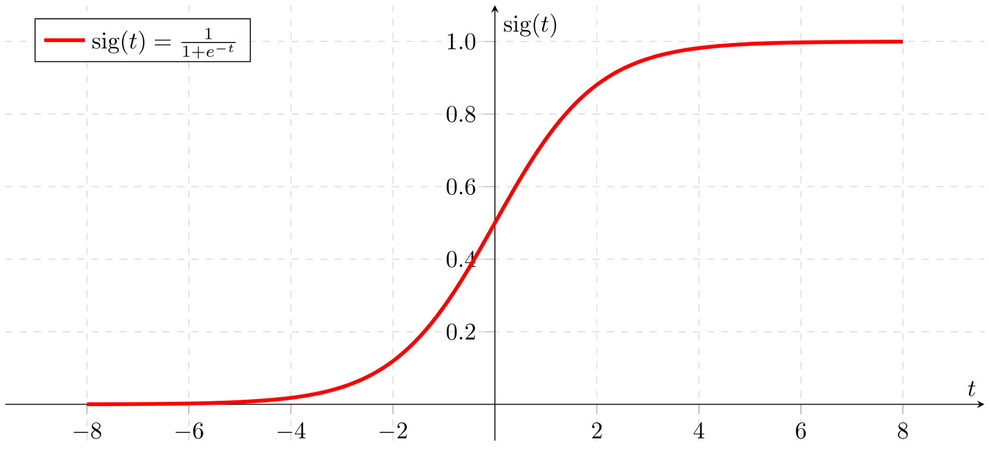
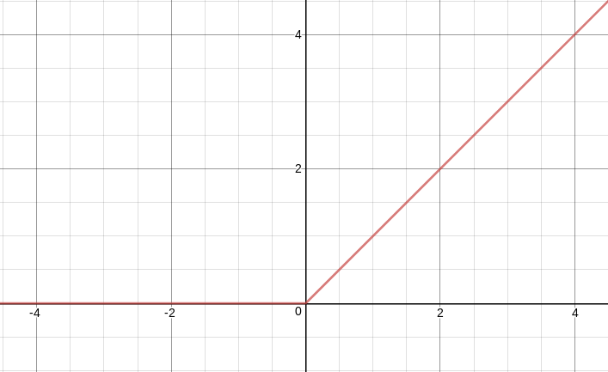
Activation Functions
Tanh
Sigmoid
ReLU

Slide 37
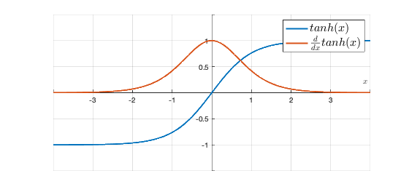
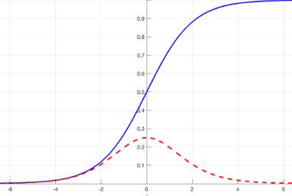
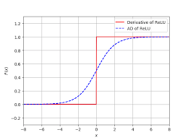
Derivatives of Activation Functions
Tanh
Sigmoid
ReLU

Slide 38
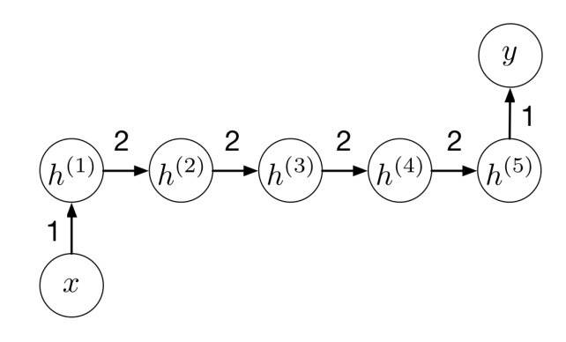
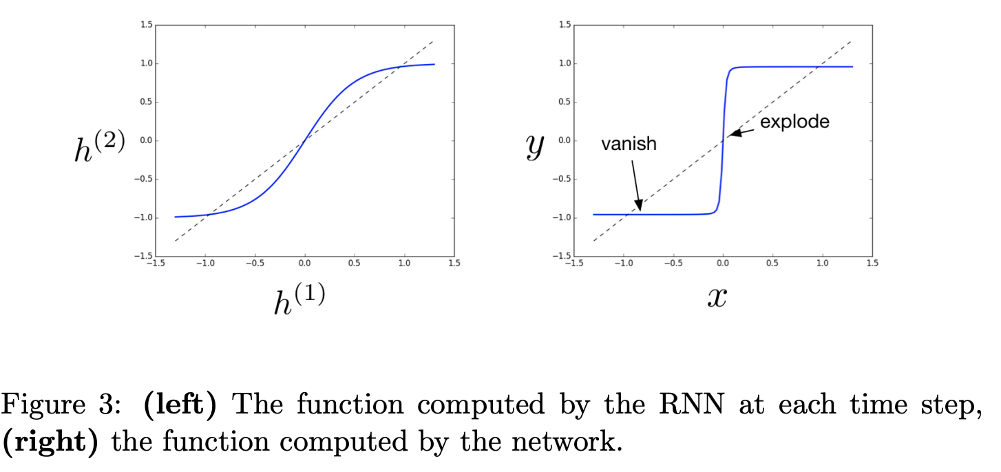
Chain Reactions
Tanh activations for all

Slide 39
Lipschitz
A real-valued function $f: ℝ →ℝ$ is Lipschitz continuous if
$∃ K$s.t. $∀x_{1},x_{2}, \left|f\left(x_{1}\right)−f\left(x_{2}\right)\right|≤K\left|x_{1}−x_{2}\right|$
Re-worded, if $x_{1} ≠x_{2}$:
$$\frac{\left|f\left(x_{1}\right)−f\left(x_{2}\right)\right|}{\left|x_{1}−x_{2}\right|}≤K$$

Slide 40
Gradients
We assert our Neural Net’s objective function f is well-behaved and Lipschitz continuous w/ a constant L
$$\left|f\left(x\right) −f\left(y\right)\right|≤L\left|x−y\right|$$
We update our parameters by $ηg$
$$⟹\left|f\left(x\right) −f\left(x−ηg\right)\right|≤Lη\left|g\right|$$
Notes:
All continuously differentiable functions are locally bounded so its gradient is locally bounded as well. Thus, all continuous differentiable function is locally Lipschitz,

Slide 41
Gradients
We assert our Neural Net’s objective function f is well-behaved and Lipschitz continuous w/ a constant L
$$\left|f\left(x\right) −f\left(y\right)\right|≤L\left|x−y\right|$$
This means, we will never observe a change by more than $Lη\left|g\right|$
We update our parameters by $ηg$
$$⟹\left|f\left(x\right) −f\left(x−ηg\right)\right|≤Lη\left|g\right|$$
Notes:
All continuously differentiable functions are locally bounded so its gradient is locally bounded as well. Thus, all continuous differentiable function is locally Lipschitz,

Slide 42
Gradients
We update our parameters by $ηg$
$$⟹\left|f\left(x\right) −f\left(x−ηg\right)\right|≤Lη\left|g\right|$$
PRO:
Limits the extent to which things can go wrong if we move in the wrong direction
CONS:
Limits the speed of making progress
Gradients may still become quite large and the optimizer may not converge
How can we limit the gradients from being so large?
Notes:
If we adjust the learning rate, that could stunt us too often. Imagine if we rarely encountered large gradients.

Slide 43
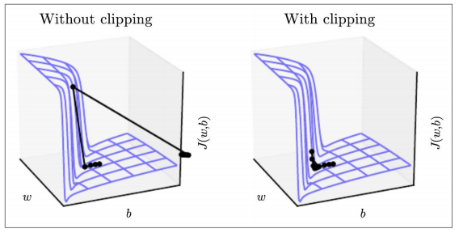
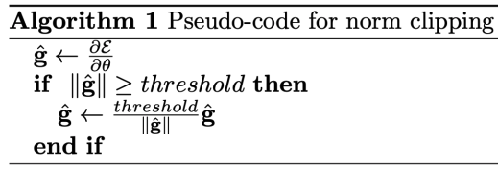
Exploding Gradients
Source: https://www.deeplearningbook.org/contents/rnn.html
Pascanu et al, 2013. http://proceedings.mlr.press/v28/pascanu13.pdf

Slide 44
Gradient Clipping
Ensures the norm of the gradient never exceeds the threshold $τ$
Only adjusts the magnitude of each gradient, not the direction (good).
Helps w/ numerical stability of training; no general improvement in performance
Notes:
This ensures the norm of the gradient never exceeds the threshold, and it only adjusts the magnitude of each gradient, not the direction (which is good).
Yet, this only addresses the numerical stability of training deep neural network models and does not offer any general improvement in performance (unless you count performance in terms of the ability to run)

Slide 45
Outline
Recurrent Neural Nets (RNNs)
Long Short-Term Memory (LSTMs)
Bi-LSTM and ELMo

Slide 46
Outline
Recurrent Neural Nets (RNNs)
Long Short-Term Memory (LSTMs)
Bi-LSTM and ELMo

Slide 47
LSTM
A type of RNN that is designed to better handle long-range dependencies
In ”vanilla” RNNs, the hidden state is perpetually being rewritten
In addition to a traditional hidden state h, let’s have a dedicated memory cell c for long-term events. More power to relay sequence info.

Slide 48
LSTM
At each each time step $t$, we have a hidden state $h^{t}$ and cell state $c^{t}:$
Both are vectors of length n
cell state $c^{t}$ stores long-term info
At each time step $t$, the LSTM erases, writes, and reads information from the cell $c^{t}$
$c^{t}$ never undergoes a nonlinear activation though, just – and +
+ of two things does not modify the gradient; simply adds the gradients

Slide 49
LSTM
$C$ and $H$ relay long- and short-term memory to the hidden layer, respectively. Inside the hidden layer, there are many weights.
Output layer
$$C^{1}$$
$$C^{2}$$
Hidden layer
$$H^{1}$$
$$H^{2}$$
Input layer
$$x_{1}$$
$$x_{2}$$
$$x_{2}$$

Slide 50
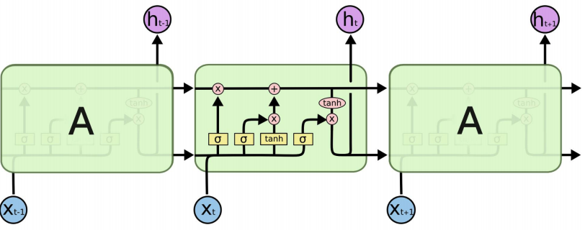
LSTM
$$C^{t}$$
$$C^{t+1}$$
$$C^{t−1}$$
$$H^{t−1}$$
$$H^{t}$$
$$H^{t+1}$$
Diagram: https://colah.github.io/posts/2015-08-Understanding-LSTMs/
Notes:
Sigmoid: [0,1]
Hyperbolic Tan: [-1, 1]

Slide 51
LSTM
some old memories are “forgotten”
$$C^{t}$$
$$C^{t+1}$$
$$C^{t−1}$$
$$H^{t−1}$$
$$H^{t}$$
$$H^{t+1}$$
Diagram: https://colah.github.io/posts/2015-08-Understanding-LSTMs/

Slide 52
LSTM
some old memories are “forgotten”
some new memories are made
$$C^{t}$$
$$C^{t+1}$$
$$C^{t−1}$$
$$H^{t−1}$$
$$H^{t}$$
$$H^{t+1}$$
Diagram: https://colah.github.io/posts/2015-08-Understanding-LSTMs/

Slide 53
LSTM
some old memories are “forgotten”
some new memories are made
$$C^{t}$$
$$C^{t+1}$$
$$C^{t−1}$$
$$H^{t−1}$$
$$H^{t}$$
$$H^{t+1}$$
a nonlinear weighted version of the long-term memory becomes our short-term memory
Diagram: https://colah.github.io/posts/2015-08-Understanding-LSTMs/

Slide 54
LSTM
some old memories are “forgotten”
some new memories are made
$$C^{t}$$
$$C^{t+1}$$
$$C^{t−1}$$
memory is written, erased, and read by three gates – which are influenced by $x$ and $h$
$$H^{t−1}$$
$$H^{t}$$
$$H^{t+1}$$
a nonlinear weighted version of the long-term memory becomes our short-term memory
Diagram: https://colah.github.io/posts/2015-08-Understanding-LSTMs/

Slide 55
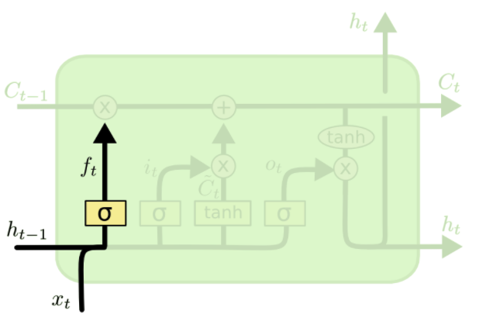
Forget Gate
Imagine the cell state currently has values related to a previous topic. Convo has shifted.
Notes:
The sigmoid can be thought of a scaling factor (0 – 1), or a gate, which determines how much of that information to let through.

Slide 56
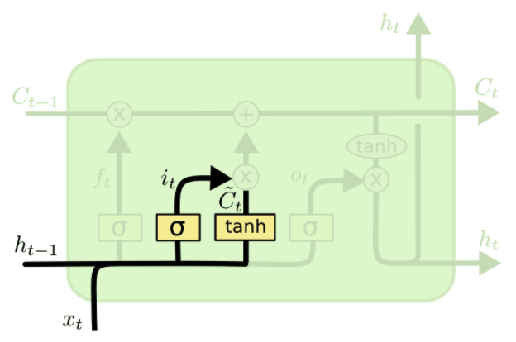
Input Gate
Decides which values to update (by scaling each of the new, incoming info).
Notes:
The tanh when calculating a value.

Slide 57
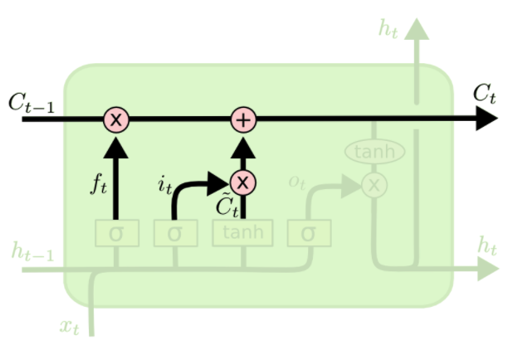
Cell State
The cell state forgets some info, then it’s simultaneously updated by us adding to it.

Slide 58
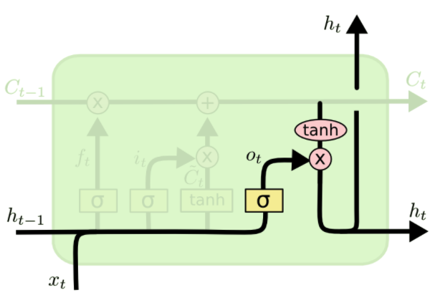
Hidden State
Decide what our new hidden representation will be. Based on: - filtered version of the cell state, and
- weighted version of recurrent, hidden layer

Slide 59
LSTM
It’s still possible for LSTMs to suffer from vanishing/exploding gradients, but it’s way less likely than with vanilla RNNs:
If RNNs wish to preserve info over long contexts, it must delicately find a recurrent weight matrix $W_{h}$ that isn’t too large or small
However, LSTMs have 3 separate mechanism that adjust the flow of information (e.g., forget gate, if turned off, will preserve all info)

Slide 60
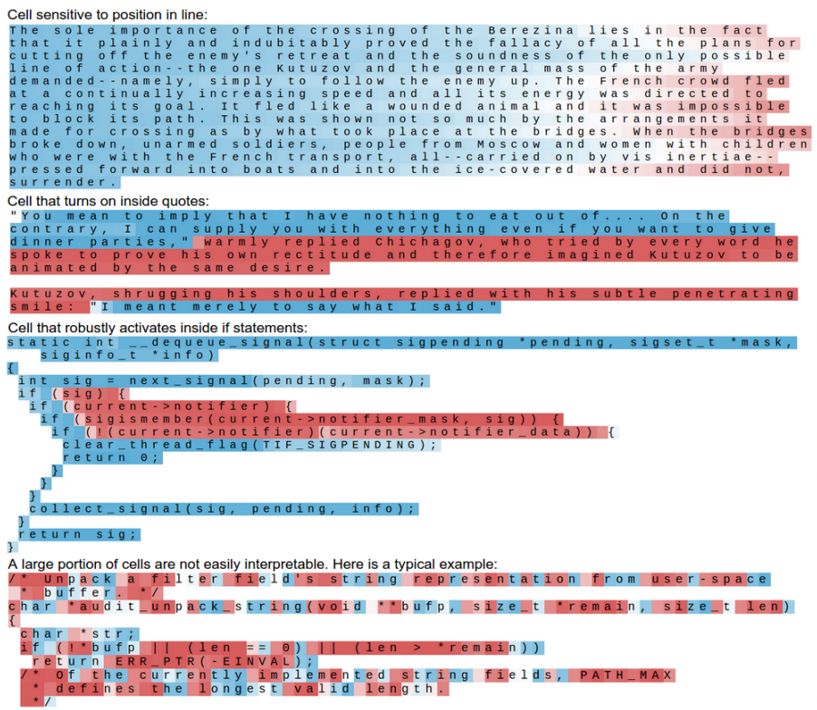
The cell learns an operative time to “turn on”.

Slide 61
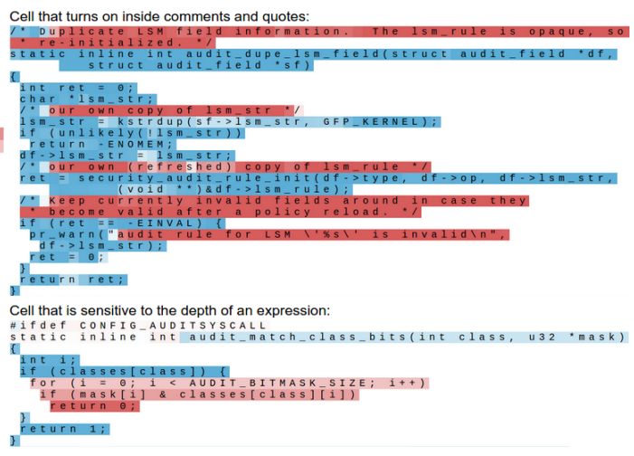
The cell learns an operative time to “turn on”.

Slide 62
LSTM
LSTM STRENGTHS?
Almost always outperforms vanilla RNNs
Captures long-range dependencies shockingly well
LSTM ISSUES?
Has more weights to learn than vanilla RNNs; thus,
Requires a moderate amount of training data (otherwise, vanilla RNNs are better)
Can still suffer from vanishing/exploding gradients

Slide 63
Sequential Modelling
IMPORTANT
If your goal isn’t to predict the next item in a sequence, and you rather do some other classification or regression task using the sequence, then you can:
Train an aforementioned model (e.g., LSTM) as a language model
Use the hidden layers that correspond to each item in your sequence

Slide 64
Sequential Modelling
Language Modelling
1-to-1 tagging/classification
$$x_{2}$$
$$x_{3}$$
$$x_{4}$$
$$x_{5}$$
$${\hat{y}}_{1}$$
$${\hat{y}}_{2}$$
$${\hat{y}}_{3}$$
$${\hat{y}}_{4}$$
Output layer
Output layer
$$U$$
$$V$$
$$U$$
$$U$$
$$U$$
$$U$$
$$V$$
$$U$$
$$U$$
$$U$$
$$V$$
$$V$$
$$V$$
$$V$$
Hidden layer
Hidden layer
$$W$$
$$W$$
$$W$$
$$W$$
$$W$$
$$W$$
$$W$$
$$W$$
Input layer
Input layer
$$x_{1}$$
$$x_{2}$$
$$x_{3}$$
$$x_{4}$$
$$x_{1}$$
$$x_{2}$$
$$x_{3}$$
$$x_{4}$$
Auto-regressive
Non-Auto-regressive

Slide 65
Sequential Modelling
Many-to-1 classification
Sentiment score
$${\hat{y}}_{4}$$
Output layer
$$U$$
$$V$$
$$U$$
$$U$$
$$U$$
$$V$$
$$V$$
Hidden layer
$$W$$
$$W$$
$$W$$
$$W$$
Input layer
$$x_{1}$$
$$x_{2}$$
$$x_{3}$$
$$x_{4}$$

Slide 66
Sequential Modelling
Many-to-1 classification
Sentiment score
Output layer
$$U$$
$$V$$
$$U$$
$$U$$
$$U$$
Hidden layer
$$V$$
$$V$$
$$W$$
$$W$$
$$W$$
$$W$$
Input layer
$$x_{1}$$
$$x_{2}$$
$$x_{3}$$
$$x_{4}$$

Slide 67
This concludes the foundation in sequential representation. Most state-of-the-art advances are based on those core RNN/LSTM ideas. But, with tens of thousands of researchers and hackers exploring deep learning, there are many tweaks that haven proven useful. (This is where things get crazy.)

Slide 68
Outline
Recurrent Neural Nets (RNNs)
Long Short-Term Memory (LSTMs)
Bi-LSTM and ELMo

Slide 69
Outline
Recurrent Neural Nets (RNNs)
Long Short-Term Memory (LSTMs)
Bi-LSTM and ELMo

Slide 70
RNN Extensions: Bi-directional LSTMs
RNNs/LSTMs use the left-to-right context and sequentially process data.
If you have full access to the data at testing time, why not make use of the flow of information from right-to-left, also?
Notes:
CAN”T BE CONCERNED WITH auto-regressive LM

Slide 71
RNN Extensions: Bi-directional LSTMs
For brevity, let’s use the follow schematic to represent an RNN
$$h_{1}^{L}$$
$$h_{2}^{L}$$
$$h_{3}^{L}$$
$$h_{4}^{L}$$
Hidden layer
Input layer
$$x_{1}$$
$$x_{2}$$
$$x_{3}$$
$$x_{4}$$

Slide 72
RNN Extensions: Bi-directional LSTMs
For brevity, let’s use the follow schematic to represent an RNN
$$h_{1}^{L}$$
$$h_{2}^{L}$$
$$h_{3}^{L}$$
$$h_{4}^{L}$$
$$h_{1}^{R}$$
$$h_{2}^{R}$$
$$h_{3}^{R}$$
$$h_{4}^{R}$$
Hidden layer
Input layer
$$x_{1}$$
$$x_{2}$$
$$x_{3}$$
$$x_{4}$$
$$x_{1}$$
$$x_{2}$$
$$x_{3}$$
$$x_{4}$$

Slide 73
RNN Extensions: Bi-directional LSTMs
$$h_{1}^{R}$$
$$h_{2}^{R}$$
$$h_{3}^{R}$$
$$h_{4}^{R}$$
Concatenate the hidden layers
$$h_{1}^{L}$$
$$h_{2}^{L}$$
$$h_{3}^{L}$$
$$h_{4}^{L}$$
$$h_{1}^{L}$$
$$h_{2}^{L}$$
$$h_{3}^{L}$$
$$h_{4}^{L}$$
$$h_{1}^{R}$$
$$h_{2}^{R}$$
$$h_{3}^{R}$$
$$h_{4}^{R}$$
Hidden layer
Input layer
$$x_{1}$$
$$x_{2}$$
$$x_{3}$$
$$x_{4}$$
$$x_{1}$$
$$x_{2}$$
$$x_{3}$$
$$x_{4}$$

Slide 74
RNN Extensions: Bi-directional LSTMs
Output layer
$${\hat{y}}_{1}$$
$${\hat{y}}_{2}$$
$${\hat{y}}_{3}$$
$${\hat{y}}_{4}$$
$$h_{1}^{R}$$
$$h_{2}^{R}$$
$$h_{3}^{R}$$
$$h_{4}^{R}$$
Concatenate the hidden layers
$$h_{1}^{L}$$
$$h_{2}^{L}$$
$$h_{3}^{L}$$
$$h_{4}^{L}$$
$$h_{1}^{L}$$
$$h_{2}^{L}$$
$$h_{3}^{L}$$
$$h_{4}^{L}$$
$$h_{1}^{R}$$
$$h_{2}^{R}$$
$$h_{3}^{R}$$
$$h_{4}^{R}$$
Hidden layer
Input layer
$$x_{1}$$
$$x_{2}$$
$$x_{3}$$
$$x_{4}$$
$$x_{1}$$
$$x_{2}$$
$$x_{3}$$
$$x_{4}$$

Slide 75
RNN Extensions: Bi-directional LSTMs
BI-LSTM STRENGTHS?
Usually performs at least as well as uni-directional RNNs/LSTMs
BI-LSTM ISSUES?
Slower to train
Only possible if access to full data is allowed

Slide 76
RNN Extensions: Stacked LSTMs
Hidden layers provide an abstraction (holds “meaning”).
Stacking hidden layers provides increased abstractions.
Hidden layer #1
$$h_{1}^{L}$$
$$h_{2}^{L}$$
$$h_{3}^{L}$$
$$h_{4}^{L}$$
Input layer
$$x_{1}$$
$$x_{2}$$
$$x_{3}$$
$$x_{4}$$

Slide 77
RNN Extensions: Stacked LSTMs
Hidden layers provide an abstraction (holds “meaning”).
Stacking hidden layers provides increased abstractions.
Hidden layer #2
$$h_{1}^{L2}$$
$$h_{2}^{L2}$$
$$h_{3}^{L2}$$
$$h_{4}^{L2}$$
Hidden layer #1
$$h_{1}^{L}$$
$$h_{2}^{L}$$
$$h_{3}^{L}$$
$$h_{4}^{L}$$
Input layer
$$x_{1}$$
$$x_{2}$$
$$x_{3}$$
$$x_{4}$$

Slide 78
RNN Extensions: Stacked LSTMs
Output layer
$${\hat{y}}_{1}$$
$${\hat{y}}_{2}$$
$${\hat{y}}_{3}$$
$${\hat{y}}_{4}$$
Hidden layers provide an abstraction (holds “meaning”).
Stacking hidden layers provides increased abstractions.
Hidden layer #2
$$h_{1}^{L2}$$
$$h_{2}^{L2}$$
$$h_{3}^{L2}$$
$$h_{4}^{L2}$$
Hidden layer #1
$$h_{1}^{L}$$
$$h_{2}^{L}$$
$$h_{3}^{L}$$
$$h_{4}^{L}$$
Input layer
$$x_{1}$$
$$x_{2}$$
$$x_{3}$$
$$x_{4}$$

Slide 79
ELMo: Stacked Bi-directional LSTMs
General Idea:
Goal is to get highly rich embeddings for each word (unique type)
Use both directions of context (bi-directional), with increasing abstractions (stacked)
Linearly combine all abstract representations (hidden layers) and optimize w.r.t. a particular task (e.g., sentiment classification)
ELMo Slides: https://www.slideshare.net/shuntaroy/a-review-of-deep-contextualized-word-representations-peters-2018

Slide 80
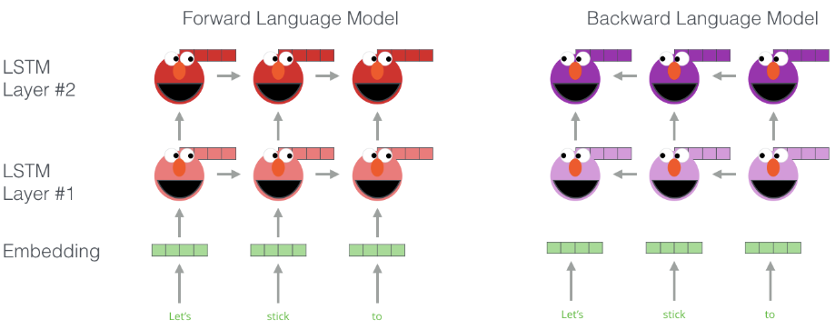
ELMo: Stacked Bi-directional LSTMs
Illustration: http://jalammar.github.io/illustrated-bert/

Slide 81
Illustration: http://jalammar.github.io/illustrated-bert/

Slide 82
ELMo: Stacked Bi-directional LSTMs
Deep contextualized word representations. Peters et al. NAACL 2018.

Slide 83
ELMo: Stacked Bi-directional LSTMs
ELMo yielded incredibly good contextualized embeddings, which yielded SOTA results when applied to many NLP tasks.
Main ELMo takeaway: given enough training data, having tons of explicit connections between your vectors is useful (system can determine how to best use context)
ELMo Slides: https://www.slideshare.net/shuntaroy/a-review-of-deep-contextualized-word-representations-peters-2018

Slide 84
SUMMARY
Distributed Representations can be:
Type-based (“word embeddings”)
Token-based (“contextualized representations/embeddings”)
Type-based models include Bengio’s 2003 and word2vec 2013
Token-based models include RNNs/LSTMs, which:
demonstrated profound results in 2015 onward.
it can be used for essentially any NLP task.

Slide 85
BACKUP

