Slide 1
Lecture 1: Introduction
Course Overview + What is NLP?
Harvard
AC295/CS287r/CSCI E-115B
Chris Tanner

Slide 2
“All I need is one mic [and a team of TFs/CAs, an A/V support staff, teaching resources like Canvas and EdStem, and 55 students who are engaged, curious, and motivated]”
-- Nasir Jones, One Mic. April 16, 2002

Slide 3
ANNOUNCEMENTS
Attendance is checked today. See a TF before you leave today.
EdStem (linked from Canvas) – introduce yourself
PyTorch tutorial will be Tues evening (more details will be posted on Ed)
Homework 1 will be released Tues
Lectures slides will be posted on the website and our Twitter @CS287_NLP
Office Hours start next Wednesday @ 5pm (see website for all OH)

Slide 4
Outline
What is this course?
Logistics
NLP: what, why, how?

Slide 5
Outline
What is this course?
Logistics
NLP: what, why, how?

Slide 6
What is this course?
Our digital world is inundated with data, most textual data
62B pages
500M tweets/day
360M user pages
13M articles

Slide 7
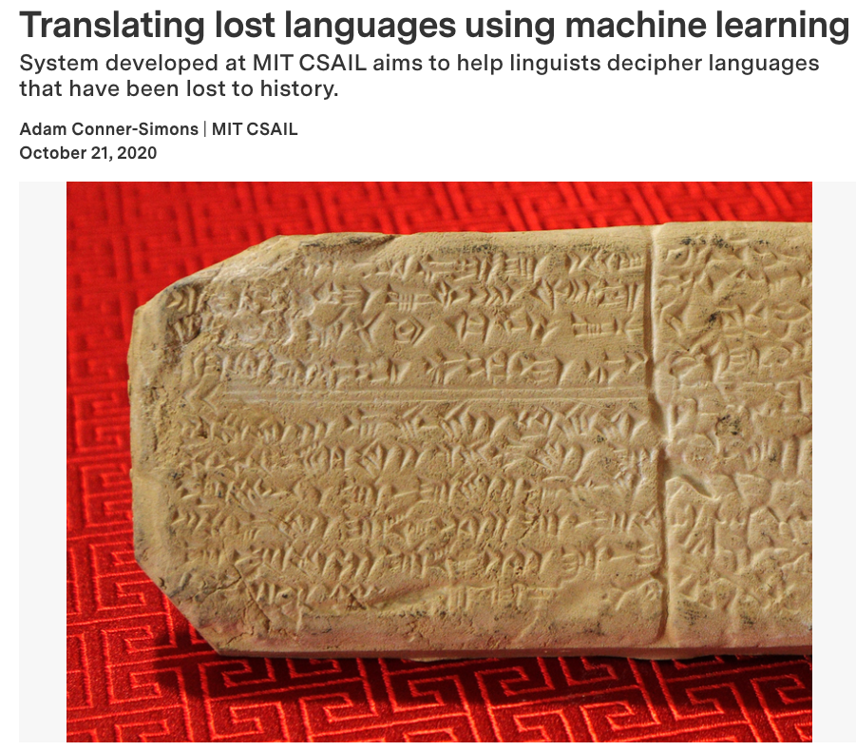
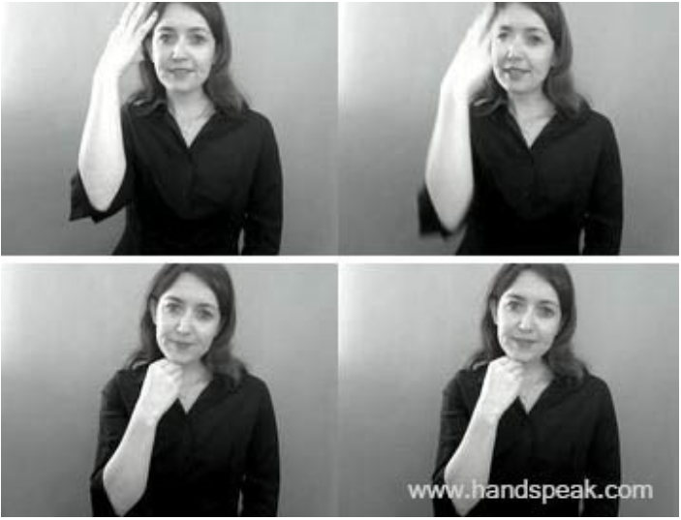
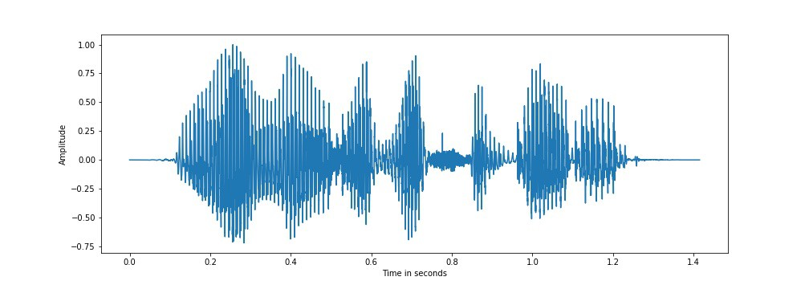
What is this course?
Natural Language Processing (NLP) is the study of how to get computers to process, “understand”, and leverage human language data.
Speech Audio
(Signal Processing work is a cousin community and often done by EE folks)
Written Text
Sign Language
Neural Decipherment via Minimum-Cost Flow: From Ugaritic to Linear B Luo, et al. (2019)
Including Signed Languages in Natural Language Processing Yin, et al. (2021)

Slide 8
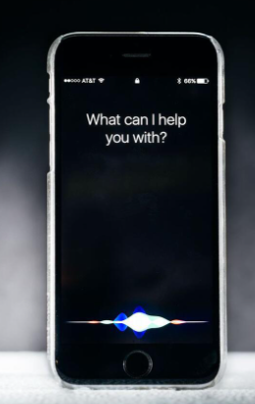
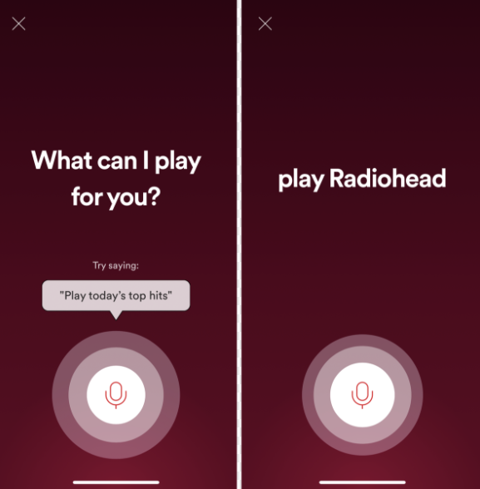
NLP Successes
NLP has been around since the 1960s, but the progress in the past 10 years has been astronomical. Models are becoming effective enough for consumer use.
Voice Assistants

Slide 9
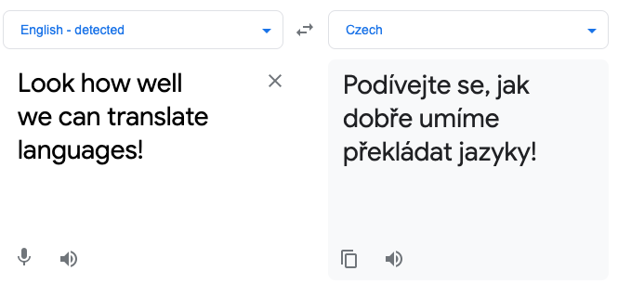
NLP Successes
NLP has been around since the 1960s, but the progress in the past 10 years has been astronomical. Models are becoming effective enough for consumer use.
Translation

Slide 10
NLP Successes
NLP has been around since the 1960s, but the progress in the past 10 years has been astronomical. Models are becoming effective enough for consumer use.
Auto-complete

Slide 11
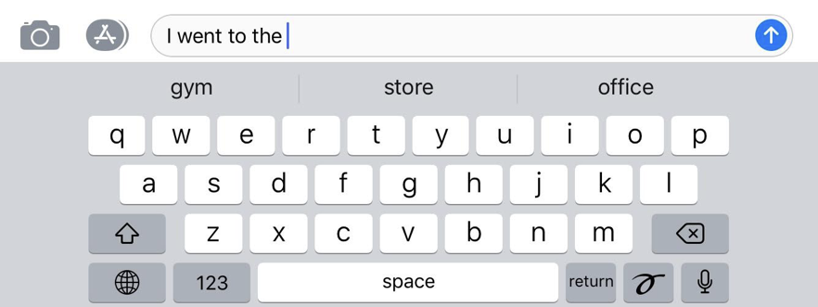
NLP Successes
NLP has been around since the 1960s, but the progress in the past 10 years has been astronomical. Models are becoming effective enough for consumer use.
Auto-complete

Slide 12
NLP Successes
NLP has been around since the 1960s, but the progress in the past 10 years has been astronomical. Models are becoming effective enough for consumer use.
Text Classification

Slide 13
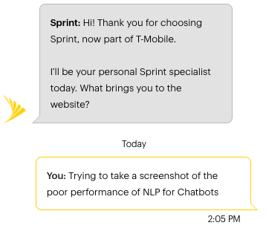
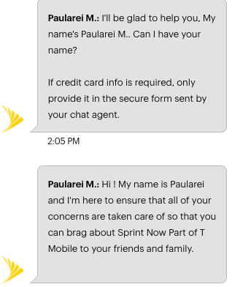
NLP Successes has room for improvement
1.
3.
Chatbots
2.
4.

Slide 14
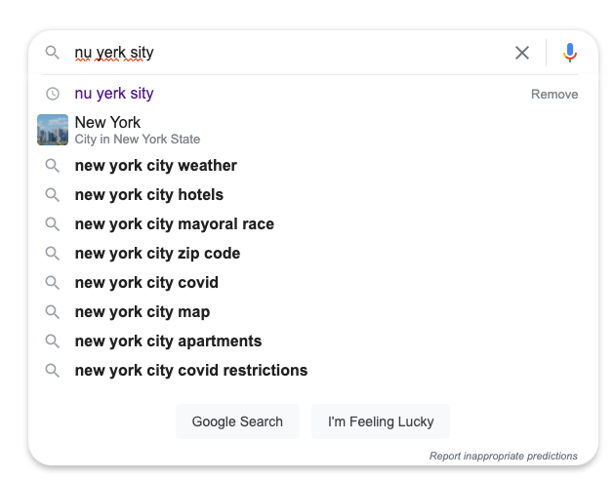
NLP Successes
NLP has been around since the 1960s, but the progress in the past 10 years has been astronomical. Models are becoming effective enough for consumer use.
Search Engines
(information retrieval)

Slide 15
How do these systems work?!
?
We have data (e.g., text format)
We want a magical blackbox
That outputs golden usefulness

Slide 16
How do these systems work?!
?
English sentences
Machine Translation System
Spanish sentences

Slide 17
How do these systems work?!
?
English sentences
Machine Translation System
Spanish sentences
X
$$f\left(X\right)$$
Y

Slide 18
How do these systems work?!
For example
While we don’t necessarily have to produce a Y for every NLP problem (i.e., supervised learning), most interesting problems do.
Luckily, we have tons of (X, Y) data pairs, right? Kind of.
?
English sentences
Machine Translation System
Spanish sentences
X
$$f\left(X\right)$$
Y

Slide 19
What’s in the box?!
Our computational model could be anything:
Rule-based system
CRF
HMM
Statistical Alignment Model (e.g., IBM Models)
Probabilistic Graphical Model
Neural Network
?
Se7en (1995)
English sentences
Model
Spanish sentences
X
$$f\left(X\right)$$
Y

Slide 20
What’s in the box?!
Regardless of the model, it doesn’t actually “understand” language. It simply approximates understanding for a particular objective. This seems good enough.
?
English sentences
Model
Spanish sentences
X
$$f\left(X\right)$$
Y

Slide 21
What’s in the box?!
Neural Networks, specifically Deep Neural Networks, dominate all of machine learning these days, including NLP.
?
English sentences
Model
Spanish sentences
X
$$f\left(X\right)$$
Y

Slide 22
What is this course?
You will learn advanced, deep learning approaches to NLP and conduct research on a significant project with classmates.

Slide 23
Learning Objectives
understand the theoretical concepts behind NLP tasks and models
Not just a surface-level understanding of LSTMs, Transformers;
What is the model actually doing? How does it work? Why does it work? What are its limitations? Past approaches? What are alternatives?
write effective programming solutions to popular problems in NLP
tackle your own, novel goals with text data once this course is over
conduct substantial, original NLP research

Slide 24
Learning Objectives
understand the theoretical concepts behind NLP tasks and models
Not just a surface-level understanding of LSTMs, Transformers;
What is the model actually doing? How does it work? Why does it work? What are its limitations? Past approaches? What are alternatives?
write effective programming solutions to popular problems in NLP
tackle your own, novel goals with text data once this course is over
conduct substantial, original NLP research
I want everyone to finish the course feeling confident and empowered to develop NLP solutions and embark on novel research

Slide 25
Why so research-heavy?
Knowledge, about anything in our world, is created via research and publishing
It’s further explored and experimented with
Knowledge/models/approaches that seem sufficiently good and important make their way into courses and books
Some of this knowledge gets added to the field’s foundation

Slide 26
Why so research-heavy?
Researcher:
What is possible to build?
How can we use existing blocks in new ways?
What are the limitations of current blocks?
Software Developer:
The Builders. Creators.
Interested in tools to build better, quicker, organized, useful structures
Manager:
Bridges everyone’s skills to make great things actually happen
Image source: lego.com

Slide 27
Research Project
Projects will last most of the semester (12 weeks)
Should explore a significant question that nobody knows the answer to
You will work in teams of 3 students
Propose ideas, we approve, all students select which projects to join
Final product will be a 4-5 page short paper (plus other deliverables)
Goal is for it to be worthy of submitting to a top conference or workshop
It’s okay if your results aren’t SOTA; your approach/methodology is what matters

Slide 28
Research Project
“Only” pushing the SOTA results is a weak research finding*
Common approaches:
Poke holes into the current understanding/papers/models
Exploit/leverage data in a novel way
Make assumptions or relax constraints to reveal new insights
Combine past approaches to yield a better approach
Make models faster or easy-to-use without losing much performance
* unless the method was novel (e.g., new architecture, approach, way of using data, etc)

Slide 29
Research Project
Inappropriate projects:
Make a chatbot for ____
Run a Transformer on ____ data
Run a summarizing system on a new, ____ corpus
This demonstrates software development and NLP applications, not research.
They might serve as the starting points for research, but research questions should be your entry point and driving force.

Slide 30
Research Project
You cannot do a research project on stock market data / prediction.
Not research-y enough
Too difficult (way too latent)
Not interesting
Difficult metrics for comparison

Slide 31
What is this course NOT about?
This is not a linguistics course
Not a foundational machine learning course (we expect you have this foundation already). This course adds to your foundation.
Not about teaching you PyTorch or TensorFlow
Not exclusively about your demonstrating the learned concepts; it includes your ability to leverage what you’re learning and extend it further (i.e., research project)

Slide 32
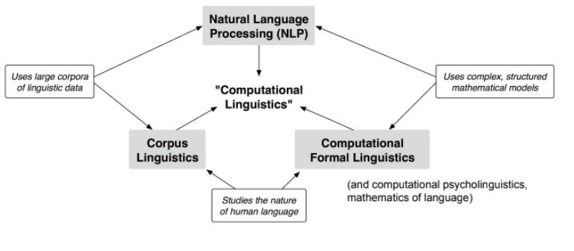
NLP vs Computational Linguistics
From Sam Bowman’s LING-GA 1012 Spring 2020

Slide 33
CS287 vs CS187
CS287
This class is new and I’m making it from scratch
Graduate course
Assumes you’ve taken an ML course and understand the basics of a Neural Net
Research-heavy (project counts 50%)
Many lectures, no labs
Covers more advanced topics and more NLP tasks than CS187

Slide 34
CS287 vs CS187
CS187
Taught by the legendary Stuart Shieber (2nd time ever)
Undergraduate course
Assumes no pre-reqs, just competency in programming and CS
No research project or exam
Many labs, few lectures (~6)
Focuses more on linguistics (e.g., parsing) than CS287

Slide 35
CS287 Pre-requisites
If you haven’t already, you should thoroughly look at and try to complete HW #0 to ensure you meet the pre-reqs, e.g.:
Basics of a feed-forward neural net
How learning works (e.g., loss functions, backprop, gradient descent)
Modifications (e.g., L1 and L2 regularization, dropout, hyperparameter optimization)
Reasonably comfortable with TensorFlow or PyTorch
We officially support PyTorch but will gladly accept assignments that are in either
I assume no prior NLP knowledge

Slide 36
Expectations of you
Expected to demonstrate not only the ability to understand the core concepts of this course, but to be able to do some research, i.e.:
read papers beyond what's mentioned in class
critique other papers (even if the concepts are new to you)
be curious
come up w/ questions
try to answer these questions
I expect you to challenge yourself. This class is intended to be challenging (but not too challenging).

Slide 37
Expectations of me
I want this course to be an incredibly rewarding experience and the best CS class you take. I pushed to create this course and offer it. Huge thanks to IACS, DCE, CS, and higher-up folks at SEAS for approving it.
Hold me accountable to make it as equitable, fair, clear, and smooth of an experience as possible. I gladly welcome anonymous feedback at any time, and I solicit such as part of each HW assignment.
If something needs improving, let’s work to make it better. I’m here to help you all learn and succeed in this course.

Slide 38
Outline
What is this course?
Logistics
NLP: what, why, how?

Slide 39
Outline
What is this course?
Logistics
NLP: what, why, how?

Slide 40
Student body
35 Harvard (non-DCE students)
9 PhDs
13 MS
2 Seniors
11 Juniors (aka Junior M.A.F.I.A.)
20 Harvard DCE students from awesomely diverse backgrounds

Slide 41
Teaching Staff
Me (instructor)
4 incredible TFs/CAs
Alex Lin
William Tong
Annie Zhu
Richard Qui
20 TF applicants, 10 hrs of interviews with mock tutoring sessions.
You’re in good hands.

Slide 42
Background:
PhD in NLP from Brown
Machine Learning since 2004
MIT Lincoln Lab (3) years + 10 internships
Hobbies:
Travelling (formerly), woodworking, playing baseball, hiking, photography, running
Chris Tanner
Most fun during the weird, past year:
Hiking the Presidential Traverse again. Grilling outdoors. Iceland this summer. Not catching COVID.

Slide 43
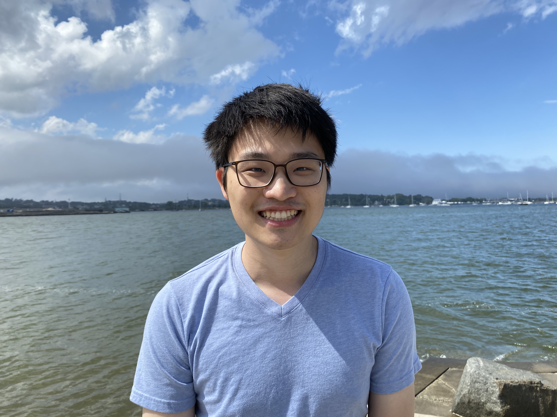
Background:
Current PhD student in Harvard CS
Former researcher @ASAPP (NLP startup)
CS Bachelor’s and CSE (IACS) Master’s @Harvard
Hobbies:
Taking long walks in scenic areas, biking, watching basketball, reading, all things machine learning :)
Alex Lin
Most fun during the weird, past year:
Watching lots of Netflix, and having friends visit me in Boston!

Slide 44
Background:
From Chicago
BA in CS and Stats from Columbia
Interested in cognitive science + ML
Hobbies:
Running, longboarding, music, cooking, learning about (and losing money on) cryptocurrency
William Tong
Most fun during the weird, past year:
Rollerblading from NYC to the Tappan Zee bridge and back. Hiking Breakneck Ridge. Hanging out with my family.

Slide 45
Background:
Senior @ Harvard
Studying a mixture of Math/CS/Stat/Physics
Two internships in Quant Finance
Hobbies:
Fiction, TV shows, singing, taking long walks, trying new restaurants, reading random Wikipedia pages about historical figures but never events
Annie Siye Zhu
Most fun during the weird, past year:
Got better at cooking, moved eight times, pretended to be a senior at senior sunrise

Slide 46
Background:
Harvard College ‘23, studying physics + CS
Physics-informed ML for turbulence @ NASA
Previously, explainable recurrent architectures for particle physics
Hobbies:
Hiking/backpacking, cooking, baking, running (badly)
Richard Qiu
Most fun during the weird, past year:
Stargazing and hiking in Banff National Park. Biked the Chesapeake & Ohio Canal. Road tripped ~6000 miles cumulatively.

Slide 47
Times
Class: Tues and Thurs @ 9:45am – 11am (attendance is mandatory)
Office Hours (will have an in-person and Zoom support):
Mon @ 1pm – 3pm: Alex and Annie
Wed @ 5pm – 7pm: Richard and William
Thurs @ 2:30pm – 4:30pm: Chris
Sat @ 10am – 11am: Annie (Zoom only)
Pop quizzes will be released at the beginning of ~8 lectures (closed book)
1 exam will be given in-class (closed book)
4 homeworks. Released on Tuesdays, due 2 weeks later (Mon night)

Slide 48
Assessment
All course assessment is structured around 3 pillars:
Building a foundation of theory/concepts (pop-quizzes and exam)
Demonstrating you can apply the knowledge (homework)
Creating new knowledge (12-week research project)

Slide 49
Assessment
foundation
application
creating knowledge
Pop quizzes
(10%)
Exam
(10%)
Homeworks
(30%)
Research project
(50%)

Slide 50
Homeworks
Individual work (cannot work in pairs)
Designed to be challenging yet fun
Content centers around 4 lectures
Everyone is granted 3 free late days for the entire semester
Beyond this, each additional late day docks 10% from that homework’s grade
Any single homework that is > 3 days late will receive a 0%
No need to communicate to us that you’re “using a late day”. We keep track.

Slide 51
Quizzes
Non-DCE: quizzes conducted in-class, on-paper
DCE: quizzes on EdStem
Your lowest 3 pop quizzes will be dropped.
Content can be from any of the previous lectures (content builds)

Slide 52
Exam
Non-DCE: exam conducted in-class, on-paper
DCE: exam on EdStem
Content will largely be from the lectures
May contain few programming questions (pseudocode, not actual TF/PyTorch)
May contain research questions (about the papers you’ve read)

Slide 53
Research Project
Please start skimming papers published in ACL, NAACL, EMNLP, COLING from the past 2 years.
It’s okay if they don’t make sense to you. For now, just try to get an idea of what people work on, later you can focus on the how.
Don’t get bogged down in the details: Abstract, Intro, Conclusions are enough.

Slide 54
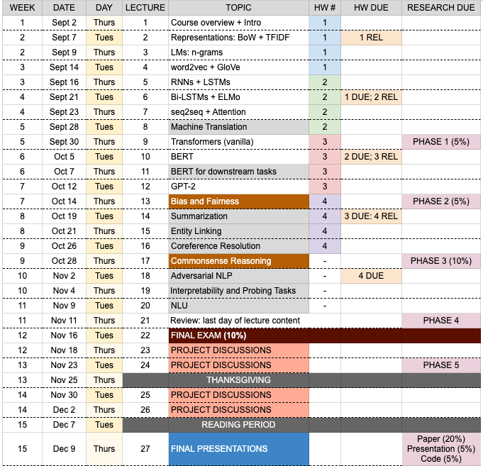
Schedule
Each HW lasts 2 weeks
Early lectures concern models
Latter lectures concern tasks (gray)
Once lectures wrap up, the research project ramps up
Plenty of time to work on the research project
Final presentations Dec 9

Slide 55
Outline
What is this course?
Logistics
NLP: what, why, how?

Slide 56
Outline
What is this course?
Logistics
NLP: what, why, how?

Slide 57
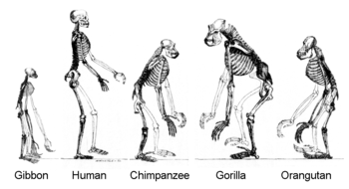
Language
Language is special and complex
Distinctly human ability
Paramount to human evolution
Influenced by many social constructs
Incredibly nuanced
Language forms capture multi-dimensions
Language evolves over time
Slide adapted from or inspired by Chris Manning and Richard Socher

Slide 58
Language
Language is constructed to convey speaker’s/writer’s meaning
More than an environmental, survival signal
Encodes complex information yet simple enough for babies to quickly learn
A discrete, symbolic communication system
Lexicographic representation (i.e., characters that comprise a word) embody real-world constructs
Nuanced (e.g., ”Sure, whatever”, “Yes”, “Yesss”, “Yes?”, “Yes!”, Niiice)
Slide adapted from or inspired by Chris Manning and Richard Socher
Notes:
‘Meaning’ is such a nebulous and philosophical term. What did I say when I presented the previous slide? You probably don’t remember my exact words at all, but you understood the meaning. You instantly interpreted my words, converted it to some meaning (which hopefully aligns w/ my intended meaning), and you saved it to your brain. Maybe to your RAM maybe to your hard drive.
The words themselves can be viewed as symbolic representations of the meaning, and the context matters so much. Imagine words w/ nearly identical surface forms, but how the implication is drastically different.
The words we say have different properties to them. From a linguistics perspective:

Slide 59
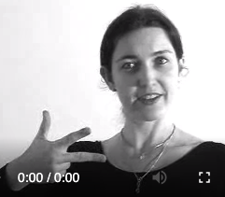
Language
Language symbols are encoded as continuous communication signals, and are invariant across different encodings (same underlying concept, different surface forms)
Slide adapted from or inspired by Chris Manning and Richard Socher

Slide 60
Language is funny
“Red tape holds up new bridges”
“Hospitals are sued by 7 foot doctors”
“Local high school dropouts cut in half”
“Tesla crashed today”
“Obama announced that he will run again”
“Kipchoge announced that he will run again”
“She made him duck”
“Will you visit the bank across from the river bank? You can bank on it”
“Yes” vs “Yes.” vs “YES” vs “YES!” vs “YAS” vs “Yea”

Slide 61
NLP: why
The entire point of computers is to assist humans.
Having computers ”understand” our language and how we communicate as a species is a natural entry point and required step to significantly assisting us in our lives.

Slide 62
Common NLP Tasks (aka problems)
Syntax
Semantics
Morphology
Word Segmentation
Part-of-Speech Tagging
Parsing
Constituency
Dependency
Sentiment Analysis
Topic Modelling
Named Entity Recognition (NER)
Relation Extraction
Word Sense Disambiguation
Natural Language Understanding (NLU)
Natural Language Generation (NLG)
Machine Translation
Entailment
Question Answering
Language Modelling
Discourse
Summarization
Coreference Resolution

Slide 63
Common NLP Tasks (aka problems)
Syntax
Semantics
Morphology
Word Segmentation
Part-of-Speech Tagging
Parsing
Constituency
Dependency
Sentiment Analysis
Topic Modelling
Named Entity Recognition (NER)
Relation Extraction
Word Sense Disambiguation
Natural Language Understanding (NLU)
Natural Language Generation (NLG)
Machine Translation
Entailment
Question Answering
Language Modelling
“Overall, Pfizer’s COVID-19 vaccine is very safe and one of the most effective vaccines ever produced”
Discourse
Summarization
Coreference Resolution

Slide 64
Common NLP Tasks (aka problems)
Syntax
Semantics
Morphology
Word Segmentation
Part-of-Speech Tagging
Parsing
Constituency
Dependency
Sentiment Analysis
Topic Modelling
Named Entity Recognition (NER)
Relation Extraction
Word Sense Disambiguation
Natural Language Understanding (NLU)
Natural Language Generation (NLG)
Machine Translation
Entailment
Question Answering
Language Modelling
Discourse
Discourse
sports
news
politics
fashion
Summarization
Coreference Resolution
Summarization
Coreference Resolution

Slide 65
Common NLP Tasks (aka problems)
Syntax
Semantics
Morphology
Word Segmentation
Part-of-Speech Tagging
Parsing
Constituency
Dependency
Sentiment Analysis
Topic Modelling
Named Entity Recognition (NER)
Relation Extraction
Word Sense Disambiguation
Natural Language Understanding (NLU)
Natural Language Generation (NLG)
Machine Translation
Entailment
Question Answering
Language Modelling
“Alexa, play Drivers License by Olivia Rodrigo”
“Alexa, play Drivers License by Olivia Rodrigo”
INTENT
SONG
ARTIST
Discourse
Summarization
Coreference Resolution

Slide 66
Common NLP Tasks (aka problems)
Syntax
Semantics
Morphology
Word Segmentation
Part-of-Speech Tagging
Parsing
Constituency
Dependency
Sentiment Analysis
Topic Modelling
Named Entity Recognition (NER)
Relation Extraction
Word Sense Disambiguation
Natural Language Understanding (NLU)
Natural Language Generation (NLG)
Machine Translation
Entailment
Question Answering
Language Modelling
El perro marrón
The brown dog
SPANISH
ENGLISH
Discourse
Summarization
Coreference Resolution

Slide 67
Very brief history of NLP
1960s: pattern-matching and rules (highly limiting)
1970s – 1980s: linguistically rich, logic-driven systems; labor-intensive successes on a few, very specific tasks
1990s – 2000s: statistical modelling takeover! ML becomes a central component; some systems are deployed for practical use (e.g., speech to text)
2010s – 2020s: Deep Learning (neural nets) yields astronomical progress on nearly every NLP task; systems become fairly useful for consumers
2020s – 2030s?: you can help drive the change
Slide adapted from or inspired by Sam Bowman

Slide 68
Very brief history of NLP
First huge revolution: early 1990s (statistical approaches)
“But it must be recognized that the notion ‘probability of a sentence’ is an entirely useless one, under any known interpretation of this term”
-- Noam Chomsky (1969)
“Anytime a linguist leaves the group, the recognition rate goes up”
-- Fredrick Jelinek (1988)

Slide 69
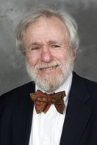
Very brief history of NLP
First huge revolution: early 1990s (statistical approaches)
“I refer to all of my work before ~1990 as the B.S. era. That is, ‘before statistics’”
-- paraphrasing my PhD adviser, Eugene Charniak at his ACL Lifetime Achievement Award (2011)

Slide 70
NLP nowadays
GPT-2 (generates text and can fine-tune on your own data)
SYSTEM PROMPT (HUMAN-WRITTEN)
A train carriage containing controlled nuclear materials was stolen in Cincinnati today. Its whereabouts are unknown.
MODEL COMPLETION (MACHINE-WRITTEN, FIRST TRY)
The incident occurred on the downtown train line, which runs from Covington and Ashland stations.
In an email to Ohio news outlets, the U.S. Department of Energy said it is working with the Federal Railroad Administration to find the thief.
“The theft of this nuclear material will have significant negative consequences on public and environmental health, our workforce and the economy of our nation,” said Tom Hicks, the U.S. Energy Secretary, in a statement. “Our top priority is to secure the theft and ensure it doesn’t happen again.”
The stolen material was taken from the University of Cincinnati’s Research Triangle Park nuclear research site, according to a news release from Department officials.
The Nuclear Regulatory Commission did not immediately release any information.

Slide 71
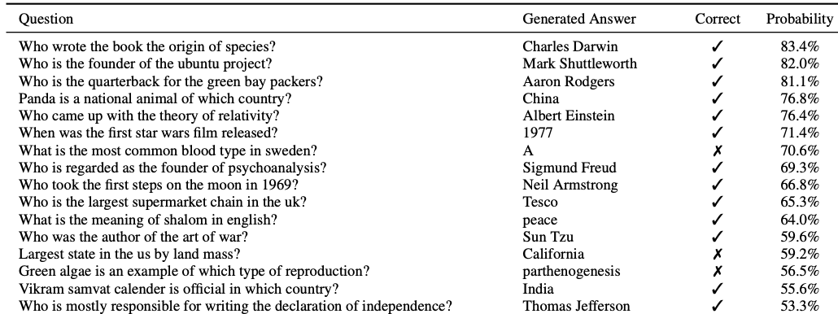
NLP nowadays
GPT-2 (generates text and can fine-tune on your own data)

Slide 72
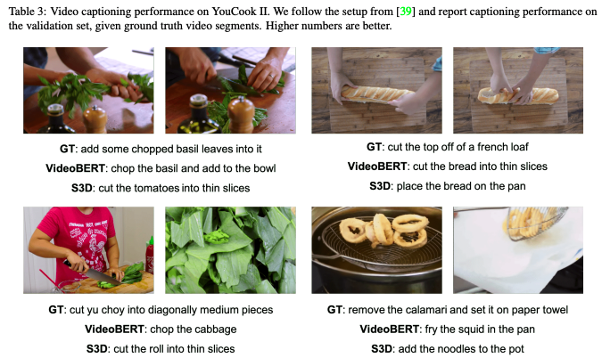
NLP nowadays
VideoBERT: A Joint Model for Video and Language Representation Learning. Sun, et al. ICCV 2019.

Slide 73
Deep Learning (breakthrough moment)
Data
AlexNet Model
14 million images. 20,000 distinct categories (e.g., shoes).
The network achieved a top-5 error of 15.3%, more than 10.8 percentage points lower than that of the runner up.
Task
Given an image, correctly predict which category it belongs to
ImageNet Classification with Deep Convolutional Neural Networks. Krizhevsky, et al. (2012)

Slide 74
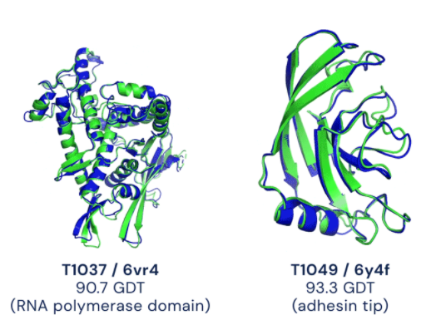
Deep Learning (recent breakthrough)

Slide 75
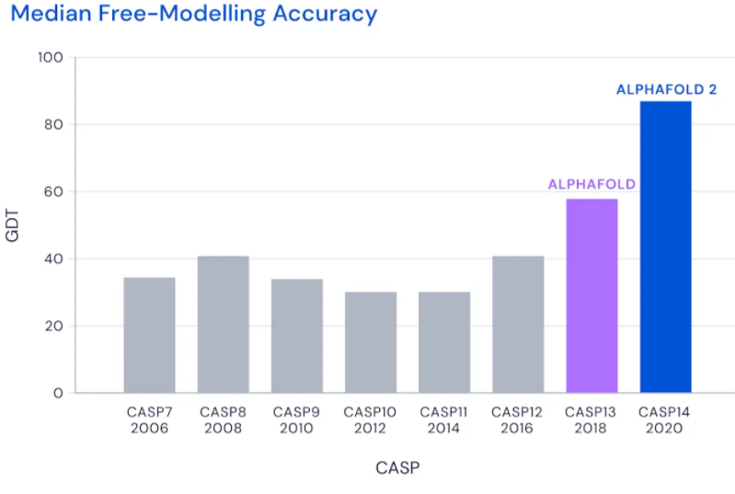
Deep Learning (recent breakthrough)

Slide 76
Deep Learning (recent breakthrough)

Slide 77
Deep Learning
Deep Learning is just neural networks with more than 1 hidden layer (non-linear activation functions).
For the 1st time ever, one paradigm of modelling (deep learning) yields the best results across nearly every domain of problems
Our understanding of why and how the results are so compelling is very surface-level.
Much work lies ahead (e.g., bias/fairness, explainability, robustness)

Slide 78
The Two Cornerstones of NLP
How do we get any system to process, ”understand”, leverage language?
Representation: how do we transform symbolic meaning (e.g., words, signs, braille, speech audio) into something the computer can use
Modelling: given these represented symbols, how do we use them to model the task at hand?

